Slide 1















Unit 5: Leisure time
Lesson 2: Task 1, 2, 3

Slide 2


1
Warm up
Puzzle game
Guess “ Weather“
Notes:
Warm-up: Play a small game “ Puzzle game”
The teacher asks SS to identify different colors and choose a color to guess the image behind the puzzles.
T calls Ss to answer and check their answers.
T asks Ss to repeat names of objects in the image.
Answer keys:
1. rope
2. horse
3. seesaw
4. hide-and-seek

Slide 3






4 letters
rope

Slide 4
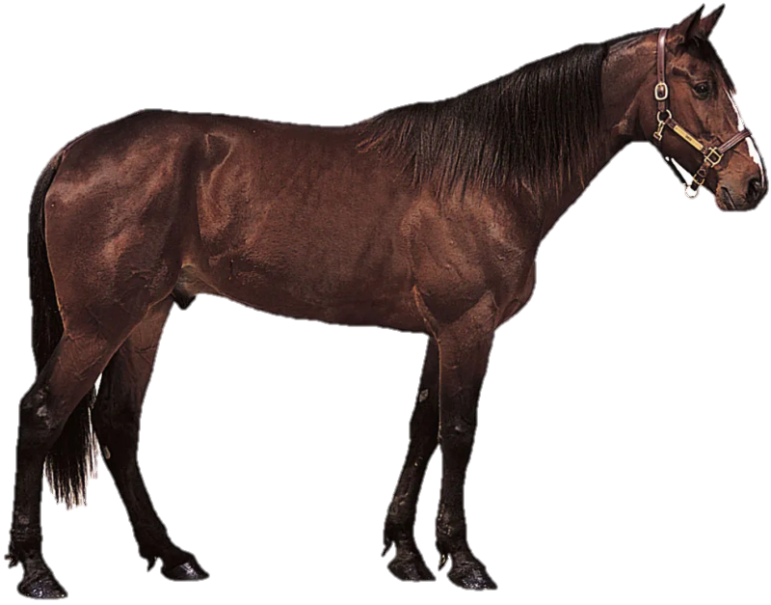
5 letters
horse

Slide 5
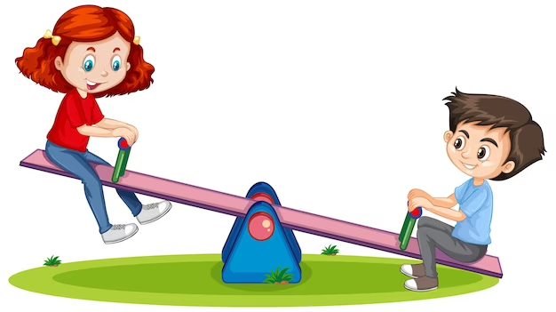
6 letters
seesaw

Slide 6
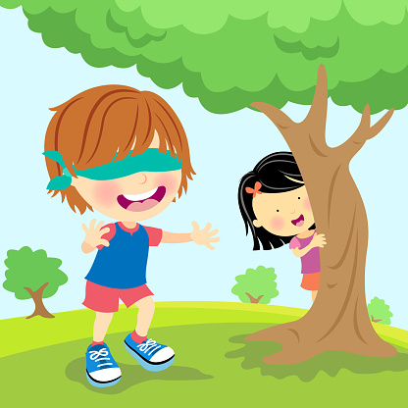
11 letters
hide-and-seek

Slide 7
2
Presentation

Slide 8
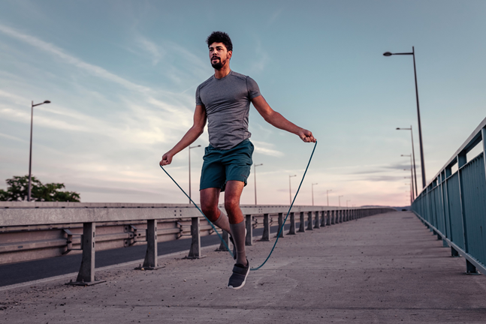
jump rope
Notes:
Task 1: Listen and point. Repeat. (Track 5.4)
- Use flashcards to introduce the vocabulary of the lesson.
- Say the words for students to listen and repeat in the chorus.
- Say a word for students to repeat then point.

Slide 9
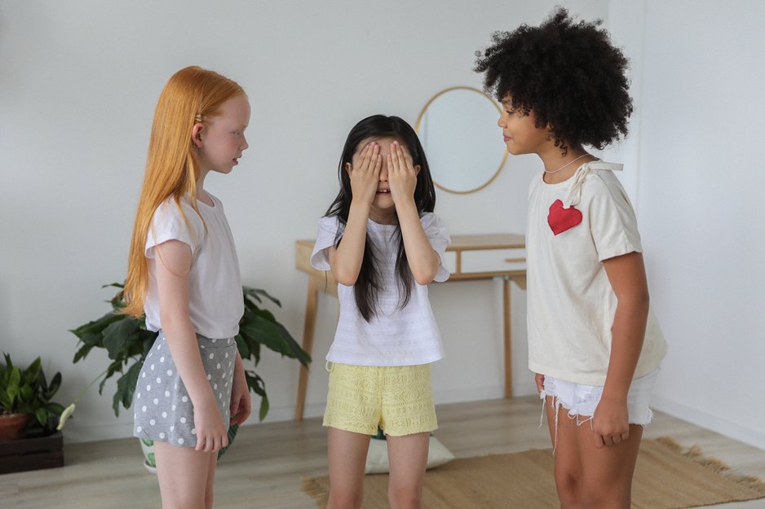
play hide-and-seek

Slide 10
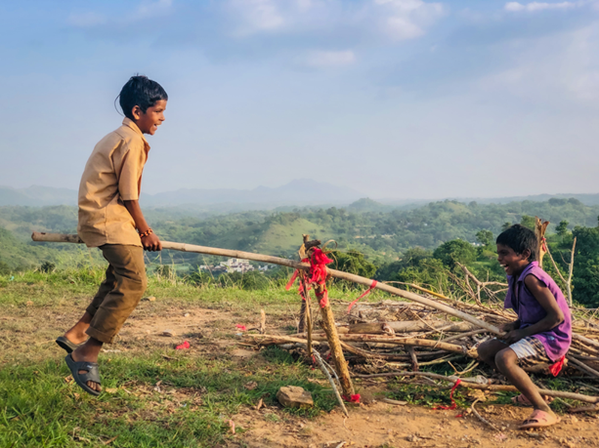
play on the seesaw

Slide 11
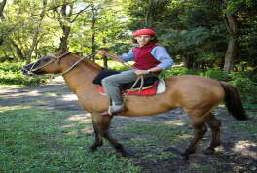
ride a horse

Slide 12



Look and match
1
jump rope
play on the seesaw
2
ride a horse
3
4
play hide – and - seek
Notes:
Checking vocabulary: Look and match.
- T asks SS to look at the pictures and words, then match them together.
- T calls SS to match and say the words again.

Slide 13








1. Listen and point. Repeat.
jump rope
play
hide – and - seek
play on
the seesaw
ride
a horse
Notes:
- Play track 5.4 for the students to listen to, point to, and repeat the words in chorus and groups.

