Slide 1







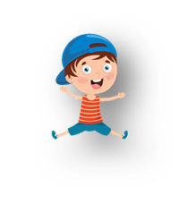

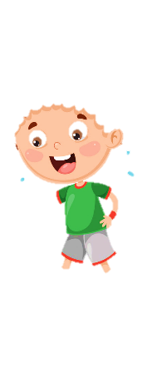









UNIT 6: OUTDOOR ACTIVITIES
Lesson 1
Period 2 – Task 4,5,6 (P.65)

Slide 2

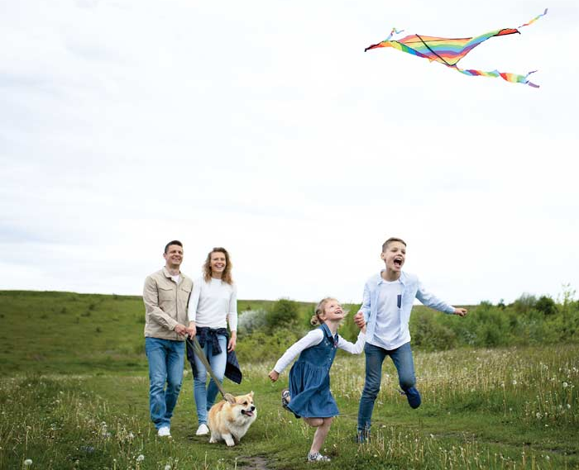
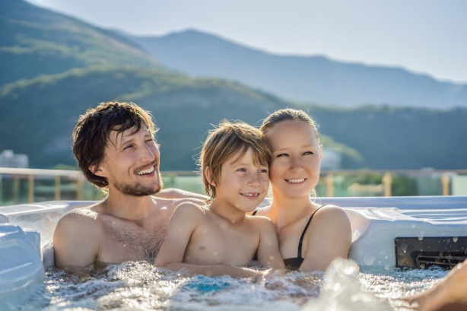
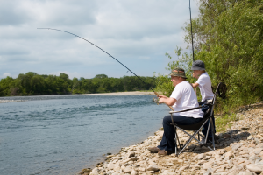
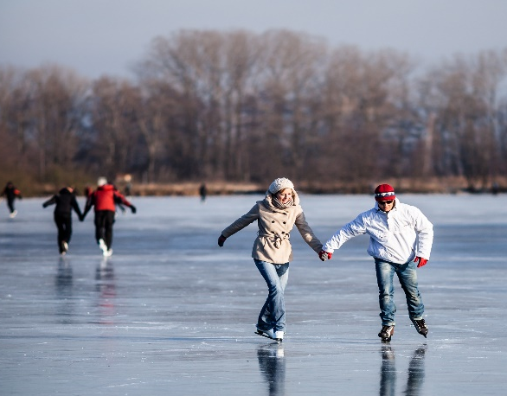
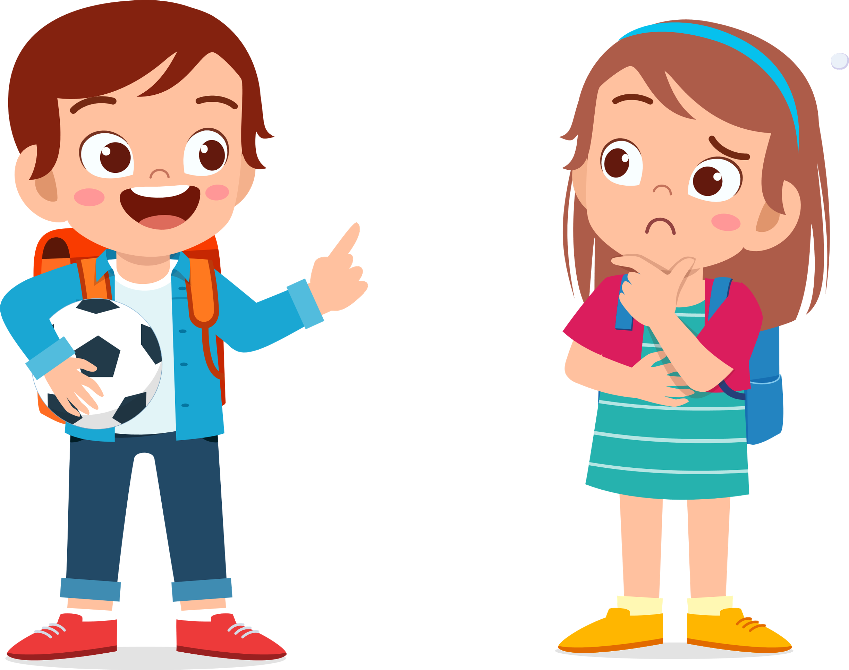
5. Look and say
(page 65)
What can we do in the field?
fly a kite/
in the field
swim/
in the pool
1
2
We can fly a kite in the field.
go fishing/
by the river
ice-skate/
on the lake
3
4

Slide 3
03
PRACTICE

Slide 4










CATCHING BUTTERFLIES

Slide 5
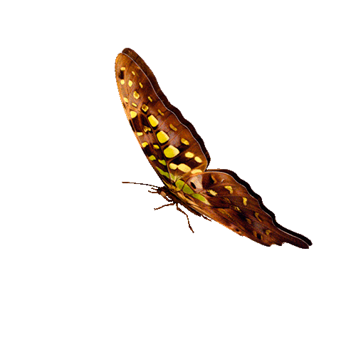

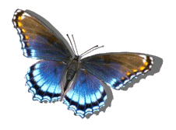



1
CONGRATULATIONS
TEAM A
5
CONGRATULATIONS
TEAM B
8
7
2
4
6
3
1
2
3
4
5
6
7
8
9
10
1
2
3
4
5
6
7
8
9
PIPI
10
TEAM A
TEAM B

Slide 6

What can we do in the field?
A. We can fly a kite.
B. We can jump rope.
C. We can take photos.
D. We can swim.
GO HOME

Slide 7
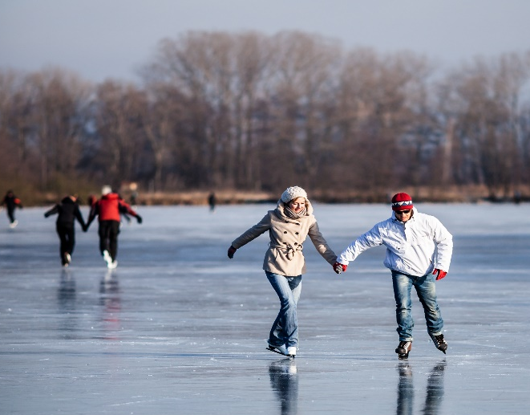
What can we do on the lake?
A. We can go fishing.
B. We can go hiking.
C. We can climb the tree.
D. We can ice-skate.
GO HOME

Slide 8
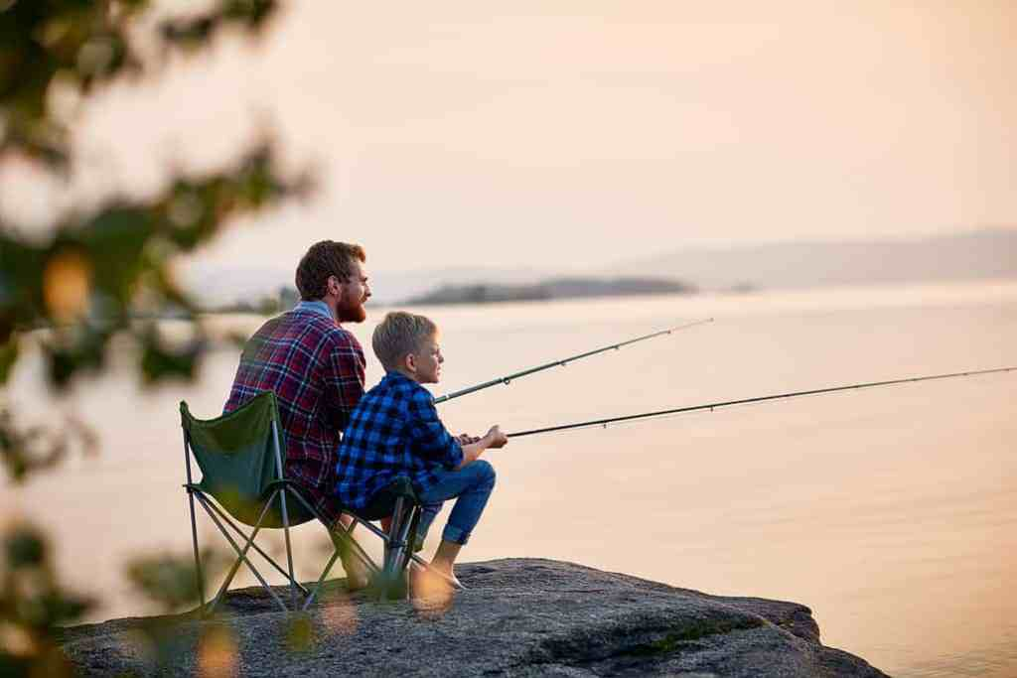
What can we do by the river?
A. We can jump rope.
B. We can go fishing.
C. We can sing a song.
D. We can dance.
GO HOME

Slide 9
What can we do in the pool?
A. We can swim.
B. We can play tennis.
C. We can go fishing.
D. We can ice-skate.
GO HOME

