Slide 1





















Slide 2




Unit 8 - Lesson 1– Period 2

Slide 3


1. Warm up

Slide 4

Do a crossword in red?
7
7
M
A
K
E
1
E
N
G
L
I
S
H
2
W
R
I
T
E
3
S
M
A
R
T
P
H
O
N
E
4
P
L
A
Y
G
A
M
E
S
5
6
R
O
B
O
T
S
Notes:
Hs chọn số để nhìn hình, trả lời từ còn thiếu và điền vào chỗ trống
Click số 7 để hiện key của crossword

Slide 5
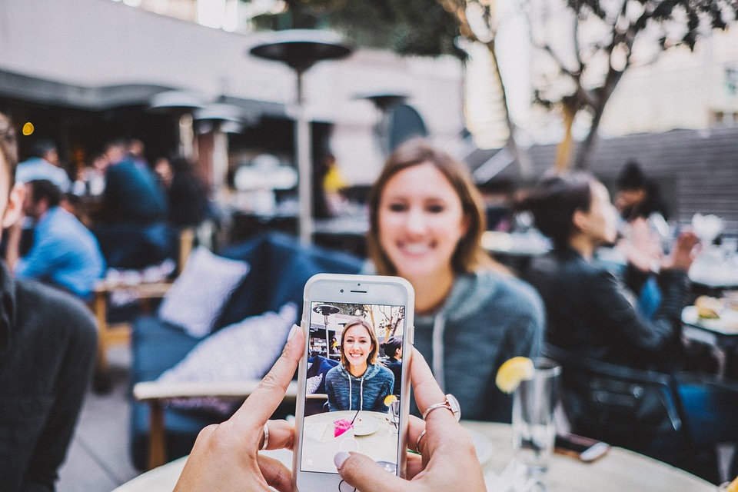
We can _____ videos on a smart phone.
HOME

Slide 6
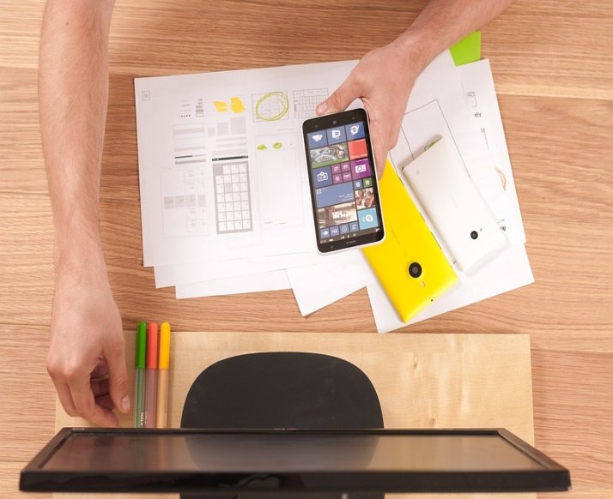
I can learn _________.
HOME

Slide 7

We can ______
emails on the
smartphone.
HOME

Slide 8
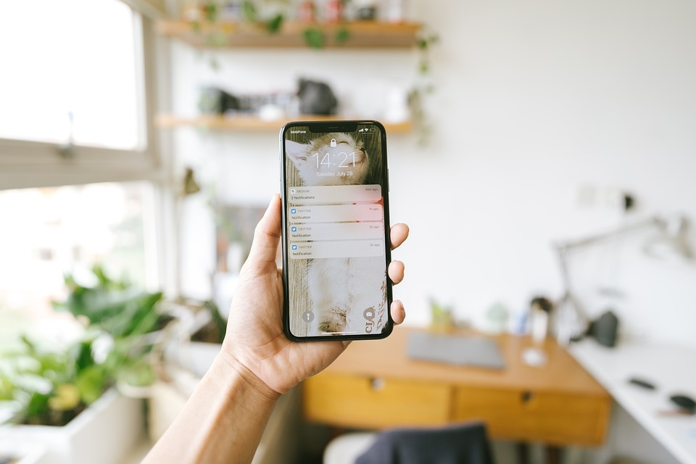
It’s a __________.
HOME

Slide 9

He can ___________.
HOME

Slide 10




They are ______.
HOME

Slide 11

Presentation
4
Listen and repeat.

Slide 12

Frequency Adverbs
Always
Sometimes

Slide 13


Choose correct answer
1
What can she do?
2
He ____ learns English.
A. She can make videos.
A. sometimes
B. She can write emails.
B. never
C. She can learn English.
C. always

Slide 14


4
Listen and repeat.
1
She sometimes makes videos on her smartphone.

Slide 15

2
He always learns English on his computer.

