Slide 1






















Slide 2





Unit 8: Technology
Lesson 2 – Period 1

Slide 3


Warm up
Matching Game

Slide 4





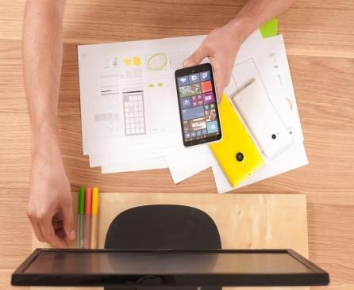

Smart
phone
make videos
write emails
robot

Slide 5

Presentation
1
Listen and point. Repeat.

Slide 6

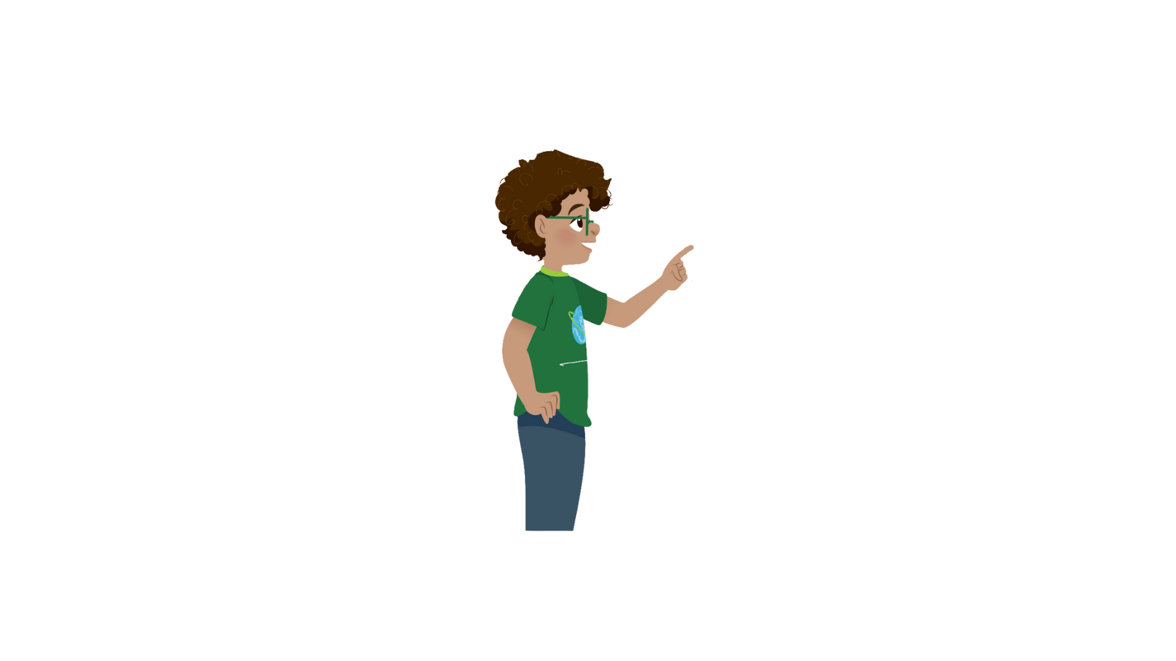


1
Listen and point. Repeat.
Surf the Internet

Slide 7


Use the tablet

Slide 8

Work in pairs

Slide 9

Work in groups

Slide 10


1
Listen and point. Repeat.
Surf the Internet
Use the tablet
Work in pairs
Work in groups

Slide 11








SLAP THE BOARD GAME

Slide 12

Practice
2
Listen and read. Tick

Slide 13



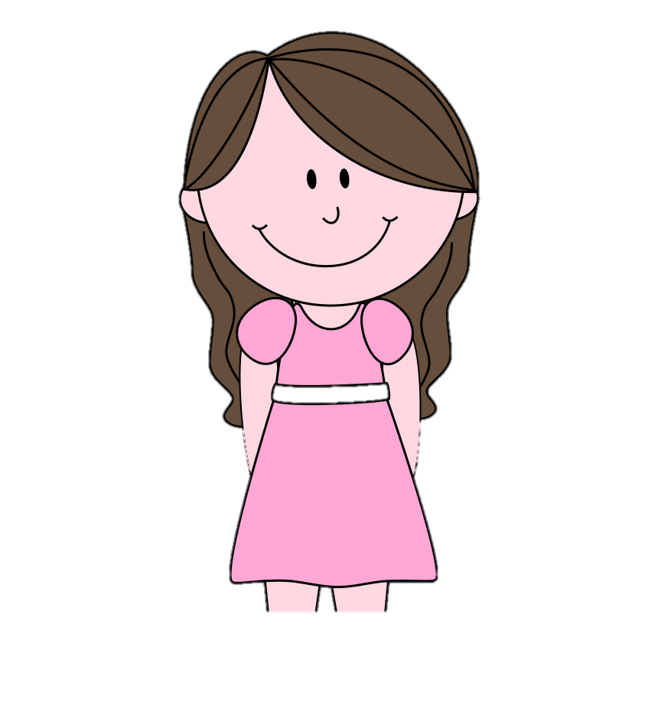

2
Listen and read.Tick.
No, you can’t. But you can open your book and look at the word list.
Robert
Teacher
Yes, teacher.
Now, let’s work in pairs and answer question 1 to 5.
I can see some new words. Teacher, can we use the tablet?

Slide 14
2
Listen and repeat.Tick.
Now, let’s work in pairs and answer question 1 to 5.
Teacher
Robert
I can see some new words. Teacher, can we use the tablet?
The teacher wants her students to work in
✓
pairs.
groups.

Slide 15

2
Listen and repeat.Tick.
2. Students can use
their tablets
their books.
✓
Teacher
Robert
No, you can’t. But you can open your book and look at the word list.
Yes, teacher.

