Slide 1














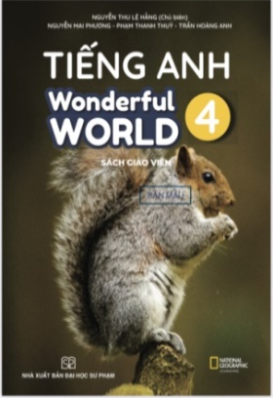





Slide 2




Unit 8 - Lesson 2 – Period 2

Slide 3

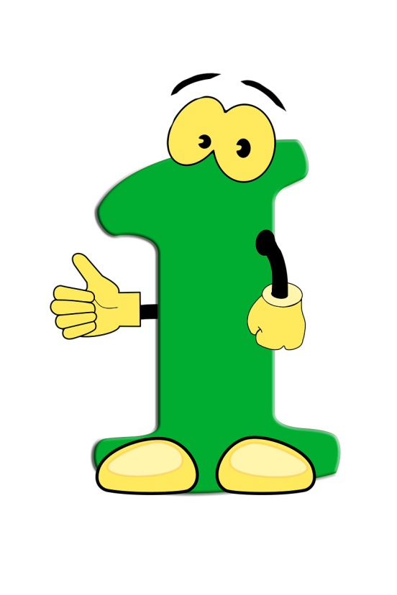
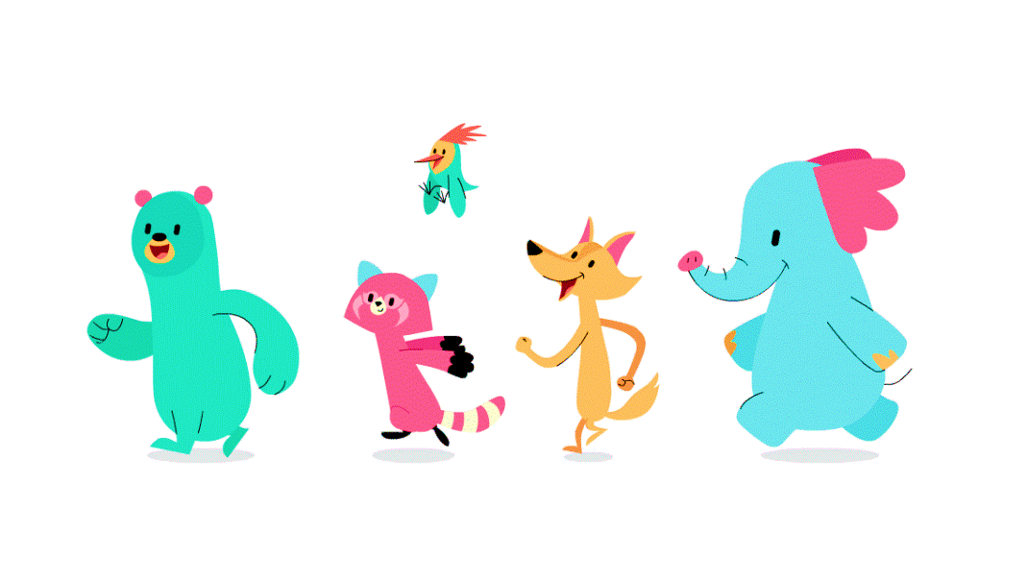


Warm up

Slide 4

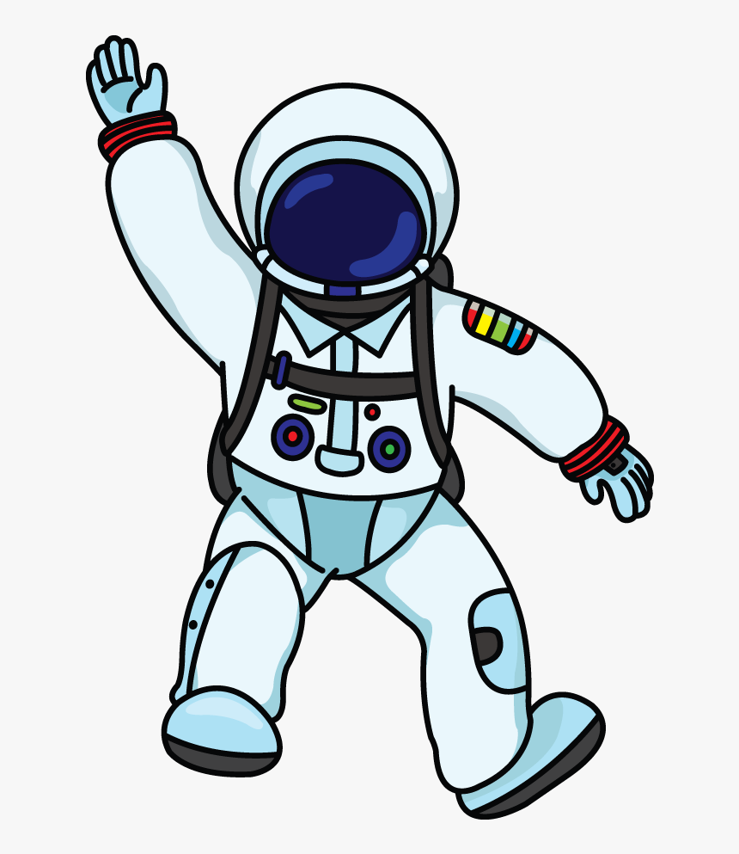



2
1
LUCKY STAR
3
4
Next
Notes:
Hs chọn số, trả lời câu hỏi để nhận điểm

Slide 5

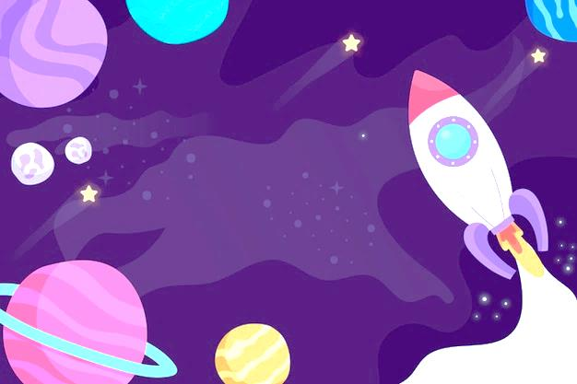
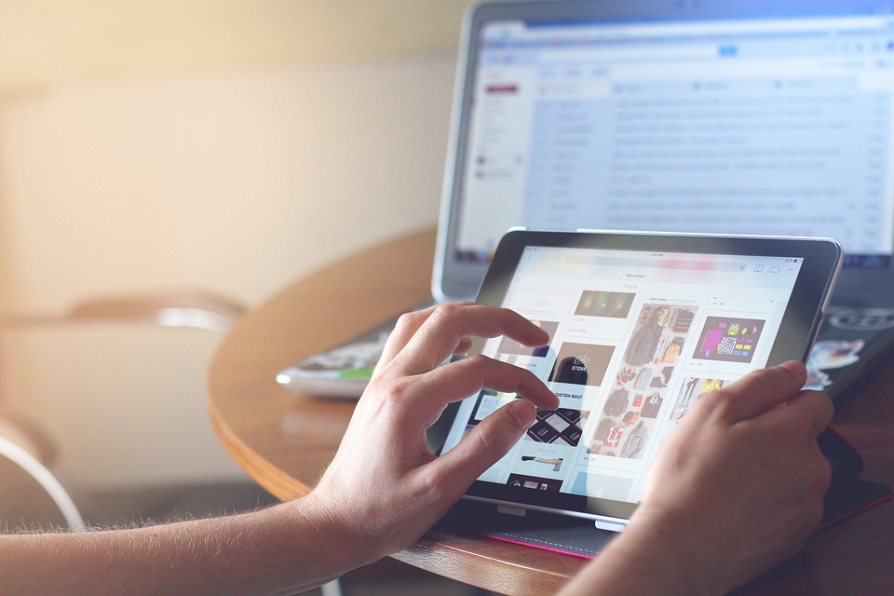

He____ uses the tablet.
never
sometimes
always
often
3
GO HOME

Slide 6
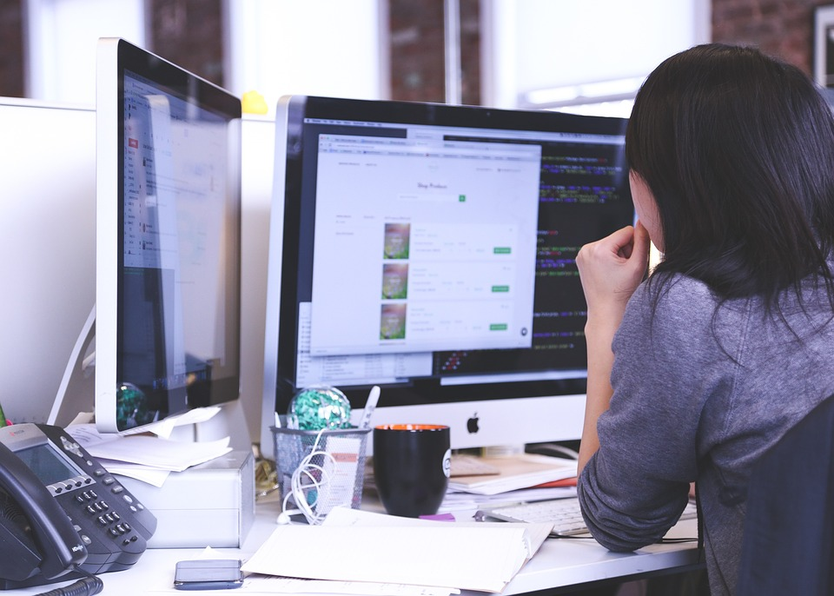
I sometimes________.
surf the Internet.
watch TV.
make videos.
write emails.
5
GO HOME

Slide 7
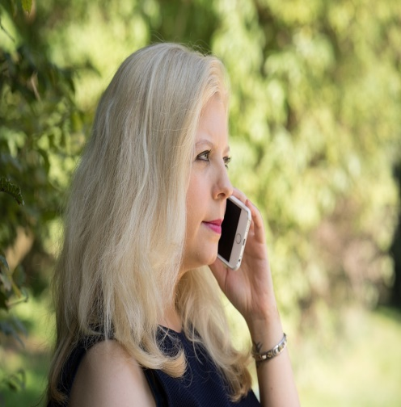
My dad makes phone calls.
True.
False.
5
GO HOME

Slide 8
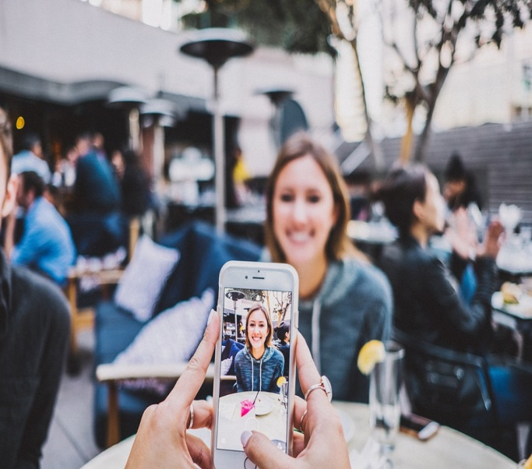
We can take photos on smart phones.
True.
False.
8
GO HOME

Slide 9

Presentation
4
Listen and repeat.

Slide 10
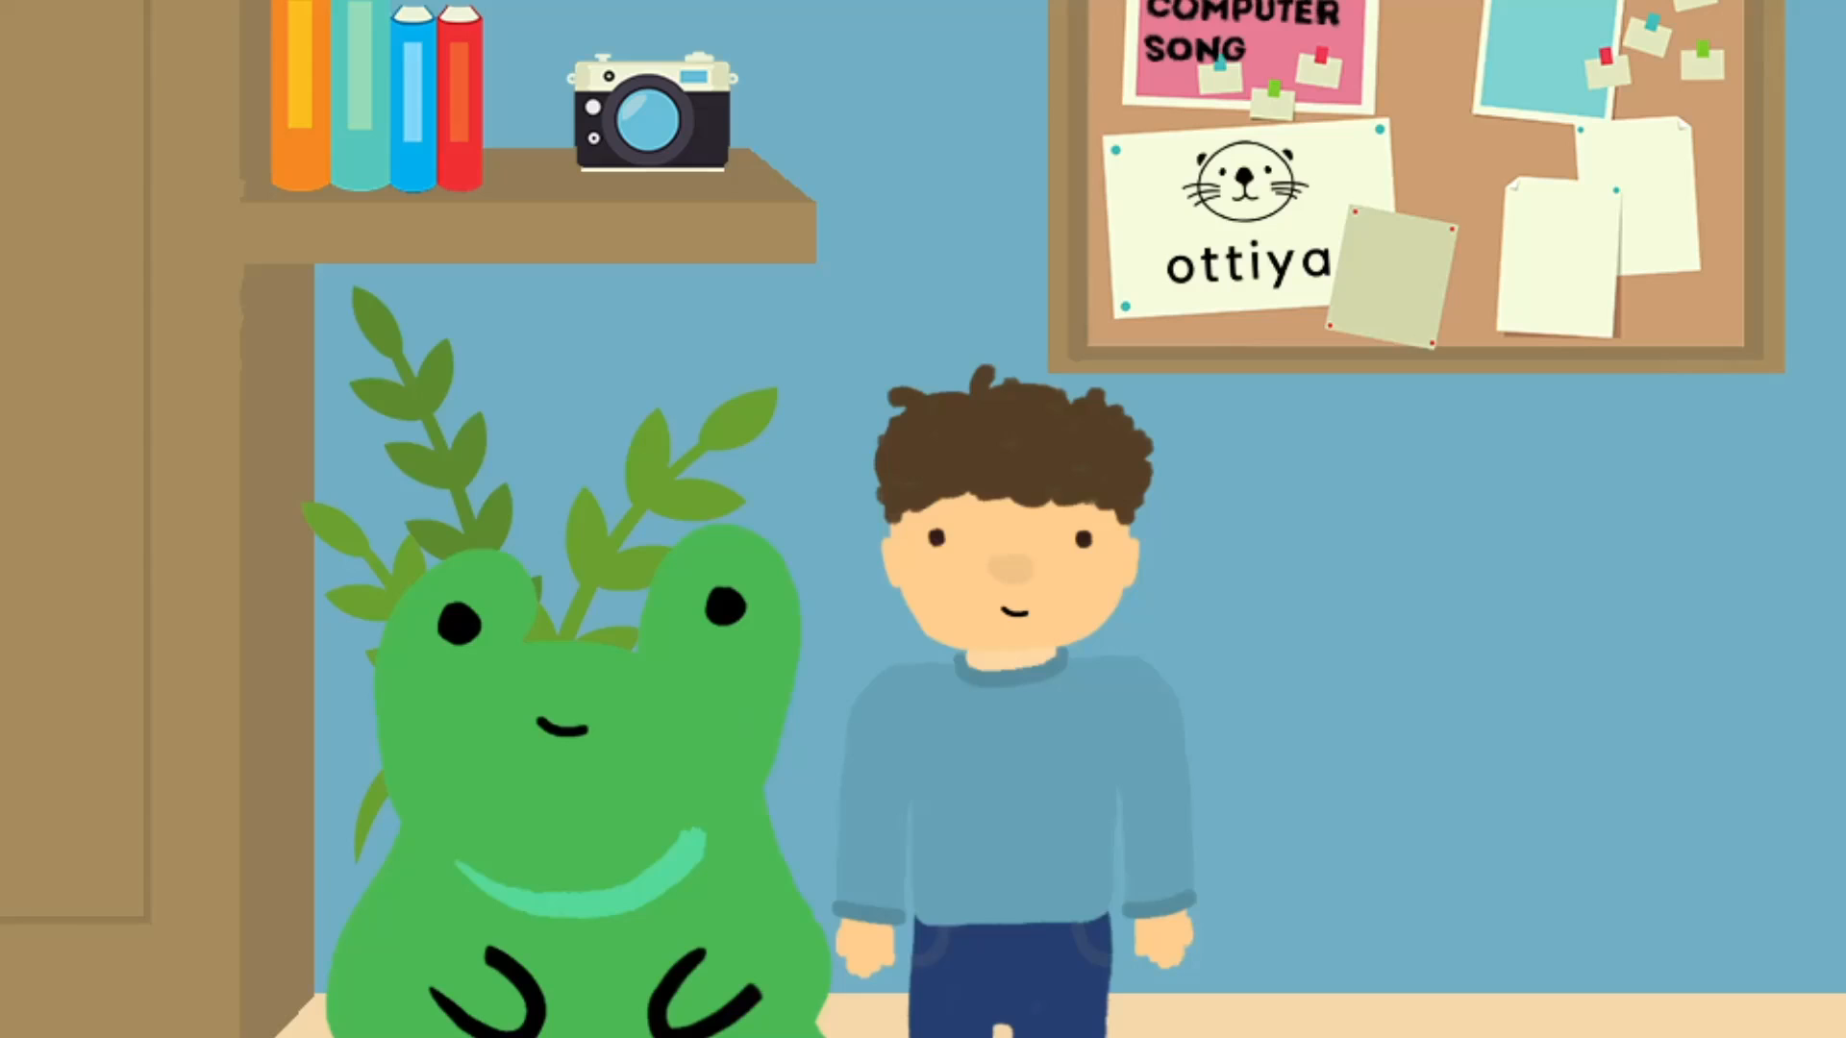

Slide 11

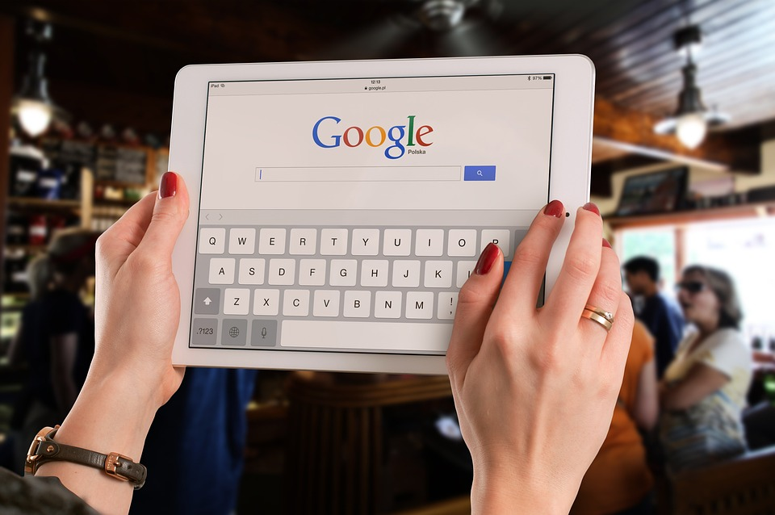
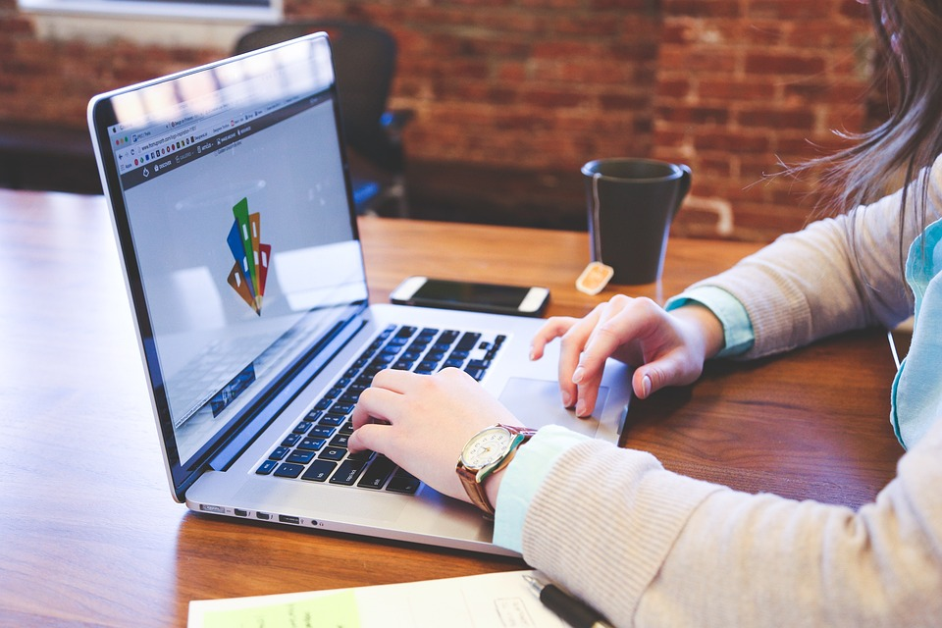
4
Listen and repeat.
2. Teacher, can we surf the Internet?
- No, you can’t.
✔
1. Teacher, can we use the tablet?
❌
- Yes, you can.

Slide 12
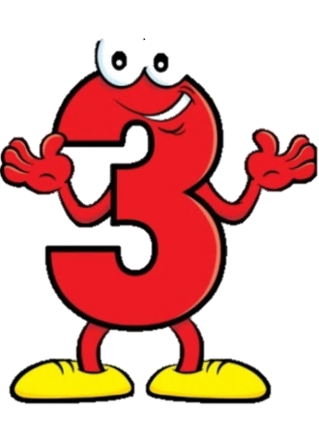
Practice
5
Look. Ask and answer.

Slide 13


Yes or No

Slide 14
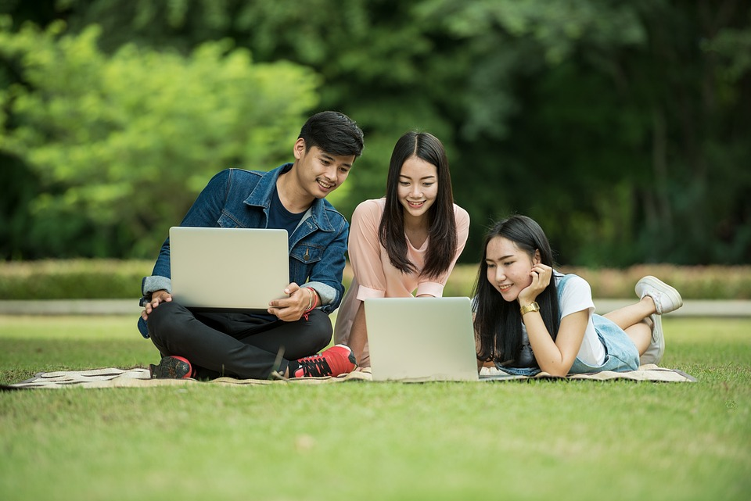
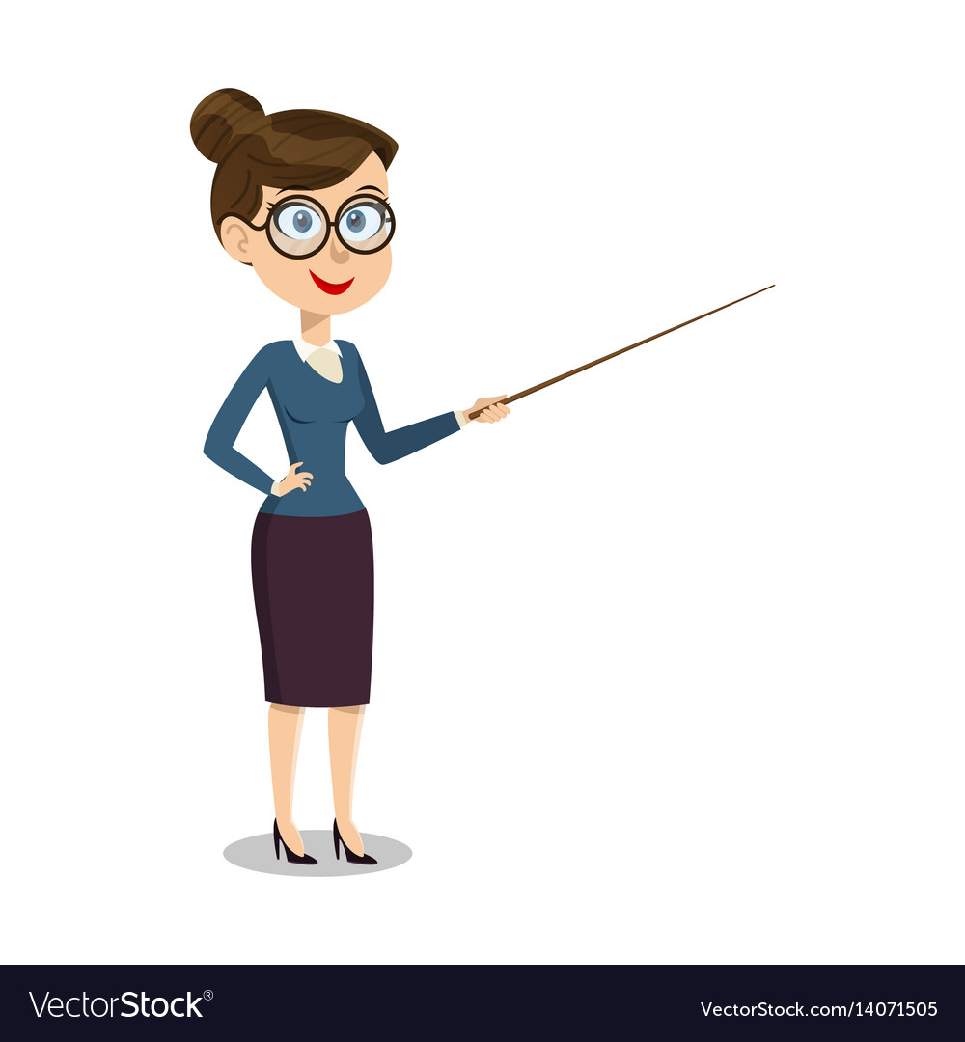

5
Look. Ask and answer.
Work in groups
✔
Teacher, can we work in groups?
Yes, you can.

Slide 15
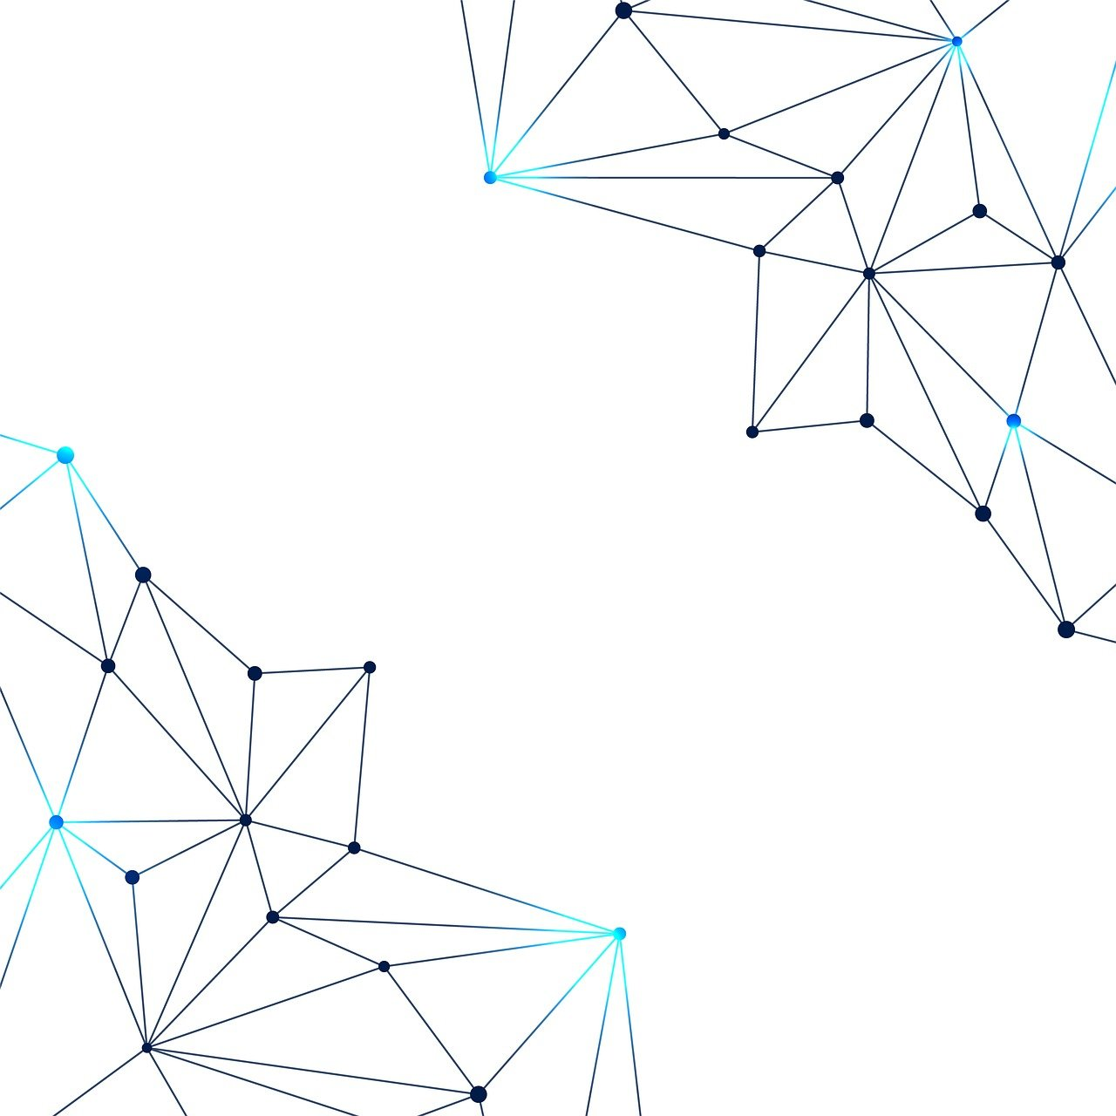
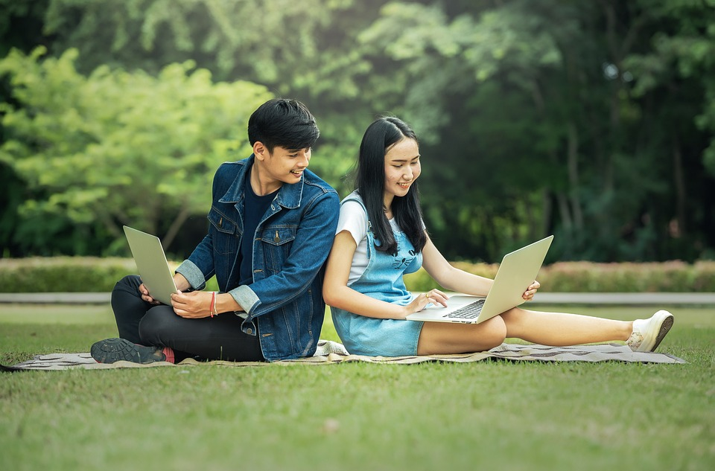

Work in pairs
✔
Teacher, can we work in pairs?
Yes, you can.

