Slide 1






















Slide 2




Unit 8 - Lesson 3 – Period 1

Slide 3
Racing game.
1 WARM UP
Notes:
Warm up
Guessing game cho 1 dòng

Slide 4
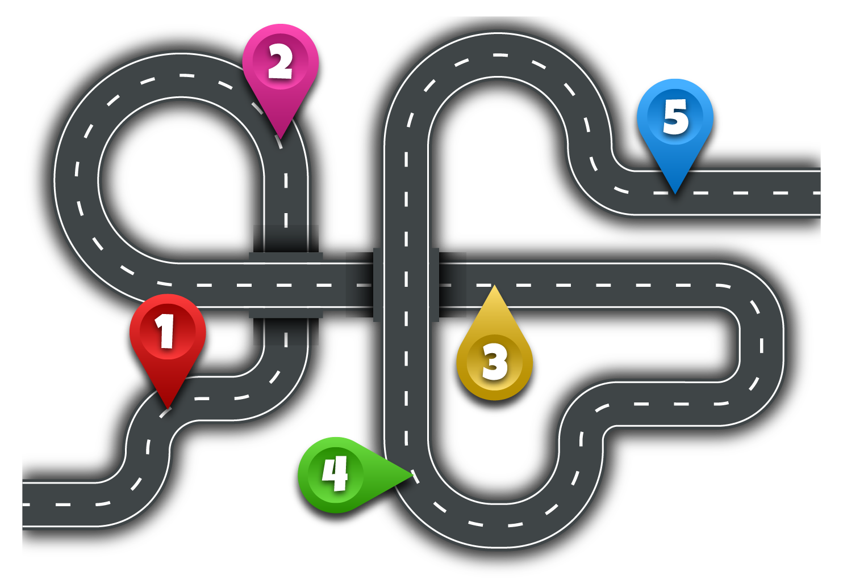








2
5
1
3
4
Next
Notes:
Ấn vào người đua xe sẽ di chuyển đến số 1, click số 1 ra câu hỏi, tương tự với các số còn lại
Ấn next sang slide Presentation

Slide 5


Q1: We can _______.
We can surf the Internet.
Check
Go

Slide 6

Can we work in groups?
Q2
✔
Yes, we can.
Check
Go

Slide 7

Q3: He can use the _____ in class.
tablet
Check
Go

Slide 8

Q4: Anna ____writes emails on phone.
always
Check
Go

Slide 9
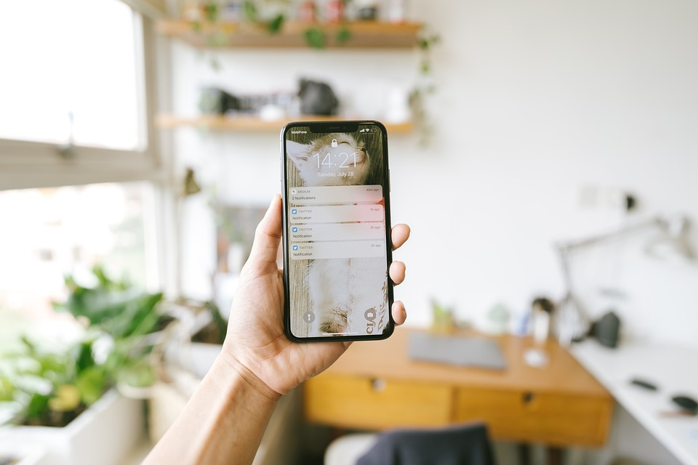
Q5: You have a new _________.
smartphone
Check
Go

Slide 10
2 Presentation
Task 1 Listen and point.
Notes:
Dấu câu

Slide 11


1.Listen and point.
Change the password

Slide 12
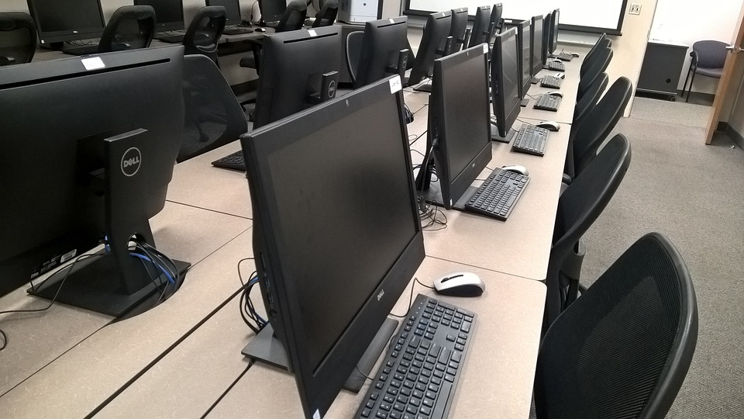
Use the computer lab
What is it?

Slide 13

Use the projector
What is it?

Slide 14

Use the speaker

Slide 15




1 Listen and point. Repeat.
Change the password
Use the computer lab
Use the projector
Use the speaker

