Slide 1





















Unit 8
Fun time
and project

Slide 2



1
Fun time
Let’s sing a song!

Slide 3

Song : A Robot Dance

Slide 4

1
Fun time

Slide 5







5
2
3
7
1
6
4
Next

Slide 6


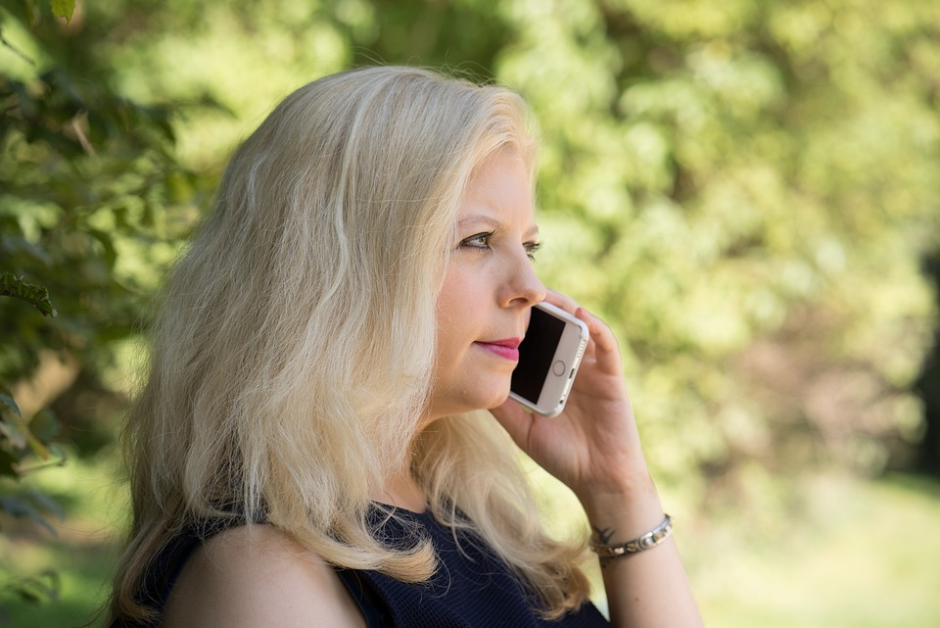




Take photos
Make videos
Make phone calls
Bowl
Make phone calls
Back

Slide 7

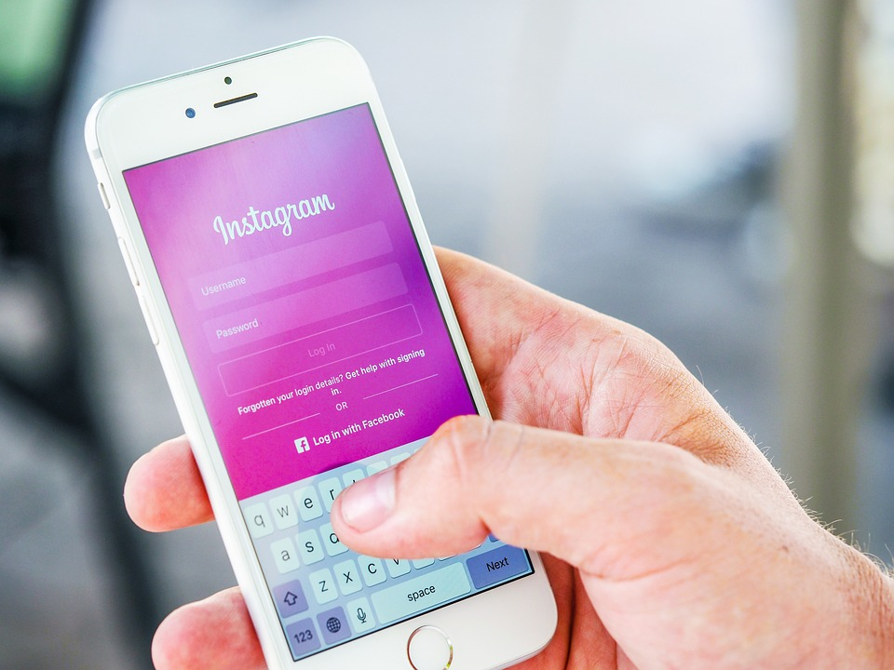

Change the password
Do homework
Change the password
Write emails
Back

Slide 8


Surf the Internet
Watch TV
Surf the Internet
Read books
Back

Slide 9

Use the computer
Use the phone
Use the tablet
Use the tablet
Bowl
Back

Slide 10
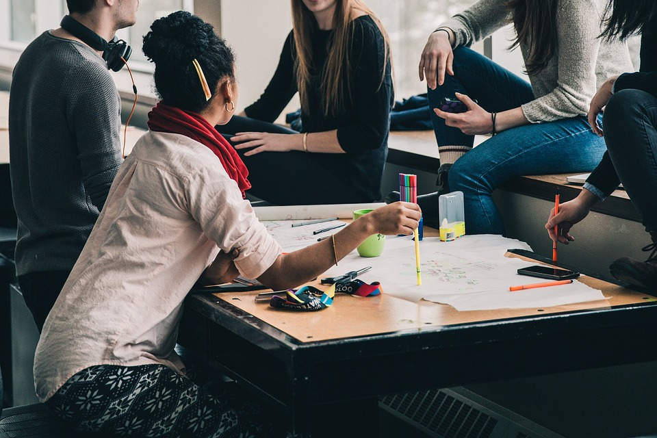
Work in groups
Wrok in
groups
Work in groups
Work in pairs
Back

Slide 11

Use the phone
Write emails
Write emails
Take photos
Bowl
Back

Slide 12

Use the phone
Use the speaker
Use the projector
Use the projector
Bowl
Back

Slide 13

2
Project
Technology quiz

Slide 14




GAME TIME

Slide 15
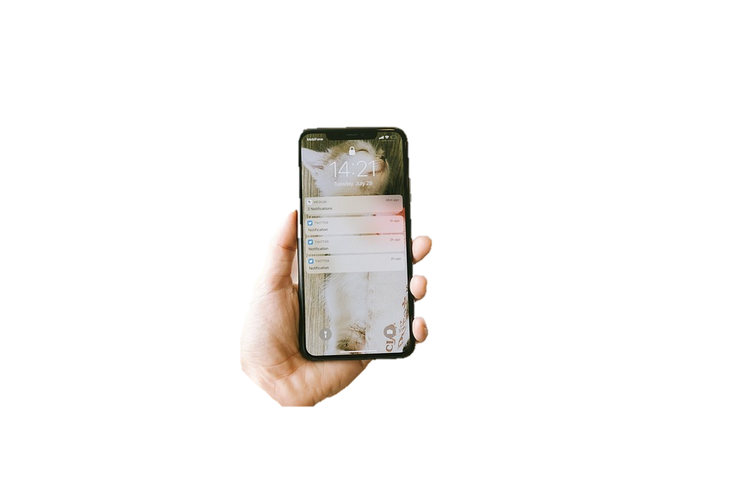
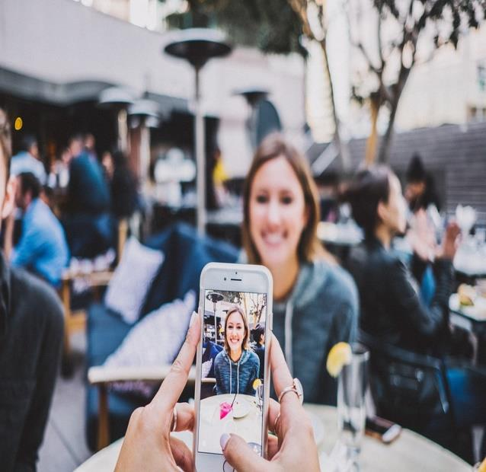

Look and tick
phone
tablet
computer
✔
play game
✔
make
videos
write emails
projector
speaker
microphone
✔
text message
play game
learn English
✔

Slide 16



Slide 17
2
Project
Technology

Slide 18
REMEMBER !
You can …. ✔
You can’t …. ✘

Slide 19



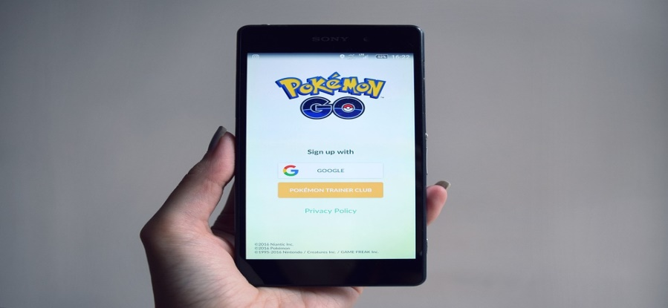
Dos and Don’ts at school
Things you can do
Things you can’t do
✔
✘

Slide 20



You can do in class.
You can use the computer lab.

Slide 21
You can do in class.
You can learn English in class.

Slide 22
You can’t do in class.
You can’t use the tablet in class.

Slide 23
What can’t we do?
You can’t play video games
in class.

Slide 24
2
Project
Your Technology

Slide 25

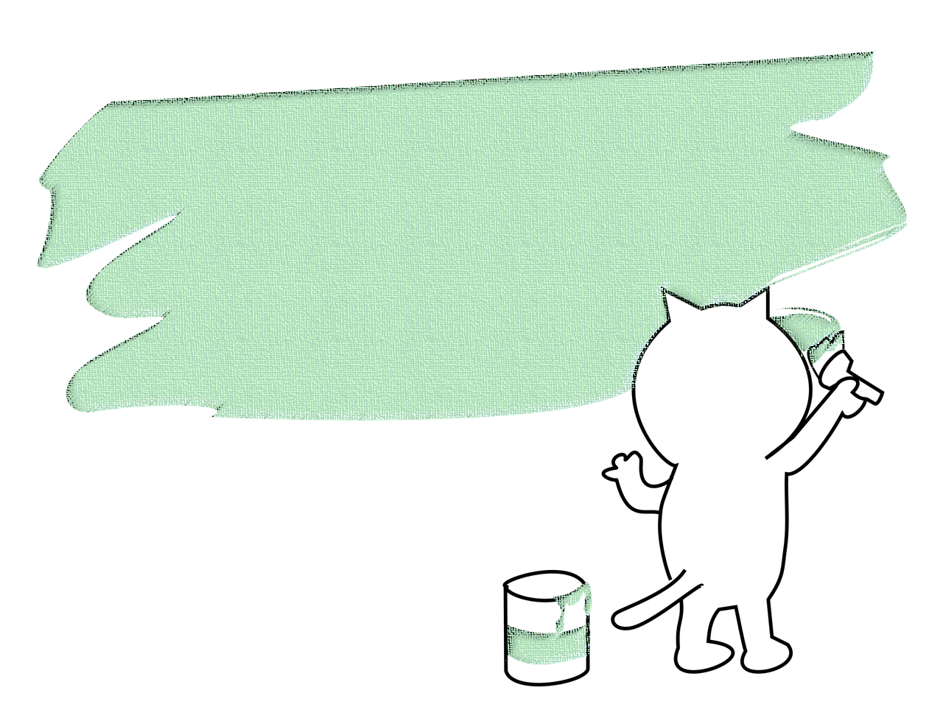
Drawing and Presenting
✘
✔

Slide 26




Thank you & goodbye!

