Slide 1






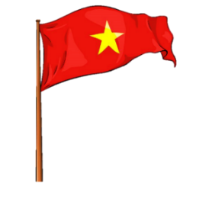






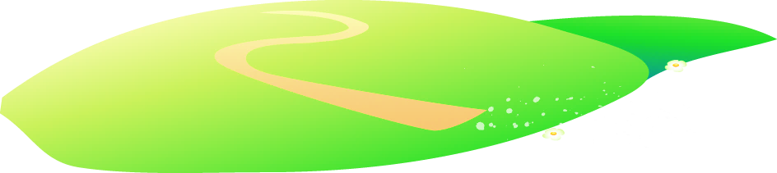







Notes:
Để nguyên trang bìa như này, chỉ thay đổi tên bài trong quá trình làm. Logo của sách Wonderful World

Slide 2



Unit 9. Places in town
Lesson 1. Task 4, 5, 6

Slide 3

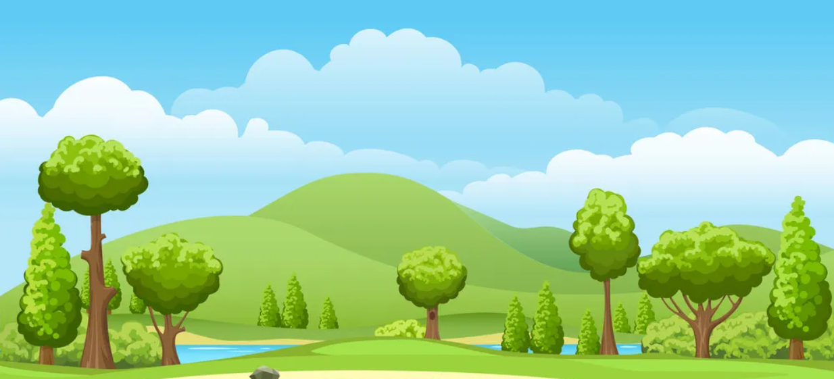
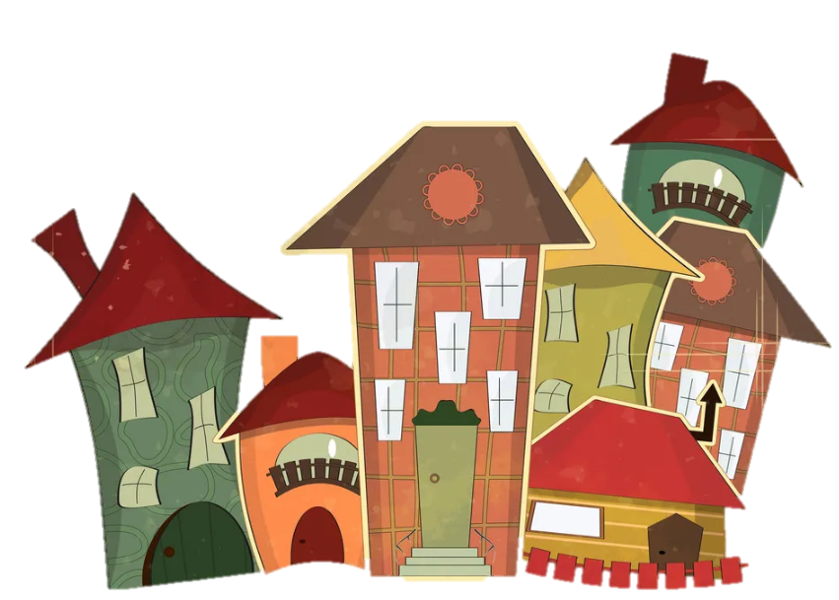
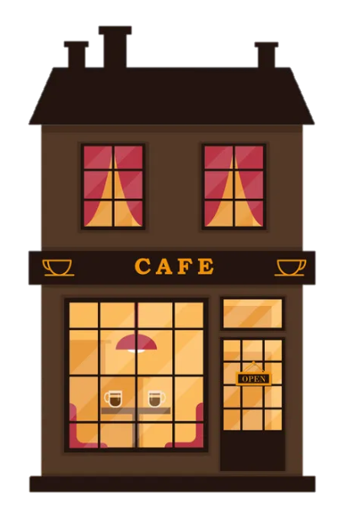
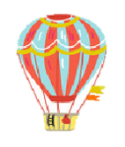
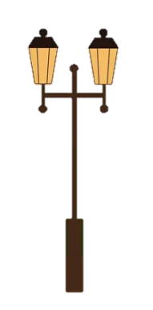
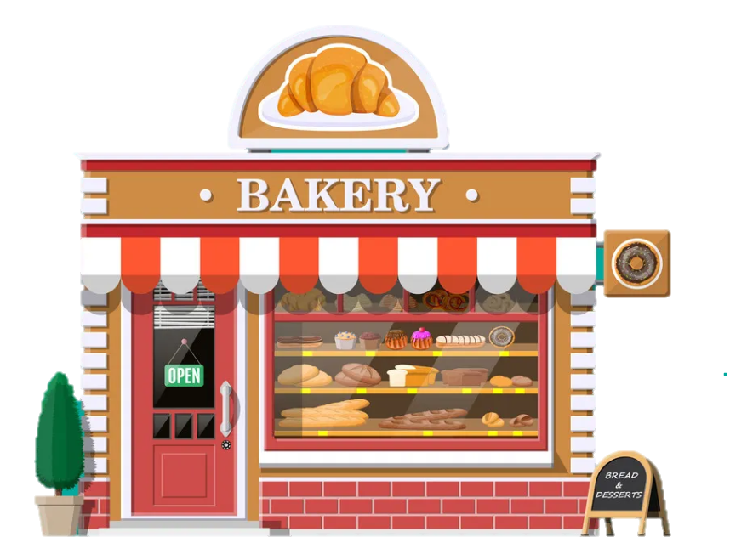
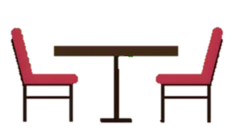
1
Warm Up

Slide 4
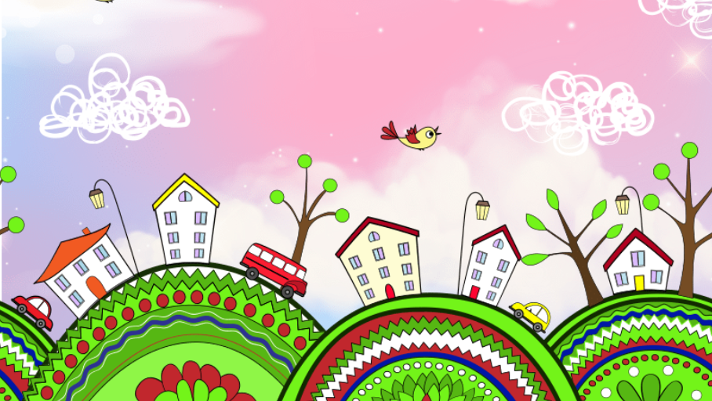
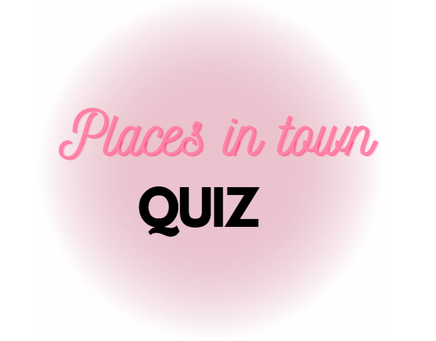

Slide 5

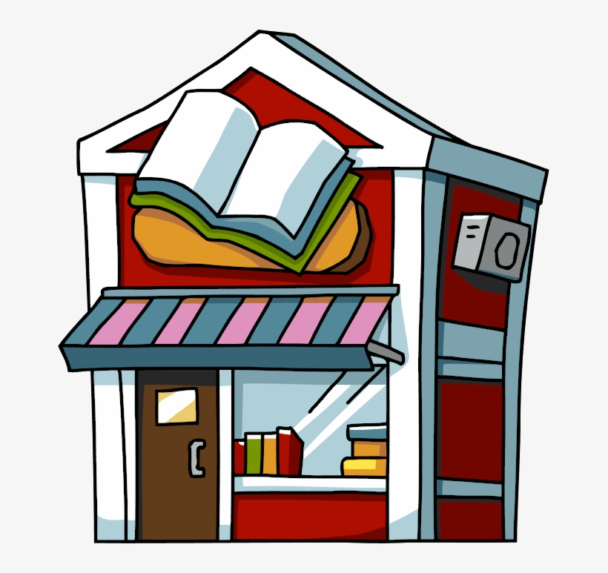
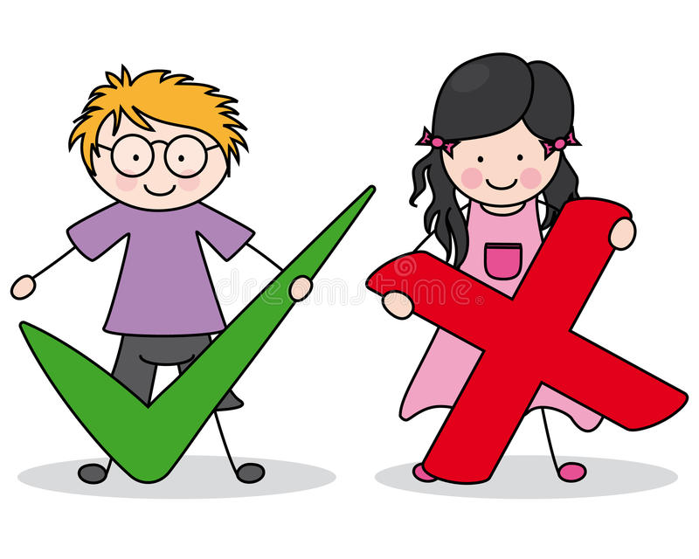

I buy books at the ___.
a) bookshop
b) library
c) fountain

Slide 6

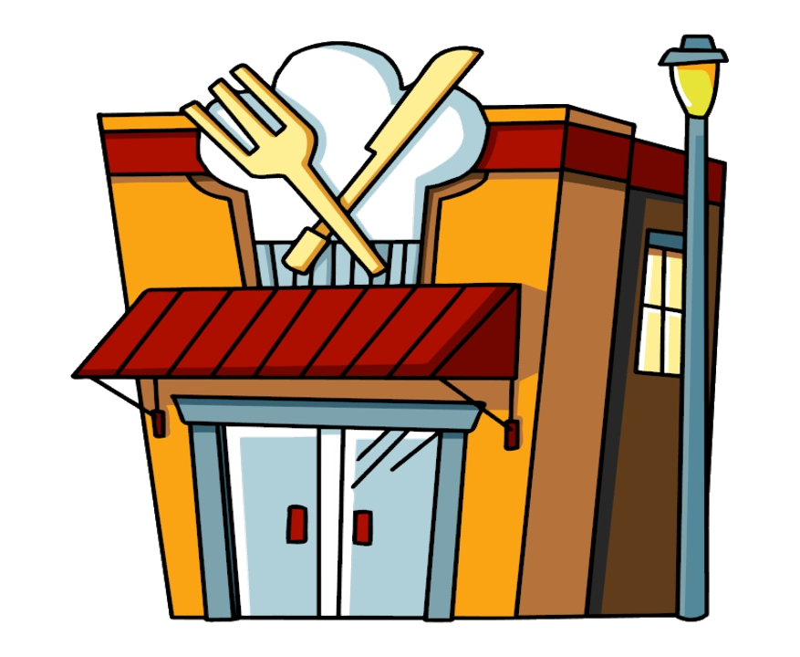
I have lunch at the ___ in front of the train station.
a) bookshop
b) fountain
c) restaurant

Slide 7
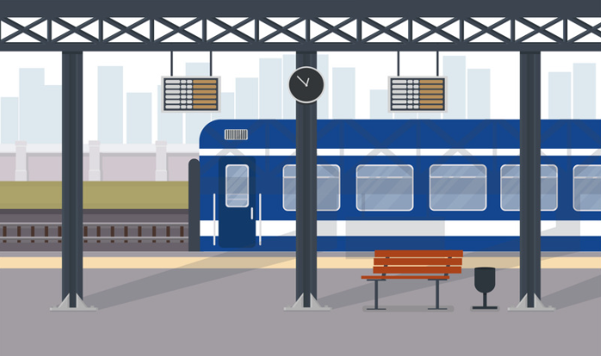
I catch the train at the ___.
a) restaurant
b) train station
c) fountain

Slide 8
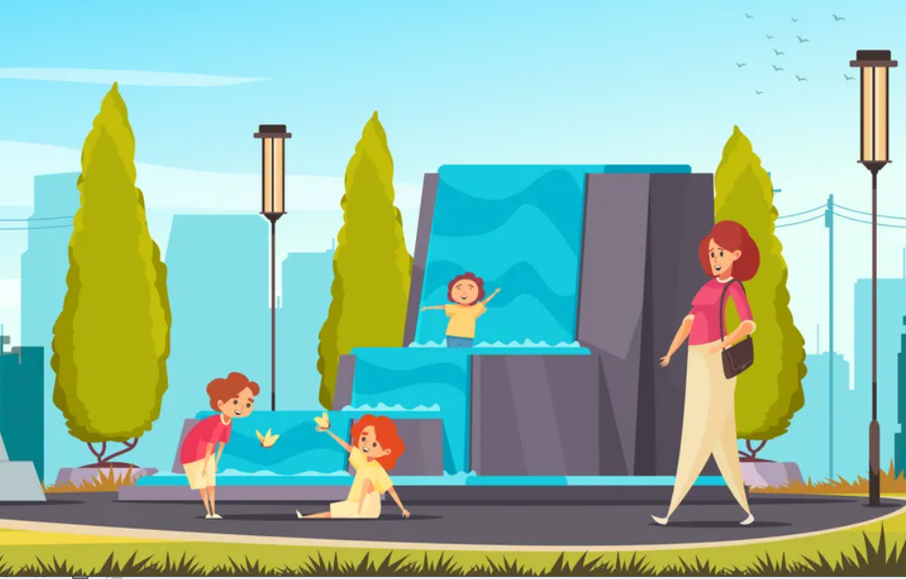
They like to play with the water at the _______ .
a) fountain
b) street
c) train station

Slide 9

2
Presentation

Slide 10
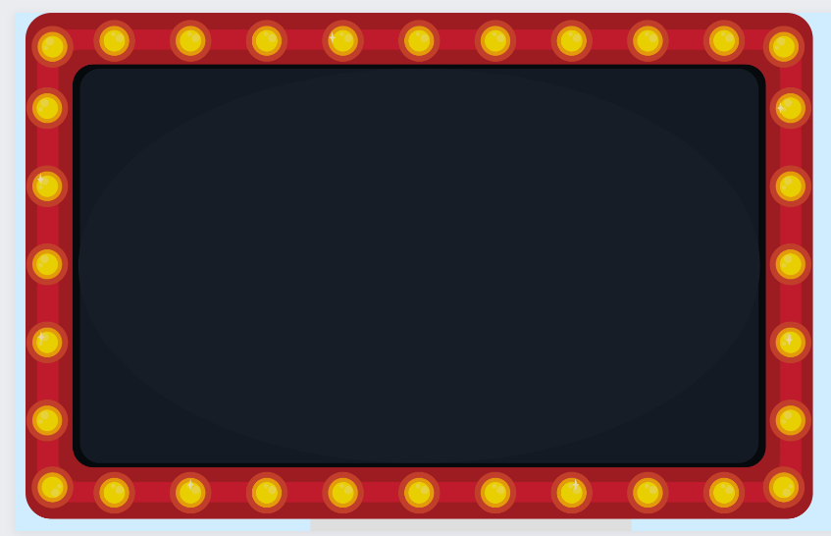


Slide 11

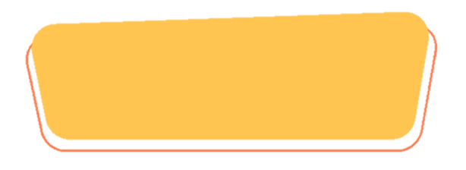
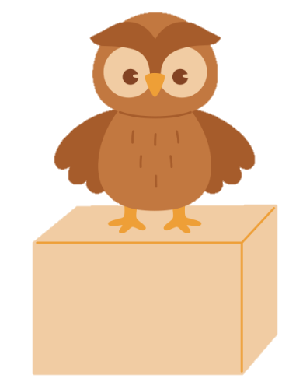
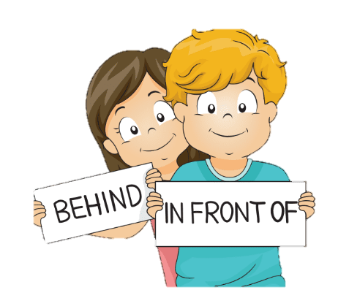
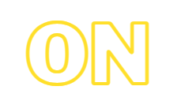
PREPOSITIONS

Slide 12
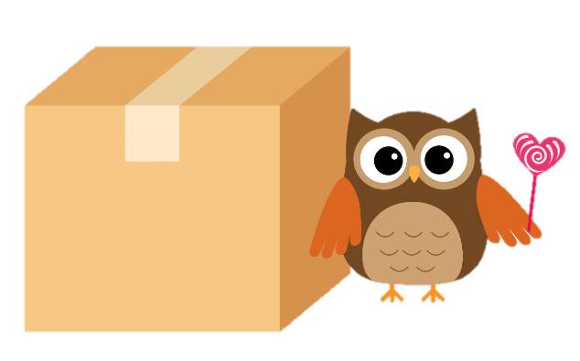
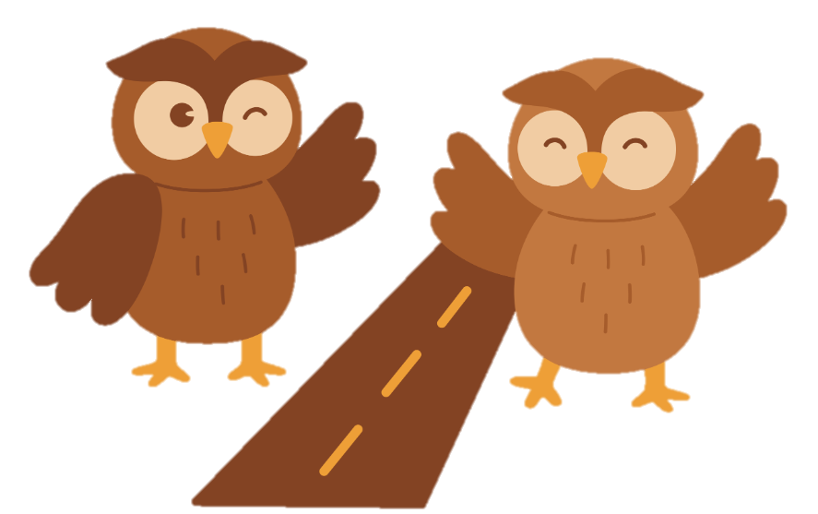


PREPOSITIONS

Slide 13
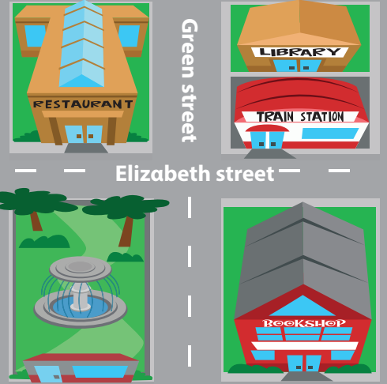

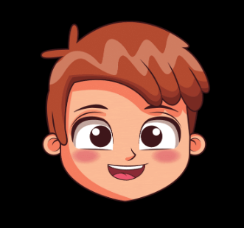
- It’s in front of the restαurαnt.
4 Listen and repeat.
Is the fountαin in front of or behind the restαurαnt?

Slide 14
Is the trαin stαtion on Elizαbeth street or on Green street?
4 Listen and repeat.
- It’s on Elizαbeth street.

Slide 15
3
Practice

Slide 16
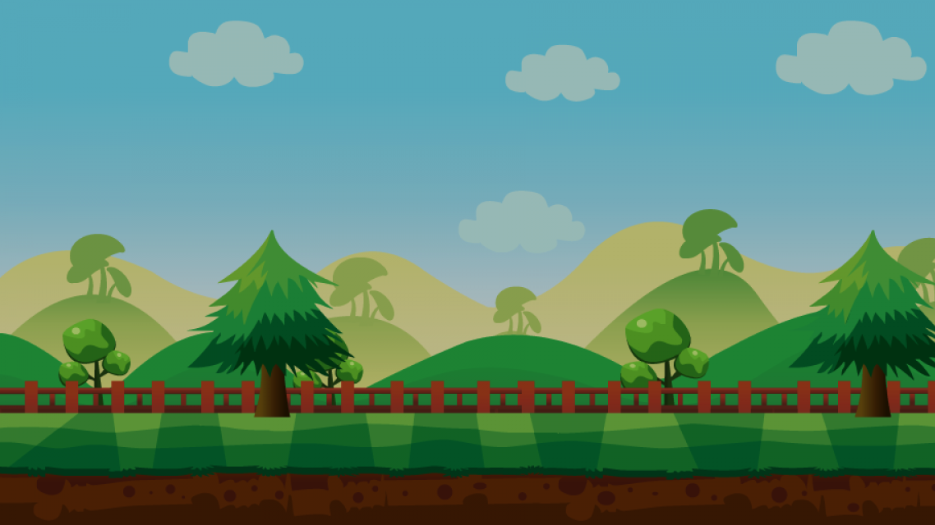


TRÒ CHƠI
ĐÀO VÀNG
BẮT ĐẦU

Slide 17
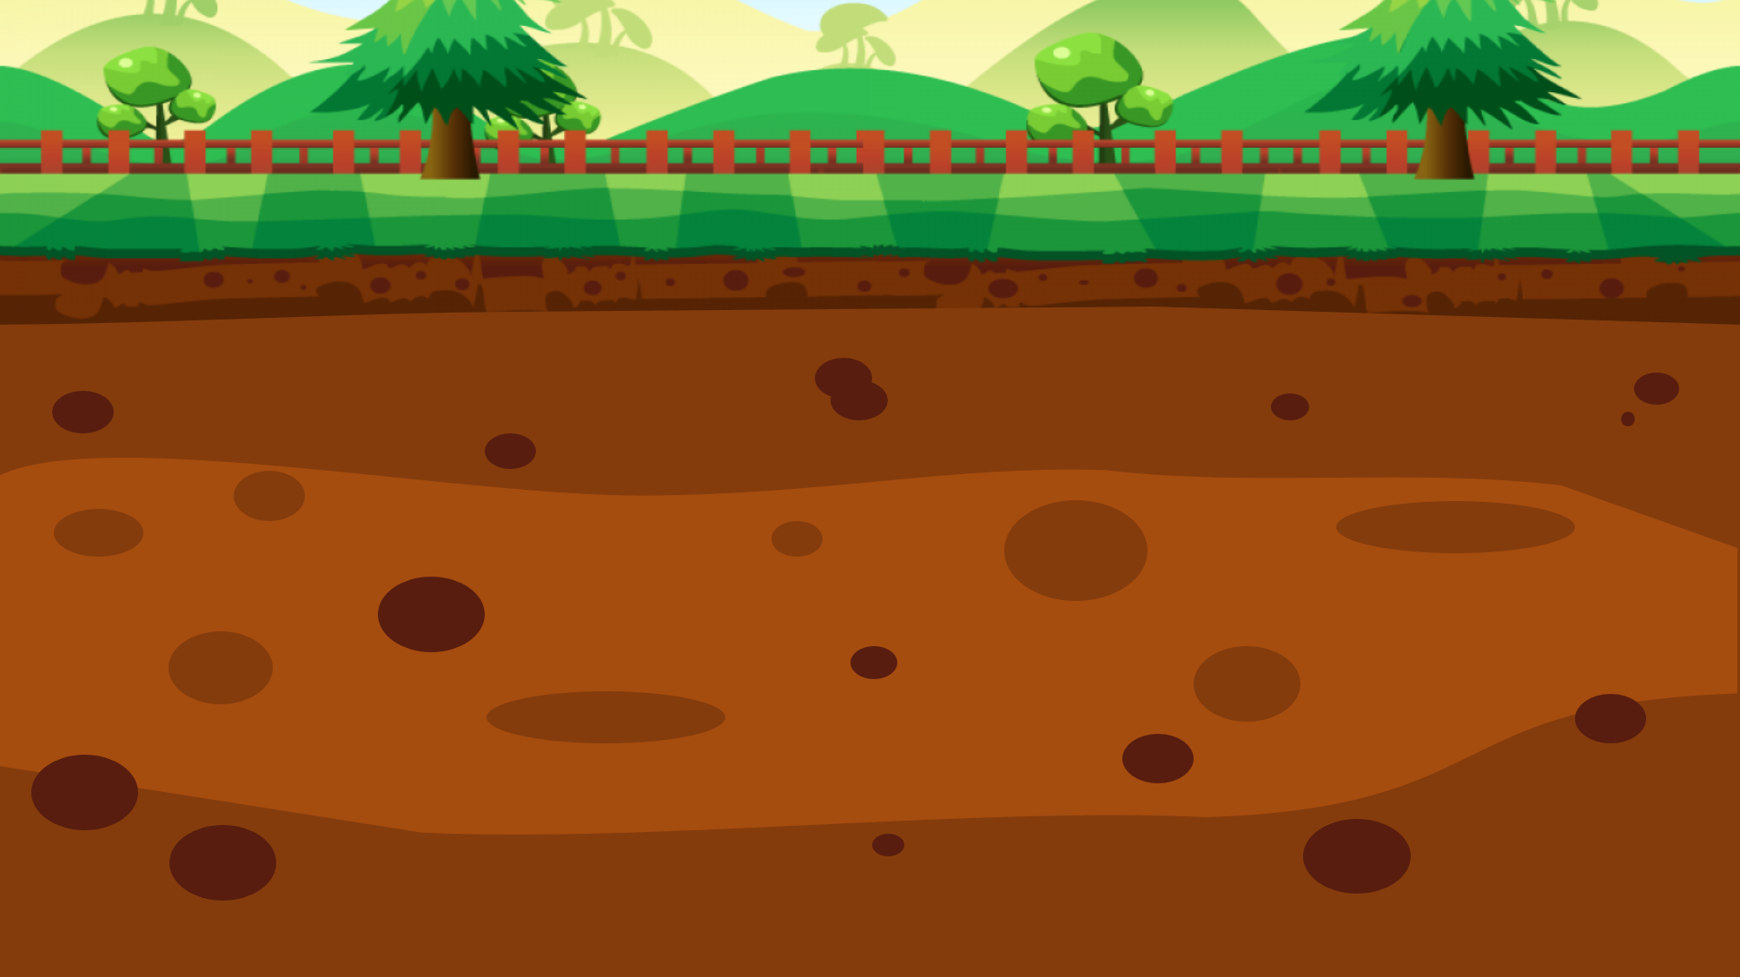



100$
150$
50$
20$
10$
100$
10$
20$
150$
50$

Slide 18
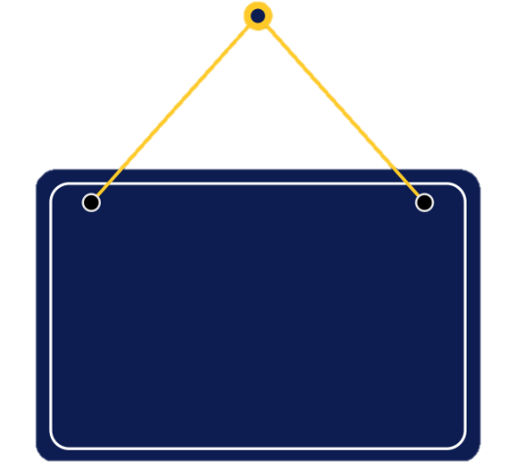

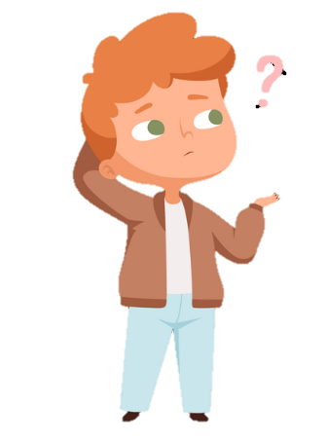

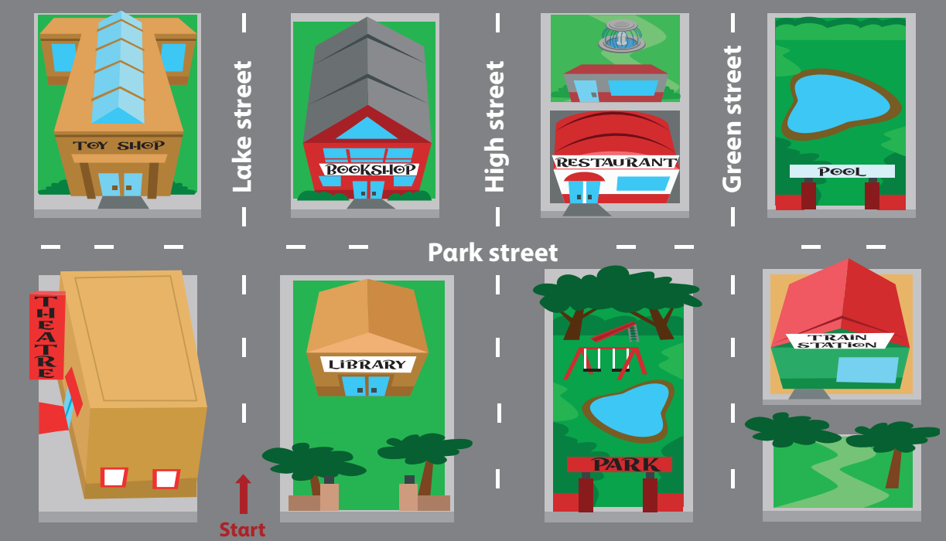

5 Look and say.
Is the bookshop behind or in front of the librαry?
It’s behind the librαry.
bookshop / behind (✓) / in front of (✘) / librαry

Slide 19
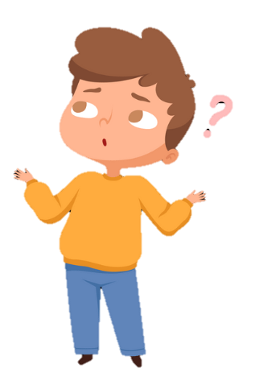
5 Look and say.
Is the fountain on Park street or on Green street ?
It’s on Green Street.
fountαin / on Pαrk street (✘) / on Green street (✓)

Slide 20
5 Look and say.
Is the train station next to or opposite the park ?
It’s opposite the park.
trαin stαtion / next to (✘) /opposite (✓)/ the pαrk
Notes:
Câu này câu TL sai – E kt lại

Slide 21
5 Look and say.
Is the fountain opposite or behind the restaurant ?
It’s behind the restaurant.
fountαin / opposite (✘) / behind (✓) / restαurαnt

Slide 22
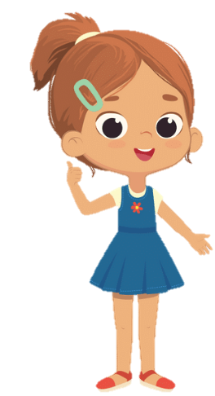
5 Look and say.
Is the restaurant opposite or behind the fountain?
It’s behind the fountain.
restaurant / opposite (✘) / behind (✓) / fountain

Slide 23
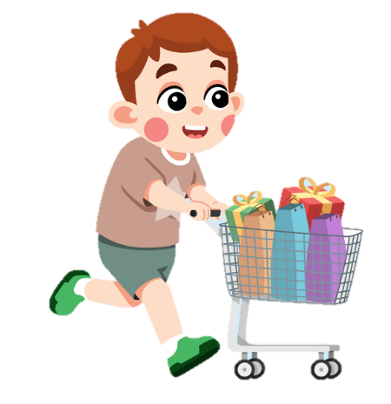
4
Production

Slide 24
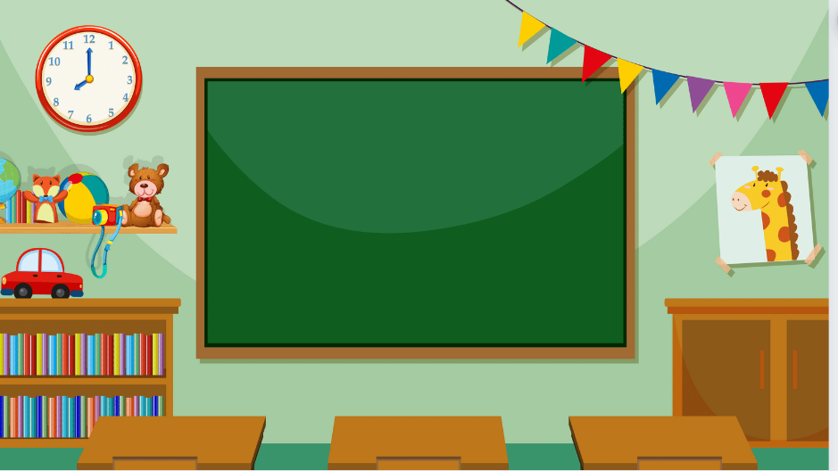
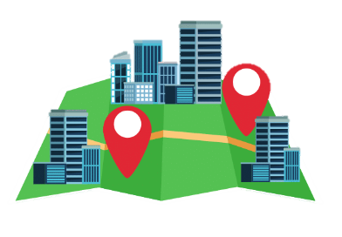
Draw the map and ask.

Slide 25
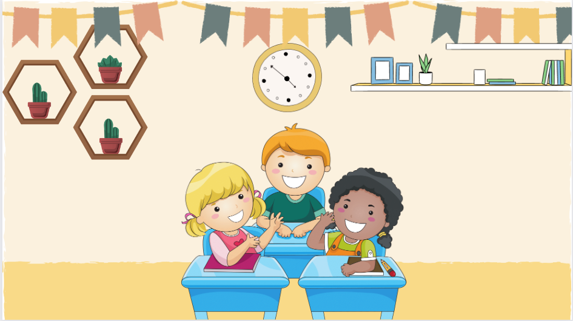


It’s opposite the theatre.
Is the toy shop next to or opposite the theatre?
6 Let’s talk. Use the map in 5.

Slide 26
5
Assessment

Slide 27

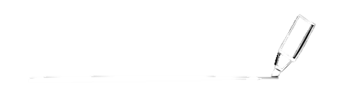
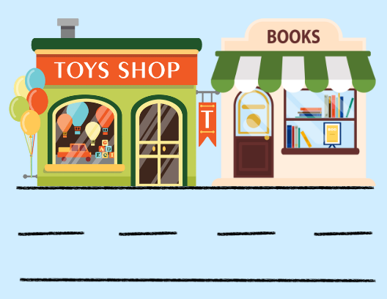

1. The toy shop is ( next to/ opposite) the book shop.
Underline the correct prepositions.
2. The fountain is ( on/ in front of ) the museum.

Slide 28
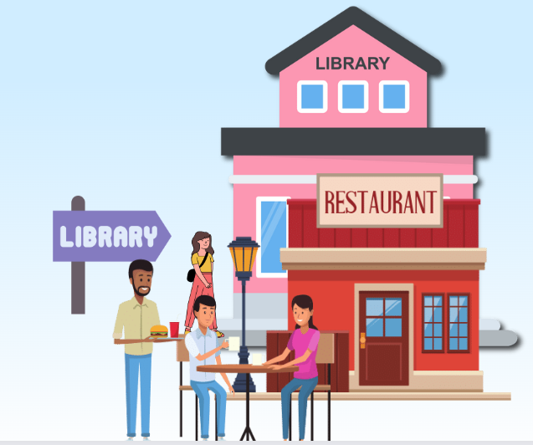
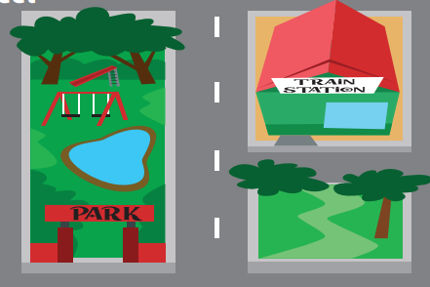
3. The library is ( behind/ in front of ) the restaurant.
4. The train station is ( opposite/ next to ) the park.

Slide 29

Thank You
Goodbye!

