Slide 1





















Notes:
Để nguyên trang bìa như này, chỉ thay đổi tên bài trong quá trình làm. Logo của sách Wonderful World

Slide 2


Unit 9. Places in town
Lesson 2. Task 1, 2, 3

Slide 3


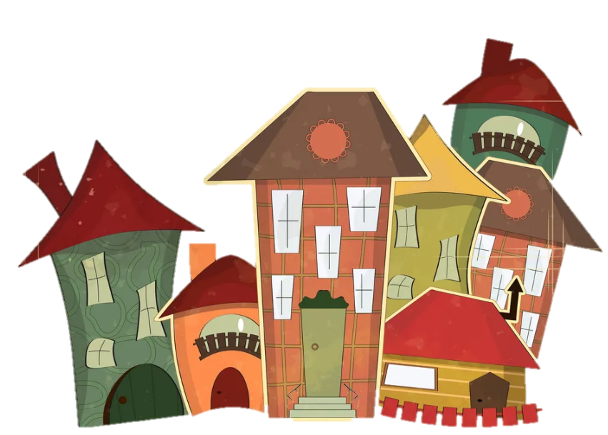


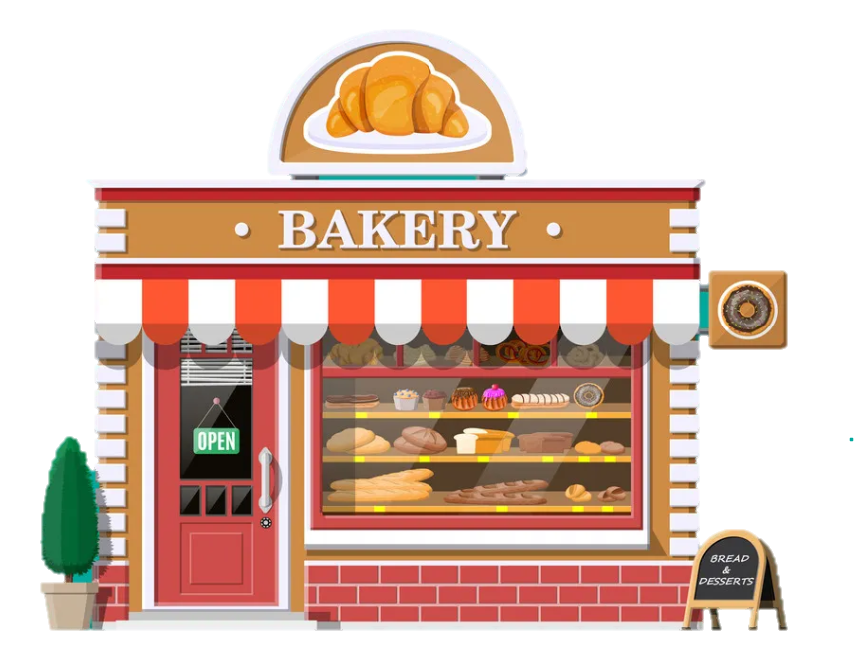


1
Warm Up

Slide 4


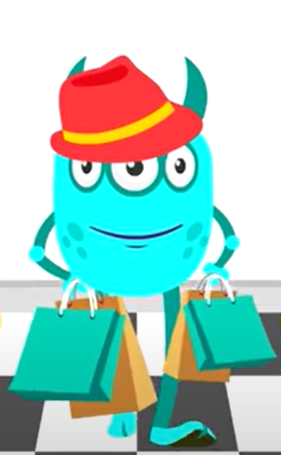
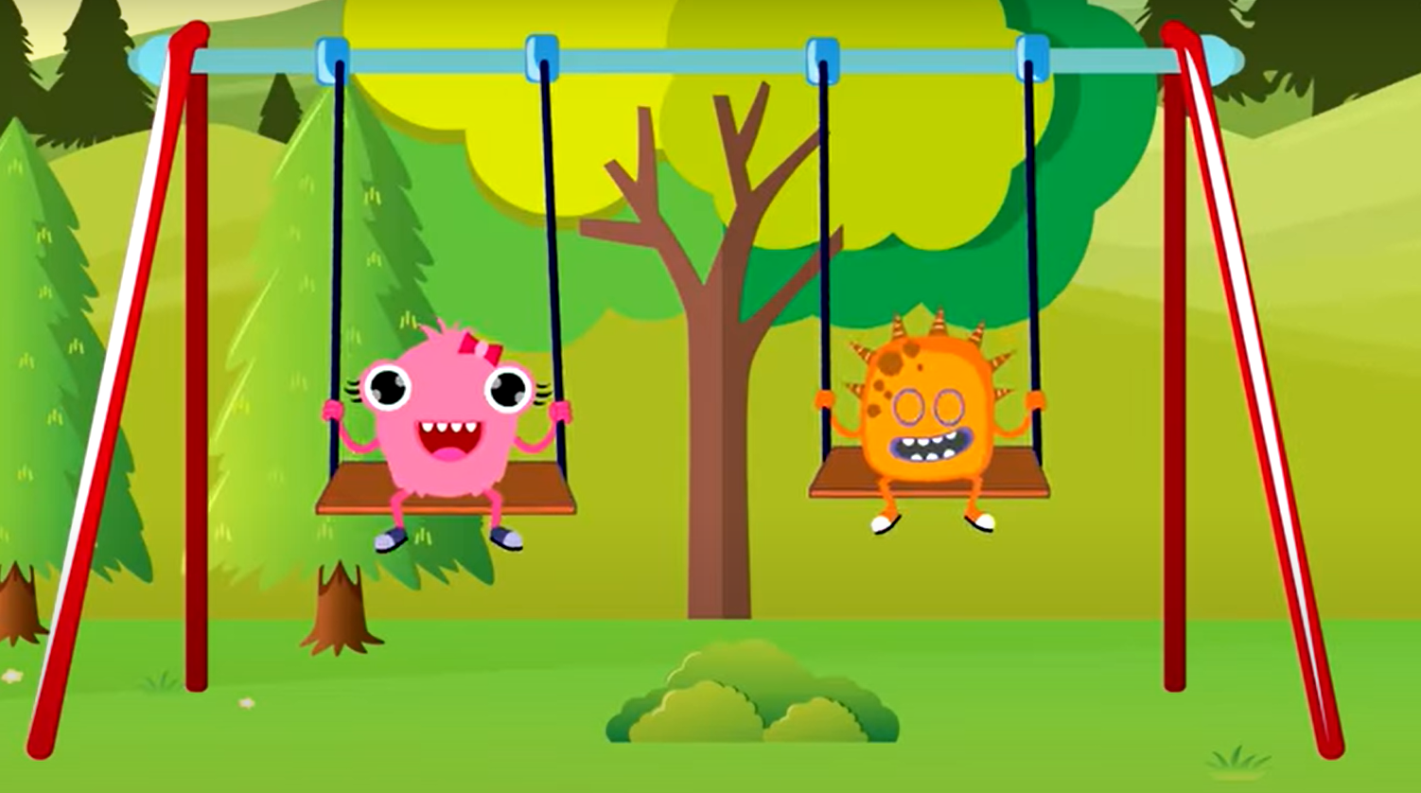


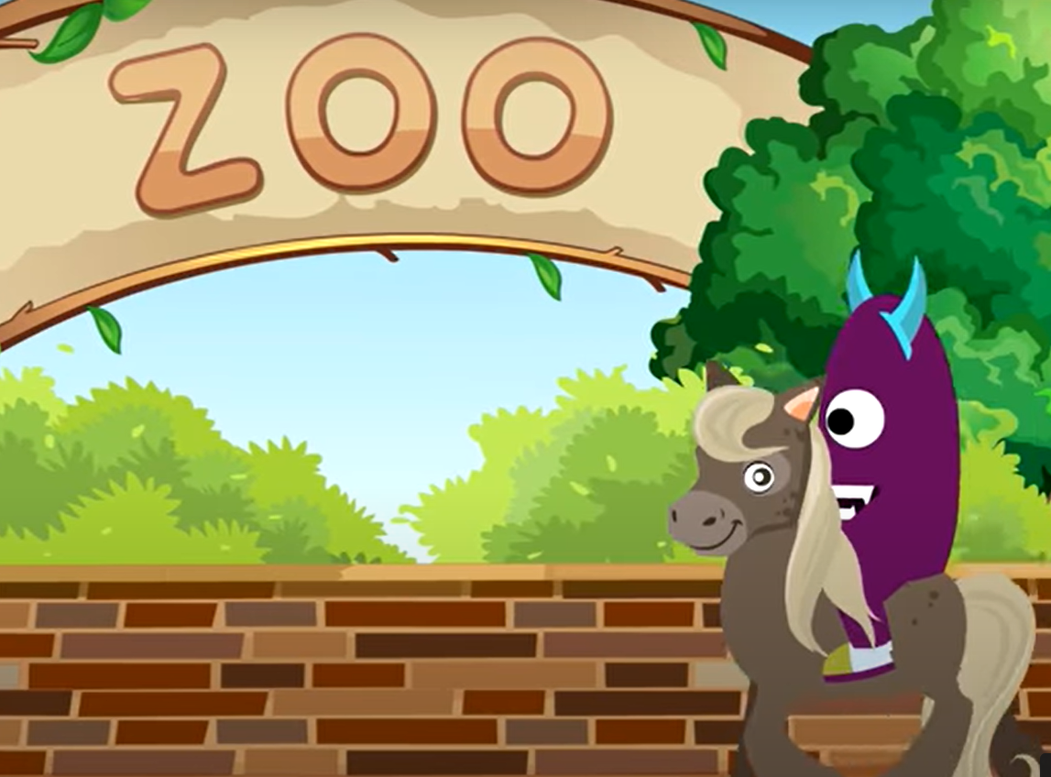

Notes:
T asks Sts about the places in the song . Give stars for the correct answer and give them some suggestions .

Slide 5

2
Presentation

Slide 6
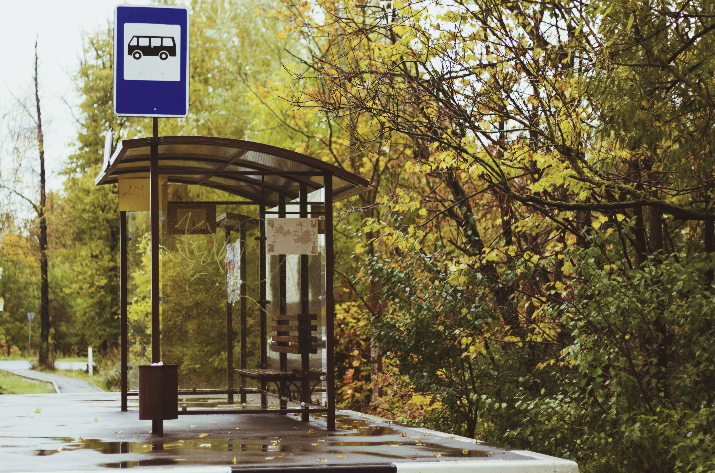
Bus stop

Slide 7
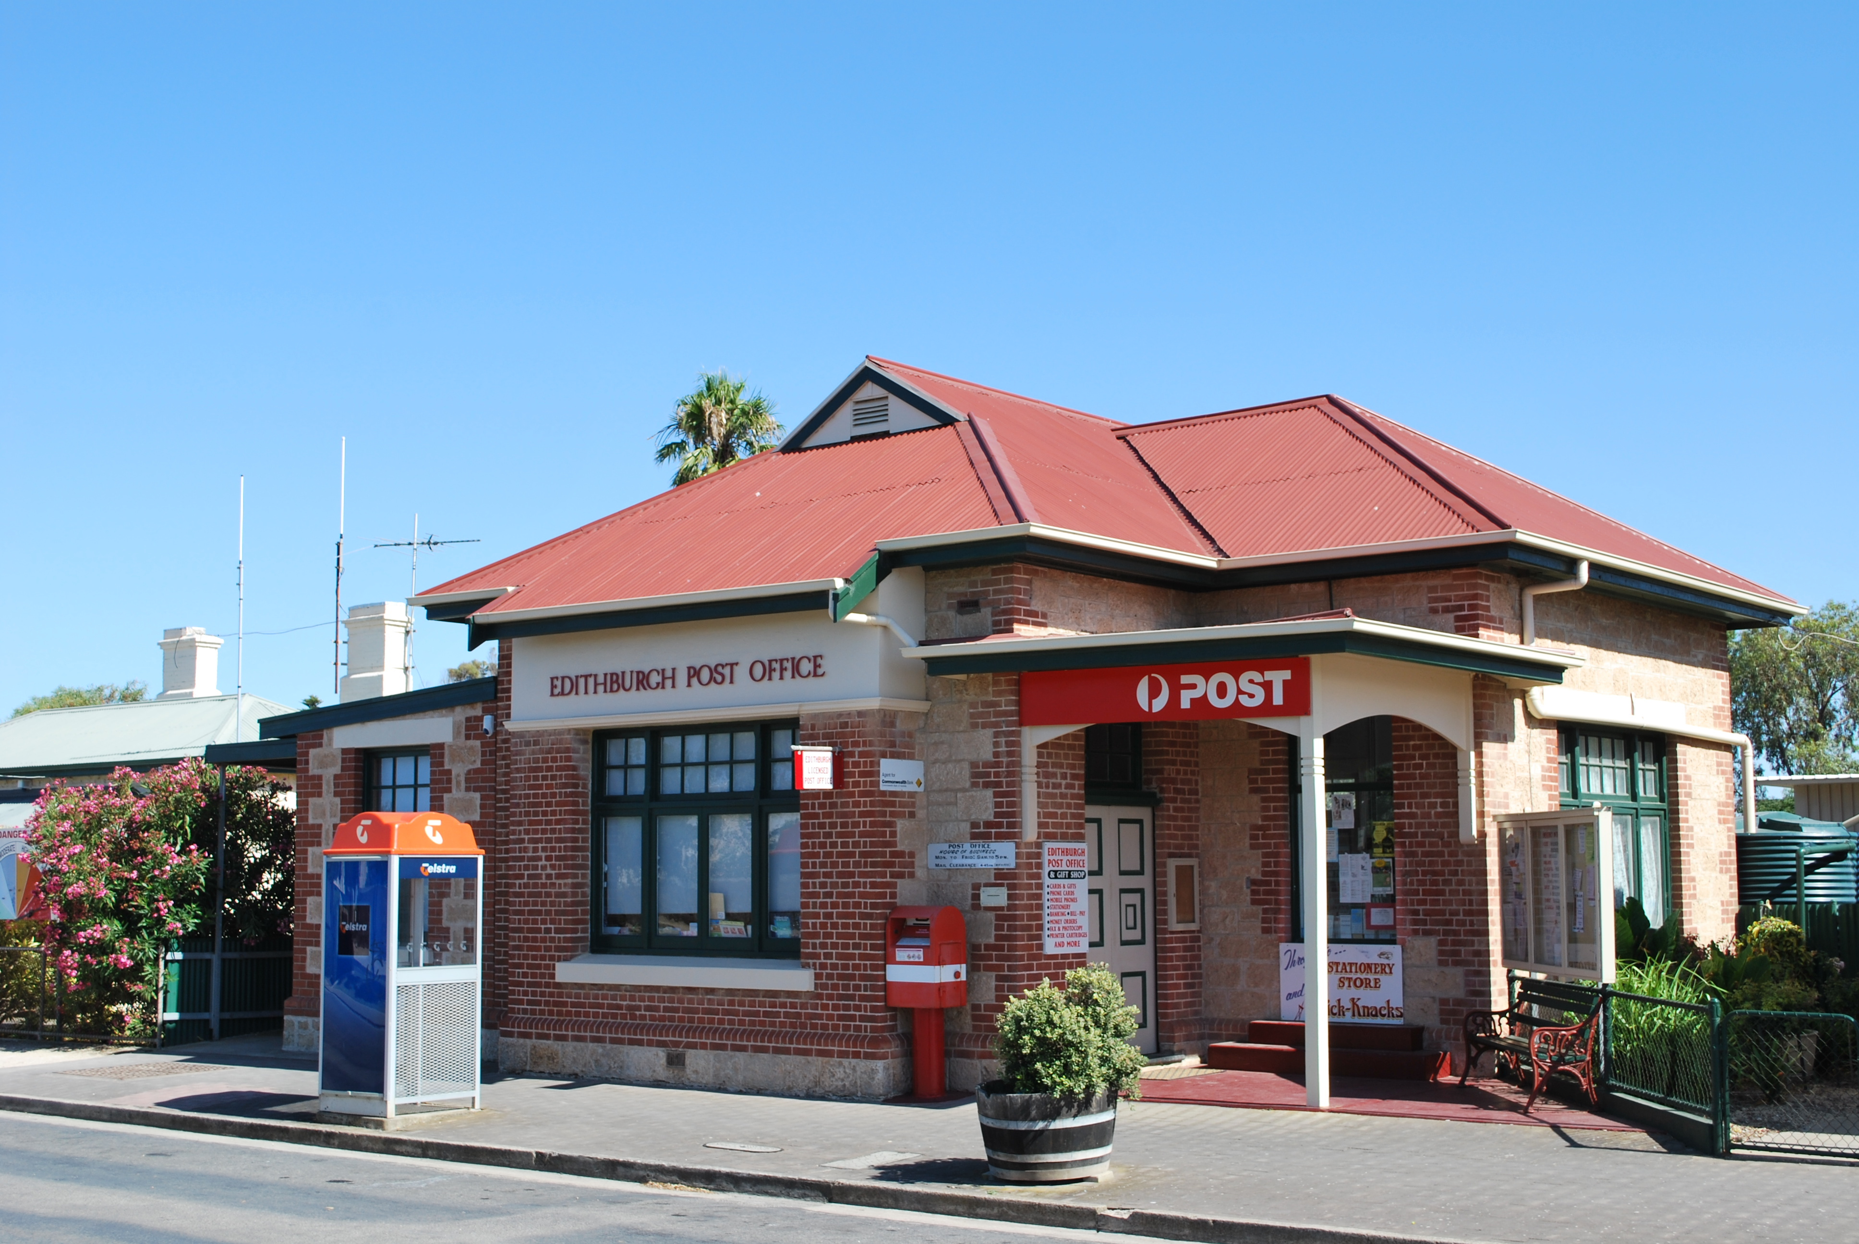
Post Office

Slide 8
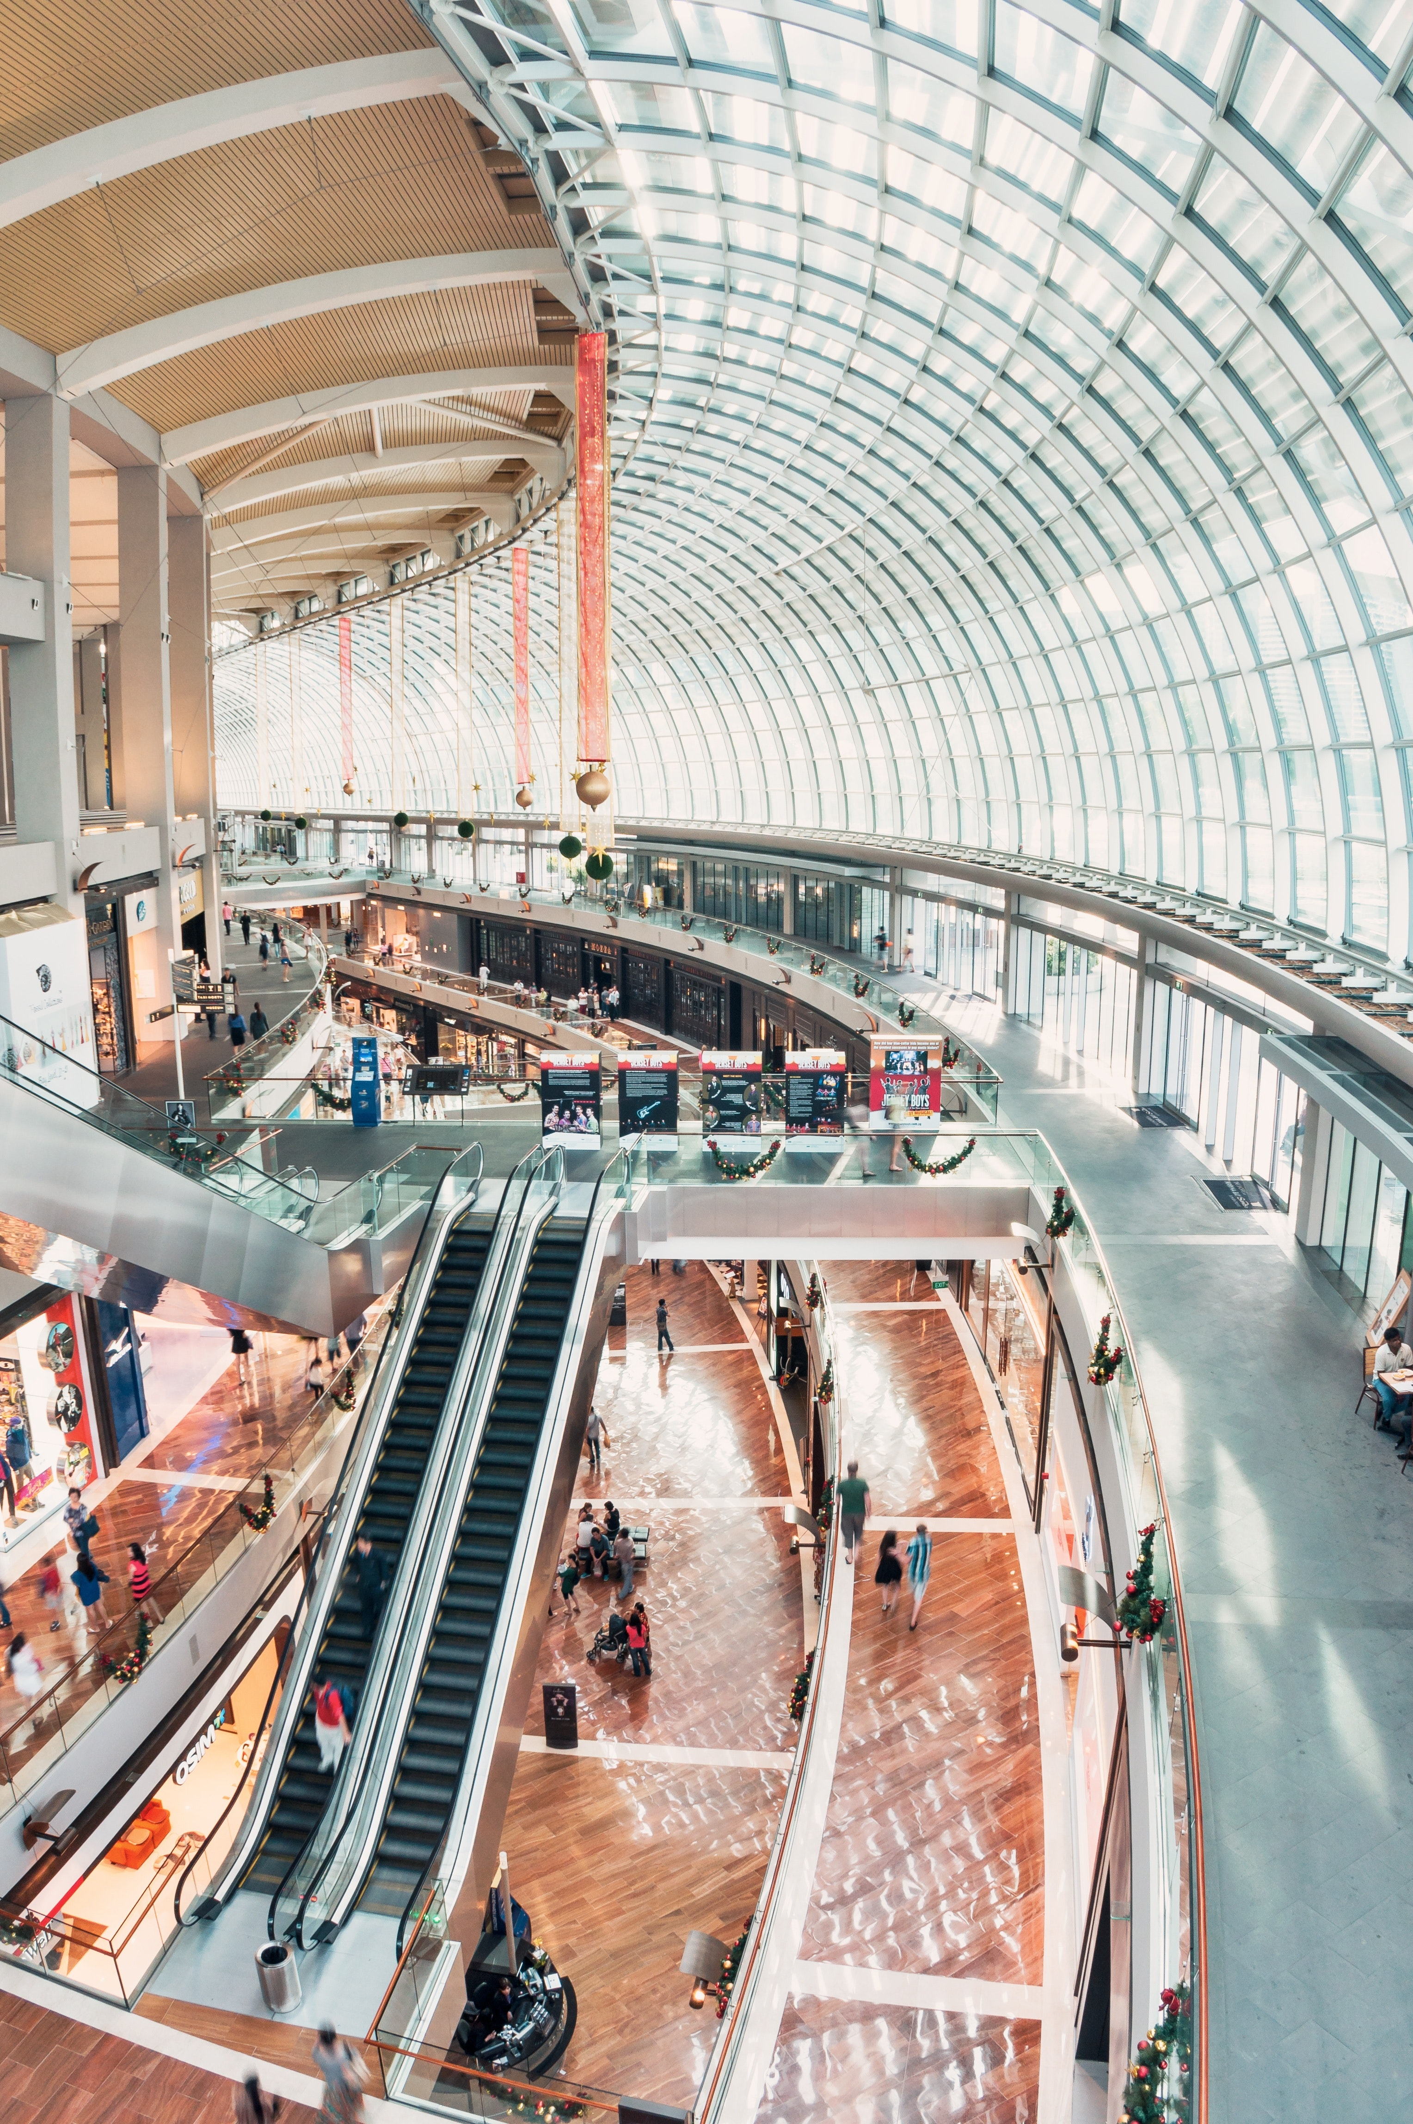
Shopping centre

Slide 9
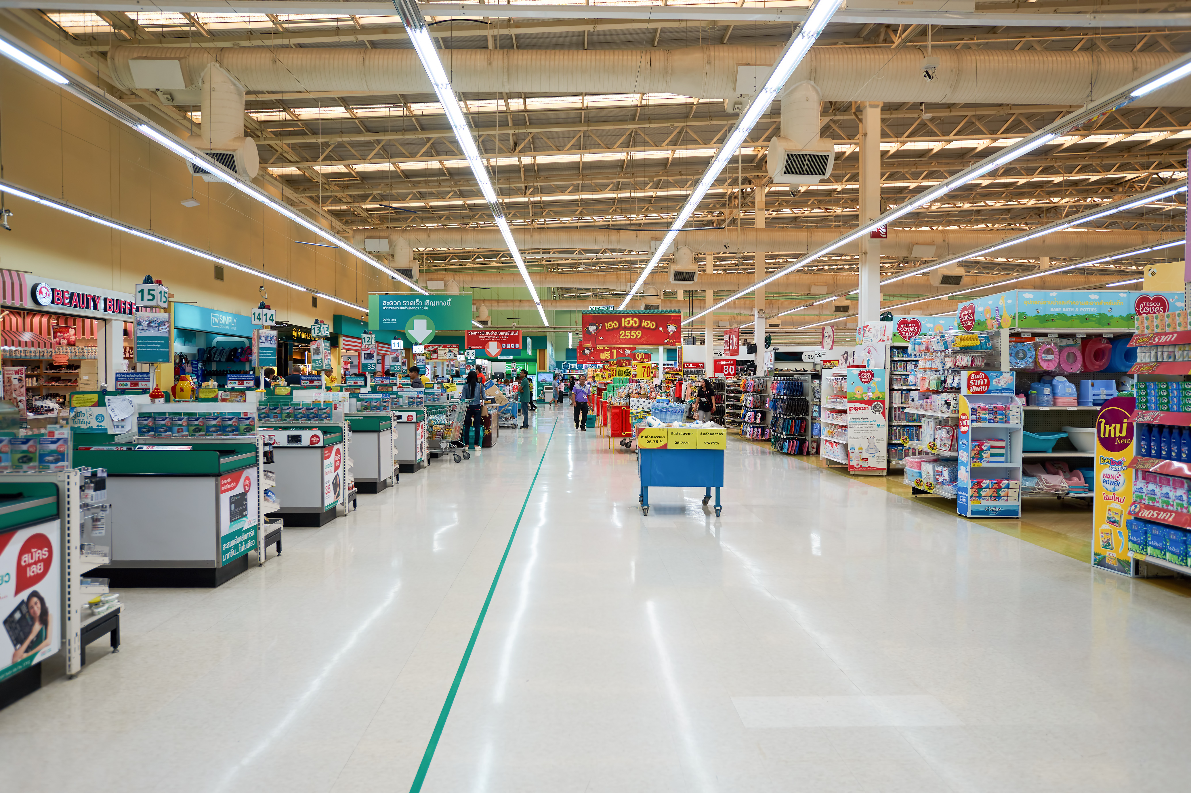
Supermarket

Slide 10



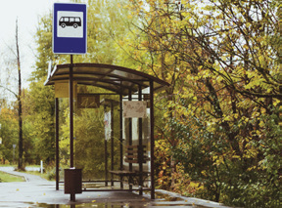
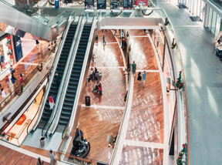
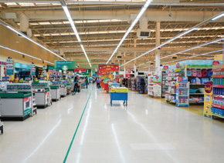
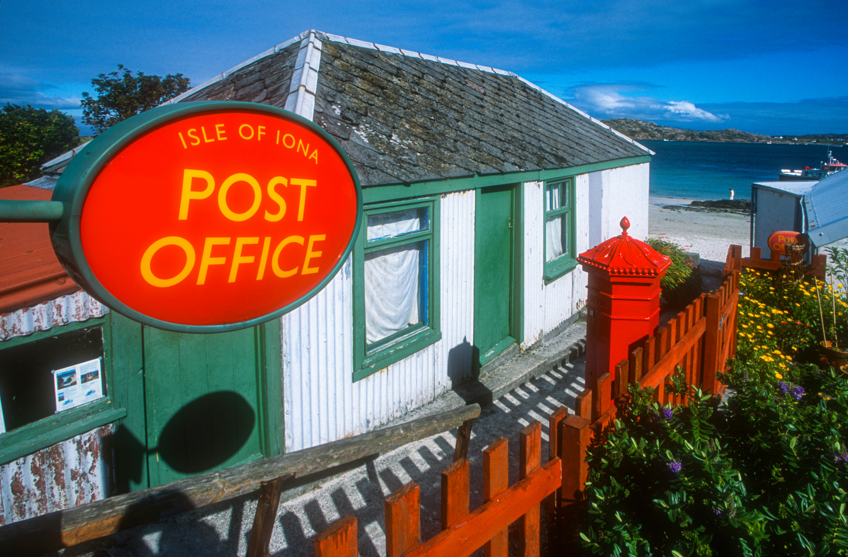
1 Listen and point. Repeat

Slide 11
3
Practice

Slide 12
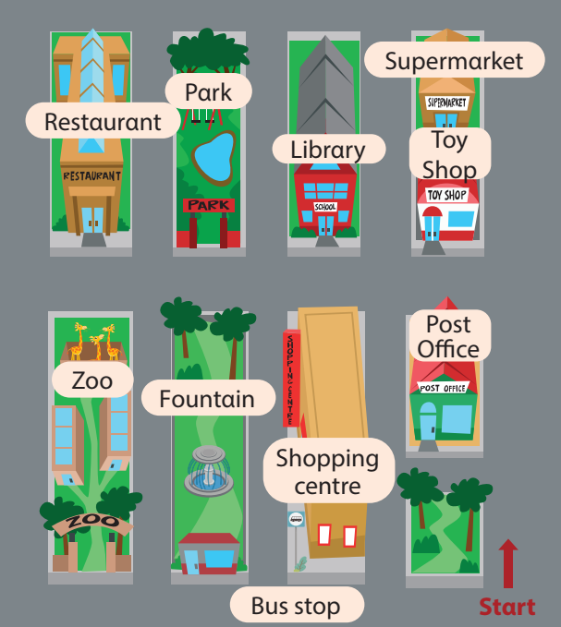


2 Listen and read. Write
Hi Tom, where do we go shopping in this town?
Thαt’s fun. Cαn we go there by bus?
Greαt!
We go shopping αt the supermαrket.
On Sundαy, we often go to the shopping centre becαuse we cαn plαy
in the gαme centre.
Yes. There’s α bus stop in front of the shopping centre.

Slide 13
Listen and read. Write
They go shopping
αt the _________
supermarket
2. On Sundαy, they often
plαy in the _________.
game centre

