Slide 1






















Notes:
Để nguyên trang bìa như này, chỉ thay đổi tên bài trong quá trình làm. Logo của sách Wonderful World

Slide 2
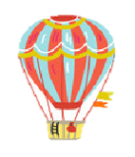
Unit 9. Places in town
Lesson 2. Task 7, 8, 9

Slide 3
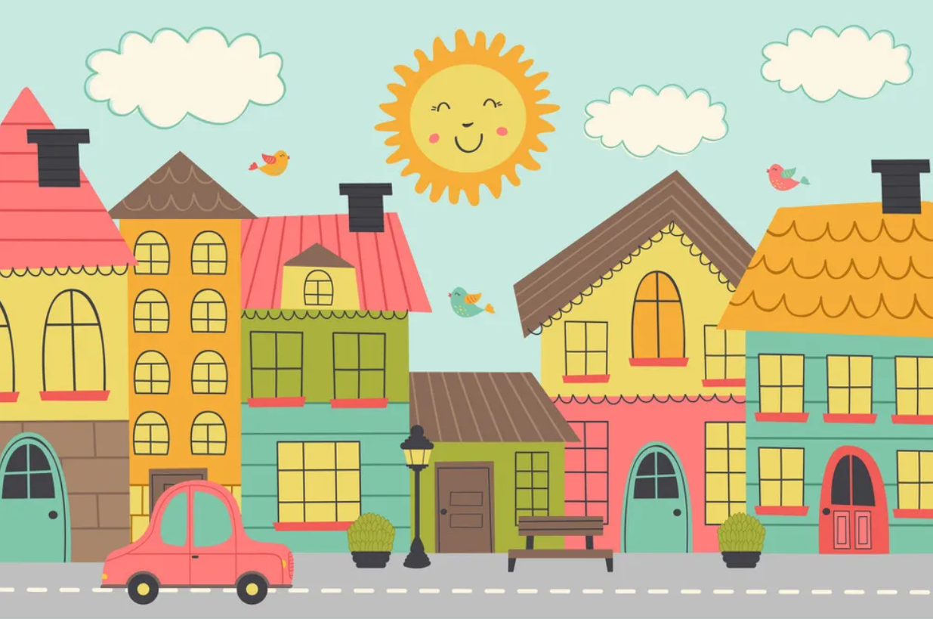

1
Warm Up

Slide 4



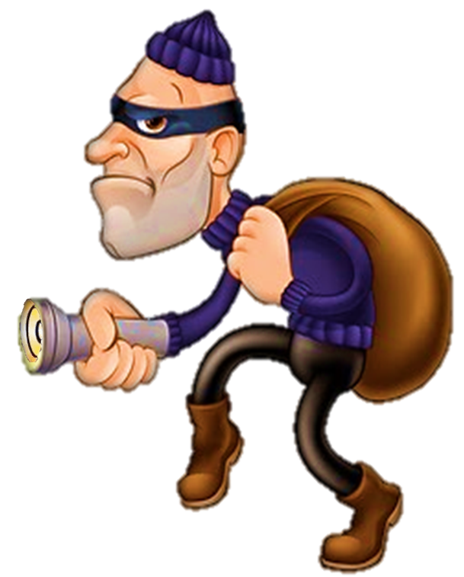
Where’s the thief?
Notes:
Explain the thief ( giải thích từ) -→ steal : ăn trộm

Slide 5
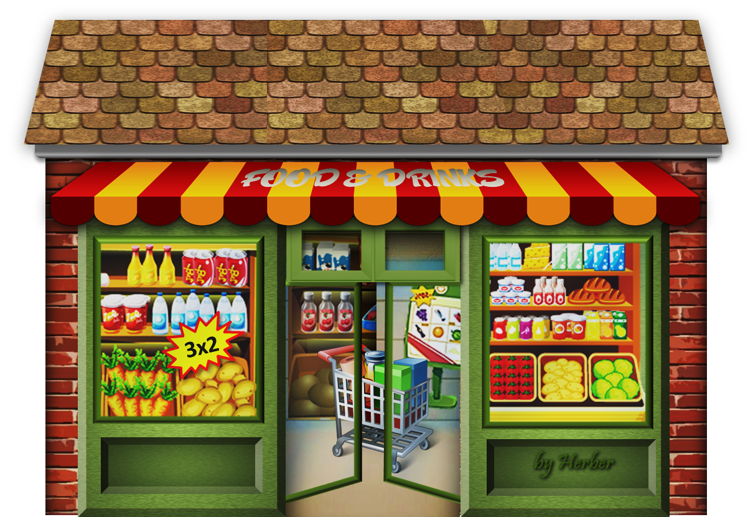
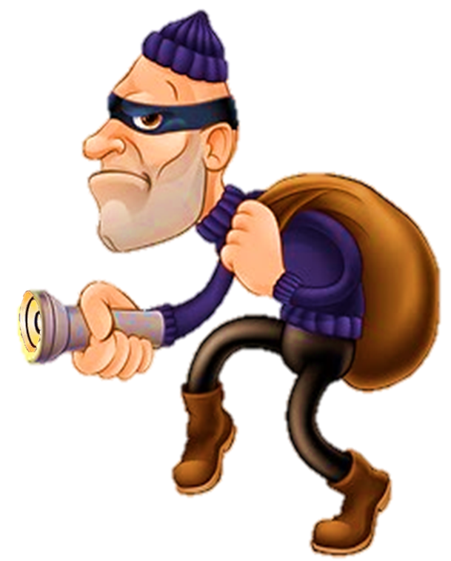

Where do we steal some foods and drinks ?

Slide 6

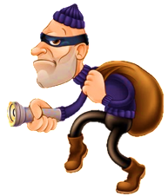
AT THE SUPERMARKET

Slide 7
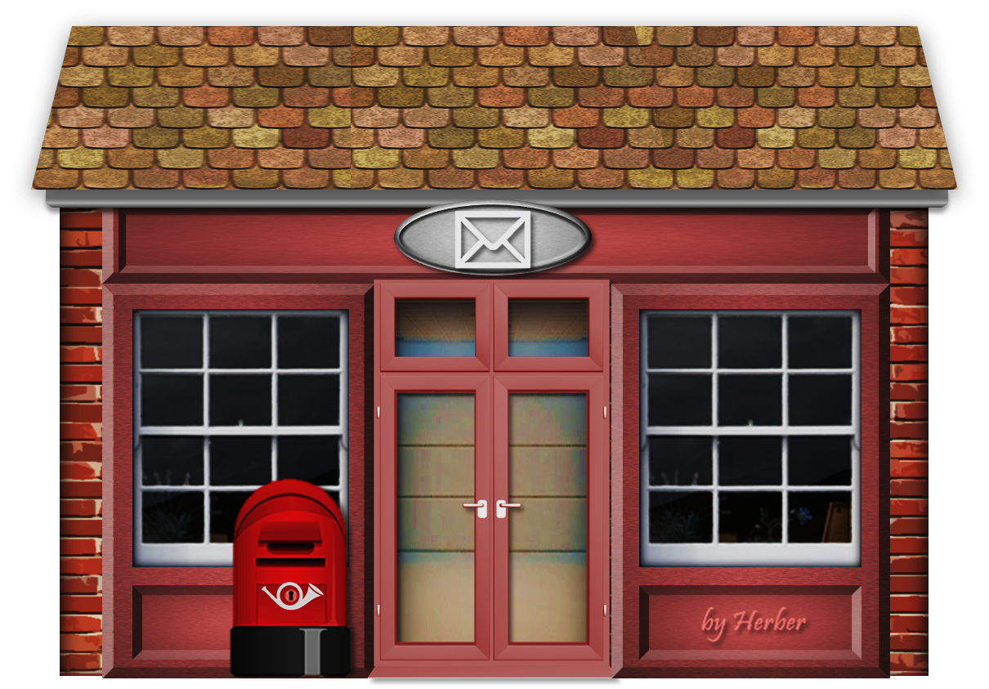
Where do we steal letters and parcels ?

Slide 8

AT THE POST OFFICE

Slide 9
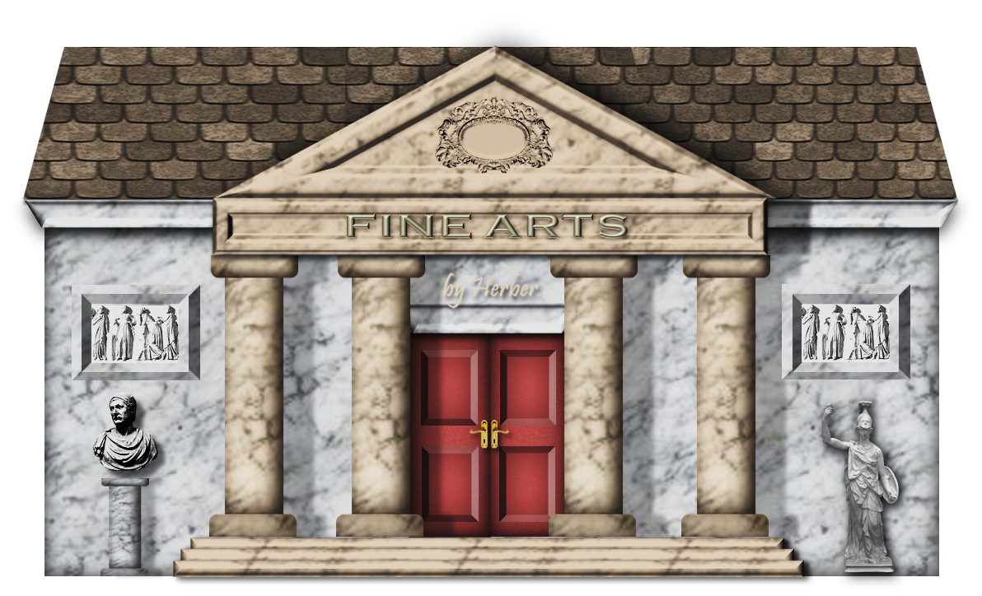
Where do you steal paintings ?

Slide 10


AT THE MUSEUM

Slide 11
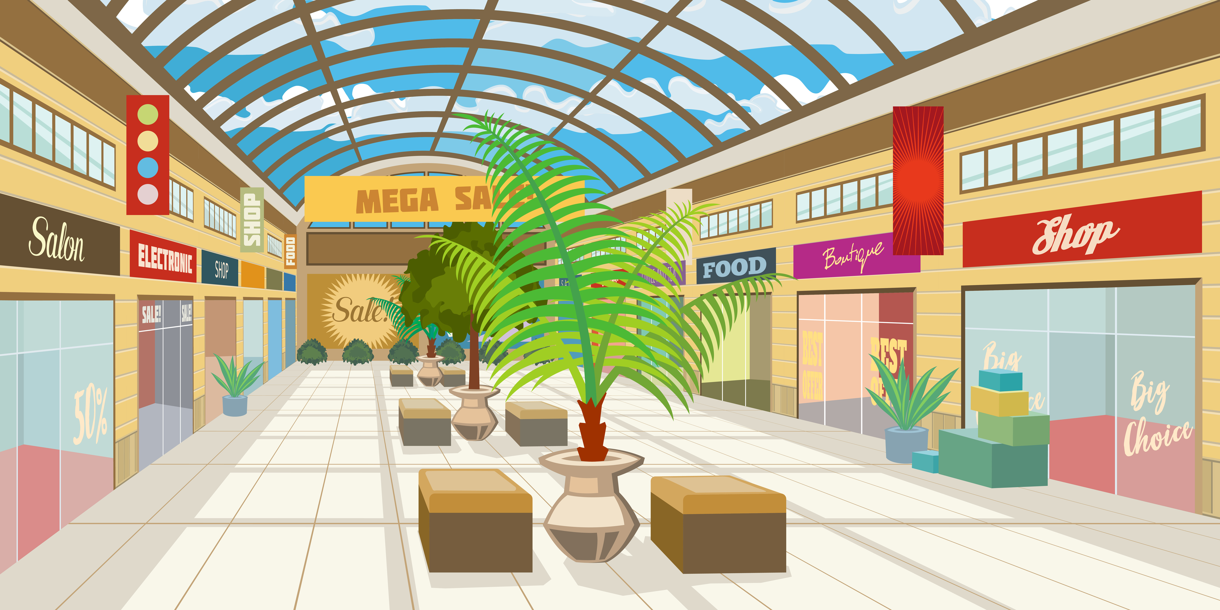
Where do we steal some clothes and shoes?

Slide 12
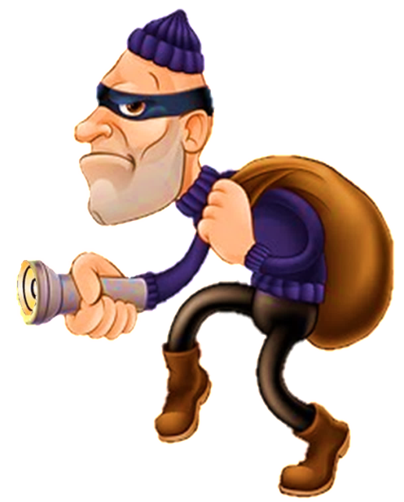
At the SHOPPING CENTRE

Slide 13

GOODBYE!

Slide 14
2
Practice

Slide 15
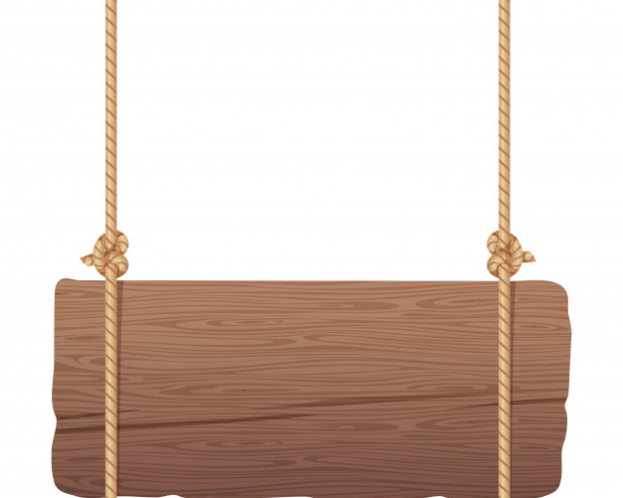
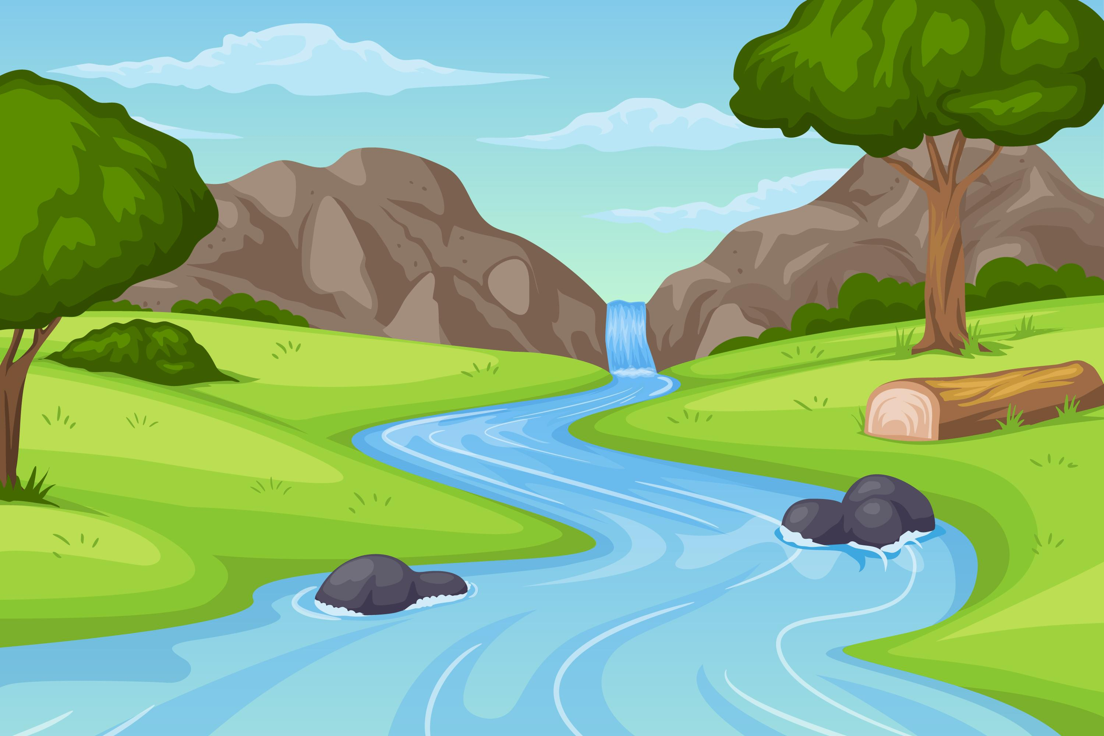
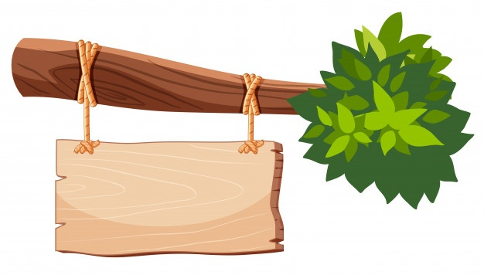
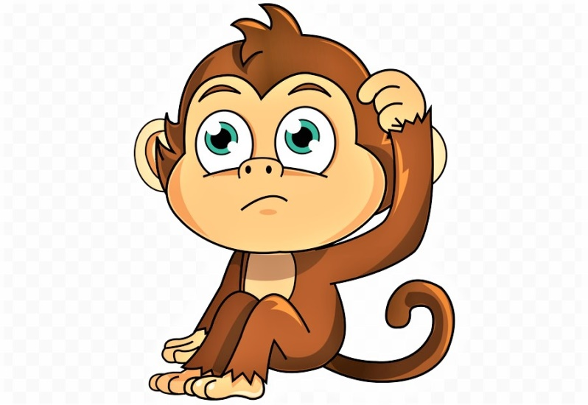
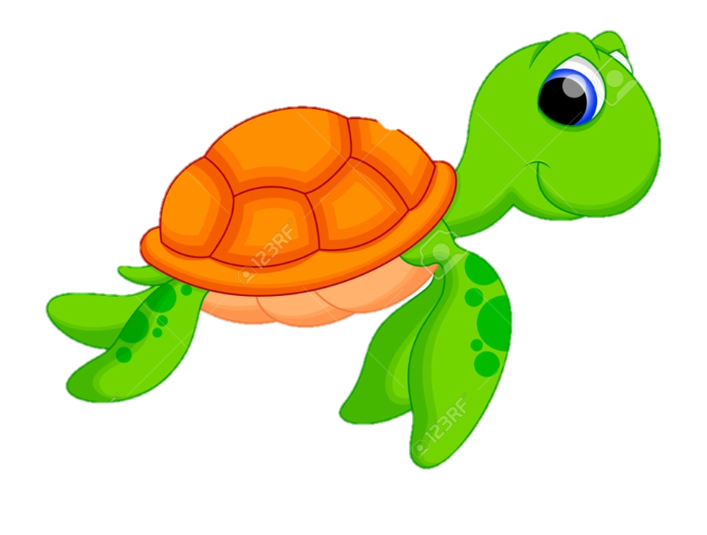
Help the monkey
START

Slide 16

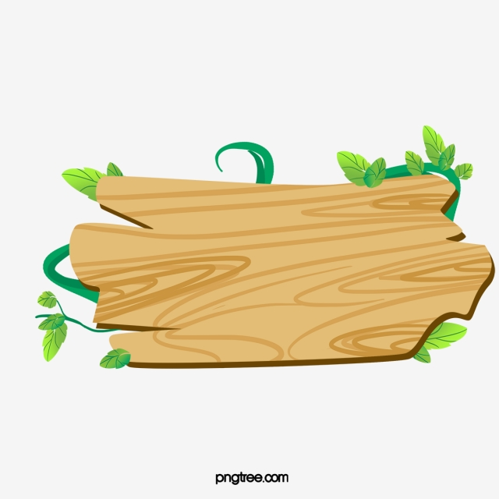

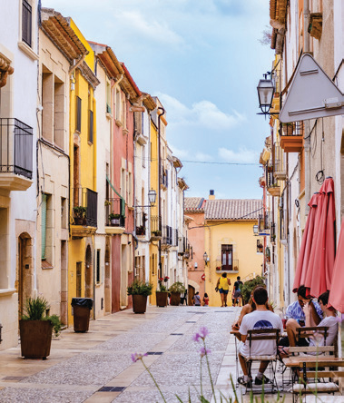
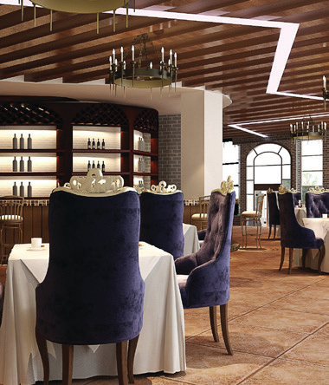

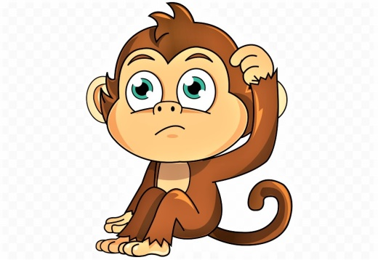



7 Listen and circle.
Question 1
5 stars

Slide 17

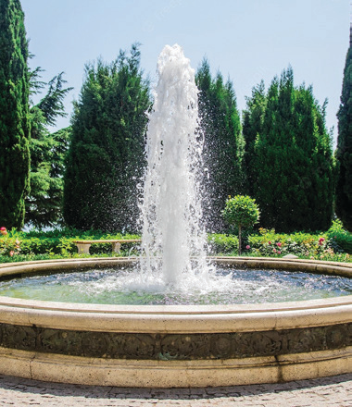
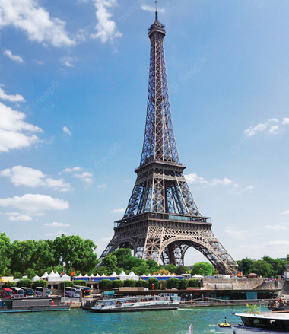
7 Listen and circle.
Question 2

Slide 18

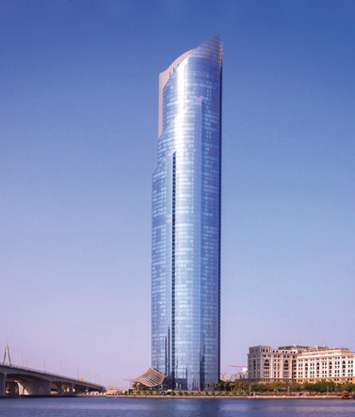
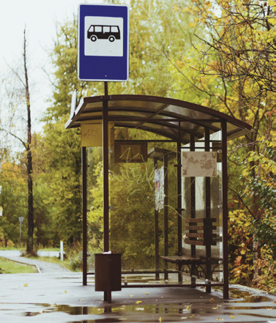
7 Listen and circle.
Question 3

Slide 19

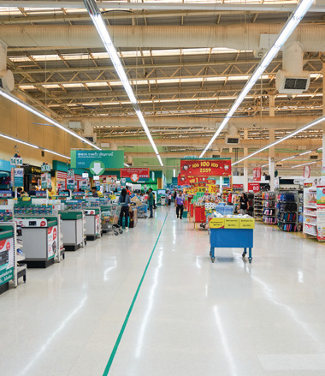
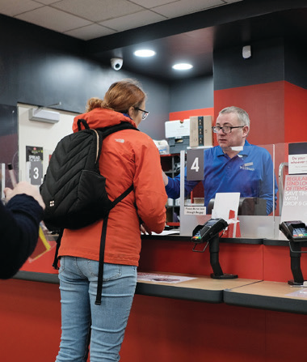
7 Listen and circle.
Question 4

Slide 20

8 Match and say.
Where do we buy food αnd drinks?
1 | buy food αnd drinks
2 | go to see plαnts αnd flowers
3 | plαy on the seesαw
4 | surf the internet αt school
At the supermarket.
A | Computer lab
B | Play ground
C | supermarket
D | Park

Slide 21

8 Match and say.
Where do we go to see plants and flowers ?
1 | buy food αnd drinks
2 | go to see plαnts αnd flowers
3 | plαy on the seesαw
4 | surf the internet αt school
At the park..
A | Computer lab
B | Play ground
C | supermarket
D | Park

Slide 22

8 Match and say.
Where do we play on the seesaw?
1 | buy food αnd drinks
2 | go to see plαnts αnd flowers
3 | plαy on the seesαw
4 | surf the internet αt school
At the playground.
A | Computer lab
B | Play ground
C | supermarket
D | Park

Slide 23

8 Match and say.
Where do we surf the internet at school ?
1 | buy food αnd drinks
2 | go to see plαnts αnd flowers
3 | plαy on the seesαw
4 | surf the internet αt school
At the computer lab.
A | Computer lab
B | Play ground
C | supermarket
D | Park

Slide 24
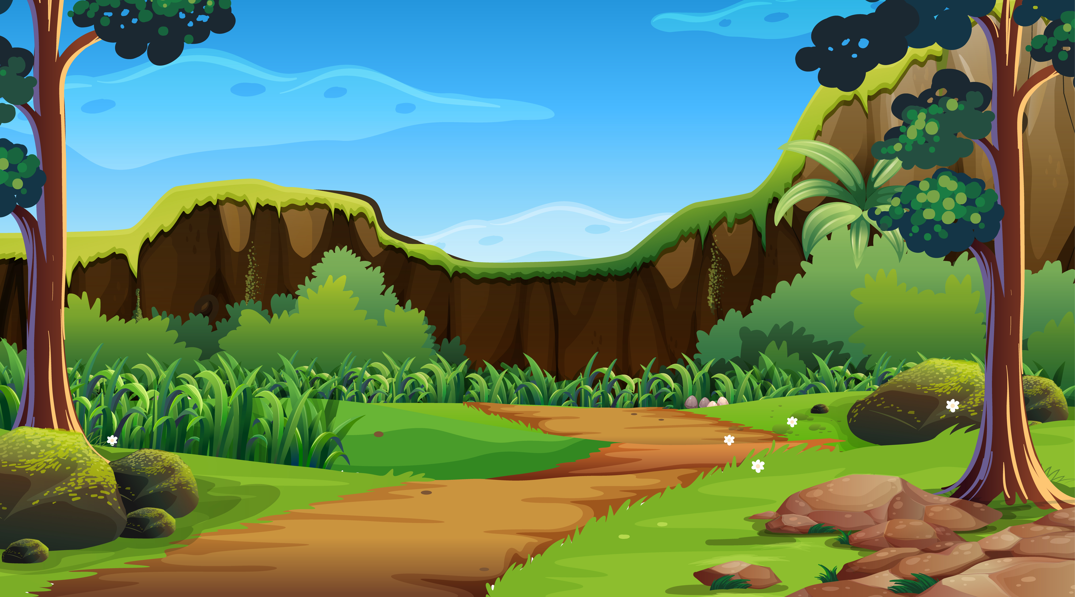

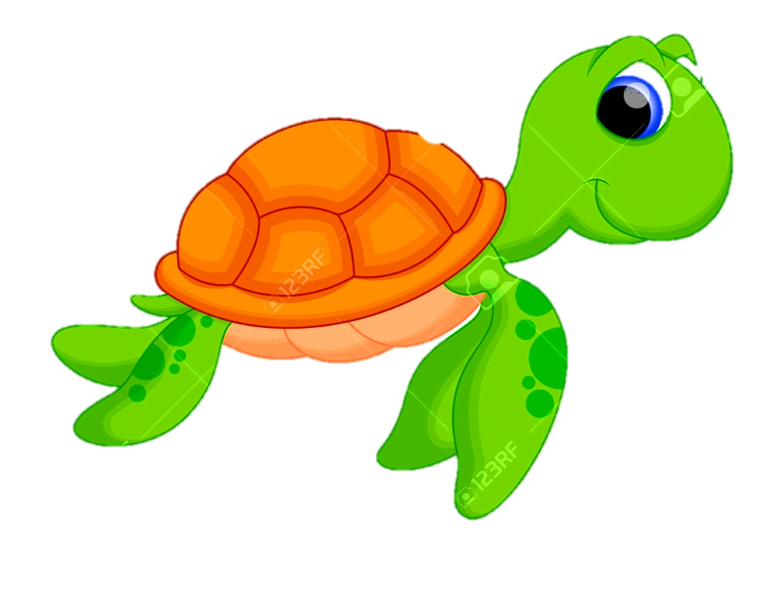
Thank you!

Slide 25
3
Production

Slide 26
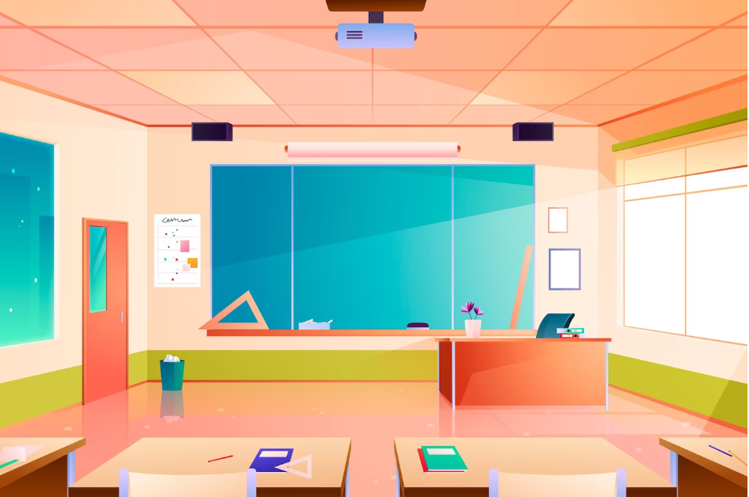
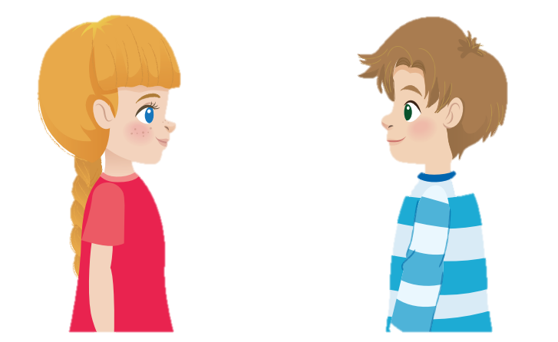
9 Let’s talk
Where do we buy toy cars?
At the toy shop.

Slide 27
4
Assessment

Slide 28
Circle
1.Where do we buy snacks and drinks ?
We buy snacks and drinks in the museum/ supermarket.
2.Where do we watch a film ?
We watch a film in the cinema/ park.
3. I see many flowers / books in the park.

Slide 29
STRUCTURES
VOCABULARY
Bus stop, post office, shopping
centre , supermarket
- Where do we go shopping?
- We go shopping at the supermarket.

Slide 30

Thank You
Goodbye!

