Slide 1
























Slide 2










Unit 9:
HOLIDAYS AND TRAVEL
Fun time and Project – Part 1, 2

Slide 3






Table of contents
01
02
Warm-up
Review
05
04
Wrap-up & Assessment
Production
03
Practice

Slide 4



01
WARM-UP
Let’s sing and do actions.

Slide 5
02
REVIEW

Slide 6
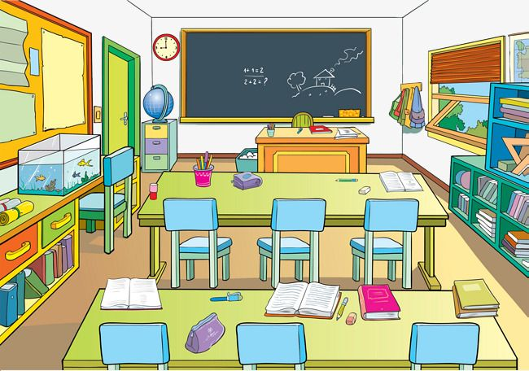
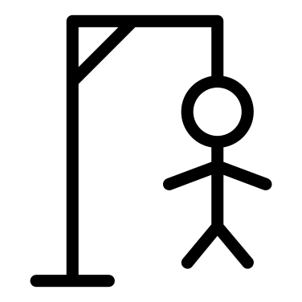
Hang-man

Slide 7
Review Vocabulary
Hang-man
_____ _____ _____ _____ _____ _____
F
L
I
G
H
T
A
B
C
D
E
F
G
H
I
J
K
L
M
N
O
P
Q
R
S
T
U
V
W
X
Y
Z

Slide 8
Review Vocabulary
Hang-man
_____ _____ _____ _____ _____ _____
B
R
I
D
G
E
A
B
C
D
E
F
G
H
I
J
K
L
M
N
O
P
Q
R
S
T
U
V
W
X
Y
Z

Slide 9
Review Vocabulary
Hang-man
_____ _____ _____ _____
S
I
L
K
A
B
C
D
E
F
G
H
I
J
K
L
M
N
O
P
Q
R
S
T
U
V
W
X
Y
Z

Slide 10
Review Vocabulary
Hang-man
_____ _____ _____ _____ _____ _____ _____ _____
V
I
L
L
A
G
E
R
A
B
C
D
E
F
G
H
I
J
K
L
M
N
O
P
Q
R
S
T
U
V
W
X
Y
Z

Slide 11
Review Vocabulary
Hang-man
_____ _____ _____ _____ _____
S
M
O
K
E
A
B
C
D
E
F
G
H
I
J
K
L
M
N
O
P
Q
R
S
T
U
V
W
X
Y
Z

Slide 12
Review Vocabulary
Hang-man
_____ _____ _____ _____ _____ _____ _____ _____
I
N
V
E
N
T
O
R
A
B
C
D
E
F
G
H
I
J
K
L
M
N
O
P
Q
R
S
T
U
V
W
X
Y
Z

Slide 13

Review regular and irregular verbs
ODD ONE OUT
Verbs in the Past
GO

Slide 14



ODD ONE OUT
cut
put
take
set
Past Tense of the verbs:
cut – put – took – set
All of the verbs are irregular verbs, but ‘take’ is the only verb that changes in the past.
Why?

Slide 15
ODD ONE OUT
fix
plan
stop
wrap
Past Tense of the verbs:
fixed – planned – stopped – wrapped
We don’t double the last consonant to form the past tense of the verb ‘fix’.
Why?

