Slide 1









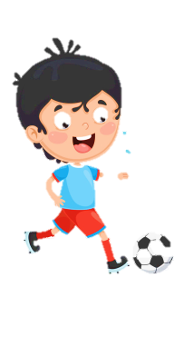












Slide 2
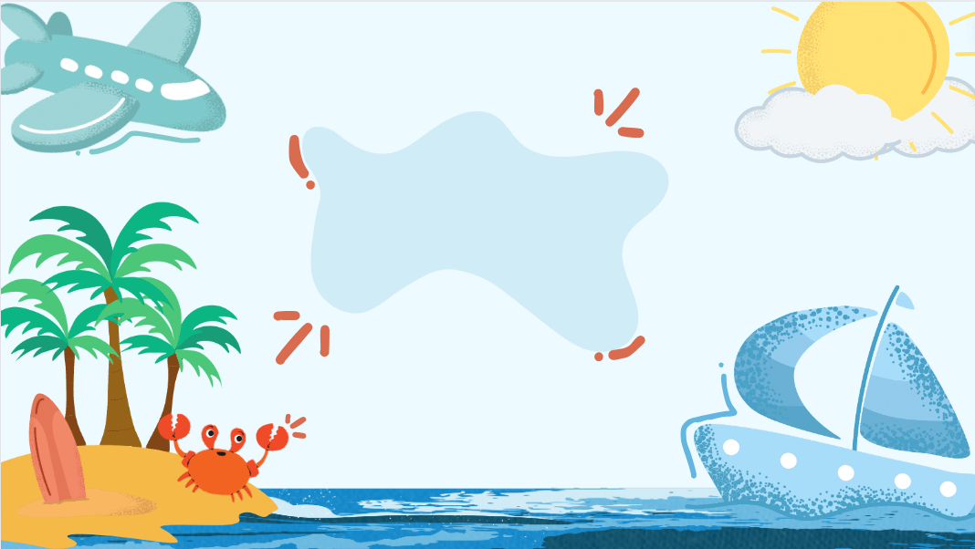
Unit 9: HOLIDAYS AND TRAVEL
Fun time & Project – Part 3, 4, 5

Slide 3






Table of contents
01
05
Warm-up
02
04
Review
Production
03
Practice
Wrap-up & Assessment

Slide 4
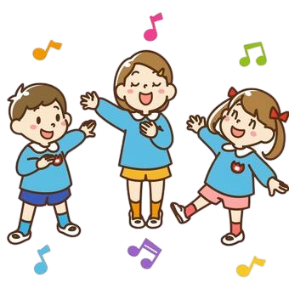
01
WARM-UP
Word puzzle.

Slide 5

02
REVIEW

Slide 6


Slide 7




1
2
3
4
TEAM 1
5
6
7
8
9
10
11
12
TEAM 2
13
14
15
16

Slide 8

NO.1
Odd one out
A. laughed
B. played
C. watched

Slide 9
NO.2
Find and correct the mistake:
I buyed a melon at the market yesterday.
buyed → bought

Slide 10
NO.3
Which words have /t/ ending sound?
watched, started, enjoyed, joined, liked
watched, liked

Slide 11
NO.4
Fill in the blank:
Did you _______ basketball yesterday? (play)
play

Slide 12
NO.5
You’ve got an O!

Slide 13
NO.6
Read aloud these words
visited, wanted, needed

Slide 14
NO.7
Read aloud these words
visited, wanted, needed

Slide 15
NO.8
Find and correct the mistake:
She asks me to go on a picnic last week.
asks → asked

Slide 16
NO.9
Which words doesn’t have /id/ or /t/ ending sounds?
played, travelled, trusted, touched, cleaned, washed
played, travelled, cleaned

Slide 17
NO.10
Read aloud these words
looked, touched, jumped

