Slide 1






















Slide 2






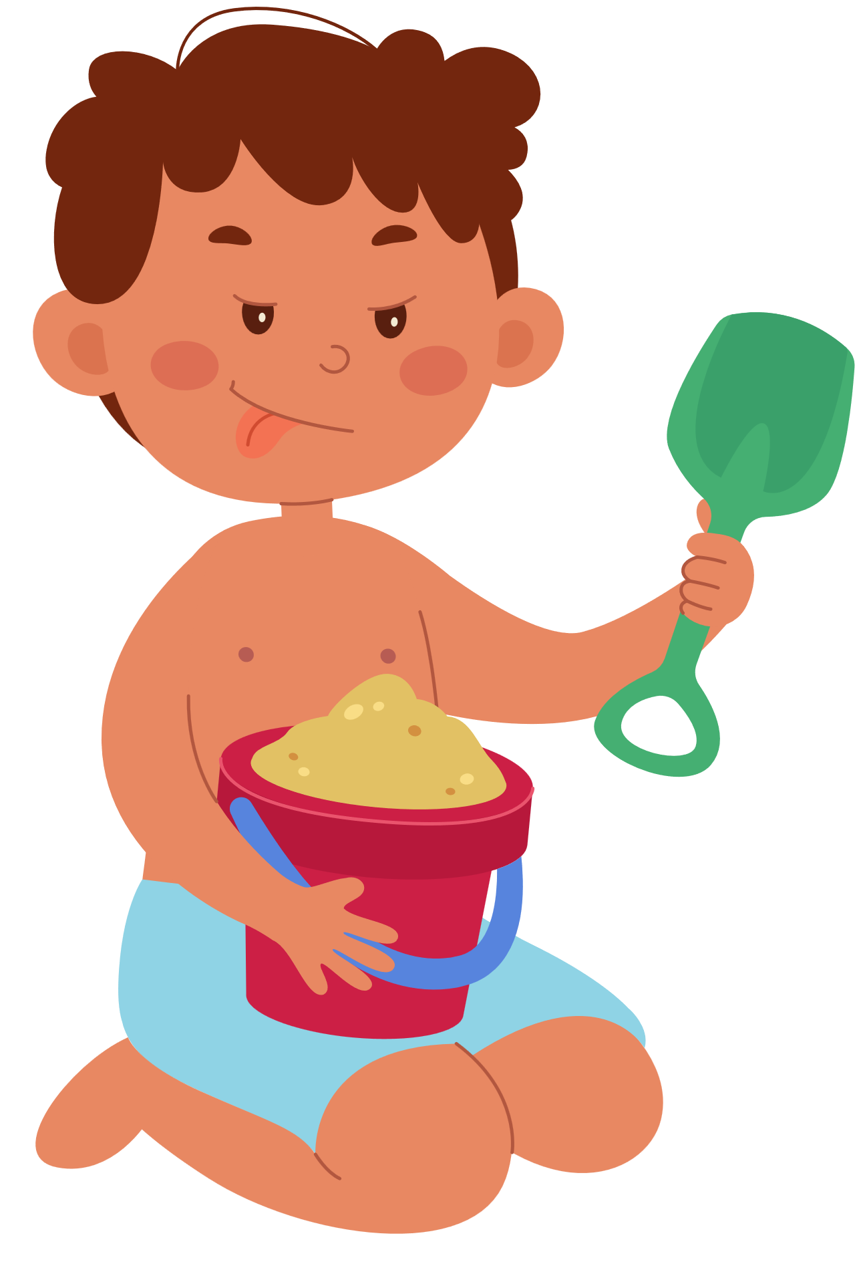




Unit 9:
HOLIDAYS AND TRAVEL
Lesson 3 – Task 1, 2, 3

Slide 3





Table of contents
01
02
Warm-up
Review
05
04
Wrap-up & Assessment
Production
03
Practice

Slide 4
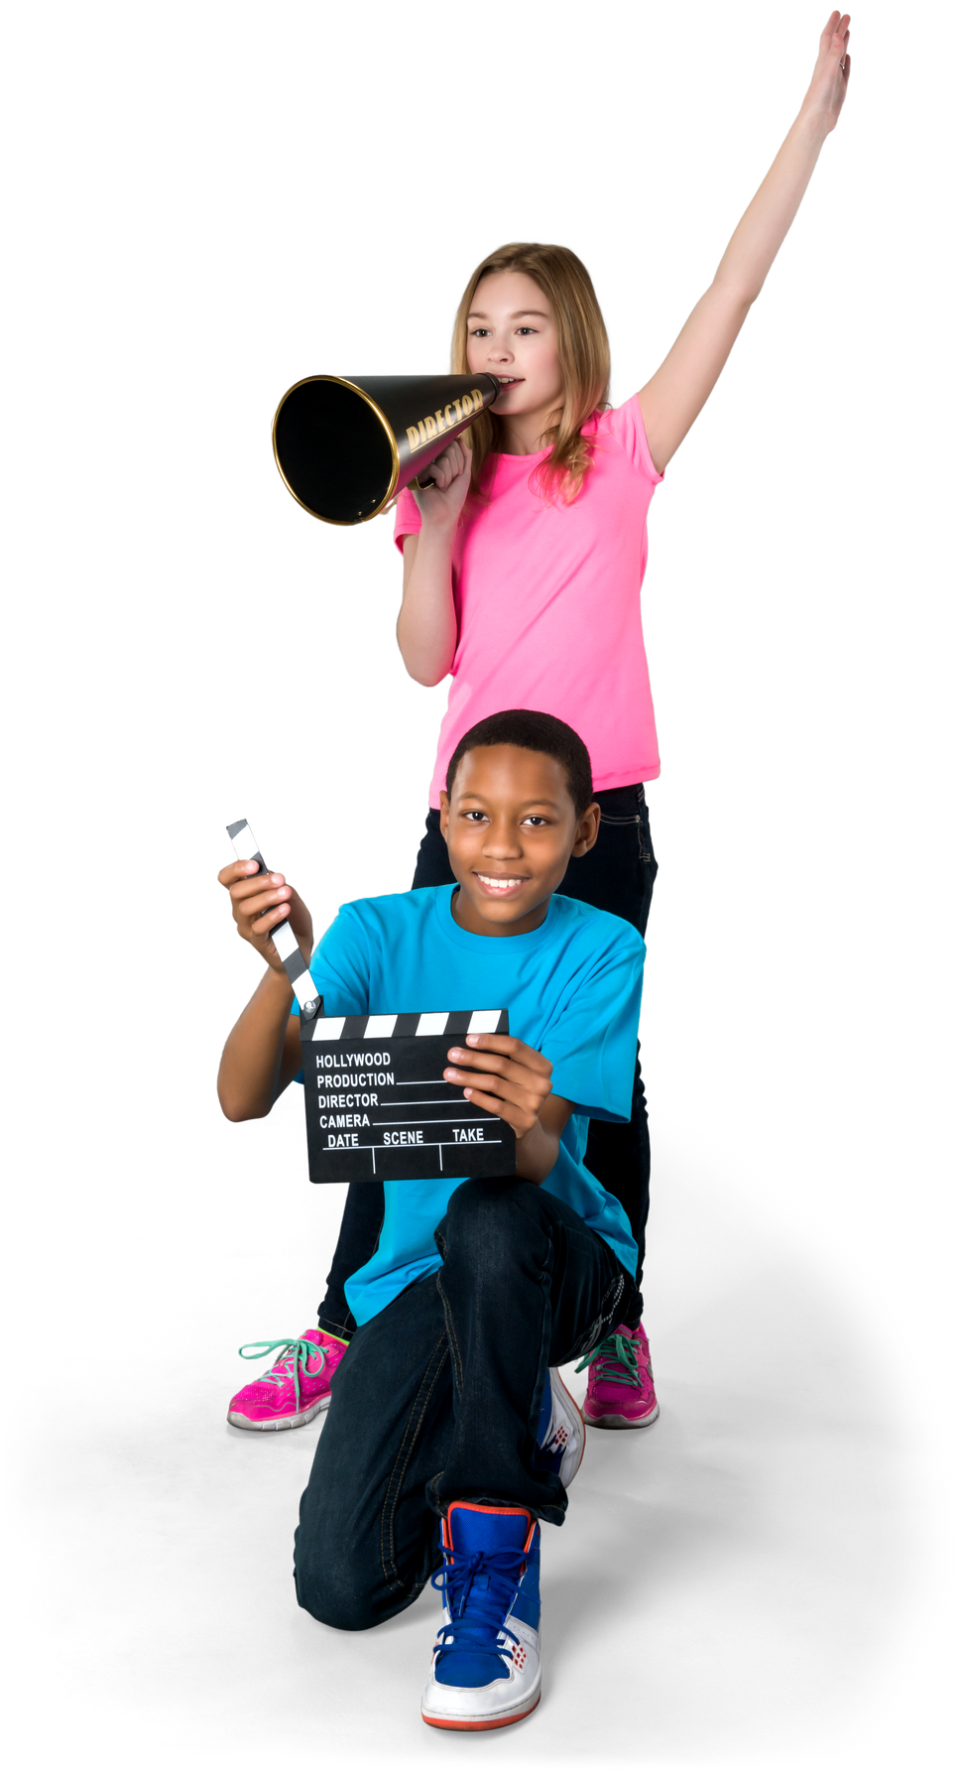





01
YOUR CATCHY TAGLINE HERE
WARM-UP

Slide 5
02
YOUR CATCHY TAGLINE HERE
REVIEW

Slide 6




brush
peel
collect
phone
cook
dance
cry
smile
hug
try
iron
wait
stop
watch

Slide 7

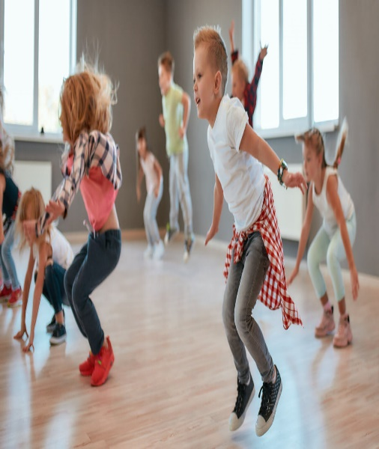

brush
peel
collect
phone
cook
dance
cry
smile
hug
try
danced
We _____ all afternoon.
iron
wait
stop
watch

Slide 8
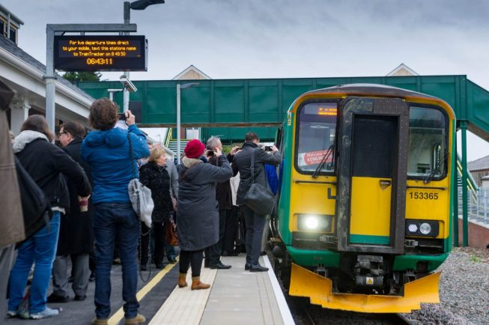
brush
peel
collect
phone
cook
cry
smile
hug
try
They ______ at the station.
stopped
iron
wait
stop
watch

Slide 9
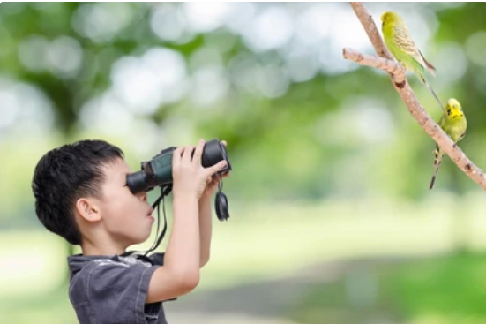
brush
peel
collect
phone
cook
cry
smile
hug
try
Thomas _______ the birds on the tree.
watched
iron
wait
watch

Slide 10
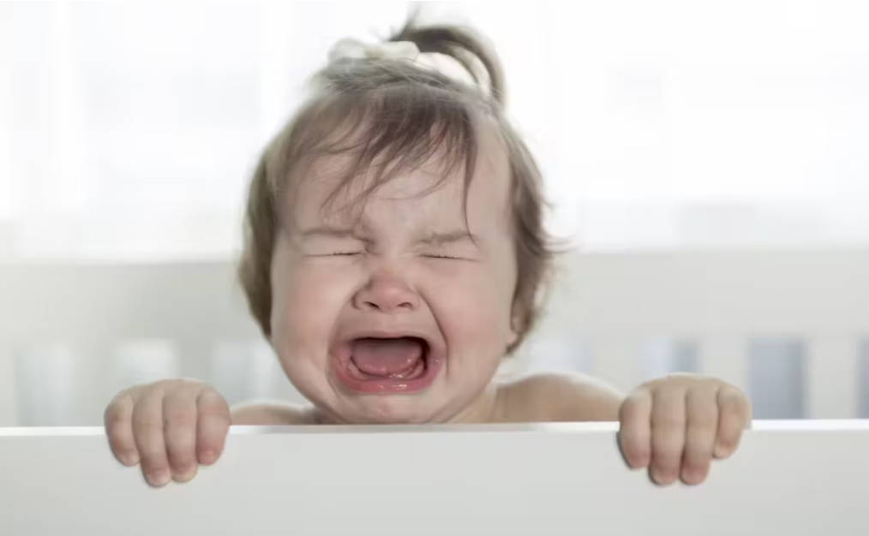
brush
peel
collect
phone
cook
cry
smile
hug
try
cried
Our neighbours’ baby ____
loudly last night.
iron
wait

Slide 11
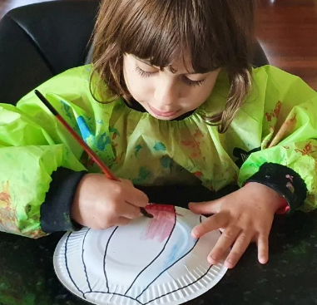
brush
peel
collect
phone
cook
smile
hug
try
Anna _____ to make a hot-air balloon.
tried
iron
wait

Slide 12
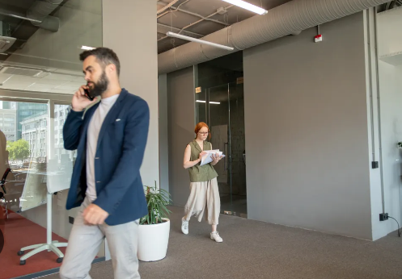
brush
peel
collect
phone
cook
smile
hug
phoned
Roger _______ Sue at his office yesterday.
iron
wait

Slide 13
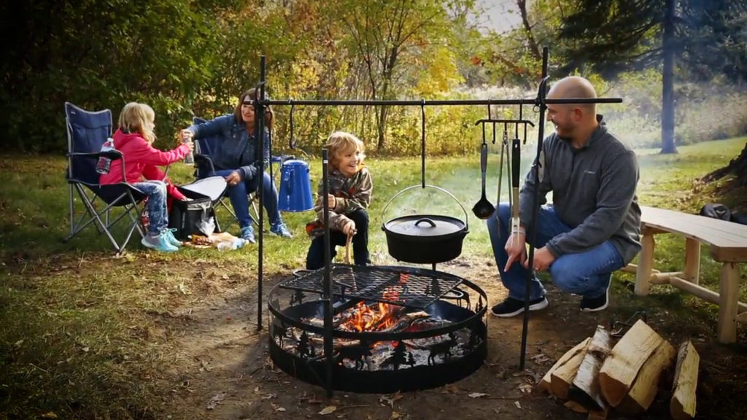
brush
peel
collect
cook
smile
hug
They _____ delicious meal on the campfire last weekend.
cooked
iron
wait

Slide 14

brush
peel
collect
smile
hug
waited
John _____ quite long for his computer to run normally.
iron
wait

Slide 15
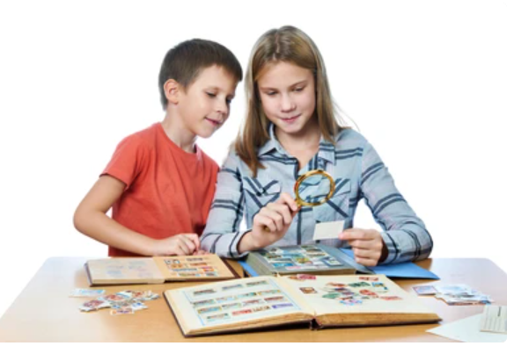
brush
peel
collect
smile
hug
collected
My sister _______ a lot of stamps when she was ten.
iron

Slide 16
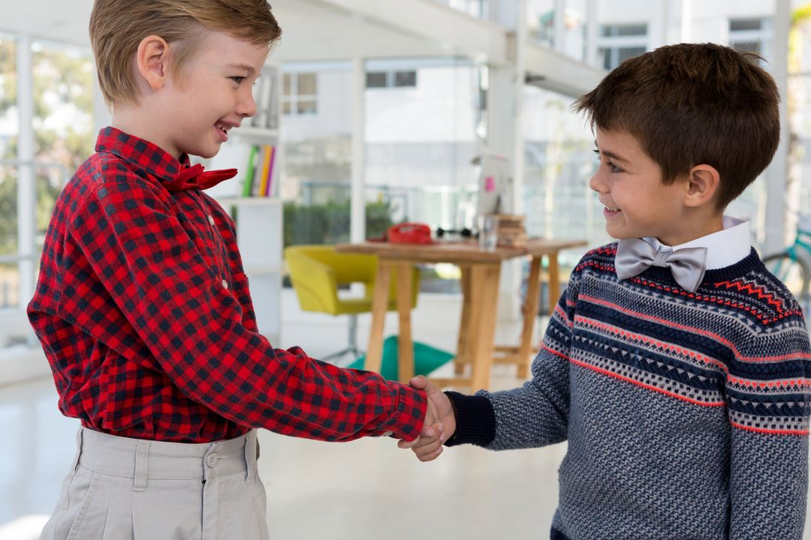
brush
peel
smile
hug
iron
smiled
He _____ and shook my hand.

