Slide 1









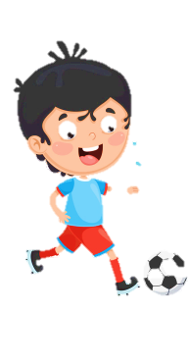













Slide 2

Unit 9:
HOLIDAYS AND TRAVEL
Lesson 3 – Task 7,8,9,10

Slide 3






Table of contents
01
02
Warm-up
Presentation
05
04
Wrap-up &
Assessment
Production
03
Practice

Slide 4

01
Warm-up
Let’s play a game!

Slide 5






Write the past form of the verbs.
wait
waited
go
went
sleep
slept
lions
watches
babies
knives
eggs
potatoes
parties
eat
ate
have
had
do
did
loaves
eyes
boxes
stories
stars
buses
berries
shelves
leaves
visit
visited
watch
watched
buy
bought
girls
glasses
countries

Slide 6
Write the past form of the verbs.
study
studied
write
wrote
tell
told
lions
watches
babies
knives
eggs
potatoes
parties
work
worked
arrive
arrived
stop
stopped
loaves
eyes
boxes
stories
shelves
stars
berries
leaves
speak
spoke
think
thought
give
gave
girls
buses
countries
glasses

Slide 7
02
Presentation

Slide 8




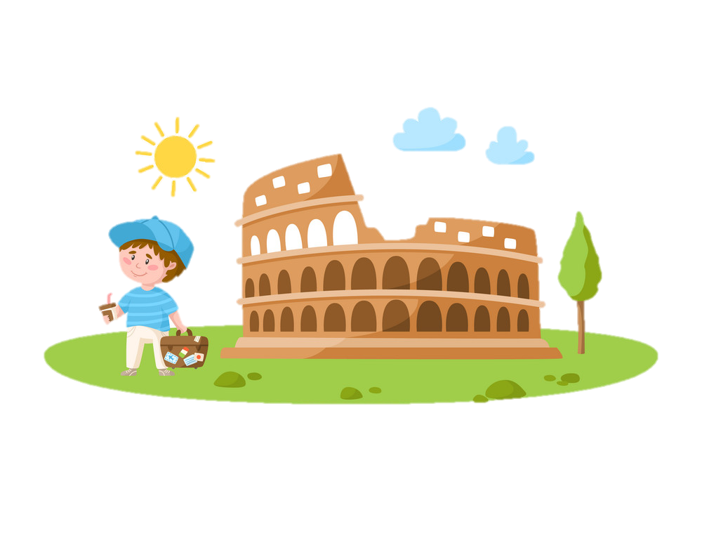

Pronunciation: -ed
There are 3 ways to pronounce “-ed”.
/t/
/d/
/id/

Slide 9


Pronunciation: -ed
After a voiceless consonant sound , we pronounce the “-ed” as
/t/
Voiceless consonant sounds /p, k, θ, f, s, ks, ʃ, tʃ/
No vibration in the vocal chords.
Push of air
kiss
/kis/
→ kissed /t/
/kist/
watch /wɒtʃ/
→ watched /t/ /wɒtʃt/

Slide 10



/t/
helped
/helpt/
laughed
/læft/
ANY EXAMPLES?
looked
/lʊkt/
fixed
/fikst/
matched
/mætʃt/
danced
/danst/
washed
/wɑːʃt/
breathed
/breθt/

Slide 11
Pronunciation: -ed
After a vowel or voiced consonant sound, we pronounce the “-ed” as
/d/
Vowel or voiced consonant sounds /b, g, ð, v, z, ʒ, dʒ, m, n, ŋ, r, l/
Vibration in the vocal chords.
No push of air
phoned
phone
→ phoned /d/ /fəʊnd/
/fəʊn/

