Slide 1


Slide 2



Slide 3

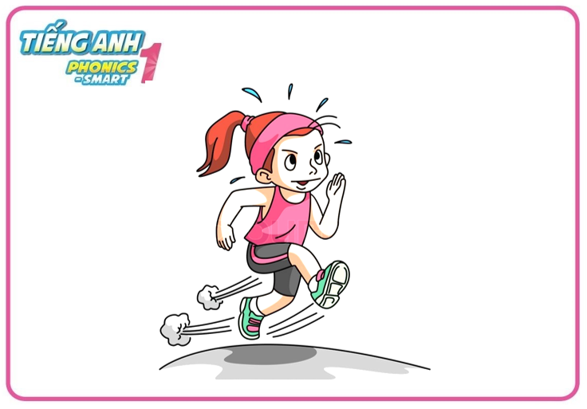


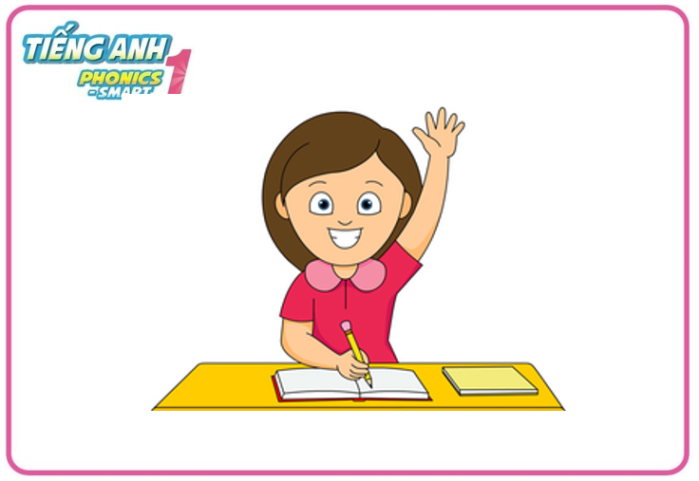
Warm - up
Game: Fast as you can
Notes:
-Let’s do 4 actions: run, walk, jump and raise your hands first.
- Teacher says the actions one by one, Ss do the correct action fast as they can.

Slide 4
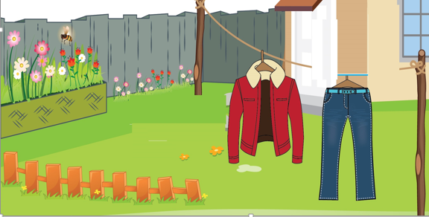
Unit 10
Lesson 3

Slide 5



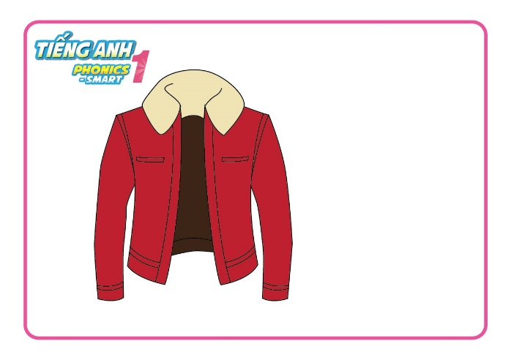
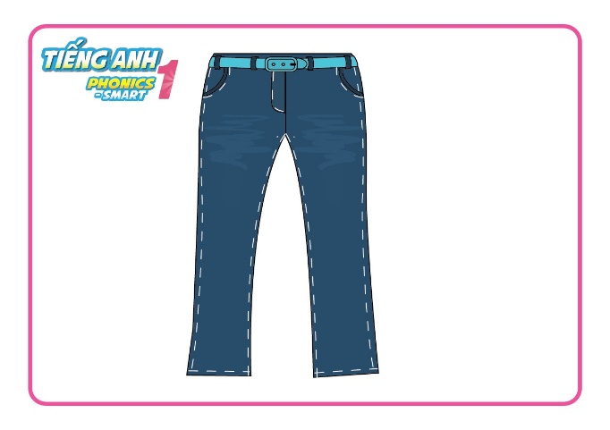
Unit 10:
Lesson 3
Revision
jacket
jeans

Slide 6

Unit 10:
Lesson 3
1. Trace the letters.
Notes:
- Have Ss watch the video and do actions.

Slide 7
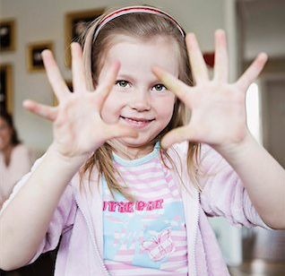

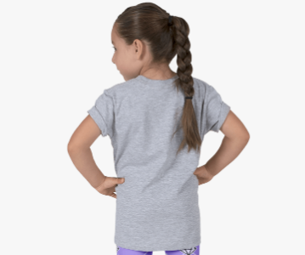
Unit 10: Lesson 3:
1. Trace the letters.
Let’s write letter Jj: in the air, in your palms and on your friend’s back

Slide 8

Unit 10: Lesson 3:
1. Trace the letters.
Let’s write letter Jj on your board
J
J
j
j
j

Slide 9
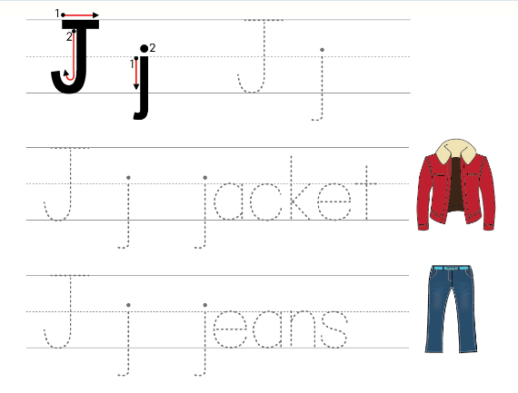
Unit 10:
Lesson 3
1. Trace the letters.
Open your book - page 46
Notes:
Hướng dẫn HS sử dụng sách.

Slide 10
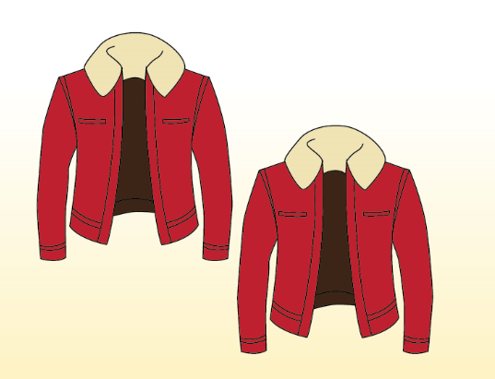
Unit 10:
Lesson 3
1. Trace the letters.
2. Look and say.
How many jackets?
What are these?
jackets
two jackets

Slide 11
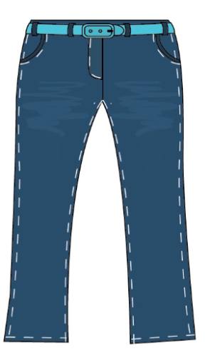
Unit 10:
Lesson 3
1. Trace the letters.
2. Look and say.
What are these?
How many jeans?
jeans
a pair of jeans

Slide 12

Unit 10:
Lesson 3
1. Trace the letters.
2. Look and say.
How many inkpots?
What are these?
inkpots
three inkpots

Slide 13
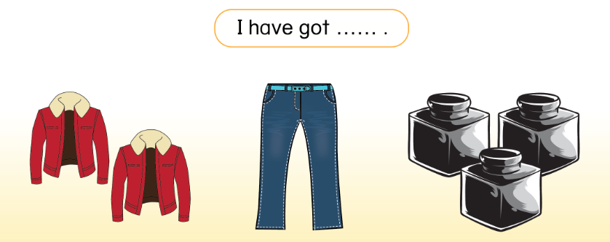
Unit 10:
Lesson 3
1. Trace the letters.
2. Look and say.
Open your book - page 46
Notes:
Hướng dẫn HS mở sách, chỉ và đọc các nội dung đã học.

Slide 14
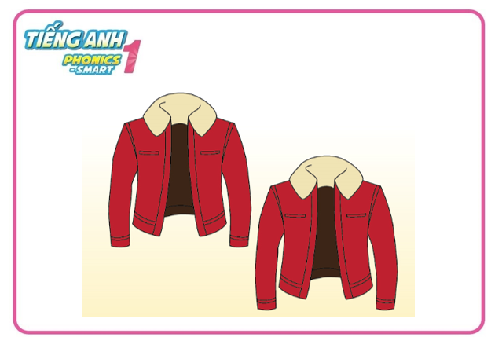
Unit 10:
Lesson 3
1. Trace the letters.
2. Look and say.
I have got
………………………
two jackets

Slide 15

Unit 10:
Lesson 3
1. Trace the letters.
2. Look and say.
I have got
……………………………
a pair of jeans

Slide 16

Unit 10:
Lesson 3
1. Trace the letters.
2. Look and say.
I have got
……………………………
three inkpots

Slide 17




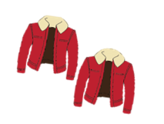


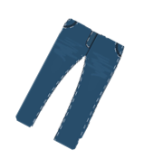






Slide 18



Spin and stop the pointer and click the pointed topic

Slide 19

three inkpots
I have got ………………………
WHEEL
CHECK

Slide 20
Spin and stop the pointer and click the pointed topic

Slide 21
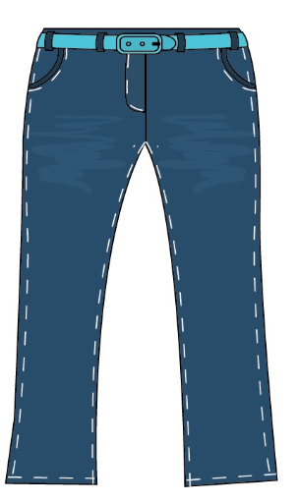
a pair of jeans
I have got ……………………………
WHEEL
CHECK

Slide 22
Spin and stop the pointer and click the pointed topic

Slide 23
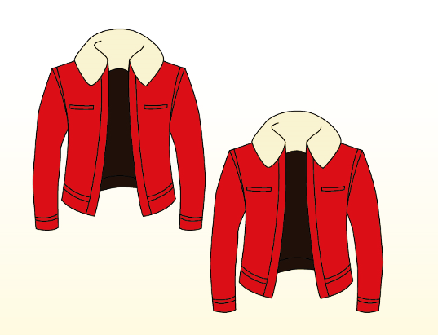
two jackets
I have got …………………..…
WHEEL
CHECK

Slide 24
Spin and stop the pointer and click the pointed topic

Slide 25
WHEEL

Slide 26
Spin and stop the pointer and click the pointed topic

Slide 27
three inkpots
I have got ………………………
WHEEL
CHECK

Slide 28
Spin and stop the pointer and click the pointed topic

Slide 29
a pair of jeans
I have got …………………………
WHEEL
CHECK

Slide 30
Spin and stop the pointer and click the pointed topic

Slide 31
two jackets
I have got …………………..…
WHEEL
CHECK

Slide 32

Unit 10:
Lesson 3
1. Trace the letters.
2. Look and say.
I have got two jackets.
I have got a pair of jeans.
Notes:
Wrap up bài học.

Slide 33


CÔNG TY CỔ PHẦN PHÁT TRIỂN GIÁO DỤC
VIỆT NAM VPBOX
Hà Nội
Biệt thự G2&G28, Làng Quốc Tế Thăng Long,
Quận Cầu Giấy, Hà Nội.
ĐT: (024) 3 3793 2405
phonics.hanoi@vpbox.edu.vn
Thành Phố Hồ Chí Minh
Số 29 Mai Thị Lựu, Quận 1, TP. HCM.
ĐT: (028) 3 820 5934
phonics.hcm@vpbox.edu.vn
www.vpbox.edu.vn

