Slide 1









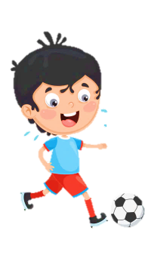













Slide 2

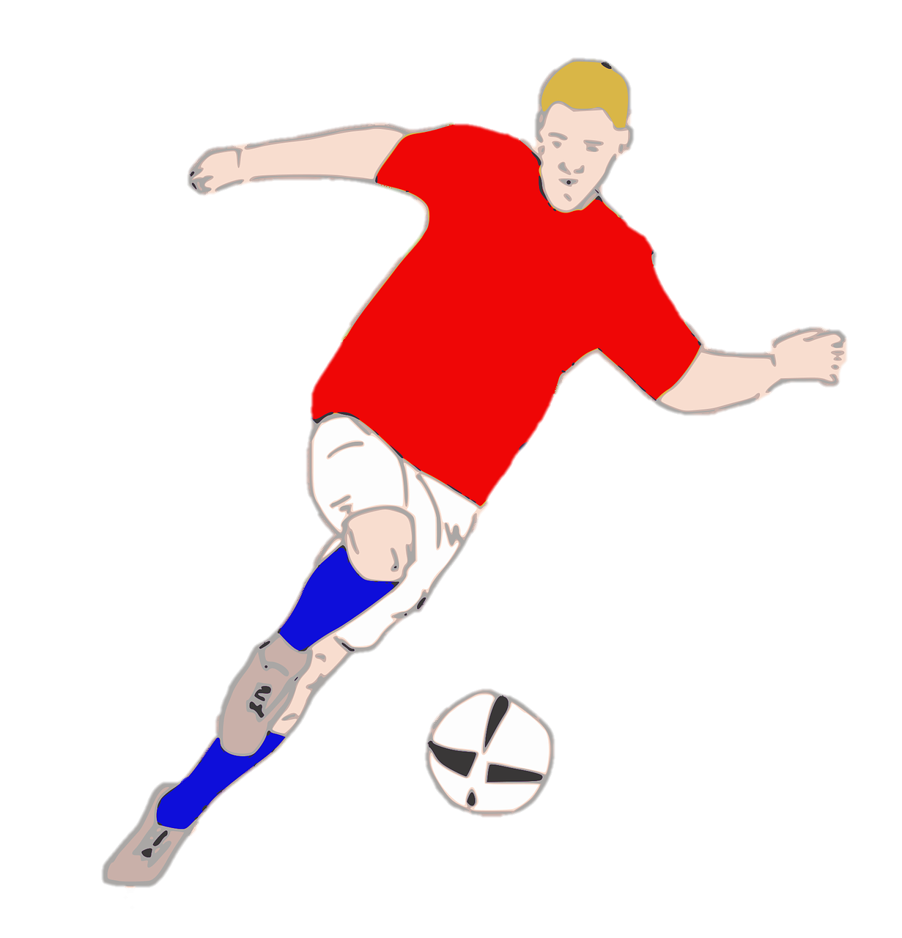
Unit 7:
SPORTS
Lesson 3 – Part 1, 2, 3

Slide 3





Table of contents
01
Warm-up
04
05
Production
Wrap-up &
Assessment
02
03
Review
Practice

Slide 4




1
Warm-up

Slide 5


Slide 6
2
Review

Slide 7

Choose and write
do exercise every day
play games 10 hours a day
eat fast food 5 days a week
learn to swim
listen to teachers
should | shouldn’t
We should do exercise every day.
We shouldn’t play games 10 hours a day.
We should learn to swim.
We shouldn’t eat fast food 5 days a week.
We should listen to teachers.

Slide 8
3
Practice

Slide 9
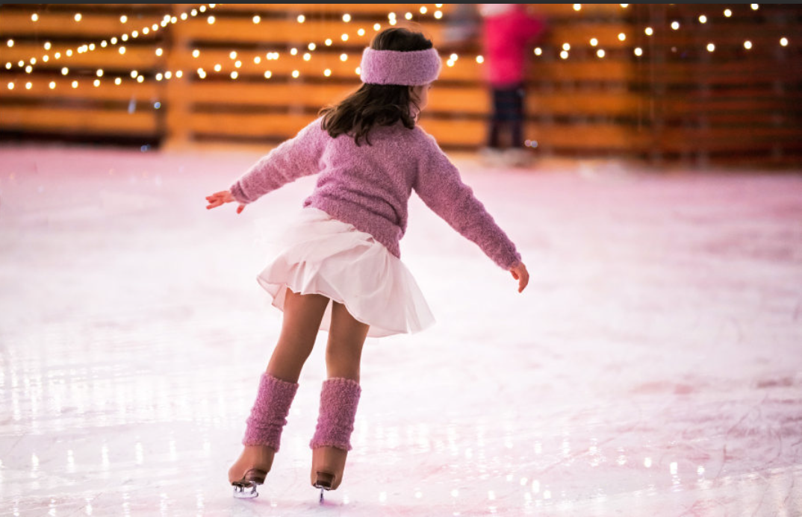

What sport is it?
It’s ice-skating.
What do we need to ice skate?
We need ice skates.
Is it popular in Vietnam?
No, it isn’t.
Do you like ice-skating? Why?

Slide 10

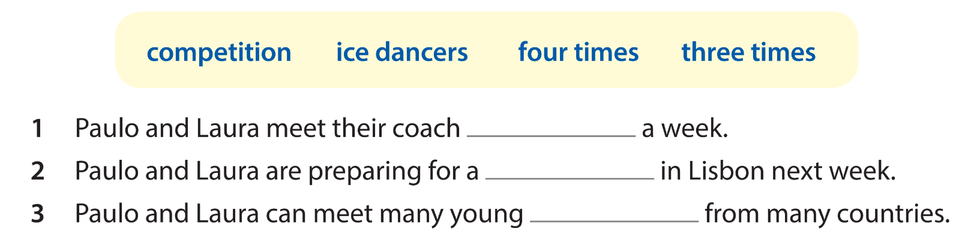
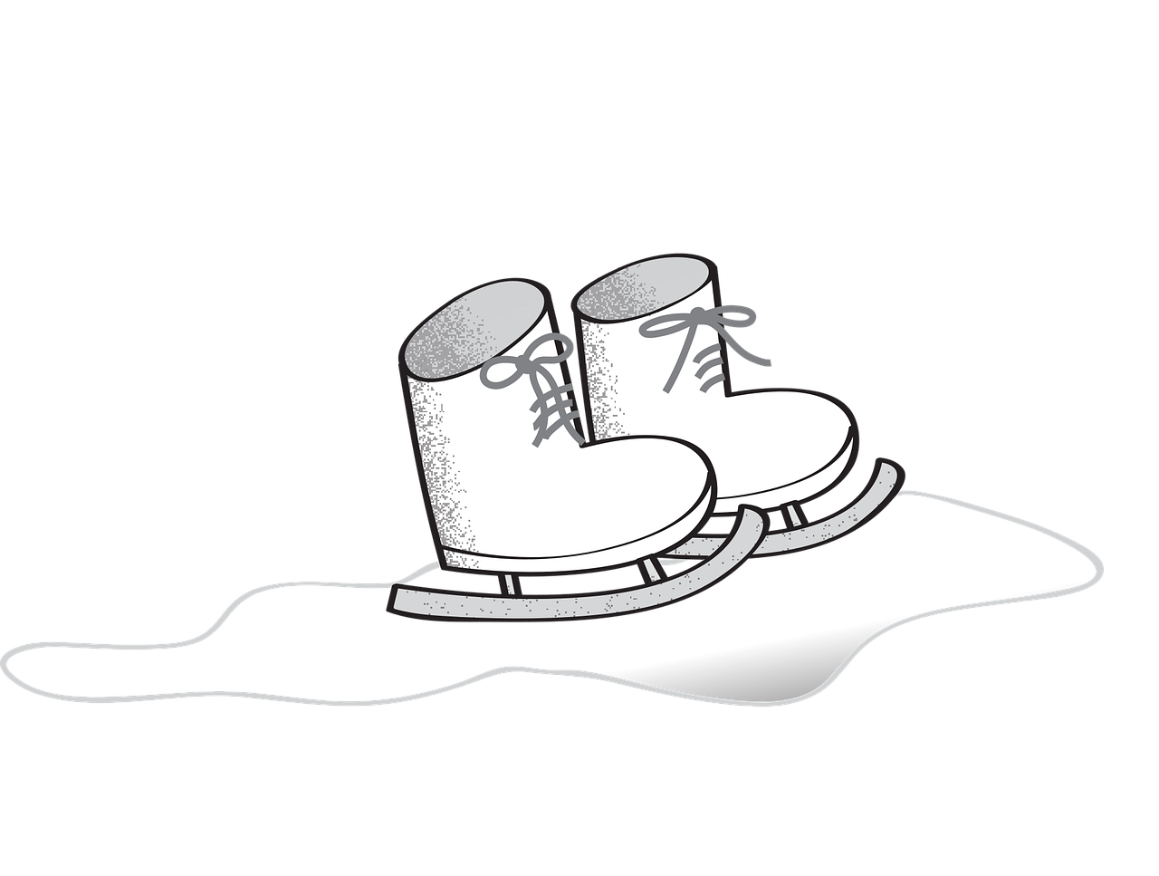
four times
competition
ice dancers

Slide 11
Paulo and Laura are Portugal's junior ice-dancing champions.
Reporter: Hi. Do you train very often?
Laura: Yes. We meet our coach four times a week and our coach teaches us many skills for the competition.
Reporter: Are you excited for the ice-dancing championship in Lisbon next week?
Paulo: Yes! We can meet many young ice dancers from many countries. It's very exciting.
Reporter: What music do you choose to skate to?
Laura: It's from the film The Lion King.
Reporter: Well, good luck!
Paulo and Laura: Thanks!

Slide 12
Paulo và Laura là hai nhà vô địch trẻ môn trượt băng nghệ thuật của Bồ Đào Nha.
Phóng viên: Chào hai bạn. Hai bạn có tập luyện thường xuyên không?
Laura: Có chứ. Chúng tôi gặp huấn luyện viên bốn buổi mỗi tuần, và cô ấy dạy chúng tôi rất nhiều kỹ năng để chuẩn bị cho cuộc thi.
Phóng viên: Hai bạn có háo hức cho giải trượt băng ở Lisbon vào tuần tới không?
Paulo: Rất háo hức! Chúng tôi sẽ được gặp nhiều bạn trẻ yêu thích trượt băng nghệ thuật đến từ nhiều quốc gia. Thật là thú vị!
Phóng viên: Hai bạn chọn nhạc gì để biểu diễn?
Laura: Là nhạc trong phim Vua Sư Tử.
Phóng viên: Chúc hai bạn may mắn nhé!
Paulo và Laura: Cảm ơn ạ!

Slide 13
4
Production

Slide 14


Let’s play
“Guess the sport!”
I’ll show you some clues about each sport. Let’s try to guess what sports they are!

Slide 15




What sport is it?
It’s tennis.

Slide 16



What sport is it?
It’s swimming.

Slide 17



What sport is it?
It’s diving.

Slide 18

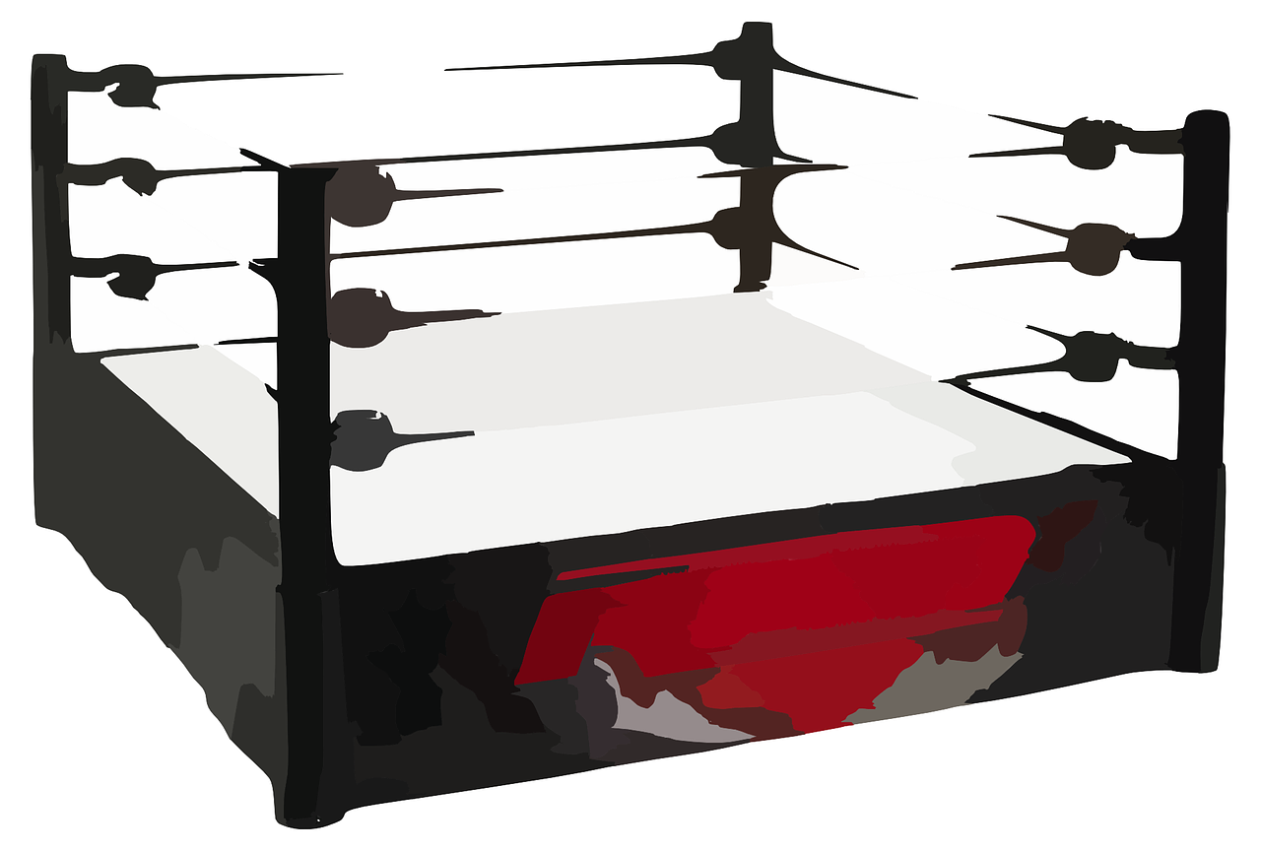

What sport is it?
It’s boxing.

Slide 19



What sport is it?
It’s cycling.

Slide 20


What sport is it?
It’s running.

Slide 21



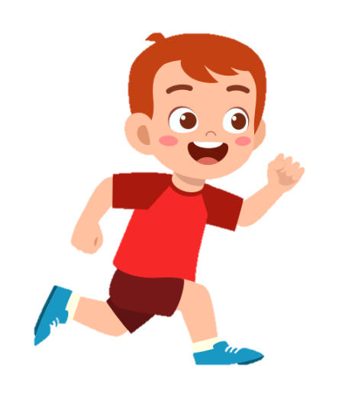
boxing dancing cycling running
diving swimming playing tennis
playing basketball playing football
Are you swimming?
No, I’m not.
Yes, I am.
Are you running?

Slide 22
5
Wrap-up & Assessment

Slide 23


Find the wrong letters in each word.
foodball
=> football

Slide 24
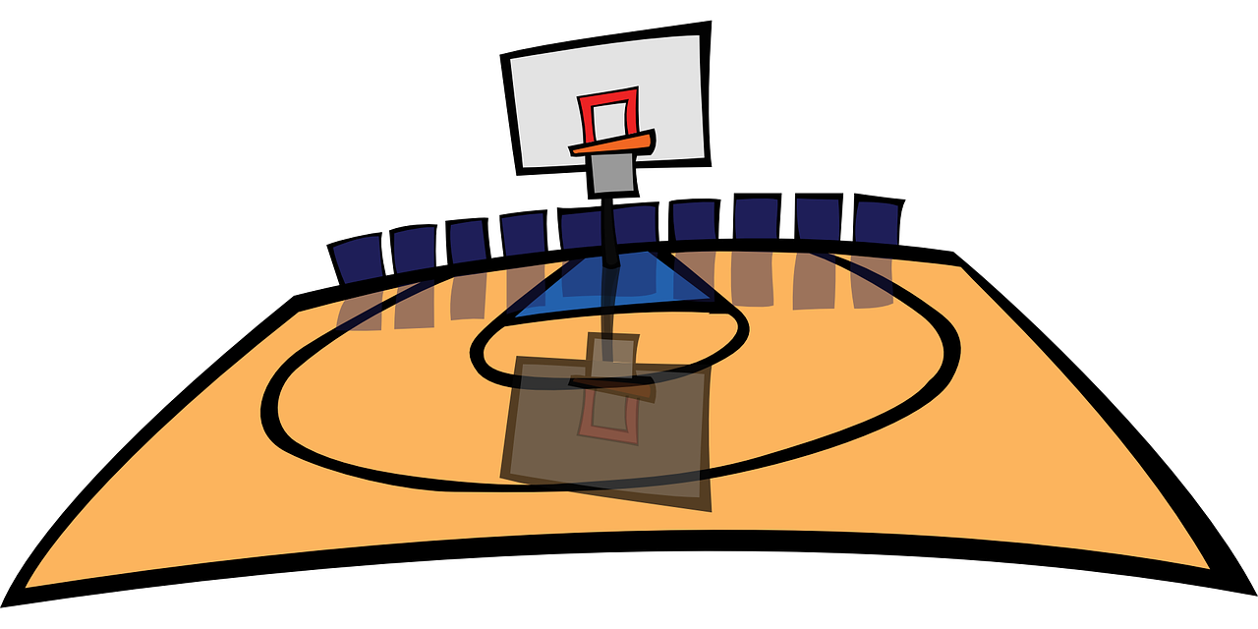

Find the wrong letters in each word.
batkitball
=> basketball

Slide 25

Find the wrong letters in each word.
daiving
=> diving

Slide 26


Find the wrong letters in each word.
betminton
=> badminton

Slide 27


Find the wrong letters in each word.
atchery
=> archery

Slide 28


Wrap-up
Unit 7: Sports
Lesson 3 – Part 1,2,3
What have we learnt today?
Practice listening and speaking about sports.

Slide 29


Thank you
& goodbye!

