Slide 1

WELCOME TO OUR CLASS

Slide 2
WARM UP
Rules:
- Choose one of the four numbers.
- Fill one word in the blank (the first letter has given).
- With each correct word you will receive a present.
- And the person who give the key word will get a bigger one.
B
1
B
2
S
3
M
4
B

Slide 3
1. My son is free but I am b _ _ _.
B | U | S | Y
B
L
O
G
1
B
2. My sister’s house is in a s_ _ _ _ town.
S
3. She lives next to a m_ _ _ _ _ building.
2
S | M | A | L | L
M
3
M | O | D | E | R | N
4. Aeon Mall is a b_ _ shopping center in Hai Phong
B | I | G
4
B

Slide 4



UNIT 4: MY NEIGHBOURHOOD
Period 32 - Lesson 5: Skills 1

Slide 5

READING

Slide 6

Task 1: Read Khang’s blog. Look at the words in the box, then find them in the text and underline them. What do they mean?
s
suburbs dislike outdoor
Friday, December 23rd...
MY NEIGHBOURHOOD
I live in the suburbs of Da Nang City. There are many things I like about my neighborhood.
It's great for outdoor activities because it has beautiful parks, sandy beaches and fine weather. There's almost everything I need here: shops, restaurants, and markets.
However, there are two things I dislike about it: there are many modern buildings and offices; and the streets are busy and crowded.
Posted by Khang at 4:55 PM
01

Slide 7
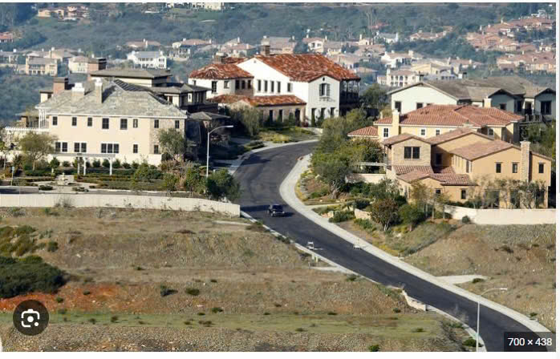

Suburb (n):
khu ngoại ô
/ ˈsʌbɜːb /

Slide 8
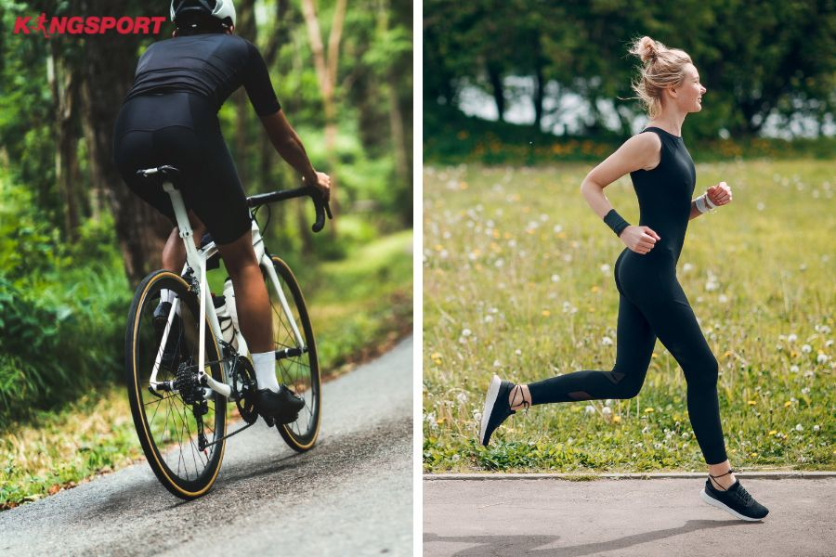
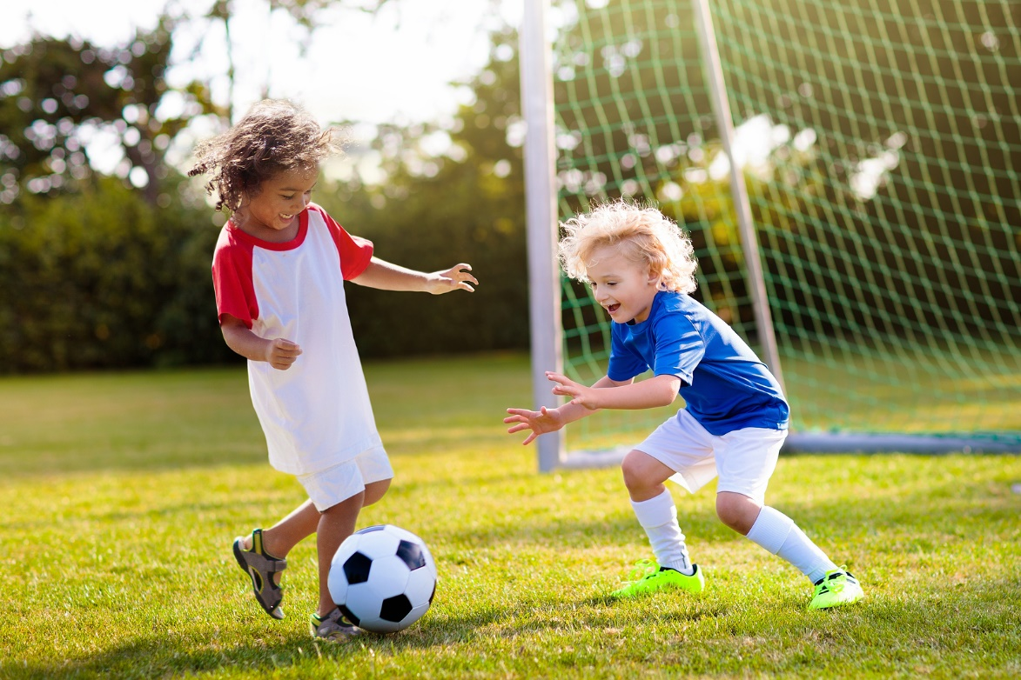
Outdoor activities:
hoạt động ngoài trời
/ ˈaʊtdɔː/
/ ækˈtɪvəti /

Slide 9

dislike (n):
không thích
/ dɪsˈlaɪk /

Slide 10
Vocabulary:
- suburb (n), /ˈsʌbɜːb/: khu ngoại ô
- outdoor activity, /ˈaʊtˌdɔːr/ /ækˈtɪvəti/:
hoạt động ngoài trời
- dislike (v), /dɪˈslaɪk/: không thích
- backyard (n), /ˌbækˈjɑːrd/:
sân sau
- incredibly (adv), /ɪnˈkredəbli/:
cực kỳ,
một cách đáng kinh ngạc
=> Learn by heart

Slide 11
Task 2: Read Khang’s blog again and fill the table with the information.
LIKES | DISLIKES
beautiful parks
modern buildings and offices
sandy beaches
busy and crowded streets
fine weather
shops, restaurant, markets
friendly people
good food

Slide 12

Task 3: Read Khang’s blog again. Then answer the questions.
1.
Where is Khang’s neighbourhood?
………………………………………………………………………………………….
2.
Why is his neighbourhood great for outdoor activities?
………………………………………………………………………………………….
3.
What are the people in his neighbourhood like?
………………………………………………………………………………………….
4.
How are the streets in his neighbourhood?
………………………………………………………………………………………….

Slide 13


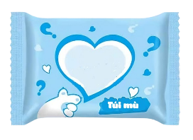






Lucky blind-bag

Slide 14

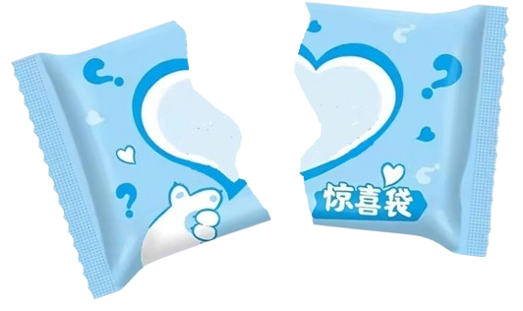
Lucky blind-bag
1
2
3
4
5
6

Slide 15




CÂU 1
Lucky blind-bag

Slide 16
CÂU 2
How are the streets in his neighbourhood?
=> They are busy and crowded.

Slide 17
CÂU 3
Why is his neighbourhood great for outdoor activities?
=> Because it has beautiful parks, sandy beaches and fine weather.

Slide 18
CÂU 4
Where is Khang’s neighbourhood?
=> It is in the suburbs of Da Nang City.

Slide 19
CÂU 5
What are the people in his neighbourhood like?
=> They are very friendly.

Slide 20
CÂU 6
Lucky blind-bag

Slide 21

II. SPEAKING

Slide 22
Task 4: Work in groups. Make notes about your neighbourhood.
Think about what you like / dislike about it.
LIKES | DISLIKES
1. Outdoor activities: 2. People: ……………….. 3. Food: ………………….. 4. School: ……………….. | 1. Streets: 2. Weather: …………………. 3. Environment: ……………………
playing football
busy and crowded

Slide 23
Task 5: Work in pairs. Ask and answer about what you like and dislike about your neighbourhood.
Example:
A: Where do you live?
the suburbs of Da Nang City.
B: I live in ________________________
A: What do you like about it?
The weather is fine. The people are friendly and the food is good.
B: ________________________________
A: What do you dislike about it?
The streets are busy and crowded.
B: _______________________________

Slide 24
HOMEWORK
- Learn by heart the new words.
- Do exercise part D – Task 1,2,3 in workbook.
- Prepare: Lesson 6 – Skills 2 (p45)

Slide 25


Slide 26
RULES:
The class will divide 2 groups, each group will choose a number:
If you choose a lucky blind – bag, you will get 2 stars and have another chance to choose other one.
If you choose a question, you will answer it and get 2 stars, if it’s right.

