Slide 1
Doan Lap Secondary School
WELCOME TO OUR CLASS
Teacher: Nguyen Thi Nha

Slide 2

WHAT COUNTRY'S BEHIND
THE BINOCULARS?
PLAY

Slide 3

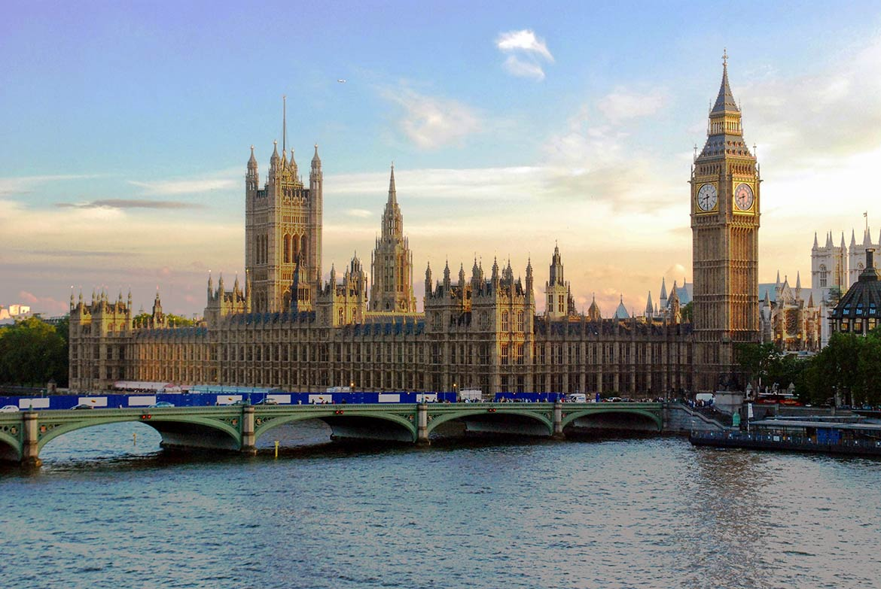
Can you guess what country it is?
Photo courtesy of Lisa L Wiedmeier (@flickr.com) - granted under creative commons licence - attribution
UNITED KINGDOM

Slide 4
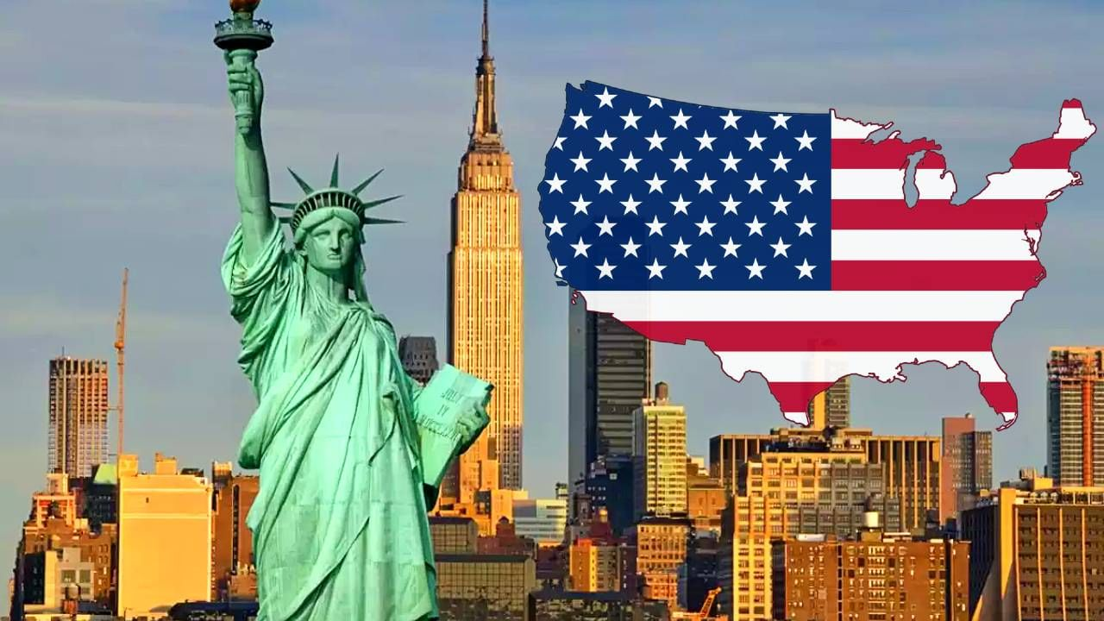
Can you guess what country it is?
Photo courtesy of Lisa L Wiedmeier (@flickr.com) - granted under creative commons licence - attribution
UNITED STATES OF AMERICA

Slide 5
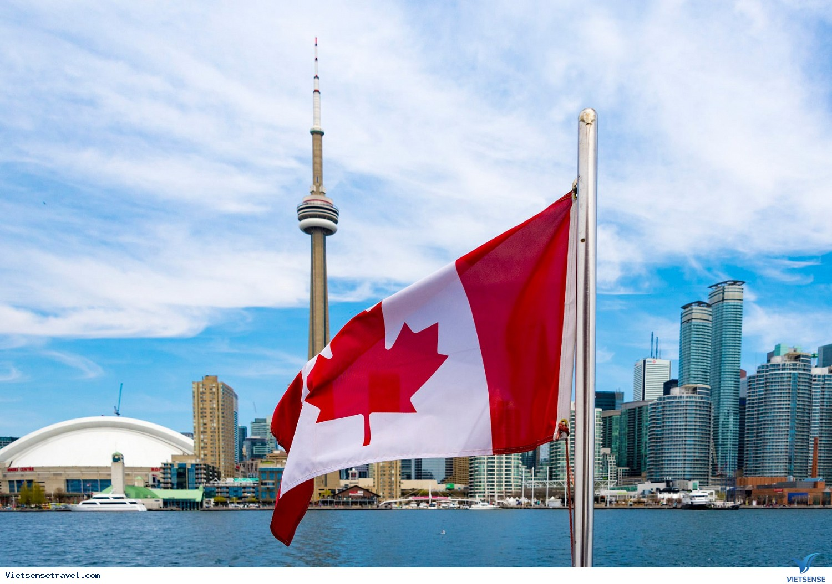
Can you guess what country it is?
Photo courtesy of Lisa L Wiedmeier (@flickr.com) - granted under creative commons licence - attribution
CANADA

Slide 6
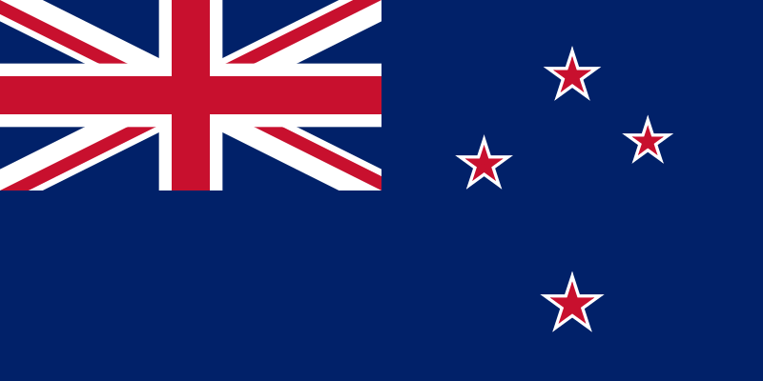
Can you guess what country it is?
Photo courtesy of Lisa L Wiedmeier (@flickr.com) - granted under creative commons licence - attribution
NEW ZEALAND

Slide 7
Look at the answers again
THE UK
(THE UNITED KINGDOM)
THE USA
(THE UNITED STATES OF AMERICA)
ENGLISH – SPEAKING COUNTRIES
CANADA
NEW ZEALAND

Slide 8
Unit 12:
ENGLISH – SPEAKING COUNTRIES
Lesson 1: Getting Started

Slide 9

VOCABULARY
local (adj)
/ˈləʊkl/
thuộc về địa phương
penguin (n)
chim cánh cụt
/ˈpeŋɡwɪn/
amazing (adj)
ngạc nhiên
(một cách thích thú)
/əˈmeɪzɪŋ/
landscape (n)
/ˈlændskeɪp/
phong cảnh

Slide 10
ARTICLES
Just around Melbourne, the city with four seasons in a day.

Slide 11

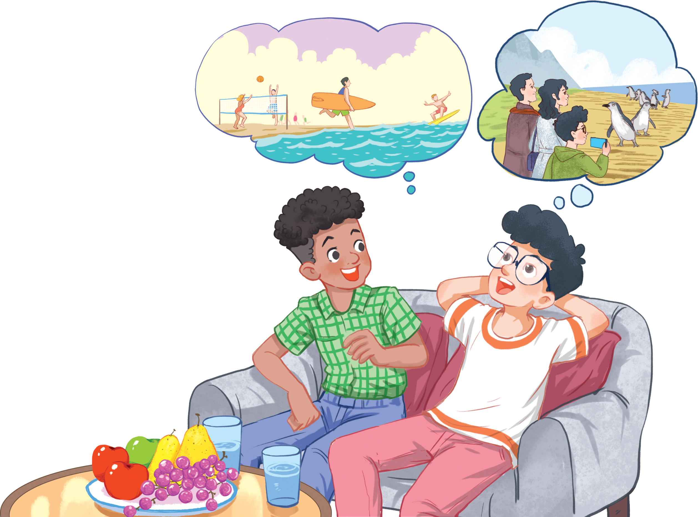
What are they talking about?
A. Phong’s holiday in Australia.
B. English-speaking countries.
C. The tour to Philip island
A. Phong’s holiday in Australia.
Phong
Mark

Slide 12
3. Read again and tick () the information you can find in the conversation.
1. In Australia, Phong used English in real life.
2. Phong visited some museums.
3. Philip Island is far from Melbourne.
4. Australia is beautiful.
5. Australians love outdoor activities.

Slide 13
Check your answers

1. In Australia, Phong used English in real life.
Mark: How was your holiday in Australia, Phong?
Phong: It was fantastic! I got to use my English in real life: asking for directions, reading maps, talking to local people..

Slide 14
Check your answers
x
2. Phong visited some museums.
Mark: What did you see?
Phong: We went penguin watching.

Slide 15
Check your answers
x
3. Philip Island is far from Melbourne.
Phong: Just around Melbourne, the city with four seasons in a day.
Mark: Wow ... I didn't know that. How was it?
Phong: It was great! We took a tour to Phillip Island.

Slide 16
Check your answers
4. Australia is beautiful.

Phong: It was. Australia has amazing landscapes.

Slide 17
Check your answers

5. Australians love outdoor activities.
Mark: Yes, and Australians love outdoor activities.
Phong: Right. There were plenty of people enjoying the parks and beaches.

Slide 18
Look at the answers again.

1. In Australia, Phong used English in real life.
2. Phong visited some museums.
x
3. Philip Island is far from Melbourne.
x

4. Australia is beautiful.

5. Australians love outdoor activities.

Slide 19
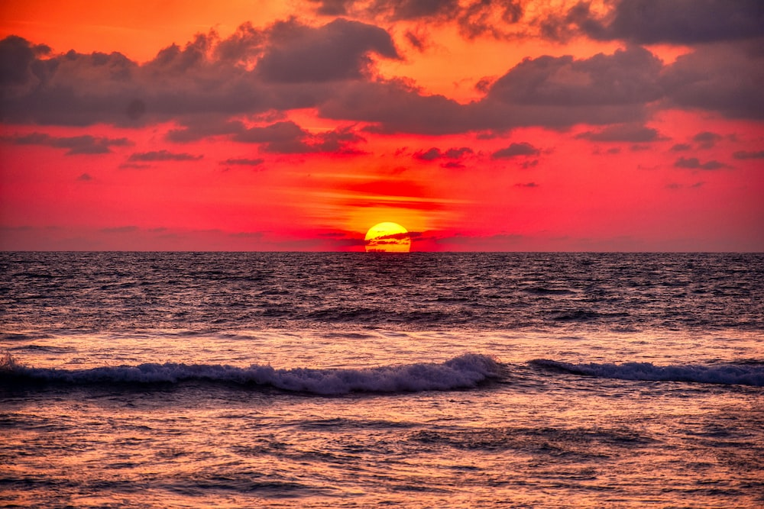
sunset

Slide 20
4. Complete the sentences with the words and phrases from the box.
island sunset landscape
Australians penguin watching
This is a picture of the ______ in my village.
- Where did you go _________? - On the beach.
- Is Phu Quoc a(n) _________? – Yes, it is.
We had dinner on the beach after __________.
Most _________ like outdoor sports and games.

Slide 21
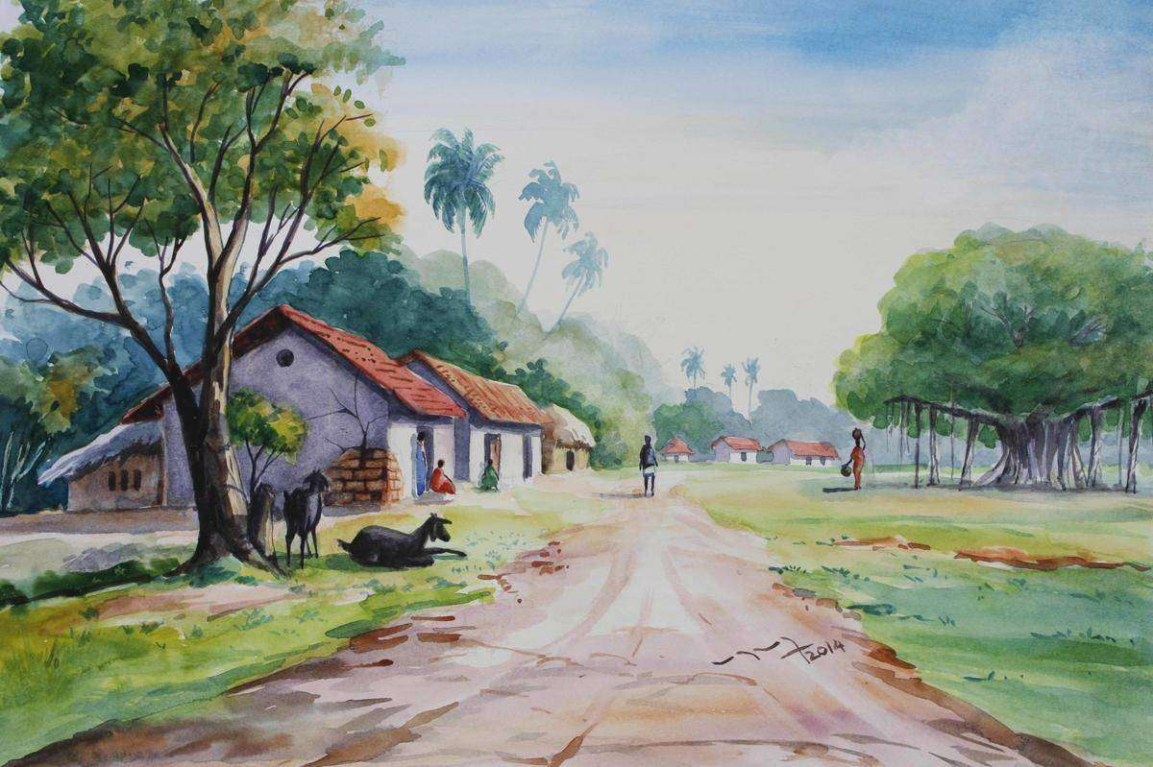
Check your answers
island sunset landscape
Australians penguin watching
This is a picture of the ________ in my village.
landscape

Slide 22
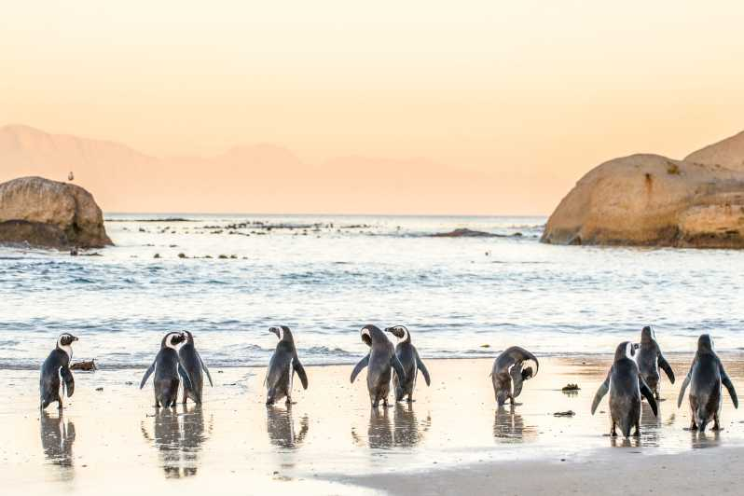
Check your answers
island sunset landscape
Australians penguin watching
2. - Where did you go ________________? - On the beach.
penguin watching

Slide 23
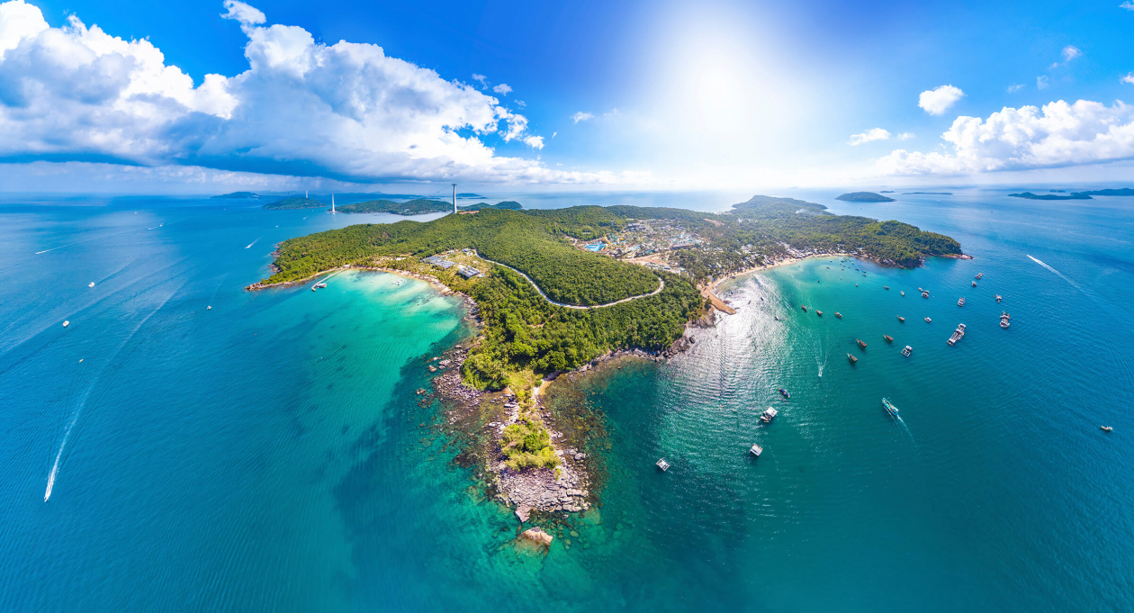
Check your answers
island sunset landscape
Australians penguin watching
3.- Is Phu Quoc a(n) _________?
– Yes, it is.
island

Slide 24
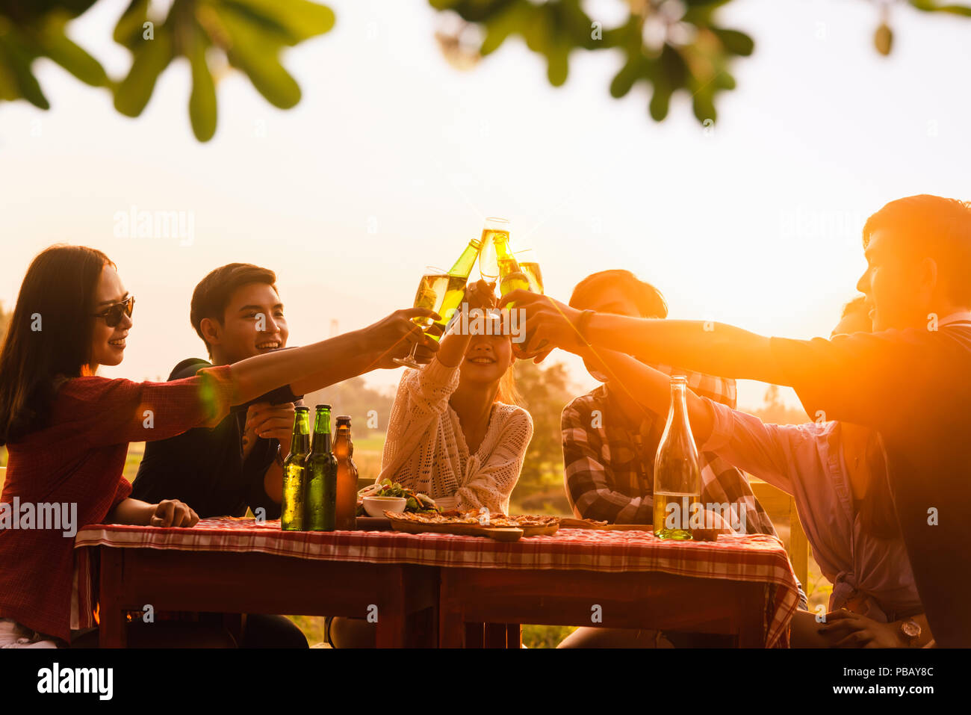
Check your answers
island sunset landscape
Australians penguin watching
4. We had dinner on the beach after __________.
sunset

Slide 25
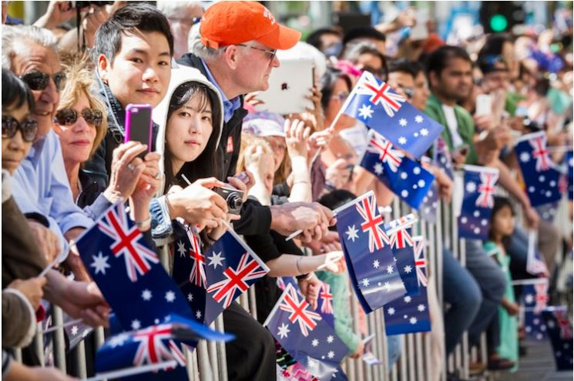
Check your answers
island sunset landscape
Australians penguin watching
5.Most _________ like outdoor sports and games.
Australians

Slide 26
Look at the answers again.
This is a picture of the landscape in my village.
- Where did you go penguin watching? - On the beach.
- Is Phu Quoc an island? – Yes, it is.
We had dinner on the beach after sunset.
Most Australians like outdoor sports and games.

Slide 27

The USA

Slide 28



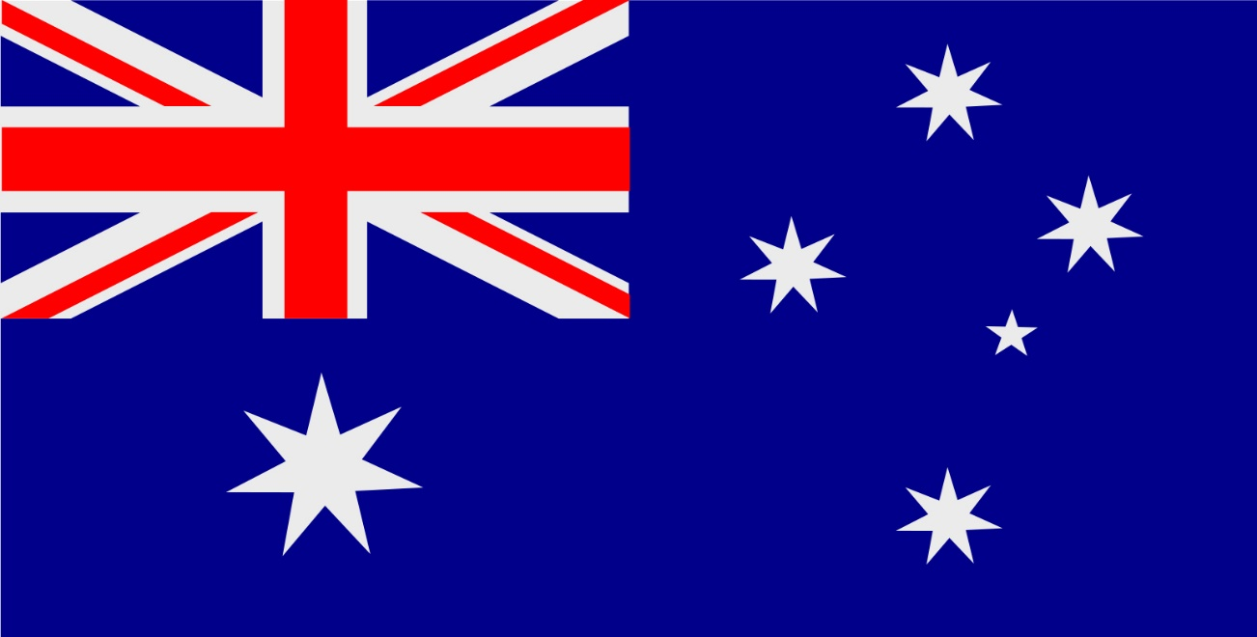
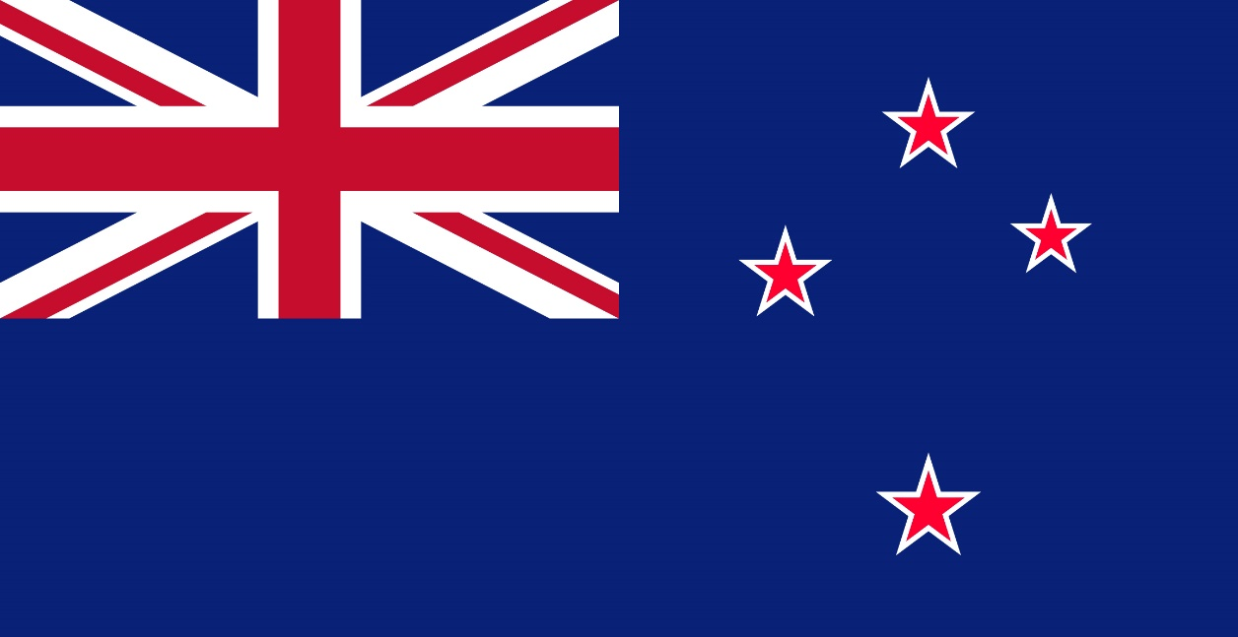
Match the countries with their capital
Canberra
London
Ottawa
Washington D.C.
Wellington
1. The USA
2. Canada
3. The UK
4. Australia
5. New Zealand

Slide 29


Ottawa – Canada
NEXT
Click on the bricks
CHECK

Slide 30

Washington D.C. – The USA
NEXT
Click on the bricks
CHECK

Slide 31

London – The UK
NEXT
Click on the bricks
CHECK

Slide 32

Wellington – New Zealand
NEXT
Click on the bricks
CHECK

Slide 33

Canberra – Australia
NEXT
Click on the bricks
CHECK

Slide 34
Look at the answers again
Washington D.C. - The USA
2. Canada
London
- The UK
Canberra
- Australia
Wellington
- New Zealand

Slide 35
WRAP UP
READING
VOCABULARY
local
Read for information about Phong’s holiday in Australia
penguin
amazing
landscape

Slide 36
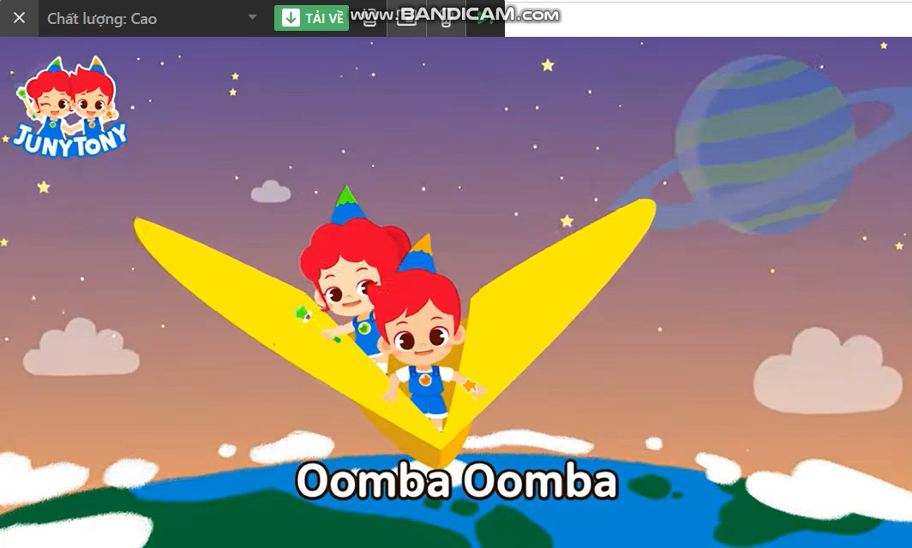
COUNTRY AND ITS CAPITAL

Slide 37
Homework
Learn by heart vocabulary
Prepare: Unit 12– A Closer Look 1
Prepare: Project (P. 133)

Slide 38
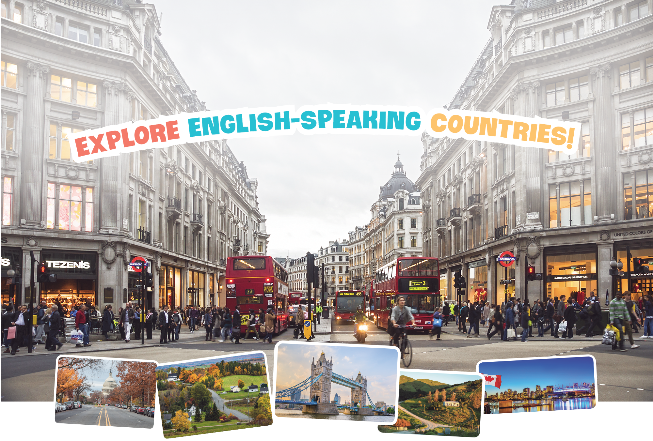
PROJECT

Slide 39
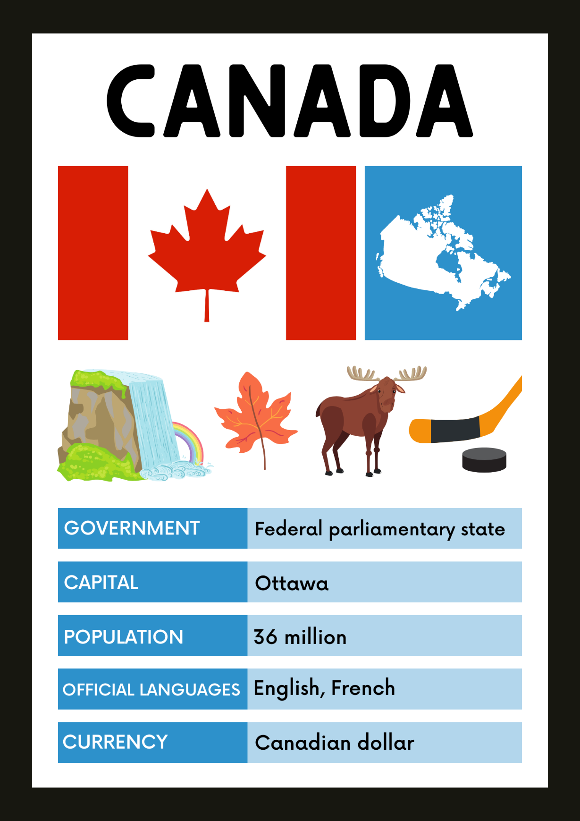
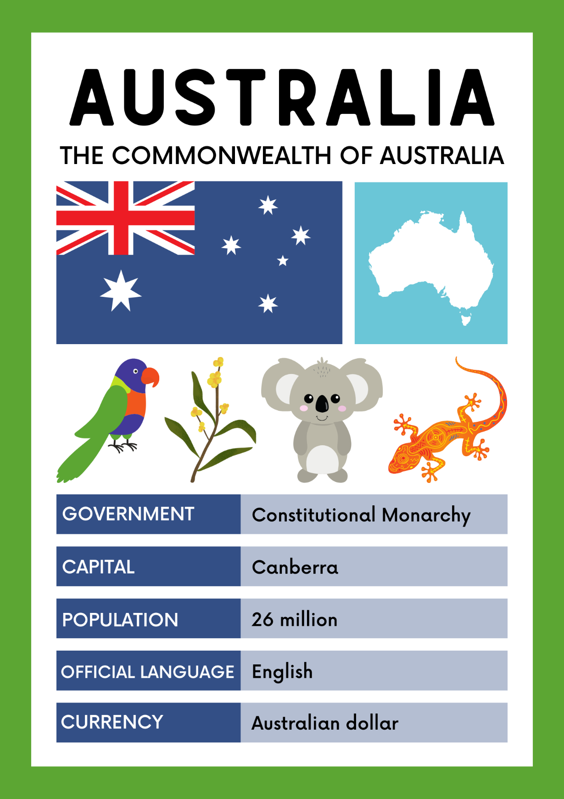
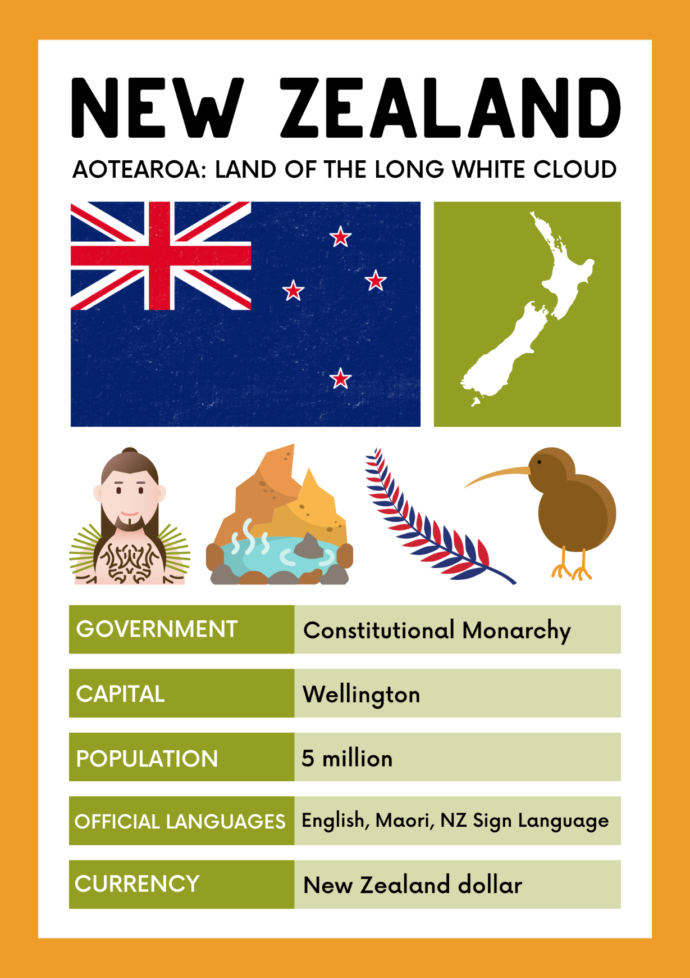
ENGLISH – SPEAKING COUNTRIES

Slide 40



PROJECT
1.DISCUSS
5.VOTE
4.PRESENT
2.FIND INFORMATION
3.DESIGN A POSTER

Slide 41
THANK
YOU
SEE YOU NEXT TIME

