Slide 1




UNIT 5:
Natural wonders of Viet Nam
Lesson 2: A closer look 1

Slide 2


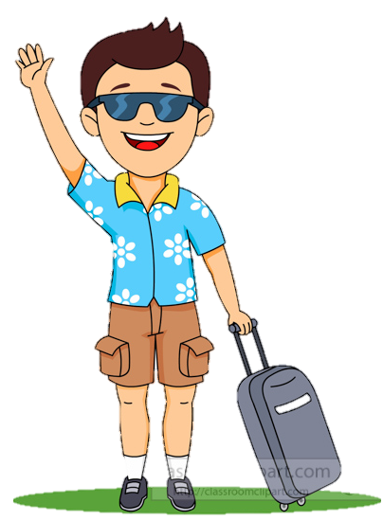
What should I bring???
I’m going to travel next month.
This is Tim.
Notes:
I have a friend, his name is ______ he wants to go travelling somewhere. But he doesn’t know what they should bring, they ask me.

Slide 3
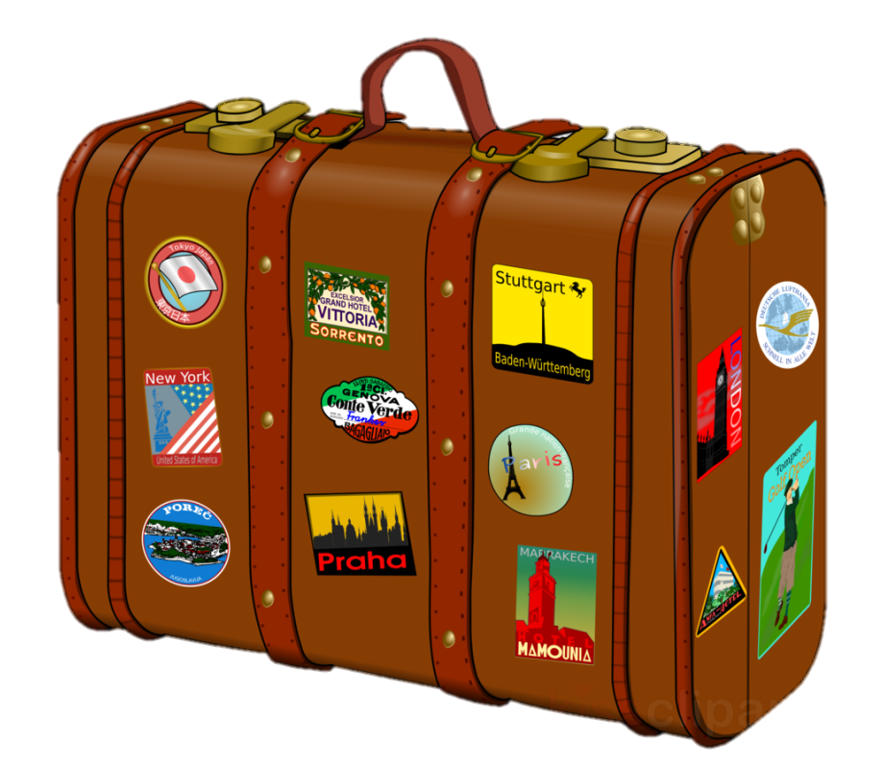

What are in the suitcase?
Guess and list in the chat box.
2 minutes
Open it
Notes:
Now I have a secret suitcase. In this suitcase, there are a lot of things in that. Now, let’s guess what are in the suitcase- 2 mins

Slide 4


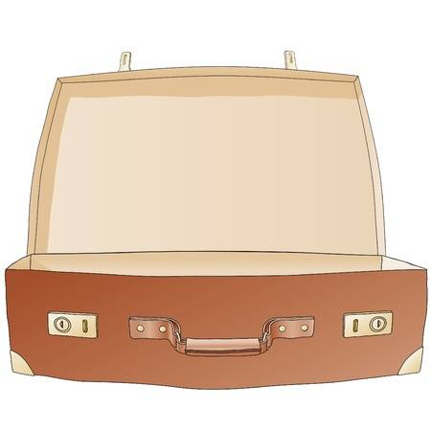
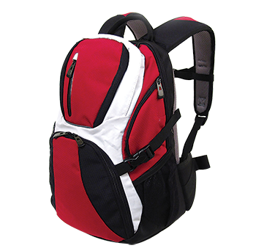
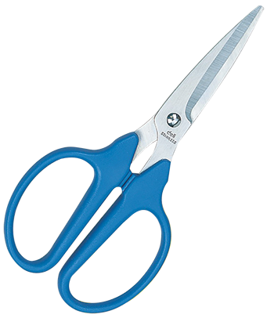

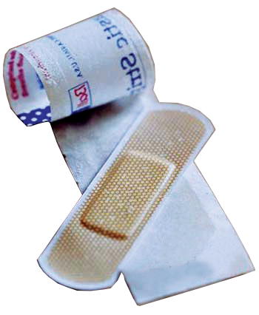
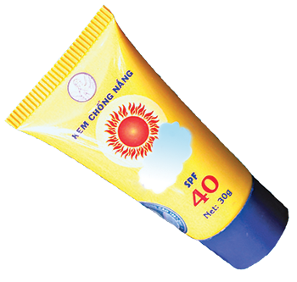
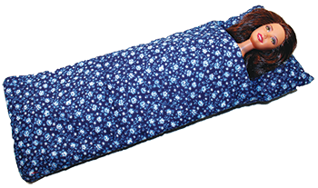
sleeping bag
suncream
backpack
compass
plaster
Let’s check!
scissors
Notes:
Now, lets check wwhat I have in the suitcase

Slide 5


1. Listen and repeat
3.
suncream
sleeping bag
1.
2.
plaster
scissors
4.
6.
5.
compass
backpack

Slide 6

Complete the sentences. Use the words in 1.
plaster
suncream
sleeping bag
backpack
scissors
compass
1. We're lost. Please give me the ____________.
2. It's so sunny today. I need to put on some ____________.
3. A ____________ is very useful when you go camping overnight.
4. I've finished packing. All my things are in my ____________.
5. My foot hurts. I need to put a ____________ on my foot.
compass
suncream
sleeping bag
backpack
plaster

Slide 7
Put the items in order of usefulness. Why?
plaster
suncream
sleeping bag
backpack
scissors
compass
1. ____________________
2. ____________________
3. ____________________
4. ____________________
5. ____________________
6. ____________________
The most useful item
The least useful item
Notes:
Type the order in the chat box.

Slide 8
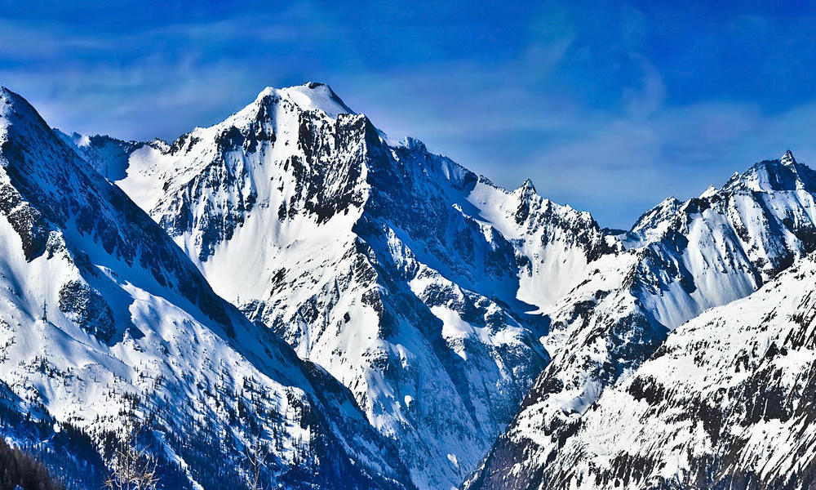
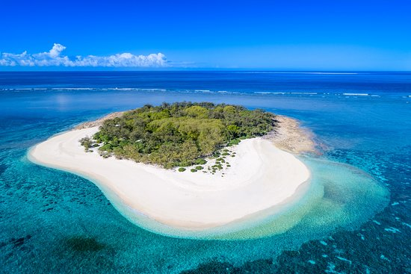
What’s it?
mountain
island
mountain
island
/t/
/d/
Notes:
Type the order in the chat box.

Slide 9



PRONUNCIATION
/t/
/d/

Slide 10
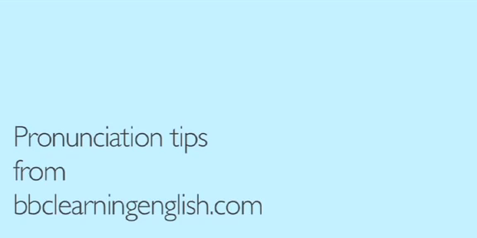

Slide 11

4. Listen and repeat.
/t/ | /d/
mountain
wonder
waterfall
island
desert
guide
plaster
holiday

Slide 12

5. Listen and repeat.
1. – Where's my hat?
– Oh, it's on your head.
2. Where do they stay on their holiday?
3. I need some meat for my cat.
4. The Sahara is a very hot desert.
5. I want to explore the island by boat.

Slide 13

THANKS!

