Slide 1
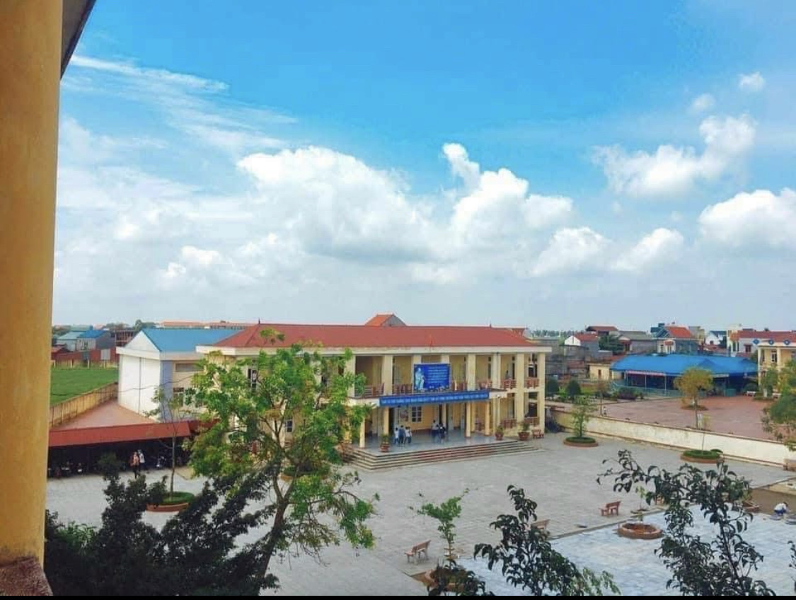
Welcome all the teachers to our class

Slide 2

Sing and dance

Slide 3


Unit 4: My neighbourhood
Lesson 1: Getting started(p38)
OBJECTIVES
By the end of the lesson today:
- Know some more knowledge about Hoi An.
- Know how to make suggestions.
- Know how to give the directions.

Slide 4


Look and answer
Hoi An
Where is it?
Notes:
Where is it?
What do you know about Hoi An? Any famous places….
Wow, fantastic,
So, Today we are going to travel around Hoi An. Let’s meet our friends

Slide 5

Look and answer
Who are they?
Phong, Nick and Khang
They are having a trip to
Hoi An but unluckily,
they are lost.

Slide 6
1.Act 1. Listen and check
1.Act 1. Ordering.
a. The girl shows them the way to Tan Ky House.
b. Nick, Khang and Phong arrive in Hoi An.
c. Nick, Khang and Phong decide to go to Tan Ky House.
d. Nick, Khang and Phong get lost.
e. Phong askes a girl how to get to Tan Ky House.
Notes:
What might happen to the three boys? Let’s order the sentences. Now. Work in pairs.

Slide 7

Lost in the old town!
Phong: Wow! We’re in Hoi An. I’m so excited.
Nick: Me too. It’s so beautiful. Where shall we go first?
Khang: Let’s go to Chua Cau.
Phong: Well, but Tan Ky house is nearer. Shall we go there first?
Nick & Khang: OK, sure.
Phong: First, cross the road, and then turn left.
Nick: Fine, let’s go.
Phong: Wait.
Khang: What’s up, Phong?
Phong: I think we’re lost.
Nick: Look, there’s a girl. Let’s ask her.
Phong: Excuse me? Can you tell us the way to Tan Ky House?
Girl: Sure. Go straight. Take the second turning on the left, and then turn right.
Phong, Nick & Khang: Thank you.

Slide 8
Answer
a. The girl shows them the way to Tan Ky House.
b. Nick, Khang and Phong arrive in Hoi An.
c. Nick, Khang and Phong decide to go to Tan Ky House.
d. Nick, Khang and Phong get lost.
e. Phong askes a girl how to get to Tan Ky House.
5
1
2
3
4

Slide 9
Lost in the old town!
1-b. Nick, Khang and Phong arrive in Hoi An
Phong: Wow! We’re in Hoi An. I’m so excited.
Nick: Me too. It’s so beautiful. Where shall we go first?
Khang: Let’s go to Chua Cau.
Phong: Well, but Tan Ky house is nearer. Shall we go there first?
Nick & Khang: OK, sure.
Phong: First, cross the road, and then turn left.
Nick: Fine, let’s go.
Phong: Wait.
Khang: What’s up, Phong?
Phong: I think we’re lost.
Nick: Look, there’s a girl. Let’s ask her.
Phong: Excuse me? Can you tell us the way to Tan Ky House?
Girl: Sure. Go straight. Take the second turning on the left, and then turn right.
Phong, Nick & Khang: Thank you.
2-c. Nick, Khang and Phong decide to go to Tan Ky House
3-d. Nick, Khang and Phong get lost.
4-e. Phong asks a girl how to get to Tan Ky House.
5-a. The girl shows them the way to Tan Ky House.

Slide 10

* New words:
neighbourhood (n)
/ˈneɪbəhʊd/
: khu vực lân cận

Slide 11

* New words:
* New words:
to be lost/get lost
: đi lạc/ bị lạc (đường)
/tuˈbɪ lɒst / /get lɒst/

Slide 12
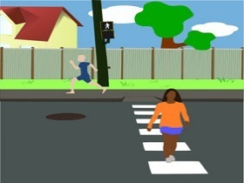
* New words:
cross the road
: băng qua đường
/krɒs ðə rəʊd/

Slide 13


* New words:
turn left / turn right
: rẽ trái/ phải
/tɜːn lɛft/ /tɜːn raɪt/
left
right

Slide 14

* New words:
go straight
: đi thẳng
/ɡəʊ streɪt/

Slide 15

* New words:
Take the second turning on the left
: rẽ vào lối rẽ thứ hai bên trái.
/teɪk ðə ˈsekənd ˈtɜːnɪŋ ɒn ðə lɛft/
2
1

Slide 16

1.Act 1.Listen and practice

Slide 17
2.Act 2. Find the sentences used to make suggestions
Phong: Wow! We’re in Hoi An. I’m so excited.
Nick: Me too. It’s so beautiful. Where shall we go first?
Khang: Let’s go to Chua Cau.
Phong: Well, but Tan Ky house is nearer. Shall we go there first?
Nick & Khang: OK, sure.
Phong: First, cross the road, and then turn left.
Nick: Fine, let’s go.
Phong: Wait.
Khang: What’s up, Phong?
Phong: I think we’re lost.
Nick: Look, there’s a girl. Let’s ask her.
Phong: Excuse me? Can you tell us the way to Tan Ky House?
Girl: Sure. Go straight. Take the second turning on the left, and then turn right.
Phong, Nick & Khang: Thank you.
Let’s go to Chua Cau
Shall we go there first?
let’s go.
Let’s ask her.

Slide 18
Structures:
Making suggestions:
Eg: Let’s go to Chua Cau.
Let’s + V … .
Eg: Shall we go to Tan Ky House?
Shall we + V… ?
Note: Shall chỉ đi với we hoặc I

Slide 19
3. Act 3. Find and underline
A. turn right B. cross the road
C. turn left D. go straight
E. take the second turning on the left
Phong: Wait.
Khang: What’s up, Phong?
Phong: I think we’re lost.
Nick: Look, there’s a girl. Let’s ask her.
Phong: Excuse me? Can you tell us the way to Tan Ky House?
Girl: Sure. Go straight. Take the second turning on the left, and then turn right.
Phong, Nick & Khang: Thank you.
Phong: Wow! We’re in Hoi An. I’m so excited.
Nick: Me too. It’s so beautiful. Where shall we go first?
Khang: Let’s go to Chua Cau.
Phong: Well, but Tan Ky house is nearer. Shall we go there first?
Nick & Khang: OK, sure.
Phong: First, cross the road, and then turn left.
Nick: Fine, let’s go.

Slide 20

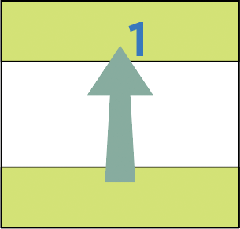
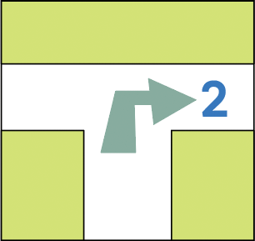
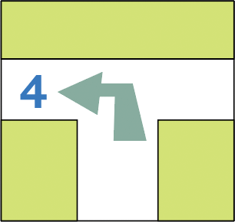
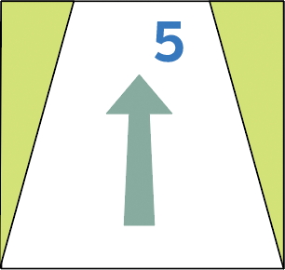
4.Act 4. Match the directions with the pictures.
B. cross the road
A. turn right
E. take the second turning on the left
C. turn left
D. go straight

Slide 21
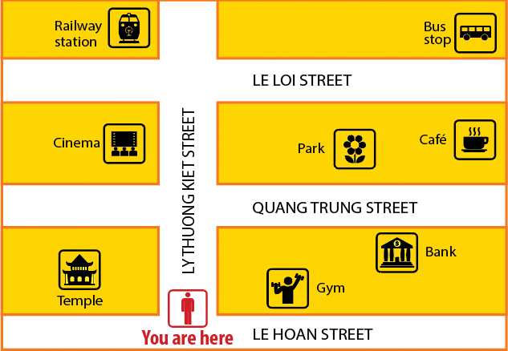
5.Act 5. Find places
Look at the map.
Take turns to give directions.
Others guess the place in 5 seconds
Example
A: Go straight. Take the second turning on the left. It’s on your right.
B: Is that the railway station ?
A: Yes, It is .

Slide 22



HOMEWORK
- Learn by heart new words and structures
- Request and respond the way to get to somewhere.
- Prepare: Unit 4 – Lesson 2 A closer look 1

Slide 23

Thanks for your attention !
GOOD BYE
See You Later.

Slide 24
ACTIVITY: WAY BACK HOME
Way back home
Group work.
(One volunteer, the others give instruction.)
Close your eyes
Listen to instructions
Find the way back to your place.
Notes:
Activity: Way back home
- Group work. One volunteer, the others give instruction.
Close your eyes
Listen to instructions
Find the way back home

Slide 25
Thanks
CREDITS: This presentation template was created by Slidesgo, including icons by Flaticon, infographics & images by Freepik
Please, keep this slide for the attribution

