Slide 1
Unit 3
Healthy living for teens
Lesson 1: Getting Started

Slide 2
OBJECTIVES
After this lesson, Ss will be able to:
Knowledge
have an overview about the topic “Healthy living for teens”
Competence
develop communication skills and awareness about the topic
Personal qualities
collaboration skills and problem solving skills

Slide 3
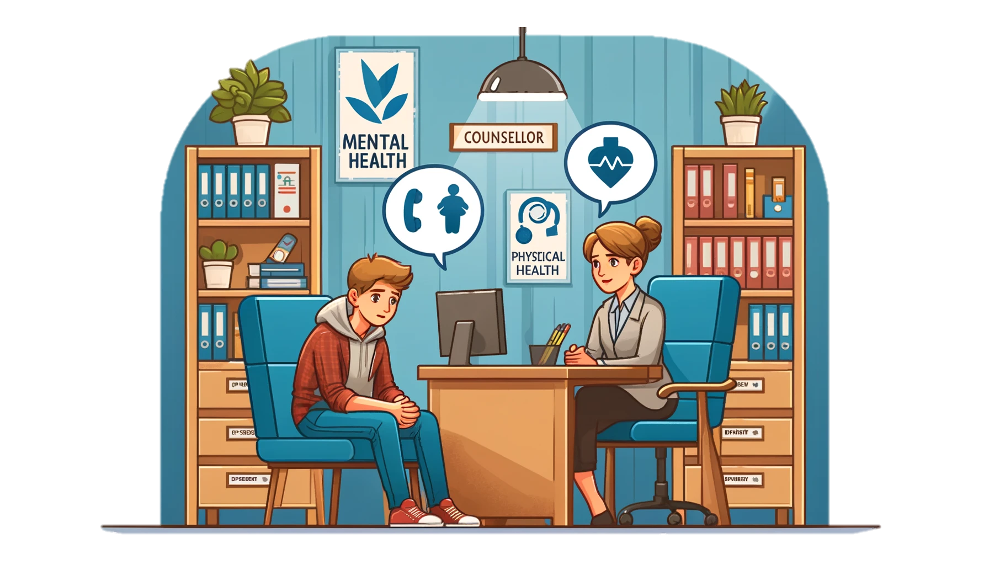
Look the picture and answer the questions
1. Where is the boy?
2. Who is he talking to?
3. What problems he might face?

Slide 4


NEW WORDS
counsellor (n)
/ˈkaʊnsələ/
người tư vấn

Slide 5

NEW WORDS
maintain (v)
/meɪnˈteɪn/
duy trì

Slide 6
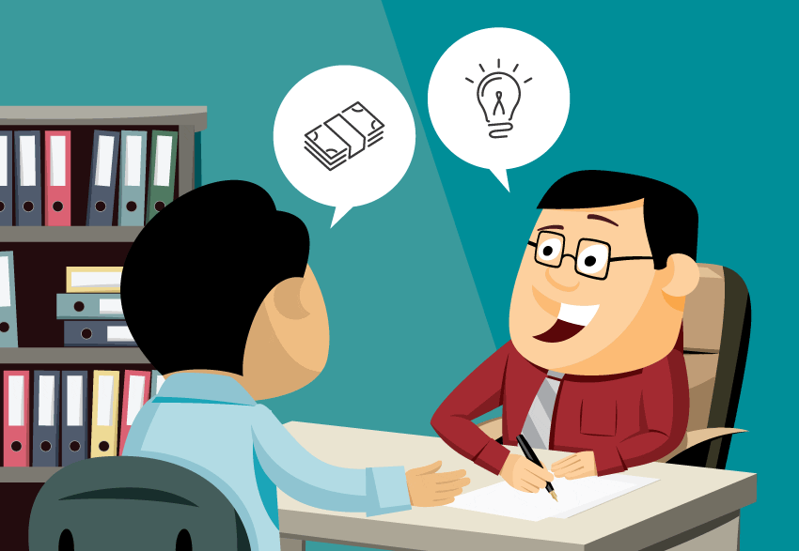
NEW WORDS
advice (n)
/ədˈvaɪs/
lời khuyên

Slide 7
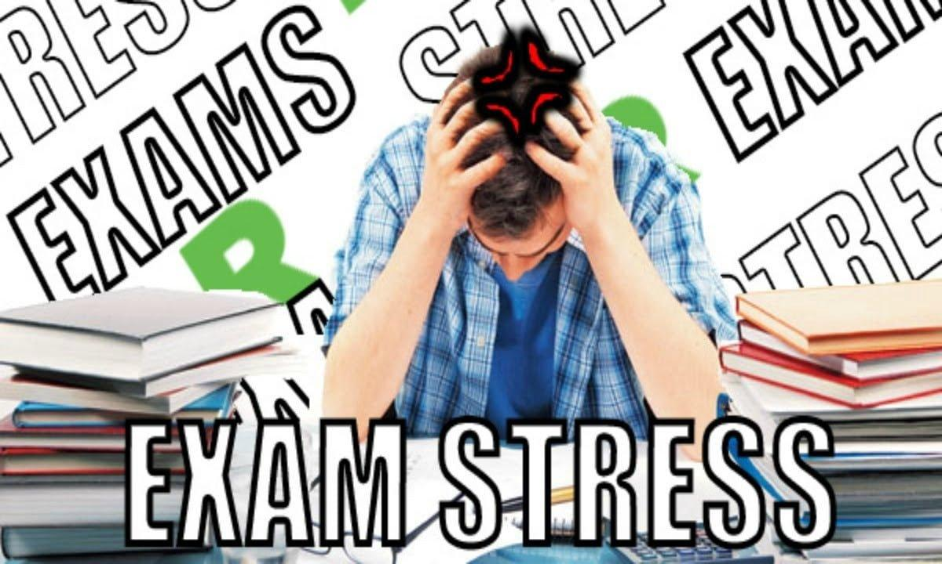
NEW WORDS
bring about
/ˌbrɪŋ əˈbaʊt/
gây ra, đem lại

Slide 8
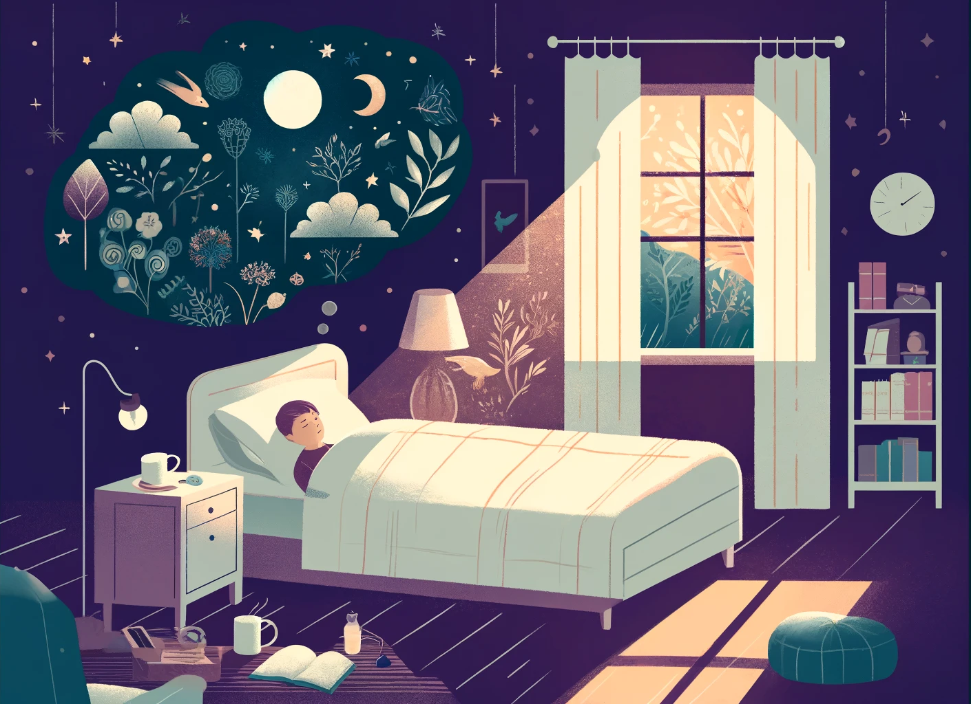
NEW WORDS
a good night’s sleeep
/ə ɡʊd naɪts sliːp/
một giấc ngủ ngon

Slide 9

NEW WORDS
balance (n, v)
/ˈbæləns/
cân bằng

Slide 10
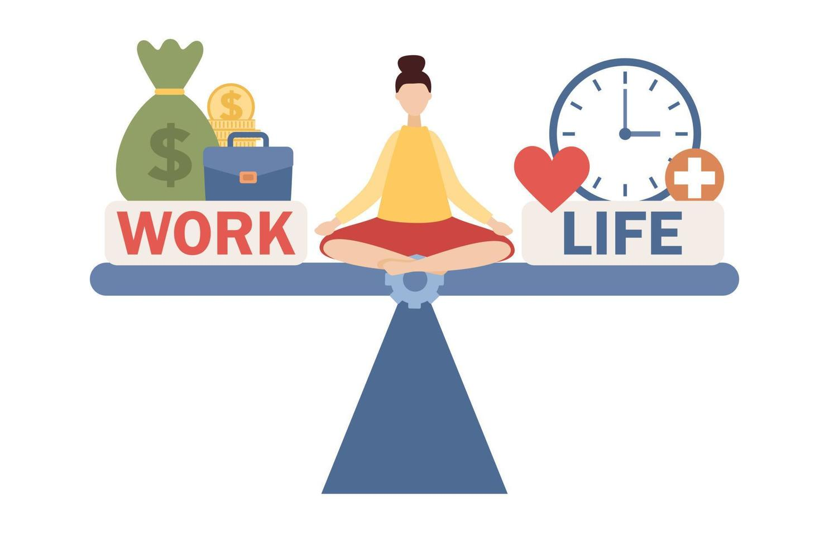
NEW WORDS
well-balanced (adj)
/ˌwel ˈbælənst/
cân bằng tốt

Slide 11

NEW WORDS
manage (v)
/ˈmænɪdʒ/
quản lí

Slide 12
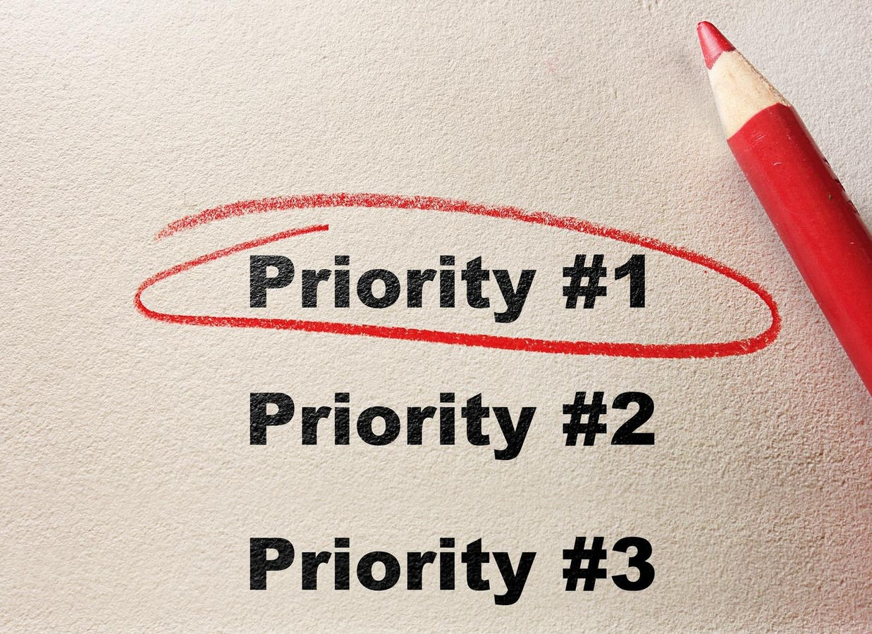
NEW WORDS
priority
/praɪˈɒrəti/
sự ưu tiên

Slide 13
New words | Pronunciation | Meaning
1. counsellor (n) | /ˈkaʊnsələ/ | người tư vấn
2. maintain (v) | /meɪnˈteɪn/ | duy trì
3. advice (n) | /ədˈvaɪs/ | lời khuyên
4. bring about | /ˌbrɪŋ əˈbaʊt/ | gây ra, đem lại

Slide 14
New words | Pronunciation | Meaning
5. a good night’s sleep | /ə ɡʊd naɪts sliːp/ | một giấc ngủ ngon
6. balance (n, v) | /ˈbæləns/ | cân bằng
7. well-balanced (adj) | /ˌwel ˈbælənst/ | cân bằng tốt
8. manage (v) | /ˈmænɪdʒ/ | quản lí
9. priority (n) | /praɪˈɒrəti/ | sự ưu tiên

Slide 15
Ex 1. Listen and read
School Counsellor: Good morning, class. Welcome to our "Tips for Good Physical and Mental Health" In this session, feel free to ask any questions.
Nick: How can we maintain good physical health?
School Counsellor: You should get enough sleep, eat a healthy diet, and do physical exercise regularly.
Mai: My parents say students of our age need to sleep at least eight hours a day. Is that right?
School Counsellor: Yes, it is.
Phong: But we often find it difficult to get a good night's sleep, especially before exams. Could you offer us any advice?
School Counsellor: I understand that exams bring about lots of stress. You can reduce this stress by studying long before the exam, not waiting until the night before it.
Phong: Thank you. Do you have any tips about looking after our mental health? School Counsellor: If you want to have good mental health, you should have a well-balanced life. I mean you should balance your study and life.
Nick: But how can we balance them?
School Counsellor: Well, you have to manage your time by planning your schedule and giving priority to your work. And you should keep a balance between study and play

Slide 16
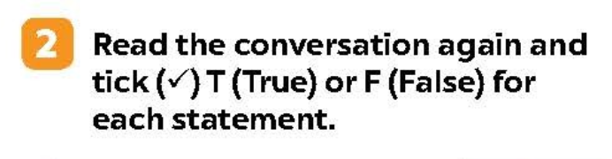
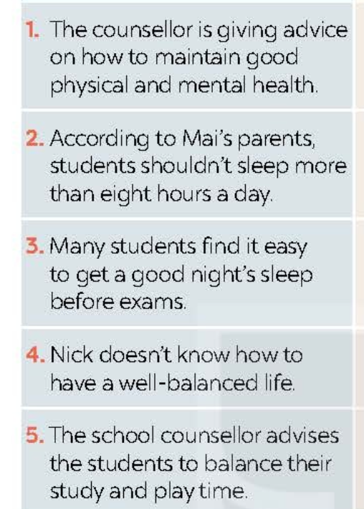
Ex 2 (pg 29) Read the statements and underline key words
Statements
1. The counsellor is giving advice on how to maintain good physical and mental health.
2. According to Mai’s parents, students shouldn’t sleep more than eight hours a day.
3. Many students find it easy to get a good night’s sleep before exams.
4. Nick doesn’t know how to have a well-balanced life.
5. The school counsellor advises the students to balance their study and play time.

Slide 17
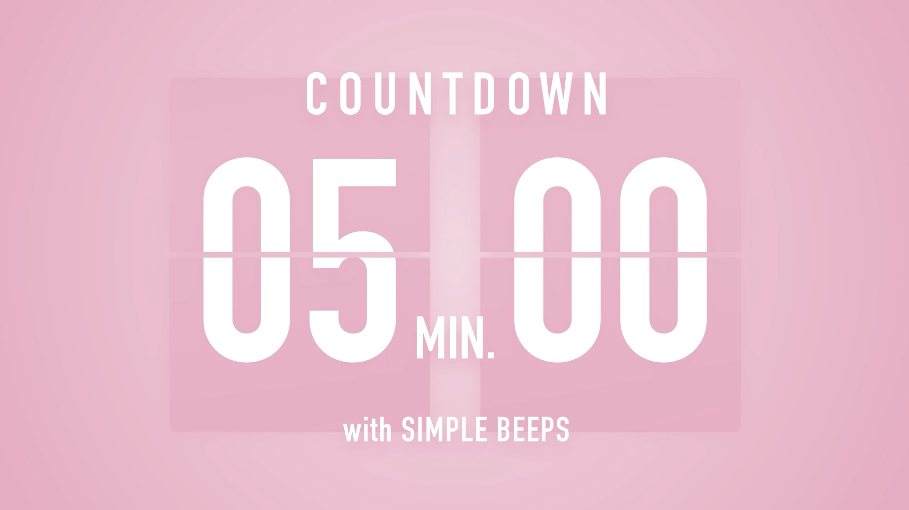
Ex 2 (pg 29) Read the conversation again and tick T (True) or F (False) for each statement.
Statements | True | False
1. The counsellor is giving advice on how to maintain good physical and mental health.
2. According to Mai’s parents, students shouldn’t sleep more than eight hours a day.
3. Many students find it easy to get a good night’s sleep before exams.
4. Nick doesn’t know how to have a well-balanced life.
5. The school counsellor advises the students to balance their study and play time.

Slide 18
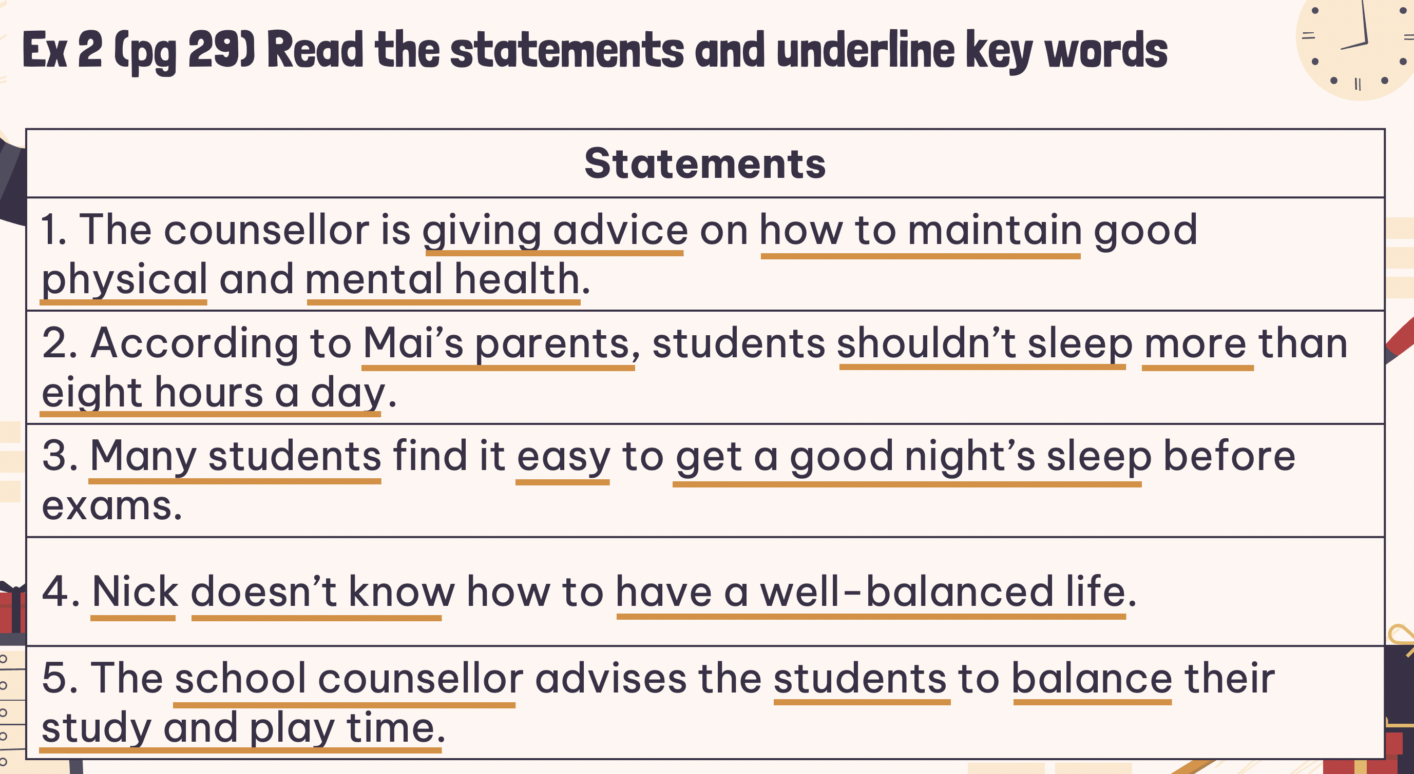

Check your answers
Statements | True | False
1. The counsellor is giving advice on how to maintain good physical and mental health.
School Counsellor: Good morning, class. Welcome to our "Tips for Good Physical and Mental Health" In this session, feel free to ask any questions.
Nick: How can we maintain good physical health?
School Counsellor: You should get enough sleep, eat a healthy diet, and do physical exercise regularly.

Slide 19
Check your answers
Statements | True | False
2. According to Mai’s parents, students shouldn’t sleep more than eight hours a day.
Mai: My parents say students of our age need to sleep at least eight hours a day. Is that right?
School Counsellor: Yes, it is.

Slide 20
Check your answers
Statements | True | False
3. Many students find it easy to get a good night’s sleep before exams.
Phong: But we often find it difficult to get a good night's sleep, especially before exams. Could you offer us any advice?
School Counsellor: I understand that exams bring about lots of stress. You can reduce this stress by studying long before the exam, not waiting until the night before it.

Slide 21
Check your answers
Statements | True | False
4. Nick doesn’t know how to have a well-balanced life.
School Counsellor: If you want to have good mental health, you should have a well-balanced life. I mean you should balance your study and life.
Nick: But how can we balance them?

Slide 22
Check your answers
Statements | True | False
5. The school counsellor advises the students to balance their study and play time.
School Counsellor: Well, you have to manage your time by planning your schedule and giving priority to your work. And you should keep a balance between study and play.

Slide 23

Matching partners
- Teacher gives students a random card.
- On each card, there’ll be a word or a definition.
- Ss find the partner and sit quickly at their table.

Slide 24
Checking your answers
1. physical
a. a person whose job is to help and support people with problems
b
2. mental
b. connected with a person’s body rather than their mind
d
3. well-balanced
e
c. something that you think is more important than other things and should be dealt with first
4. priority
c
d. connected with the state of health of the mind
5. counsellor
a
e. having the right amounts of all the different parts that make up something

Slide 25
Ex 4. Complete the sentences with the words in the box.
physical | counsellor |  | well-balanced
priority |  | mental
1. You should make a list of all the jobs you have to do and give _________ to them.
2. Maintaining a ______________ life often means making time for the things you have to do, as well as the things you want to do in a suitable way.
3. The police asked them to describe his ___________ appearance.
4. You need to maintain your physical and ___________ health.
5. The ______________ is willing to listen to the students to help them solve their problems.

Slide 26
Check your answer
physical | counsellor |  | well-balanced
priority |  | mental
1. You should make a list of all the jobs you have to do and give _________ to them.
2. Maintaining a ______________ life often means making time for the things you have to do, as well as the things you want to do in a suitable way.
3. The police asked them to describe his ___________ appearance.
4. You need to maintain your physical and ___________ health.
5. The ______________ is willing to listen to the students to help them solve their problems.
give priority to sth: dành ưu tiên cho thứ gì
priority
well-balanced
maintain a well-balanced life: duy trì c/sống cân bằng
physical
physical appearance: ngoại hình
mental
mental heath: sức khoẻ tinh thần
counsellor
counsellor: ng tham vấn/ tư vấn

Slide 27
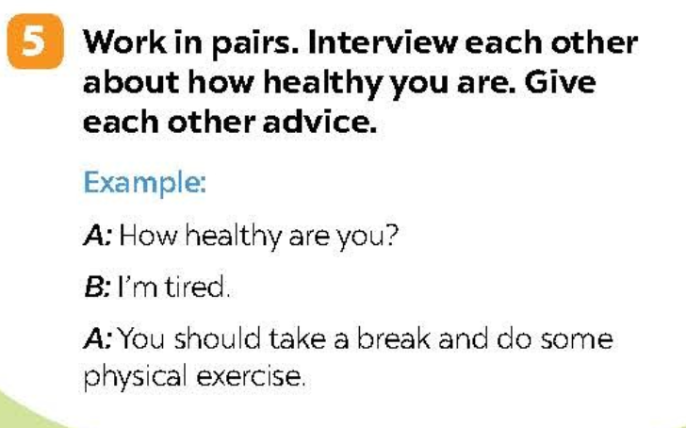
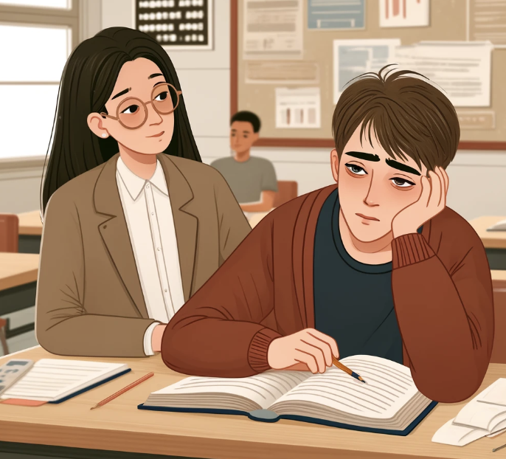
Ex 5. Work in pairs. Interview each other about how healthy you are. Give each other advice.
Ex:
A: How healthy are you?
B: I’m tired.
A: you should take a break and do some physical exercise.

Slide 28
One-minute paper
1. Take out a piece of paper
2. Write your answers to these questions:
- What is the topic of the lesson?
- What will you do if you want to maintain good mental and physical health?
Notes:
At this stage, it is highly beneficial for students to reflect on their opinions about the lesson. The teacher should encourage this by having them write down their thoughts and offering some incentives

Slide 29
THANKS!
Does anyone have any questions?
addyouremail@freepik.com
+91 620 421 838
yourcompany.com
Please keep this slide for attribution

Slide 30
ICONS PACK

