Slide 2
B.I.N.G.O
WARM-UP
Work in pairs.
Receive slips of paper with halves of a sentence.
Join two slips of paper together to make meaningful sentences.
Say “Bingo” when finish.
Ss who are the fastest with more correct answers will be the winner.
RULES

Slide 3
B.I.N.G.O
WARM-UP
ANSWER
Tourists
who are interested in architecture often visit Hoi An.
The beach
which we discovered during our road trip was pristine.
whose restaurant has earned a Michelin star.
That is the chef
whose walls were damaged by the tornado.
We explored a historic castle
Notes:
who are interested in architecture often visit landmarks

Slide 4


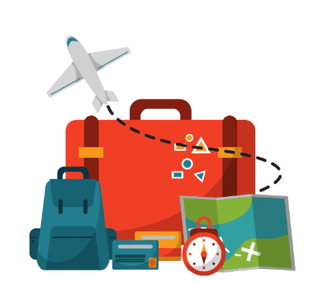
Unit
8
TOURISM
LESSON 3: A CLOSER LOOK 2
Grammar: Relative pronouns: which, who, and whose
1

Slide 5
LESSON 3: A CLOSER LOOK 2
LESSON 1: GETTING STARTED
WARM-UP
Game: B.I.N.G.O
Relative pronouns: which, who, and whose
PRESENTATION
Task 1: Underline the noun or noun phrase in each sentence that which or who refers to.
Task 2: Underline the correct relative pronoun for each sentence.
Task 3: Complete each sentence with who or whose.
Task 4: Match a clause in A with a clause in B to make a complete sentence.
Task 5: Work in pairs. Discuss and finish the sentences.
PRACTICE
PRODUCTION
Game: LUCKY NUMBERS
CONSOLIDATION
Wrap-up
Homework

Slide 6
PRESENTATION
 | SENTENCES | Nouns/Noun phrases that relative pronouns refer to
 | Tourists who are interested in architecture often visit Hoi An.
 | The beach which we discovered during our road trip was pristine.
 | That is the chef whose restaurant has earned a Michelin star.
 | We explored a historic castle whose walls were damaged by the tornado.
Tourists
a person
The beach
a thing
the chef
possession by people
a historic castle
possession by things

Slide 7
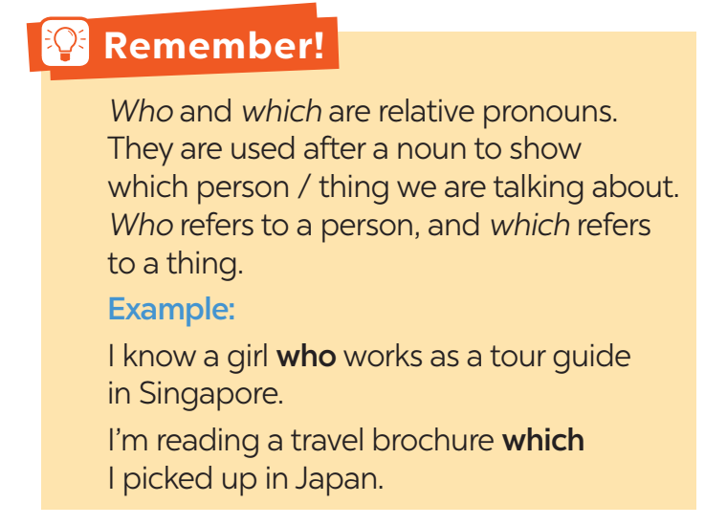
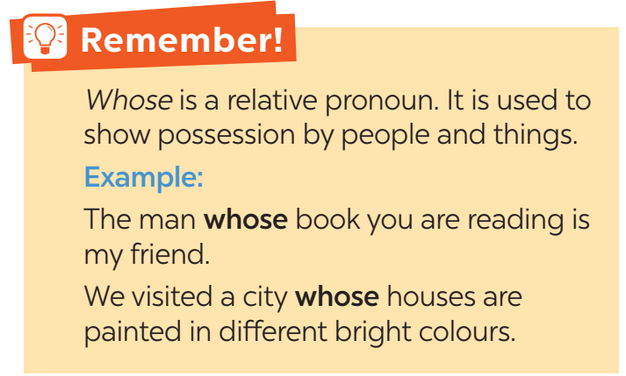
PRESENTATION

Slide 8
mental
PRACTICE
1
Underline the noun or noun phrase in each sentence that which or who refers to.
1. People who travel abroad usually use travel apps.
2. The brochure which you can get free at the airport is useful for your stay in Bangkok.
3. Is this the video which explains some new trends in tourism?
4. Could you recommend to me a local tour guide who can speak English?
5. They want to visit a city which is famous for its rich history.

Slide 9
PRACTICE
2
Underline the correct relative pronoun for each sentence.
1. This is the brochure which / who provides the information you need for your visit to Beijing.
2. ABC is the company which / who won the Best Travel Agency Award last year.
3. The elders which / who are not good at using online apps prefer package tours.
4. A hop-on hop-off bus which / who runs from here every hour is the fastest way to visit a city.
5. Food tourism is for tourists which / who want to explore the unique dishes of a place.
Notes:
1. which 2. which 3. who 4. which 5. Who

Slide 10
PRACTICE
3
Complete each sentence with who or whose.
1. Mr Minh, ______ will guide us on our Cu Chi Tunnel tour, is on his way.
2. This is the writer ________ book Travel on $50 a Day is my favourite travel guide.
3. My son, ______ is a huge fan of Taylor Swift, is on a music tour to see her in concert.
4. Ha Giang, _______ beauty and history are appealing, is a must-go in my tour list.
5. While travelling, my father often spends time talking with the locals ______ stories, he says, are interesting about the land we are visiting.
who
whose
who
whose
whose
Notes:
1. who 2. whose 3. who 4. whose 5. whose

Slide 11
PRACTICE
4
Match a clause in A with a clause in B to make a complete sentence.
1. Don’t forget to visit the National Air and Space Museum
2. Yesterday I phoned Pierre,
3. There, I could see the ruinous hall
4. Could you recommend a local tour guide
5. We were lucky to meet some artisans
a. whose products are on display at the Handicraft Show.
b. who knows a lot about the history of this area?
c. which appeared in the film “Jane Eyre”.
d. whose breathtaking collection is a must-to-see.
e. who is arranging accommodation for our stay in Paris.

Slide 12
PRACTICE
4
Match a clause in A with a clause in B to make a complete sentence.
1. Don’t forget to visit the National Air and Space Museum
2. Yesterday I phoned Pierre,
3. There, I could see the ruinous hall
4. Could you recommend a local tour guide
5. We were lucky to meet some artisans
d. whose breathtaking collection is a must-to-see.
e. who is arranging accommodation for our stay in Paris.
c. which appeared in the film “Jane Eyre”.
b. who knows a lot about the history of this area?
a. whose products are on display at the Handicraft Show.
Notes:
1. d 2. e 3. c 4. b 5. a

Slide 13

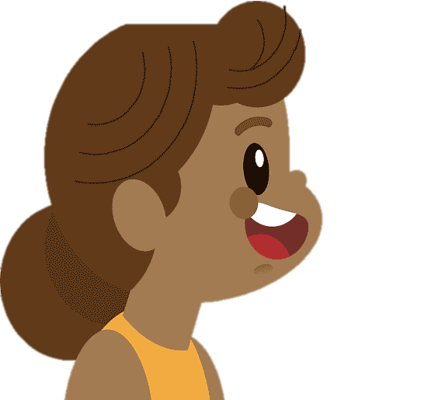

PRODUCTION
5
Work in pairs. Discuss and finish the sentences.
1. Son Doong is now a world-famous
destination for travellers who ______.
2. I’m personally against tours which ______.
3. We shared a holiday home with two Germans whose ______.
4. I bought a city map which ______.
5. Most travellers prefer working with tour guides who ______.

Slide 14
PRODUCTION
5
Work in pairs. Discuss and finish the sentences.
SUGGESTED ANSWER
1. Son Doong is now a world-famous destination for travellers who ________________________________________________________
2. I’m personally against tours which __________________________
3. We shared a holiday home with two Germans whose
____________________________
look for adventures / love exploring caves.
use animals for entertainment.
English was easy to understand.

Slide 15
PRODUCTION
5
Work in pairs. Discuss and finish the sentences.
SUGGESTED ANSWER
4. I bought a city map which___________________________ __________________________________________________5. Most travellers prefer working with tour guides who __________________________________________________
has attractions clearly marked and directions how to get there.
are friendly and helpful.

Slide 16

EXTRA ACTIVITY
LUCKY NUMBERS
1
2
3
4
5
6
7
END GAME

Slide 17

LUCKY NUMBERS
You have 2 points.
GO BACK

Slide 18
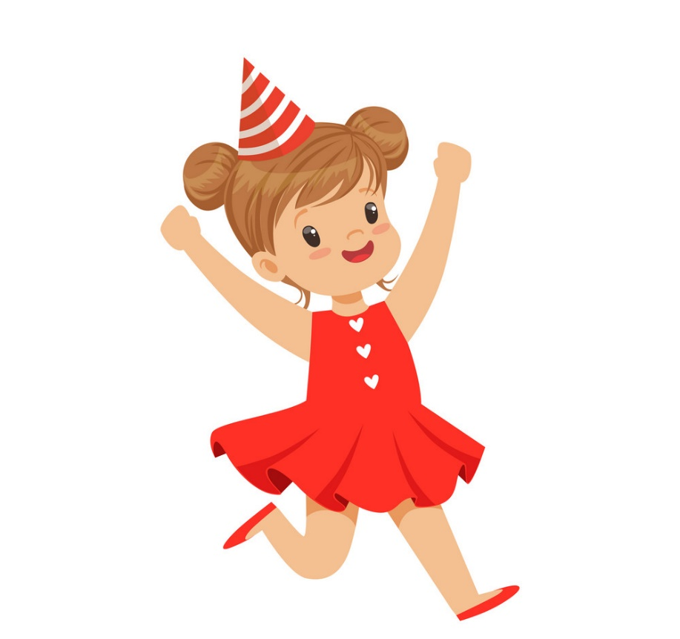
LUCKY NUMBERS
Circle the extra word in each sentence.
The girl who she wore a pink dress at the party is my cousin.
GO BACK

Slide 19

LUCKY NUMBERS
Circle the extra word in each sentence.
The book which I lent you it is my brother’s.
GO BACK

Slide 20
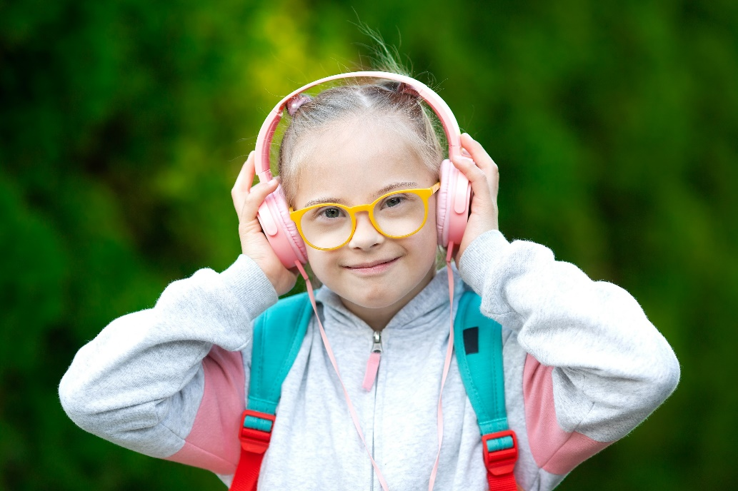
LUCKY NUMBERS
Circle the extra word in each sentence.
The song which I was listening to it when you came in is my favourite.
GO BACK

Slide 21
LUCKY NUMBERS
You have 2 points.
GO BACK

Slide 22
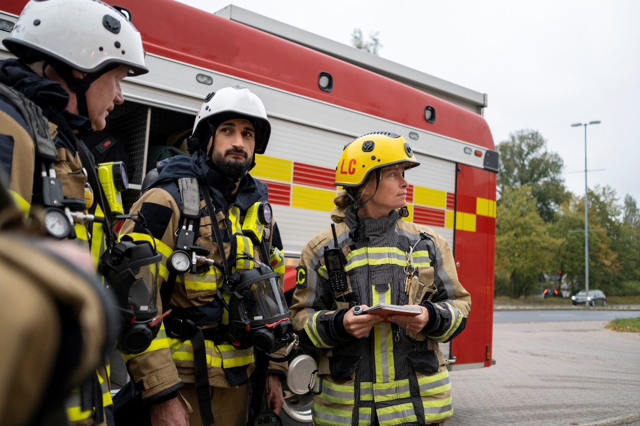
LUCKY NUMBERS
Circle the extra word in each sentence.
This is the photo of the heroes whose their actions we admired so much.
GO BACK

Slide 23
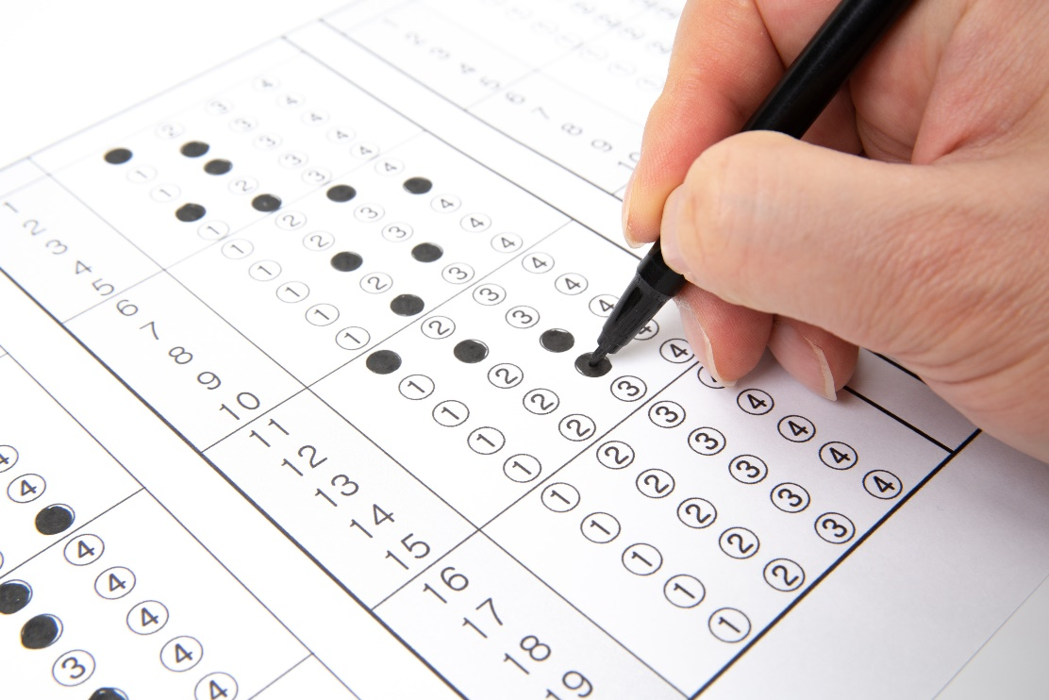
LUCKY NUMBERS
Circle the extra word in each sentence.
Students whose test results they were over eight will go to class A.
GO BACK

Slide 24

CONSOLIDATION
1
Wrap-up
What have we learnt in this lesson?
Summarise the main points of the lesson;
Use relative pronouns: which, who, and whose to make sentences about your travel experience.

Slide 25

CONSOLIDATION
2
Homework
Do exercises in the workbook.

Slide 26
Website: hoclieu.vn
Fanpage: facebook.com/tienganhglobalsuccess.vn/

