Slide 1

Good morning class

Slide 2

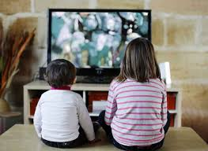
* Complete the sentences with question words
How many
1. _________ hours a day do you watch TV?
2. _________ is your favourite TV programme?
→ I like game show.
What

Slide 3
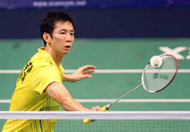
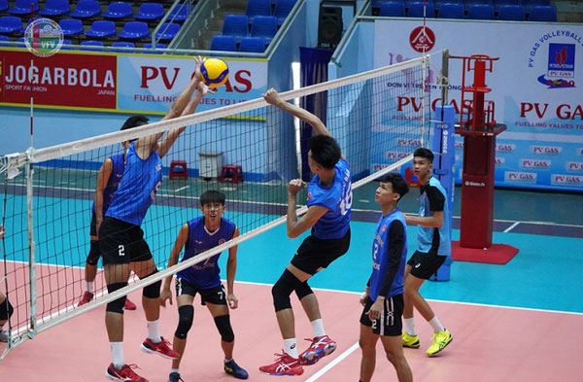

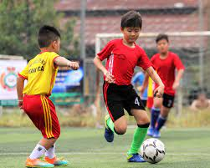
* Complete the sentences with conjunctions
but
My father likes playing tennis, ______ I like playing volleyball.
2. I have a lot of homework tonight, ______ I can’t play football with you.
so

Slide 4


UNIT 8: SPORTS AND GAMES
LESSON1 : GETTING STARTED

Slide 5
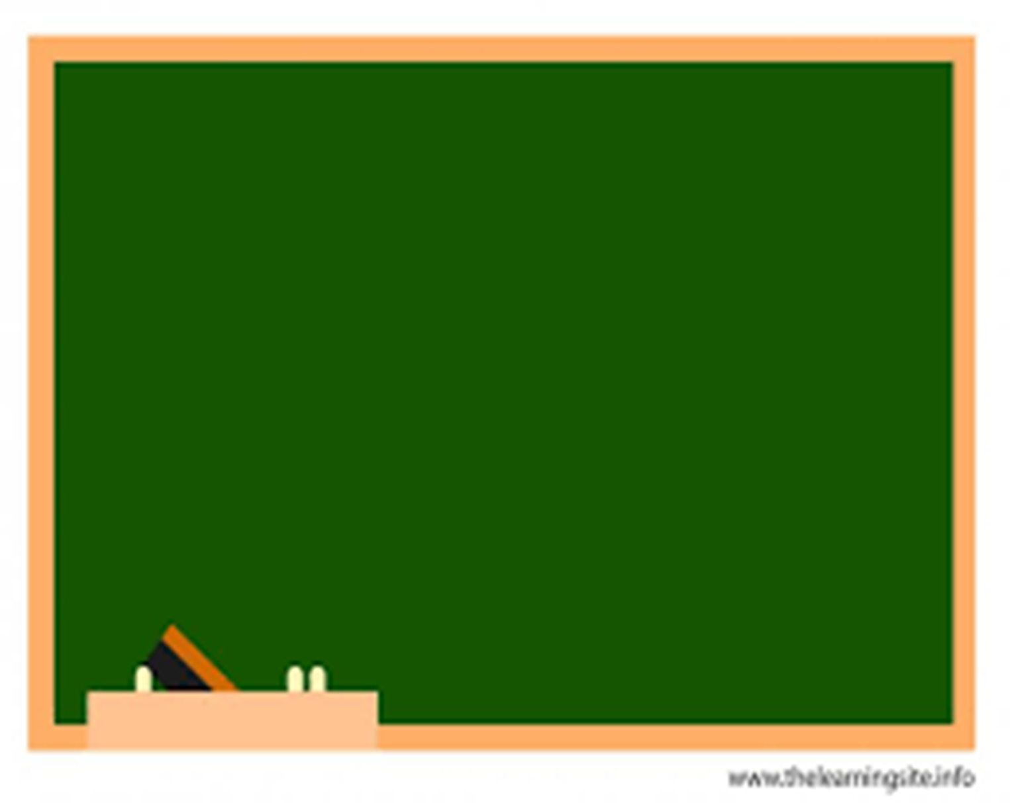

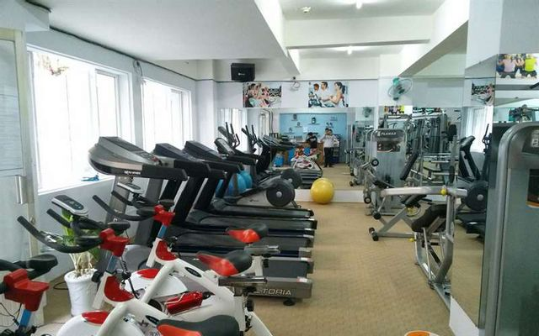
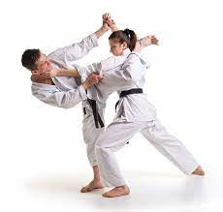
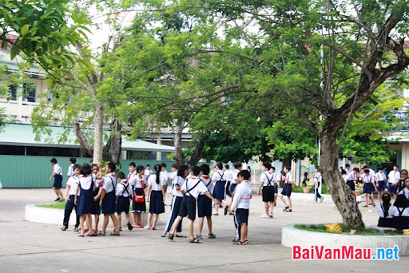
UNIT 8: SPORTS AND GAMES
* Vocabulary
- gym (n)
/dʒɪm/
: phòng tập thể dục
- equipment (n)
/ɪˈkwɪpmənt/
:dụng cụ, thiết bị
- karate (n)
/kəˈrɑːti/
: môn võ karate
- breaktime (n)
/ˈbreɪk taɪm/
:giờ giải lao

Slide 6

UNIT 8: SPORTS AND GAMES
* Checking vocab
- gym (n)
/dʒɪm/
: phòng tập thể dục
- equipment (n)
/ɪˈkwɪpmənt/
:dụng cụ, thiết bị
- karate (n)
/kəˈrɑːti/
: môn võ karate
- breaktime (n)
/ˈbreɪk taɪm/
:giờ giải lao

Slide 7
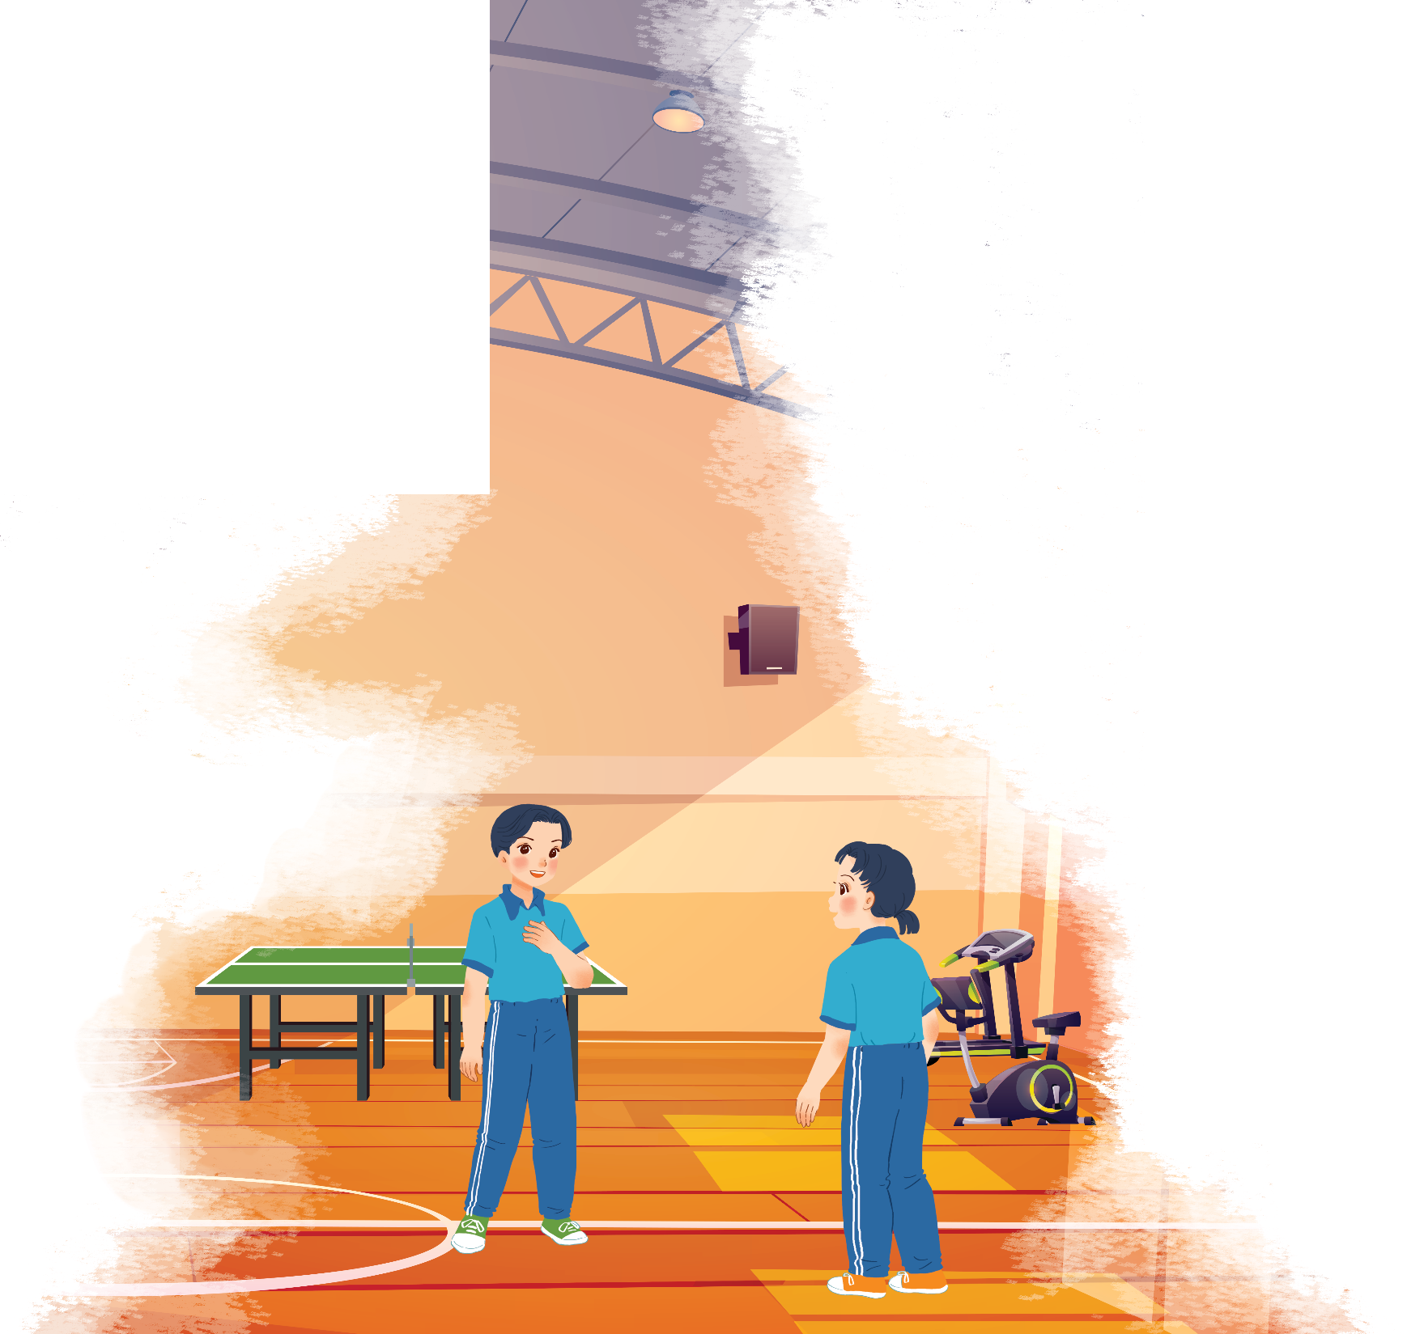

Listen and read.
At the gym
- Who are they in the picture ?
They are Duong and Mai.
- Where are they?
They are at the gym.
- What might they talk about?
They are talking about
some sports
Duong
Mai

Slide 8

Listen and read.
At the gym
Duong: Wow! This gym is big!
Mai: Yeah. The equipment is great. What sports do you do, Duong?
Duong: Well, I do karate, and I play table tennis. Yesterday I played with Duy, and I won!
Mai: Congratulations! You look f it! I’m not good at sports.
Duong: I have an idea – you can go to the karate club with me.
Mai: No, I can’t do karate.
Duong: But you can learn! You’ll love it.
Mai: Well ... OK.
Duong: Great! I’ll meet you there at 10 a.m. on Sunday.
Mai: Where’s the club?
Duong: It’s Superfit Club, in Pham Hung Road. You can cycle there.
Mai: OK. See you then.

Slide 9



Put ONE word from the conversation in each gap.
1. Duong looks ................ He often does karate.
2. Mai likes going to the............... The equipment there is great
3. Duong played .................... with Duy yesterday,
and he won.
4. Mai and Duong are going to meet at Superfit ............... on Sunday.
5. Mai will…………to Superfit Club.

Slide 10




3
4
Lucky apple?
2
5
6
1
7

Slide 11


1. Duong looks ................ He often does karate.
fit

Slide 12
2. Mai likes going to the............... The equipment there is great
gym

Slide 13
3. Duong played .................... with Duy yesterday, and he won.
table tennis

Slide 14
4. Mai and Duong are going to meet at Superfit ............... on Sunday.
Club

Slide 15
5. Mai will…………to Superfit Club.
cycle

Slide 16

LUCKY apple!
YOU GET A GIFT

Slide 17
LUCKY apple!
YOU GET A GIFT

Slide 18
Put ONE word from the conversation in each gap.
1. Duong looks ................ He often does karate.
2. Mai likes going to the............... The equipment there is great
3. Duong played .................... with Duy yesterday,
and he won.
4. Mai and Duong are going to meet at Superfit ............... on Sunday.
5. Mai will…………to Superfit Club.
fit
gym
table tennis
Club
cycle

Slide 19

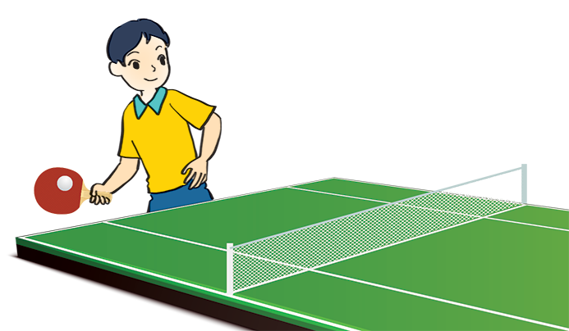
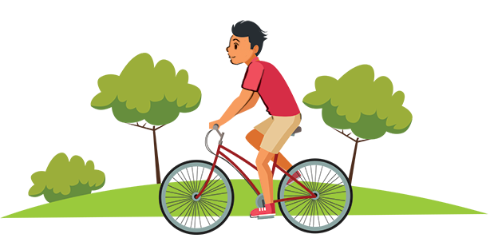
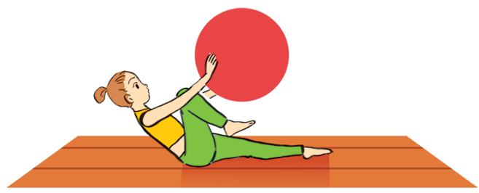
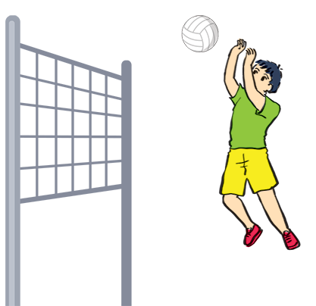
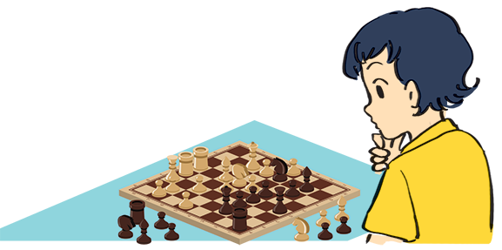
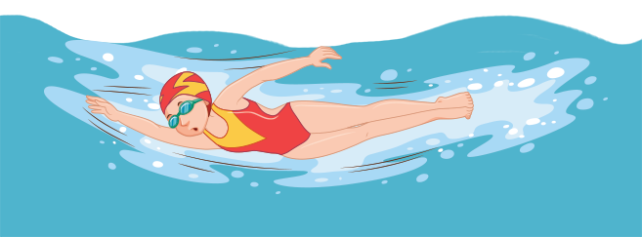
Name these sports and games, using the words from the box.
chess
cycling
aerobics
swimming
table tennis
volleyball
cycling
aerobics
3. table tennis
1.
2.
3.
4.
swimming
5.
chess
6.
volleyball

Slide 20
What is the difference between
a sport and a game ?

Slide 21

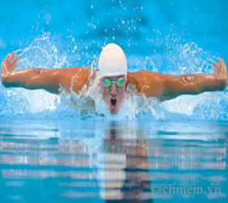
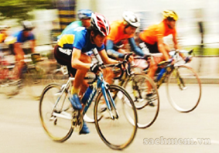
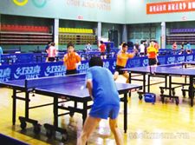
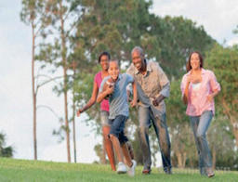
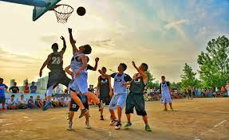
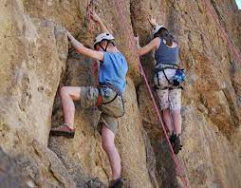
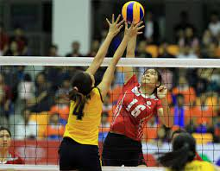
* Notes:
A sport: an activity that you do for pleasure and that needs physical exercise.
swimming
cycling
table tennis.
running
basketball
mountain climbing
volleyball

Slide 22
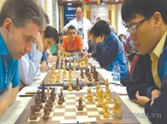
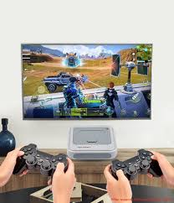
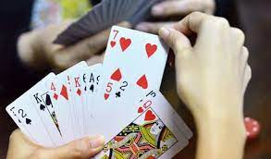
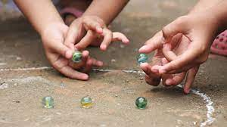
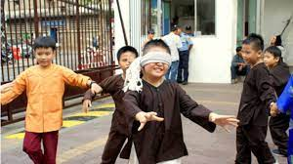
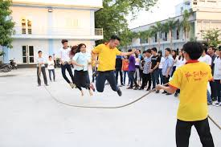
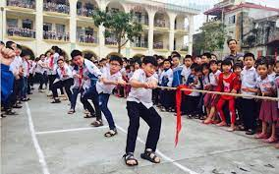
* Notes:
- A game: an activity or a sport with rules in which people or teams compete against each other ( or entertaining and funny activity)
chess
computer games
card games
marbles
blind man's bluff
skipping
tug of war

Slide 23


Work in pairs. Ask your partner these questions to find out how sporty they are.
1.
Can you swim?
A.
Yes.
B.
No.
2.
Do you play outdoors every day?
A.
Yes.
B.
No.
3.
Do you usually do morning excerise?
A.
Yes.
B.
No.
4.
What do you usually do at break time at school?
A.
Play in the school yard.
B.
Sit in the classroom.
5.
What do you think of sports and games?
A.
Very good.
B.
Not useful.

Slide 24
Homework
Prepare : Lesson2 .
Learn new words by heart.
Do exercise in workbook.

