Slide 1



Slide 2

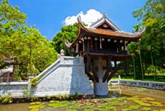
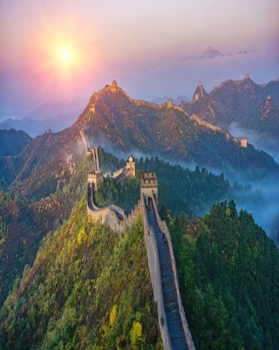
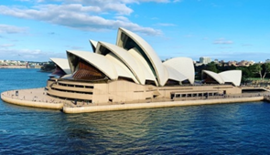
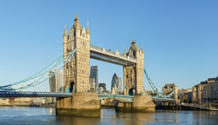
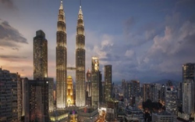
Warm up:
Game:Pelmanism
1
2
3
4
5
Sydney Opera
House
Tower Bridge
One Pillar Pagoda
6
8
9
10
Great
wall
Twin Tower
7

Slide 3



LESSON 2
*Vocabulary
*Pronunciation
/əʊ/ and /aʊ/

Slide 4
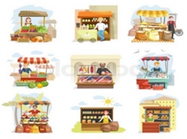
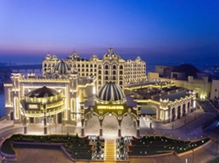
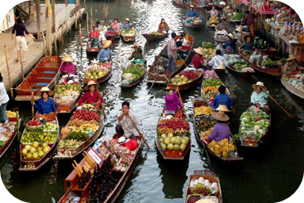
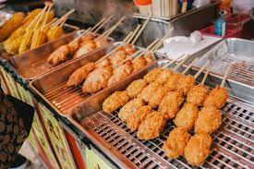
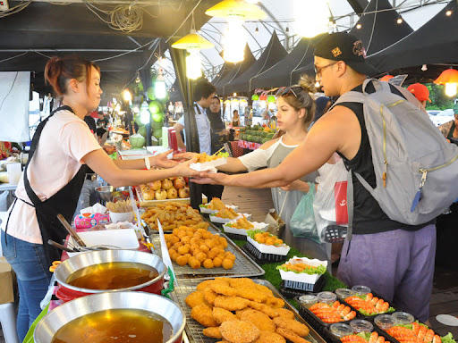
* Vocabulary
# rainy
- sunny (adj) /ˈsʌni/
- delicious (adj) /dɪˈlɪʃəs/
# tasty
- stall (n) /stɔːl/ :
quán, quày hàng
- palace (n) /ˈpæləs/:
cung điện
- street food (nph) /ˈstriːt fuːd/:
món ăn đường phố
- floating market (nph) /ˈfləʊtɪŋ mɑːrkɪt/ :
chợ nổi

Slide 5

Fill each box with an adjective.
* Vocabulary
rainy
old
exciting
old
city
delicious
delicious
tasty
friendly
food
exciting
friendly
helpful
sunny
people
tasty
rainy
sunny
helpful
weather

Slide 6

Complete the sentences with the words in 1.
* Vocabulary
1.
- What’s the weather like in Sydney in summer?
- It’s and dry.
2.
I love the buildings in Edinburgh. I feel that they can tell stories.
3.
There are so many things to do in New York. It’s very .
4.
The people in my city are and helpful.
5.
Ha Noi is famous for its street food.
Game : Lucky number0

Slide 7
LUCKY NUMBER
1
8
2
Team A
Team B
2
3
8
10
4
7
4
6
6
8
10
2
6
4
5
TIẾP

Slide 8
Complete the sentences with the words in 1.
1.
- What’s the weather like in Sydney in summer?
sunny
- It’s and dry.

Slide 9


LUCKY NUMBER!

Slide 10
LUCKY NUMBER!

Slide 11
Complete the sentences with the words in 1.
old
2.
I love the buildings in Edinburgh. I feel that they can tell stories.

Slide 12
Complete the sentences with the words in 1.
3.
There are so many things to do in New York. It’s very .
exciting

Slide 13
Complete the sentences with the words in 1.
friendly
4.
The people in my city are and helpful.

Slide 14
Complete the sentences with the words in 1.
delicious / tasty
5.
Ha Noi is famous for its street food.

Slide 15


LUCKY NUMBER!
YOU GET A GIFT

Slide 16
Complete the sentences with the words in 1.
* Vocabulary
1.
- What’s the weather like in Sydney in summer?
sunny
- It’s and dry.
I love the buildings in Edinburgh. I feel that they can tell stories.
2.
old
There are so many things to do in New York. It’s very .
3.
exciting
4.
The people in my city are and helpful.
friendly
5.
Ha Noi is famous for its street food.
delicious / tasty

Slide 17

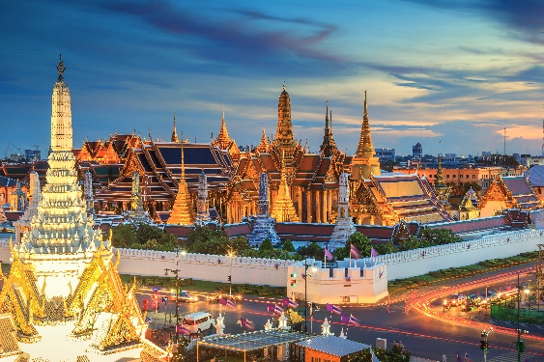
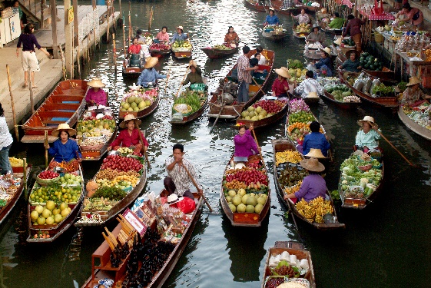
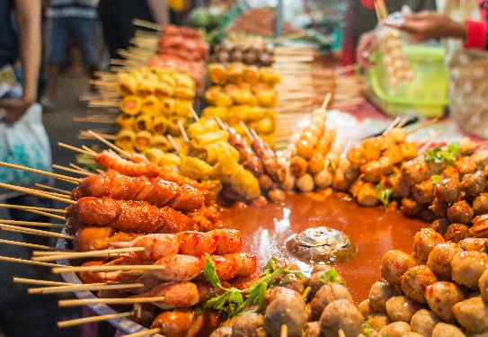
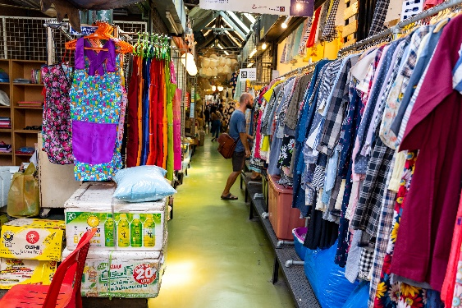
Write the words / phrases below under the correct pictures.
* Vocabulary
stall
street food
palace
floating market
1.
palace
2.
floating market
3.
street food
4.
stall

Slide 18


Listen and write the words in the correct column. Then listen and repeat.
* Pronunciation :
/əʊ/ and /aʊ/
boat
house
town
tower
postcard
crowded
coast
pagoda
/əʊ/
/aʊ/
boat
house
postcard
crowded
coast
town
pagoda
tower

Slide 19

Listen and repeat. Pay attention to the underlined words.
* Pronunciation :
/əʊ/ and /aʊ/
1.
The town is crowded at the weekend.
2.
There’s lots of snow in Tokyo in winter.
3.
It’s very cold on the boat.
4.
He’s running aroud the house.

Slide 20
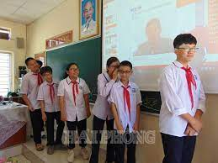
* Game: Game Whispering
* Suggested sentences:
1. The house is very old.
2. I visited a famous floating market.
3. He lives in an old house.

Slide 21

homework
Learn new words by heart.
Redo all the exercises.

