Slide 1


Hello every one !!!
love

Slide 2
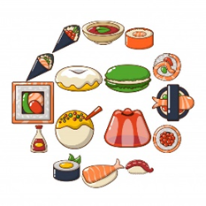




* Game: Brainstorming:
Write adjectives related to city, weather, people, food, building
food
weather
people
city
building

Slide 3

* Suggested answers:
- City: peaceful, lively, busy, industrial, cosmopolitan, green, historic, modern, etc.
- Weather: rainy, wet, humid, dry, arid, frigid, foggy, windy, stormy, breezy, windless, calm, etc.
- People: reliable, passionate, generous, kind, ambitious, etc.
- Food: delicious, salty, bitter, creamy, awful, etc.
- Building: tall, small, big, mordern, historic, new, beautiful,

Slide 4





LESSON 7

Slide 5

Choose the best two options to complete the sentences.
* Vocabulary
1.
The city is .
A.
exciting
B.
amazing
C.
long
2.
The weather is .
A.
cold
B.
quiet
C.
sunny
3.
The people are .
B.
C.
helpful
A.
friendly
expensive
4.
The buildings are .
A.
B.
beautiful
C.
fast
tall
5.
The food is .
A.
B.
delicious
C.
good
cute

Slide 6

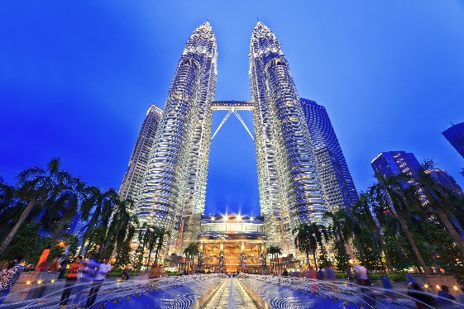
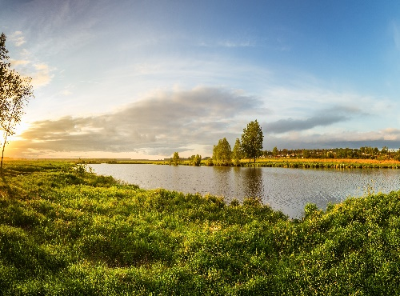
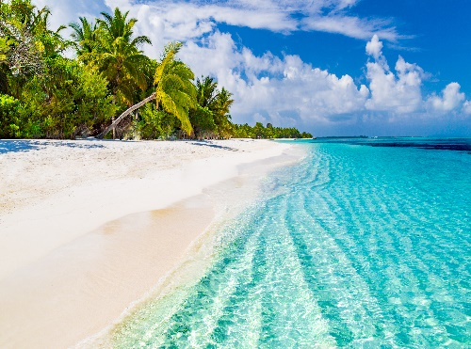
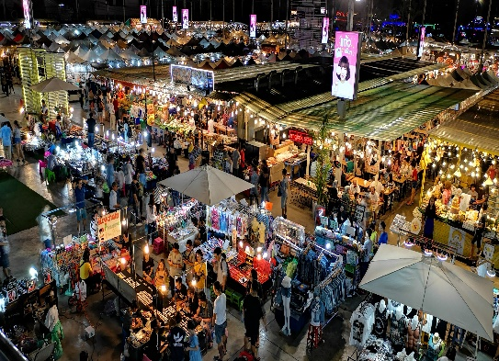
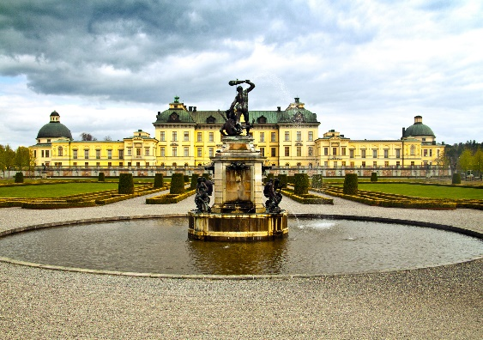

Write the words in the box under their pictures.
towers
beach
river bank
postcard
palace
night market
1.
towers
2.
river bank
3.
beach
4.
night market
5.
palace
6.
postcard

Slide 7

Complete the sentences with the correct possessive pronouns in the box.
* Vocabulary
theirs
hers
yours
mine
ours
1.
Hey Phong. You’re wearing my hat. It’s not .
2.
We’re looking for Mr and Mrs Smith’s house. Is that ?
3.
This is my drawing. It’s .
4.
This is your room. is next door. So call us if you need anything.
5.
Sue doesn’t need to borrow my pen. She’s got .

Slide 8

LUCKY NUMBER!
1
2
3
4
5
6
7

Slide 9
Complete the sentences with the correct possessive pronouns in the box.
theirs
hers
yours
mine
ours
1.
Hey Phong. You’re wearing my hat. It’s not
yours

Slide 10
Complete the sentences with the correct possessive pronouns in the box.
theirs
hers
yours
mine
ours
2. We’re looking for Mr and Mrs Smith’s house.
Is that ?
theirs

Slide 11
Complete the sentences with the correct possessive pronouns in the box.
theirs
hers
yours
mine
ours
3.
mine
This is my drawing. It’s .

Slide 12

LUCKY NUMBER!

Slide 13
Complete the sentences with the correct possessive pronouns in the box.
theirs
hers
yours
mine
ours
4.
ours
This is your room. is next door. So call us if you need anything.

Slide 14
LUCKY NUMBER!

Slide 15
Complete the sentences with the correct possessive pronouns in the box.
5.
Sue doesn’t need to borrow my pen.
She’s got .
hers

Slide 16
Complete the sentences with the correct possessive pronouns in the box.
* Vocabulary
theirs
hers
yours
mine
ours
1.
Hey Phong. You’re wearing my hat. It’s not .
yours
2.
We’re looking for Mr and Mrs Smith’s house. Is that ?
theirs
3.
mine
This is my drawing. It’s .
4.
Ours
This is your room. is next door. So call us if you need anything.
5.
Sue doesn’t need to borrow my pen. She’s got .
hers

Slide 17

Read the sentences and correct the underlined words.
1.
Bangkok is an exciting city. I love it’s people
its
2.
We are watching the sunrise at Angkor Wat with ours local friends.
our
3.
Discover Beijing and Shanghai through theirs food tours.
their
4.
Visit Hue and try your food.
its
5.
Venice is your city and Jakarta is our.
ours

Slide 18



Work in groups.
Choose one city in the world you would like to visit.
Find necessary information for your visit.
Make a report of your findings and present it to the class.

Slide 19

Suggestions:
What city is it?
Where is it?
How can you go there?
What’s the weather like there?
What would you like to see and do there?
Make a report of your findings and present it to the class.

Slide 20

1. It is Seoul.
2. It’s in Korea.
3. I can go there from Viet Nam by plane.
4. The weather is very different among for seasons. The most pleasant seasons for most people in the city are spring and autumn,
5.-I’d to discover Lotte World, buy cosmetics at Myeongdong, explore Bukchon Hanok Village, …….

Slide 21


homework
- Redo all exercises in the texbook
- Prepare Unit 10 : Getting started.

