Slide 1
typhoon
eruption
tornado
10 Natural disasters
snow storm
Earthquake
tidal wave
flood
landslide

Slide 2

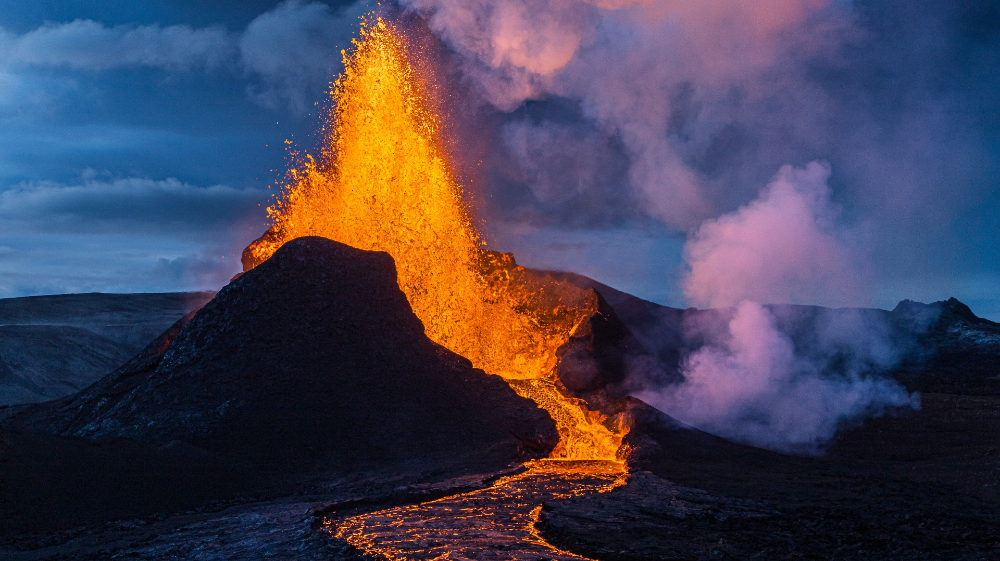
Unit
9
NATURAL DISASTERS
Unit
ETHNIC GROUPS OF VIET NAM
LESSON 5: SKILLS 1
LESSON 3: A CLOSER LOOK 2
HOBBIES

Slide 3
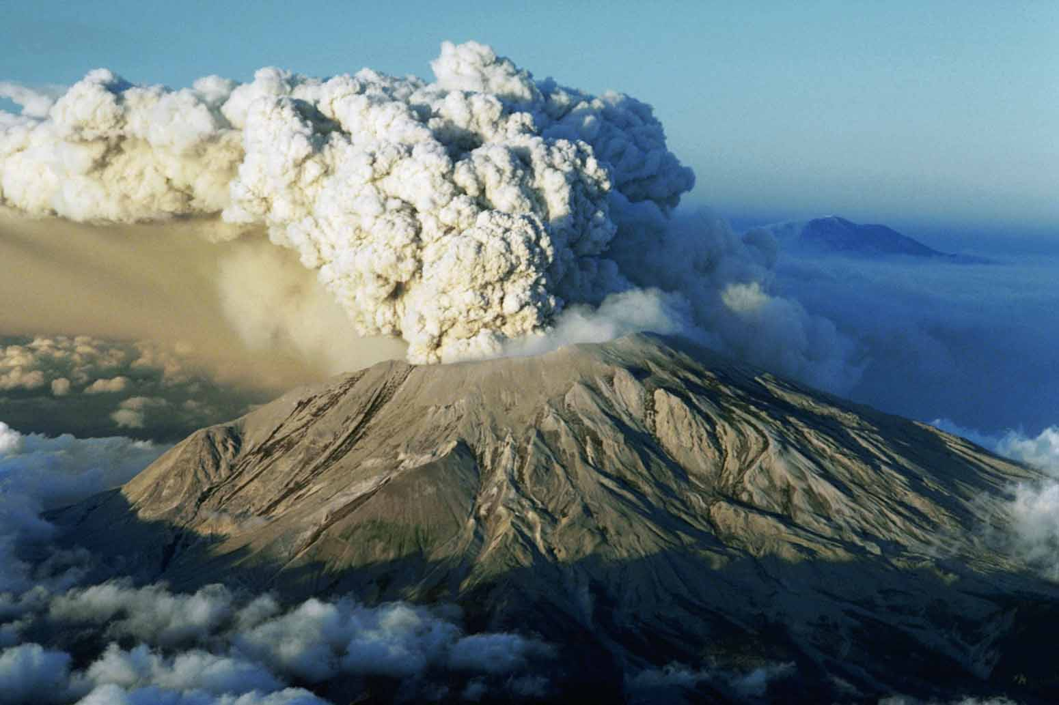

* VOCABULARY
- ash (n):
tro
/æʃ/

Slide 4
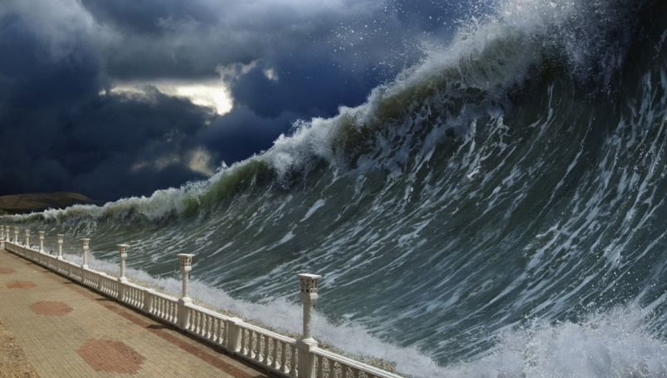
- tsunami (n):
trận sóng thần
/tsuːˈnɑːmi/

Slide 5
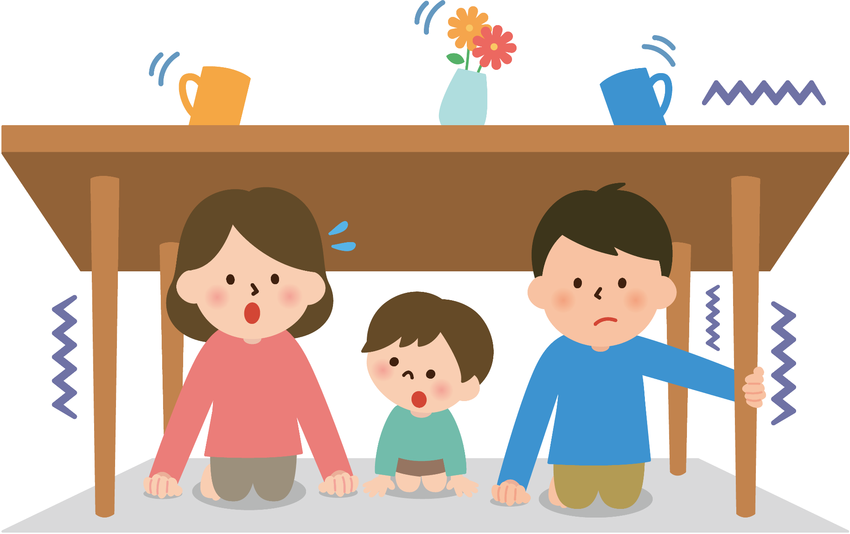
* VOCABULARY
- tremble (v):
rung lắc
/ˈtrembl/

Slide 6
* VOCABULARY
New words | Pronunciation | Meaning
1. ash (n) | /æʃ/ | tro
2. tsunami (n) | /tsuːˈnɑːmi/ | trận sóng thần
3. tremble (v) | /ˈtrembl/ | rung lắc

Slide 7
* Checking Vocabulary
New words | Meaning
1. ash (n)
2. tsunami (n)
3. tremble (v)
trận sóng thần
rung lắc
tro

Slide 8
I. READING
1
Match the headlines (1 – 2) with the natural disasters (A – B).
Headlines |  | Natural disasters
1. 30 seconds of a slight shaking in Ha Noi
2. A thick layer of ash covers Tonga
A. volcanic eruption
B. earthquake

Slide 9
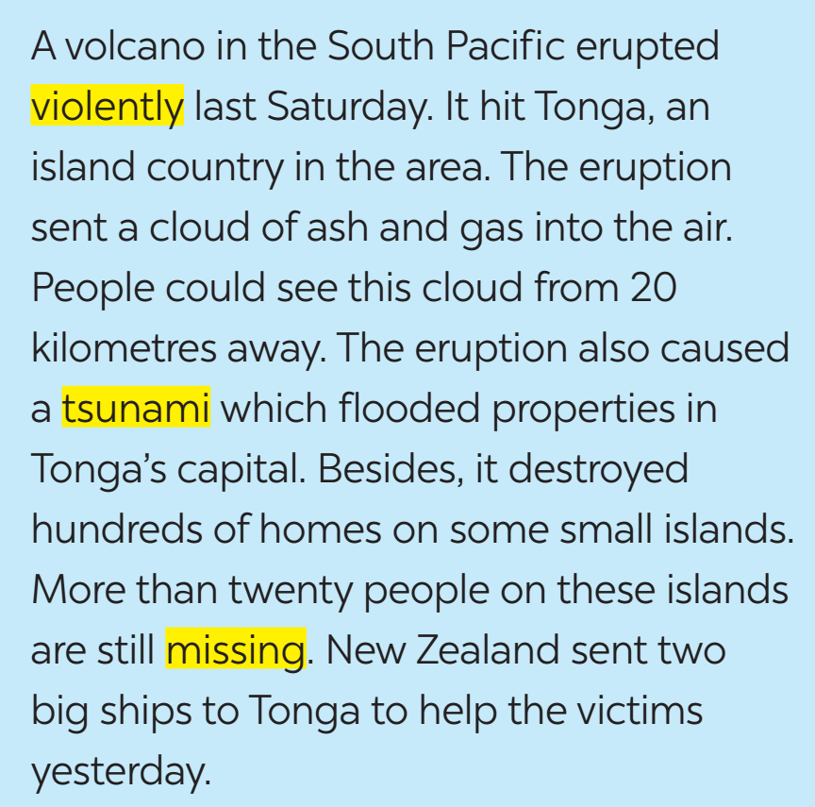
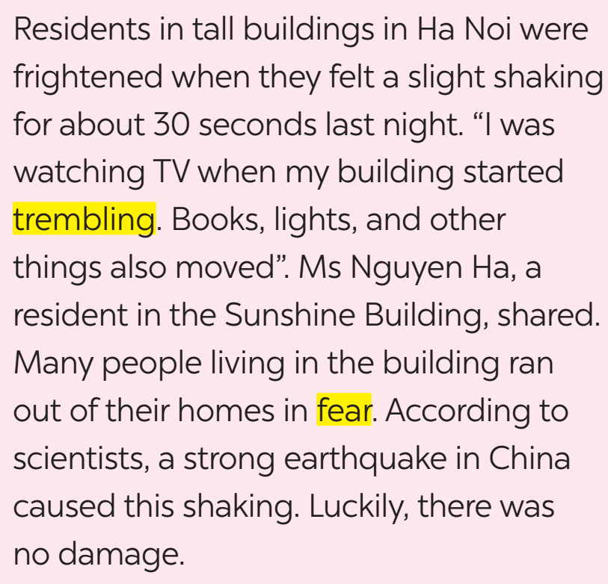
I. READING
2
Read the two news articles. Match the highlighted words with their meanings.

Slide 10
2
Read the two news articles. Match the highlighted words with their meanings.
Highlighted words |  | Meanings
1. violently
2. tsunami
3. missing
4. trembling
5. fear
a. not yet found
b. slightly shaking
c. the bad feeling you have when you are frightened
d. very strongly
e. very large waves in the sea

Slide 11
3
Read the articles again and answer the questions.
1. Where and when did the eruption happen?
=>
2. What did the eruption cause?
=>
3. What were the other effects of the eruption?
=>
In the South Pacific last Saturday.
A tsunami.
It destroyed hundreds of homes on some small islands, and more than twenty people on these islands are missing.

Slide 12
3
Read the articles again and answer the questions.
4. How long did the buildings shake?
=>
5. What caused the shaking?
=>
For about 30 seconds.
A strong earthquake in China.

Slide 13
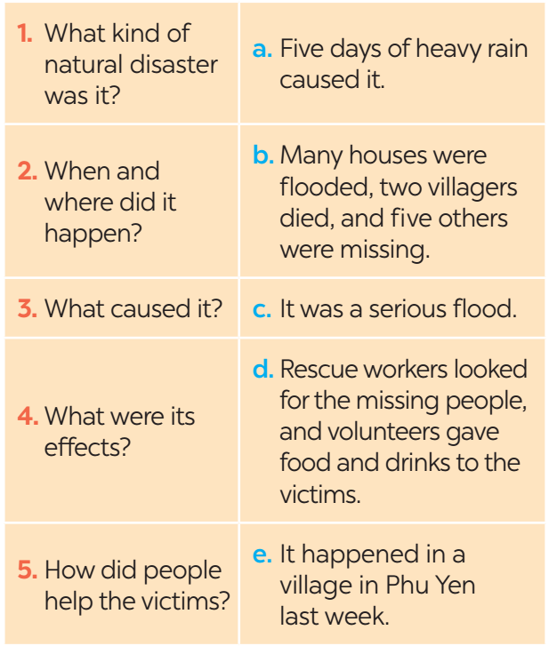
II. SPEAKING
4
Work in pairs. Match the questions with the answers.

Slide 14
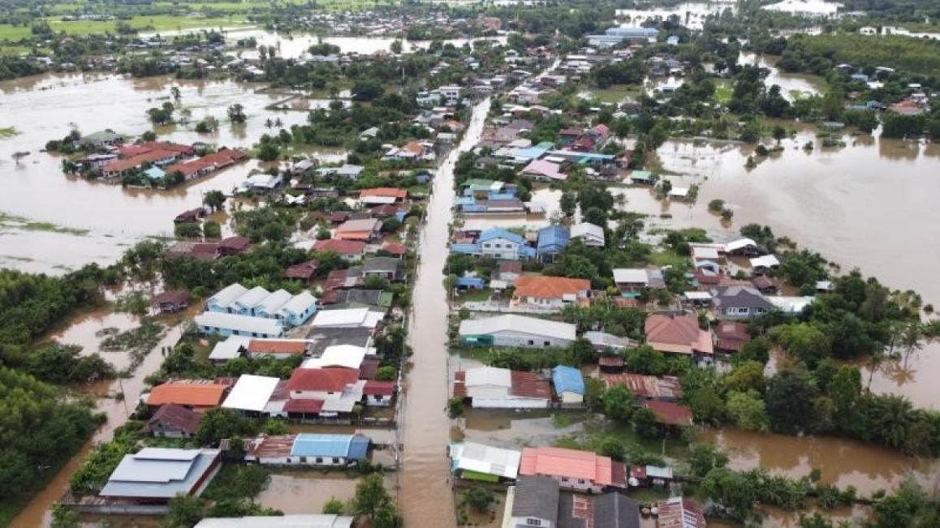
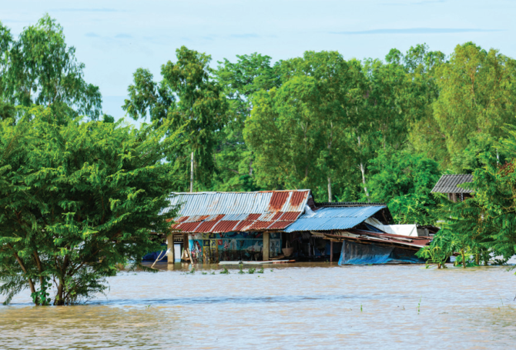
II. SPEAKING
5
Work in groups. Prepare a short piece of news about the natural disaster in 4 or one you know of. Report the news to the class.
Example:
Five days of heavy rain caused a serious flood in a village in Phu Yen. The flood happened last week. …

Slide 15
II. SPEAKING
5
Work in groups. Prepare a short piece of news about the natural disaster in 4 or one you know of. Report the news to the class.
Five days of heavy rain caused a serious flood in a village in Phu Yen. The flood happened last week. Many houses were flooded, two villagers died, and five others were missing. Rescue workers looked for the missing people, and volunteers gave food and drinks to the victims.

Slide 16

* CONSOLIDATION
In this lesson, you have:
learnt new words related to natural disasters.
read 2 passages about volcano and earthquake.
report a short piece of news about the natural disaster.

Slide 17

* Homework
Learn the words by heart.
Do exercises in the workbook.
Prepare for Lesson 6 – Skills 2.

Slide 18



