Slide 1
WELCOME TO OUR CLASS!
Presented by: ………………………….

Slide 2

WARM UP
+ How long have you learnt English?
+ In your opinion how many types of English are there?
+ Do you know any differences between American English and British English?

Slide 3

American English and British English

Slide 4
UNIT 9 WORLD ENGLISHES
Lesson 1: Getting started

Slide 5
OBJECTIVES
01
02
After this lesson, students will be able to:
Use the words related to WORLD ENGLISHES
Gain vocabulary to talk about WORLD ENGLISHES

Slide 6
01
VOCABULARY

Slide 7


Vocabulary
exchange student
a student from one country who attends a school in another country
/ɪksˈtʃeɪndʒ
stjuːdnt/
học sinh trao đổi

Slide 8

Vocabulary
immigrant (n)
a person who has come to a different country in order to live there permanently.
/ˈɪmɪɡrənt/
người nhập cư

Slide 9
Vocabulary
New words | Pronunciation | Meaning
1. exchange student | /ɪksˈtʃeɪndʒ stjuːdnt/ | học sinh trao đổi
2. immigrant (n) | /ˈɪmɪɡrənt/ | người nhập cư

Slide 10
02
LISTENING READING
WORLD ENGLISHES

Slide 11

Look and guess.
Who do you see in the picture?
What does the picture show?

Slide 12
1. Listen and choose the correct answer
01
What do most American students wear to school?
A. School uniforms
B. Pants and T-shirts
C. Dresses and skirts
02
Are all students in Jack's school American?
A. Yes, all of them are American.
B. No, some are immigrants from other countries.
C. Only a few are American.

Slide 13
2. Read the conversation again. Fill in each blank with no more than TWO words from the conversation
Teacher: Hi class. I’d like to introduce an exchange student who comes from New York. Welcome Jack!
Students: Hello, Jack. Nice to meet you.
Jack: Nice to meet you all. This is my first time in Viet Nam.
Teacher: Now you can ask Jack any questions you would like to ask.
Phong: Do American students wear school uniforms every day, Jack?
Jack: No, most American students don’t wear school uniforms. Most students at my school wear pants and T-shirts.
Phong: What do you mean by ‘pants’, Jack?
Jack: Ah, I mean trousers. In American English, ‘pants’ mean ‘trousers’.
Phong: I see.
Teacher: Yeah, there are some differences in vocabulary between American English and British English. Are there any more questions?
Mi: Yes. I want to know about the students in your school. Are all of you
American? And do all of you speak English?
Jack: Good question. Most of us are American, but some are immigrants
from other countries like Viet Nam, India, and Mexico. Their first language is not English, but they all speak English at school.
Mi: That’s interesting!

Slide 14
2. Read the conversation again. Fill in each blank with no more than TWO words from the conversation
Jack is an exchange student from ______________.
This is the ____________ Jack has visited Viet Nam.
Most students at Jack’s school wear _________ and T-shirts.
American English and British English have __________ in vocabulary
Not all students in Jack’s school are _________, but they all speak English.

Slide 15
Check the answers
Jack is an exchange student from ______________.
This is the ____________ Jack has visited Viet Nam.
Most students at Jack’s school wear _________ and T-shirts.
American English and British English have __________ in vocabulary
Not all students in Jack’s school are _________, but they all speak English.
Teacher: Hi class. I’d like to introduce an exchange student who comes from New York. Welcome Jack!
New York

Slide 16
Check the answers
Jack is an exchange student from ______________.
This is the ____________ Jack has visited Viet Nam.
Most students at Jack’s school wear _________ and T-shirts.
American English and British English have __________ in vocabulary
Not all students in Jack’s school are _________, but they all speak English.
Jack: Nice to meet you all. This is my first time in Viet Nam.
New York
first time

Slide 17
Check the answers
Jack is an exchange student from ______________.
This is the ____________ Jack has visited Viet Nam.
Most students at Jack’s school wear _________ and T-shirts.
American English and British English have __________ in vocabulary
Not all students in Jack’s school are _________, but they all speak English.
Jack: No, most American students don’t wear school uniforms. Most students at my school wear pants and T-shirts.
New York
first time
pants

Slide 18
Check the answers
Jack is an exchange student from ______________.
This is the ____________ Jack has visited Viet Nam.
Most students at Jack’s school wear _________ and T-shirts.
American English and British English have ______________ in vocabulary
Not all students in Jack’s school are _________, but they all speak English.
Teacher: Yeah, there are some differences in vocabulary between American English and British English. Are there any more questions?
New York
first time
pants
some differences

Slide 19
Check the answers
Jack is an exchange student from ______________.
This is the ____________ Jack has visited Viet Nam.
Most students at Jack’s school wear _________ and T-shirts.
American English and British English have ______________ in vocabulary
Not all students in Jack’s school are _________, but they all speak English.
Jack: Good question. Most of us are American, but some are immigrants
from other countries like Viet Nam, India, and Mexico. Their first language is not English, but they all speak English at school.
New York
first time
pants
some differences
American

Slide 20

3. Match the words and phrases with their definitions
1. exchange student | a. all the words in a language | 1.
2. mean | b. a student who attends a school in a foreign country for a period of time | 2.
3. vocabulary | c. people who have come to live permanently in a different country | 3.
4. immigrants | d. the language someone learns to speak from birth | 4.
5. first language | e. to express or represent something | 5.
b
e
a
c
d

Slide 21
4. Fill in each blank with a word or phrase from 3
mean
1. – What does your name ____________, Mi?
– It’s the name of a bird.
2. English ____________ is increasing because it borrows words from other languages.
3. In Australia, there are a lot of ___________ who have come from other countries.
4. His _______________is Vietnamese, but he can speak English and French fluently.
5. This year our school has a(n) _______________ from Britain. She will study with us for one month.
vocabulary
immigrants
first language
exchange student

Slide 22
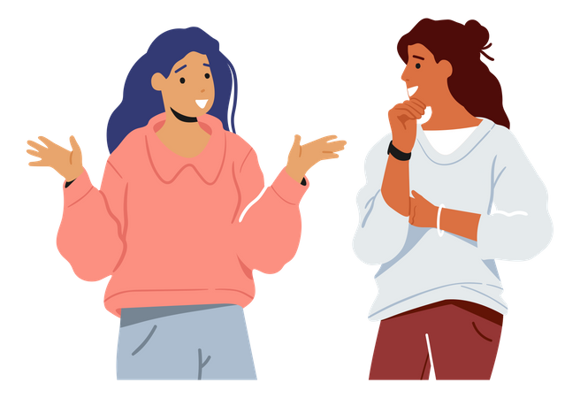
5. Match the words in British English with those in American English so that they mean the same.
BRITISH ENGLISH
flat
holiday
jumper
chips
football
AMERICAN ENGLISH
sweater
apartment
soccer
vacation
French fries

Slide 23
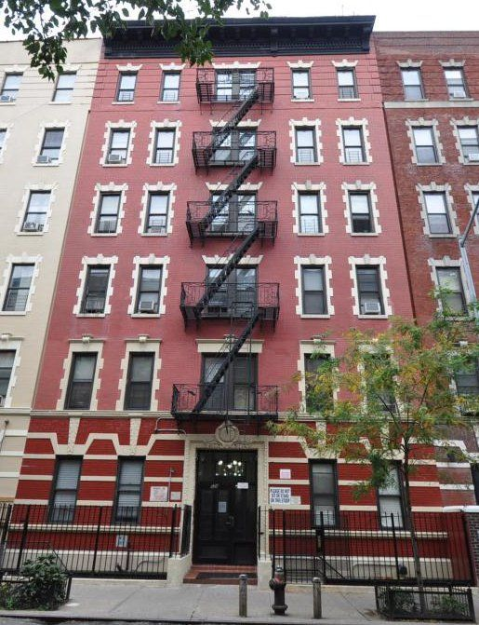
LOOK AT THE PICTURES
flat
apartment
Zalo 0793833272

Slide 24

LOOK AT THE PICTURES
holiday
vacation

Slide 25
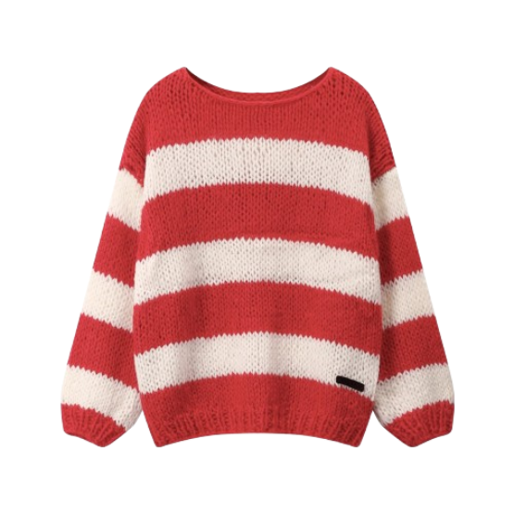
LOOK AT THE PICTURES
jumper
sweater

Slide 26

LOOK AT THE PICTURES
chips
French fries

Slide 27
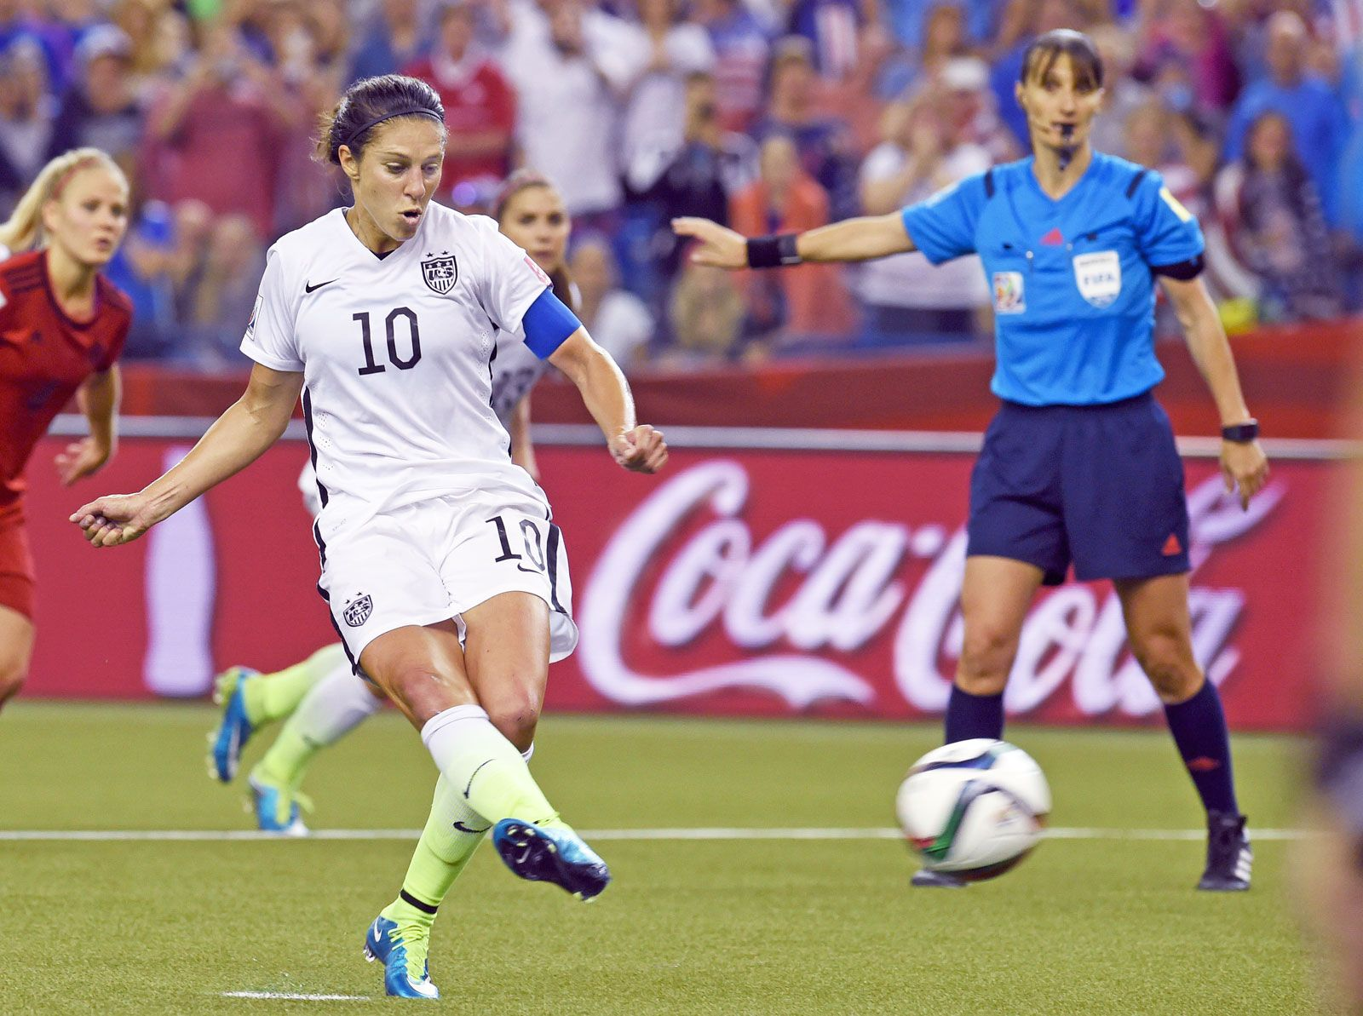
LOOK AT THE PICTURES
football
soccer

Slide 28
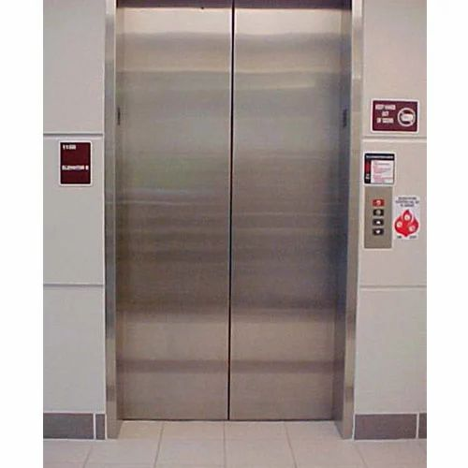
LOOK AT THE PICTURES
lift
elevator

Slide 29
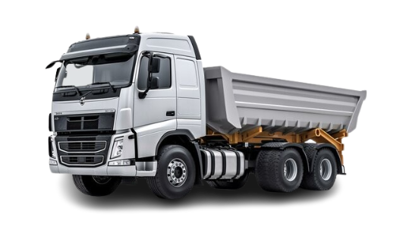
LOOK AT THE PICTURES
lorry
truck

Slide 30
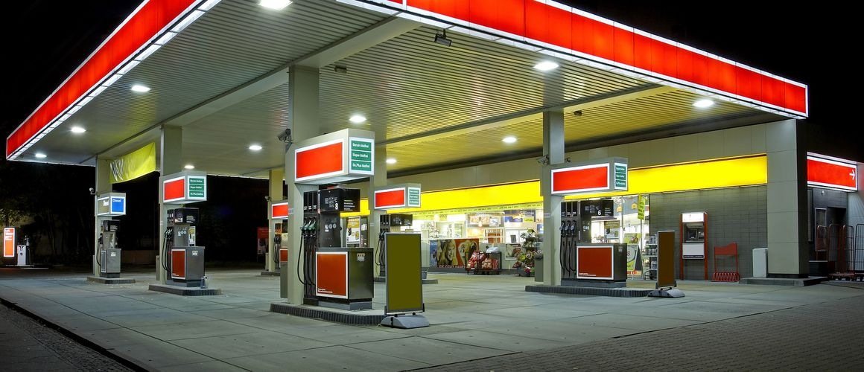
LOOK AT THE PICTURES
petrol station
gas station

Slide 31
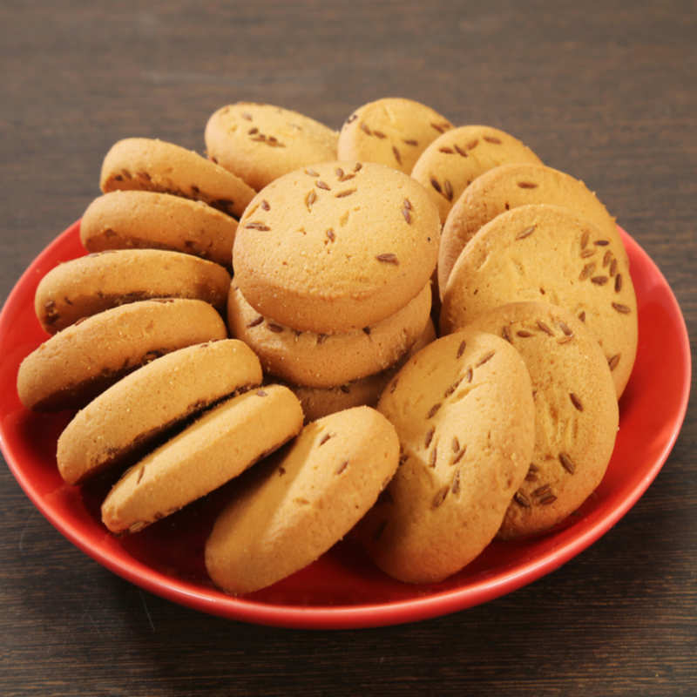
LOOK AT THE PICTURES
biscuit
cookie

Slide 32
WRAP-UP
What have we learnt in this lesson?
✓ identify the topic of the unit
✓ use lexical items related to leisure activities

Slide 33
HOMEWORK
Learn by heart vocabulary
Prepare: A Closer Look 1
Prepare: Project P.101

Slide 34
THANKS FOR YOUR ATTENTION!

