Slide 1
WELCOME TO OUR CLASS!
Presented by: ……………

Slide 2

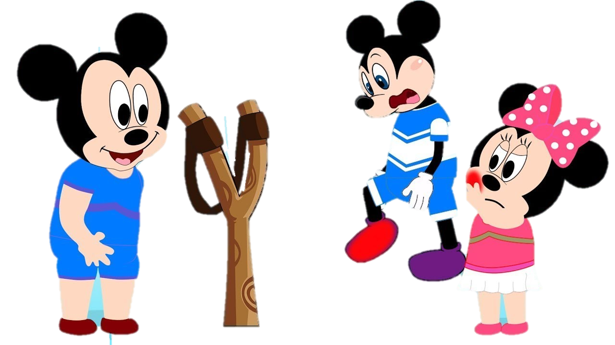



Slide 3
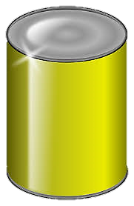

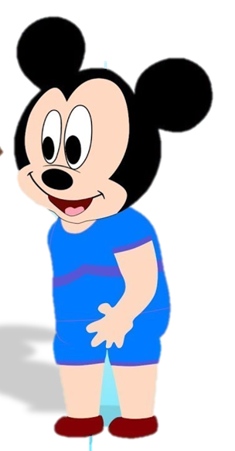

1. Which of these languages has the highest number of native speakers?
English
Chinese
Spanish
NEXT
Click on the right can

Slide 4
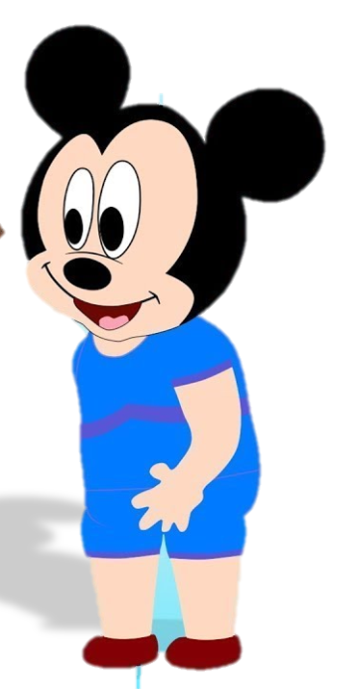

2. Which language do people use the most at international events?
English
Chinese
Spanish
NEXT
Click on the right can

Slide 5
3. Americans call it “truck”. What do the British call it?
car
bus
lorry
NEXT
Click on the right can

Slide 6
4. The British call it “chemist’s”. What do Americans call it?
Shop
Drugstore
Store
NEXT
Click on the right can

Slide 7
5. Which is the longest word in English which has only one vowel?
length
Strengths
depth
NEXT
Click on the right can

Slide 8
Unit 9.
WORLD ENGLISHES
Lesson 4. Communication

Slide 9
EVERYDAY ENGLISH

Slide 10

1. Listen and read the conversations below. Pay attention to the highlighted parts.
Tom: Good luck with your English exam.
Mi: Thanks. I’ll try my best.
Phong: I’ve heard that you’re moving to the US. I wish you all the best of luck.
Neighbour: Thank you so much.

Slide 11
Structures:
Saying Good Luck:
Good luck with + noun/noun phrase
I wish you + all the best of luck.
Respond:
Thanks / Thank you…
Some other ways to say good luck in English:
+ Best of luck with your....
+ Fingers crossed.
+ Break a leg

Slide 12
2. Work in pairs. Make similar conversations to ask for permission and respond in the following situations.
Situation:
Good luck with your English presentation this week
1. Your friend is giving a presentation in English this week.
2. Your cousin is taking the university entrance exam next week.
3. Your English teacher is going to the UK for further study.

Slide 13
1. Your friend is giving a presentation in English this week.
Good luck with your university entrance exam next week.
Good luck with your English presentation this week
Thanks. I’ll try my best.

Slide 14
2. Your cousin is taking the university entrance exam next week.
I’ve heard that you’re going to the UK for further study. I wish you all the best of luck
Good luck with your university entrance exam next week.
Thanks. I’ll try my best.

Slide 15
3. Your English teacher is going to the UK for further study.
I’ve heard that you’re going to the UK for further study. I wish you all the best of luck
Thank you so much.

Slide 16
- Tell me any interesting facts about English.
Suggested answers:
- The English language borrows words from all over the world. This is why we have words like "pasta" from Italian, "gymnasium" from Greek, and "sushi" from Japanese.
- English is spoken by over 1.35 billion people around the world, making it the third most spoken language globally.

Slide 17
INTERESTING FACTS ABOUT ENGLISH

Slide 18
3. Work in pairs. Read the interesting facts below about English. Order them from the most interesting to the least interesting.
1. The most common letter in English is ‘e’.
2. Only two English words in current use end in ‘-gry’. They are ‘angry’ and ‘hungry’
3. The word ‘uncopyrightable’ is the longest English word in normal use which contains no letter more than once.
4. The longest English word without a true vowel (a, e, i, o, or u) is ‘rhythms
5. ‘Queueing’ and ‘cooeeing’ are the two words with five consecutive vowels(five vowels in a row).

Slide 19
Some fun facts:
1.The most common vowel in English is "e", followed by "a".
2.The most common consonant in English is "r", followed by "t".
3.Every syllable in English must have a vowel (sound). Not all syllables have consonants.
4.More English words begin with the letter "s" than with any other letter.
5.The word "alphabet" comes from the first two letters of the Greek alphabet: alpha and bēta.

Slide 20
Choose the correct answer
1. The four languages most spoken in the world are Chinese, ___________, English and Hindi.
A. Spanish
C. German
B. French
D. Arab
2. Apart from Wales, the Welsh is also spoken in _______.
A. Scotland
C. Ireland
B. Argentina
D. Sweden

Slide 21
Choose the correct answer
3. Which European language gave us the words ‘cookie’, ‘nitwit’ and ‘sleigh’?
A. Norwegian
C. Czech
B. Dutch
D. German
4. What language is the most common one in Europe because of a number of native speakers?
A. French
C. Russian
B. German
D. English

Slide 22
Choose the correct answer
5. What are the official languages of Canada?
A. French and English
C. English and German
B.German and French
D.English and Dutch

Slide 23
WRAP-UP
What have we learnt in this lesson?
Say good luck and respond.
Talk about WORLD ENGLISHES and tourism

Slide 24
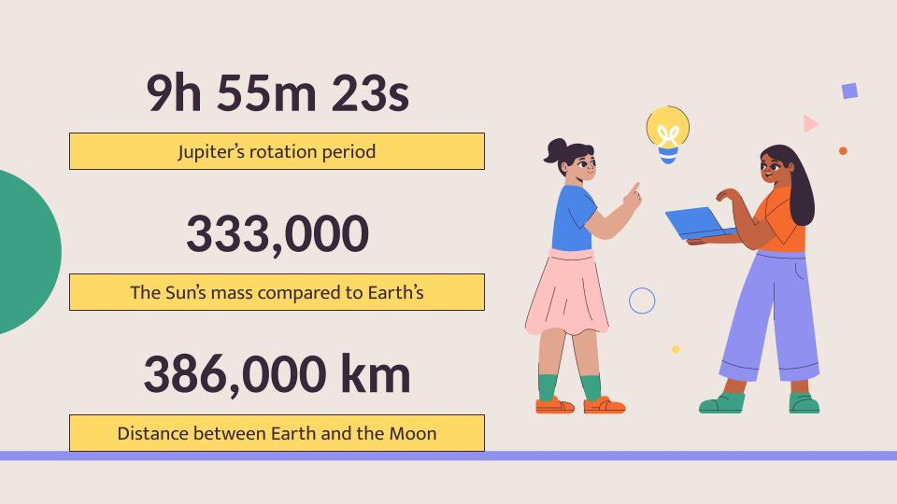
HOMEWORK
- Do exercises in the workbook.

