Slide 1
WELCOME TO OUR CLASS!
Presented by: ………………

Slide 2
Unit 9: WORLD ENGLISHES
LESSON 7: LOOKING BACK

Slide 3
PRONUNCIATION
-ion | -ity
relation, decision, position, education, operation
charity, quality, clarity, ability, obesity

Slide 4
VOCABULARY
ASPECTS OF LANGUAGES: bilingual, variety, fluent, concentric, official language…
ENGLISH LANGUAGE LEARNING: translate from Vietnamese to English, copy words into a notebook, pick up a new language, look up new words in an English- English dictionary, go over the grammatical points.

Slide 5
1. Fill in the blank with word from the box
bilingual
mean
immigrants
concentric
fluent
mean
1. What does this word _____________in English?
concentric
2. The Kachru’s model has three _______________circles
3. The little boy talks to his mum in Vietnamese and to his dad in English. He’s ____________.
bilingual
fluent
4. Many children in this area are _________English speakers, but they can’t write in English
immigrants
5. The number of ____________ in this country has increased quickly for the last three years

Slide 6
2. Choose the correct answer A, B, C, or D to complete each sentence.
1. My students usually go ______ their homework before they hand it in.
A. into B. over C. in D. up
2. Do you know how many ______ of English are there?
A. grammars B. vocabulary
C. varieties D. official languages
3. For homework, please copy these English sentences ______ your notebook.
A. into B. over C. on D. up
4. She’s good at ______ English short stories into Vietnamese
A. translating B. picking C. looking D. copying
5. After living in Singapore for several years, she has ______ up some Singaporean English
A. copied B. gone C. looked D. picked

Slide 7


FINDING NEMO

Slide 8





1. My students usually go ______ their homework before they hand it in.
A. into
B. over
C. in
D. up

Slide 9

2. Do you know how many ______ of English are there?
A. grammars
B. vocabulary
C. varieties
D. official languages

Slide 10
3. For homework, please copy these English sentences ______ your notebook.
A. into
B. over
C. on
D. up

Slide 11
4. She’s good at ______ English short stories into Vietnamese.
A. translating
B. picking
C. looking
D. copying

Slide 12
5. After living in Singapore for several years, she has ______ up some Singaporean English
A. copied
B. gone
C. looked
D. picked

Slide 13
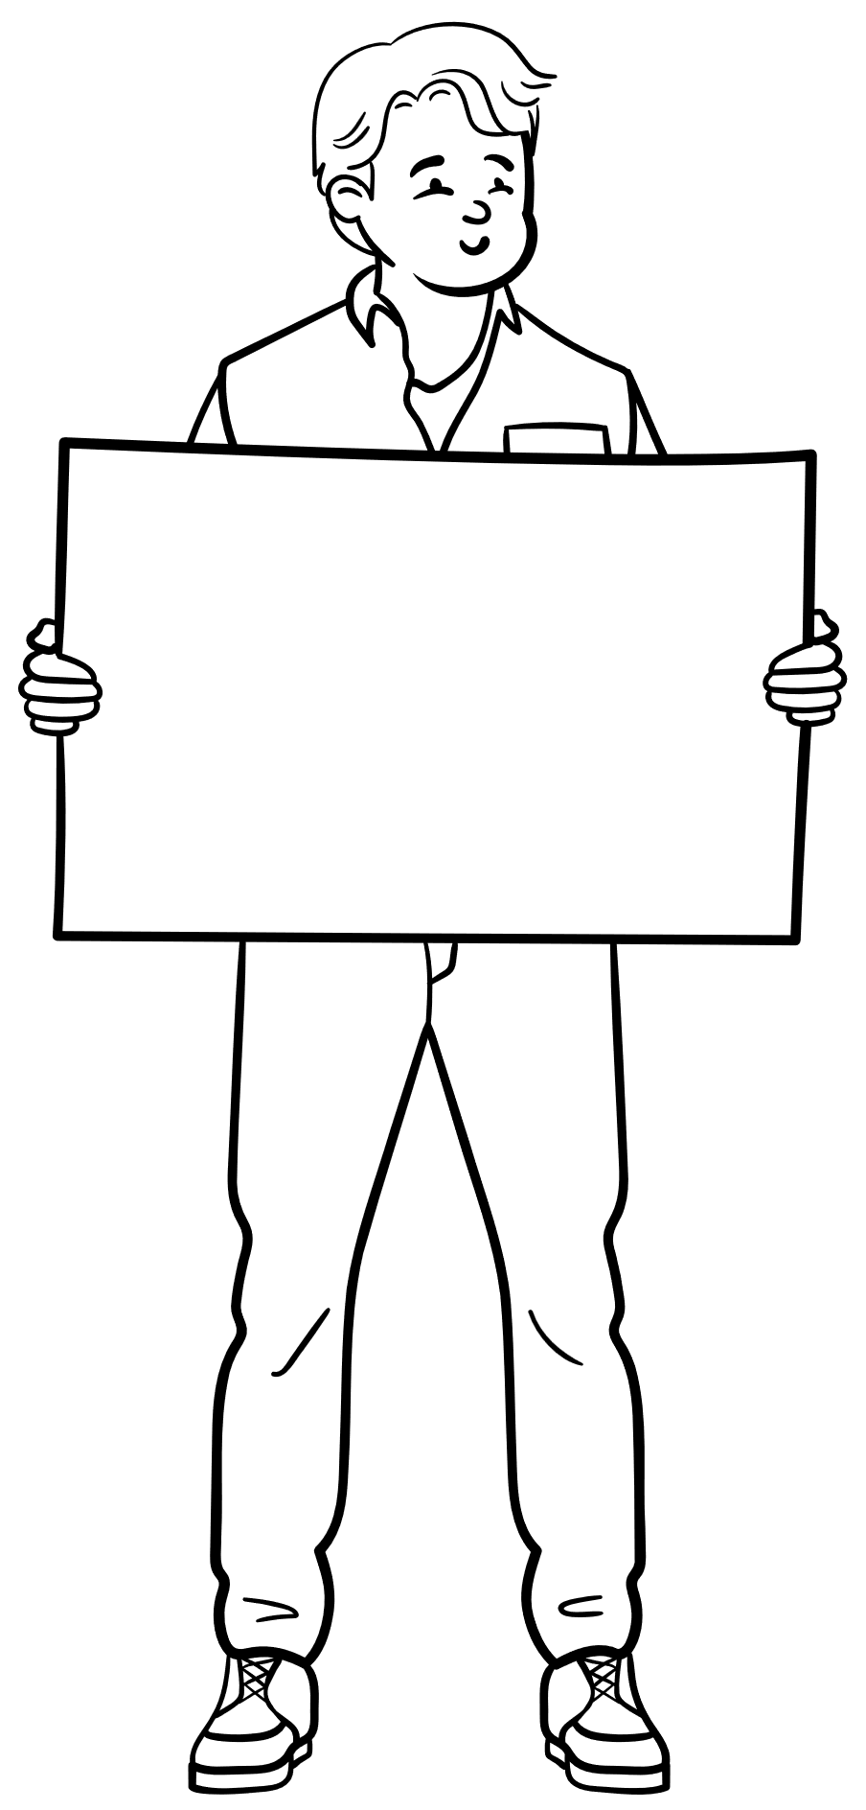
We can omit a relative pronoun in English when it is an object.
When we can omit a relative pronoun in a relative clause?

Slide 14
GRAMMAR
A relative clause tells us more about people and things. It usually starts with a relative pronoun.
Defining relative clauses give us essential information. Without this information, people are not clear which person(s) or thing(s) we are talking about.
Example:
– The teacher who taught me my first words in English is Mr Vinh.
– He gave me the dictionary which you suggested.

Slide 15
GRAMMAR
The relative pronoun who or which can be the subject or the object of the relative clause. We must use it when it is the subject of the relative clause. We can omit it if it is the object.
Example:
– The man who is talking to the girl is bilingual in English and French.
→must use who
– The man who you met this morning is bilingual in English and French.
→can omit who

Slide 16
3. Read each sentence and circle the relative pronoun which can be omitted.
1.These are the words which are the same in both British English and American English.
=> Can’t omit
2. English is the language which people use the most in the world.
=> Can omit “which”
=> English is the language which people use the most in the world.

Slide 17
3. Read each sentence and circle the relative pronoun which can be omitted.
3. The boy who is giving a presentation in English on the stage is my student.
=> Can’t omit
4. Spanish is the language which has the second largest number of native speakers
=> Can’t omit

Slide 18
3. Read each sentence and circle the relative pronoun which can be omitted.
5. The exchange student who we invited to join our club comes from the Philippines, so his English is so good.
=> Can omit “which”
=> The exchange student we invited to join our club comes from the Philippines, so his English is so good.

Slide 19
4. Combine the two sentences, using a relative pronoun. Start the new sentence with the given phrase.
1. The English-English dictionary is on the table. My dad gave it to me last year.
➔ The English-English dictionary _________________________
2. She used some words in her speech. These words are from French
➔ She used some ______________________________________
3. He has learnt English on a website. I recommended the website to him two years ago.
➔ He has learnt _______________________________________
4. Some languages have a lot of speakers. English is one of them.
➔ English is one of ____________________________________
5. My sister is learning English at a language centre. It has the best teachers in our town.
➔ My sister is learning _________________________________
Zalo 0793833272

Slide 20
4. Combine the two sentences, using a relative pronoun. Start the new sentence with the given phrase.
1. The English-English dictionary is on the table. My dad gave it to me last year.
➔ The English-English dictionary
(which) my dad gave to me last year is on the table.
2. She used some words in her speech. These words are from French.
➔ She used some
She used some
words which are from French in her speech.
He has learnt

Slide 21
4. Combine the two sentences, using a relative pronoun. Start the new sentence with the given phrase.
3. He has learnt English on a website. I recommended the website to him two years ago.
➔ He has learnt
English on a website (which) I recommended to him two years ago.
4. Some languages have a lot of speakers. English is one of them.
➔ English is one of
She used some
the languages (which) has a lot of speakers.
He has learnt

Slide 22
4. Combine the two sentences, using a relative pronoun. Start the new sentence with the given phrase.
5. My sister is learning English at a language centre. It has the best teachers
in our town.
➔ My sister is learning
English at a language centre which has the best teachers in our town
She used some
He has learnt

Slide 23



ENGLISH AROUND THE WORLD
PROJECT

Slide 24
1/ Self-assessment
 | Tick where appropriate | Comments (in English or Vietnamese)
DELIVERY
1. I greeted the audience.
2. I spoke clearly and naturally.
3.I cooperated with my group members when delivering the talk.
4. I interacted with the audience.
5. I used some photos/pictures to illustrate my points.
6. I concluded my part of the talk appropriately.
CONTENT: presentation includes the following information
1. the number of English speakers in the country
2. any other languages its people speak
3. the roles of English in the country

Slide 25

WRAP-UP
What have we learnt in this lesson?
Review the vocabulary and grammar of Unit 9
Apply what they have learnt (vocabulary and grammar) into practice through a project.

Slide 26

HOMEWORK
Do exercises in the workbook
Prepare for the next lesson

