Slide 1

Memory check
What are endangered species?
Animals or plants at risk of disappearing
Species that are always safe and protected
from harm.
Animals or plants that live in cities and towns.

Slide 2

Card choosing
There are 5 endangered
species under the card.
Divide class into 3-4 groups.
Each group choose 3-4
random cards.
If it is an endangered
species, they get one point.
The team with most point
win the game.

Slide 3
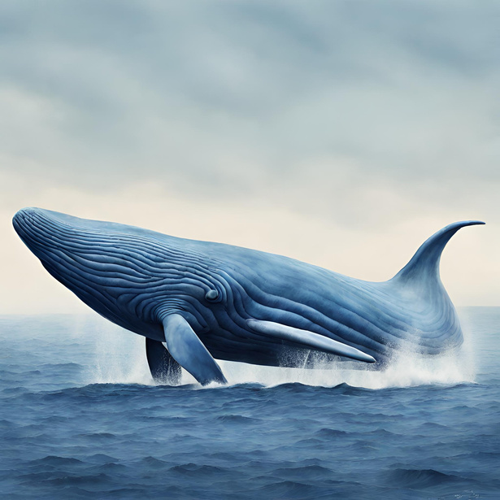
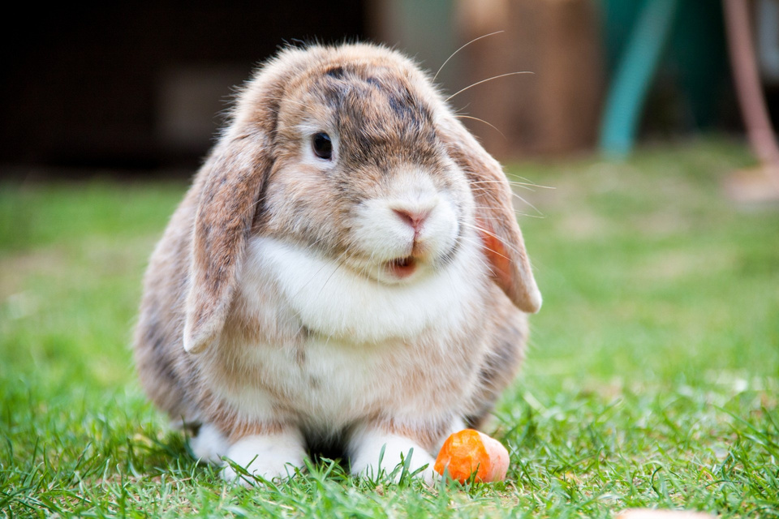
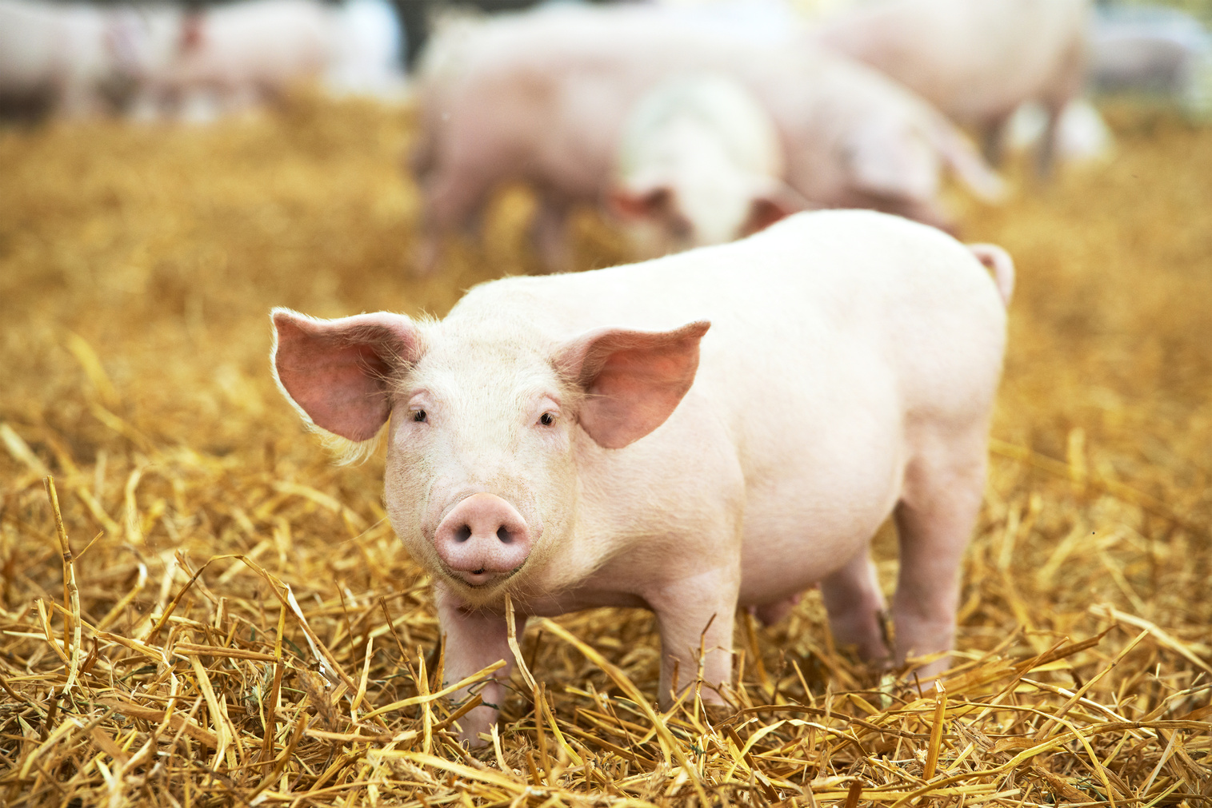
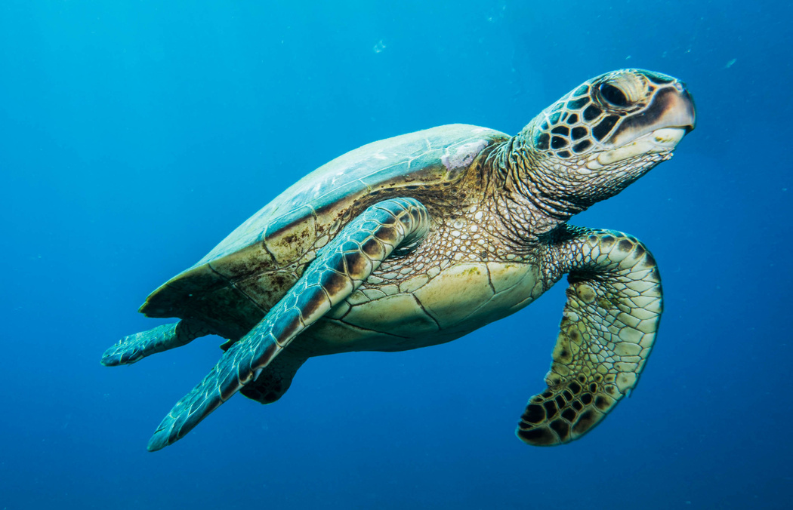
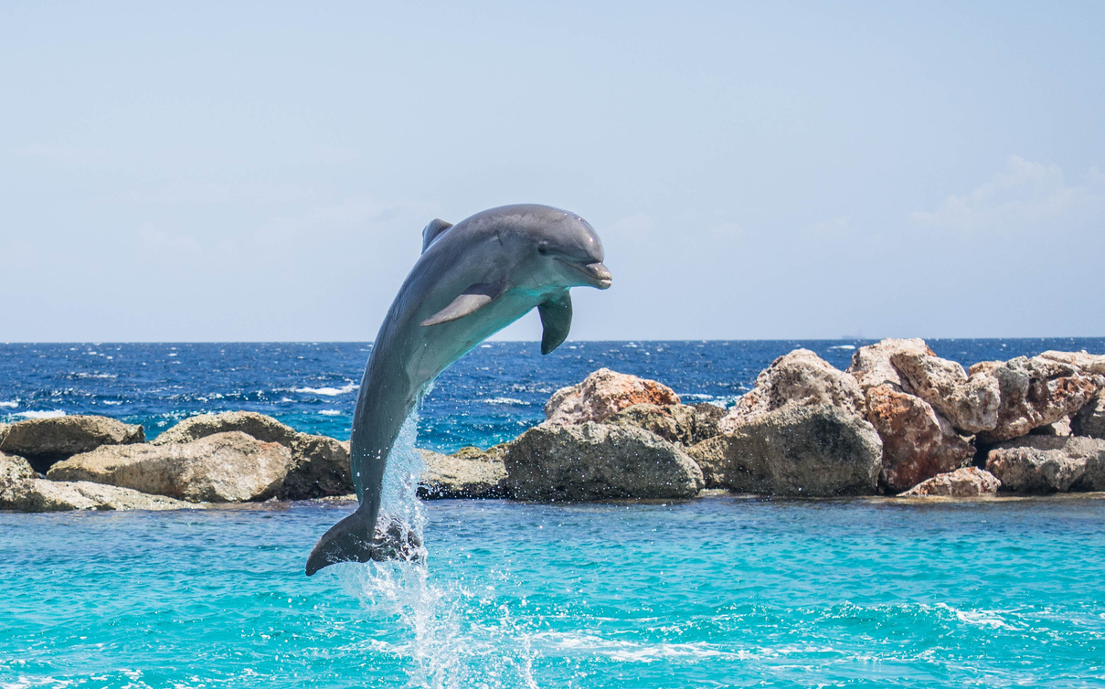
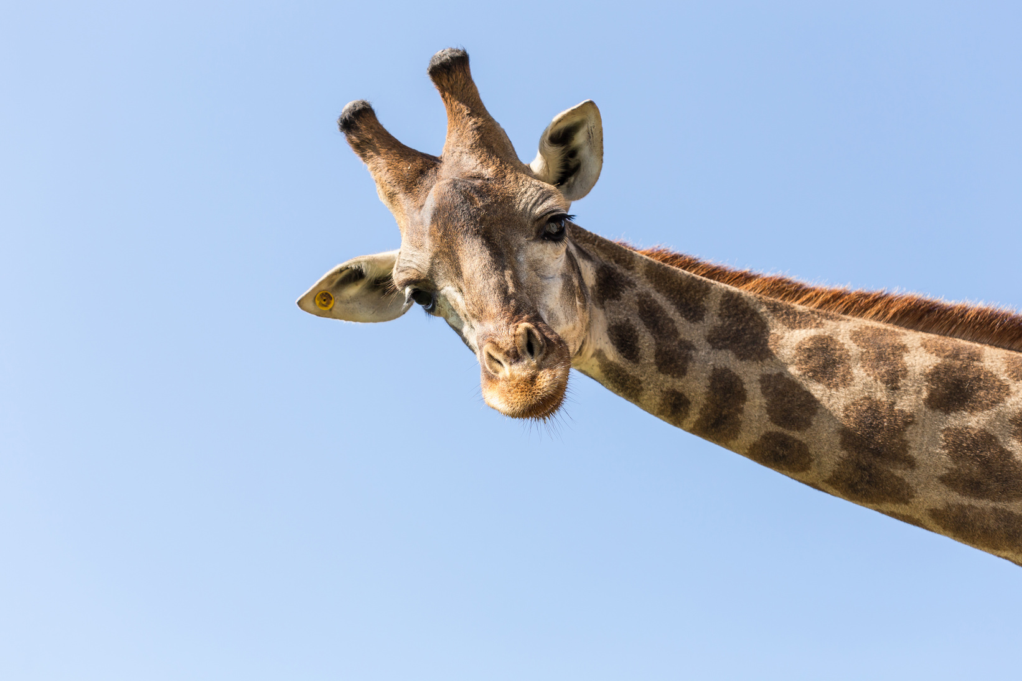
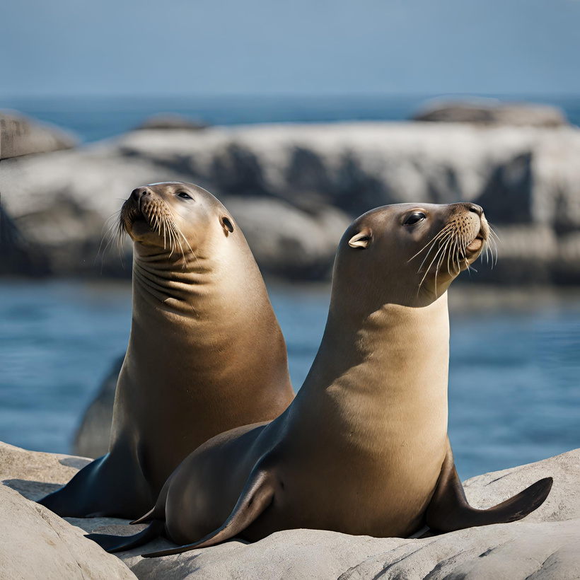
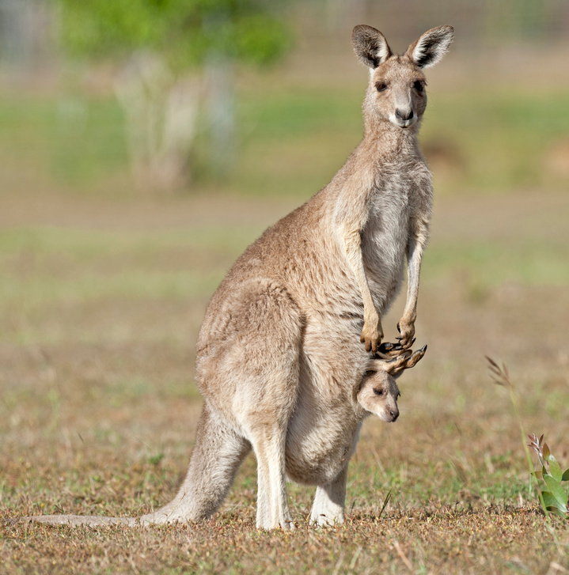
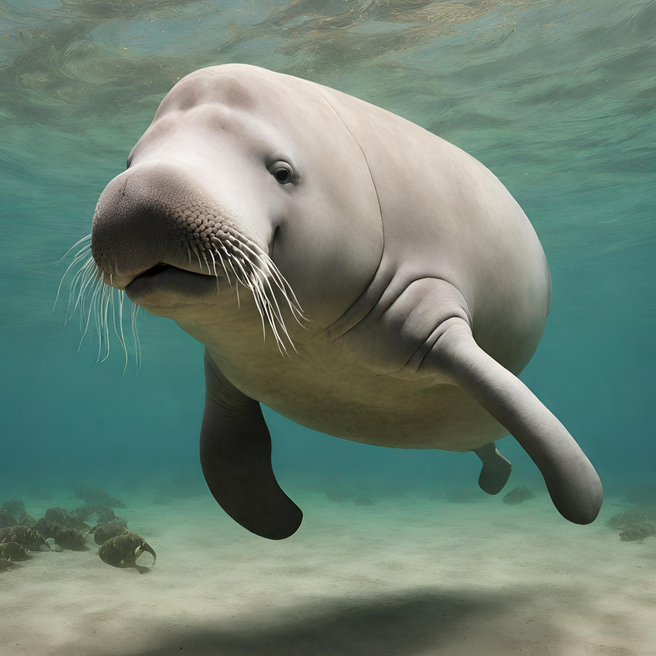
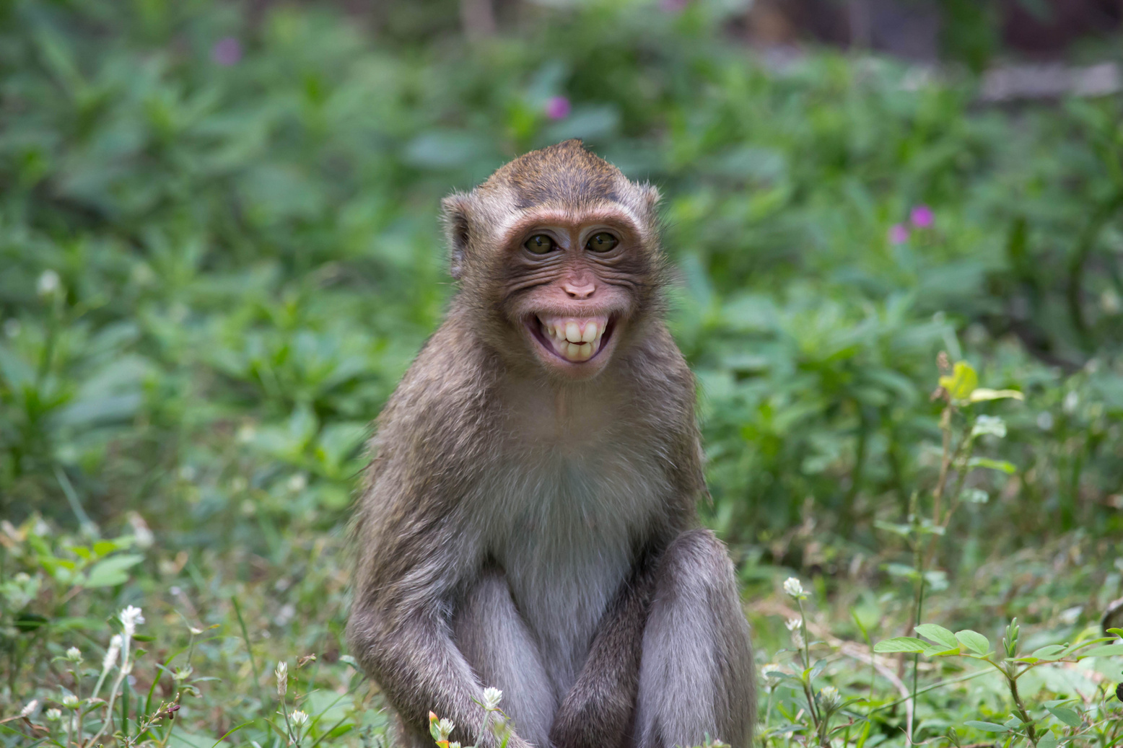
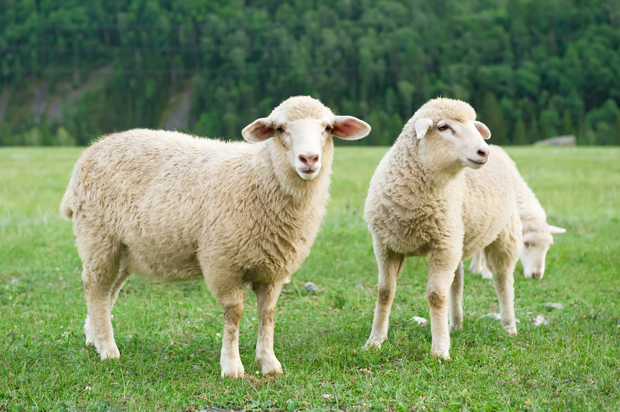
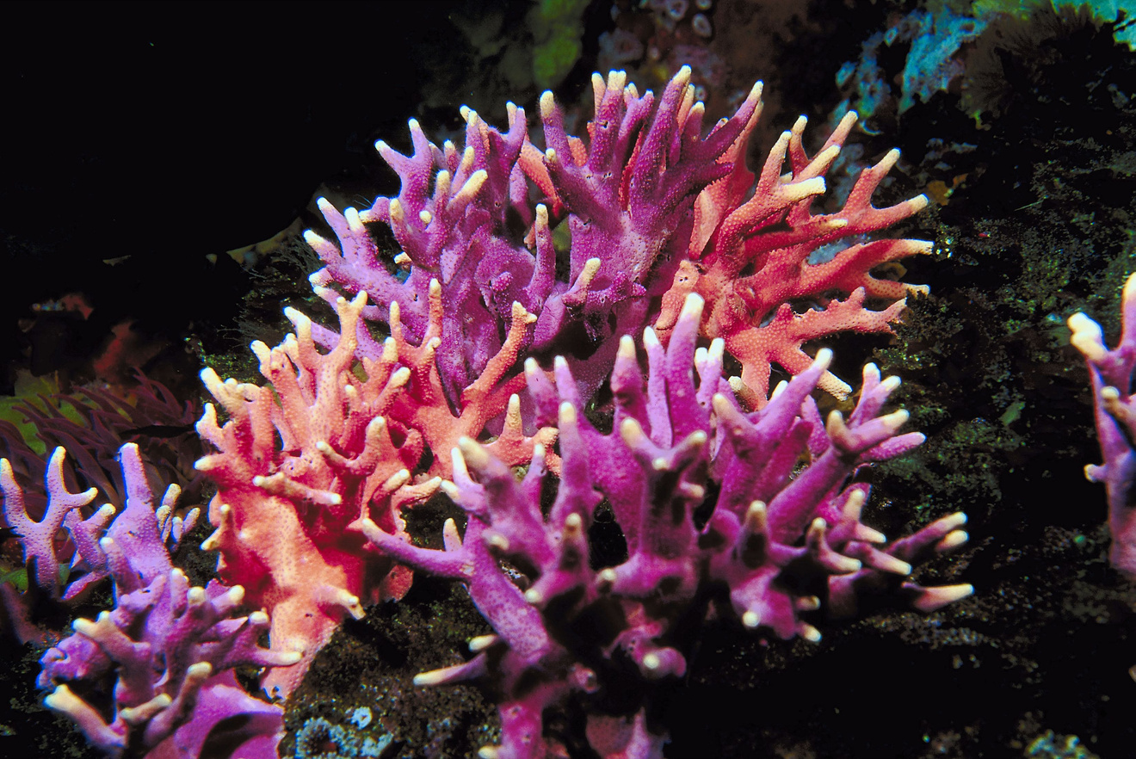
1
2
3
4
5
6
7
8
9
10
11
12

Slide 4
ENDANGERED SPECIES
BLUE WHALE
SEA LION
DUGONG
BLUE WHALE
SEA TURTLE
DOLPHIN

Slide 5
Where do we preserve them?
BLUE WHALE
SEA LION
DUGONG
BLUE WHALE
SEA TURTLE
DOLPHIN

Slide 6
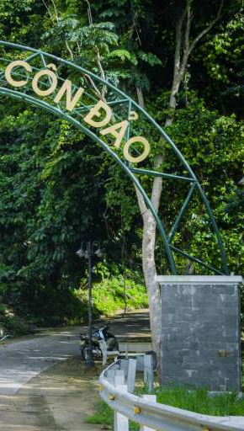
national parks
/ˈnæʃənəl pɑːks/
vườn quốc gia

Slide 7
Unit 7 Environmental protection
Lesson 5 | Skills 1 (page 77, 78)

Slide 8
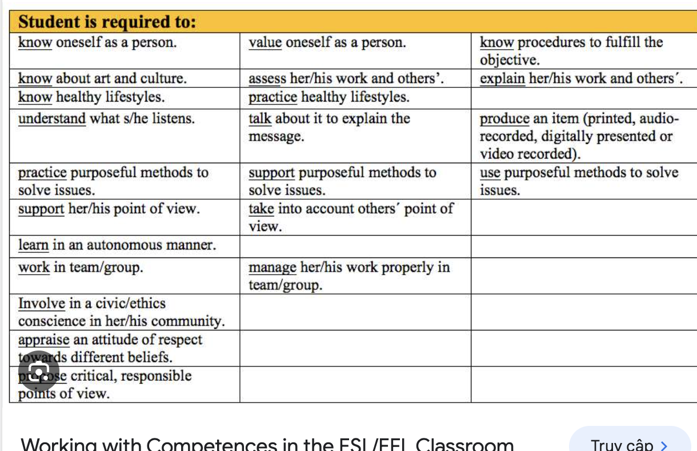
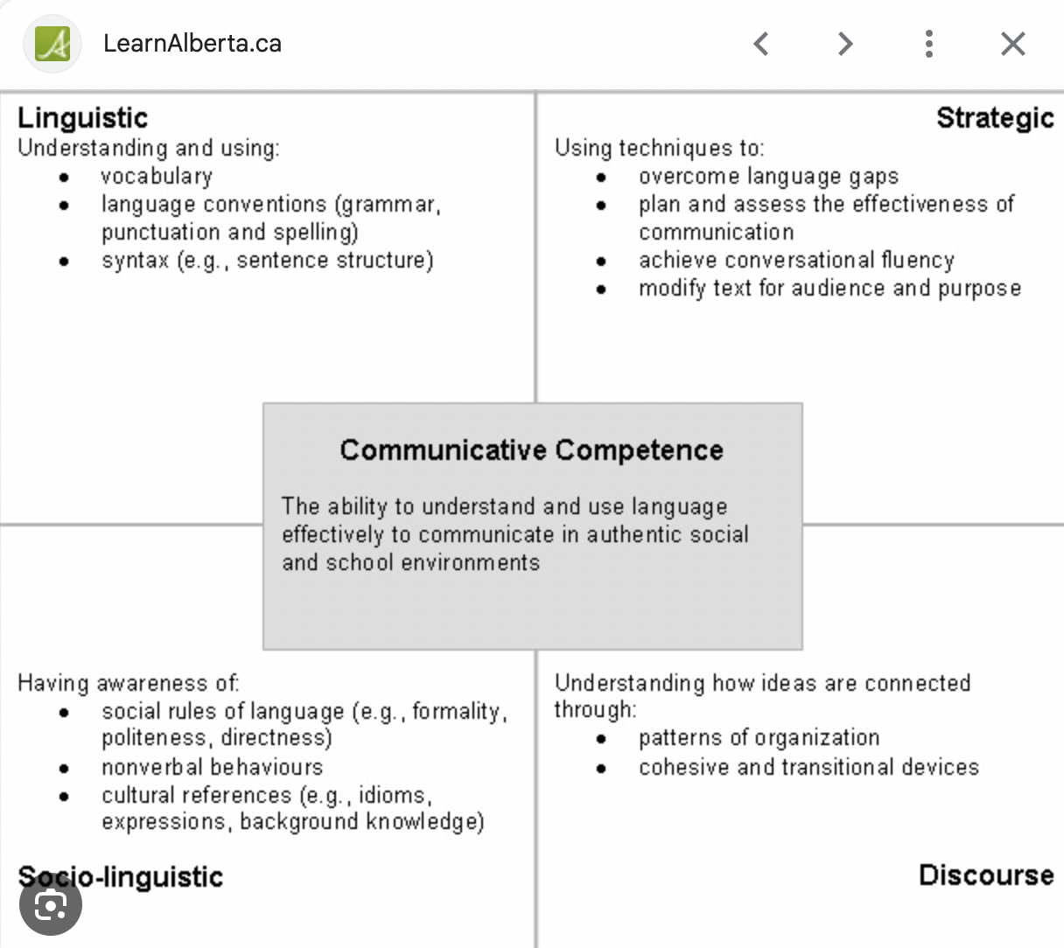
After this lesson, Ss will be able to:
Knowledge
Competence
+ Read for general and specific information about Con Dao national park.
+ Talk about Vu Quang national park in Vietnam
+ Understand about what is “national park”
+ Plan a presentation about topic “Environmental protection”
Personal qualities
+ Increase understanding about the importance of preserving nature
+ Respect for the efforts made in protection of endangered species

Slide 9
READING
about Con Dao national park

Slide 10


NEW WORD
contain (v)
/kənˈteɪn/
chứa đựng

Slide 11
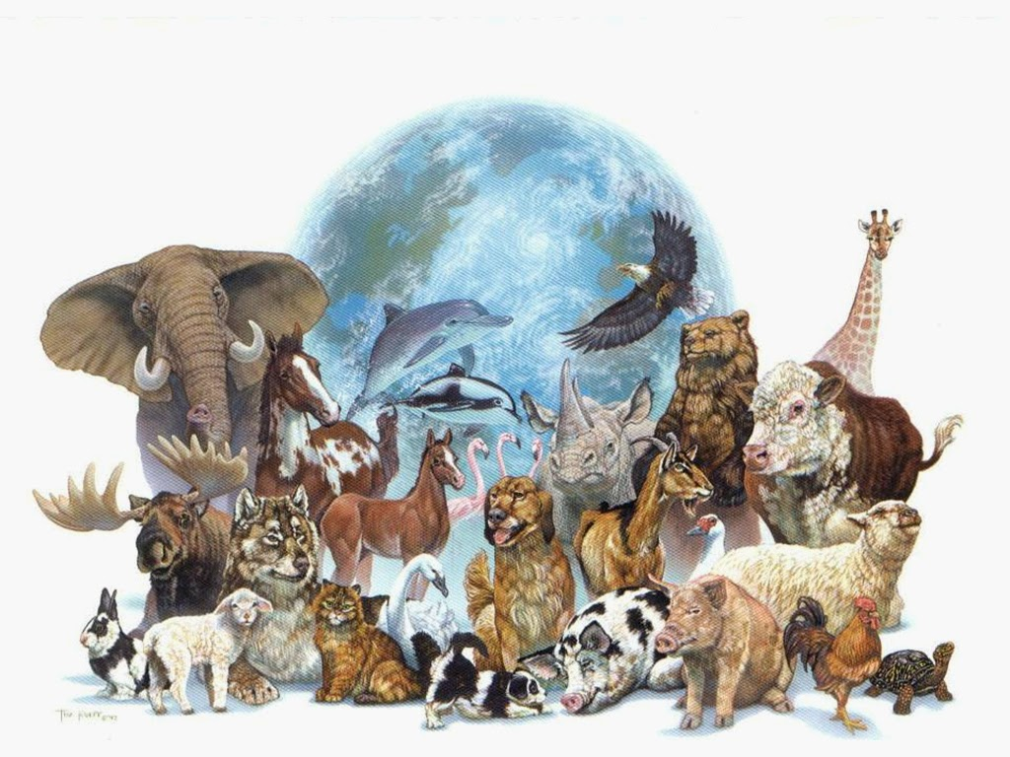
NEW WORD
diverse (adj)
/daɪˈvɜːs/
phong phú
đa dạng

Slide 12

NEW WORD
meditional
(adj)
/məˈdɪsənəl/
phong phú
đa dạng

Slide 13
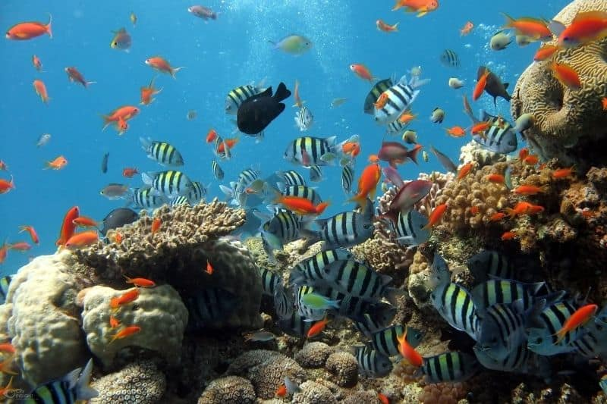
NEW WORD
marine
animals
/məˈriːnˈænəməlz/
sinh vật biển

Slide 14
Checking vocabulary
New words | Pronunciation | Meaning
1. contain (v) | /kənˈteɪn/ | chứa đựng
2. diverse (adj) | /daɪˈvɜːs/ | phong phú
3. medicinal (adj) | /məˈdɪsɪnl/ | (cây) thuốc
4. marine animals | /məˈriːnˈænəməlz/ | sinh vật biển

Slide 15
Exercise 2: Read the text and choose the words or phrases to make the following statements correct.
1. There are 34 national parks / nations’ parks in Viet Nam now.
2. The conservation / ecosystem in Con Dao is very diverse.
3. The dugong is a(n) dangerous / endangered animal.
4. National parks play a key role in saving the environment / small islands.

Slide 16
Exercise 2: Check your answers.
1. There are 34 national parks / nations’ parks in Viet Nam now.
2. The conservation / ecosystem in Con Dao is very diverse.
3. The dugong is a(n) dangerous / endangered animal.
4. National parks play a key role in saving the environment / small islands.
In Viet Nam, there are now 34 national parks. Con Dao National Park is one of them. It became a national park in 1993. The park is in Con Dao District, Ba Ria-Vung Tau Province. It contains 16 small islands covering 20,000 hectares. T

Slide 17
Exercise 2: Check your answers.
1. There are 34 national parks / nations’ parks in Viet Nam now.
2. The conservation / ecosystem in Con Dao is very diverse.
3. The dugong is a(n) dangerous / endangered animal.
4. National parks play a key role in saving the environment / small islands.
The ecosystem here is very diverse with thousands of species, including marine animals. Many species of corals as well as sea turtles, dolphins, and endangered dugongs live here as well.

Slide 18
Exercise 2: Check your answers.
1. There are 34 national parks / nations’ parks in Viet Nam now.
2. The conservation / ecosystem in Con Dao is very diverse.
3. The dugong is a(n) dangerous / endangered animal.
4. National parks play a key role in saving the environment / small islands.
The ecosystem here is very diverse with thousands of species, including marine animals. Many species of corals as well as sea turtles, dolphins, and endangered dugongs live here as well.

Slide 19
Exercise 2: Check your answers.
1. There are 34 national parks / nations’ parks in Viet Nam now.
2. The conservation / ecosystem in Con Dao is very diverse.
3. The dugong is a(n) dangerous / endangered animal.
4. National parks play a key role in saving the environment / small islands.
Con Dao National Park, like other national parks, plays a key role in saving endangered species as well as protecting the environment and natural resources.

Slide 20
ARE YOU READY FOR A GAME?

Slide 21


Title Slide
IN CON DAO NATIONAL PARK
Notes:
This template is for educational, non-commercial purposes only. For more free game templates like this one, visit https://www.taysteachingtoolkit.com
-----
The goal of this game is for teams to try to collect all 6 Infinity Stones. If a team collects all the stones before the game is over, I have 4 ideas for how the game proceeds:
That team wins and the game is over.
That team is out for the rest of the game, so they don’t have to answer anymore questions and the game continues with the other teams.
That team is out for the time being, so they don’t have to answer anymore questions, but other teams can still steal and exchange stones with them. In which case, they are back in the game if they lose any stones.
The team continues to play and answer questions with the possibility that they can still lose stones. In which case, I think the team(s) that has/have collected all the stones/the most stones by the end of the game is/are the winner(s).
Feel free to use any of these ideas or come up with your own ☺

Slide 22








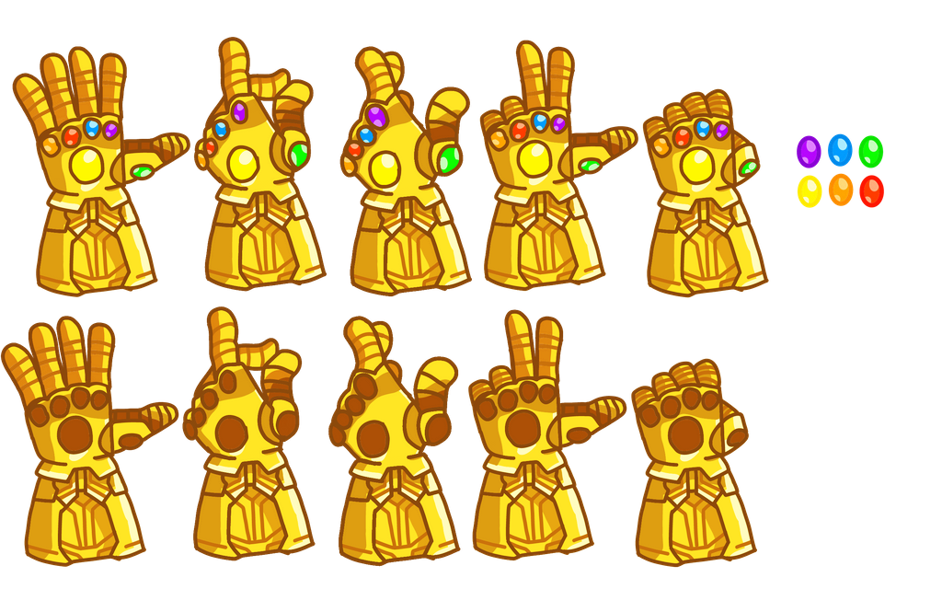




Score Slide
COLLECT AS MANY STONES AS POSSIBLE!
Team 1
Team 2
Team 3
Team 4
Notes:
Click the empty spaces on the gauntlets to fill in the Infinity Stones as they’re collected by the teams
You can also click on them again to remove them (for example if a team loses a stone or exchanges one with another team)
The stones at the top of slide represent the order the stones are in on the glove to help you know which space on the gauntlet to click (In order on the glove from left to right, smallest to biggest: Orange, Red, Blue, Purple, Green, Yellow)
IMPORTANT: ONCE FINISHED, CLICK THE AVENGERS LOGO IN THE TOP, RIGHT-HAND CORNER TO GO TO THE QUESTION-CHOOSING SLIDE. IF YOU PRESS THE SPACEBAR OR AN ARROW KEY, SCORES AND QUESTIONS WILL RESET.
-------
Background: By vectorpouch on Freepik https://www.freepik.com/vectorpouch
Marvel Team Icons: By XaR623 on DevianArt https://www.deviantart.com/xar623

Slide 23







Question-Choosing Slide
CHOOSE A LETTER OR A NUMBER
Notes:
A team chooses a letter or number
Click the letter or number they choose to go to a question
IMPORTANT: IF YOU NEED TO GO BACK TO THE SCORING PAGE, CLICK THE INFINTY GAUNTLET IN THE TOP, RIGHT-HAND CORNER. IF YOU PRESS THE SPACEBAR OR AN ARROW KEY, SCORES AND QUESTIONS WILL RESET.
-------
Background: By vectorpouch on Freepik https://www.freepik.com/vectorpouch

Slide 24
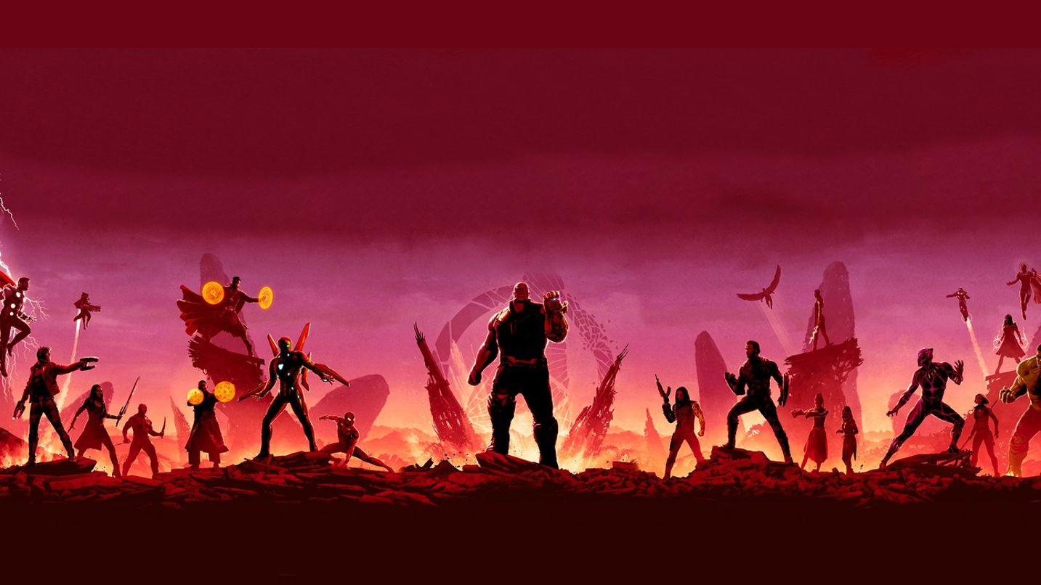


Question 1
what is the best title for the passage?
National Parks in Viet Nam
Con Dao National Park
The Protection of Wildlife
B. Con Dao National Park
Notes:
Click the spacebar to make the ANSWER appear.
The blank space in the middle is for any extra text/images you need.
Click the green icon to go to the reward slide.
Click the red icon to go back to the question-choosing slide.

Slide 25
Question 2
national parks are areas for ______.
A. the protection of the environment
B. the management of marine life
C. the sale of animal products
A. the protection of the environment
Notes:
Click the spacebar to make the ANSWER appear.
The blank space in the middle is for any extra text/images you need.
Click the green icon to go to the reward slide.
Click the red icon to go back to the question-choosing slide.

Slide 26
Question 3
what is the area of Con Dao National Park?
A. 34 hectares
B. 16 hectares
C. 20,000 hectares
C. 20,000 hectares
Notes:
Click the spacebar to make the ANSWER appear.
The blank space in the middle is for any extra text/images you need.
Click the green icon to go to the reward slide.
Click the red icon to go back to the question-choosing slide.

Slide 27
Question 4
Con Dao National Park has many kinds of ___
A. valuable plants
B. ancient trees
C. natural values
A. valuable plants
Notes:
Click the spacebar to make the ANSWER appear.
The blank space in the middle is for any extra text/images you need.
Click the green icon to go to the reward slide.
Click the red icon to go back to the question-choosing slide.

Slide 28
Question 5
Which of the following is NOT true, according to the passage?
A. There are more and more national parks in the world.
B. Con Dao National Park is rich in animal species.
C. Con Dao National Park’s mission is to help other national parks.
The correct answer is C
Notes:
Click the spacebar to make the ANSWER appear.
The blank space in the middle is for any extra text/images you need.
Click the green icon to go to the reward slide.
Click the red icon to go back to the question-choosing slide.

Slide 29
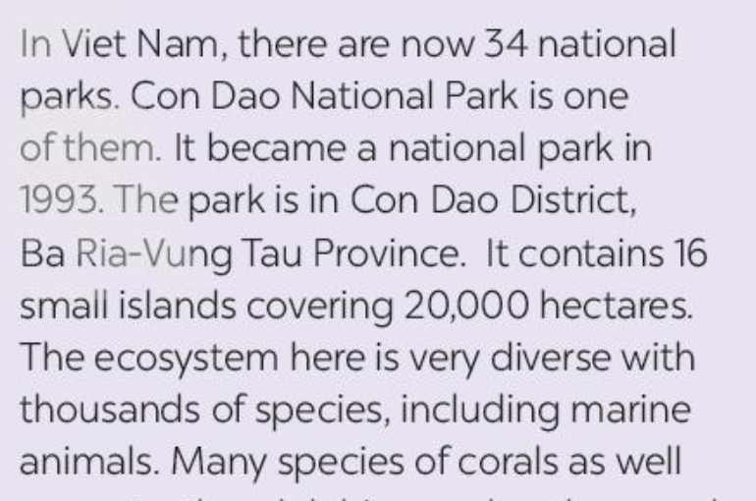
Question 6
Where is Con Dao national park?
A. Quang Ngai province
B. Ba Ria– Vung Tau province
C. Dong Nai province
B. Ba Ria – Vung Tau province
Notes:
Click the spacebar to make the ANSWER appear.
The blank space in the middle is for any extra text/images you need.
Click the green icon to go to the reward slide.
Click the red icon to go back to the question-choosing slide.

Slide 30
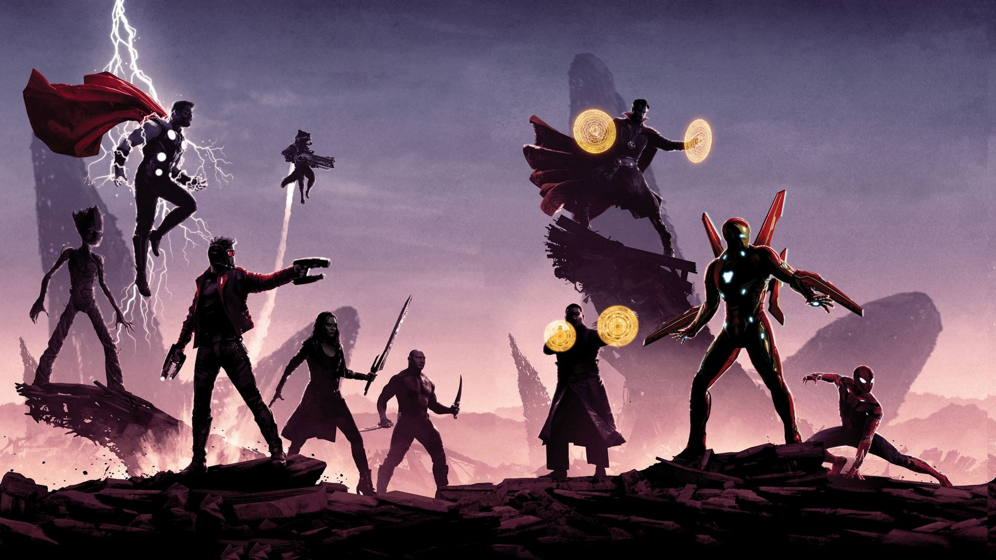


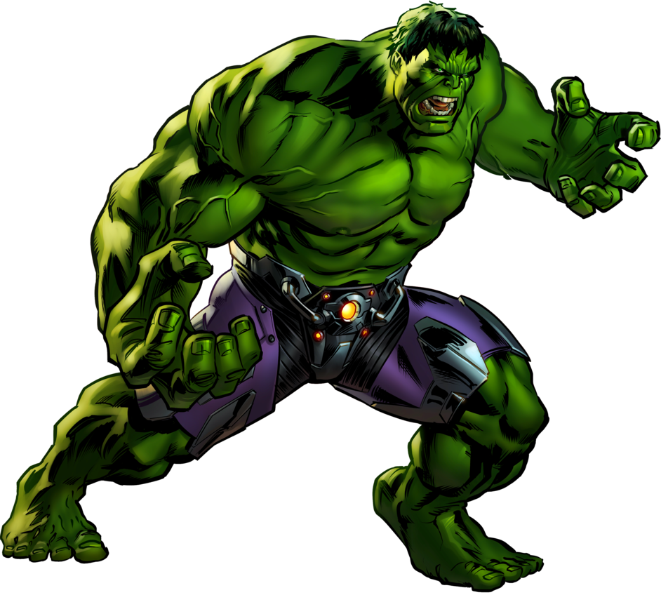
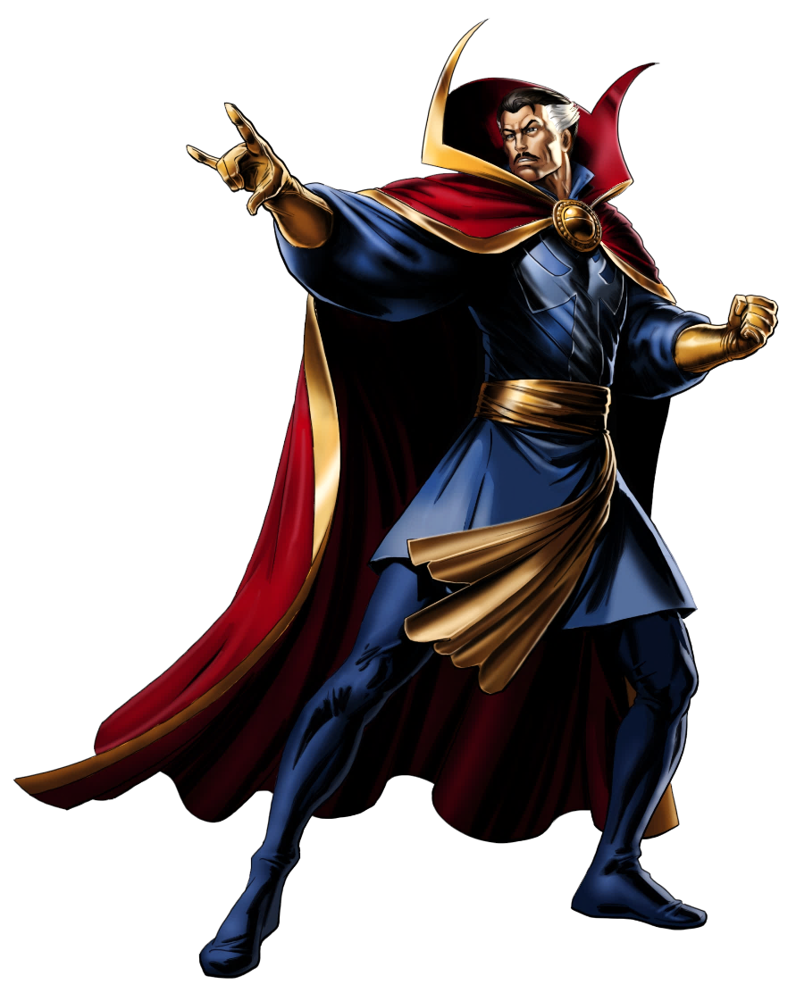



Reward 1 - Choose
Fight with Thanos!
If you win, you can choose 2 stones of ANY color. If you lose, you lose 1 of your stones.
or
Notes:
A team chooses “A” or “B”
Click the letter they choose to reveal if they won or lost the fight

Slide 31


Reward 1 - A
Fight with Thanos!
If you win, you can choose 2 stones of ANY color. If you lose, you lose 1 of your stones.
Notes:
A team can choose 1 Infinity Stone of any color to add to their gauntlet
Click the Infinity Gauntlet icon to go to the scoring slide.

Slide 32

Reward 1 - B
Fight with Thanos!
If you win, you can choose 2 stones of ANY color. If you lose, you lose 1 of your stones.
Notes:
A team loses 1 of their Infinity Stones from their gauntlet
Click the Infinity Gauntlet icon to go to the scoring slide.

Slide 33





Reward 2
Steal stones from another team
Choose a team and do 1 round of Rock-Paper-Scisssors.
If you win, you steal 2 stones If you lose, they steal 2 stones.
Notes:
A team (attackers) chooses another team (defenders) they want to try to steal from
They will do 3 rounds of rock, paper, scissors
If the attacking team wins all 3 rounds, they get to steal 2 stones from the defending team.
If the attacking team wins 2 rounds, they get to steal 1 stone from the defending team.
If the attacking team wins 1 or no rounds, they don’t get to steal any stones from the defending team.
Click the Infinity Gauntlet icon to go to the scoring slide.
-------
Background: By upklyak on Freepik https://www.freepik.com/upklyak

Slide 34


Reward 3
Open 3 Tesseracts
1
2
3
4
5
6
Notes:
A team chooses 2 tesseracts by saying their numbers
Click on the tesseracts to “open” them and reveal what two Infinity Stones the team receives
Click the Infinity Gauntlet icon to go to the scoring slide.
-------
Background: By Freepik https://www.freepik.com/free-photos-vectors/background

Slide 35
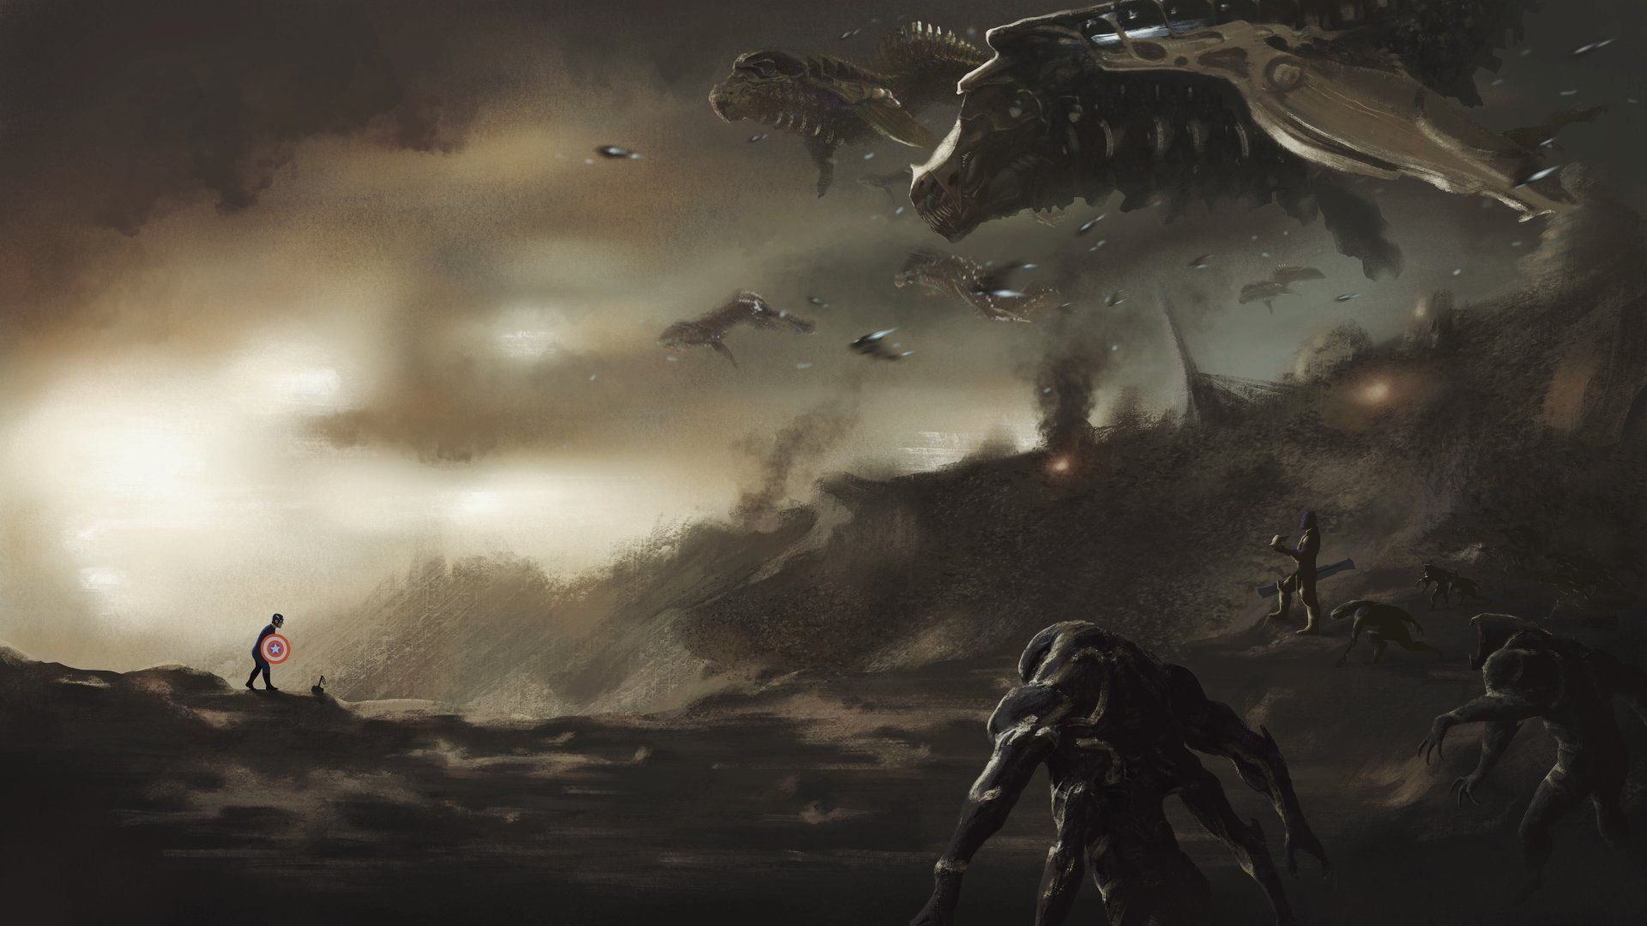
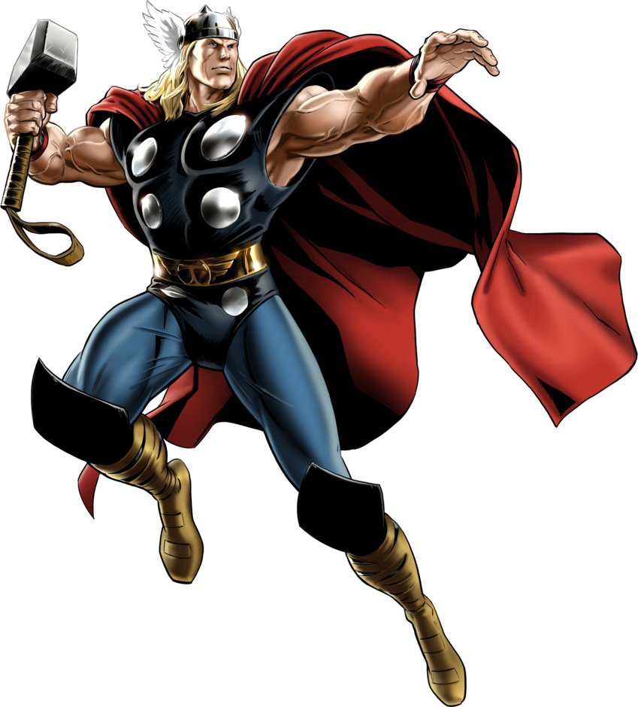

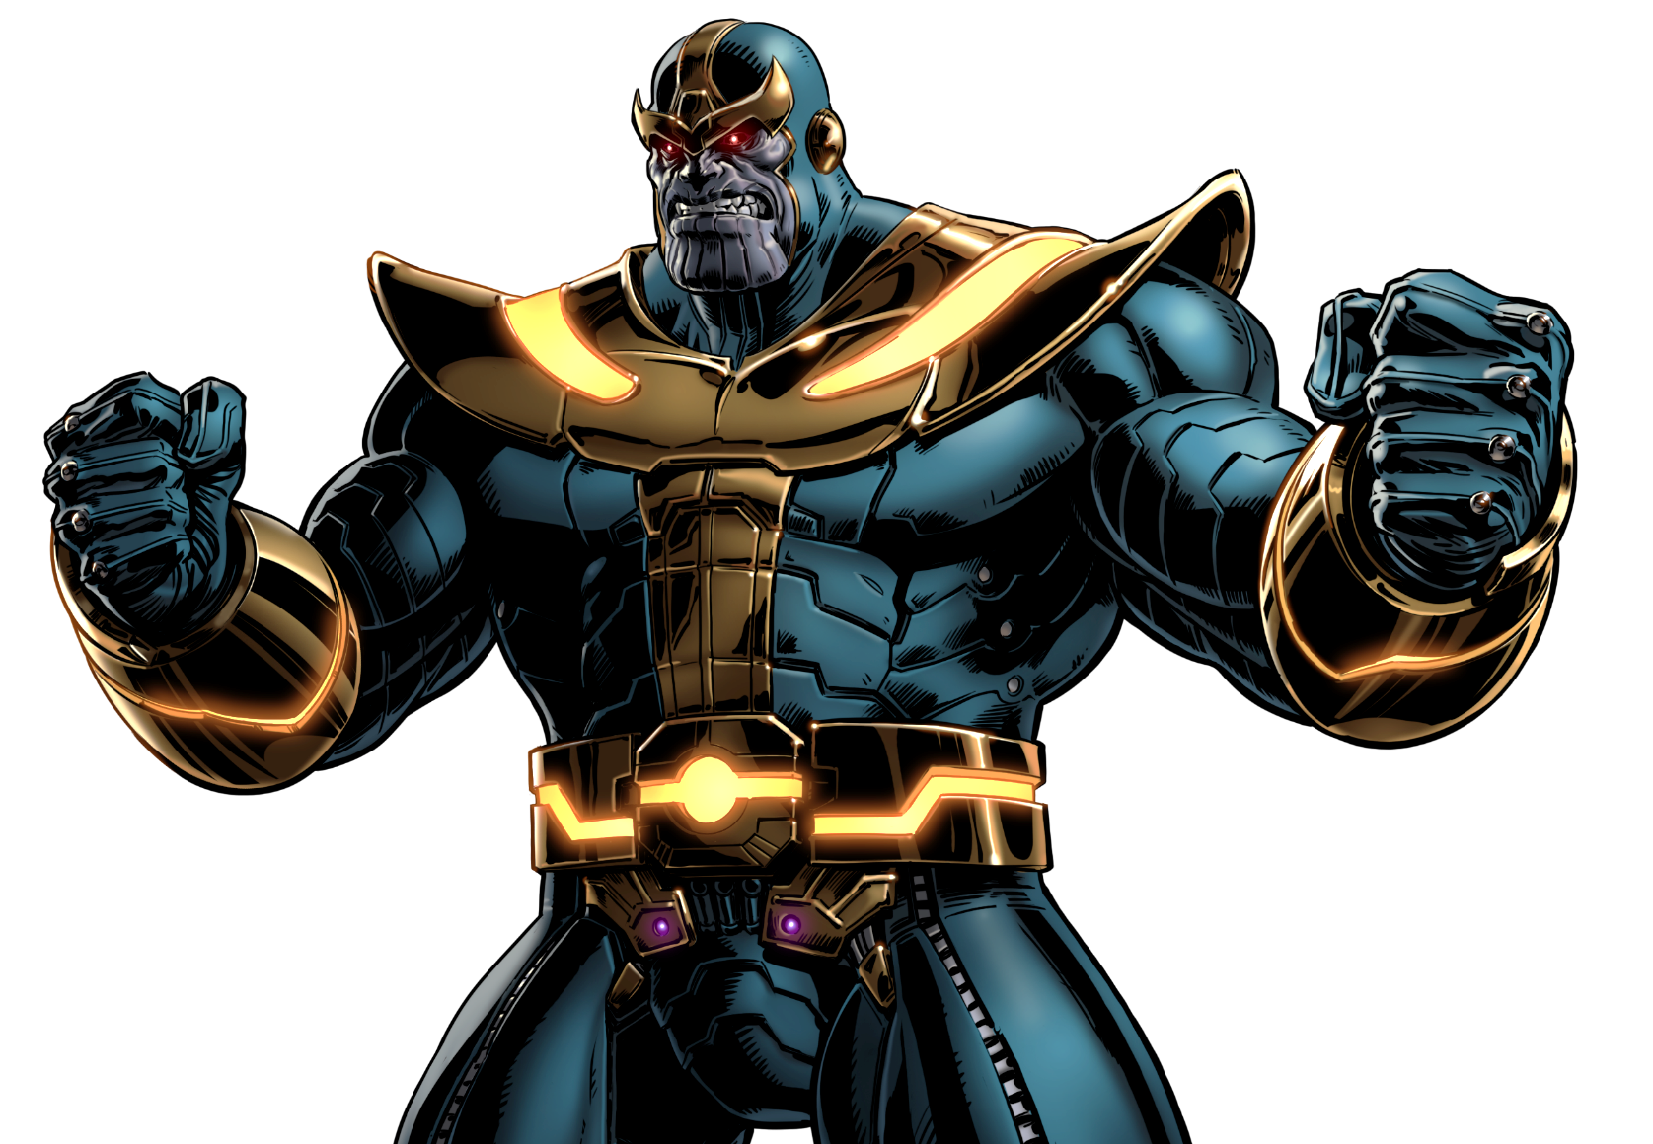



Reward 4 - Choose
Fight with Thanos!
If you win, you can choose 2 stones of ANY color. If you lose, you lose 1 of your stones.
or
Notes:
A team chooses “A” or “B”
Click the letter they choose to reveal if they won or lost the fight

Slide 36
Reward 4 - A
Fight with Thanos!
If you win, you can choose 2 stones of ANY color. If you lose, you lose 1 of your stones.
Notes:
A team loses 1 of their Infinity Stones from their gauntlet
Click the Infinity Gauntlet icon to go to the scoring slide.

Slide 37
Reward 4 - B
Fight with Thanos!
If you win, you can choose 2 stones of ANY color. If you lose, you lose 1 of your stones.
Notes:
A team can choose 1 Infinity Stone of any color to add to their gauntlet
Click the Infinity Gauntlet icon to go to the scoring slide.

Slide 38
Reward 5
Open 3 Tesseracts
1
2
3
4
5
6
Notes:
A team chooses 2 tesseracts by saying their numbers
Click on the tesseracts to “open” them and reveal what two Infinity Stones the team receives
Click the Infinity Gauntlet icon to go to the scoring slide.
-------
Background: By Freepik https://www.freepik.com/free-photos-vectors/background

Slide 39
Reward 6
Open 3 Tesseracts
1
2
3
4
5
6
Notes:
A team chooses 2 tesseracts by saying their numbers
Click on the tesseracts to “open” them and reveal what two Infinity Stones the team receives
Click the Infinity Gauntlet icon to go to the scoring slide.
-------
Background: By Freepik https://www.freepik.com/free-photos-vectors/background

Slide 40
CHECK YOUR ANSWER
In Viet Nam, there are now 34 national parks. Con Dao National Park is one of them. It became a national park in 1993. The park is in Con Dao District, Ba Ria-Vung Tau Province.
1. What is the best title for the passage?
A. National Parks in Viet Nam
B. Con Dao National Park
C. The Protection of Wildlife
2. National parks are areas for ______.
A. the protection of the environment
B. the management of marine life
C. the sale of animal products
Today, there are national parks all over the world, and the number is rising all the time. A national park is a special area for the protection of the environment and wildlife.

Slide 41
CHECK YOUR ANSWER
3. What is the area of Con Dao National Park?
A. 34 hectares
B. 16 hectares
C. 20,000 hectares
4. Con Dao National Park has many kinds of
A. valuable plants
B. ancient trees
C. natural values
The park is in Con Dao District, Ba Ria-Vung Tau Province. It contains 16 small islands covering 20,000 hectares.
The park is also home to a lot of valuable kinds of woods and medicinal plants. Three ancient trees in the park were named "Vietnamese Heritage Trees".

Slide 42
CHECK YOUR ANSWER
5. Which of the following is NOT true, according to the passage?
A. There are more and more national parks in the world.
B. Con Dao National Park is rich in animal species.
C. Con Dao National Park’s mission is to help other national parks.
Con Dao National Park, like other national parks, plays a key role in saving endangered species as well as protecting the environment and natural resources. It also helps raise the awareness of local residents about the importance of nature.

Slide 43
SPEAKING
about Vu Quang national park

Slide 44
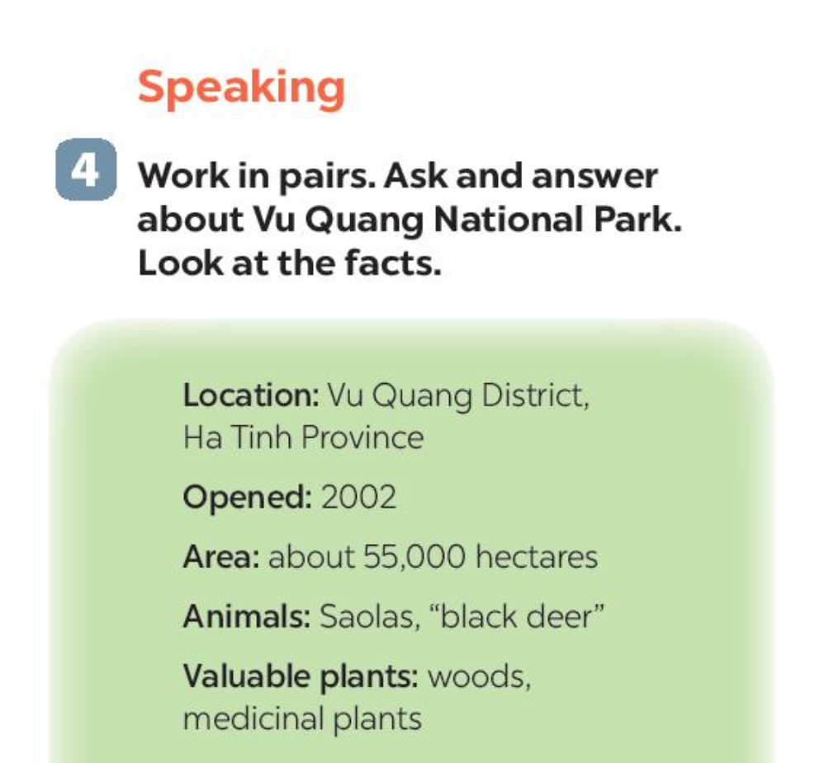
RUNNING DICTATION
Location
Opened
Area
Animals
Valuable plants
Vu Quang district,
Ha Tinh Province
Student A: Ask and write in the table
2002
Student B: Run to find the answer, read for student A
about 55,000 hectares
St A: Where is Vu Quang National Park?
Saolas, “black deer”
St B: It’s in Vu Quang District, Ha Tinh Province
woods,
medicinal plants

Slide 45
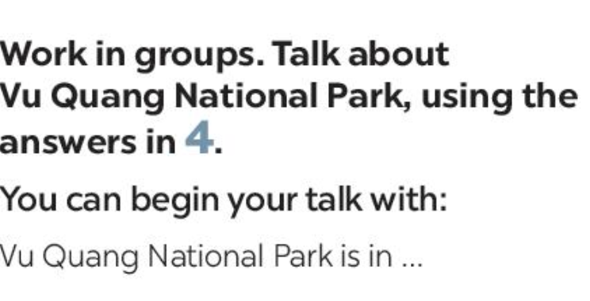
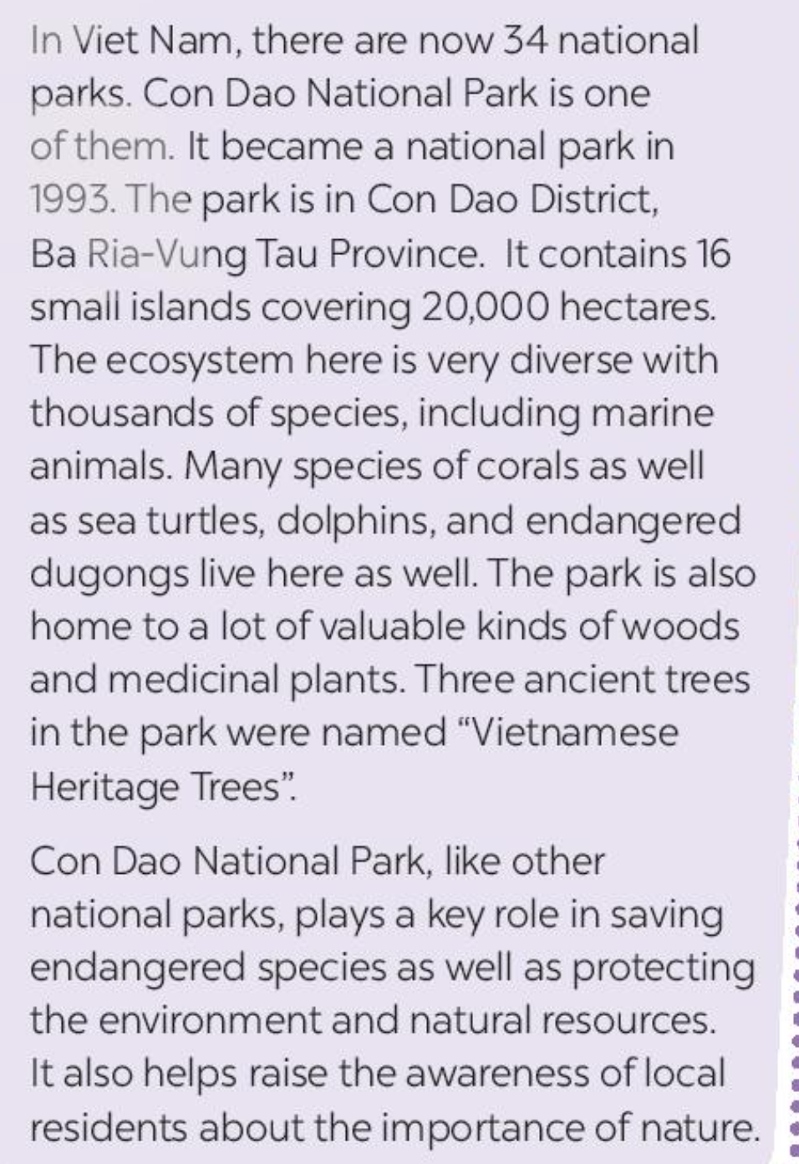
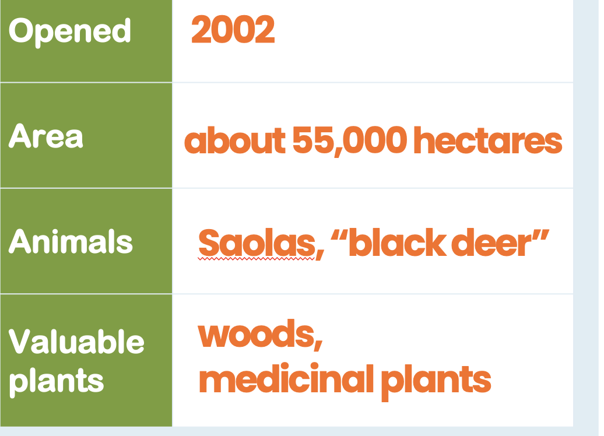
Exercise 4: Work in groups.
Talk about Vu Quang National Park, using answer in 4.
You can begin your talk with:
Introduction: Hi everyone, my name is … I will present about ....
Body: Vu Quang National Park is in …
It’s is about ….. hectares, including …
The ecosystem is very diverse with …..
The park is also home to a lot of …. such as …
(adding more details, etc)
Conclusion: Thanks for listening

Slide 46
Show time!
Assess your speaking
Did he/she introduce about his/her name?
Did he/she answer all the questions?
Did he/she have any grammatical errors?
Did he/she speak without any hesitation?

Slide 47
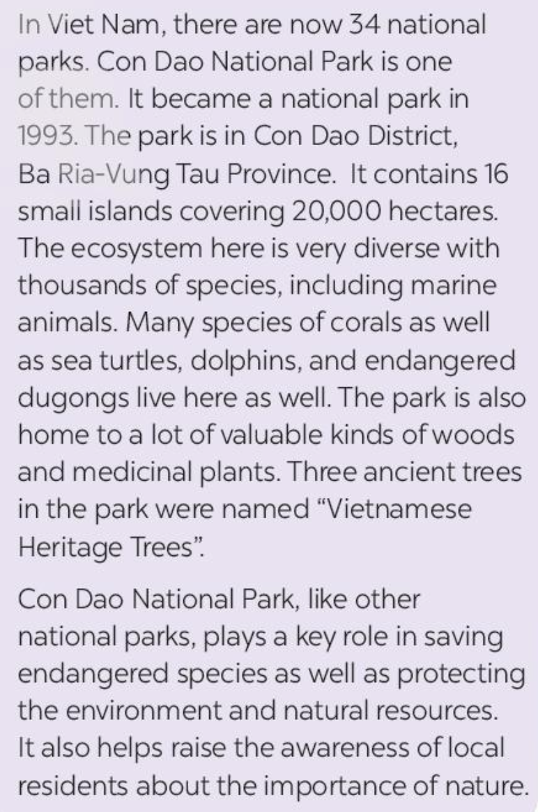
WRAP UP
Matching the numbers with the correct information about Con Dao National Park
3
ancient trees in the park
national parks
in Vietnam
16
small islands
ancient trees
in the park
34
national park in Vietnam
hectares
1993
it became national park in
small islands
hectares
It became
national park in
20,000

Slide 48
Thanks
Do you have any questions?
addyouremail@freepik.com
+91 620 421 838
yourwebsite.com
Please keep this slide for attribution

