Slide 1
Unit 7.
Environmental Protection
Lesson 6. Skills 2

Slide 2
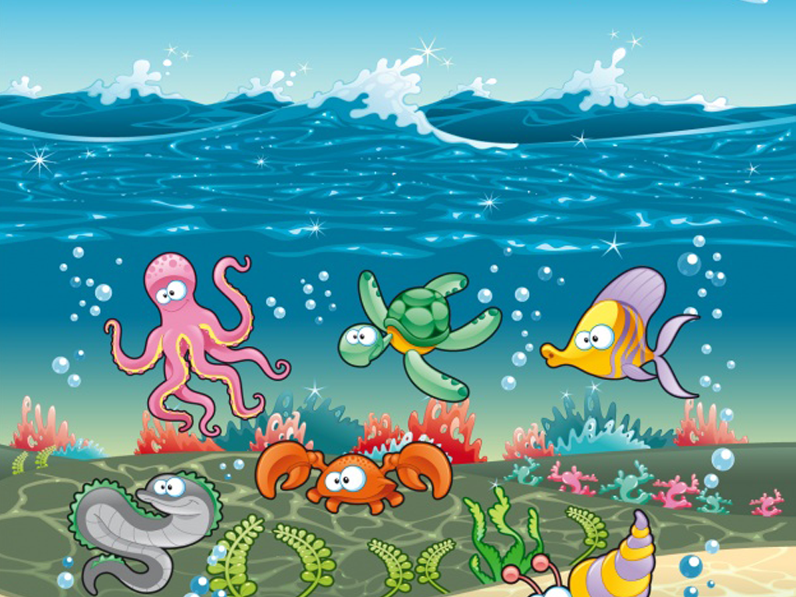
Save the ocean

Slide 3

The evil, sinister wizard has kidnapped all the sea creatures

Slide 4
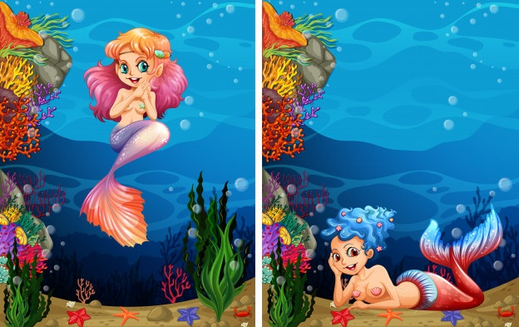
Please help the mermaids rescue sea creatures!

Slide 5
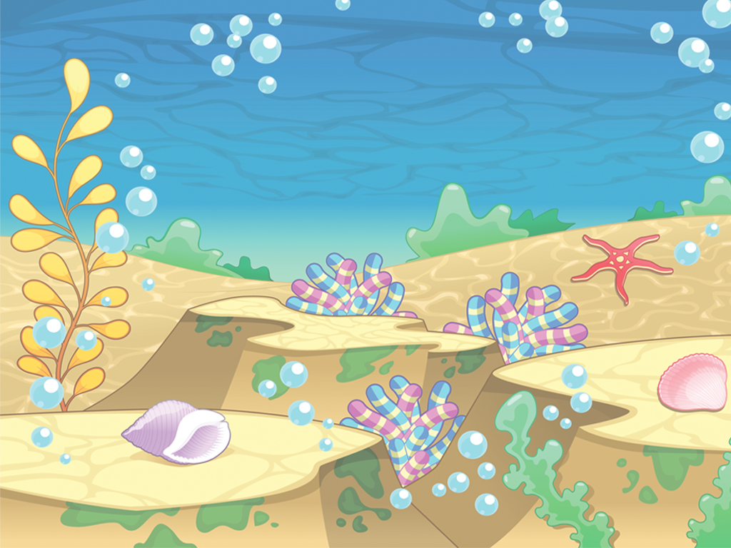


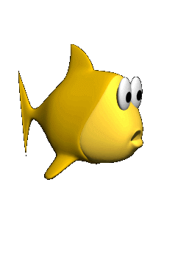

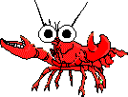

HOME

Slide 6
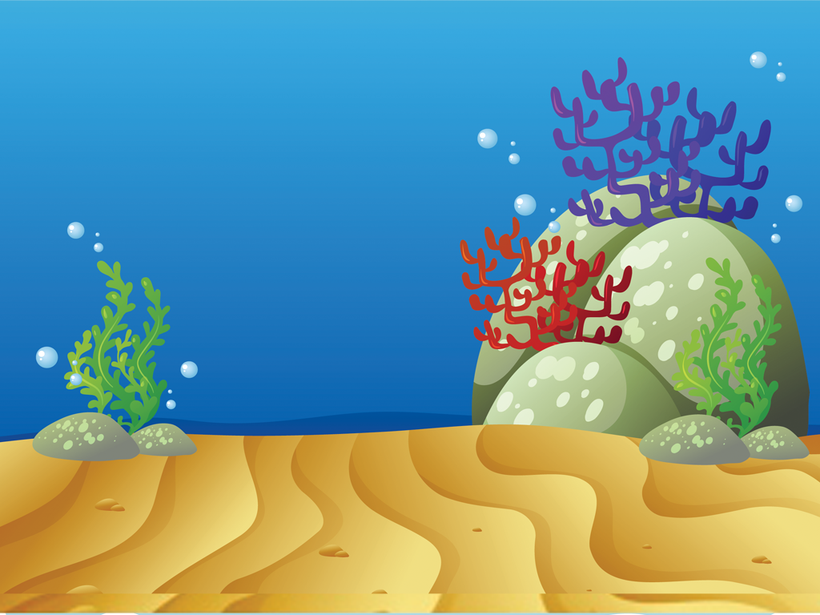
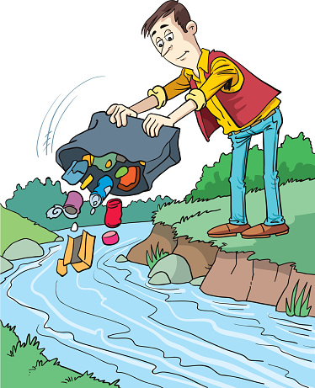

THROWING RUBBISH

Slide 7

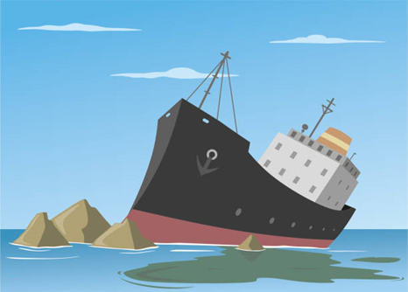
SPILLING FUEL

Slide 8

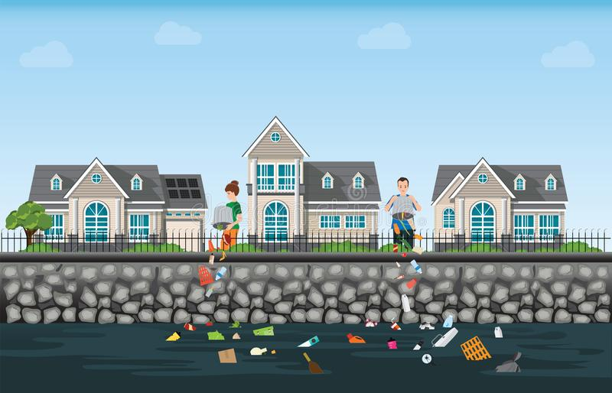
DOMESTIC WASTE

Slide 9

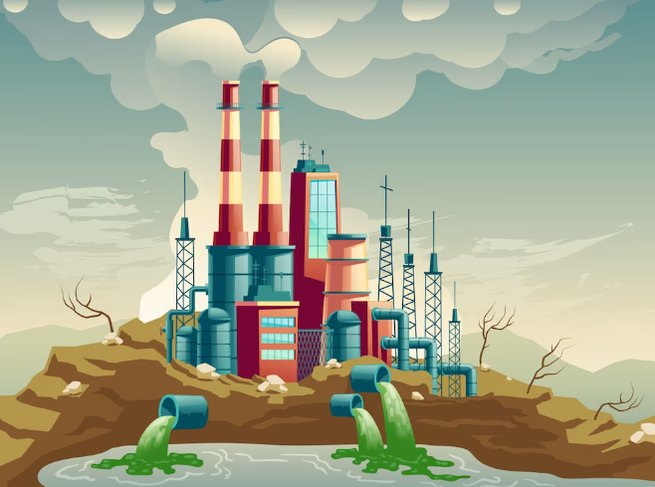
INDUSTRIAL WASTE

Slide 10
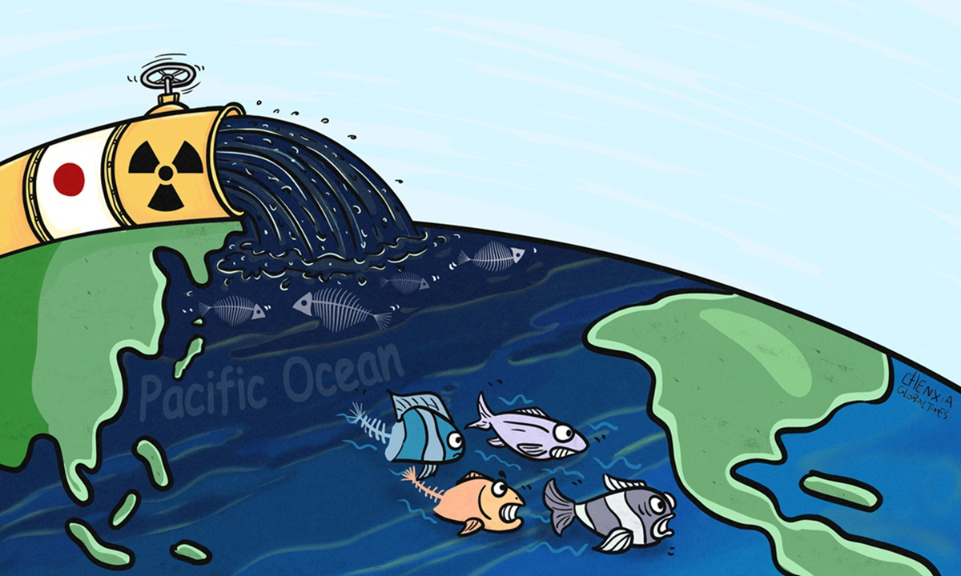
RADIOACTIVE WASTE

Slide 11

GLOBAL WARMING

Slide 12

Based on the above causes. What are the effects on sea water?

Slide 13
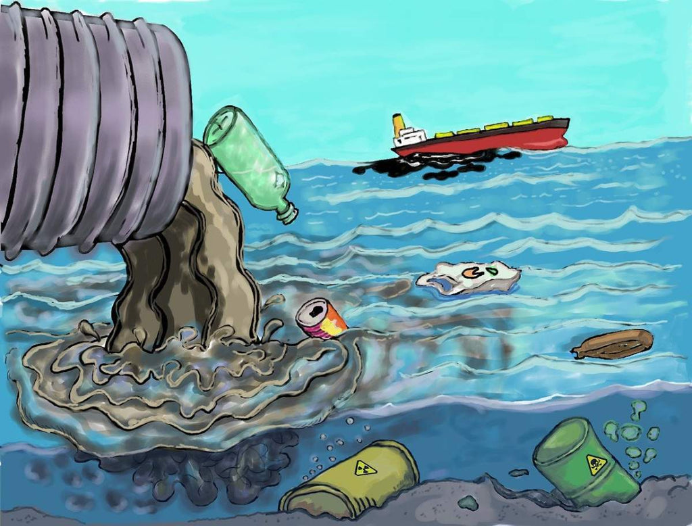

Objectives
01
02
By the end of this lesson, Ss will be able to:
Listening about water pollution
Writing a notice

Slide 14

Ex 2. Listen to a talk and choose the correct word to complete each sentence.
1. Polluted water is unsafe for drinking / cooking and for other uses.
2. Sometimes toxic substances ﬂow into rivers from factories / hospitals.
3. Water pollution has a dangerous / harmful eﬀect on our life.
4. We couldn’t / shouldn’t throw litter into rivers and lakes.
📌 Man-made substances pollute water when they flow into the water from factories and homes.
📌 Water pollution has a harmful effect on our lives.
📌 We should also stop littering, especially dumping waste into rivers and lakes.

Slide 15
Ex 3. Listen again and give short answers to the following questions.
Use no more than THREE words.
1. What is the listening text about?
📌 All living things need water, but water pollution has become a serious problem.
2. How many sources of water pollution are there?
3. What are two common sources of drinking water?
4. What type of effect does water pollution have on our life?
5. What products can we use to reduce water pollution?
→ Water pollution
📌 There are two sources of water pollution, man made and natural.
→ Two
→ Rivers and lakes
📌 These rivers and lakes are a source of drinking water for humans.
→ A harmful effect
📌 Water pollution has a harmful effect on our lives.
→ Green products
📌 Finally, we can reduce water pollution by using green products and avoiding single use products like plastic bags.

Slide 16
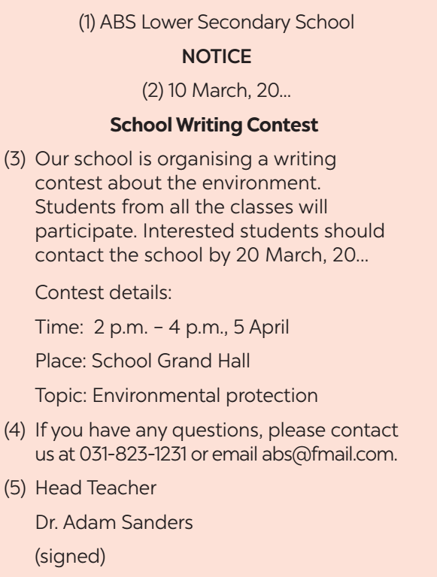
Ex 4. Work in pairs.
Read the notice and match the headings (a – e) below with the numbers (1 – 5).
1 - a. Name of institution or organisation (school, etc.)
2 - c. Date of writing the notice
a. Name of institution or organisation (school, etc.)
b. Body (date / time / duration / place, etc.)
3 - b. Body (date / time / duration / place, etc.)
c. Date of writing the notice
4 - e. Contact details
d. Author's name and signature
5 - d. Author's name and signature
e. Contact details

Slide 17
What types of notice are there?
What does it contain?
Is this brief or long?
Warning
Invitation
Brief
Announcement
All the necessary details

Slide 18
Ex 5. Write a notice for the Go Green Club leader to invite students to attend a lecture on water pollution. Use the following details.
Go Green Club NOTICE 12 January, 2024 Lecture on Water Pollution
Details: Time: 2 p.m. – 4 p.m., 6 March Place: School Grand Hall Topic: Water pollution
Club Leader Nguyen Hong Mai
Green Earth Club is organising a lecture about the Water Pollution. Students from all the classes can participate. Interested students should contact the school by 20 May, 2024.
If you have any questions, please contact us at 012-3476-789 or email gogreen@gmail.com.

Slide 19
What have you learnt today?
Listen to get information about water pollution.
Write a notice

Slide 20
Thanks!
Do you have any questions?

Slide 21
Icon pack

Slide 22
Alternative resources
Here’s an assortment of alternative resources whose style fits the one of this template:
Vectors
Flat design tree planting illustration
Flat Earth day background

