Slide 1

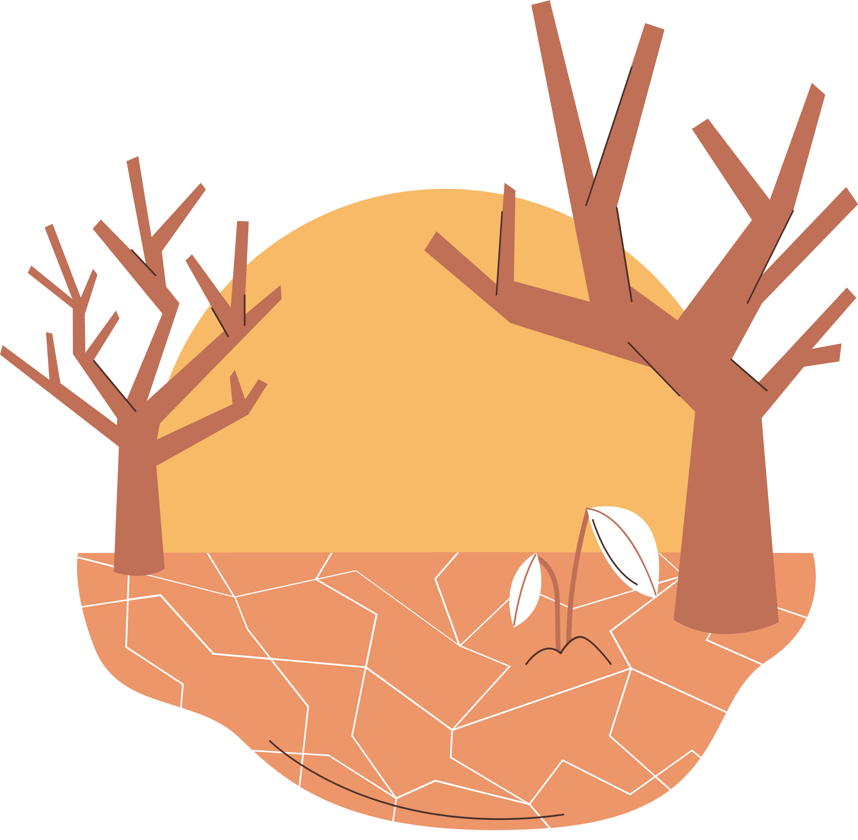
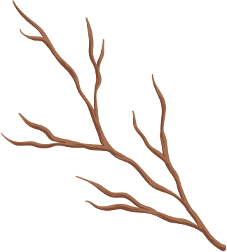

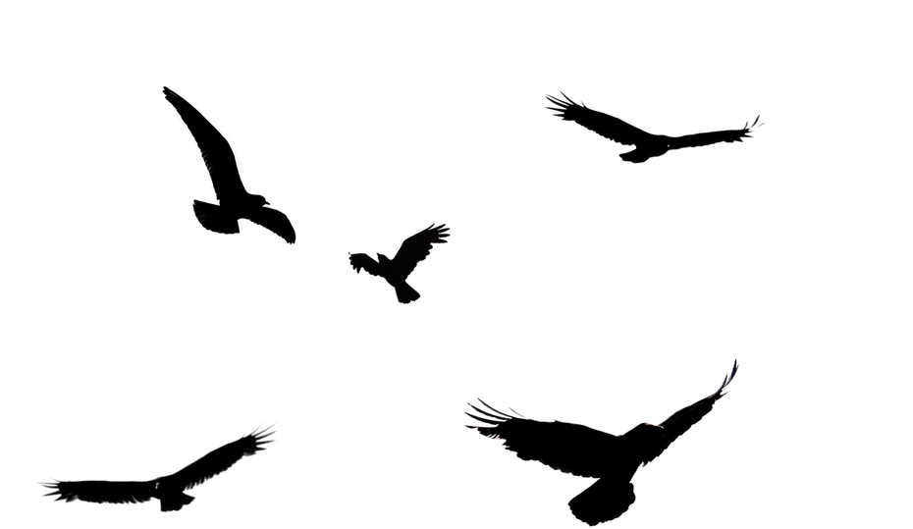
WELCOME TO OUR CLASS!
Presented by: ……………..

Slide 2


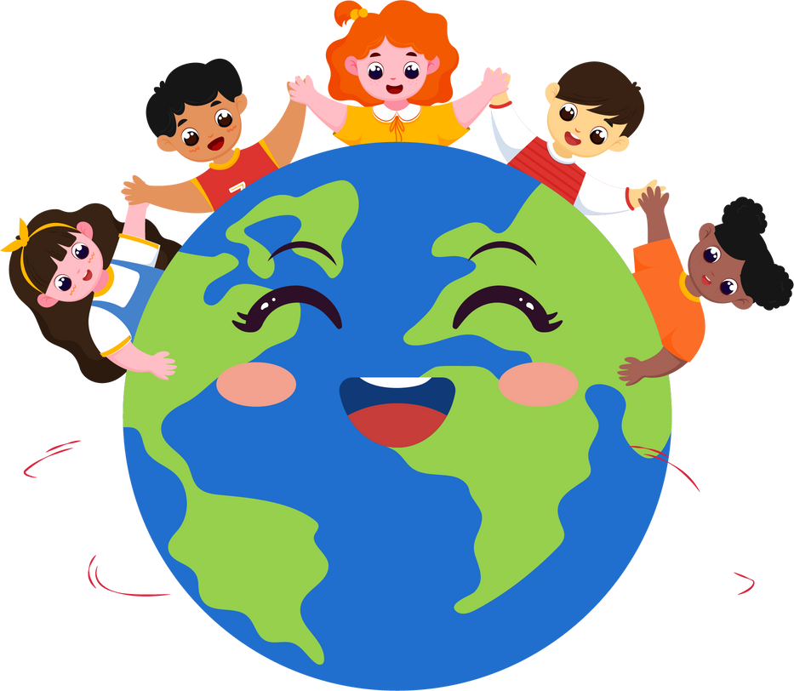
WARM-UP

Slide 3
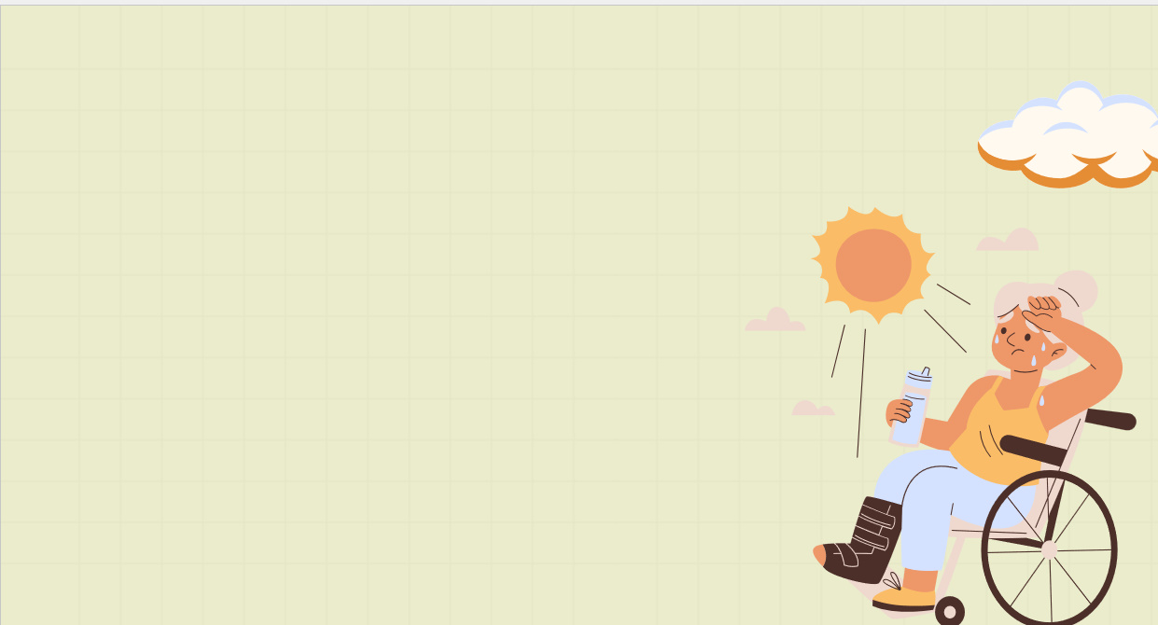
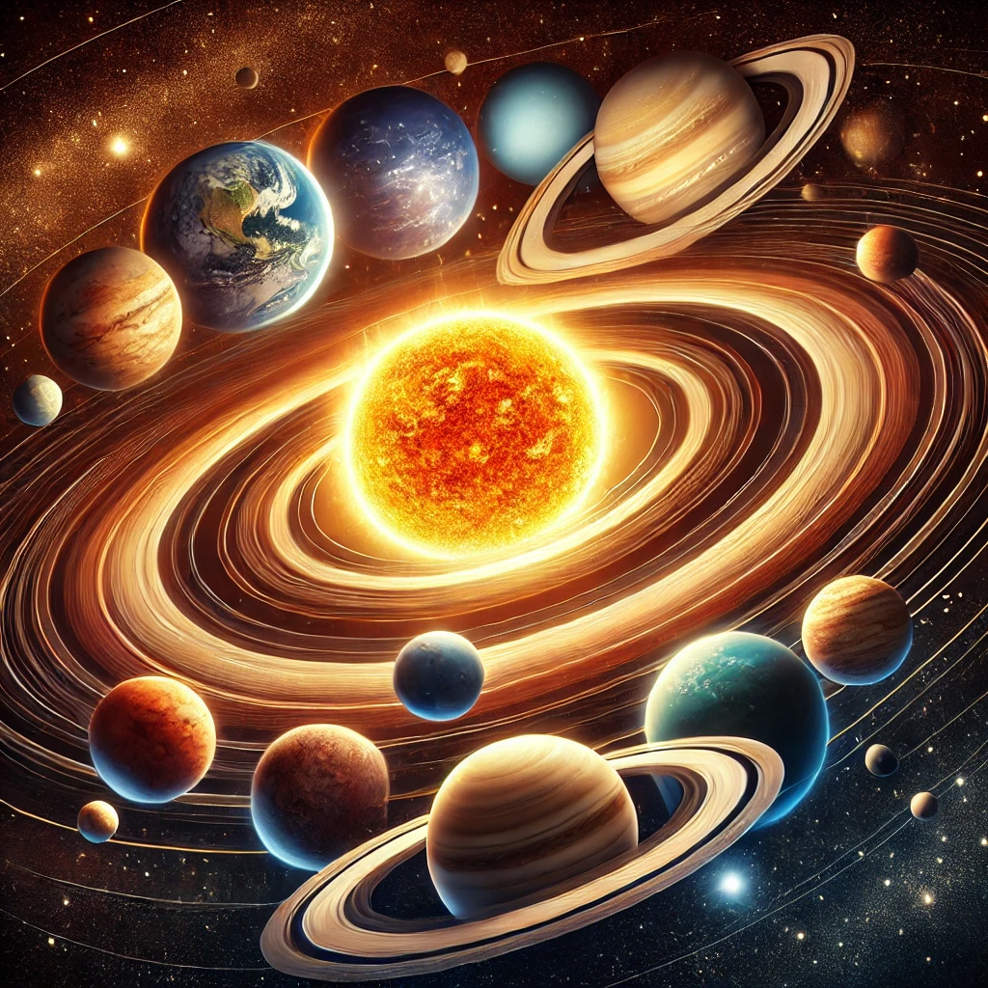
solar system

Slide 4
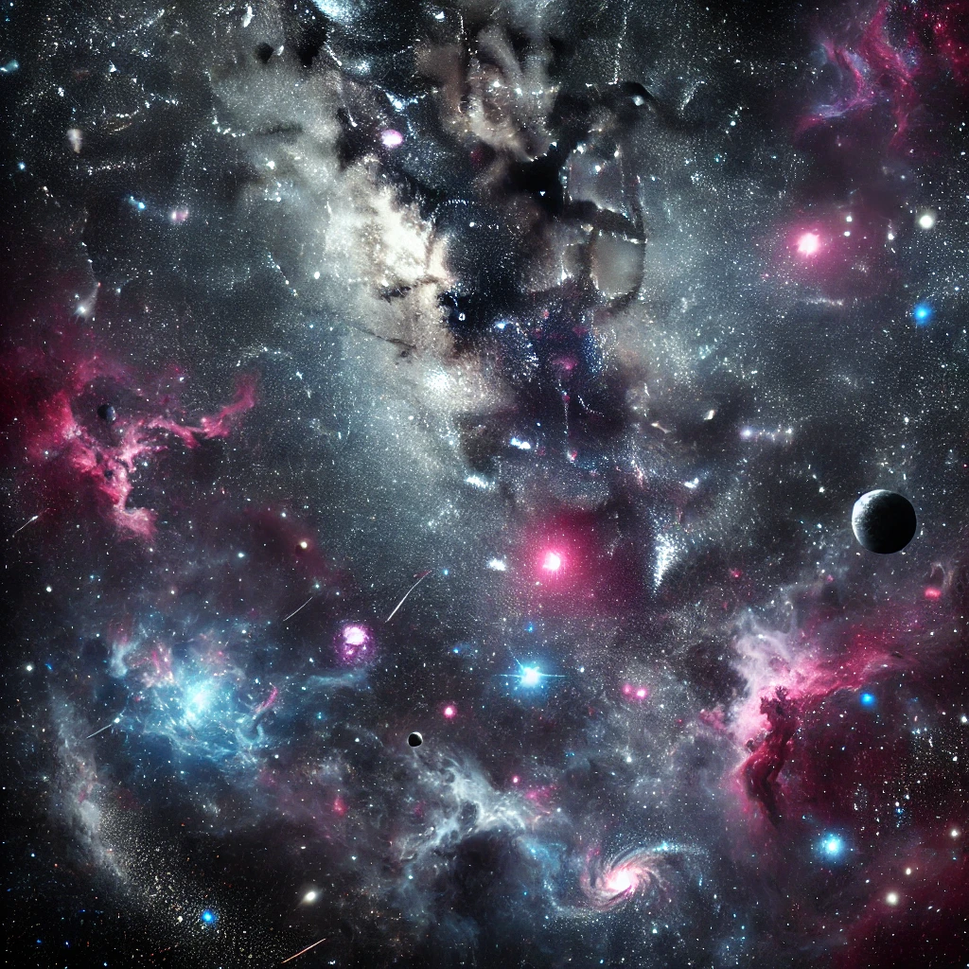
outer space

Slide 5
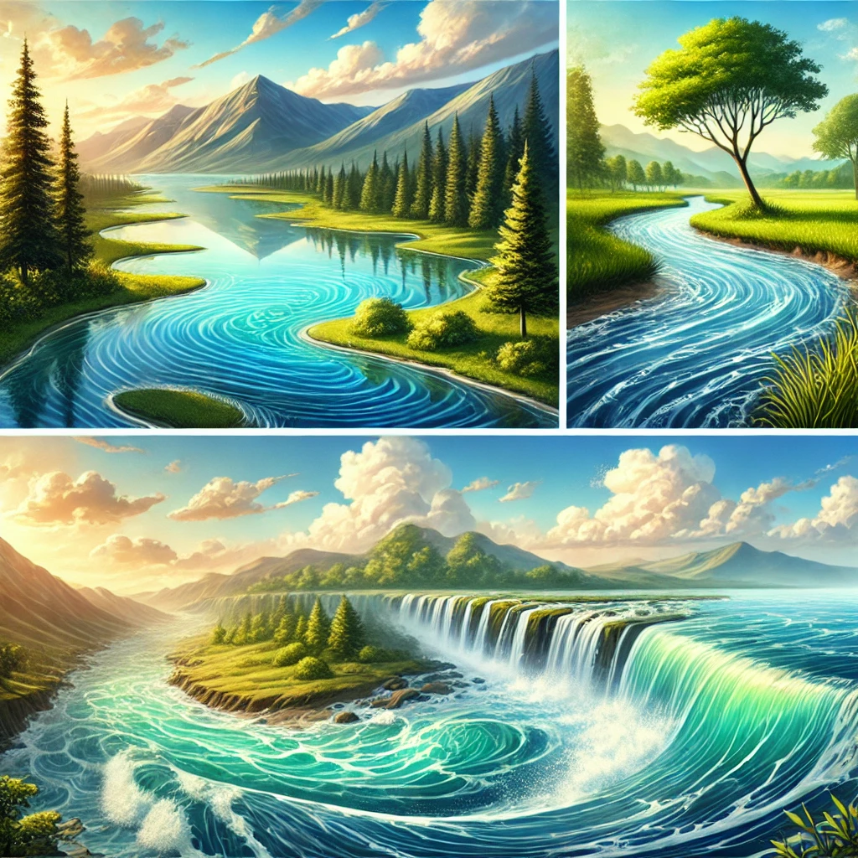
water bodies

Slide 6
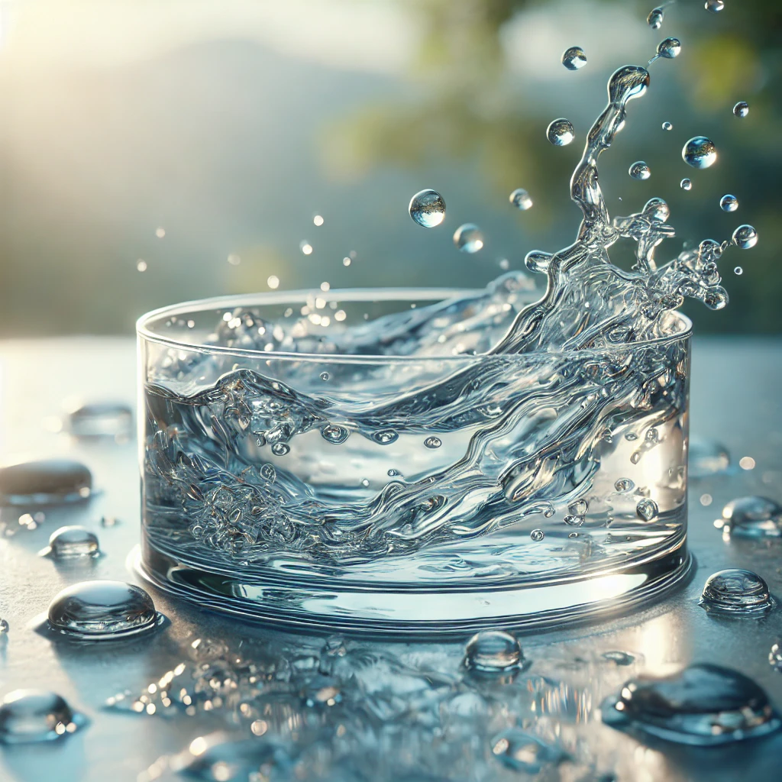
liquid water

Slide 7
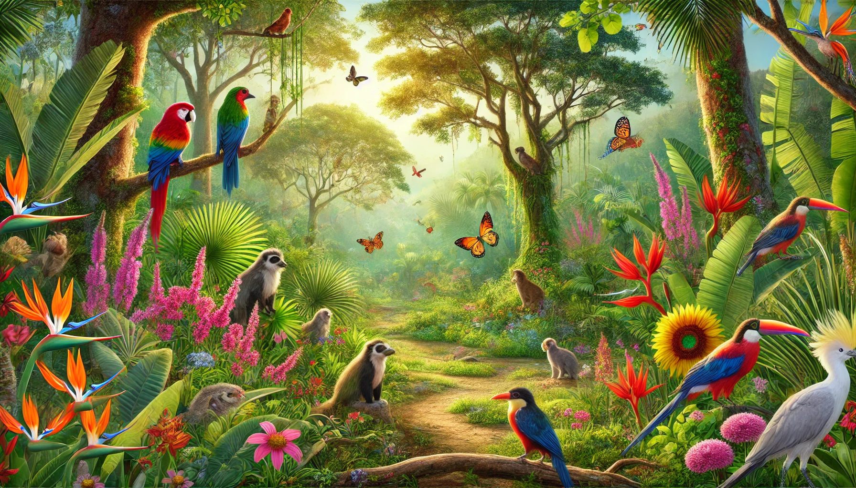
flora and fauna

Slide 8
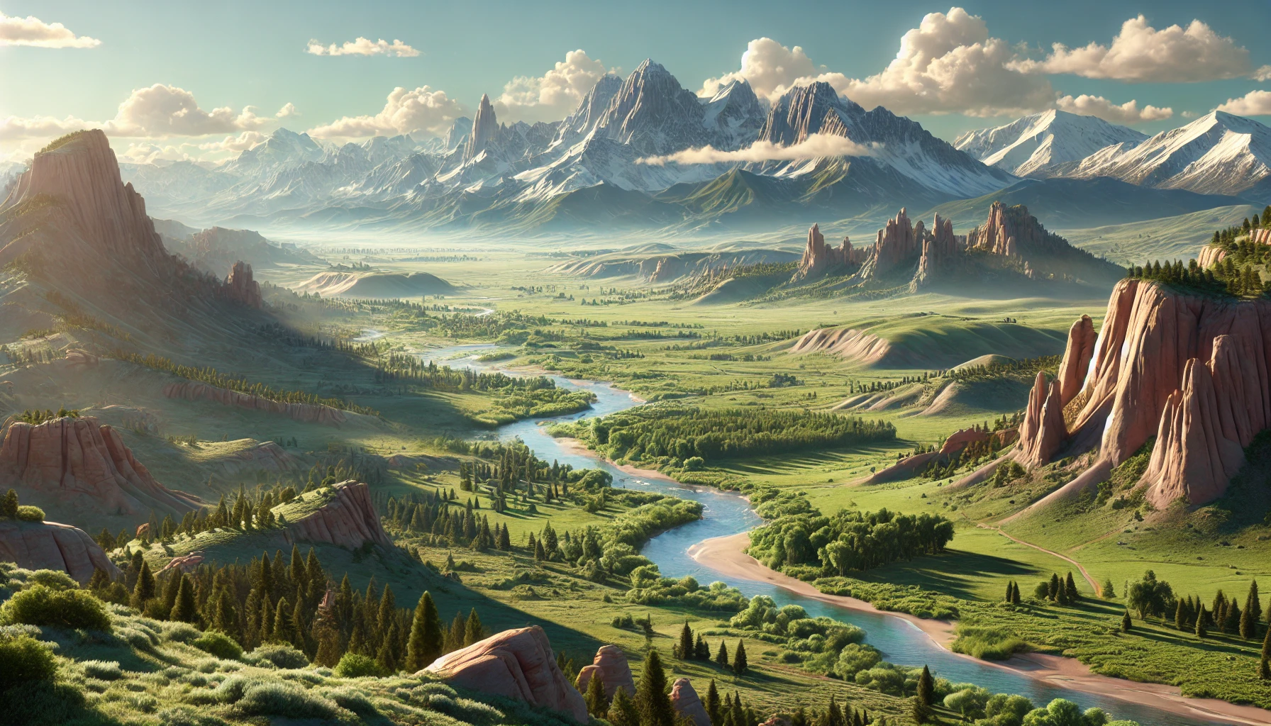
landforms

Slide 9

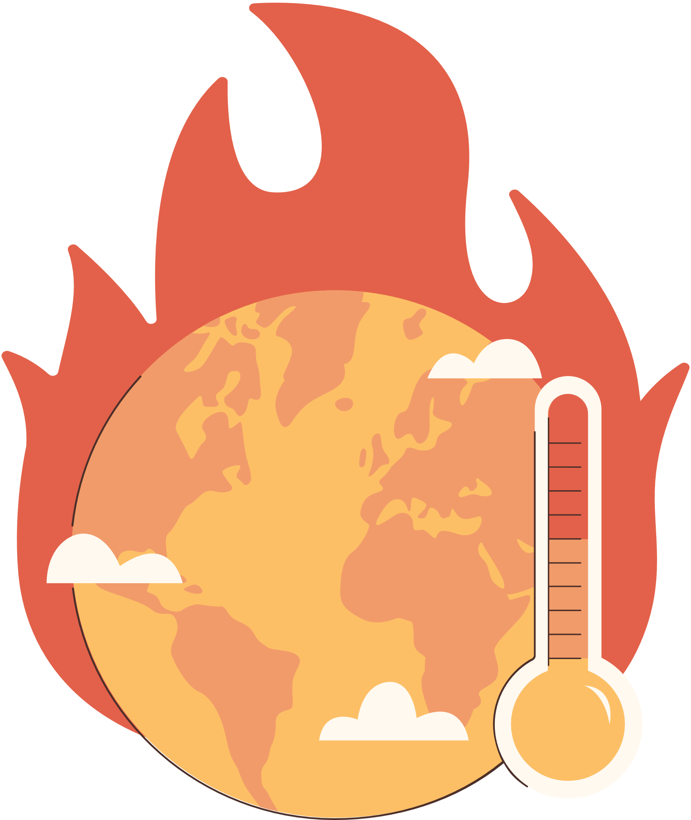
Unit 10:
PLANET EARTH
Lesson 2: A Closer Look 1

Slide 10
VOCABULARY

Slide 11


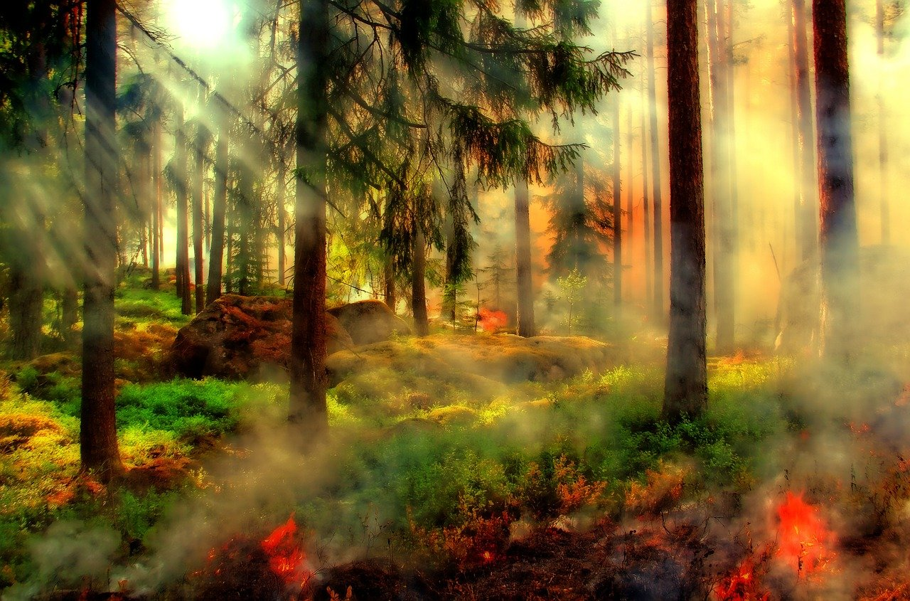
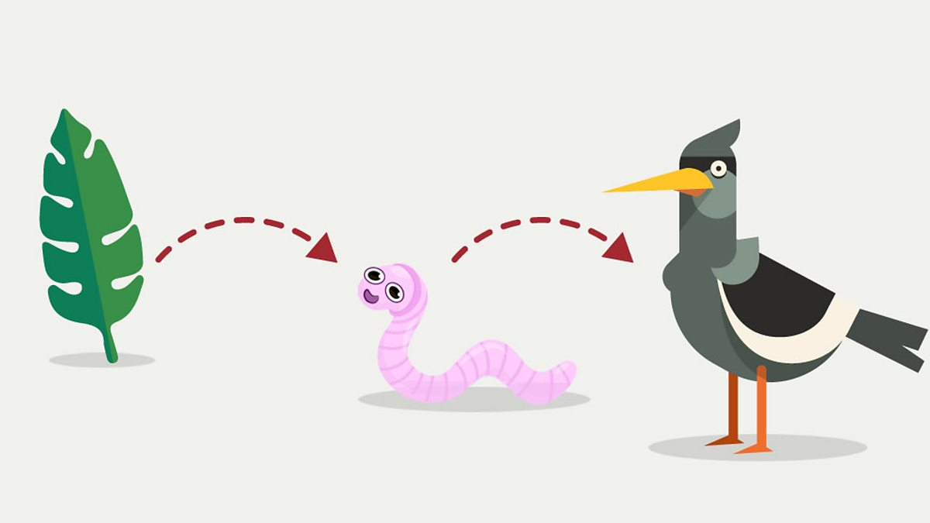
Vocabulary
nature reserve (n)
an area of land that is protected in order to keep safe the animals and plants that live there because they are rare.
/ˈneɪtʃə rɪzɜːv/
khu bảo tồn thiên nhiên

Slide 12
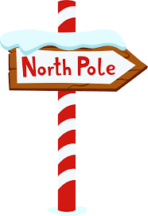
Vocabulary
food chain (n)
a sequence of organism where one eats another.
/ˈfuːd tʃeɪn/
chuỗi thức ăn

Slide 13
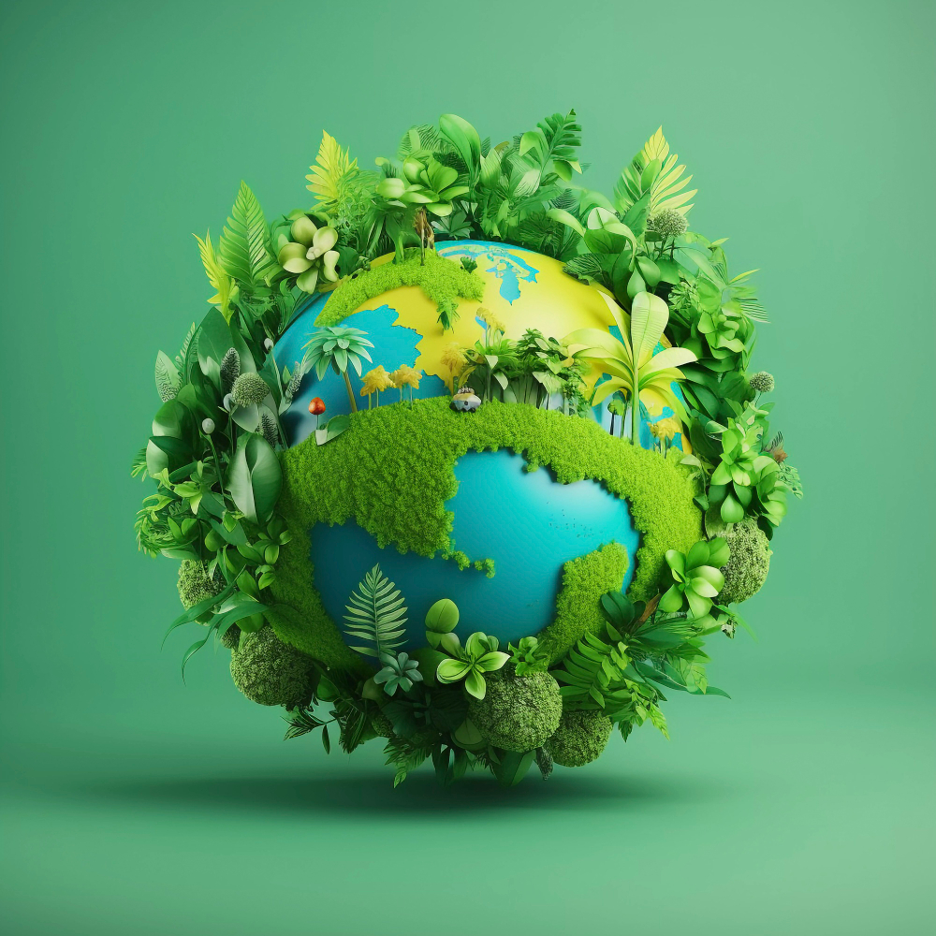
Vocabulary
pole (n)
either of two points at the most northern and most southern ends of the earth around which the earth turns.
/pəʊl/
cực (Bắc/Nam)

Slide 14
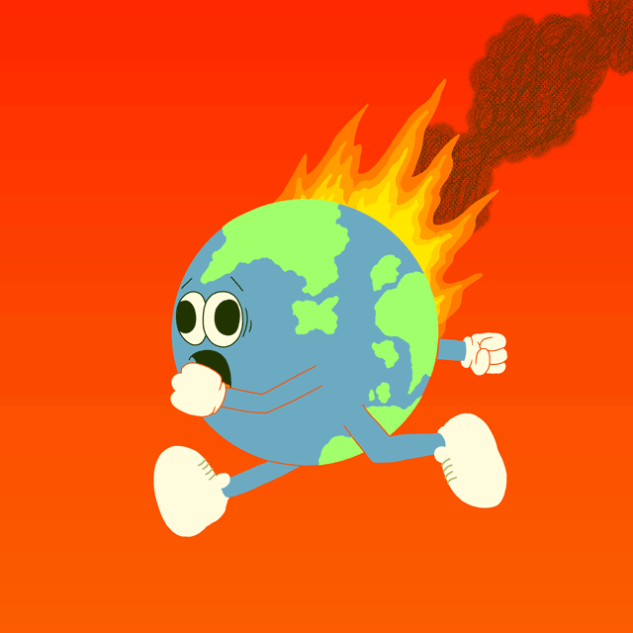
Vocabulary
ecological balance
a term describing how ecosystems are organized in a state of stability where species coexist with other species and with their environment
/ˌiːkəˈlɒdʒɪkl ˈbæləns/
cân bằng sinh thái

Slide 15
Vocabulary
changes in the world’s weather, particularly and increase in temperature.
climate change (n)
/ˈklaɪmət tʃeɪndʒ/
biến đổi khí hậu

Slide 16
Vocabulary
New words | Pronunciation | Meaning
1. nature reserve (n) | /ˈneɪtʃə rɪzɜːv/ | khu bảo tồn thiên nhiên
2. food chain (n) | /ˈfuːd tʃeɪn/ | chuỗi thức ăn
3. pole (n) | /pəʊl/ | cực (Bắc/Nam)
4. ecological balance | /ˌiːkəˈlɒdʒɪkl ˈbæləns/ | cân bằng sinh thái
5. climate change (n) | /ˈklaɪmət tʃeɪndʒ/ | biến đổi khí hậu

Slide 17
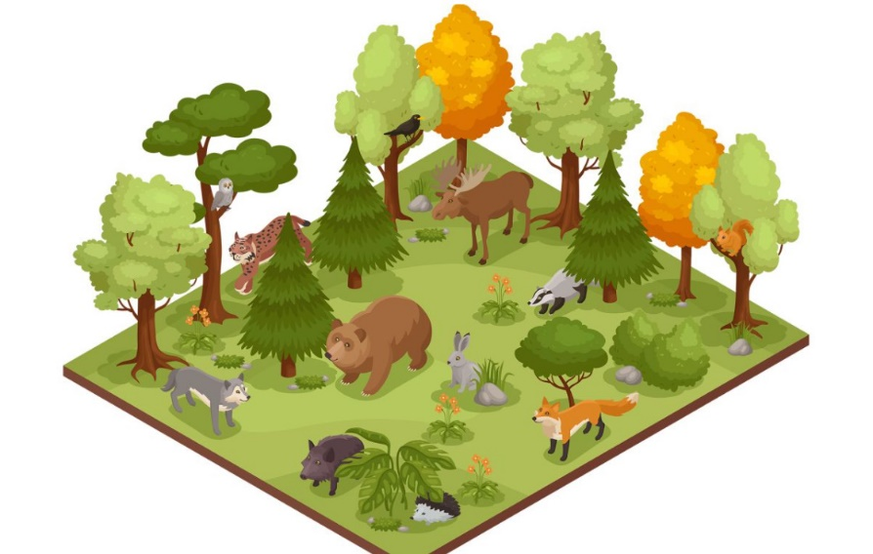
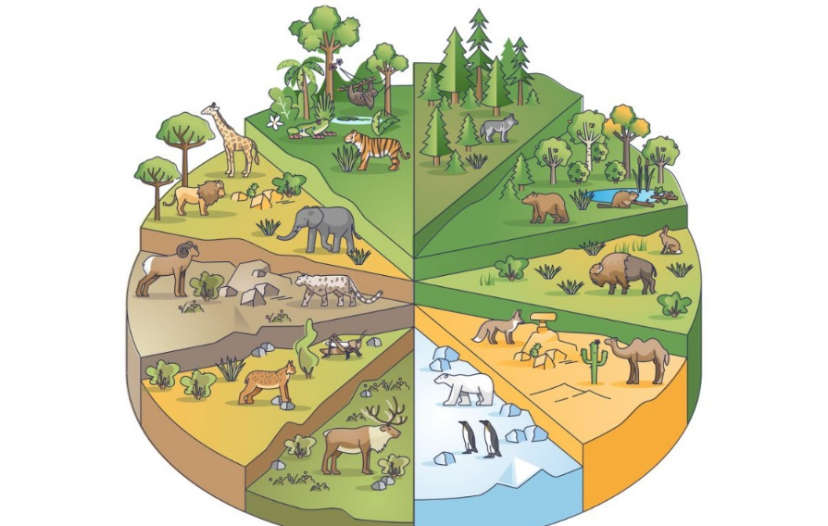
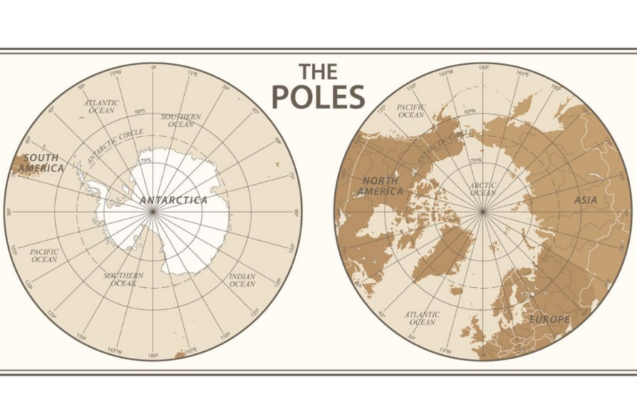
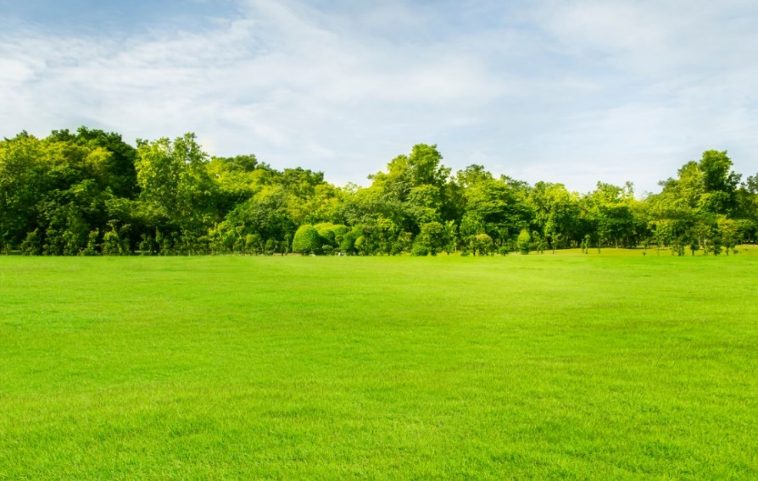
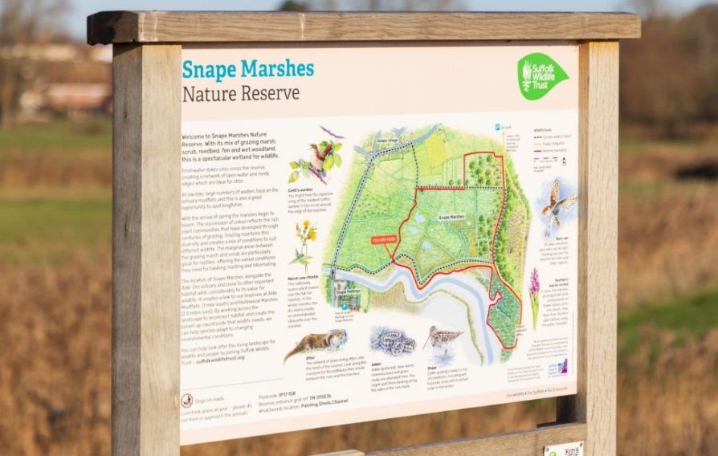
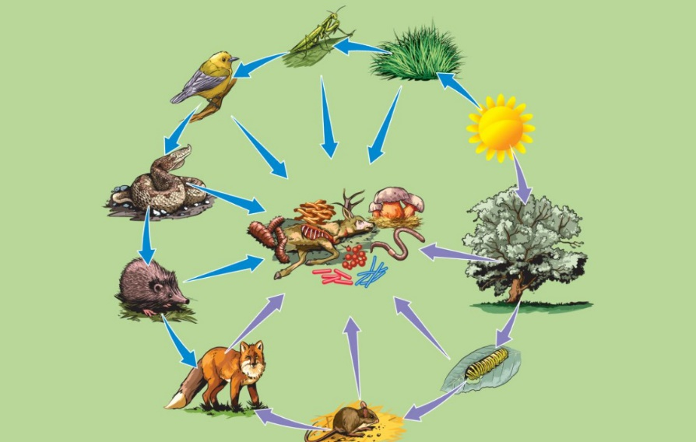
1. Write a word or phrase from the box under each picture.
habitats
flora and fauna
grassland
nature reserves
food chain
poles

Slide 18

Check your answer
habitats
flora and fauna
grassland
nature reserves
food chain
poles
habitats

Slide 19
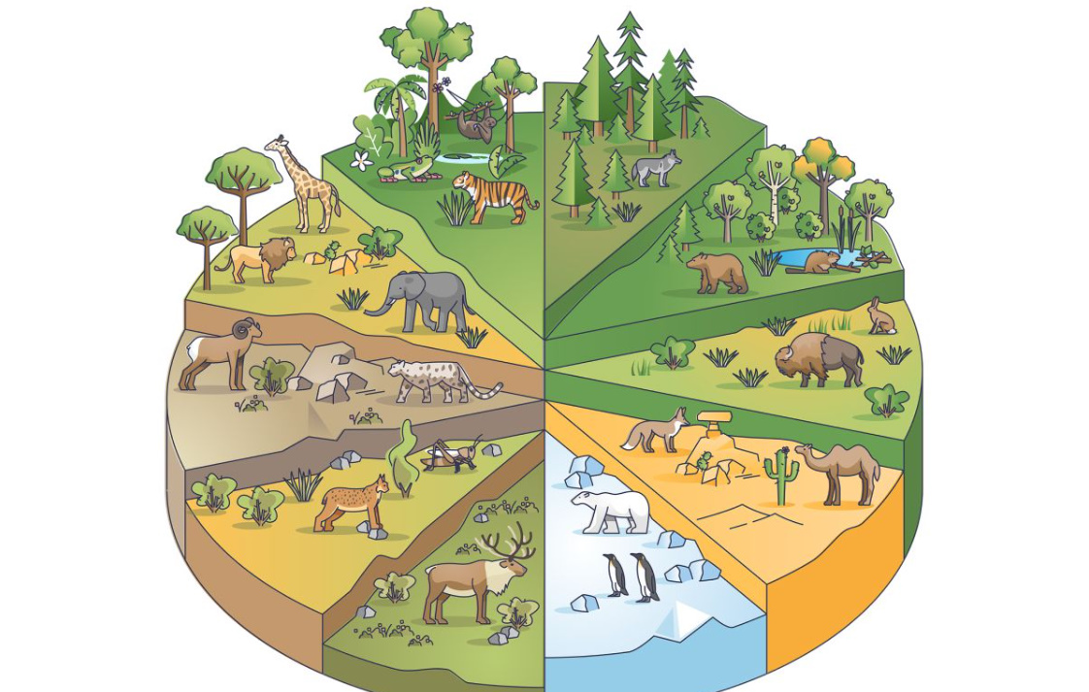
Check your answer
flora and fauna
grassland
nature reserves
food chain
poles
flora and fauna

Slide 20

Check your answer
grassland
nature reserves
food chain
poles
poles

Slide 21

Check your answer
grassland
nature reserves
food chain
grassland

Slide 22

Check your answer
nature reserves
food chain
Nature reserves

Slide 23

Check your answer
food chain
Food chain

Slide 24
2. Complete each sentence with a word or phrase from 1.
food chain
1. In a _______________, some animals eat other animals and become food for a third group of animals.
grassland
2. A _____________ is often wide and its plants are mostly grass and flowers.
3. Areas of land to protect animals and plants are called _________.
nature reserves
poles
4. The North and South ______ are both extremely cold and icy.
habitats
5. Natural ______________ for pandas are bamboo forests.

Slide 25








3

Slide 26





- Work in two groups.
- There is a picture with initial letter (s) of the word/ phrase describing the things in the pictures.
- The group with more correct answers wins.
3

Slide 27
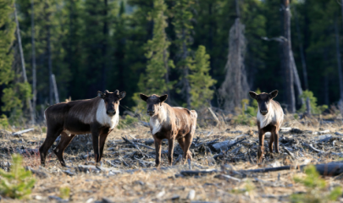
h______ l___
habitat loss

Slide 28
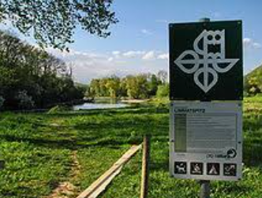
nature reserves
n_______ r______

Slide 29
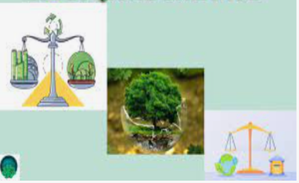
e_______ b______
ecological balance

Slide 30
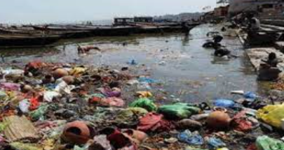
p____ed
polluted

Slide 31
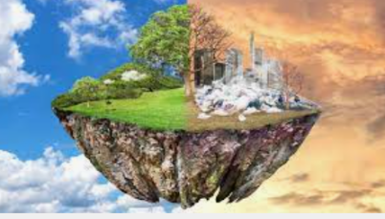
g_____ w______
global warming

Slide 32
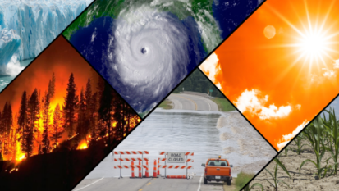
climate change
c______ c_____

Slide 33
3. Choose the correct answer A, B, C, or D to complete each sentence.
1. When humans use a natural habitat for farming and housing, they cause ______.
A. climate change B. global warming
C. habitat loss D. ecological balance
2. When Earth’s average temperature increases, we face ______.
A. ecological balance B. global warming
C. pollution D. protection
3. Each of us can lend a hand to ______the natural environment.
A. hunt B. change C. preserve D. pollute
4. We can keep a(n) ______ by stopping hunting and cutting down trees.
A. ecological balance B. habitat loss
C. climate change D. nature reserve
5. One way to ______ Mother Earth is by planting more trees.
A. keep B. harm C. provide D. protect
A. climate change
C. habitat loss
B. global warming
D. ecological balance

Slide 34
3. Choose the correct answer A, B, C, or D to complete each sentence.
1. When humans use a natural habitat for farming and housing, they cause ______.
A. climate change
C. habitat loss
B. global warming
D. ecological balance
2. When Earth’s average temperature increases, we face ______.
A. ecological balance
C. pollution
B. global warming
D. protection

Slide 35
3. Choose the correct answer A, B, C, or D to complete each sentence.
3. Each of us can lend a hand to ______ the natural environment.
A. hunt
C. preserve
B. change
D. pollute
4. We can keep a(n) ______ by stopping hunting and cutting down trees.
A. ecological balance
C. climate change
B. habitat loss
D. nature reserve

Slide 36
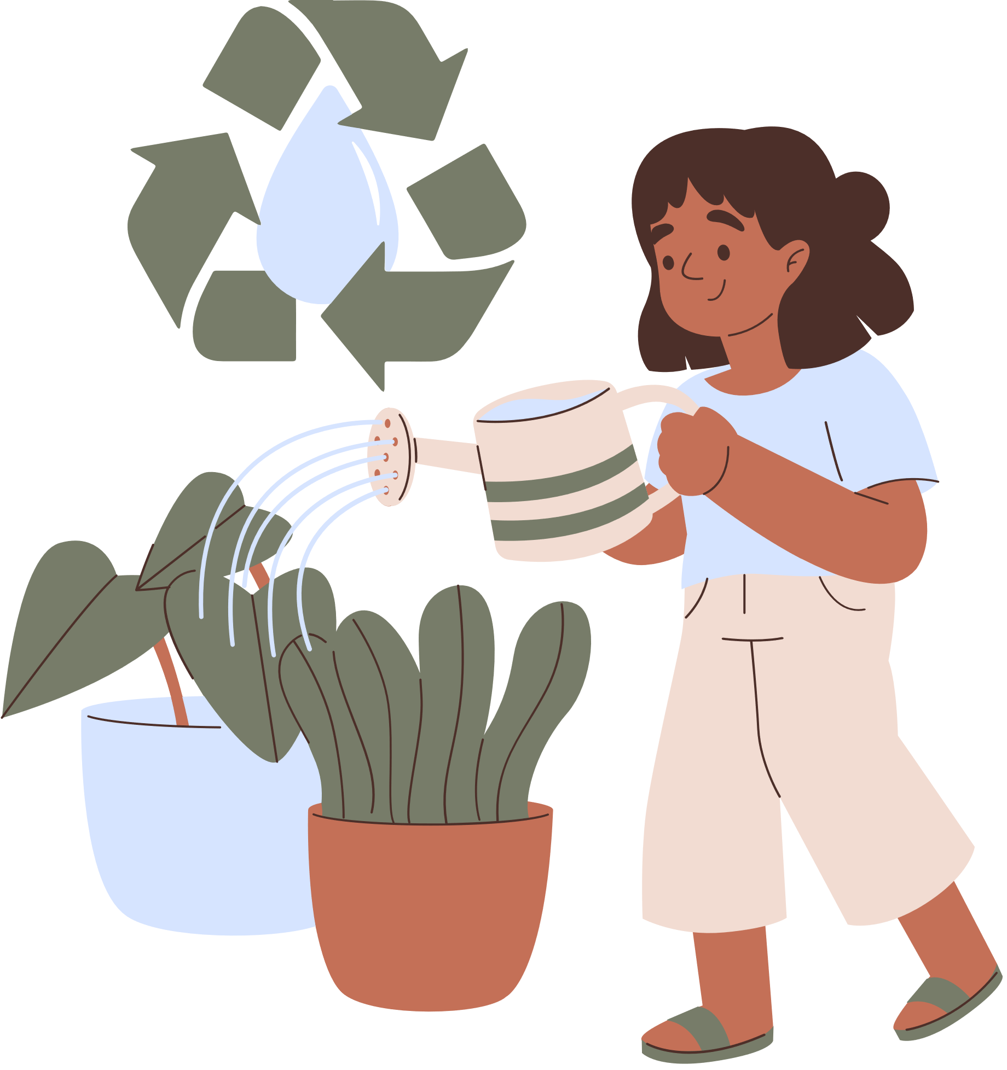
3. Choose the correct answer A, B, C, or D to complete each sentence.
5. One way to ______ Mother Earth is by planting more trees.
A. keep
C. provide
B. harm
D. protect

Slide 37
PRONUNCIATION

Slide 38

Look at Remember box (p.106)
When we speak English, we place stress on certain syllables in a sentence. The combination of stressed and unstressed syllables produces rhythm in spoken English.
1. Earth is the third planet from the Sun.
2. Oceans, seas, rivers, and lakes are water bodies.
3. The North and South poles are extremely cold and icy.
4. Do moonquakes last up to half an hour?
5. Preserving natural resources is very important.

Slide 39
4. Listen to the sentences and pay attention to the bold syllables. Does the speaker place stress on them?
1. Earth is the third planet from the Sun.
2. Oceans, seas, rivers, and lakes are water bodies.
3. The North and South poles are extremely cold and icy.
4. Do moonquakes last up to half an hour?
5. Preserving natural resources is very important.

Slide 40
5. Circle the stressed syllables in the sentences. Listen, check, and repeat.
1. We’re doing a study on climate change.
2. What is the distance from Earth to Mars?
3. They’ll have a discussion on natural habitats.
4. Plants provide us with food, oxygen, and energy.
5. Our school organised various activities on Earth Day.
4
4
4
5
6

Slide 41
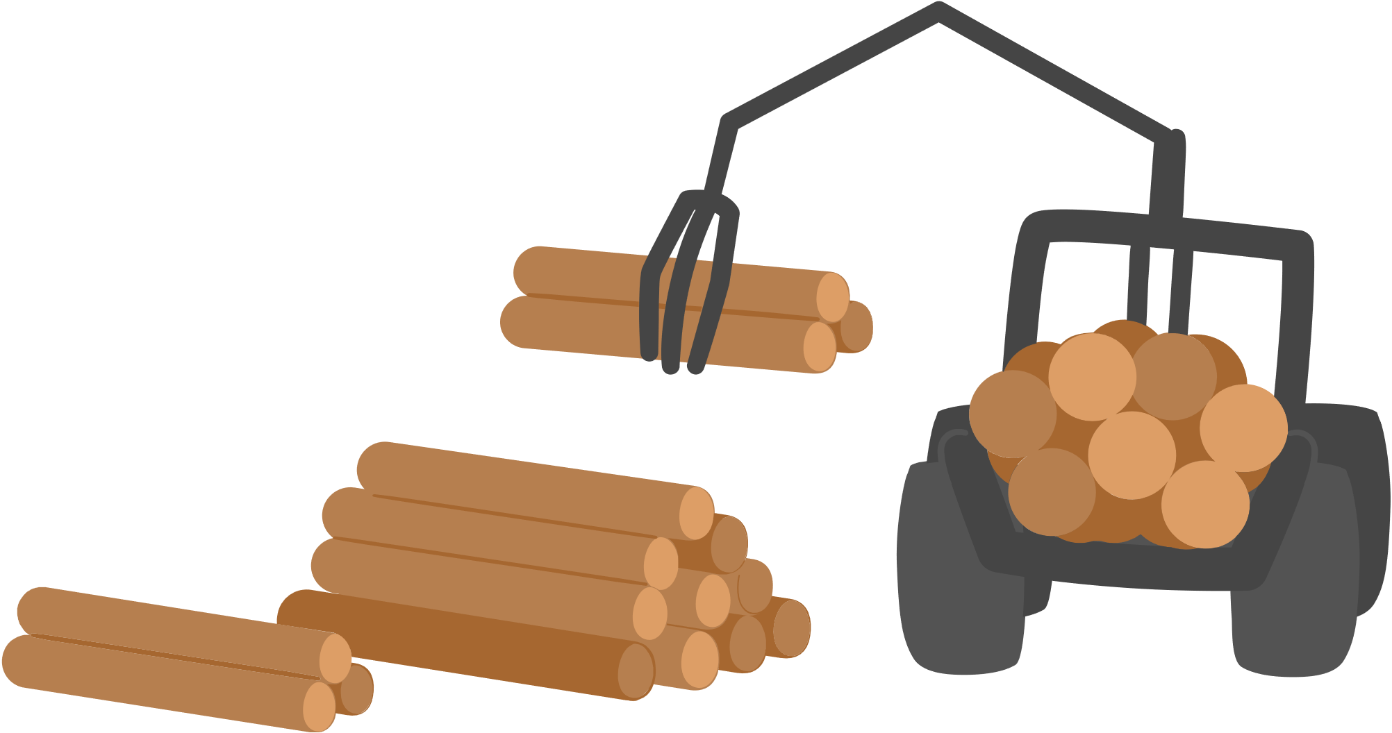
Wrap-up
What have we learnt in this lesson?
Use the lexical items related to the topic Planet Earth
Have the right rhythm in sentences;

Slide 42
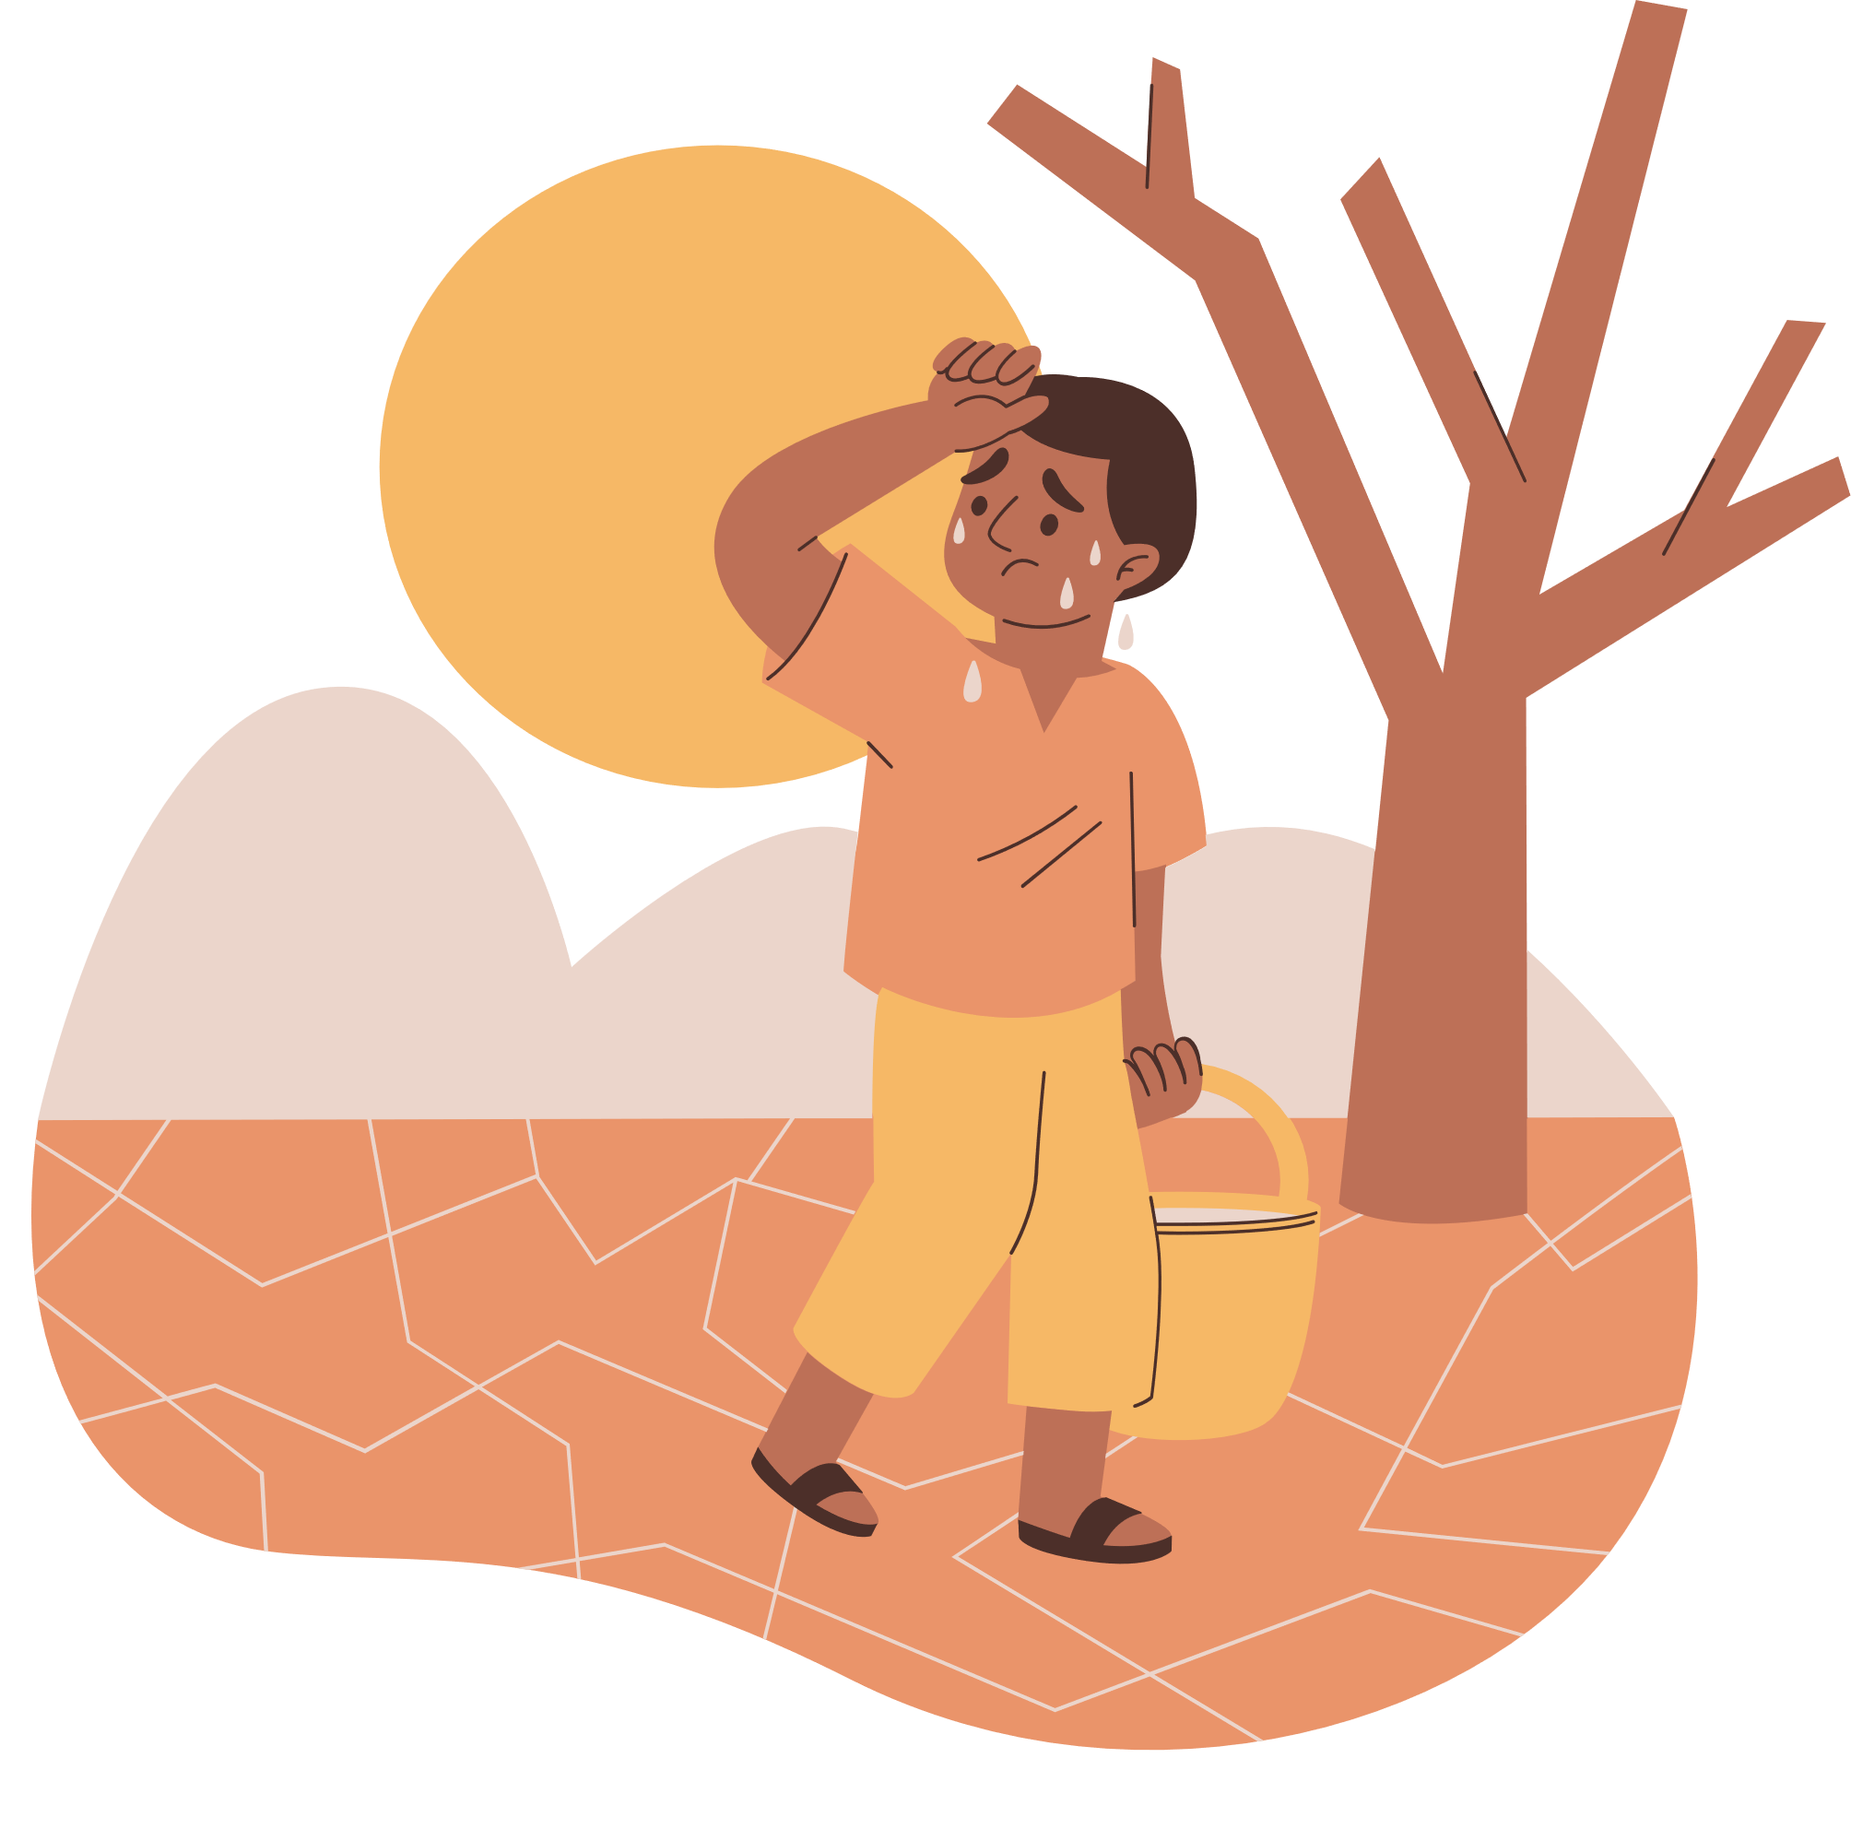
HOMEWORK
Learn by heart vocabulary
Prepare for the next lesson

Slide 43
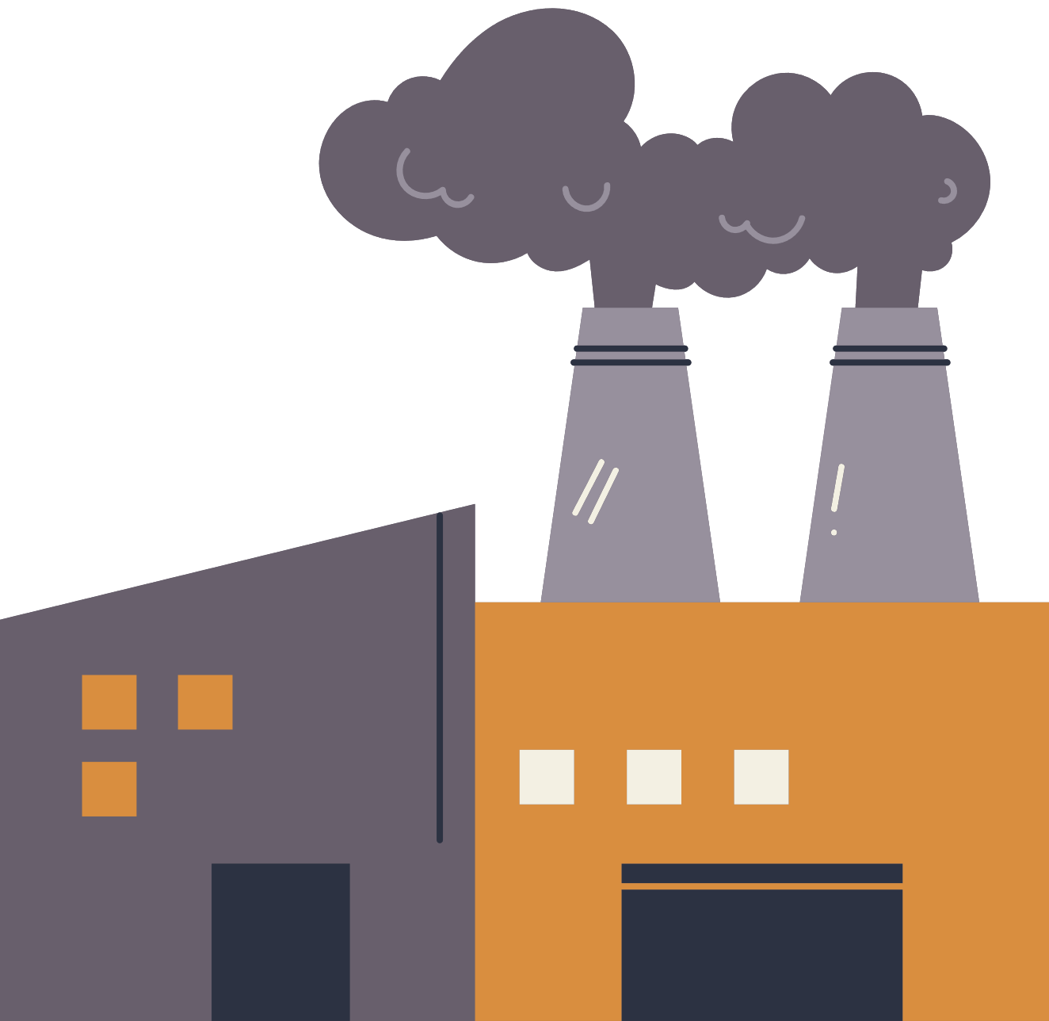

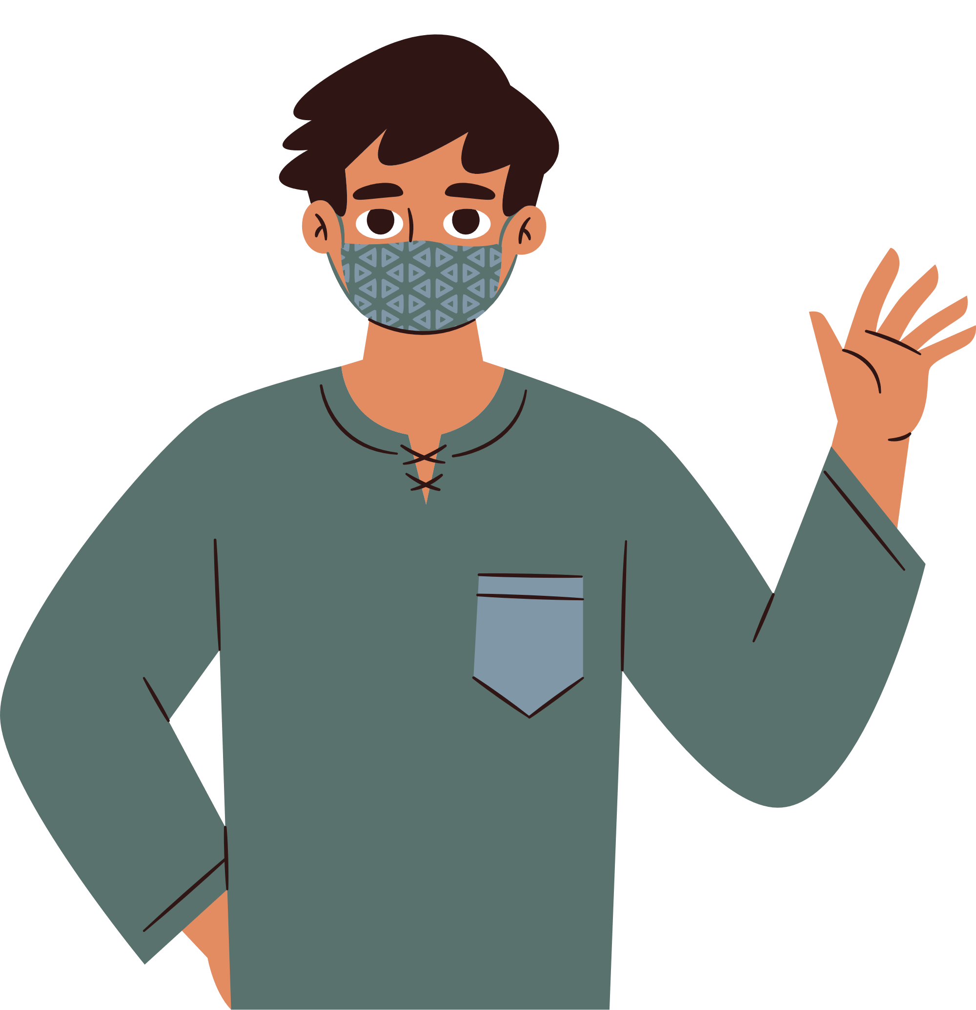
Thank you!

