Slide 1







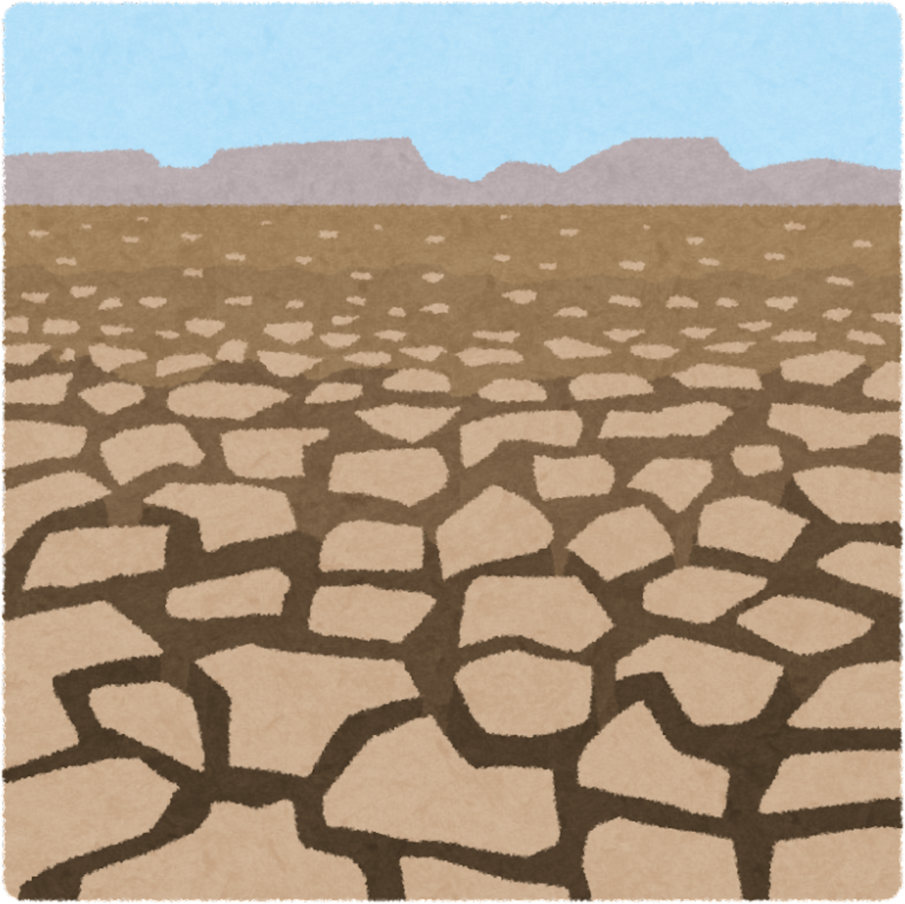
WELCOME TO OUR CLASS!
Presented by: …………………

Slide 2

Unit 10:
PLANET EARTH
Lesson 4: Communication

Slide 3


01
EVERYDAY ENGLISH

Slide 4
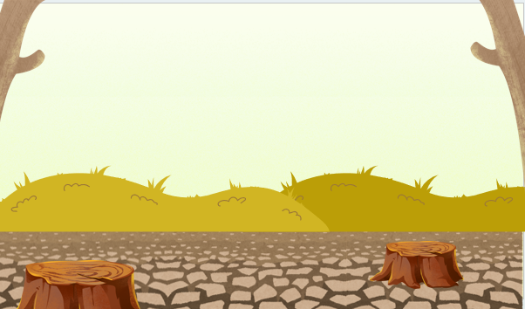

1. Listen and read the conversations below. Pay attention to the highlighted parts.
1
Mi: Have you read this book about the Solar System?
Tom: Not yet. I don’t feel like reading it.
Mi: Why don’t you give it a go? You will like it.
Tom: OK, I’ll think about that.
2
Lan: How would you feel about contributing to the fund to protect our wildlife?
Local resident: Contribute to a fund?
Lan: Yes, your contribution would really help us out.
Local resident: Alright. I’ll make a contribution.

Slide 5
Structures:
Suggest something to someone in general:
Why don’t you give it a go?
Respond:
Ok, I’ll think about that.
When the persuasion is more specific with a specific verb like contributing in
How would you feel about contributing…
Respond:
Alright. I’ll contribute some.

Slide 6
2. Work in pairs. Make similar conversations with the following situations.
Situation:
1. You persuade your friend to watch a movie about planet Earth.
2. You persuade local people to contribute to a fund to build a nature reserve.

Slide 7
Suggested answer:
1
You: Hey, heard of "Planet Earth"? It's this insane doc about our crazy planet.
Friend: Scoffs Pfff, sounds more like "Animal Planet After Dark." Not really my scene.
You: No, trust me! It's like an extreme nature travel program. Why don't you give it a go?
Friend: Hmm, you got me curious. Okay, I'll think about it.
You: Hi, B! Have you heard about the plans for a new nature reserve? Imagine we could have hiking trails, a butterfly garden... wouldn't that be lovely?
B: It sounds peaceful, dear. But these things cost money, and times are tight.
You: True, but how would you feel about contributing to the plans to make our lives better?
B: Alright, I'll contribute some.

Slide 8
Suggested answer:
2
You: Hi, B! Have you heard about the plans for a new nature reserve? Imagine we could have hiking trails, a butterfly garden... wouldn't that be lovely?
B: It sounds peaceful, dear. But these things cost money, and times are tight.
You: True, but how would you feel about contributing to the plans to make our lives better?
B: Alright, I'll contribute some.

Slide 9
Situation:
You persuade your peer to read about the Earth’s habitats.
Dialogue:
Mi: Have you read this book about the Earth’s habitats?
Tom: Not yet. I don’t feel like reading it.
Mi: Why don’t you give it a go? You will like it.
Tom: Ok, I’ll think about that.
Notes:
We will have a chance to read about some of the Earth’s habitats.

Slide 10
02
EARTH’S HABITAT

Slide 11
3. Read the short descriptions of various habitats and match them with their features.
include the North Pole and the South Pole. These habitats are covered in ice and extremely cold and dry. Animals here include small fish, polar bears, penguins, leopard seals, etc.
Polar habitats
include tropical forests, temperate forests, and boreal forests. They are considered the Earth’s lungs because they produce oxygen. They also provide homes to bats, owls, deer, squirrels, foxes, lizards, etc.
Forest habitats

Slide 12
3. Read the short descriptions of various habitats and match them with their features.
include the Pacific, Atlantic, Indian, Southern, and Arctic Oceans. They produce more than 50 per cent of Earth’s oxygen and help adjust the climate. They provide living places for plants like sea grasses, microscopic algae, and fish, etc.
Polar habitats
Ocean habitats
3
include the North Pole and the South Pole. These habitats are covered in ice and extremely cold and dry. Animals here include small fish, polar bears, penguins, leopard seals, etc.
include tropical and temperate ones. The main plants are grasses. They are crucial for grazing livestock. Grassland animals include giraffes, zebras, lions, elephants, etc.
Grasslands
Forest habitats
include tropical forests, temperate forests, and boreal forests. They are considered the Earth’s lungs because they produce oxygen. They also provide homes to bats, owls, deer, squirrels, foxes, lizards, etc.

Slide 13
3. Read the short descriptions of various habitats and match them with their features.
include the North Pole and the South Pole. These habitats are covered in ice and extremely cold and dry. Animals here include small fish, polar bears, penguins, leopard seals, etc.
Polar habitats
3
Ocean habitats
include the Pacific, Atlantic, Indian, Southern, and Arctic Oceans. They produce more than 50 per cent of Earth’s oxygen and help adjust the climate. They provide living places for plants like sea grasses, microscopic algae, and fish, etc.
include tropical forests, temperate forests, and boreal forests. They are considered the Earth’s lungs because they produce oxygen. They also provide homes to bats, owls, deer, squirrels, foxes, lizards, etc.
Forest habitats
Grasslands
include tropical and temperate ones. The main plants are grasses. They are crucial for grazing livestock. Grassland animals include giraffes, zebras, lions, elephants, etc.

Slide 14
3. Read the short descriptions of various habitats and match them with their features.
1. Polar regions | a. two main types and are crucial for livestock grazing | 1.
2. Forests | b. largest, produce oxygen and adjust the climate | 2.
3. Oceans | c. extremely cold, dry, covered in snow and ice | 3.
4. Grasslands | d. the lungs of Earth, home to many species | 4.

Slide 15
3. Read the short descriptions of various habitats and match them with their features.
c. extremely cold, dry, covered in snow and ice
1. Polar regions
Polar habitats include the North Pole and the South Pole. These habitats are covered in ice and extremely cold and dry.

Slide 16
3. Read the short descriptions of various habitats and match them with their features.
2. Forests
d. the lungs of Earth, home to many species.
Forest habitats … are considered the Earth's lungs ... They also provide homes to bats, owls, deer, squirrels, foxes, lizards, etc.

Slide 17
3. Read the short descriptions of various habitats and match them with their features.
b. largest, produce oxygen and adjust the climate
3. Oceans
Ocean habitats include the Pacific, Atlantic, Indian, Southern, and Arctic Oceans. They produce more than 50 per cent of Earth's oxygen and help adjust the climate.

Slide 18
3. Read the short descriptions of various habitats and match them with their features.
a. two main types and are crucial for livestock grazing
4. Grasslands
Grasslands include tropical and temperate ones. They are crucial for grazing livestock.

Slide 19
Look at the answers again
1. Polar regions | a. two main types and are crucial for livestock grazing | 1.
2. Forests | b. largest, produce oxygen and adjust the climate | 2.
3. Oceans | c. extremely cold, dry, covered in snow and ice | 3.
4. Grasslands | d. the lungs of Earth, home to many species | 4.
c
d
b
a

Slide 20
4. Work in pairs. Choose two habitats and compare them.
You can refer to the following:
- their specific types / examples
- their importance
- plants /animals living there
- other special features

Slide 21
4. Work in pairs. Choose two habitats and compare them.
Example:
FEATURES | OCEANS | FOREST
Habitat type | Water bodies | Landform habitats
Specific types | Pacific, Atlantic, Indian, Southern, Arctic Oceans | Tropical rainforests, temperate forests, boreal forests, deciduous forests
Importance | Regulate Earth's climate, absorb carbon dioxide, provide oxygen, habitat for marine species | Absorb carbon dioxide, produce oxygen, habitat for terrestrial species, regulate climate, prevent soil erosion.
Plants /animals living there | Fish, whales, dolphins, sharks, sea turtles, coral reefs, plankton, etc. | Trees (oak, maple, pine), mammals (bears, deer, monkeys), birds (eagles, owls, parrots), insects (butterflies, ants, beetles), amphibians (frogs, salamanders), etc.

Slide 22
5. Report the results of your comparison to the class.
Example:
While oceans are water bodies, forests are landform habitats. They share a critical role in sustaining life on Earth—they both provide oxygen to Earth, absorb carbon dioxide and regulate climate. Each has its own unique characteristics and importance. Forest habitats include tropical forests, temperate forests, and boreal forest; whereas ocean habitats include the Pacific, Atlantic, Indian, Southern, and Arctic Oceans. Oceans are home to a diversity of marine life, from the smallest plankton to the largest whales. Coral reefs, found in tropical waters, are vibrant "underwater cities". Meanwhile, forests are teeming with biodiversity, with a treasure trove of flora and fauna, including trees, mammals, birds, insects, amphibians (frogs, salamanders), etc. In conclusion, while oceans and forests may seem worlds apart, they are both ensuring the well-being of our planet and all its inhabitants. Let us cherish and protect these invaluable ecosystems for generations to come.

Slide 23
WRAP-UP
Persuade someone to do something and responding to persuasions;
Read for general and specific information about new technology;

Slide 24

HOMEWORK
Do exercises in the workbook
Prepare: Skills 1

Slide 25





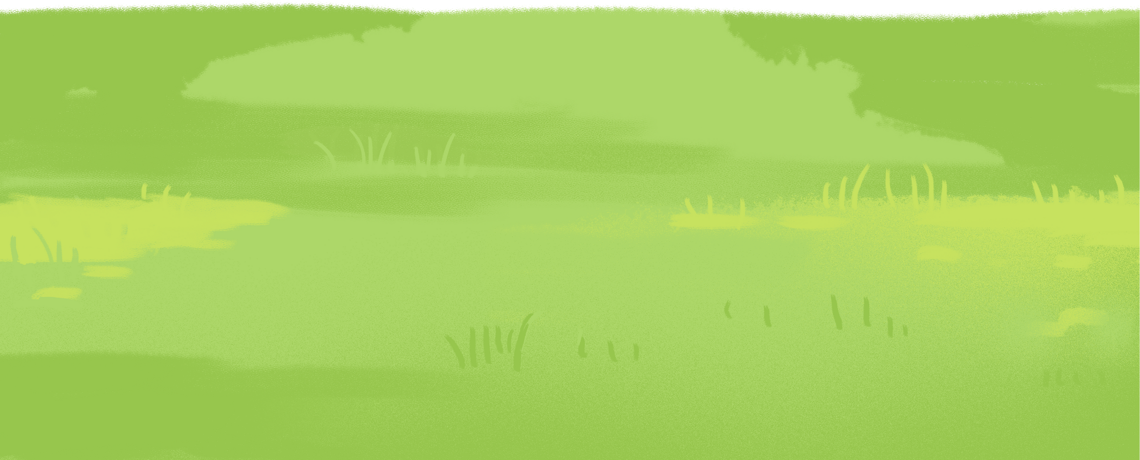
THANK YOU!

