Slide 1





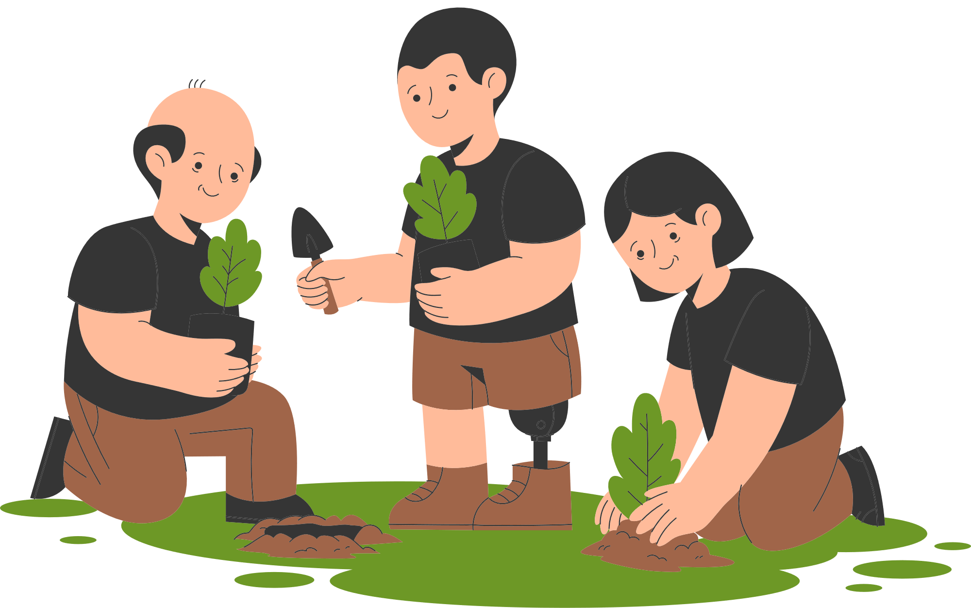
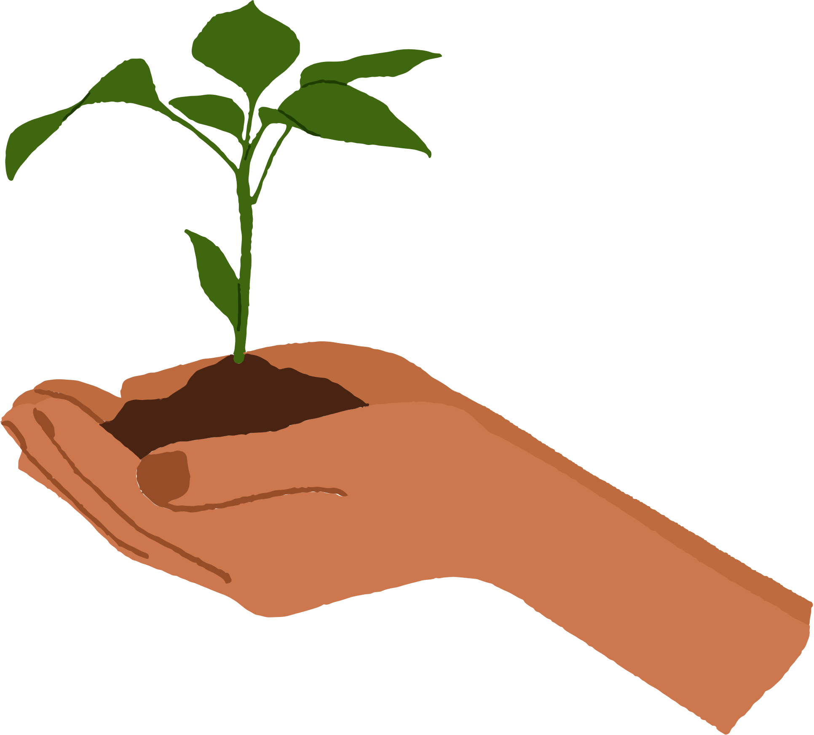


WELCOME TO OUR CLASS!
Presented by: …………..

Slide 2
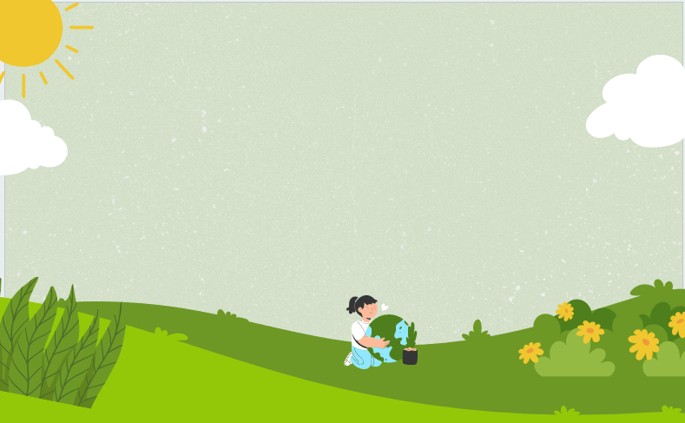
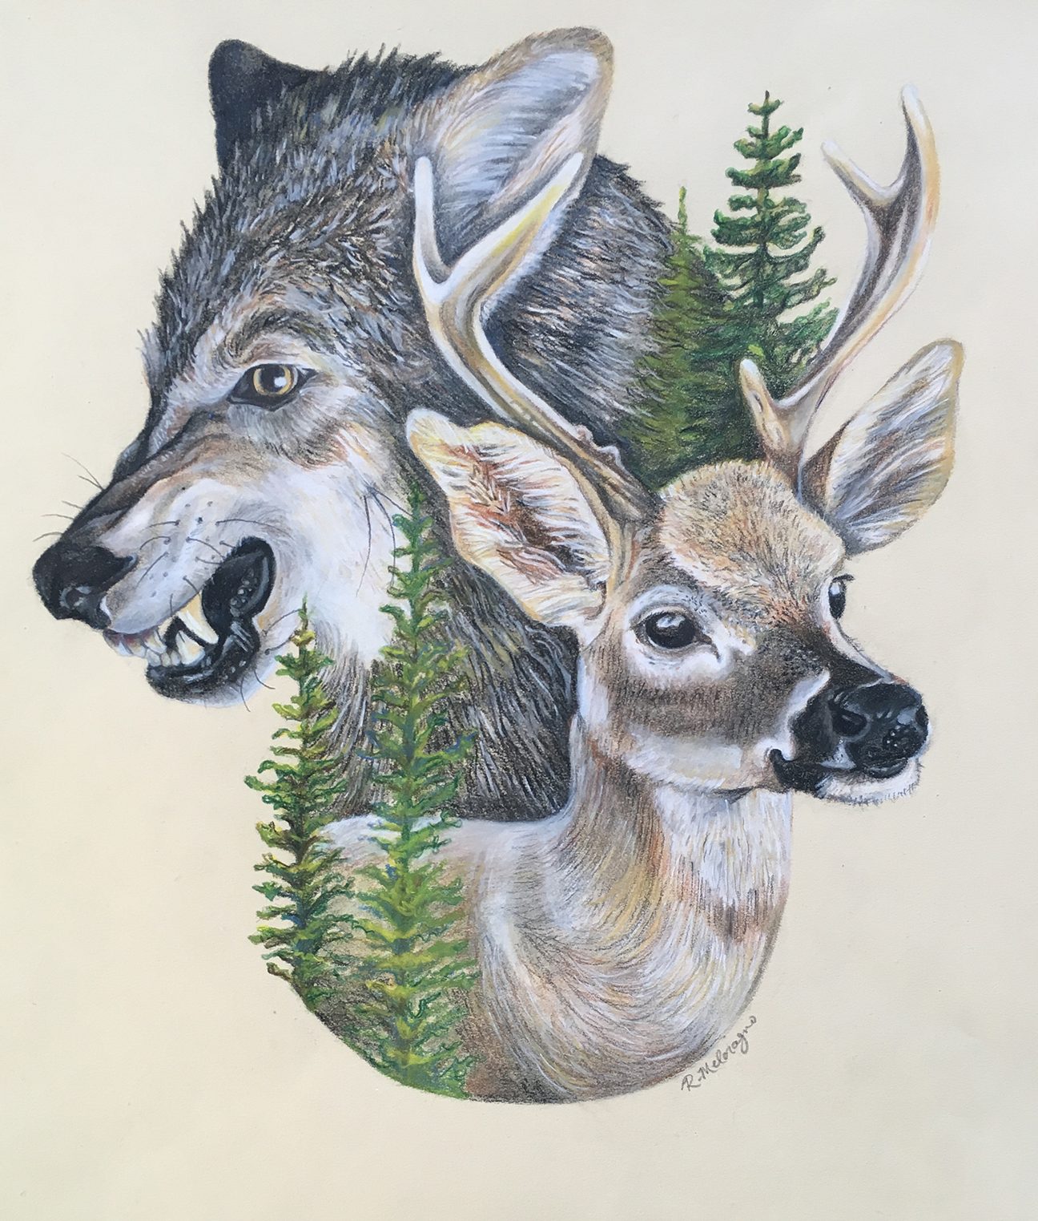
Predator-Prey Chain Challenge.

Slide 3
Predator-Prey Chain Challenge.
- Work in groups to represen different organisms in a food chain.
- Acts out their role (standing, crouching, etc.)
Example:
grass -> grasshopper -> frog -> snake
- Discuss the roles each organism plays in the chain and how disruptions can affect the ecosystem.

Slide 4
Predator-Prey Chain Challenge.
Grass → Grasshopper → Frog → Snake → Hawk
Algae → Zooplankton → Small Fish → Big Fish → Shark
Acorns → Squirrel → Owl
Leaves → Caterpillar → Bird → Fox
Phytoplankton → Krill → Penguin → Leopard Seal → Killer Whale

Slide 5
Predator-Prey Chain Challenge.
Overall, each organism plays a vital role in maintaining the balance of the ecosystem. Any disruption can have cascading effects, impacting the populations of other organisms and potentially causing widespread damage. Understanding these interconnected relationships is crucial for conservation efforts and maintaining healthy ecosystems.

Slide 6
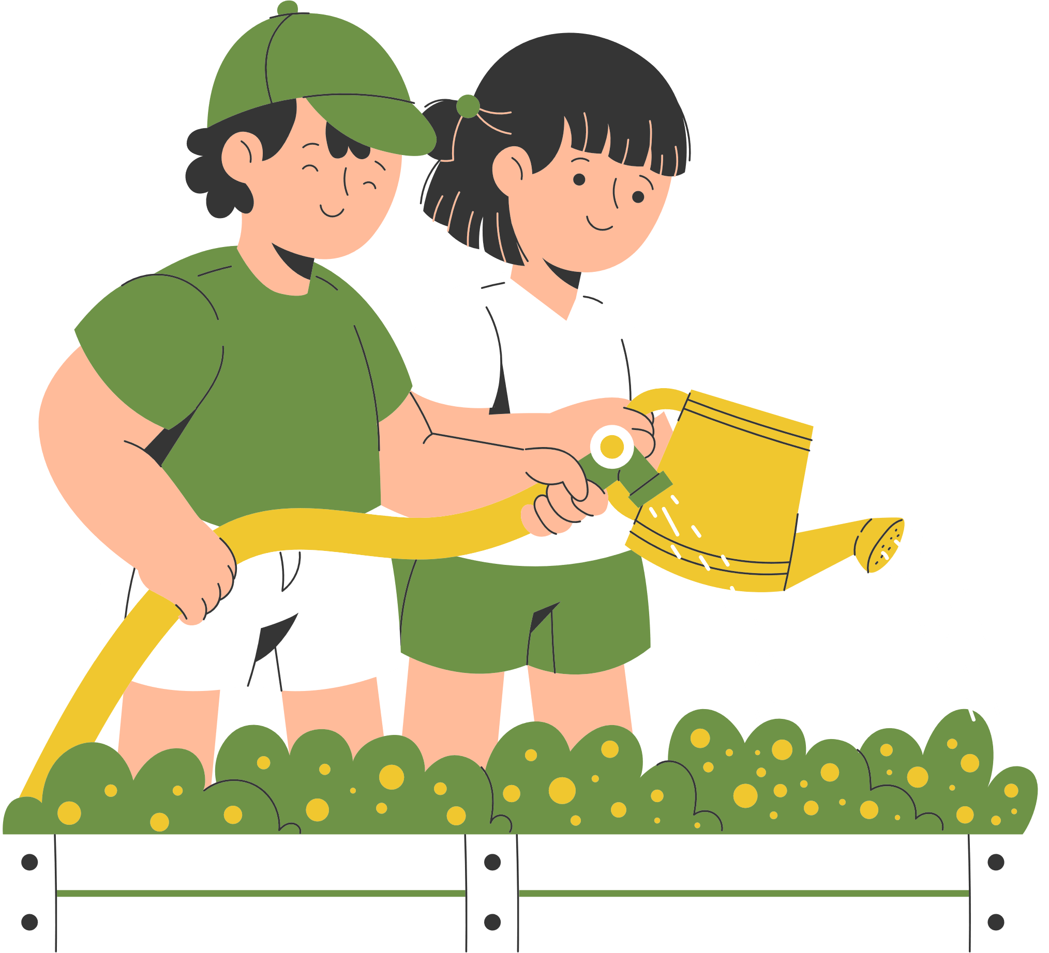

Unit 10:
PLANET EARTH
Lesson 5: Skills 1

Slide 7
1. Tick (√) the things that show the roles of plants and animals.
1. providing sources of food
2. causing habitat loss
3. keeping the ecological balance
4. making Earth beautiful
√
√
√

Slide 8
2. Read the article and choose the correct answer A, B, C, or D
Plants and animals are an essential part of Earth's ecology. When we speak about a specific habitat and time, we refer to them as flora and fauna. Flora refers to plants and fauna refers to animals. They are fascinating to study due to their beauty and significance to human life.
First, the flora and fauna on Earth create an ecological balance, making life possible for humans. Flora releases oxygen for humans. The carbon dioxide we breathe out is vital to plants. Humans also rely on the plants and animals for food, medicine, and water.
Second, plants and animals combine to create a food chain. In the food chain, the animals play an important part. They feed on plants and, in turn, are the prey of other animals. Their droppings become fertilizers for plants.
Finally, plants and animals add a lot of beauty to our earth. People love and appreciate the natural beauty, the relaxed feeling in green spaces and water areas.
However, plants and animals are facing habitat loss, pollution, and climate change. To protect them, we should raise people’s awareness of their significance, stop hunting, plant more trees, and build nature reserves for our wildlife.

Slide 9
2. Read the article and choose the correct answer A, B, C, or D
1. What is the passage mainly about?
A. The beauty of plants and animals.
B. How plants and animals protect the environment.
C. The wonder of plants and animals.
D. The natural food chain.
2. The author mentions ____ significant roles plants and animals play.
A. Two B. three C. four D. five
3. Which of the following do plants provide humans?
A. Oxygen. B. Aquatic environment.
C. Carbon dioxide D. Habitat loss.
4. Which action does NOT preserve plants and animals?
A. Planting more trees. B. Raising awareness.
C. Building nature reserves. D. Hunting animals.
5. The word "appreciate" means _______.
A. protect the qualities of B. recognise the wonder of
C. learn more about D. be aware of

Slide 10
2. Read the article and choose the correct answer A, B, C, or D
1. What is the passage mainly about?
A. The beauty of plants and animals.
B. How plants and animals protect the environment.
C. The wonder of plants and animals.
D. The natural food chain.
They are fascinating to study due to their beauty and significance to human life.

Slide 11
2. Read the article and choose the correct answer A, B, C, or D
2. The author mentions ______significant roles plants and animals play.
A. two B. three
C. four D. five
First, the flora and fauna on Earth create an ecological balance, making life possible for humans… Second, plants and animals combine to create a food chain… Finally, plants and animals add a lot of beauty to our earth.

Slide 12
2. Read the article and choose the correct answer A, B, C, or D
3. Which of the following do plants provide humans?
A. Oxygen. B. Aquatic environment.
C. Carbon dioxide D. Habitat loss.
Flora releases oxygen for humans.

Slide 13
2. Read the article and choose the correct answer A, B, C, or D
4. Which action does NOT preserve plants and animals?
A. Planting more trees. B. Raising awareness.
C. Building nature reserves. D. Hunting animals.
To protect them, we should raise people's awareness of their significance, stop hunting, plant more trees, and build nature reserves for our wildlife.

Slide 14
2. Read the article and choose the correct answer A, B, C, or D
5. The word "appreciate" means _______.
A. protect the qualities of B. recognise the wonder of
C. learn more about D. be aware of
People love and appreciate the natural beauty, the relaxed feeling in green spaces and water areas.

Slide 15
Look at the answers again
1. What is the passage mainly about?
A. The beauty of plants and animals.
B. How plants and animals protect the environment.
C. The wonder of plants and animals.
D. The natural food chain.
2. The author mentions ____ significant roles plants and animals play.
A. two B. three C. four D. five
3. Which of the following do plants provide humans?
A. Oxygen. B. Aquatic environment.
C. Carbon dioxide D. Habitat loss.
4. Which action does NOT preserve plants and animals?
A. Planting more trees. B. Raising awareness.
C. Building nature reserves. D. Hunting animals.
5. The word "appreciate" means _______.
A. protect the qualities of B. recognise the wonder of
C. learn more about D. be aware of

Slide 16
3. Read the article again and choose the correct answer A, B, C, or D
1. What is the word ‘significance’ in paragraph 1 closest in meaning to?
A. consequence B. threats C. importance
2. What is the word ‘fascinating’ in paragraph 1 closest in meaning to?
A. charming B. interesting C. ideal
3. What is the word ‘release’ in paragraph 2 closest in meaning to?
A. let out B. set free C. throw
4. What does the word “their” in paragraph 3 refer to?
A. of the flora and fauna B. of plants C. of animals
5. What do you think the paragraph after the last one would be about?
A. Problems wildlife face
B. Measures to protect wildlife
C. Importance of wildlife

Slide 17
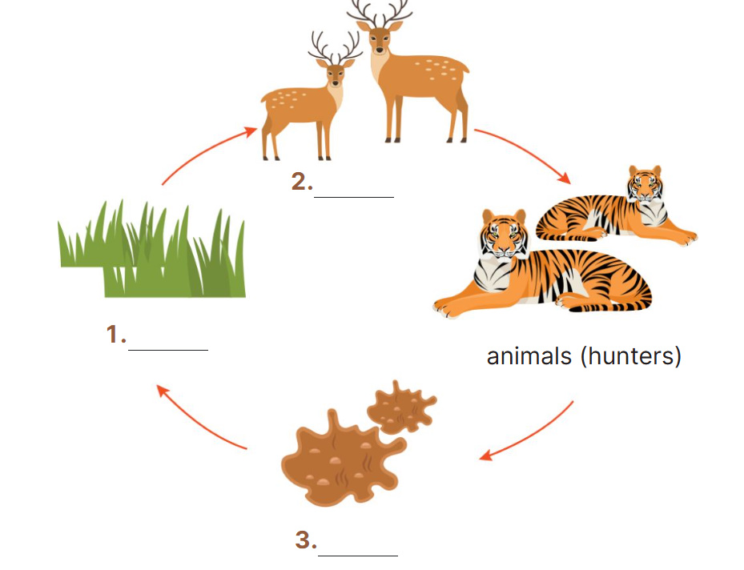
4. Read the passage again and fill in the diagram.
animals
(predator)
plants
droppings

Slide 18
5. Work in pairs. Discuss the threats to plants and animals and how we can protect them. You can use the ideas from the reading or your own ideas.
Threats | Actions
habitat loss | buiding nature reserves
deforestation
stop hunting
pollution
stop cutting down forest
climate change
plant more trees
global warming
raise people’s awareness
Threats | Actions
habitat loss | buiding nature reserves

Slide 19
6. Report the result of your discussion to the class.
Example:
There are many threats to the flora and fauna. First, they face habitat loss. For example, when a river is polluted, the water habitat cannot be suitable for water species. Many other animals and plants suffer from deforestation because people cut down trees and clear the forests. Global warming is another threat to a large number of animals because when the temperature is not appropriate, many animals may die out.
We can do several things to preserve their habitats. We should build natural reserves to preserve endangered animals and plants. People should also stop hunting and cutting down forests. If possible, people should start planting more trees. Above all, governments should have policies to raise people’s awareness of the protection of natural habitats.

Slide 20
Wrap-up
What have we learnt in this lesson?
Read for main idea and specific about role of plant and animals.
Talk about threats to flora and fauna and how to protect them.

Slide 21

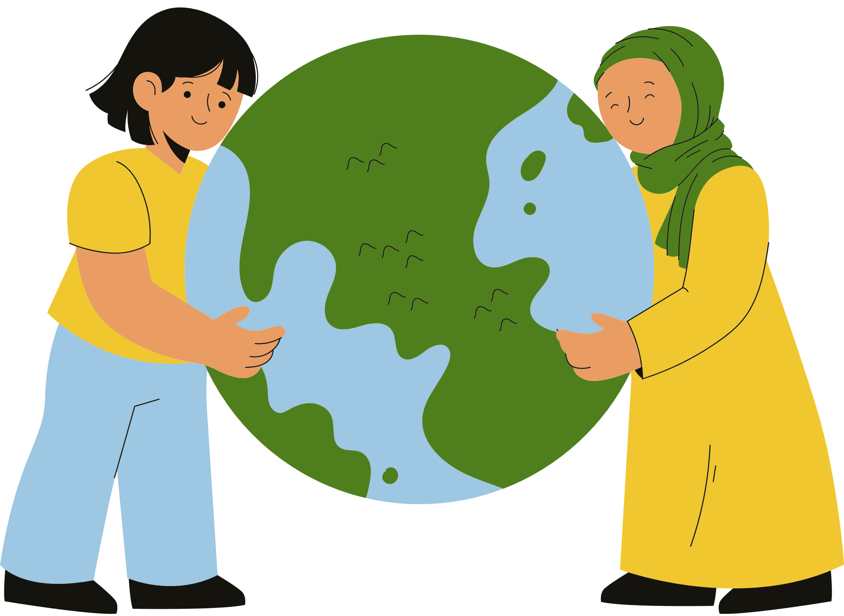



Thank You

