Slide 1

WELCOME TO
OUR CLASS!

Slide 2
Unit 7.
TRAFFIC
Lesson 4. Communication

Slide 3
Objectives
01
02
By the end of the lesson, students will be able to:
learn how to ask and answer about means of transport and some strange traffic rules.
practise using some grammar points and vocabulary related to the topic.

Slide 4
VOCABULARY

Slide 5


dangerously (adv)
/ˈdeɪndʒərəsli/
Example: Children shouldn’t ride their bikes dangerously.
một cách nguy hiểm

Slide 6
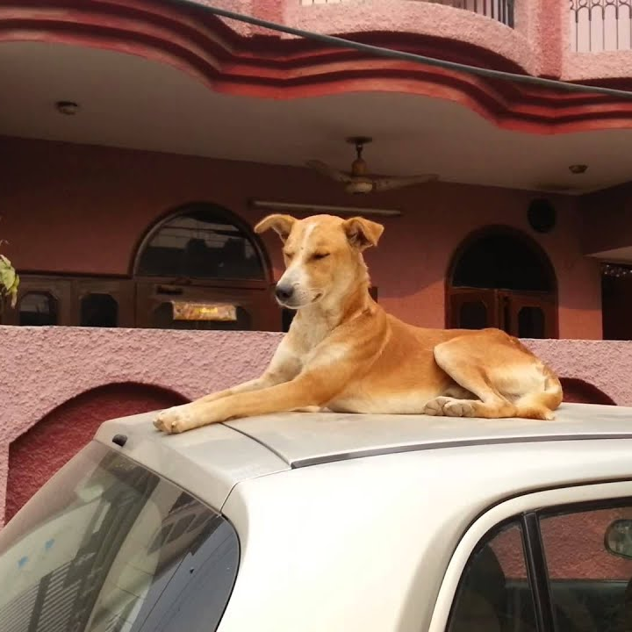

be not allowed to do something
/biː nɒt əˈlaʊd tuː duː ˈsʌmθɪŋ/
Example: In Alaska, you are not allowed to drive with a dog on the roof of your car.
không được phép làm gì

Slide 7
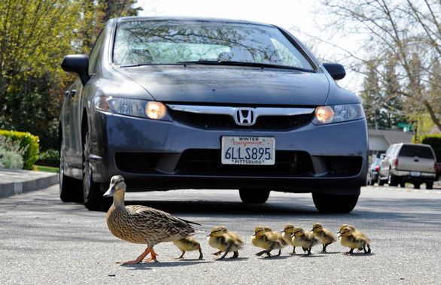

let animals go first
/lɛt ˈænɪməlz gəʊ fɜːst/
cho động vật đi trước

Slide 8
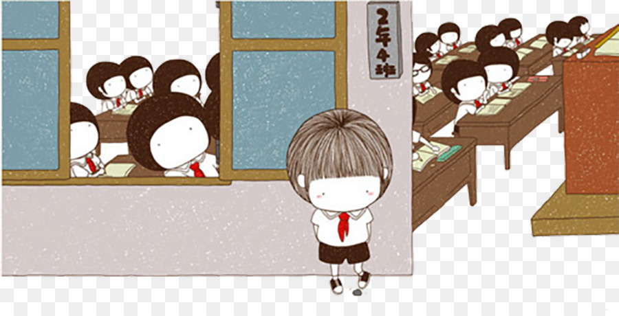

fine (v)
/faɪn/
bị phạt

Slide 9
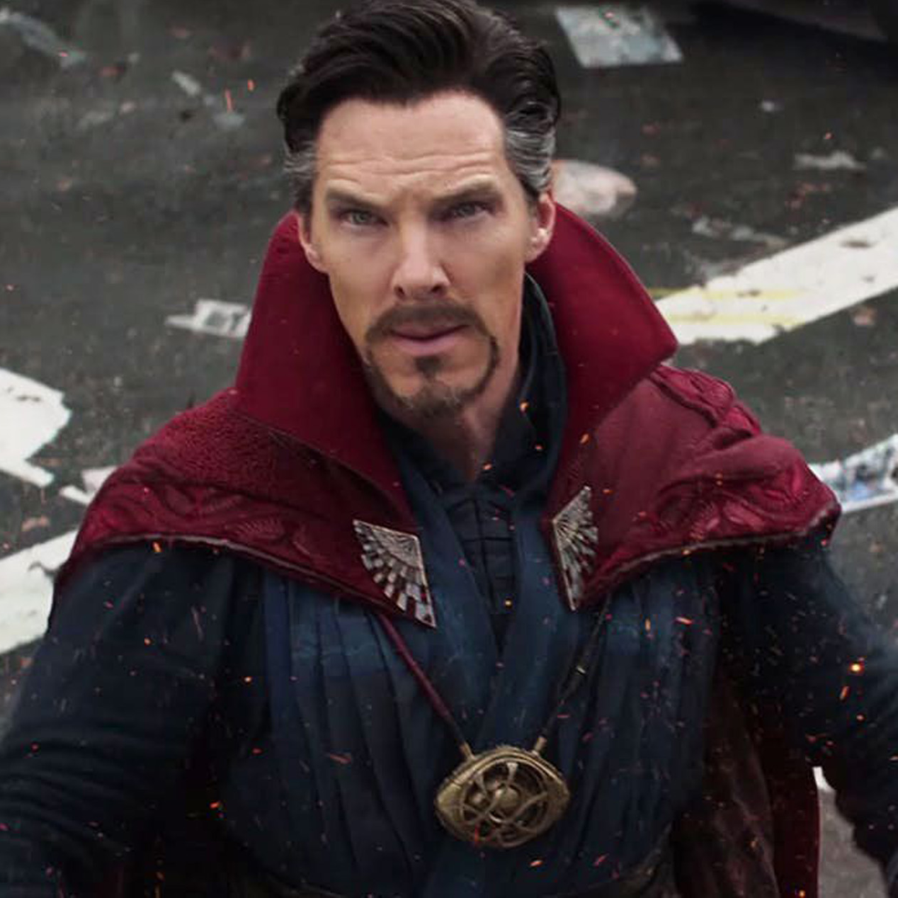
strange (adj)
/streɪndʒ/
lạ lùng

Slide 10
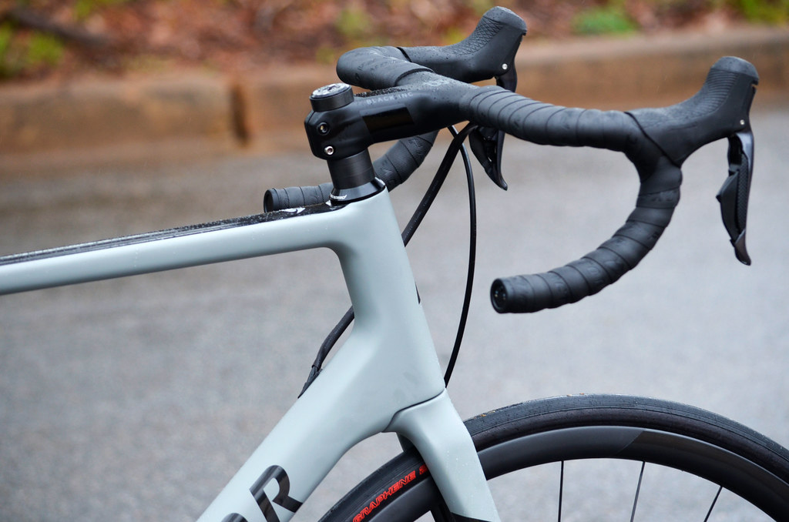

handlebars (n)
/ˈhændlbɑːz/
tay cầm

Slide 11
Checking vocabulary
Word | Pronunciation | Meaning
Strange | /streɪndʒ/ | lạ lùng
Handlebars | /ˈhændlbɑːz/ | tay cầm
Be not allowed to do something | /biː nɒt əˈlaʊd tuː duː ˈsʌmθɪŋ/ | không được phép làm gì
Fine | /faɪn/ | bị phạt
Dangerously | /ˈdeɪndʒərəsli/ | một cách nguy hiểm
Let animals go first | /lɛt ˈænɪməlz gəʊ fɜːst/ | cho động vật đi trước

Slide 12
01
Everyday English
Asking and answering about means of transport.

Slide 13

1. Listen and read the conversation, paying attention to the highlighted parts.
Nick: How does your mum get to work?
Minh: She goes by motorbike. What about your mum?
Nick: She usually goes by bus. Sometimes she cycles.

Slide 14
Show me!!!
Asking about about means of transport
How do/does + S + get/get + to + place?
Answering about about means of transport
S + go/goes/gets ….. + by/on + means of transport.

Slide 15
2. Work in pairs. Take turns to ask and answer about the means of transport your family members use every day.
Example:
A: How does your dad get to work?
B: He goes to work by car. What about your dad?
A: He often goes by bike. He wants to protect the environment.

Slide 16
02
Strange traffic rules!

Slide 17
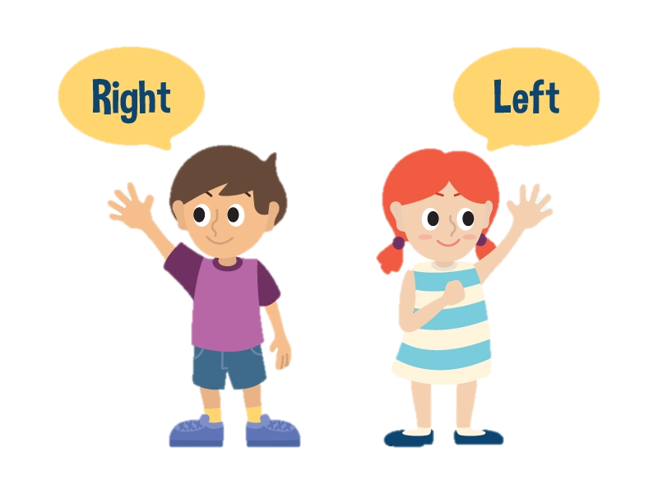
When you go on the road, which side do you keep, to the right or to the left?
When you go on the road, which side do you keep, to the right or to the left?

Slide 18


3. Which countries below keep to the left? Tick (✓) the correct answers.
3. Listen and check your answer.
The United Kingdom
The United States of America
Australia
Thailand
China

Slide 19
One explanation is that some countries use _______________ as the UK.
4. Listen again and complete the sentence with no more than THREE words.
the same system
What is the system of the UK?
The traffic rule keeps to the left.

Slide 20

5. Read the strange driving rules below.
1. In Alaska, you are not allowed to drive with a dog on the roof of your car.
2. In Moscow, police will fine you if you drive a dirty car.
3. A man has to wear a shirt or T-shirt while driving in Thailand.
4. In South Africa, you have to let animals go first.
5. In Switzerland, you can't wash your car on Sunday.
6. In Wisconsin, USA, you must always ride your bike with your hands on the handlebars.
Work in groups. Which one do you think is the strangest?
Do you know any other strange traffic rules?

Slide 21

WRAP-UP
How do you get to school?
On foot
By foot
By bike

Slide 22
Which countries below keep to the right?
Vietnam
Italia
Thailand
Germany
China
Hong Kong

Slide 23
Thank you!

