Slide 1

WELCOME TO OUR CLASS
Presented by: …………………………………………….

Slide 2



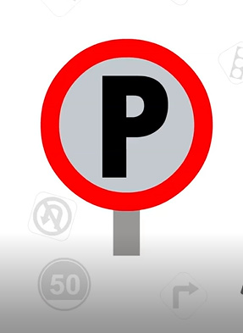
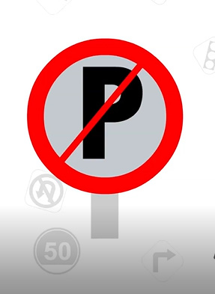
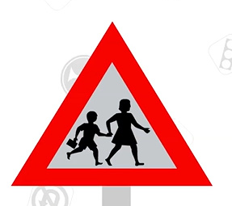

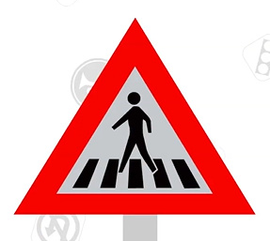
Pelmanism
1
2
3
4
No horn
School ahead
Speed limit
No parking
Parking here
8
5
6
7
Pedestrian crossing
No U-Turn
Traffic light
A
B
C
D
E
F
G
H

Slide 3
Listen and repeat.
Traffic light
Speed limit
No horn
Parking here
No parking
School ahead
No U-turn
Pedestrian

Slide 4
UNIT 7: TRAFFIC
Lesson 7: Looking back & Project

Slide 5
VOCABULARY

Slide 6
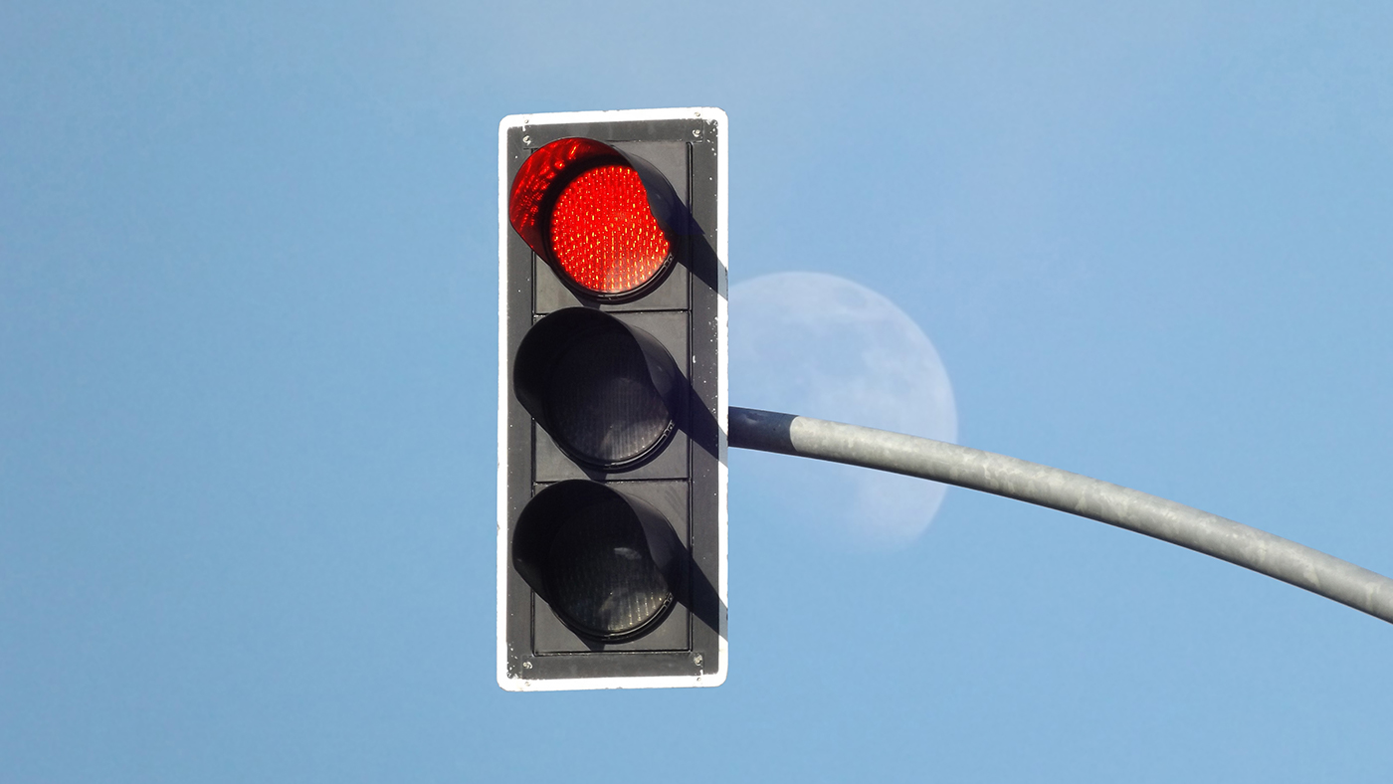






1. Label each sign.
1. ………………
2. ………………
3. ………………
4. ………………
5. ………………
6. ………………

Slide 7

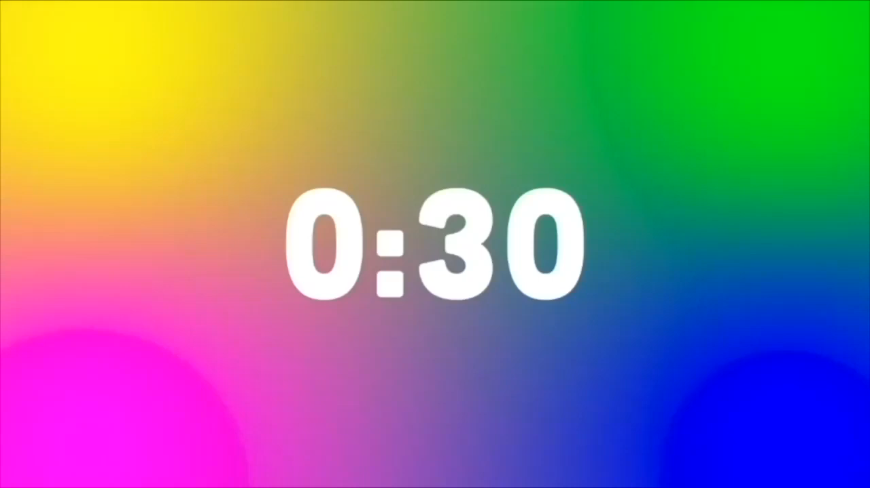
No left turn

Slide 8

No cycling

Slide 9

Cycle lane

Slide 10
School ahead

Slide 11
Red light

Slide 12
Hospital ahead

Slide 13
Look at the answers again
1. Red light
2. School ahead
3. Hospital ahead
4. Cycle lane
5. No left turn
6. No cylcing

Slide 14
2. Fill in each gap with one word to complete the sentences.
A road ___________ is anyone who uses a road, such as a pedestrian, cyclist or motorist.
Does your dad _____________ his motorbike carefully?
A __________ is a person travelling in a car, bus, train,… but not driving.
My cousin wants to become a pilot. He is learning to _______ planes.
We should be careful when the __________ light turns yellow.
user
ride
passenger
fly
traffic

Slide 15
GRAMMAR

Slide 16




How far is it from your house to school?
It is about 1km from my house to school.
1km

Slide 17
It indicating distance
- It is about 1km from my house to school.
It is + distance + from A to B

Slide 18
3. Write complete sentences, using these cues.
Over 100km/ my hometown/ Ho Chi Minh city.
It’s over 100km from my hometown to Ho Chi Minh City
2. About 25 km/ my grandparents' house.
→ It is about 25km to my grandparents’ house.
3. not very far / our school / the city museum.
It is not very far from our school to the city museum.
4. how far / your house / the gym?
→ How far is it from your house to the gym?
5. it / a long distance / Ha Noi / Ban Gioc Waterfall?
→ Is it a long distance from Ha Noi to Ban Gioc Waterfall?

Slide 19
Should / Shouldn’t
There are a lot of cars out today. He shouldn’t drive so fast.
I think that he should eat less. He’s becoming overweight.
→ To give advice
→ To say what is the correct or best things to do.
Should / shouldn’t + V
Notes:
When do we use should/ shouldn’t

Slide 20
4. Choose A, B or C to complete the sentences.
1. You ________ put the rubbish in the waste bins over there.
A. should B. would C. shouldn’t
2. You_________ be over eighteen to ride a motorbike.
A. would B. must C. could
3. Children _________ ride their bikes too fast.
A. mightn’t B. wouldn’t C. shouldn’t
4. I am a bit lost. _______ you help me, please?
A. Could B. Should C. Might
5. You_________ eat so many cookies. Too much sugar is bad of you.
A. couldn’t B. wouldn’t C. shouldn’t
6. This is a big park. You ________ run or cycle here.
A. should B. can C. could

Slide 21
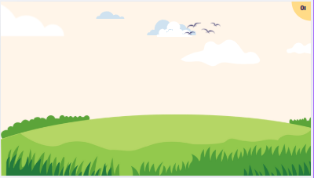
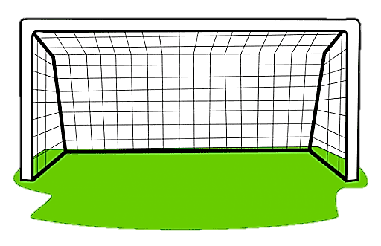
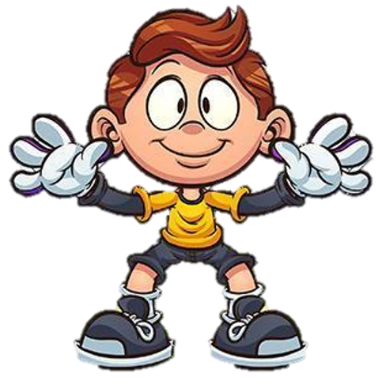

1. You ________ put the rubbish in the waste bins over there.
A. should
B. would
C. shouldn’t

Slide 22
2. You_________ be over eighteen to ride a motorbike.
A. would
B. must
C. could

Slide 23
3. Children _________ ride their bikes too fast.
A. mightn’t
B. wouldn’t
C. shouldn’t

Slide 24
4. I am a bit lost. _______ you help me, please?
A. Could
B. Should
C. Might

Slide 25
5. You_________ eat so many cookies. Too much sugar is bad of you.
A. couldn’t
B. wouldn’t
C. shouldn’t

Slide 26
6. This is a big park. You ________ run or cycle here.
A. should
B. can
C. could

Slide 27
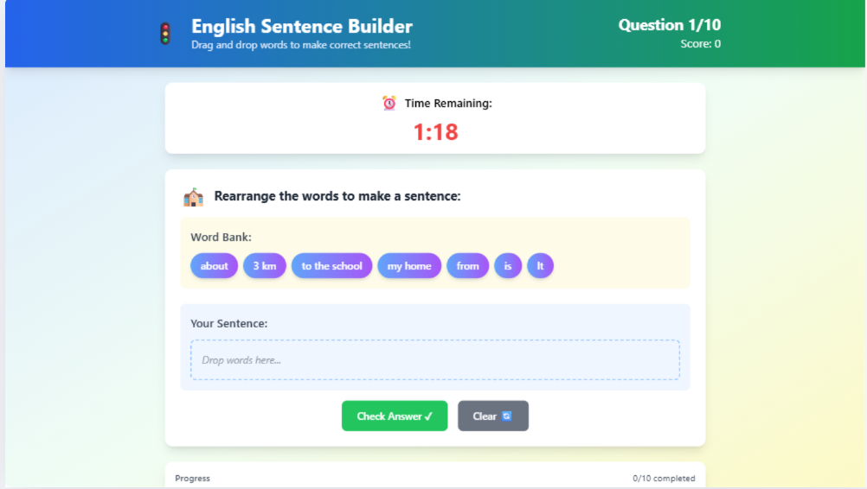
Play game on Canva AI
https://english6unit5.my.canva.site/designing-an-interactive-drag-and-drop-english-exercise

Slide 28
PROJECT PRESENTATION

Slide 29
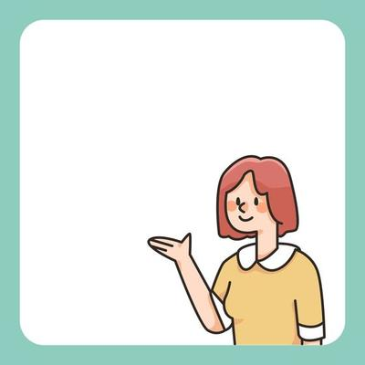
Homework
- Review all the knowledge in unit 7
- Prepare Unit 8: Getting Started

Slide 30
Thanks!

Slide 31
See you next time!

