Slide 1


Teacher:

Slide 2
Photo flash
remember and write
all the festivals

Slide 3
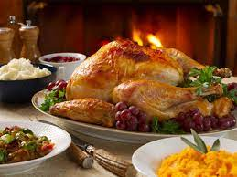
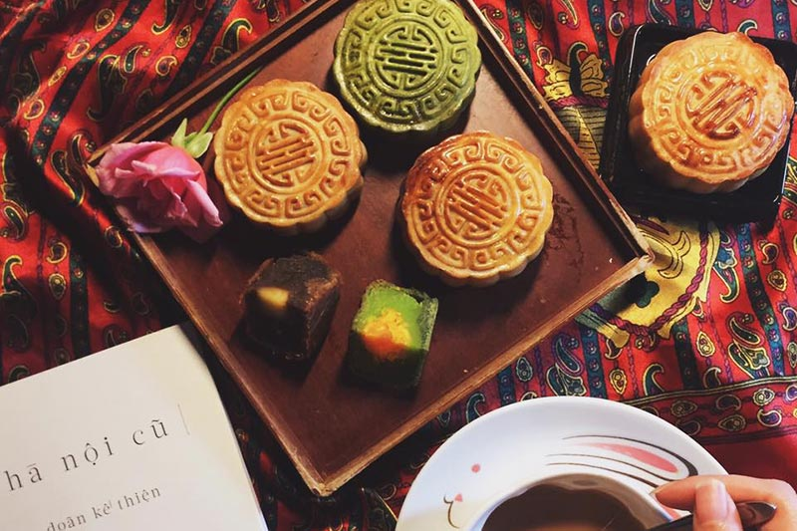
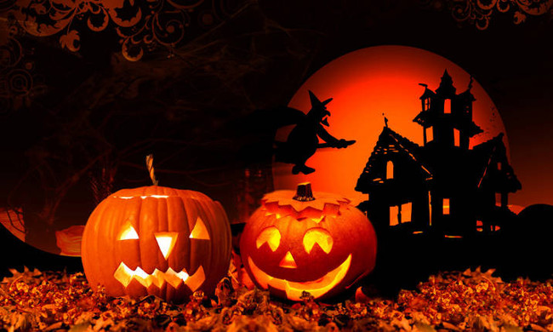

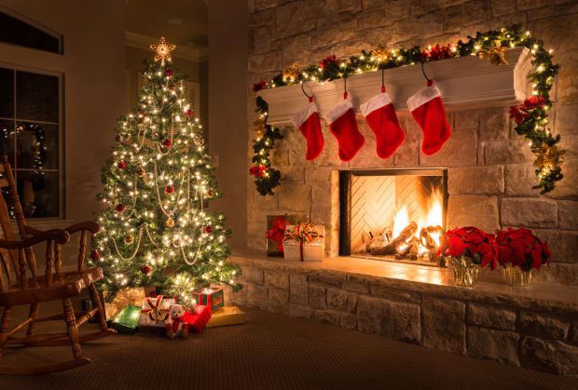
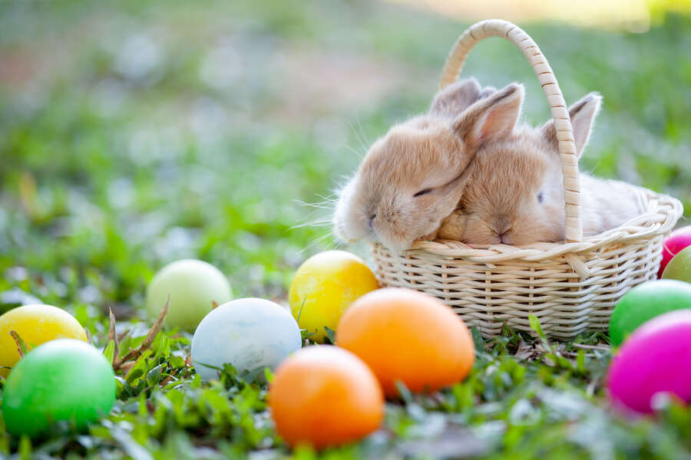

Show all
Fast
Medium
Slow
Hide all
Notes:
Right-click on an image and select change picture.
Select your picture. Click on insert.
Start your presentation.
Click on Fast, Medium or Slow to show the series of images.
Click Show All to see all the images.
Click Hide All to hide all the images.

Slide 4
UNIT 9: FESTIVALS AROUND THE WORLD
……, March …… , 2026
Lesson 4: Communication

Slide 5
Objectives
1. Everyday English
2. Festival symbols
Express disappointment
Understand and talk about the concept of festival symbols and their meanings

Slide 6
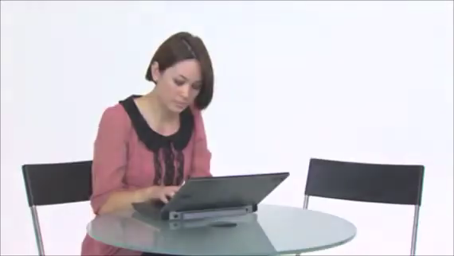
How does the girl and the boy feel?
Notes:
T lead to the next part: today we will learn how to express disappointment.

Slide 7
01
Everyday English
Expressing Disappointment

Slide 8
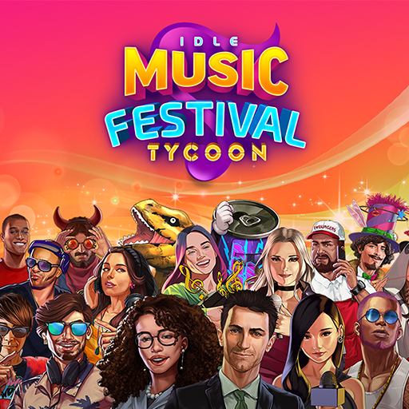
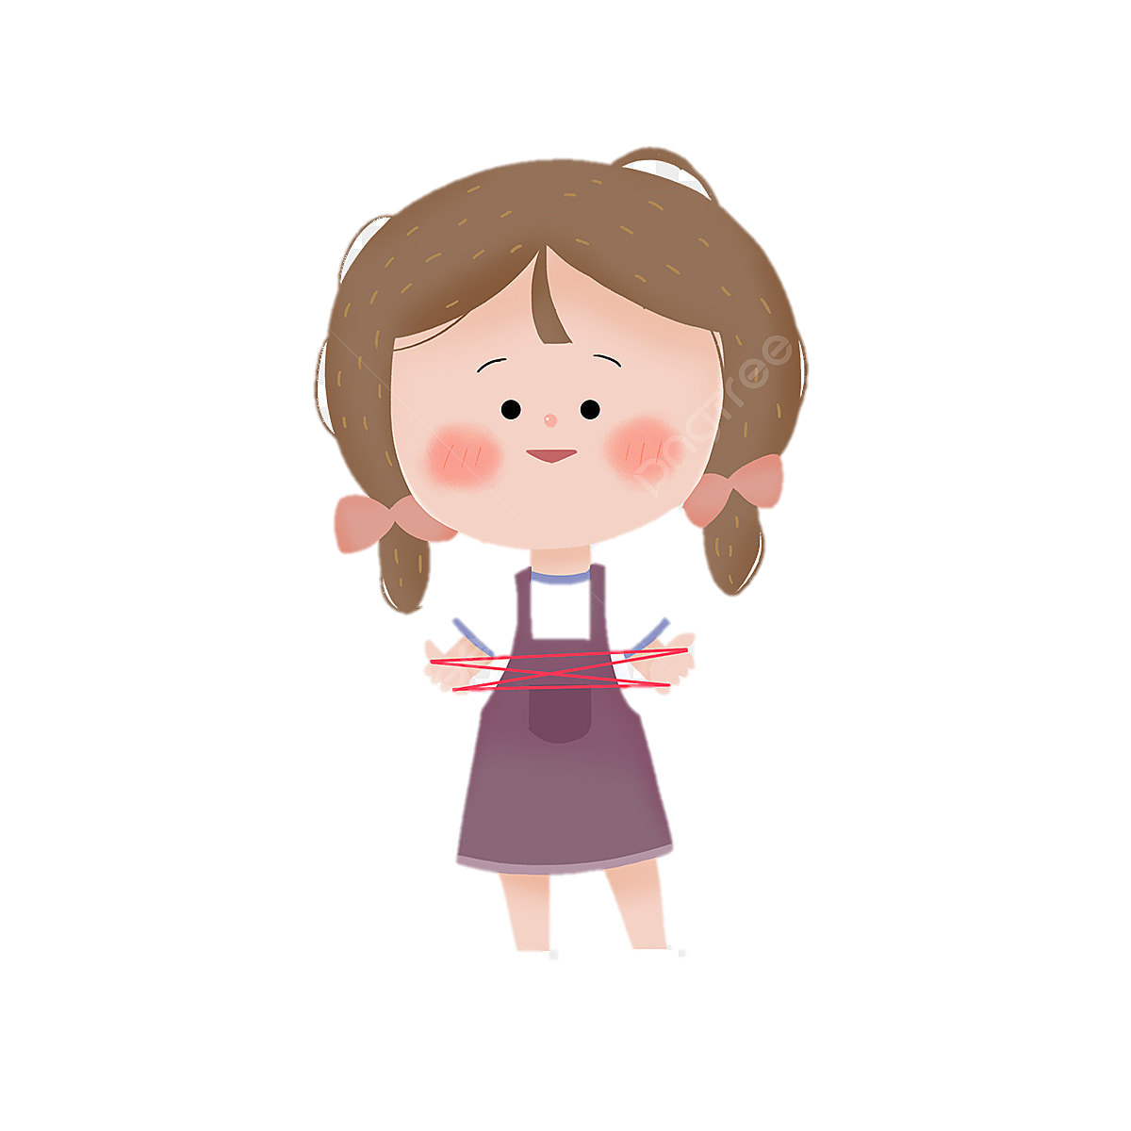
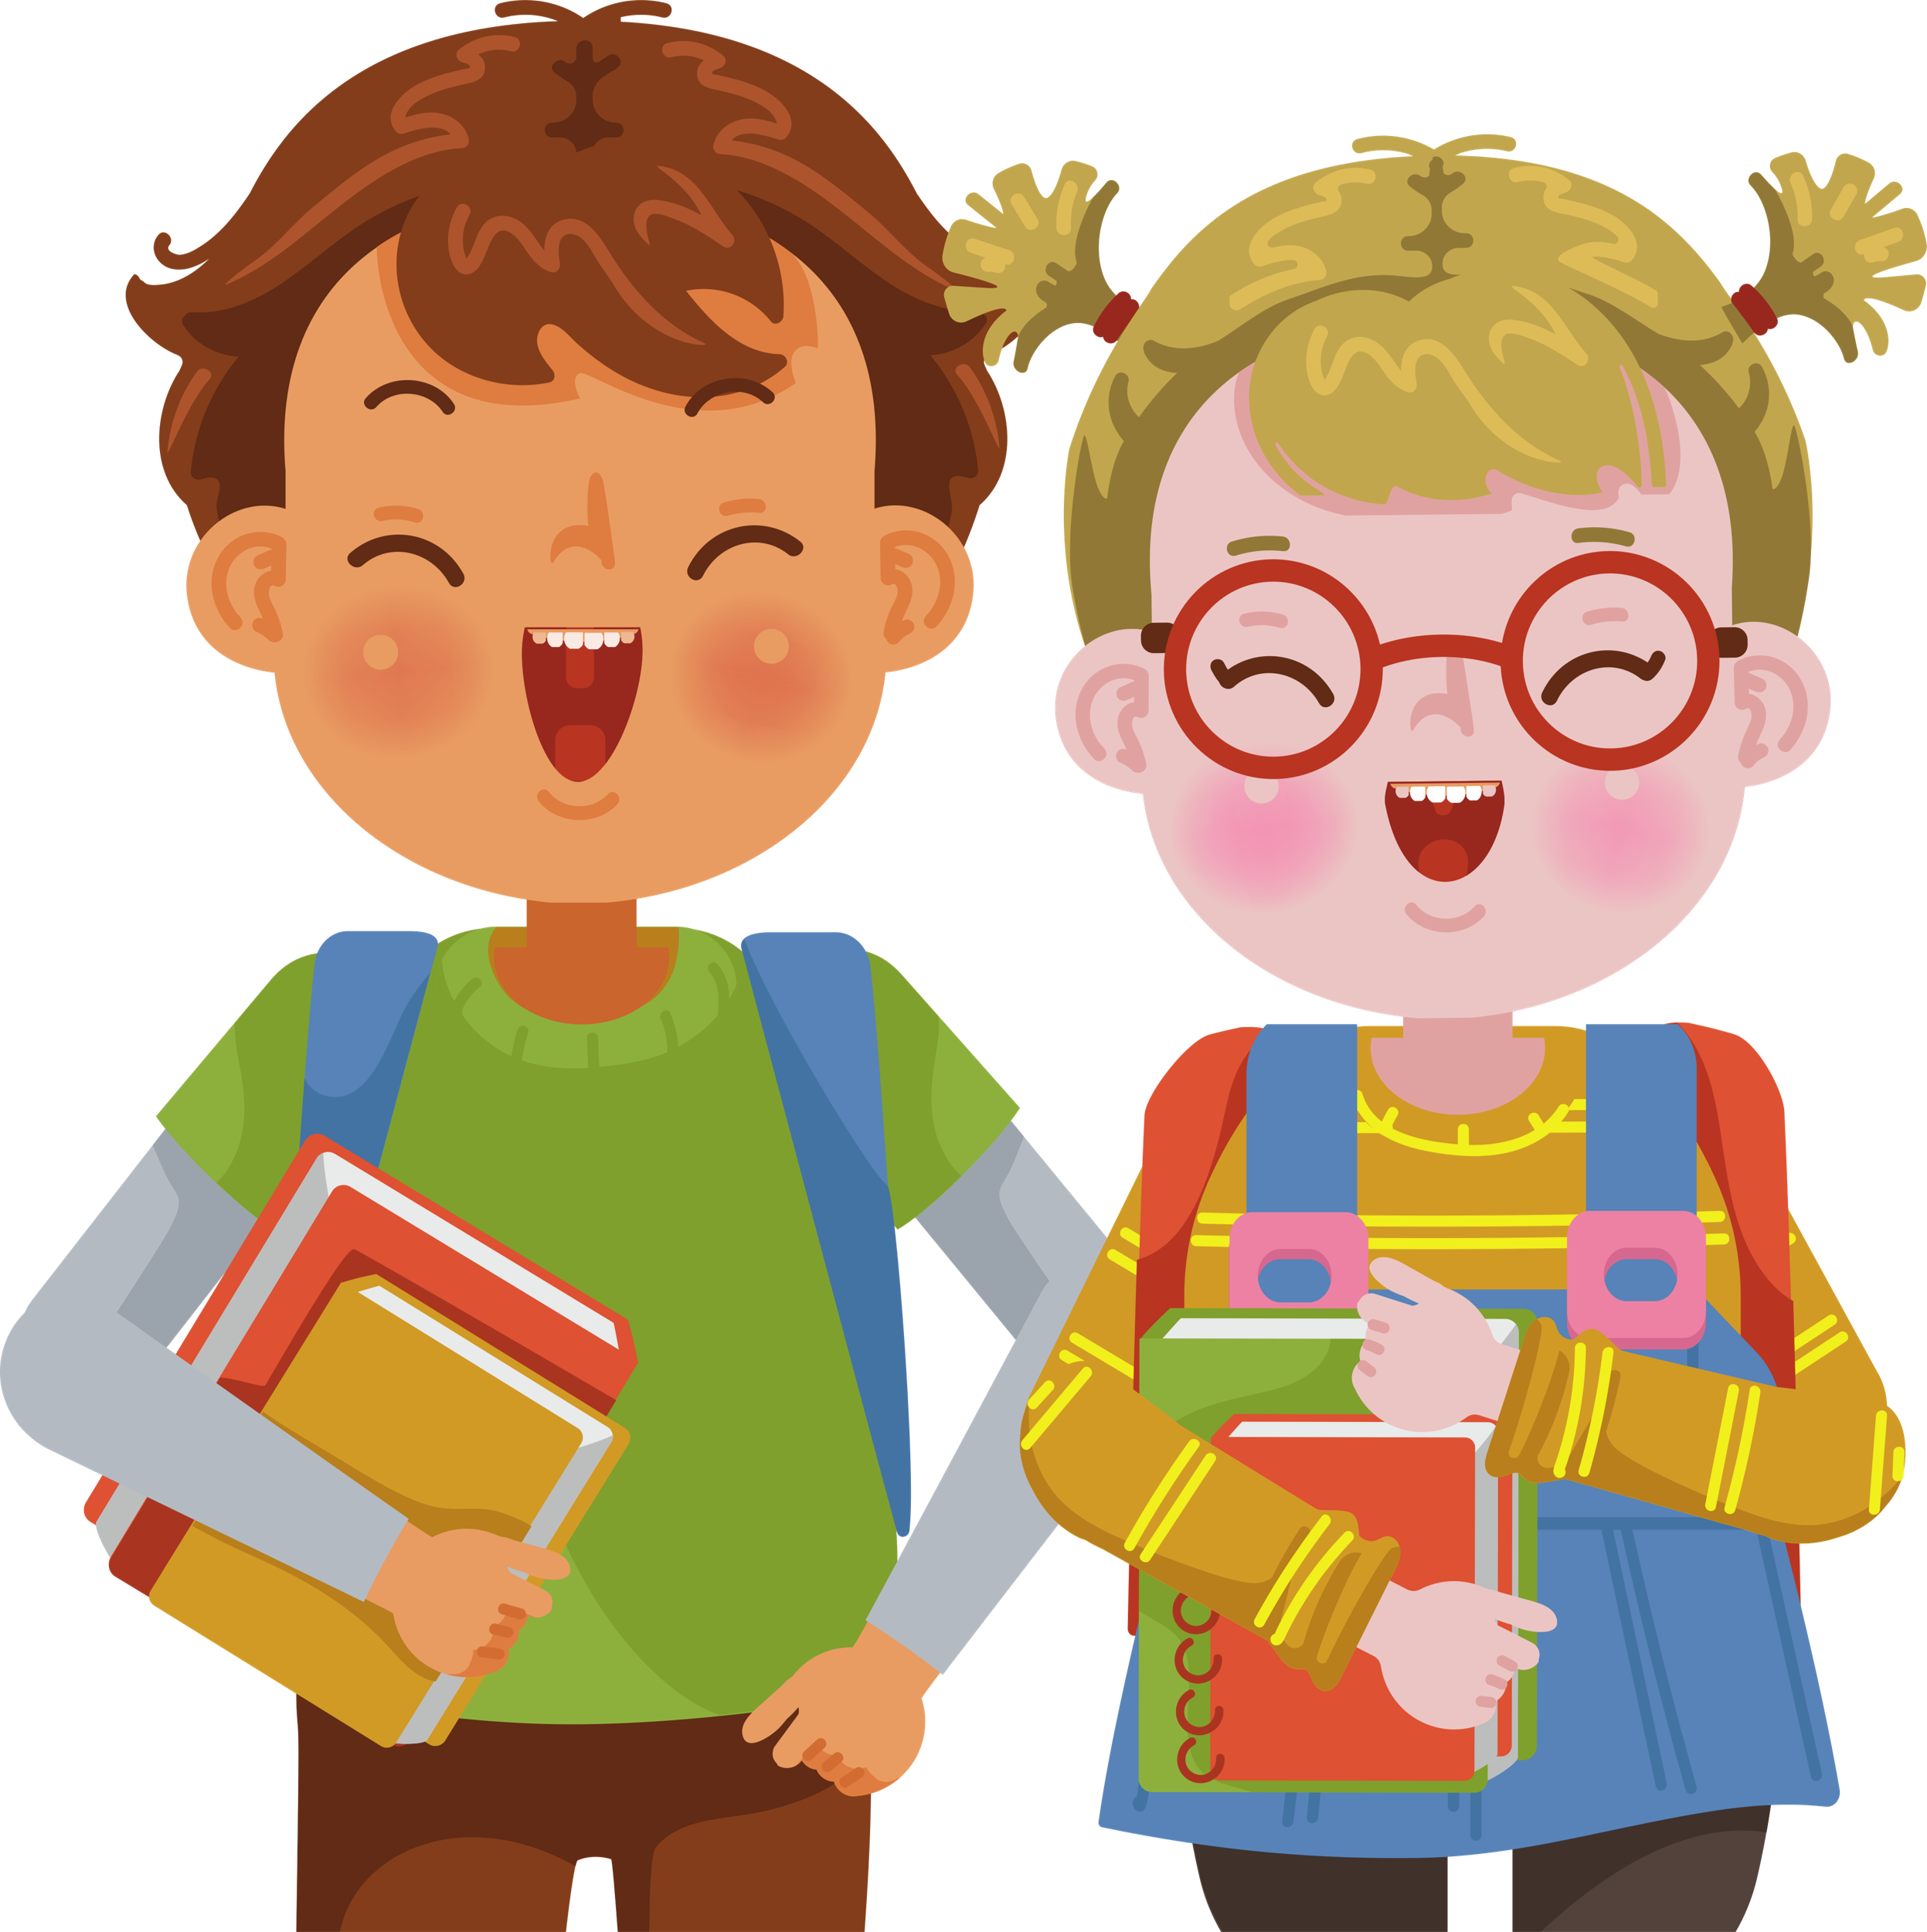
Mi
Mark and Trang

Slide 9

1. Listen and read the conversation. Pay attention to the highlighted sentences.
Mi: How was the music festival last Sunday?
Mark: It was disappointing!
Mi: Why?
Mark: The band was late.
Trang: And the singers weren’t very good either. It was a big disappointment.
What phrases did they use to express disappointment?
Can you add more?
Notes:
Suggestion: That’s too bad!, What a disaster!; That’s so disappointing!, what a bummer!, That’s a pity!, What a shame!, that's a real downer. ...

Slide 10
Expressing disappointment
It was disappointing!
It was a big disappointment!
That’s too bad!
That’s so disappointing!
That’s a pity!
What a shame!

Slide 11

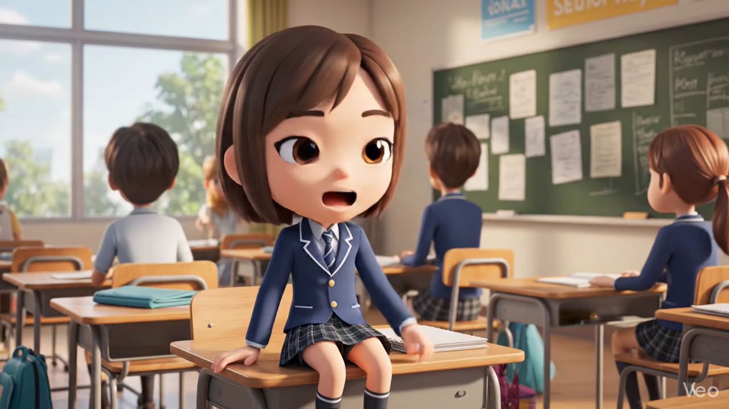
2. Work in groups. Make a similar conversation for each situation below.
1
Your friend went to a film festival for teenagers, but there were not many films he / she liked.

Slide 12
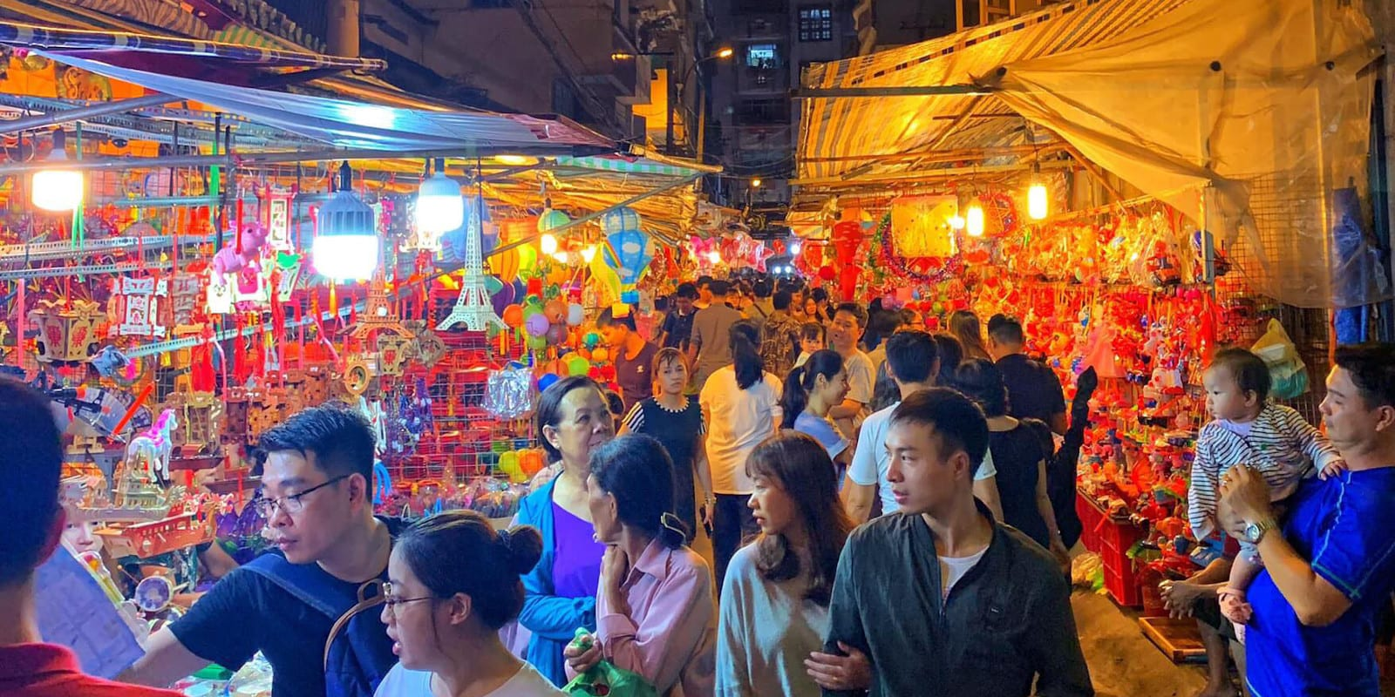
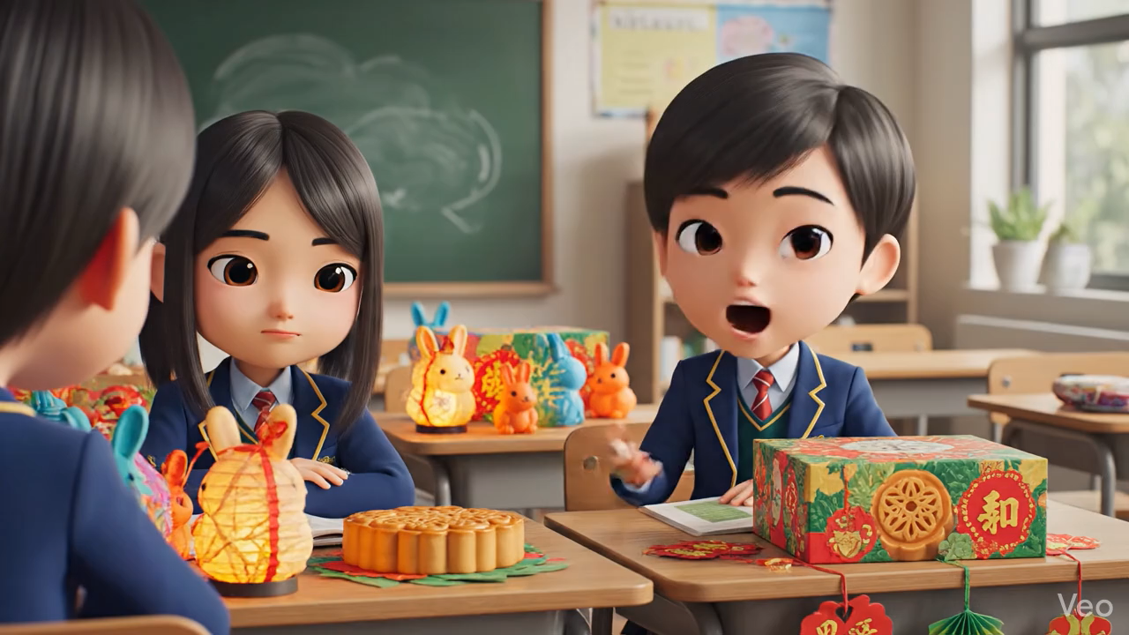
2. Work in groups. Make a similar conversation for each situation below.
2
Your friend went to the market to buy decorations for the Mid-Autumn Festival. But there were not many decorations to choose from.

Slide 13

2. Work in groups. Make a similar conversation for each situation below.
1
2
Your friend went to a film festival for teenagers, but there were not many films he / she liked.
Your friend went to the market to buy decorations for the Mid-Autumn Festival. But there were not many decorations to choose from.

Slide 14
Present time!!

Slide 15
02
Festival Symbols

Slide 16

3. Listen to Mark talking about festival symbols. Fill in each blank with ONE word.
1. A symbol is an image we use or think of when celebrating a festival.
2. A symbol usually has a special meaning.
3. The Christmas tree is the symbol of a long life.
4. Santa Claus is the symbol of joy and happiness.
Notes:
Suggestion: what a bummer!, That’s a pity!, What a shame!, That’s too bad, that's a real downer. ...

Slide 17
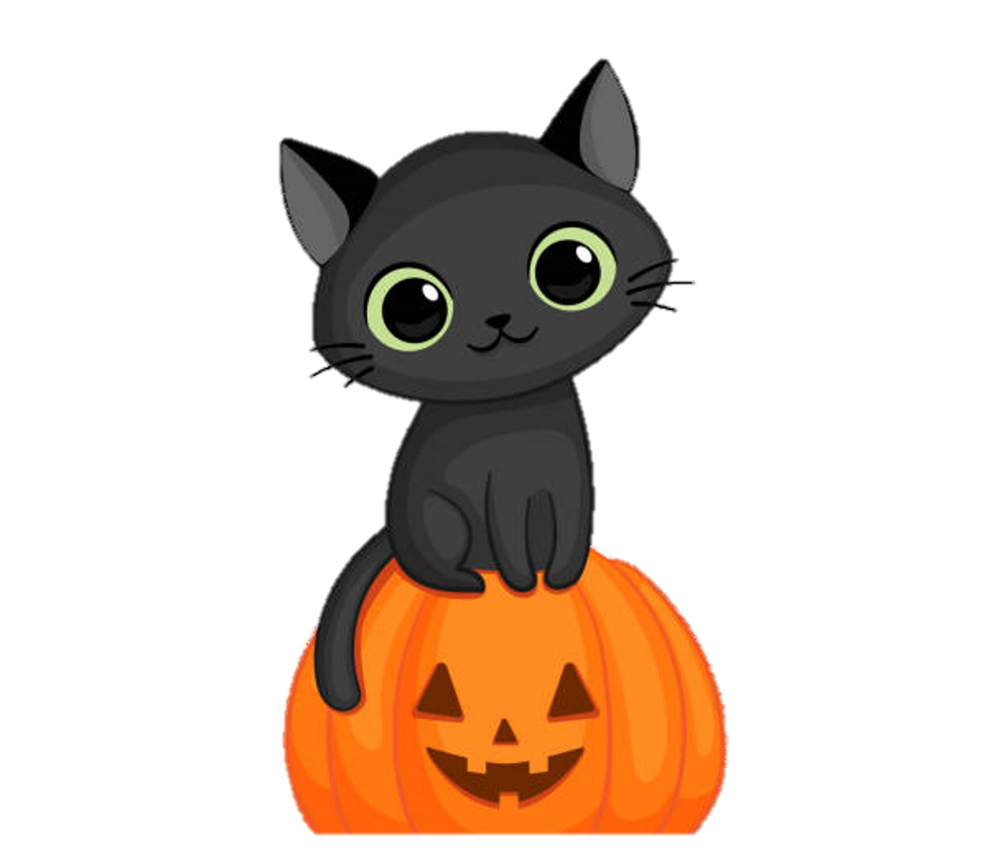
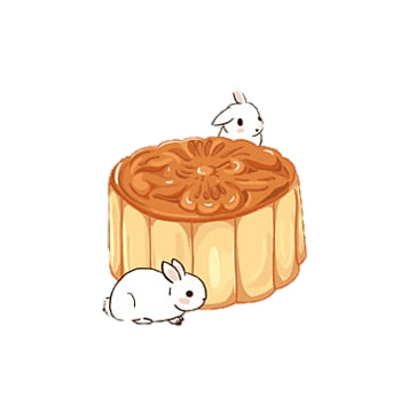

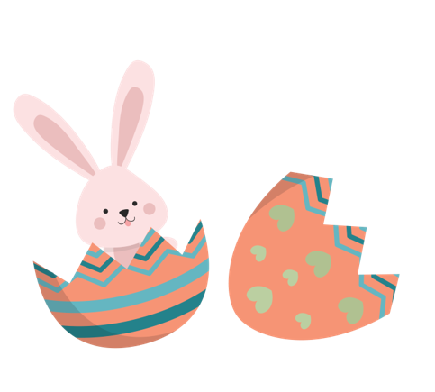
Pelmanism
THE FESTIVAL AND ITS SYMBOL
1
2
3
4
Halloween
Cannes Film Festival
Easter
Mid-autumn festival
A
B
C
D

Slide 18
4. Match the festival with its symbol and meaning.
1. Mid-Autumn Festival | a. It is the symbol of a new life because it has a lot of babies.
2. Halloween | b. It is the symbol of the moon, prosperity and family reunion.
3. Easter | c. It is the symbol of bad luck.
4. Cannes Film Festival | d. It is the symbol of the winner's prize.

Slide 19
Look at the answers again.
Mid-autumn Festival
Halloween
Easter
Cannes Film Festival
It’s the symbol of the moon, prosperity and family reunion.
It’s the symbol of bad luck
It’s the symbol of a new life because it has a lot of babies
It’s the symbol of the winner’s prize.

Slide 20
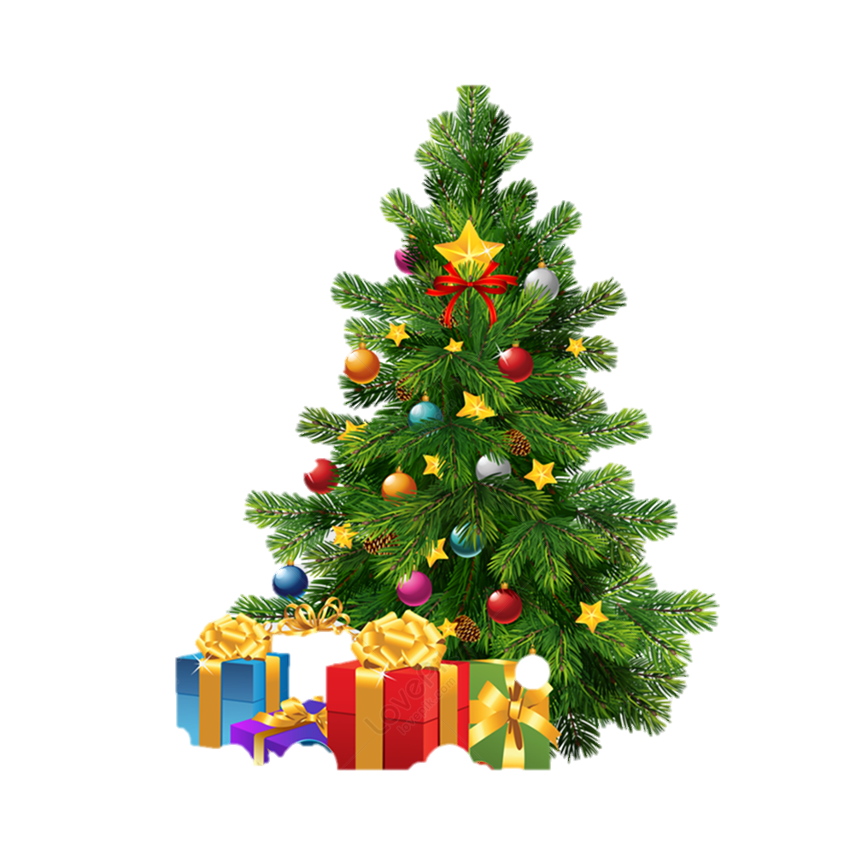
When we talk about Christmas, we think of the Christmas tree. It is the symbol of a long life.

Slide 21
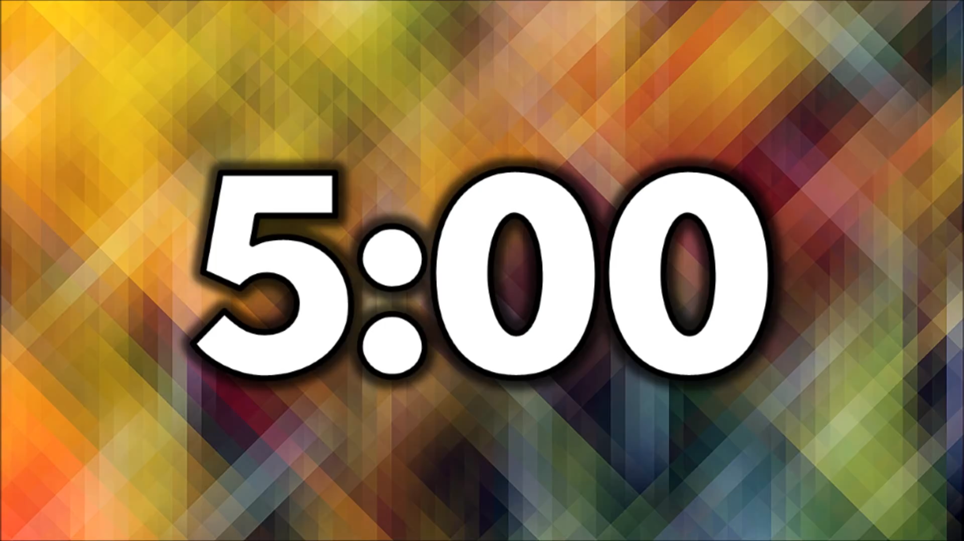
Ex 5: Work in groups. Choose a festival and talk about its symbol(s) and meaning.
Work in group of 6 in 5 minutes
Choose a festival and talk about its symbols
Present to the class in 2 minutes
Example:
When we talk about Christmas, we think of the Christmas tree. It is the symbol of a long life.

Slide 22
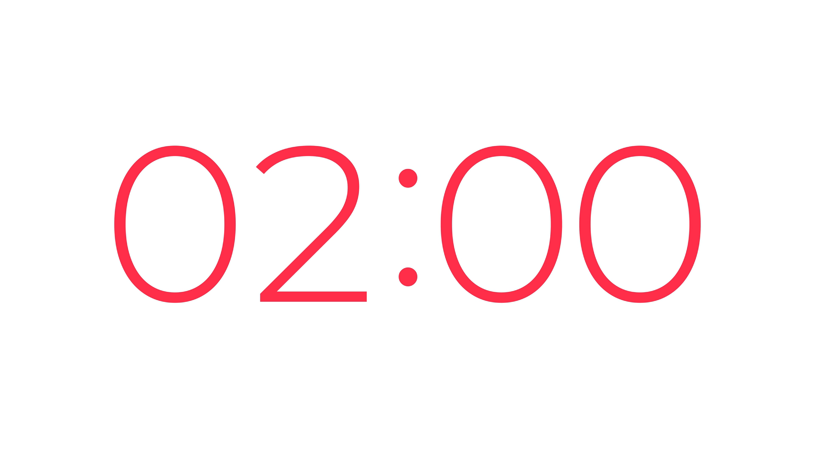
Present time!!

Slide 23
WRAP-UP
What have you learnt today?

Slide 24
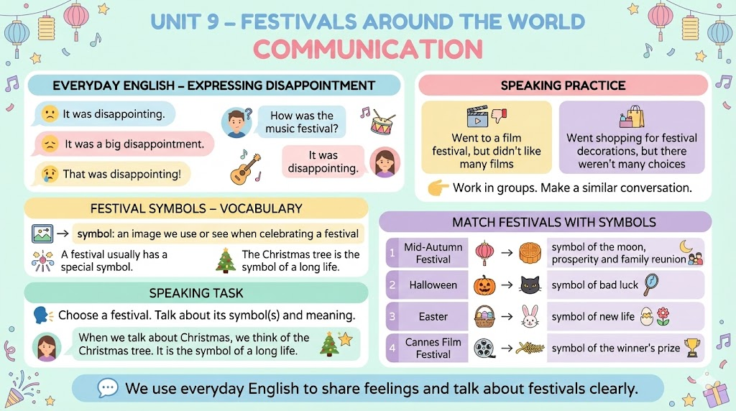

Slide 25
THANK YOU!
Homework:
Finish your talk about festivals and their symbols.
Prepare for the next lesson.

