Slide 1

WELCOME TO OUR CLASS!
Presented by: …………………

Slide 2
Which energy source is behind the binoculars?
GAME:

Slide 3


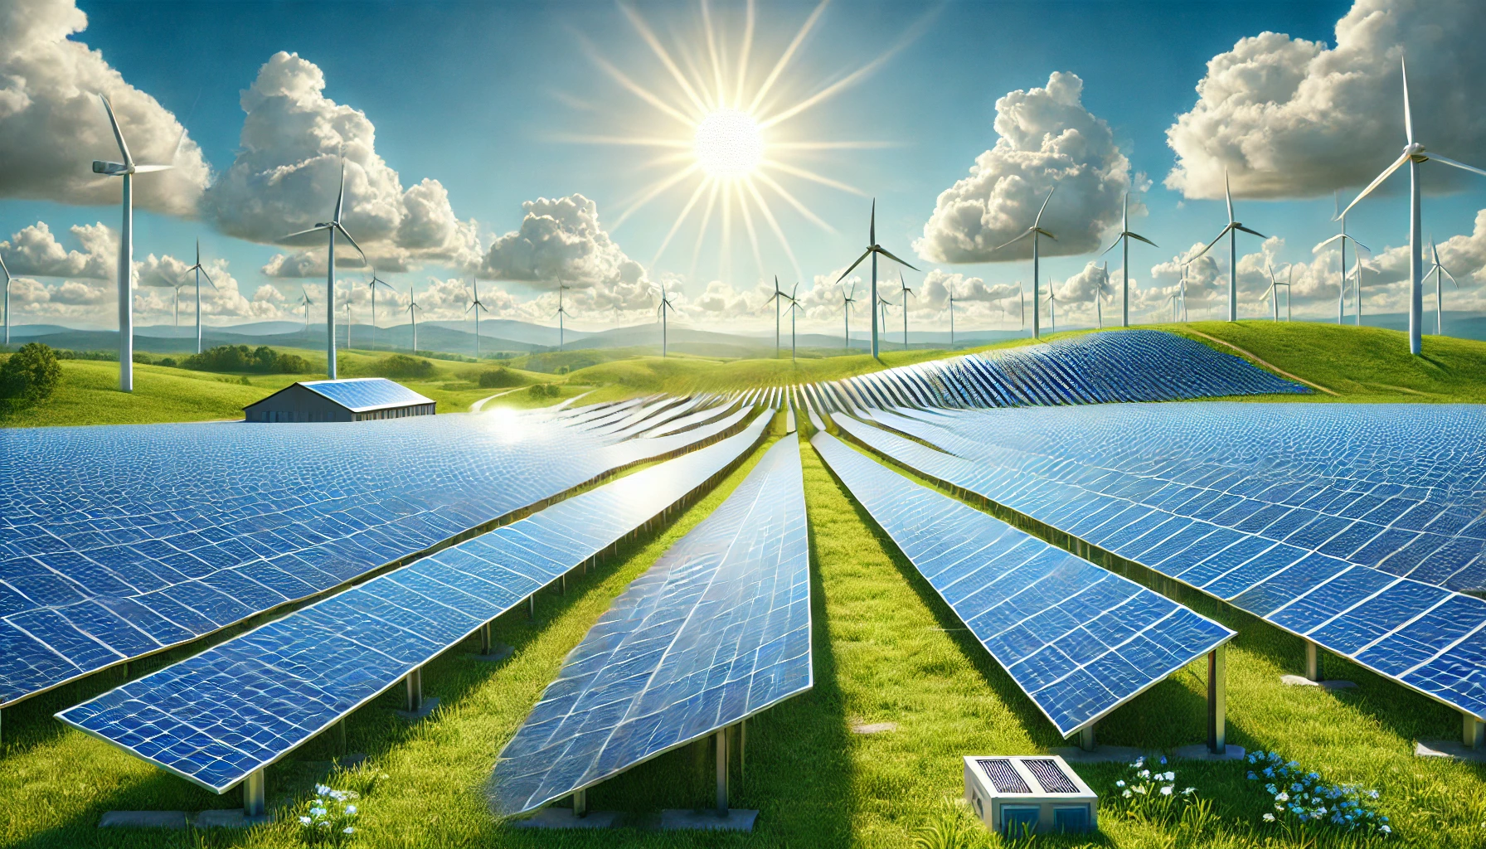
Photo courtesy of Lisa L Wiedmeier (@flickr.com) - granted under creative commons licence - attribution
Solar energy

Slide 4
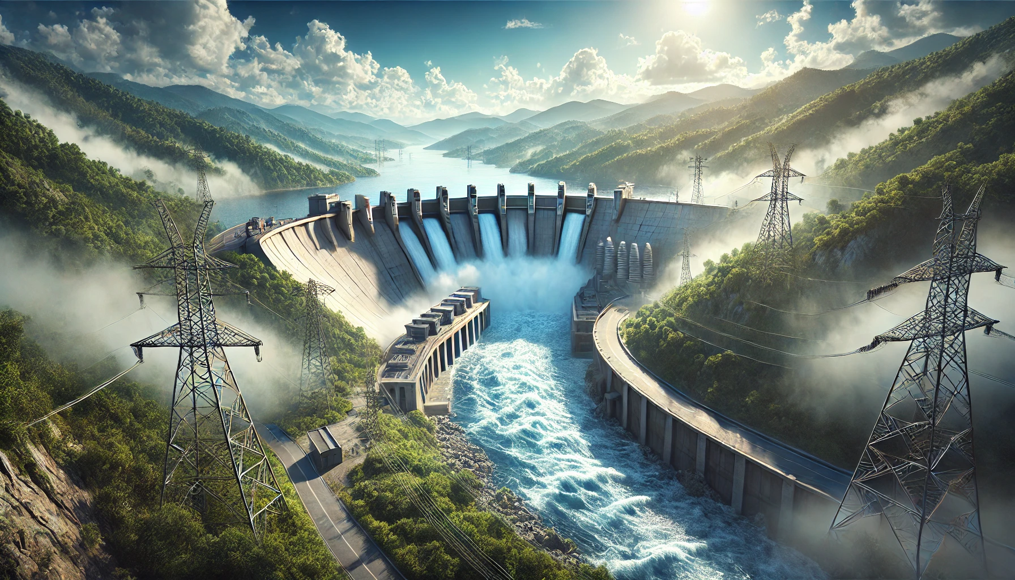
Photo courtesy of Lisa L Wiedmeier (@flickr.com) - granted under creative commons licence - attribution
Hydro energy

Slide 5
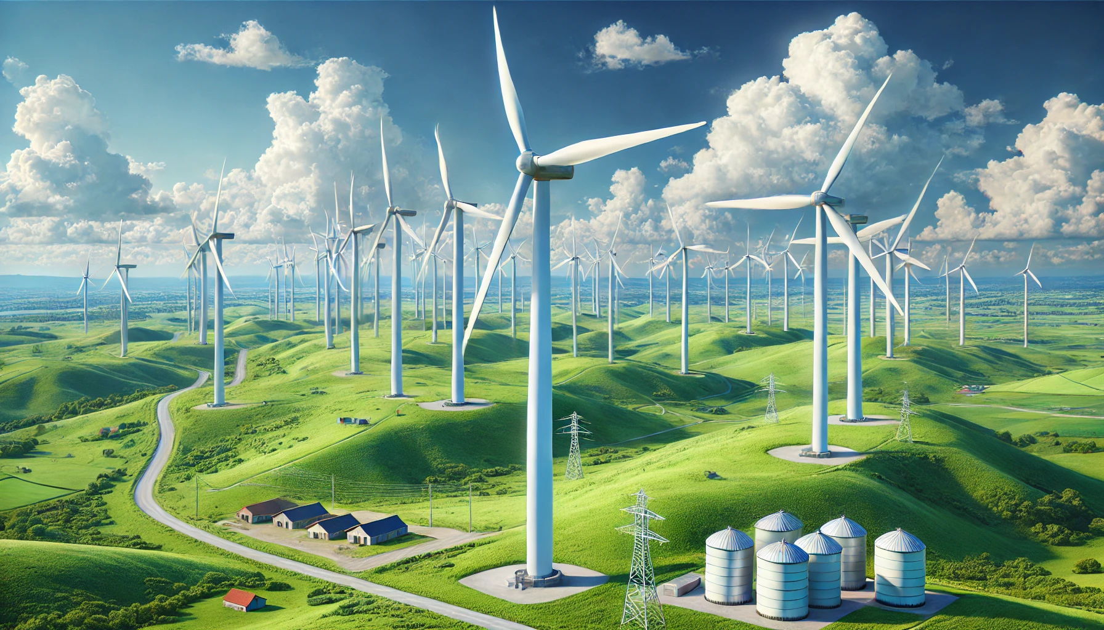
Photo courtesy of Lisa L Wiedmeier (@flickr.com) - granted under creative commons licence - attribution
Wind energy

Slide 6
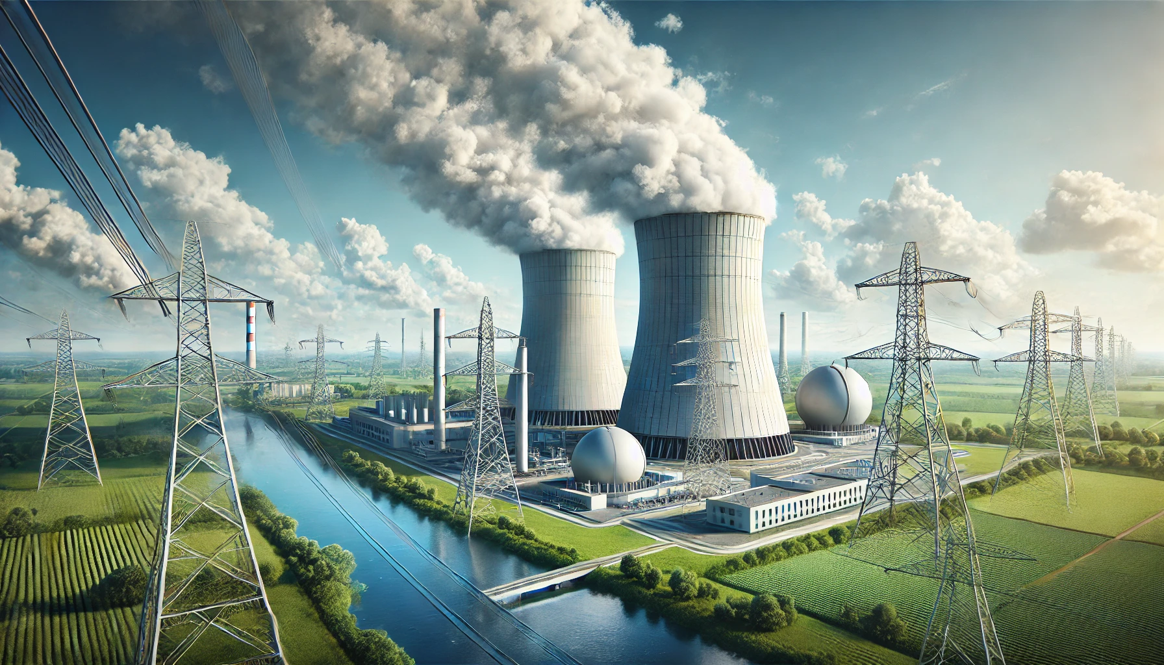
Photo courtesy of Lisa L Wiedmeier (@flickr.com) - granted under creative commons licence - attribution
Nuclear energy

Slide 7
Unit 10
Energy sources
…….., April ….., 2026
LESSON 4: COMMUNICATION

Slide 8
01
EVERYDAY ENGLISH
ASKING FOR EXPLANATIONS

Slide 9

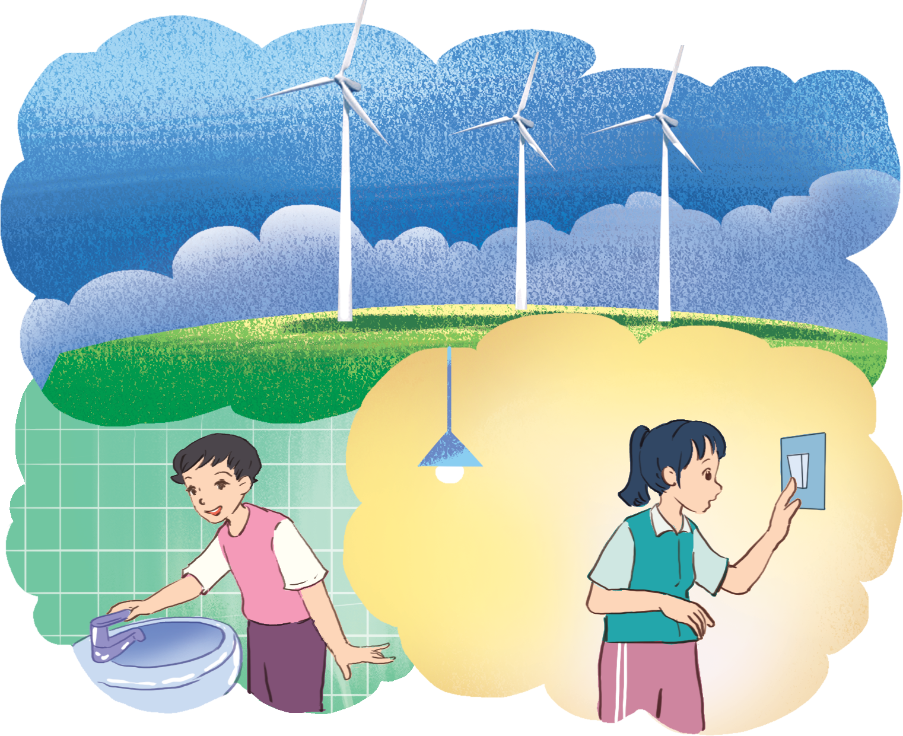
1. Listen and read. Pay attention to the highlighted words.
Lan: What does “solar energy” mean?
Mr Tan: Well, it’s energy that comes from the sun.
Lan: And what does “wind energy” mean?
Mr Tan: It’s another type of energy, and it comes from wind.
How can you ask for explanation?

Slide 10
STRUCTURES
?
What + does + S + mean?
+
S + means + …

Slide 11
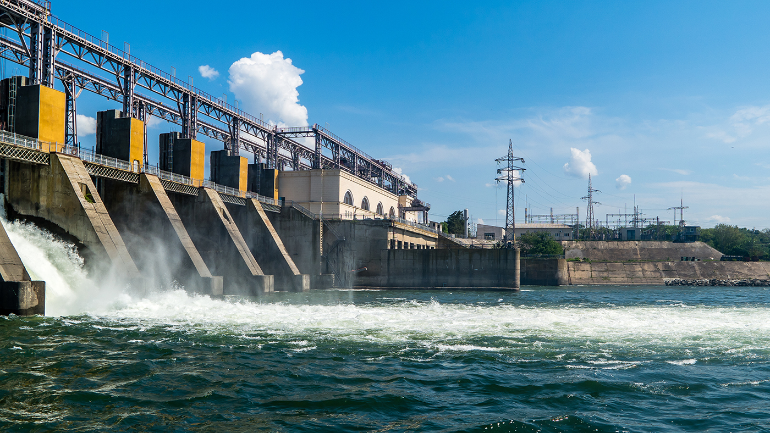
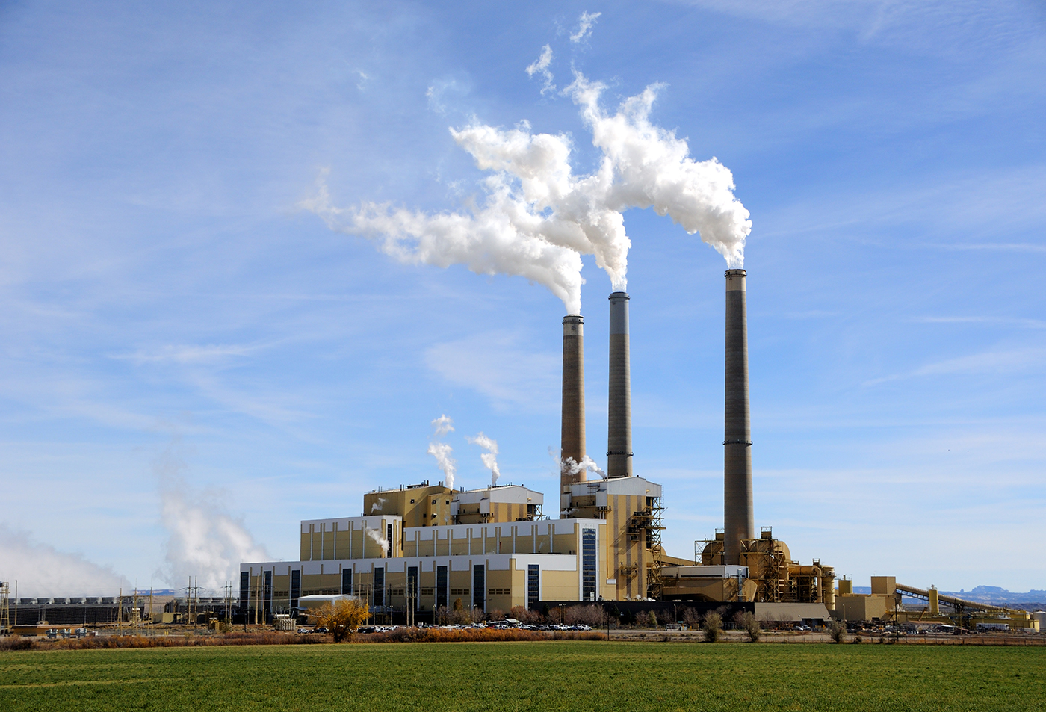
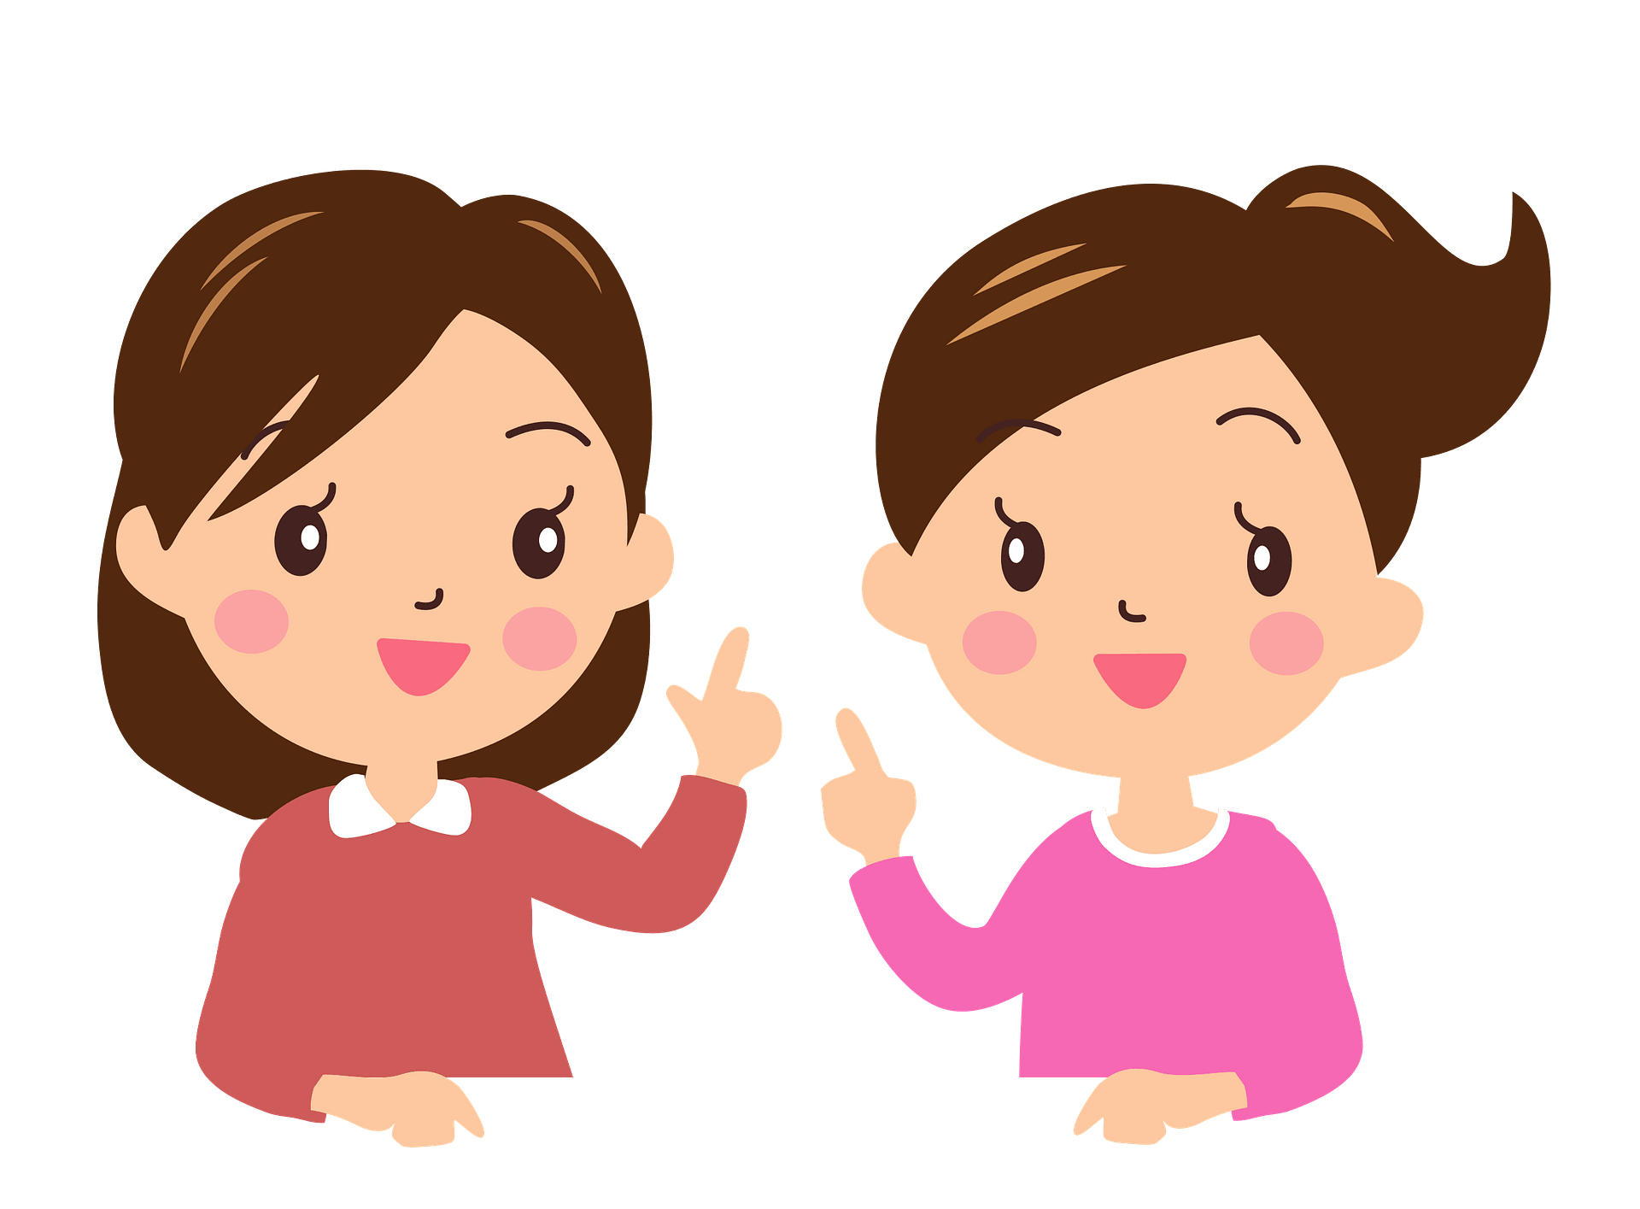

2. Work in pairs. Make similar conversations to ask for explanation of the phrases:
What does hydro energy mean?
It’s energy that comes from the water. What does nuclear energy mean?
Hydro energy
It’s energy that comes from nuclear power.
energy from coal

Slide 12
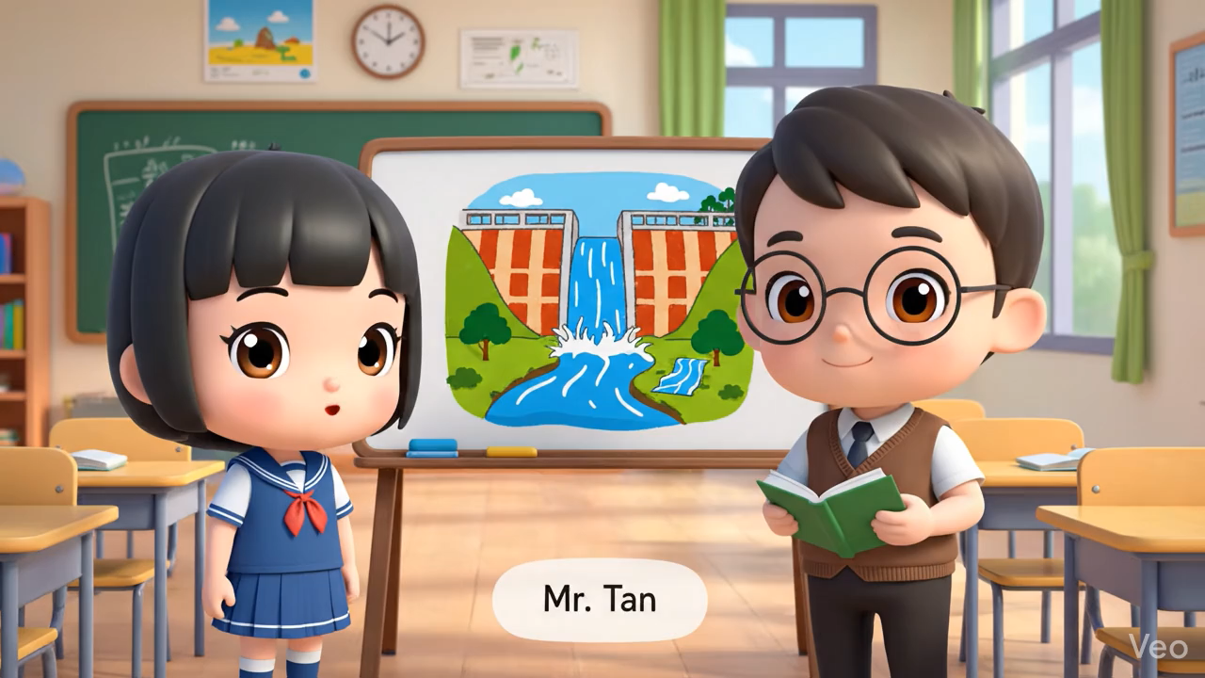
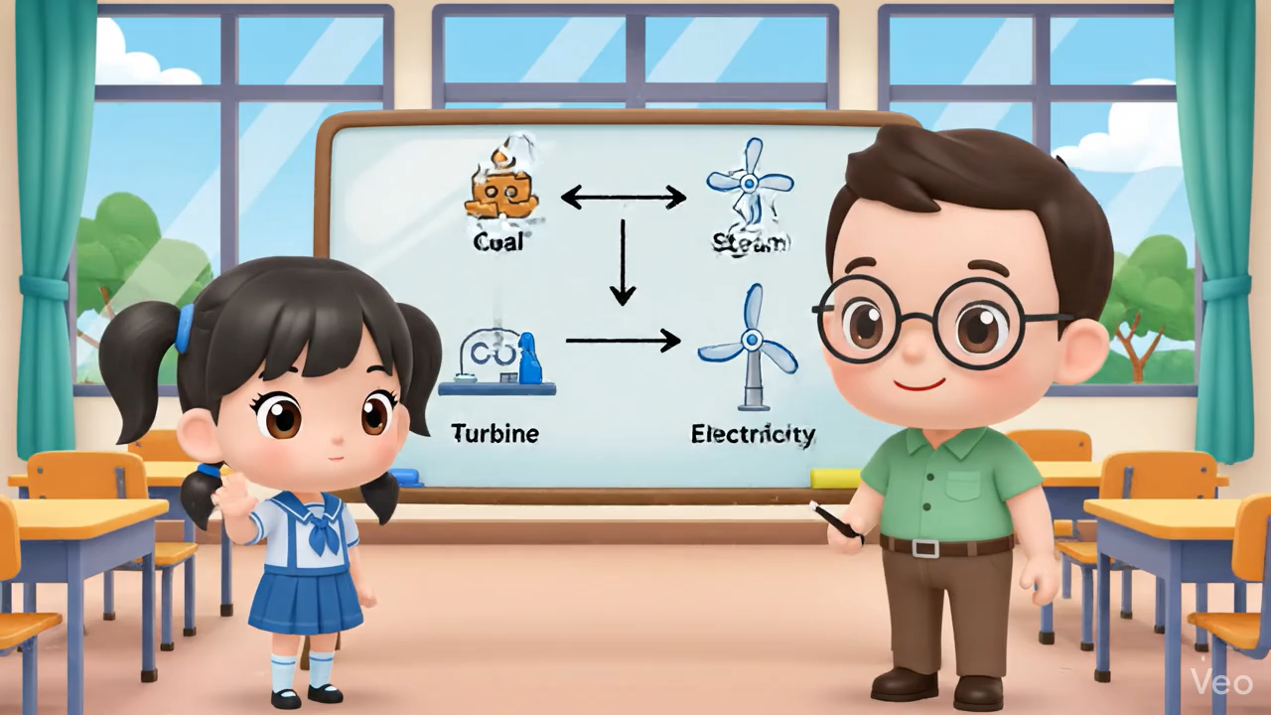
2. Work in pairs. Make similar conversations to ask for explanation of the phrases:

Slide 13
SAVING ENERGY
02

Slide 14
3. Answer the questions on your own.
 | YES | NO
1. Do you go to school on foot?
2. Do you use public transport?
3. Do you use low energy light bulbs at home?
4. Do you use solar energy to warm water?
5. Do you turn off the lights when going to bed?
6. Do you turn off the TV when not watching it?
How well do you save energy?

Slide 15
Work in groups. Ask and answer.
 | YES | NO
1. Do you go to school on foot?
2. Do you use public transport?
3. Do you use low energy light bulbs at home?
4. Do you use solar energy to warm water?
5. Do you turn off the lights when going to bed?
6. Do you turn off the TV when not watching it?
How well do your friends save energy?

Slide 16
Let’s present
How well do you and your friends save energy?

Slide 17
Example
“Mai saves a lot of energy. She often goes to school on foot and uses public transport. She always turns oﬀ the lights when going to bed.”

Slide 18
WRAP-UP
What have you learnt today?
ask for explanations
talk about saving energy

Slide 19
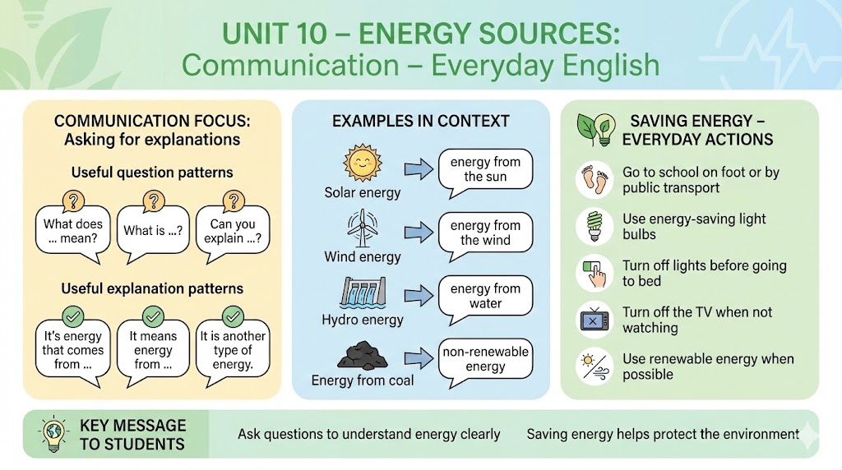

Slide 20
HOMEWORK
Practice asking for explanation
Prepare for the next lesson: Skills 1

Slide 21
Thanks!

