Slide 1
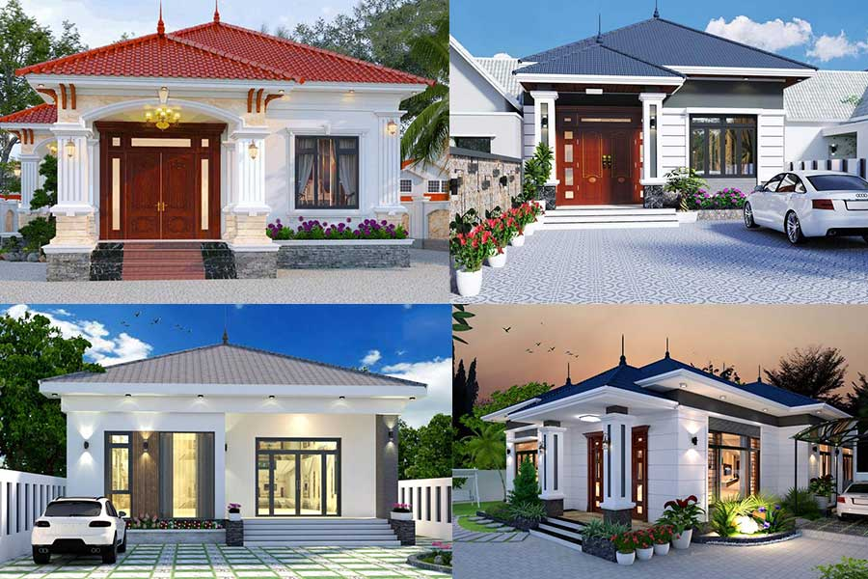
Welcome to our class

Slide 2

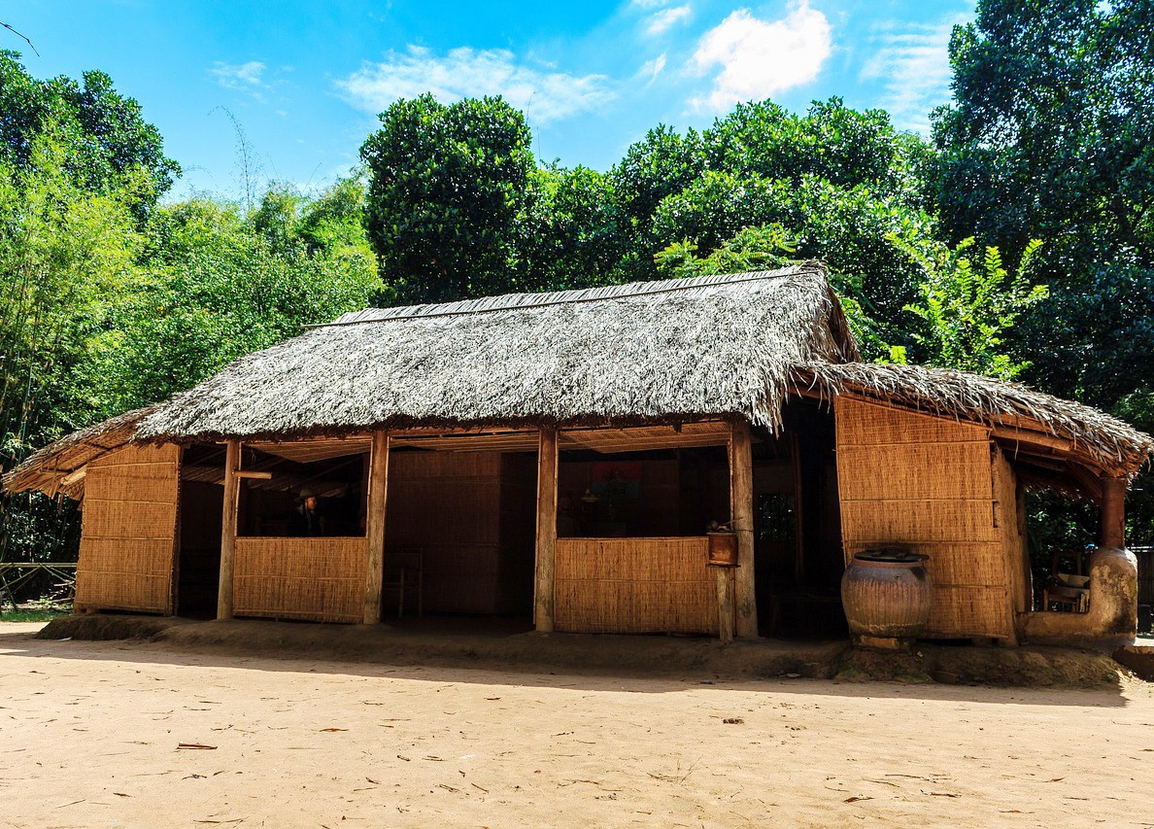
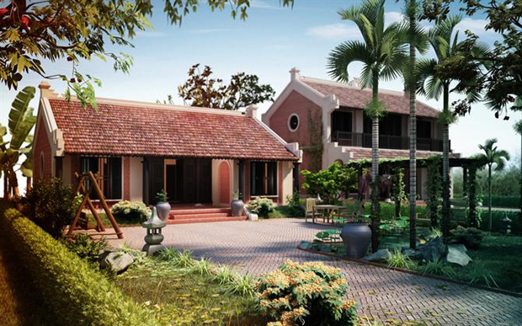
v_ _ _ _
cottage
c_ _ _ _ _ _
c_ _ _ _ _ _ _ _ _ _ e
villa
country house

Slide 3
WARM UP GAME
List the type of houses shown in the video

Slide 4


Slide 5
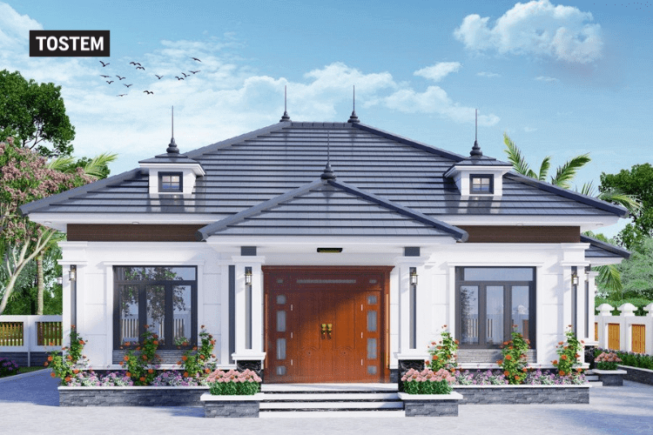

Unit 10:
Our houses in the future
Lesson 1: getting started
My future house

Slide 6


1. What can you see?
UNIT 10 – OUR HOUSES IN THE FUTURE
Phong
Nick
2. What is Phong doing?
3. What are they talking about?

Slide 7
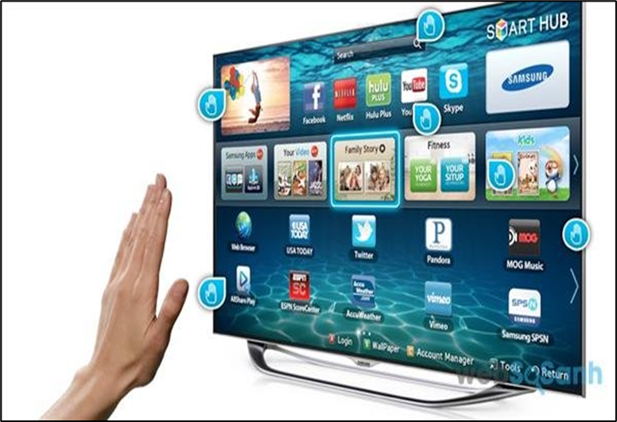
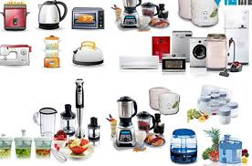
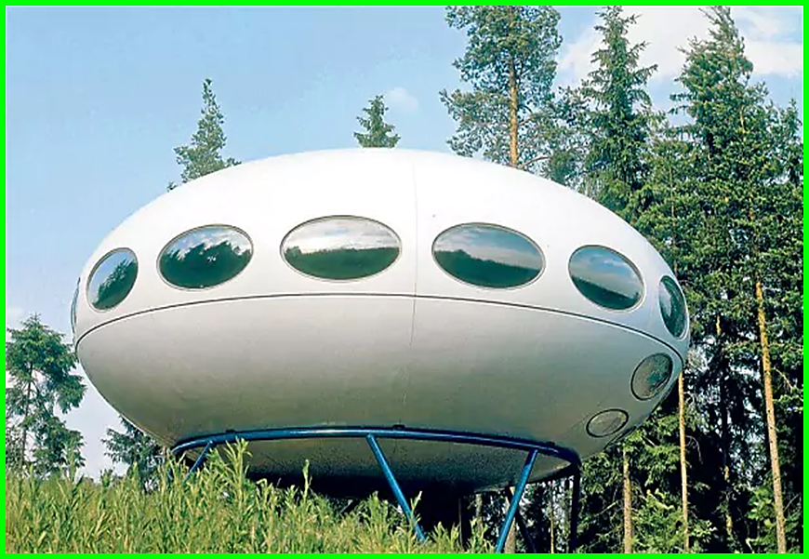



UNIT 10 – OUR HOUSES IN THE FUTURE
Vocabulary
UFO (n)
- Unidentified Flying Object:
vật thể bay, đĩa bay.
solar energy (n):
/‘səʊlə(r)‘enədʒi/
năng lượng mặt trời.
appliance (n):
/ə'plaiəns/(n)
thiết bị
smart TV (n):
/smɑːt/
ti vi thông minh
robot (n):
/’rəʊbɒt/
rô bốt
ocean (n):
/’əʊʃn/
đại dương
ĐẠI DƯƠNG
location (n):
/ləʊ’keɪʃn/
vị trí, địa điểm

Slide 8
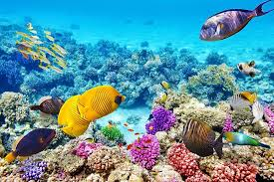
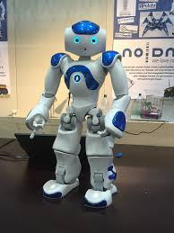
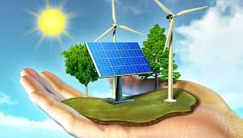
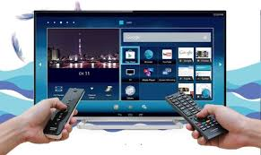
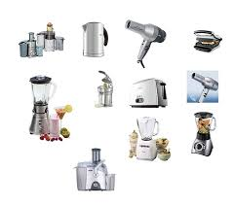
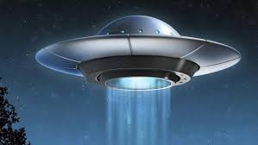
UNIT 10 – OUR HOUSES IN THE FUTURE
UFO
solar energy
appliance
smart TV
robot
ocean

Slide 9
My future house
Nick: What are you doing, Phong?
Phong: I’m painting a picture of my house.
Nick: Your house! That’s a UFO.
Phong: It looks like a UFO but it’s my house in the future.
Nick: Where will it be?
Phong: It’ll be in the mountains.
Nick: What will it be like?
Phong: It’ll be a large house. It’ll have twenty rooms.
Nick: Twenty rooms!
Phong: Yes, and it’ll have solar energy.
Nick: Fantastic! Which room will you like best?
Phong: My bedroom, of course.
Nick: What appliances might the house have?
Phong: My house might have some smart TVs and ten robots.
Nick: Sounds great! And how much will ...

Slide 10
My future house
Nick: What are you doing, Phong?
Phong: I’m painting a picture of my house.
Nick: Your house! That’s a UFO.
Phong: It looks like a UFO but it’s my house in the future.
Nick: Where will it be?
Phong: It’ll be in the mountains.
Nick: What will it be like?
Phong: It’ll be a large house. It’ll have twenty rooms.
Nick: Twenty rooms!
Phong: Yes, and it’ll have solar energy.
Nick: Fantastic! Which room will you like best?
Phong: My bedroom, of course.
Nick: What appliances might the house have?
Phong: My house might have some smart TVs and ten robots.
Nick: Sounds great! And how much will ...

Slide 11
  Ex 2. Read the conversation again. Find and write down the words or phrases that show.
Type of house
UFO
Location
in the mountains
Appliances in the house
some smart TVs and ten robots

Slide 12
  Ex 3. Read the conversation again. Tick () T (True) or F (False).
 | T | F
1. Phong’s house will be in the mountains.

2. His house will be large.

3. There’ll be a lot of rooms in his house.

4. He might have a smart TV and five robots.


Slide 13
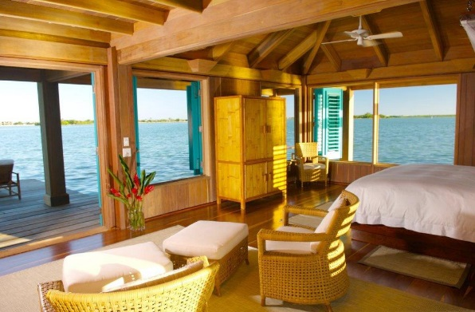
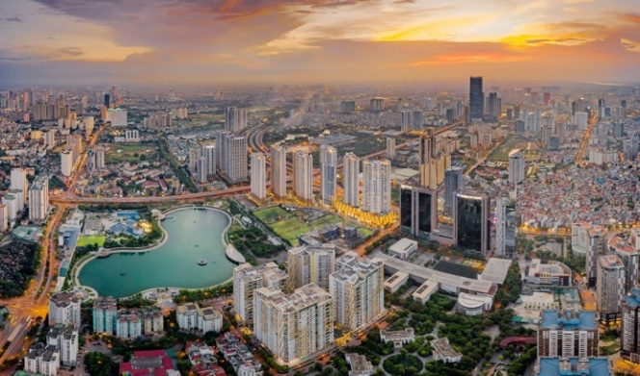
  EX 4. Order the words to make a phrase about a place. Each group has one extra word.
1. sea/ a / by/ the
2. on/ in/ the/ city
by the sea
in the city

Slide 14
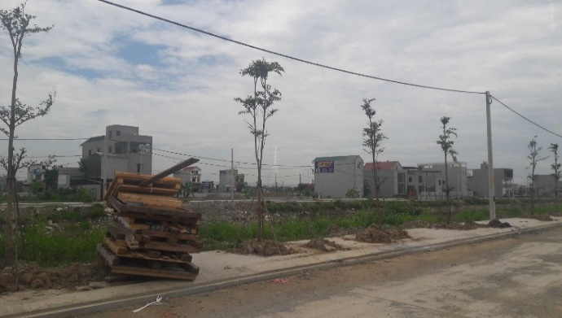
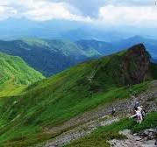
3. the/ in/ at/town
4. the/ on/ in/ mountains
in the town
in the mountains

Slide 15
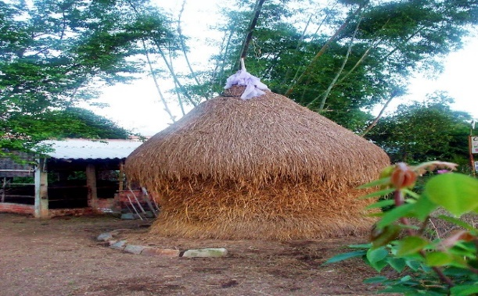
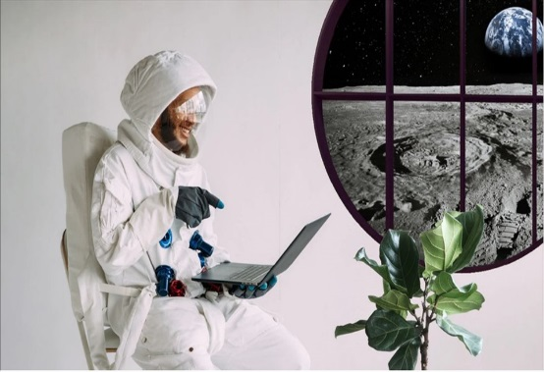
5. countryside/ a/ the/ in
6. Moon/ in/ the/on
in the countryside
on the Moon

Slide 16

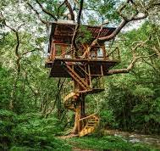
7. In/ at/the/sky
8.In/ the/on/tree
in the sky
On the tree

Slide 17
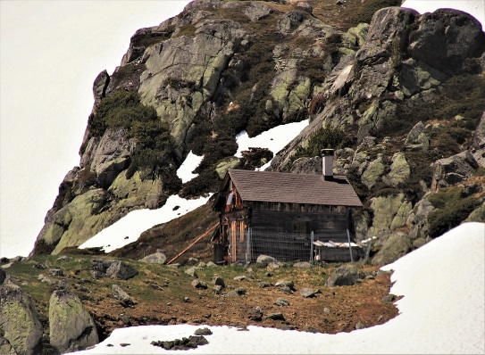

ME TOWN
in the sea
2. on/ in/ the/ city
3. the/ in/ at/town
4. the/ on/ in/ mountain
in the city
in the town
in the mountains
5.countryside/ a/ the/ in
6.Moon/ in/ the/on
7. In/ at/the/sky
8.In/ the/on/tree
in the countryside
on the Moon
in the sky
On the tree

Slide 18
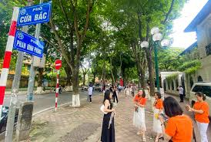

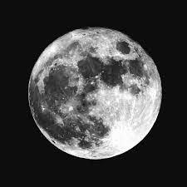
in the sea
in the city
in the town
in the mountain
in the countryside
on the Moon
in the sky
on the tree

Slide 19
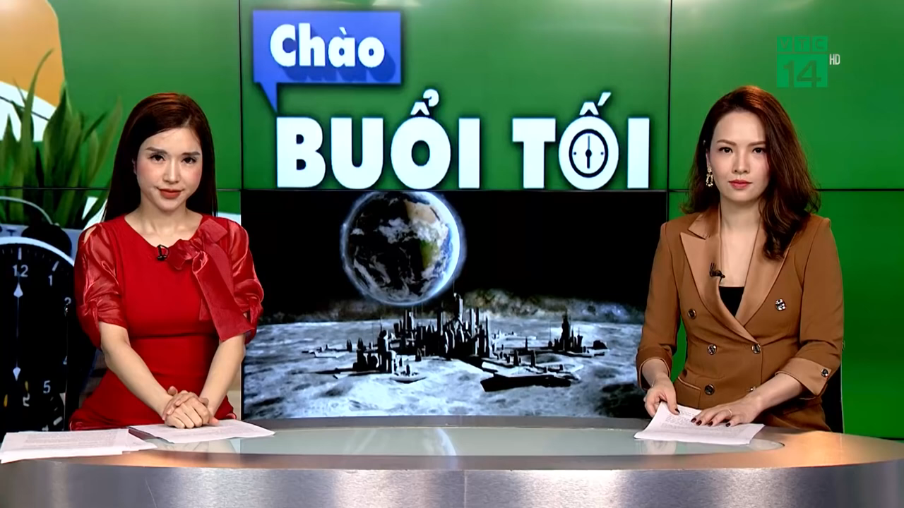
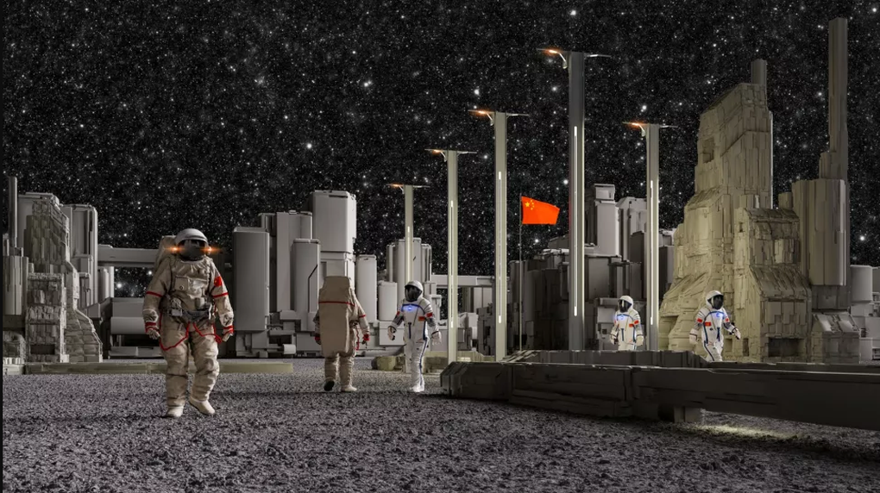
My house will be __________.
on the Moon

Slide 20
EX 5. In groups, describe to your classmates what you can see outside the window of your future house. Your group tries to guess where your house is.
Example:
A: Outside my window I can see the beach and the water. Where’s my house?
B: It’s by the sea.
A: Correct!

Slide 21


Type of house
Location
Surroundings
Number of rooms
Appliances in the room
-Write a short paragraph describing your houses in the future
Describe your future house.
Learn vocabulary, do exercise B1,2,3 in workbook
Prepare: Unit 10 – A Closer look 1

