Slide 1

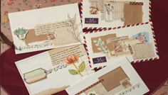
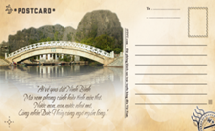
Chatting
1. What’s this?
2. Have you ever written a postcard?
3. If yes, who did you write to? If no, do you intend to write a postcard in the future?

Slide 2



LESSON 1
* Reading
* Speaking

Slide 3

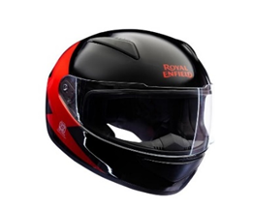
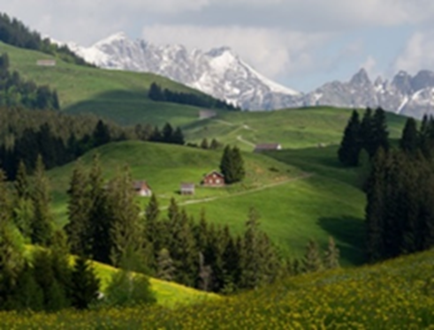
* VOCABULARY
- fantastic (adj)
= great
- perfect (adj)
= ideal
: hoàn hảo
- rent (v) :
thuê, mướn
- helmet (n) :
mũ bảo hiểm
- traditional (adj)
# modern :
mang tính truyền thống
- landscape (n) :
Phong cảnh

Slide 4
* Checking vocabulary
- fantastic (adj)
= great
- perfect (adj)
= ideal
: hoàn hảo
- rent (v) :
thuê, mướn
- helmet (n) :
mũ bảo hiểm
- traditional (adj)
# modern :
mang tính truyền thống
- landscape (n) :
Phong cảnh

Slide 5

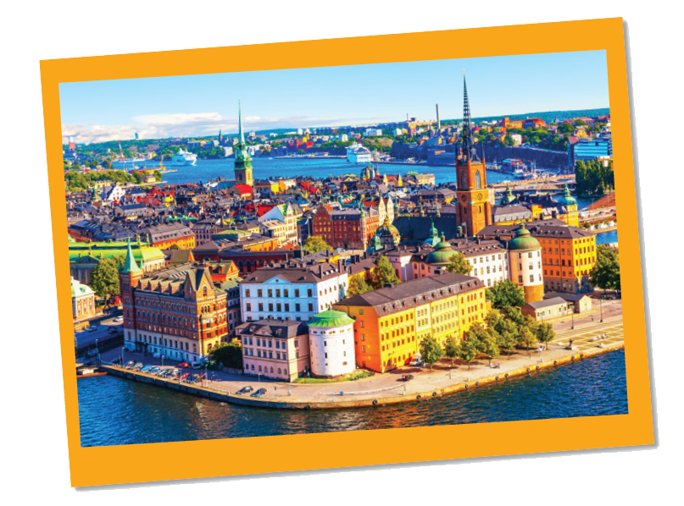
Work in groups. Look at the postcard and discuss.
I. Reading
Love from Sweden
1. Do you know where this is?
It’s Stockholm , capital and largest city of Sweden.

Slide 6
Work in groups. Look at the postcard and discuss.
I. Reading
Love from Sweden
1.
When do people write a postcard?
When they are away from home, often on holiday or business. They want to tell their family or friends what they see and do, and how they feel about their time here.
2.
What do they often write on a postcard?
The sender often writes about his/her stay in a city or country.

Slide 7

Read the postcard and answer the questions.
September 6
Dear Grandpa and Grandma,
To: Grandpa & Grandma
Hoan Kiem, Ha Noi, Viet Nam
Stockholm is fantastic!
Its weather is perfect, sunny all the time! Our hotel is good. It has a swimming pool and a gym. It offers delicious breakfast. Yesterday Mum, Dad and I rented three bikes and cycled to the Old Town. My parents wore their helmets and I wore mine. We visited the Royal Palace f irst. What a beautiful place! Mum loved it. She said, “Swedish art is amazing.” After that, we had “fika”, a coffee break, in a traditional café. Everything is so wonderful!
Wish you were here!
Love,
Mai

Slide 8
Read the postcard and answer the questions.
1.
This postcard is about in Stockholm.
A.
the weather
B.
a holiday
C.
landscapes
?
2.
Guests can in the hotel.
A.
exercise
B.
cycle
C.
See Swedish art
?
3.
Mai and her parents rented bikes to .
A.
cycle around the hotel
B.
visit the old town
?
C.
go shopping
4.
“Fika” is a .
B.
palace
A.
traditional café
C.
coffee break
?

Slide 9
SUGGEST
September 6
Dear Grandpa and Grandma,
Stockholm is fantastic!
Its weather is perfect, sunny all the time! Our hotel is good. It has a swimming pool and a gym. It offers delicious breakfast. Yesterday Mum, Dad and I rented three bikes and cycled to the Old Town. My parents wore their helmets and I wore mine. We visited the Royal Palace first. What a beautiful place! Mum loved it. She said, “Swedish art is amazing.” After that, we had “fika”, a coffee break, in a traditional café. Everything is so wonderful!
Wish you were here!
Love,
Mai

Slide 10
SUGGEST
September 6
Dear Grandpa and Grandma,
Stockholm is fantastic!
Its weather is perfect, sunny all the time! Our hotel is good. It has a swimming pool and a gym. It offers delicious breakfast. Yesterday Mum, Dad and I rented three bikes and cycled to the Old Town. My parents wore their helmets and I wore mine. We visited the Royal Palace first. What a beautiful place! Mum loved it. She said, “Swedish art is amazing.” After that, we had “fika”, a coffee break, in a traditional café. Everything is so wonderful!
Wish you were here!
Love,
Mai

Slide 11
SUGGEST
September 6
Dear Grandpa and Grandma,
Stockholm is fantastic!
Its weather is perfect, sunny all the time! Our hotel is good. It has a swimming pool and a gym. It offers delicious breakfast. Yesterday Mum, Dad and I rented three bikes and cycled to the Old Town. My parents wore their helmets and I wore mine. We visited the Royal Palace first. What a beautiful place! Mum loved it. She said, “Swedish art is amazing.” After that, we had “fika”, a coffee break, in a traditional café. Everything is so wonderful!
Wish you were here!
Love,
Mai

Slide 12
SUGGEST
September 6
Dear Grandpa and Grandma,
Stockholm is fantastic!
Its weather is perfect, sunny all the time! Our hotel is good. It has a swimming pool and a gym. It offers delicious breakfast. Yesterday Mum, Dad and I rented three bikes and cycled to the Old Town. My parents wore their helmets and I wore mine. We visited the Royal Palace first. What a beautiful place! Mum loved it. She said, “Swedish art is amazing.” After that, we had “fika”, a coffee break, in a traditional café. Everything is so wonderful!
Wish you were here!
Love,
Mai

Slide 13

Read the text and match the places with the things they have.
a.
the Royal Palace
1.
The hotel in Stockholm
b.
delicious breakfast
c.
Swimming pool
2.
The Old Town
d.
‘fika’
e.
Swedish art

Slide 14
SUGGEST
September 6
Dear Grandpa and Grandma,
Stockholm is fantastic!
Its weather is perfect, sunny all the time! Our hotel is good. It has a swimming pool and a gym. It offers delicious breakfast. Yesterday Mum, Dad and I rented three bikes and cycled to the Old Town. My parents wore their helmets and I wore mine. We visited the Royal Palace first. What a beautiful place! Mum loved it. She said, “Swedish art is amazing.” After that, we had “fika”, a coffee break, in a traditional café. Everything is so wonderful!
Wish you were here!
Love,
Mai

Slide 15
SUGGEST
September 6
Dear Grandpa and Grandma,
Stockholm is fantastic!
Its weather is perfect, sunny all the time! Our hotel is good. It has a swimming pool and a gym. It offers delicious breakfast. Yesterday Mum, Dad and I rented three bikes and cycled to the Old Town. My parents wore their helmets and I wore mine. We visited the Royal Palace first. What a beautiful place! Mum loved it. She said, “Swedish art is amazing.” After that, we had “fika”, a coffee break, in a traditional café. Everything is so wonderful!
Wish you were here!
Love,
Mai

Slide 16

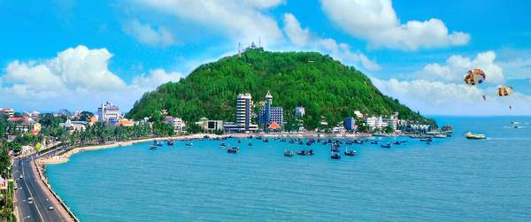
Work in groups. Choose a city you know. Discuss and answer the questions below.
* Speaking
What city is it?
What is it like? (the weather, the food…)
What can you see and do there?
How do you feel about it?
* Suggested answers:
1. It’s Vung Tau city.
2. It has many beautiful beaches, the weather is usually cool, the seafood is fresh, cheap and delicious.
3. In Vung Tau city, I can cycle along the beach, climb mountains, take beautiful photos, swim in the sea and play on the beach, enjoy special food and seafood, buy souvenirs….
4. It’s really great to be in Vung Tau city. It’s a liveable place.

Slide 17

Share the information you have collected in 4 with your class.
You may start your talk with:
We’re going to tell you about …
We’re going to tell you about Vung Tau city. It has many beautiful beaches, the weather is usually cool, seafood is fresh, cheap and delicious. In Vung Tau city, I can cycle along the beach, do sightseeing, climb mountains, take beautiful photos, swim in the sea and play on the beach, enjoy special food and seafood, buy souvenirs. It’s really great to be in Vung Tau city. For me, it’s a liveable place.

Slide 18

Homework
- Learn all the new words by heart. - Do exercises in the workbook.

