Slide 1



LESSON 2
Vocabulary
Pronunciation

Slide 2
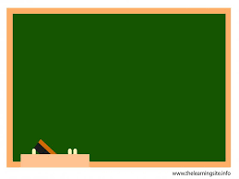
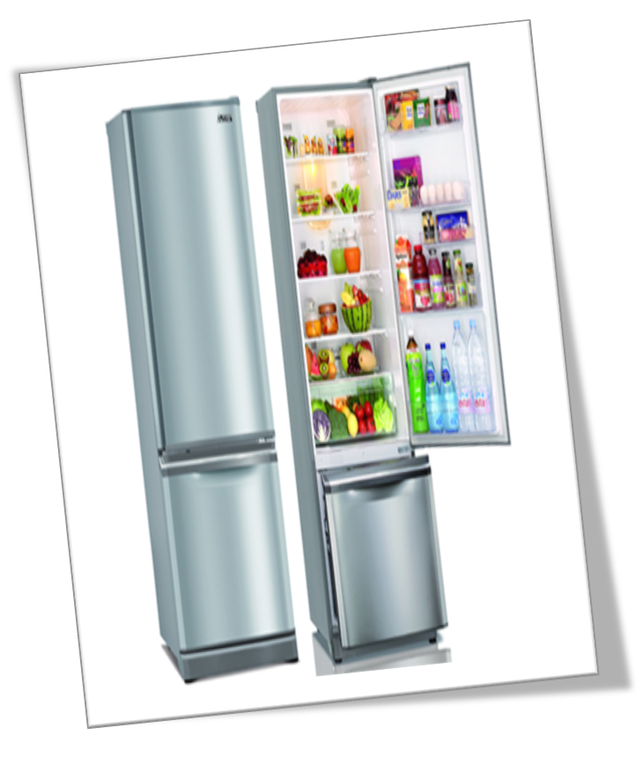
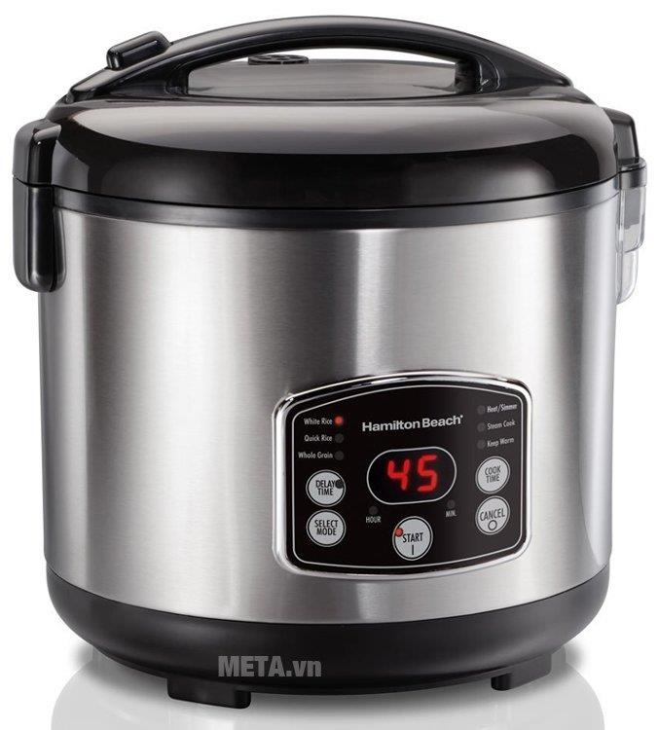
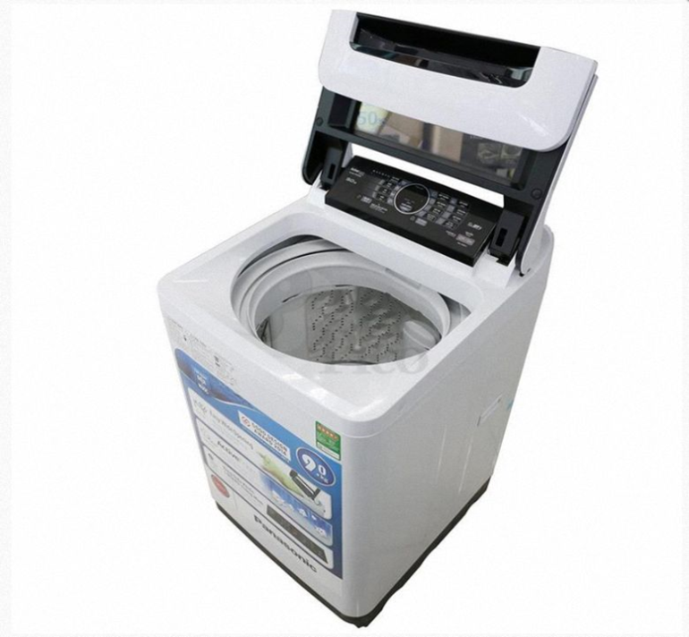
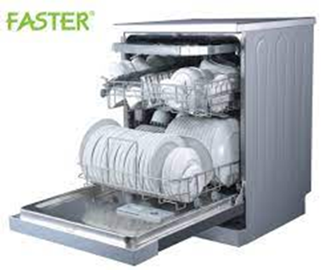
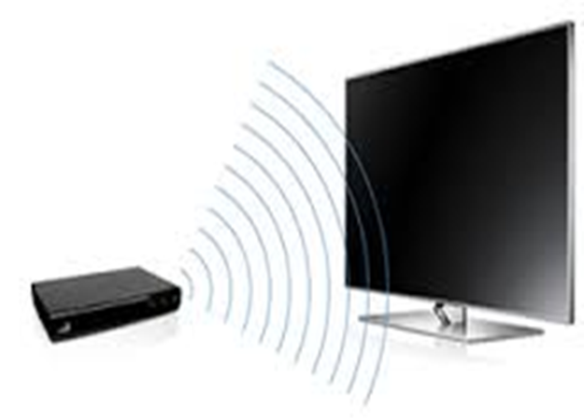
UNIT 10: HOUSES IN THE FUTURE
Lesson 2: A closer look 1
* Vocabulary
electric cooker (n):
fridge (n) :
dish washer (n):
washing machine (n):
- wireless TV (phrn):
nồi cơm điện
tủ lạnh
máy rữa chén
máy giặt
TV không dây

Slide 3
UNIT 10: HOUSES IN THE FUTURE
Lesson 2: A closer look 1
* Checking vocabulary
electric cooker (n):
fridge (n) :
dish washer (n):
washing machine (n):
- wireless TV (phrn):

Slide 4


Listen and repeat the words / phrases in the box. Then put them in the appropriate columns. You may use some more than once.
electric cooker
fridge
dishwasher
electric fan
washing machine
computer
wireless TV
smart clock
living room | bedroom | kitchen
wireless TV
wireless TV
electric cooker
electric fan
smart clock
fridge
smart clock
computer
dishwasher
computer
washing machine

Slide 5

Match the appliances in A with what they can help us to do in B.
A
1. electric cooker
2. dishwasher
3. fridge
4. washing machine
5. computer
B
B
c. cook rice
d. wash and dry dishes
b. keep food fresh
e. wash and dry clothes
a. receive and send emails
a. receive and send emails
b. keep food fresh
c. cook rice
d. wash and dry dishes
e. wash and dry clothes

Slide 6

Work in pairs. Ask and answer questions about appliances, using the information in 2.
Example:
A: What can an electric cooker help us to do?
B: It can help us to cook rice.
Notice :
Help sb do/ to do st : giúp ai làm gì
* Play game: The big wheel.

Slide 7
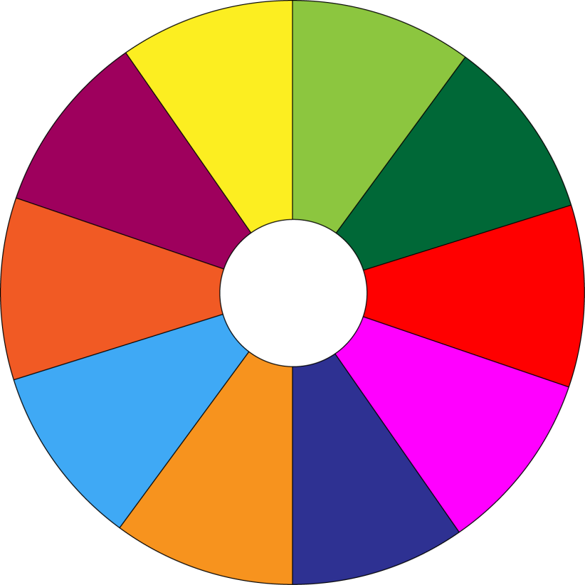
THE BIG WHEEL GAME
QUESTIONS
1
10
40
30
50
2
SPIN
20
10
3
-15
-20
05
60
4

Slide 8

Work in pairs. Ask and answer questions about appliances, using the information in 2.
1. dishwasher
A: What can a dishwasher help us to do?
B: It can help us to wash and dry dishes.

Slide 9
Work in pairs. Ask and answer questions about appliances, using the information in 2.
2. fridge
A: What can a fridge help us to do?
B: It can help us keep food fresh.

Slide 10
Work in pairs. Ask and answer questions about appliances, using the information in 2.
3. washing machine
A: What can a washing machine help us to do?
B: It can help us to wash and dry clothes .

Slide 11
Work in pairs. Ask and answer questions about appliances, using the information in 2.
4. Computer
A: What can a computer help us to do?
B: It can help us to receive and send emails .

Slide 12

* Pronunciation
Stress in two-syllable words
Listen and repeat the words.
‘picture
‘robot
‘bedroom
‘kitchen
‘housework
‘palace
‘village
‘mountains

Slide 13
Quy tắc nhấn trọng âm của từ có 2 âm tiết
1. Đối với hầu hết các danh từ và tính từ có hai âm tiết trong tiếng Anh thì trọng âm rơi vào âm tiết thứ nhất.
- money (n.) /ˈmʌni/
- artist (n.) /ˈɑːtɪst/
- lovely (adj.) /ˈlʌvli/
healthy (adj.) /ˈhelθi/
Pretty (adj): /'priti/
famous (adj):/'feiməs/

Slide 14
Quy tắc nhấn trọng âm của từ có 2 âm tiết
2. Trọng âm rơi vào âm tiết đầu nếu:
+ âm tiết thứ 2 của từ gồm một nguyên âm ngắn
+ và kết thúc với ít hơn hoặc bằng một phụ âm
- answer/ ˈænsər/
- summer/ˈsʌmər/
- question/ˈkwestʃən/
- music/ ˈmjuzɪk/
- practise / ˈpræktɪs/
- visit/ ˈvɪzɪt/
- clever /'klevə[r]/

Slide 15

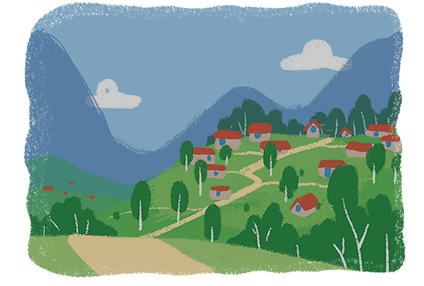
Listen and repeat the sentences. Pay attention to the stress of the underlined words.
1.
The picture is on the wall of the bedroom.
2.
The robot helps me to do the housework.
3.
There’s a very big kitchen in the palace.
4.
Their village is in the mountains.

Slide 16
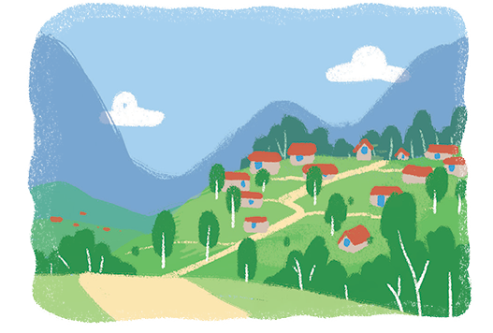
Listen and repeat the sentences. Pay attention to the stress of the underlined words.
1.
The picture is on the wall of the bedroom.
2.
The robot helps me to do the housework.
3.
There’s a very big kitchen in the palace.
4.
Their village is in the mountains.

Slide 17
* Production
Game: “Up and down”
Eg: cushion (stand up)
table ( stand up)
famous (sit down)
modern ( sit down )

Slide 18

* Homework
- Learn by heart all the new words. - Prepare lesson 3 ( A closer look 2).

