Slide 1
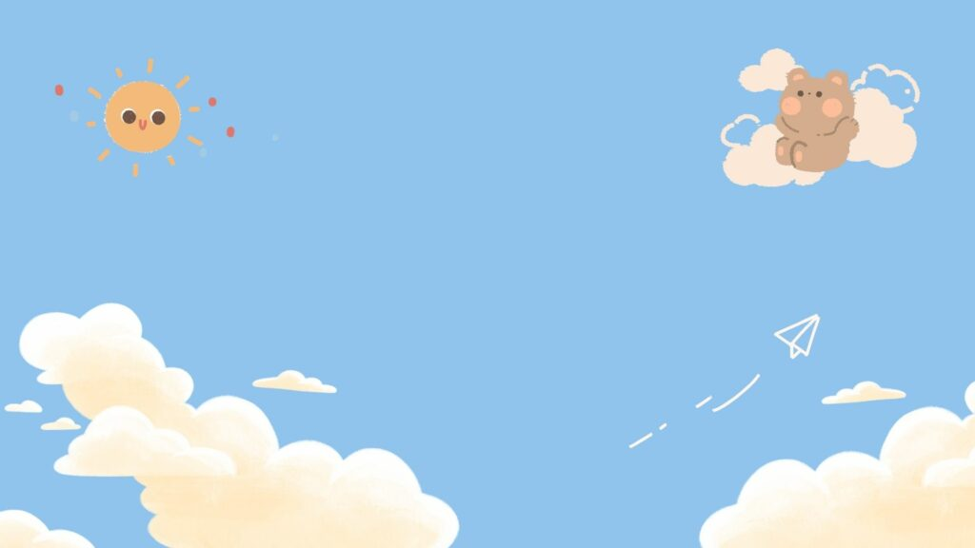
WELCOME TO OUR CLASS!
Teacher:……….

Slide 2

Warm-up:
JUMBLED WORDS

Slide 3
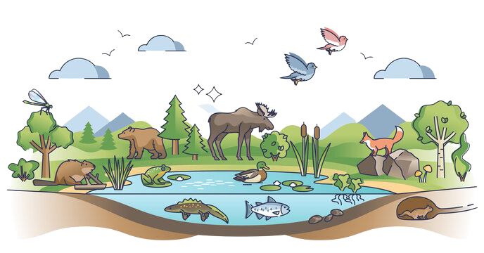
HABITAT
H
B
T
A
I
T
A

Slide 4
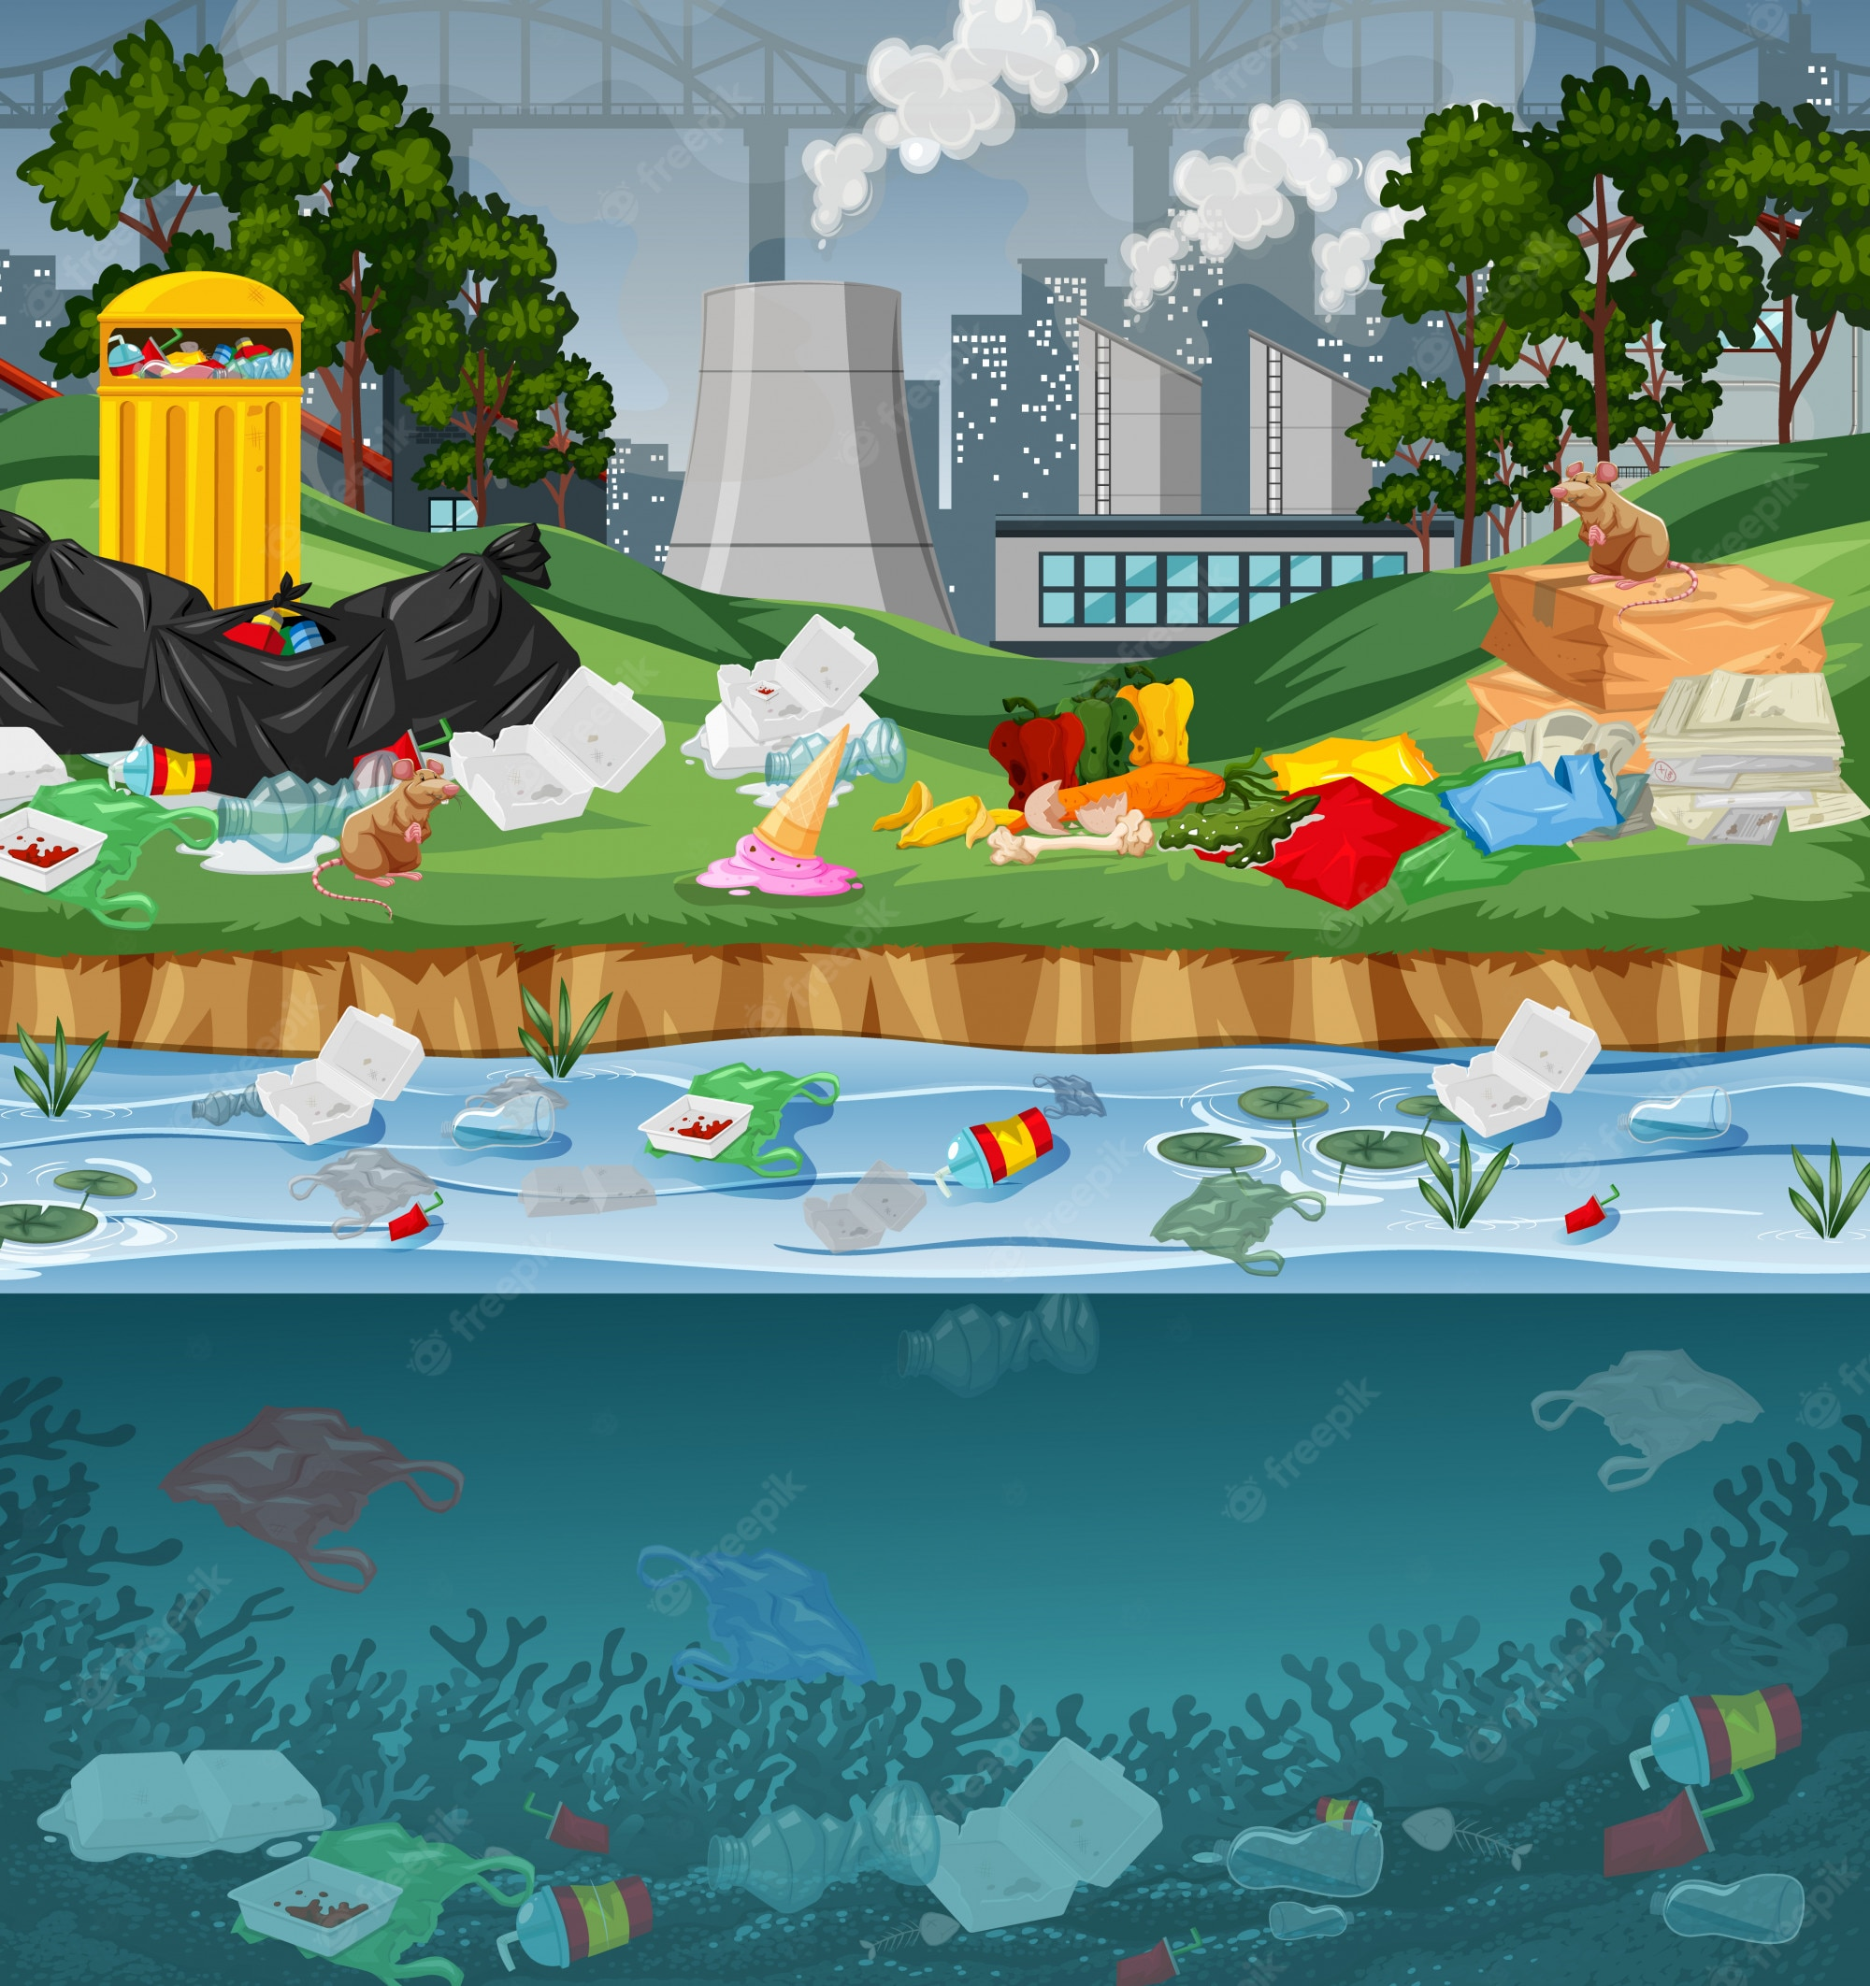
POLLUTION
N
I
T
P
U
L
O
L
O

Slide 5
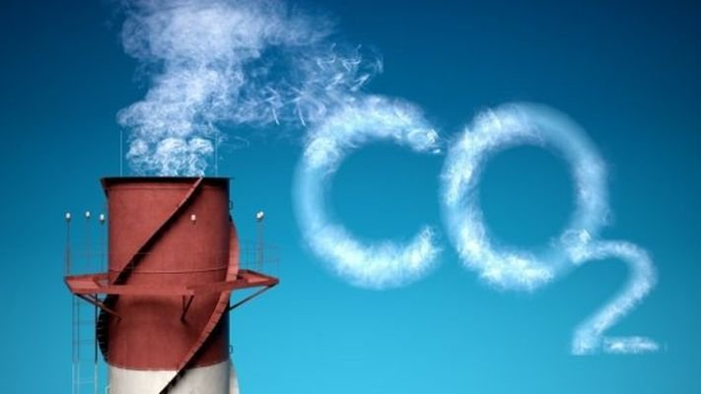
RELEASE
E
R
S
E
E
L
A

Slide 6
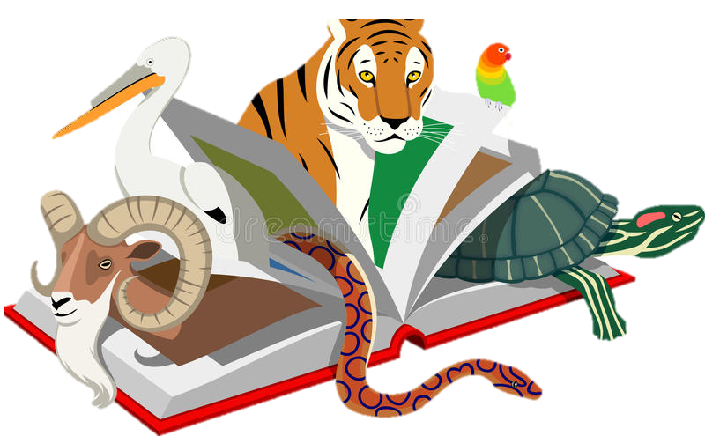
ENDANGERED SPECIES
N
G
R
A
D
N
E
D
E
E
E
S
C
P
I
S
E

Slide 7


Slide 8
………..., January …, 202…
Unit 7:
ENVIRONMENTAL PROTECTION
Lesson 2: A Closer Look 1

Slide 9
VOCABULARY

Slide 10
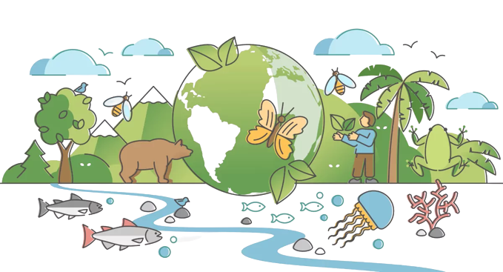

Vocabulary
ecosystem (n)
/ˈiːkəʊsɪstəm/
hệ sinh thái

Slide 11
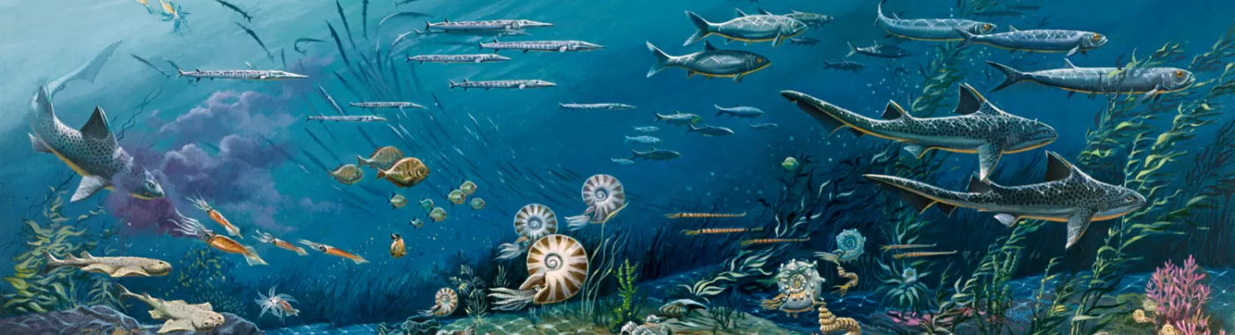
Vocabulary
marine life (n)
/ məˈriːn laɪf/
hệ sinh thái nước

Slide 12
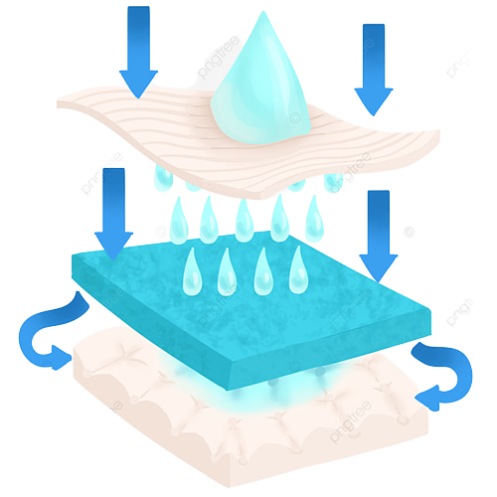

Vocabulary
absorb (v)
/əbˈzɔːb/
thẩm thấu

Slide 13
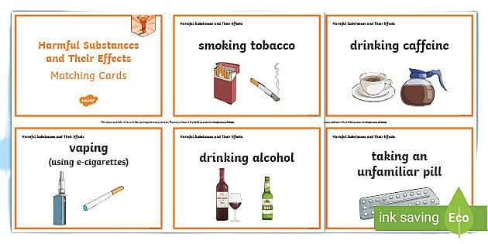
Vocabulary
harmful substance (n)
/ˈhɑːmfl ˈsʌbstəns/
tác nhân gây hại

Slide 14
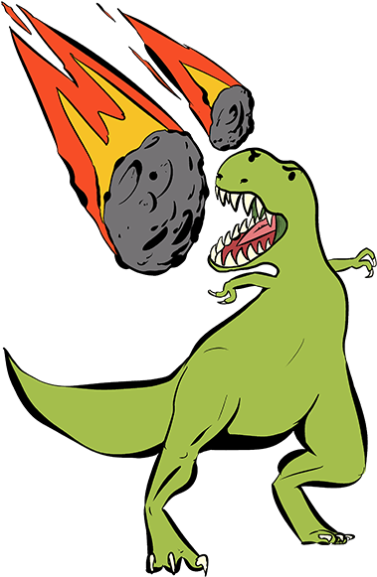
Vocabulary
extinction (n)
/ ɪkˈstɪŋkʃn/
sự tuyệt chủng

Slide 15
Vocabulary
ecosystem (n) | /ˈiːkəʊsɪstəm/ | hệ sinh thái
marine life (n) | / məˈriːn laɪf/ | hệ sinh thái nước
absorb (v) | /əbˈzɔːb/ | thẩm thấu
harmful substance (n) | /ˈhɑːmfl ˈsʌbstəns/ | tác nhân gây hại
extinction (n) | / ɪkˈstɪŋkʃn/ | sự tuyệt chủng

Slide 16
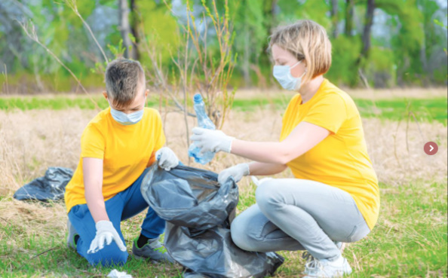
What are they doing?

Slide 17
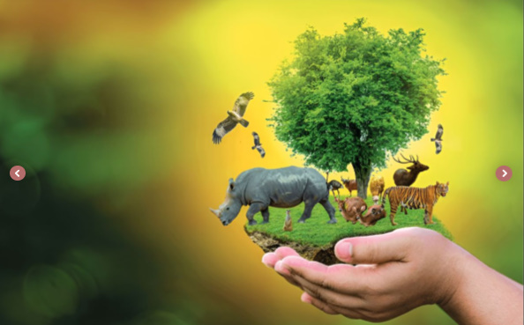
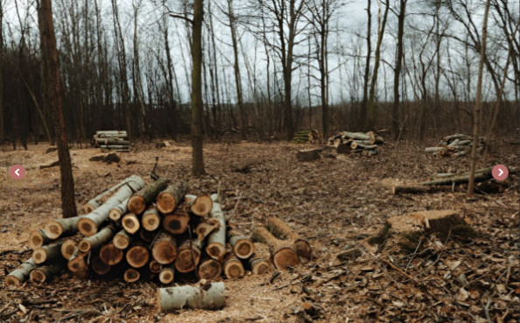
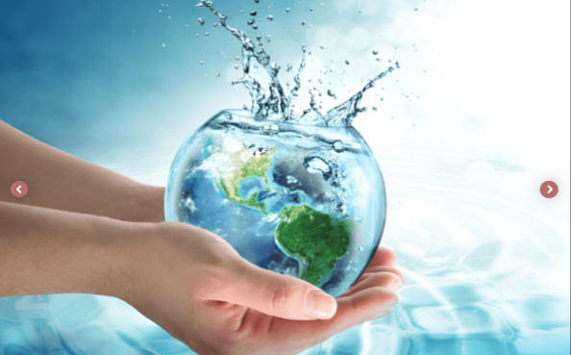
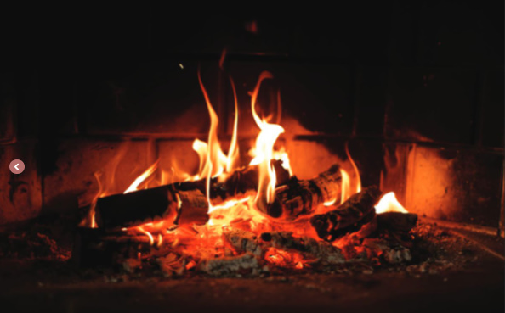
1. Label each picture with a phrase from the list.
building a campfire
cutting down trees
picking up rubbish
protecting endangered species
saving water
protecting endangered species
picking up rubbish
2. _____________________
1. _____________________
cutting down trees
saving water
5. _____________________
3. _____________________
4. _____________________
building a campfire

Slide 18
What is an ecosystem?

Slide 19

2. Match each word or phrase in column A with its meaning in column B.
1. c
2. a
3. e
4. b
5. d
A | B
1. ecosystem | a. the process of making water, air, soil, etc. dirty by adding harmful substances
2. pollution | b. the practice of protecting the natural environment
3. habitat | c. the way living and non-living things in a particular area are related to each other
4. environment protection | d. animals facing a high risk of extinction in the wild
5. endangered species | e. the place where a type of plant or animal lives

Slide 20
a. the process of making water, air, soil, etc. dirty by adding harmful substances
2. pollution

Slide 21
b. the practice of protecting the natural environment
4. environment protection

Slide 22
c. the way living and non-living things in a particular area are related to each other
1. ecosystem

Slide 23
d. animals facing a high risk of extinction in the wild
5. endangered species

Slide 24
e. the place where a type of plant or animal lives
3. habitat

Slide 25
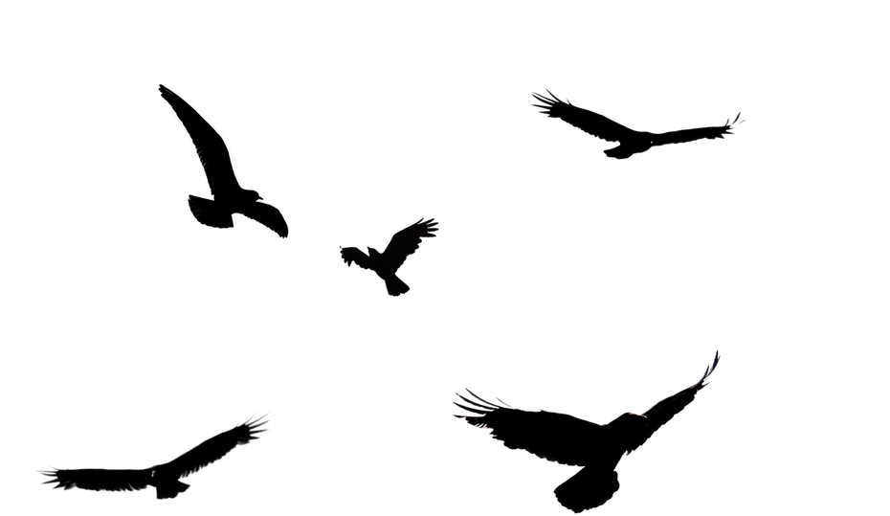
Look at the answers again
A | B
1. ecosystem | c. the way living and non-living things in a particular area are related to each other
2. pollution | a. the process of making water, air, soil, etc. dirty by adding harmful substances
3. habitat | e. the place where a type of plant or animal lives
4. environment protection | b. the practice of protecting the natural environment
5. endangered species | d. animals facing a high risk of extinction in the wild
1. c
2. a
3. e
4. b
5. d

Slide 26
3. Complete each sentence with a word or phrase from the box
habitat | ecosystem | carbon dioxide | cutting down trees | endangered species
1. People in my neighbourhood are doing a lot to save ____________.
2. Con Dao National Park provides a rich ____________ for marine life.
3. Forests help release oxygen and absorb ______________; they also provide homes for many species.
4._____________________ is a serious environmental concern as it harms natural habitats.
5. An _____________ may be a whole forest, or a small pond, and it can be of any size.

Slide 27



Pick a box
Answer the question
Get a random prize below
The winning team has the most points
10
Your point
Blow friend’s point
Swap point

Slide 28

PICK A BOX
1
2
3
10
10
4
5
6
10
10

Slide 29

1. People in my neighbourhood are doing a lot to save _________________________.
endangered species

Slide 30
2. Con Dao National Park provides a rich ____________ for marine life.
habitat

Slide 31
3. Forests help release oxygen and absorb ___________________; they also provide homes for many species.
carbon dioxide

Slide 32
Cutting down trees
4.________________________ is a serious environmental concern as it harms natural habitats.

Slide 33
ecosystem
5. An _____________ may be a whole forest, or a small pond, and it can be of any size.

Slide 34

LUCKY NUMBER

Slide 35
Look at the answers again
endangered species
1. People in my neighbourhood are doing a lot to save ____________.
2. Con Dao National Park provides a rich ____________ for marine life.
3. Forests help release oxygen and absorb ______________; they also provide homes for many species.
4._____________________ is a serious environmental concern as it harms natural habitats.
5. An _____________ may be a whole forest, or a small pond, and it can be of any size.
habitat
carbon dioxide
Cutting down trees
ecosystem

Slide 36



What color is it?
How is it?
black
clean
/bl/ and /kl/

Slide 37
PRONUNCIATION
/bl/ and /kl/

Slide 38
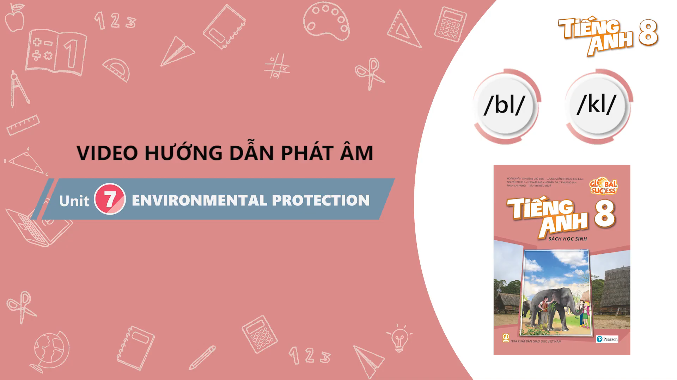
Pay attention to the sound: /bl/ and /kl/

Slide 39
4. Listen and repeat the words. Pay attention to the sounds /bl/ and /kl/
/bl/ | /kl/
block blast blanket black problem | clean clown club class clear

Slide 40
5. Listen and practice the sentences. Underline the words with /bl/, and circle the words with /kl/.
1. Look! There are black clouds all over!
2. A truck blocked the way to the club.
3. The students painted the classroom blue.
4. The wind blew the clock down.
5. We cleaned up the environment after the blast.

Slide 41
Wrap – up
What have we learnt in this lesson?
Vocabulary: The lexical items related to Environmental Protection
Pronunciation: Correctly pronounce words that contain the sounds: /bl/ and /kl/

Slide 42
Choose the correct answer for each sentence
1. The Amazon rainforest is one of the most diverse _____ in the world, providing a home to thousands of plant and animal species. A. ecosystems B. pollution C. habitats
2. Air _____ caused by factories and vehicles can lead to serious health problems and environmental damage.
A. protection B. pollution C. ecosystem
3. The destruction of forests forces many animals to leave their _____, making survival more difficult for them.
A. habitat B. pollution C. endangered species
4. _____ without planting new ones can destroy the balance of the ecosystem.
A. Picking up rubbish B. Saving water C. Cutting down trees
5. Taking shorter showers and turning off taps while brushing your teeth are good ways of _____.
A. protecting endangered species B. saving water C. building a campfire

Slide 43
HOMEWORK
Learn by heart vocabulary
Practice the words with the sounds /bl/ and/kl/
Prepare for the next lesson

Slide 44
THANK YOU

