Slide 1

WELCOME TO OUR CLASS!
Teacher: …………….

Slide 2
WARM-UP

Slide 3
Matching
1. I always take a bath
2. Will you wait here
3. I was not at home
4. As soon as she finished that project,
5. After he has finished his work,
a. he will accompany you to the park
b. she started working on the next
c. until I am ready?
d. before I go to bed.
e. when he came to see me.

Slide 4
Look at the sentences
ADVERB CLAUSES OF TIME
1. I always take a bath before I go to bed.
2. Will you wait here until I am ready?
3. I was not at home when he came to see me.
4. As soon as she finished that project, she started working on the next
5. After he has finished his work, he will accompany you to the park
1. I always take a bath before I go to bed.
2. Will you wait here until I am ready?
3. I was not at home when he came to see me.
4. As soon as she finished that project, she started working on the next
5. After he has finished his work, he will accompany you to the park

Slide 5
Unit 7:
ENVIRONMENTAL PROTECTION
Lesson 3: A Closer Look 2

Slide 6
Complex sentences with adverb clauses of time
– A complex sentence contains one independent clause and at least one dependent clause.
Example:
The roads were slippery when it rained.
independent clause dependent clause
– An adverb clause is a dependent clause.
– An adverb clause of time shows when something happens. It is usually introduced by time connectors: before, after, when, while, till / until, as soon as, …

Slide 7
1. Read the sentences and write I.C if the underlined clause is an independent clause or D.C if it is a dependent clause
Example:
You must be careful when you cross the street.
1. I’ll wait for you here until you get back.
2. Make sure you lock the door when you go out.
3. You must get a permit before you build a campfire at a national park.
4. Don’t use too much water while you are having a shower.
5. As soon as my friends come, we will pick up rubbish on the beach.
D.C
I.C
D.C
I.C
D.C
D.C

Slide 8
2. Choose A, B, or C to complete each sentence.
1. I was not at home ______ he came to see me yesterday.
A. when B. until C. as soon as
2. We called the forest guard unit ______ we saw the bush fire.
A. as soon as B. while C. until
3. I went straight to the gym ______ I left home.
A. while B. before C. after
4. You can stay with us ______ you find a suitable place to stay.
A. as soon as B. before C. until
5. We cleaned up everything at the campsite ______ we left.
A. until B. before C. while

Slide 9
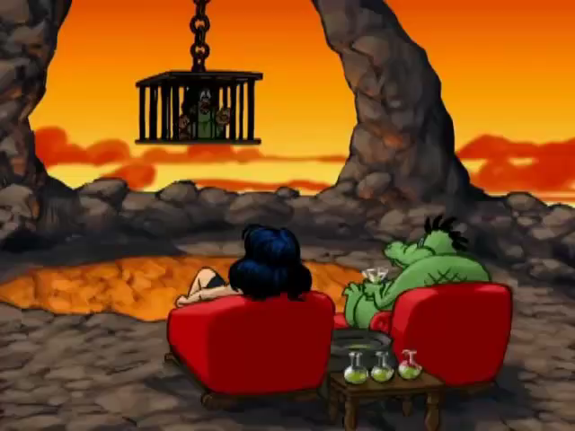
We have captured Hugo’s family. I am waiting for Hugo to come and I’ll capture him too. [Ha..ha]
PLAY
Hugo, you need to answer correct the questions to save your wife and son.

Slide 10
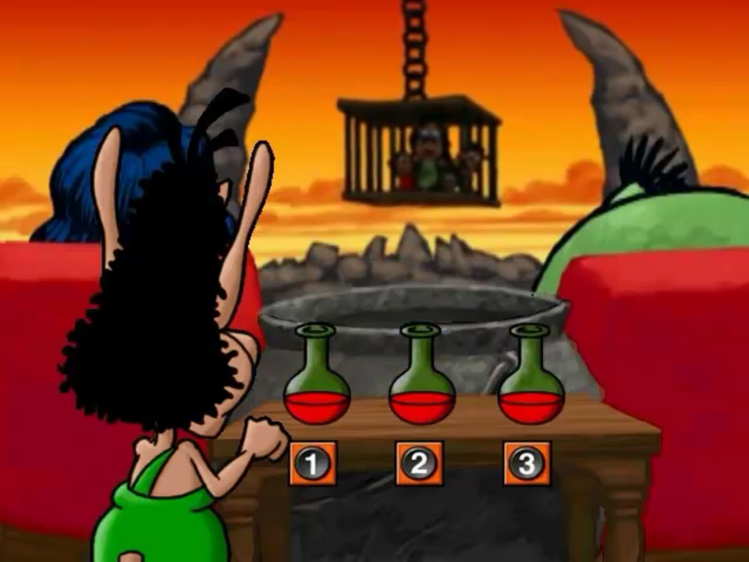
1. I was not at home ______ he came to see me yesterday.
A. when
B. until
C. as soon as
NEXT
A
B
C

Slide 11
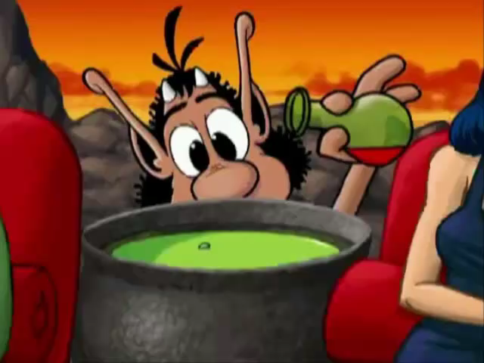
BACK

Slide 12
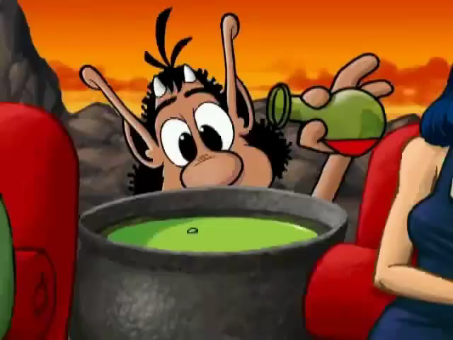
BACK

Slide 13
2. We called the forest guard unit ______ we saw the bush fire.
A. as soon as
B. while
C. until
NEXT
A
B
C

Slide 14
BACK

Slide 15
BACK

Slide 16
3. I went straight to the gym ______ I left home.
A. while
B. before
C. after
NEXT
A
B
C

Slide 17
BACK

Slide 18
BACK

Slide 19
4. You can stay with us ______ you find a suitable place to stay.
A. as soon as
B. before
C. until
NEXT
A
B
C

Slide 20
BACK

Slide 21
BACK

Slide 22
5. We cleaned up everything at the campsite ______ we left.
A. until
B. before
C. while
NEXT
A
B
C

Slide 23
BACK

Slide 24
BACK

Slide 25
Look at the answers again
1. I was not at home ______ he came to see me yesterday.
A. when B. until C. as soon as
2. We called the forest guard unit ______ we saw the bush fire.
A. as soon as B. while C. until
3. I went straight to the gym ______ I left home.
A. while B. before C. after
4. You can stay with us ______ you find a suitable place to stay.
A. as soon as B. before C. until
5. We cleaned up everything at the campsite ______ we left.
A. until B. before C. while

Slide 26
3. Match the clauses in the two columns to form complex sentences
1. We will clean up the beach
2. Don’t forget to turn off the lights
3. You have to show your ticket
4. Can you help me lay the table
5. Thomas Edison kept trying
a. until he made a successful light bulb
b. as soon as it stops raining
c. while I’m cooking the soup?
d. before you go out
e. when you get on the train.

Slide 27

4. Combine each pair of sentences, using the conjunction in brackets
1. I arrive at the station. I will call you right after. (as soon as)
__________________________________________________________________
2. Many Vietnamese women wear conical hats. They work in the field. (when)
_________________________________________________________________
3. My father taught me how to use the computer. Then he bought one for me. (before)
__________________________________________________________________
4. Nick is reading a novel. Jack is reading a cartoon. (while)
__________________________________________________________________
5. The tornado hit. There were only a few houses left standing. (After)
__________________________________________________________________

Slide 28
4. Combine each pair of sentences, using the conjunction in brackets
1. I arrive at the station. I will call you right after. (as soon as)
__________________________________________________________________
2. Many Vietnamese women wear conical hats. They work in the field. (when)
__________________________________________________________________
I will call you as soon as I arrive at the station.
Many Vietnamese women wear conical hats when they work in the field.

Slide 29
4. Combine each pair of sentences, using the conjunction in brackets
3. My father taught me how to use the computer. Then he bought one for me. (before)
__________________________________________________________________
4. Nick is reading a novel. Jack is reading a cartoon. (while)
__________________________________________________________________
5. The tornado hit. There were only a few houses left standing. (After)
__________________________________________________________________
My father taught me how to use the computer before he bought one for me.
Nick is reading a novel while Jack is reading a cartoon.
After the tornado hit, there were only a few houses left standing.

Slide 30
Do the quiz: Complex sentence
https://english6unit5.my.canva.site/grade-9-interactive-grammar-quiz-natural-wonders

Slide 31

Matching game:
Work in two groups, A and B.
Group A write the main clauses.
Group B write adverb clauses of time.

Slide 32
Wrap-up
What have we learned in this lesson?
use Complex sentences with adverb clauses of time;

Slide 33
HOMEWORK
Practice the grammar point
Prepare: Communication

Slide 34
Thank you!

