Slide 1

Welcome to our class!
Presented by: …………………………………………

Slide 2
WARM-UP
What is the video about?

Slide 3
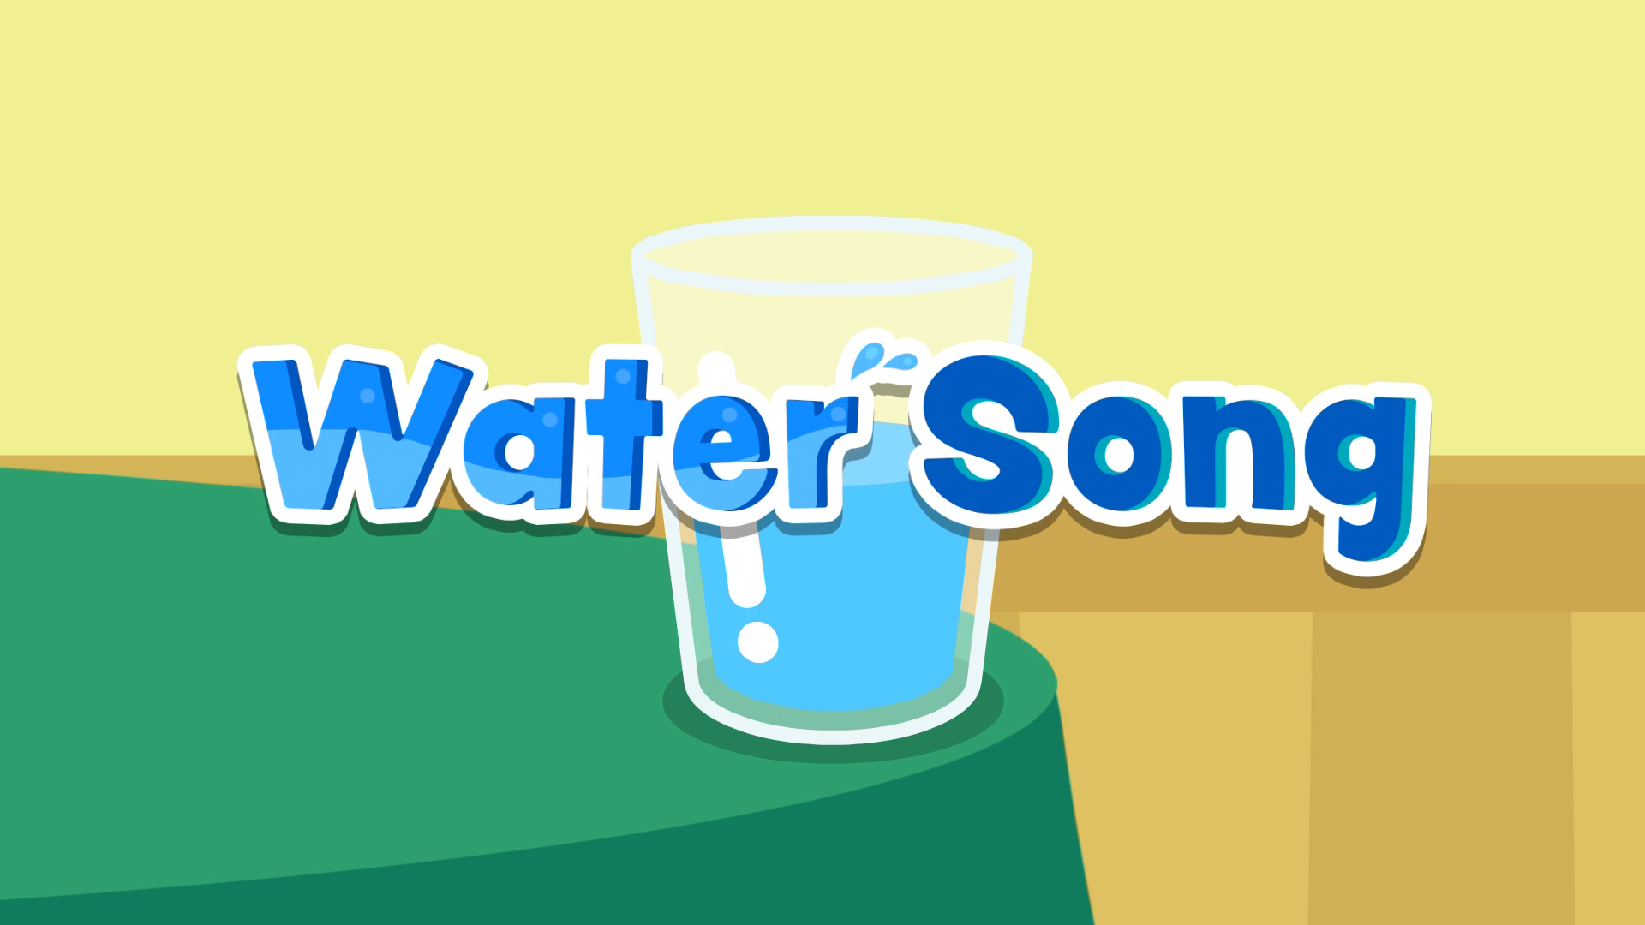
What is the video about?

Slide 4
UNIT 7. ENVIRONMENT PROTECTION
............, January ......., 202.....
Lesson 6. Skills 2

Slide 5

OBJECTIVES
By the end of this lesson, Ss will be able to:
Develop their listening skill for specific information about water pollution
Write a notice

Slide 6
VOCABULARY

Slide 7


vocabulary
institution (n)
/ˌɪnstɪˈtjuːʃn/
cơ quan, tổ chức

Slide 8

vocabulary
toxic (n)
/ˈtɒksɪk/
độc hại

Slide 9
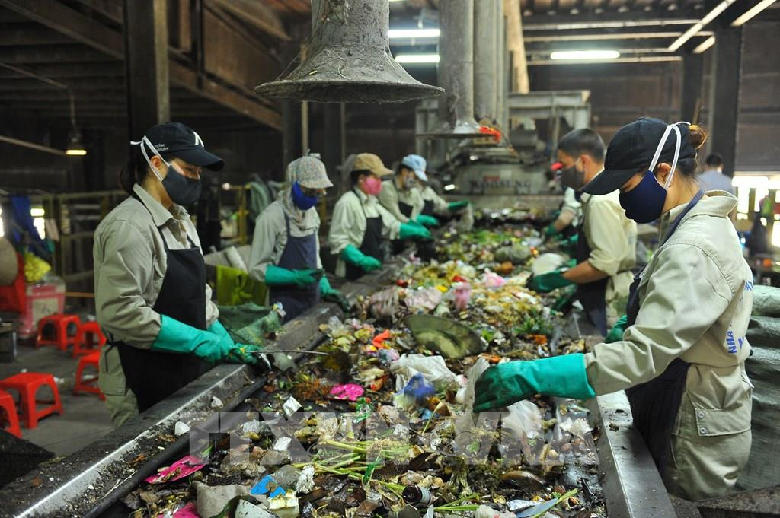
vocabulary
treat (v)
/triːt/
xử lí

Slide 10
Vocabulary
institution (n)
cơ quan, tổ chức
/ˌɪnstɪˈtjuːʃn/
toxic (n)
/ˈtɒksɪk/
độc hại
treat (v)
/triːt/
xử lí

Slide 11
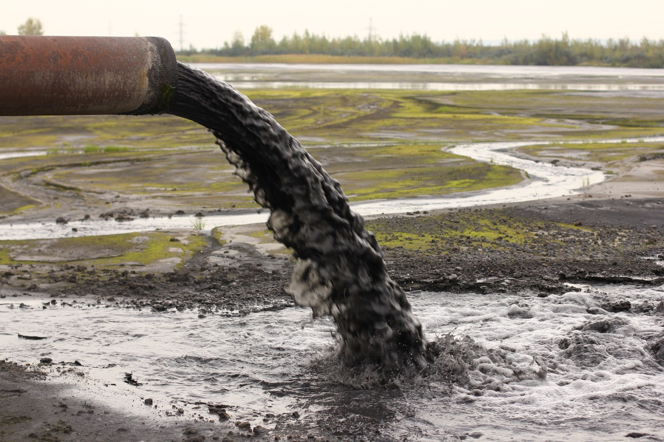
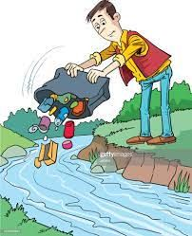
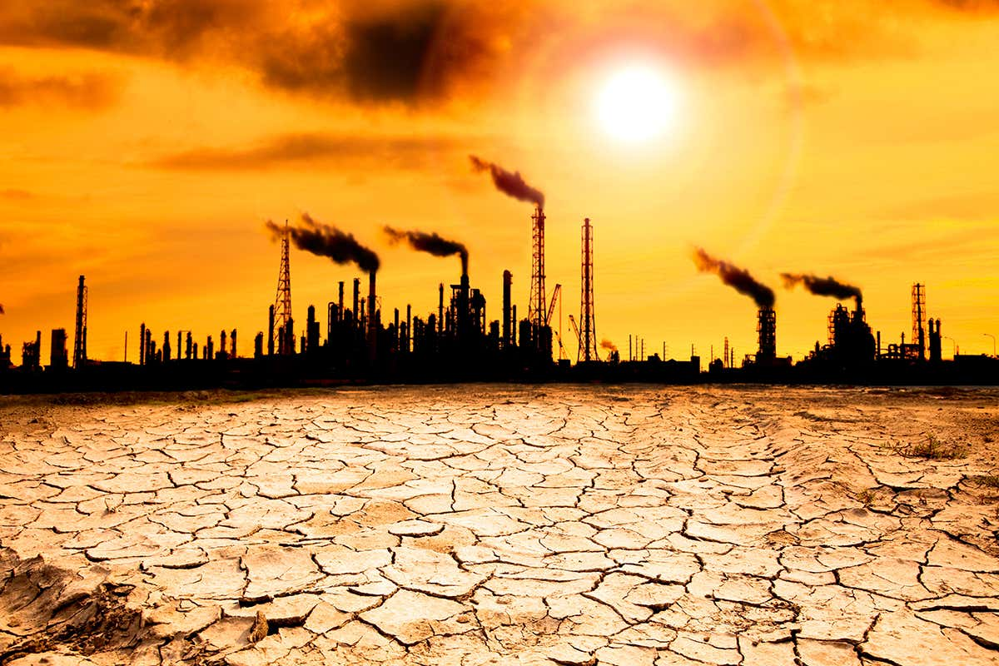
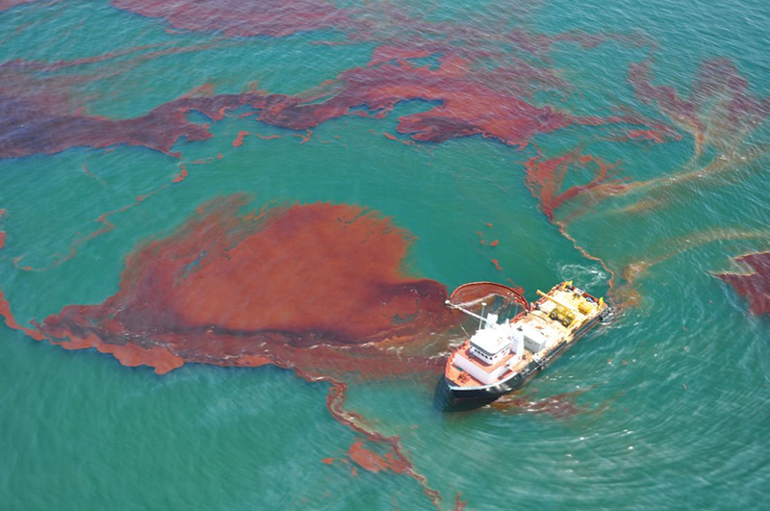
Match the phrases to the correct pictures.
throwing rubbish into rivers and lakes
Activities that cause water pollution
industrial waste
oil leaks and spills
1
global warming
2
3
4
throwing rubbish into rivers and lakes

Slide 12
LISTENING
WATER POLLUTION

Slide 13

2. Listen to the conversation and choose the correct word to complete each sentence
1. Polluted water is unsafe for drinking / cooking and for other uses.
2. Sometimes toxic substances flow into rivers from factories / hospitals.
3. Water pollution has a dangerous / harmful effect on our life.
4. We couldn’t / shouldn’t throw litter into rivers and lakes.

Slide 14
3. Listen again and choose the correct answer.
1. What is the listening text about?
A. Water pollution B. Water protection C. Water consumption
2. How many sources of water pollution are there?
A. One B. Two C. Three
3. What are two common sources of drinking water?
A. Rivers and lakes B. Soil and rock C. Man-made and natural
4. What type of effect does water pollution have on our life?
A. beneficial B. harmful C. helpful
5. What products can we use to reduce water pollution?
A. green products B. single-use products C. plastic bags

Slide 15





LUCKY WHEEL
30
20
1
2
3
40
10
50
80
4
5
6
60
70
PLAY
Notes:
Click the yellow heart to move to the 02 WRITING.

Slide 16

01
What is the listening text about?
A. Water pollution B. Water protection C. Water consumption
All living things need water but water pollution has become a serious problem. Polluted water is unsafe for drinking and for other uses.
B. WATER POLLUTION

Slide 17
02
How many sources of water pollution are there?
A. One B. Two C. Three
There are two sources of water pollution: man-made and natural.
B. TWO

Slide 18
03
What are two common sources of drinking water?
A. Rivers and lakes
B. Soil and rock
C. Man-made and natural
These rivers and lakes are a source of drinking water for humans.
A. Rivers and lakes

Slide 19
04
What type of effect does water pollution have on our life?
A. beneficial B. harmful C. helpful
Water pollution has a harmful effect on our lives.
B. HARMFUL

Slide 20
05
What products can we use to reduce water pollution?
A. green products B. single-use products C. plastic bags
Finally, we can reduce water pollution by using green products and avoiding single-use products like plastic bags.
A. GREEN PRODUCTS

Slide 21
LUCKY NUMBER

Slide 22
Look at the answers again
1. What is the listening text about?
A. Water pollution B. Water protection C. Water consumption
2. How many sources of water pollution are there?
A. One B. Two C. Three
3. What are two common sources of drinking water?
A. Rivers and lakes B. Soil and rock C. Man-made and natural
4. What type of effect does water pollution have on our life?
A. beneficial B. harmful C. helpful
5. What products can we use to reduce water pollution?
A. green products B. single-use products C. plastic bags

Slide 23
Writing
Write a notice

Slide 24
4. Work in pairs. Read the notice and match the headings (a – e) below with the numbers (1 – 5)
(1) ABS Secondary School
NOTICE
(2) March 10, 20...
Inter-School Writing Contest
(3) Our school is organizing an inter-school writing contest about the environment. Students from more than 10 schools from all over our town will participate. Interested students should contact the school by March 20, 20...
Contest details:
Time: 2 p.m. – 4 p.m., April 5
Place: School Grand Hall
Topic: Environmental Protection
(4) If you have any questions, please contact us at 031-823-1231 or email abs@fmail.com.
(5) Head Teacher
Dr. Adam Sanders (signed)
a. Name of institution or organization
(School, etc.)
b. Body (date / time / duration / place, etc.)
c. Date of writing the notice
d. Author’s name and signature
e. Contact details

Slide 25
4. Work in pairs. Read the notice and match the headings (a – e) below with the numbers (1 – 5)
(1) ABS Secondary School
NOTICE
a. Name of institution or organization
(School, etc.)
b. Body (date / time / duration / place, etc.)
c. Date of writing the notice
d. Author’s name and signature
e. Contact details

Slide 26
4. Work in pairs. Read the notice and match the headings (a – e) below with the numbers (1 – 5)
(2) March 10, 20...
b. Body (date / time / duration / place, etc.)
c. Date of writing the notice
d. Author’s name and signature
e. Contact details

Slide 27
4. Work in pairs. Read the notice and match the headings (a – e) below with the numbers (1 – 5)
(3) Our school is organizing an inter-school writing contest about the environment. Students from more than 10 schools from all over our town will participate. Interested students should contact the school by March 20, 20...
Contest details:
Time: 2 p.m. – 4 p.m., April 5
Place: School Grand Hall
Topic: Environmental Protection
b. Body (date / time / duration / place, etc.)
d. Author’s name and signature
e. Contact details

Slide 28
4. Work in pairs. Read the notice and match the headings (a – e) below with the numbers (1 – 5)
(4) If you have any questions, please contact us at 031-823-1231 or email abs@fmail.com.
d. Author’s name and signature
e. Contact details

Slide 29
4. Work in pairs. Read the notice and match the headings (a – e) below with the numbers (1 – 5)
(5) Head Teacher
Dr. Adam Sanders (signed)
d. Author’s name and signature

Slide 30
Look at the answers again.
(1) ABS Secondary School
NOTICE
(2) March 10, 20...
Inter-School Writing Contest
(3) Our school is organizing an inter-school writing contest about the environment. Students from more than 10 schools from all over our town will participate. Interested students should contact the school by March 20, 20...
Contest details:
Time: 2 p.m. – 4 p.m., April 5
Place: School Grand Hall
Topic: Environmental Protection
(4) If you have any questions, please contact us at 031-823-1231 or email abs@fmail.com.
(5) Head Teacher
Dr. Adam Sanders (signed)
a. Name of institution or organization
(School, etc.)
b. Body (date / time / duration / place, etc.)
c. Date of writing the notice
d. Author’s name and signature
e. Contact details

Slide 31

5. Write a notice for the Go Green Club leader to invite students to attend a lecture on water pollution. Use the following details.
Go Green Club
NOTICE
January 12, 20...
Lecture On Water Pollution
______________________
_______________________
Club Leader
Nguyen Hong Mai
Time: 2 p.m. – 4 p.m., March 6 Place: School Grand Hall Topic: Water pollution

Slide 32
PEER CHECK
Criteria | Yes | No
1. Are the verbs in the correct form?
2. Are the nouns in the correct form?
3. Is the spelling correct?
4. Has the notice enough information?

Slide 33
Suggested answer
Go Green Club
NOTICE
12 January, 2023
Lecture on Water Pollution
Green Earth Club is organizing a lecture about the Water Pollution. Students from all the classes can participate. Interested students should contact the school by 20 May, 2023.
Lecture details:
Time: 2 p.m - 4 p.m., 6 June
Place: School Grand Hall
Topic: Water Pollution
If you have any questions, please contact us at 045-281-4769 or email greenearthclub@gmail.com
Club Leader,
Nguyen Hong Mai

Slide 34

recap
Circle the correct answers.
1. What skills have you leant today?
A. Speaking and Writing
B. Reading and Writing C. Listening and Writing
2. What content have you leant today?
A. Water pollution
B. How to write a notice
C. Ways to use water

Slide 35
Thank you!

