Slide 1



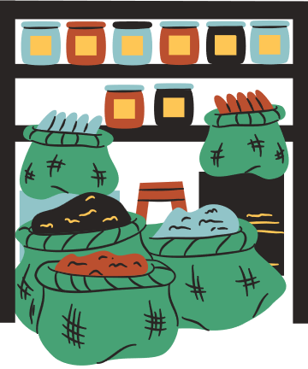
Welcome to our class!
Teacher:……………………………………….

Slide 2
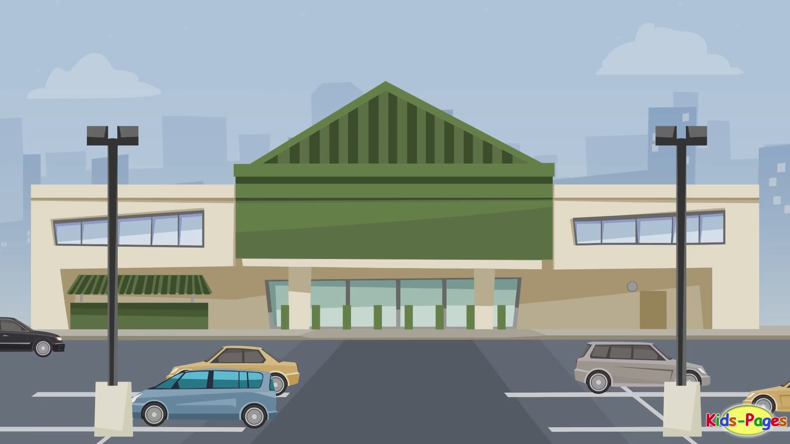

What are they doing? And Where are they?

Slide 3


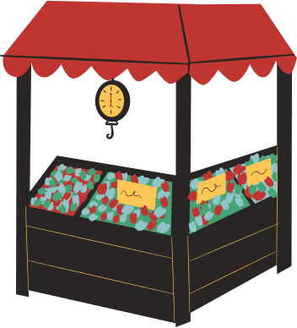
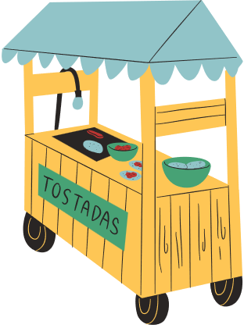
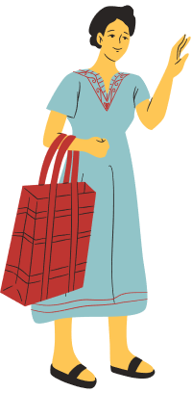
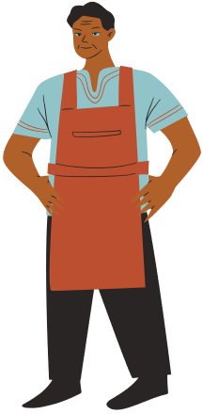
Unit 8
Shopping
Lesson 1: Getting Started

Slide 4


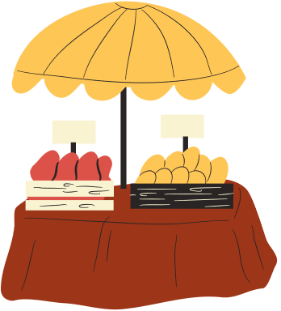
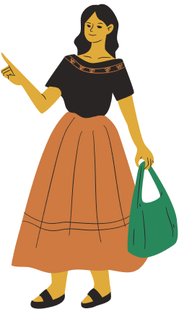
Vocabulary

Slide 5

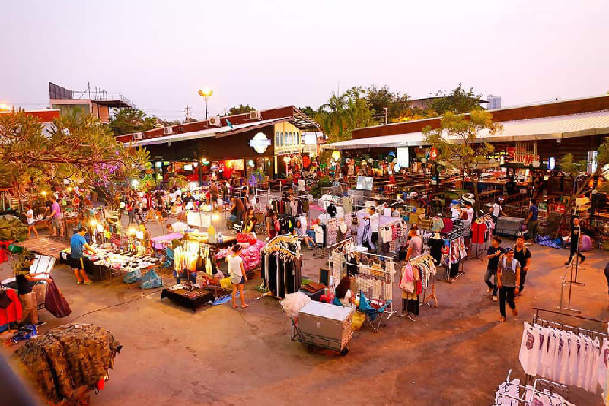

Vocabulary
open-air market (n)
/ˌəʊpən ˈeə(r) ˈmɑːkɪt/
chợ họp ngoài trời

Slide 6
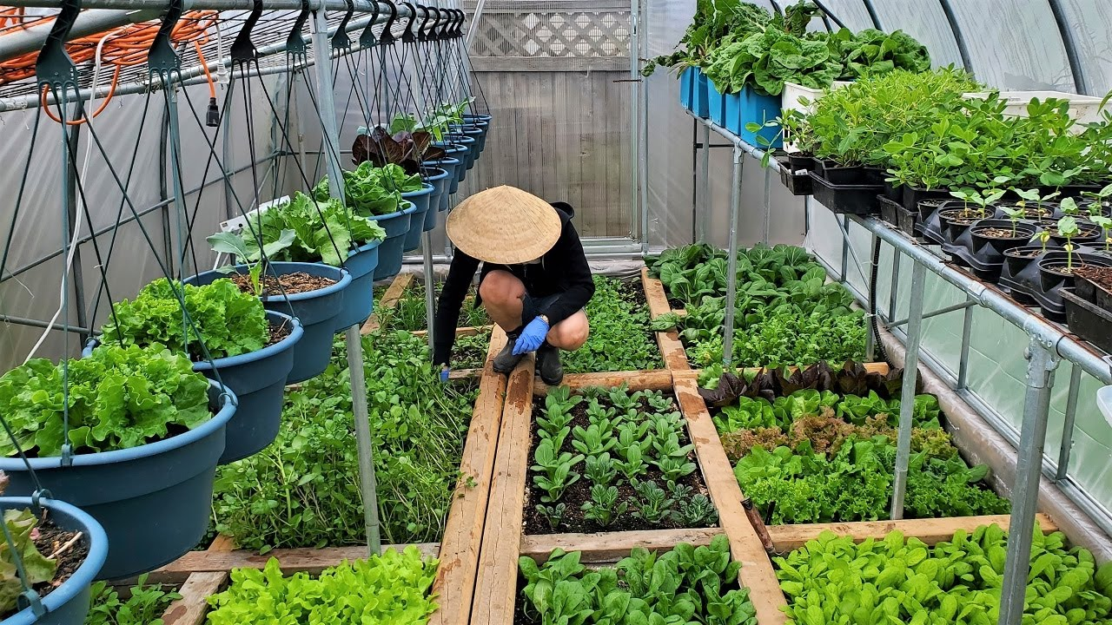
Vocabulary
home-grown (adj)
/ˌhəʊm ˈɡrəʊn/
tự trồng

Slide 7

Vocabulary
home-made (adj)
/ˌhəʊm ˈmeɪd/
tự làm

Slide 8
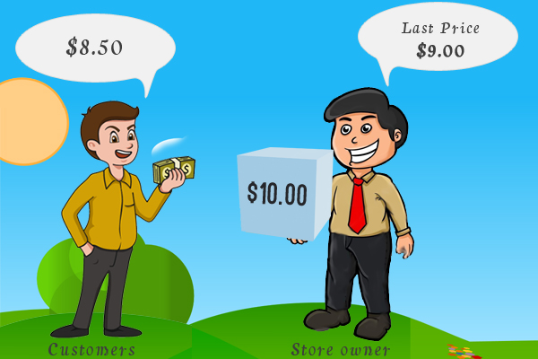
Vocabulary
bargain (v)
/ˈbɑːɡən/
mặc cả

Slide 9
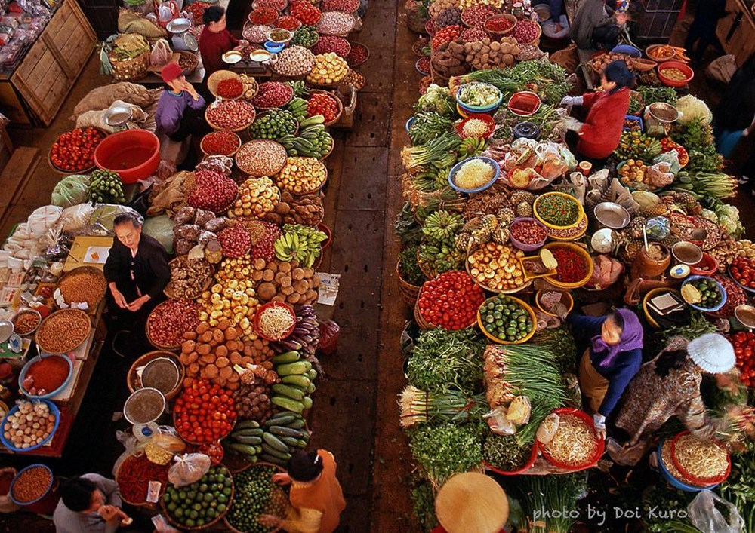
Vocabulary
farmers’ market (n)
/ˈfɑːməz mɑːkɪt/
chợ nông sản

Slide 10
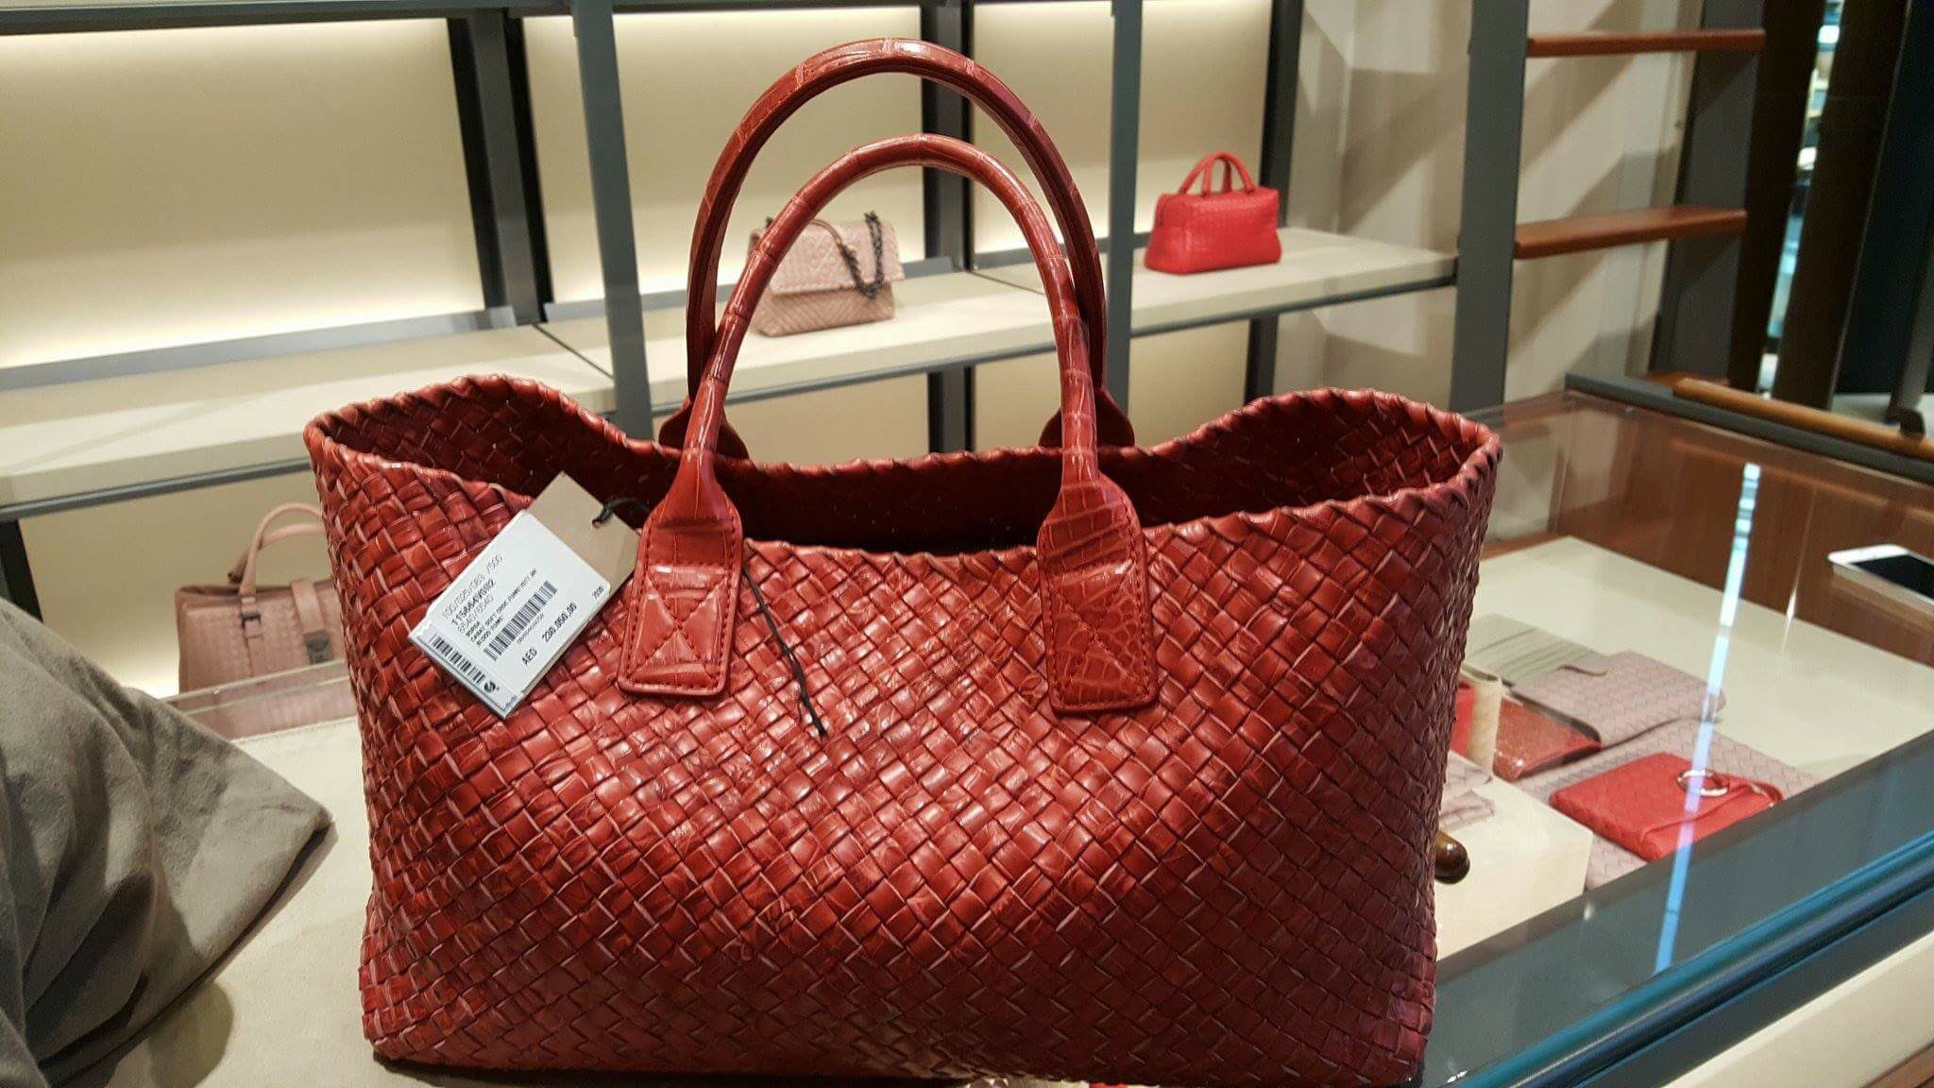
Vocabulary
price tag (n)
/ˈpraɪs tæɡ/
nhãn ghi giá mặt hàng

Slide 11
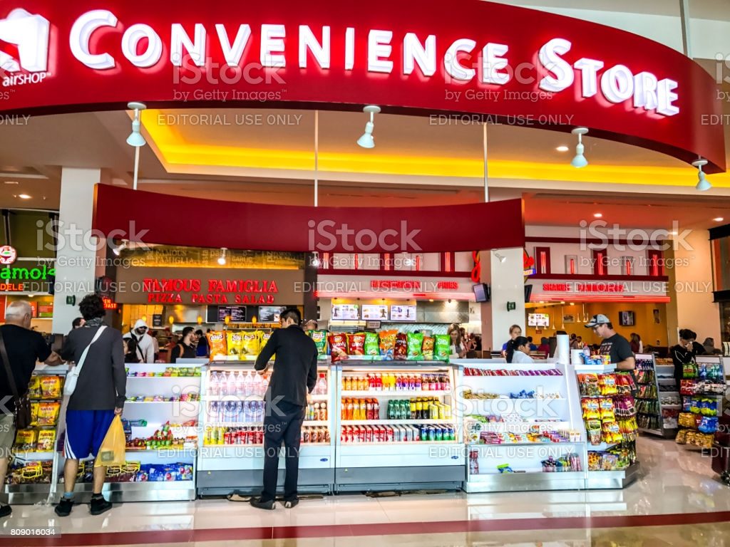
Vocabulary
convenience store (v)
/kənˈviːniəns stɔː(r)/
cửa hàng tiện lợi

Slide 12
Vocabulary
- open-air market (n) | /ˌəʊpən ˈeə(r) ˈmɑːkɪt/ | chợ họp ngoài trời
- home-grown (adj) | /ˌhəʊm ˈɡrəʊn/ | tự trồng
- home-made (adj) | /ˌhəʊm ˈmeɪd/ | tự làm
- bargain (v) | /ˈbɑːɡən/ | mặc cả
- farmers’ market (n) | /ˈfɑːməz mɑːkɪt/ | chợ nông sản
- price tag (adj) | /ˈpraɪs tæɡ/ | nhãn ghi giá mặt hàng
- convenience store (n) | /kənˈviːniəns stɔː(r)/ | cửa hàng tiện lợi

Slide 13
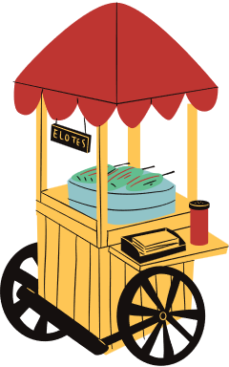
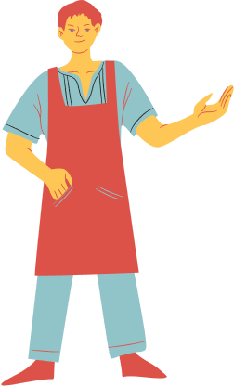
Listening & Reading

Slide 14
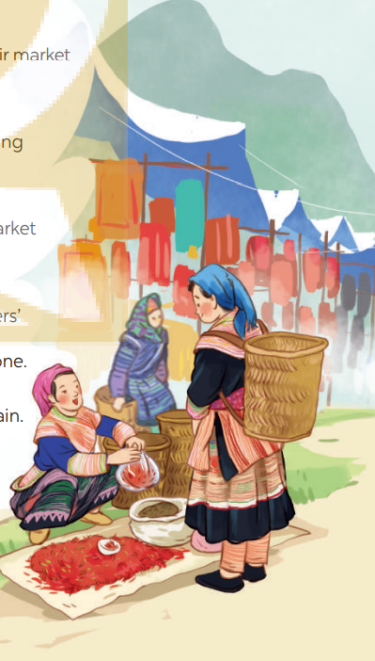
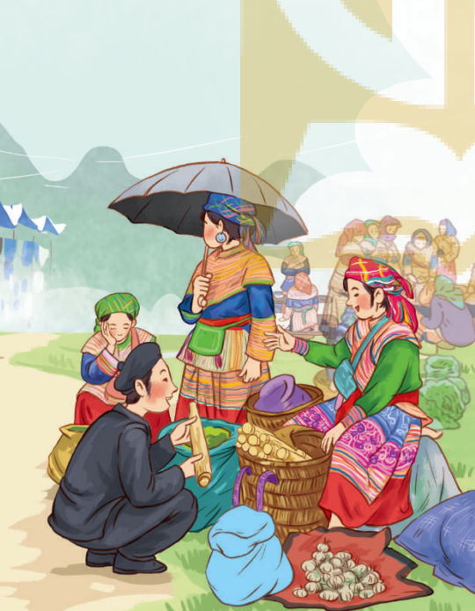
Answer the questions:
1. What are the pictures of?
2. What are the people in the pictures doing?

Slide 15


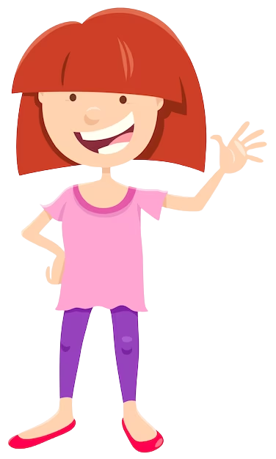
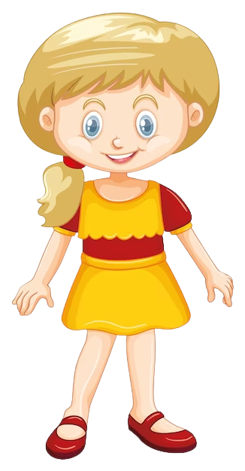

Choose the correct answer
1. Where does Alice like shopping?
A. open-air market
B. supermarket
2. Where does Mai like shopping?
open-air market
B. supermarket
Mai
Alice

Slide 16
1. Listen and read.
Mai: How was your trip to Bac Ha, Alice?
Alice: It’s awesome. I like Bac Ha Fair. It’s an open-air market in Lao Cai.
Mai: What do you like about it?
Alice: Many things. The people at the market were wearing really colourful costumes.
Mai: Yeah…They came from different minority groups.
Alice: I think so, and most of the products sold at the market were home-grown and home-made. I love it.
Mai: Do you have similar markets in New Zealand?
Alice: We do. Back in my city, Auckland, we have a farmers’ market every Saturday where farmers sell their products. My mother loves shopping there, and she rarely misses one.
Mai: I prefer shopping at the supermarket. I can find almost everything I need there, I don’t have to bargain. All the items have fixed prices on their price tags.
Alice: Right. It’s more convenient.
Mai: Yeah…Oh, I’ve got to go. My art lesson starts at one o’clock, and I want to go to a convenience store on the way. See you later.
Alice: See you.

Slide 17

2. Mail and Alice mentioned four places where they can buy things. Complete the list.
1. open-air market
2. _______________________________
3. _______________________________
4. _______________________________
farmers’ market
supermarket
convenience store

Slide 18
3. Match the types of markets with the features.
Types of markets | Features
open-air market supermarket | It’s outdoor. Goods are display on shelves. Shoppers can bargain. All items have fixed prices. The weather does not affect shopping.

Slide 19
4. Complete the sentences with the words and phrases from the box.
home -grown
bargain
price tag
home -made
convenience store
- What is “_____________”?
- It’s when buyers talk to the sellers to get a lower price.
2. A _______________ is a small shop and is usually open 24/7.
3. This salad is made of ___________ vegetables.
4. How much is this T-shirt? I cannot see the ___________.
5. Try our ___________ bread, Mai. My mother made it this morning.

Slide 20


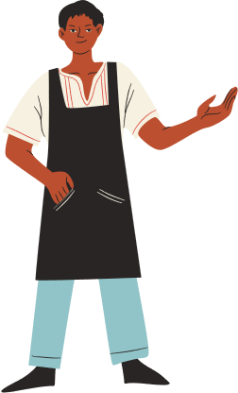
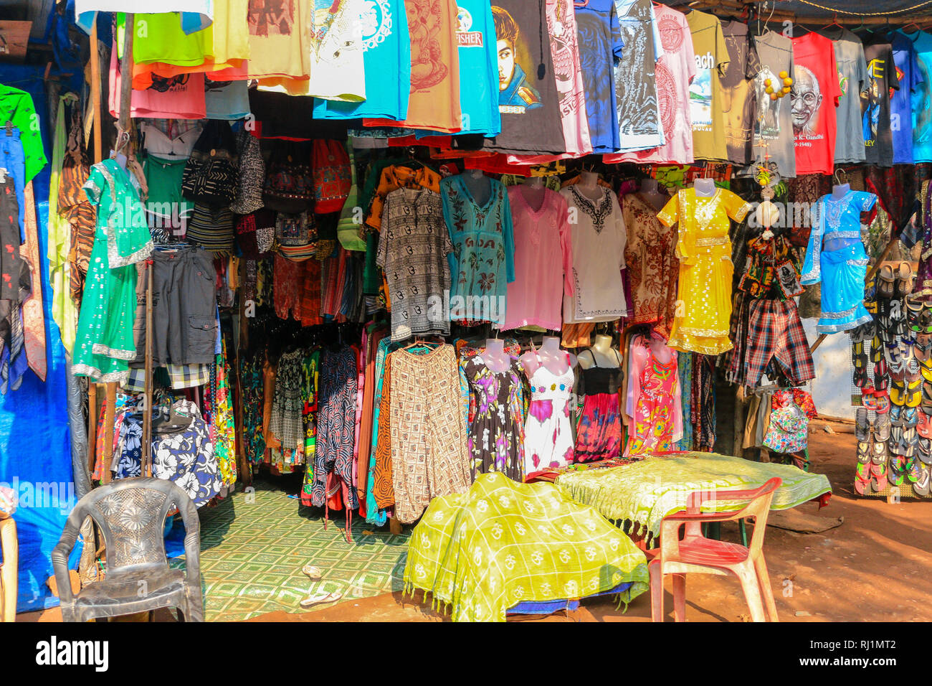
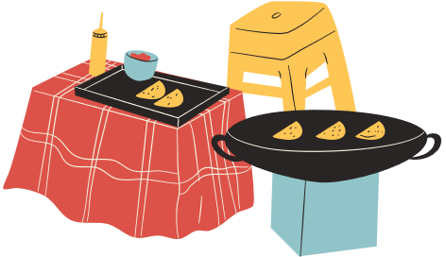
Look at the picture and say the shop’s name.
Clothes shop

Slide 21
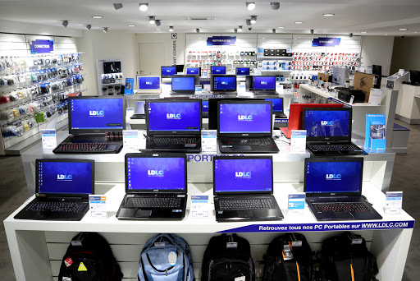
Look at the picture and say the shop’s name.
Computer shop

Slide 22
Look at the picture and say the shop’s name.
Bakery

Slide 23
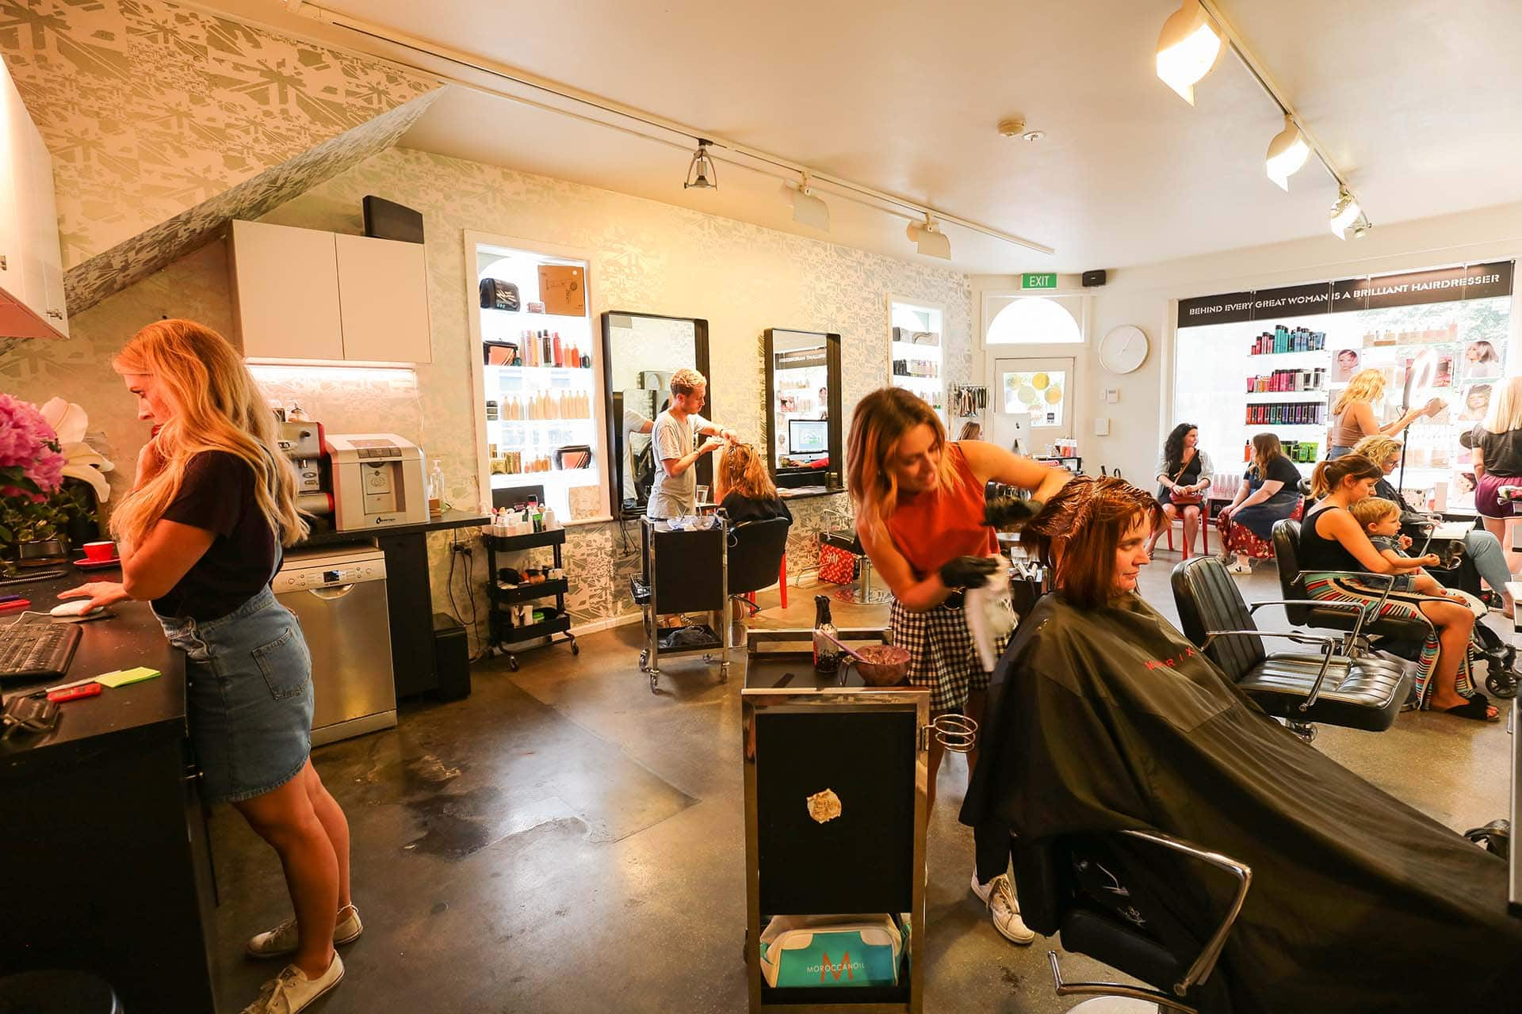
Look at the picture and say the shop’s name.
Hairdresser

Slide 24
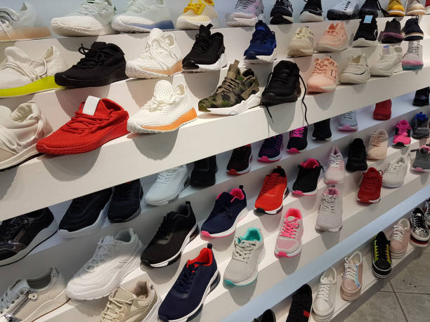
Look at the picture and say the shop’s name.
Shoe shop

Slide 25
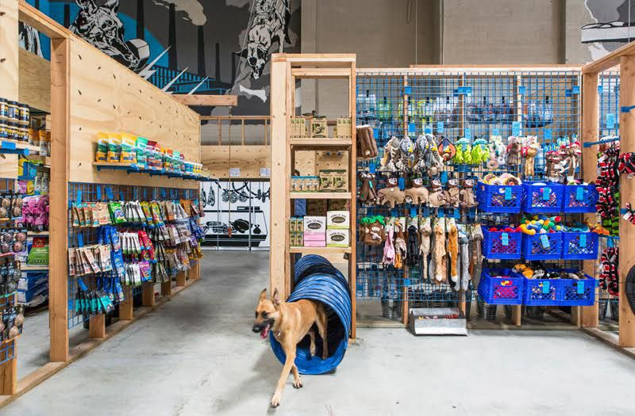
Look at the picture and say the shop’s name.
Pet shop

Slide 26
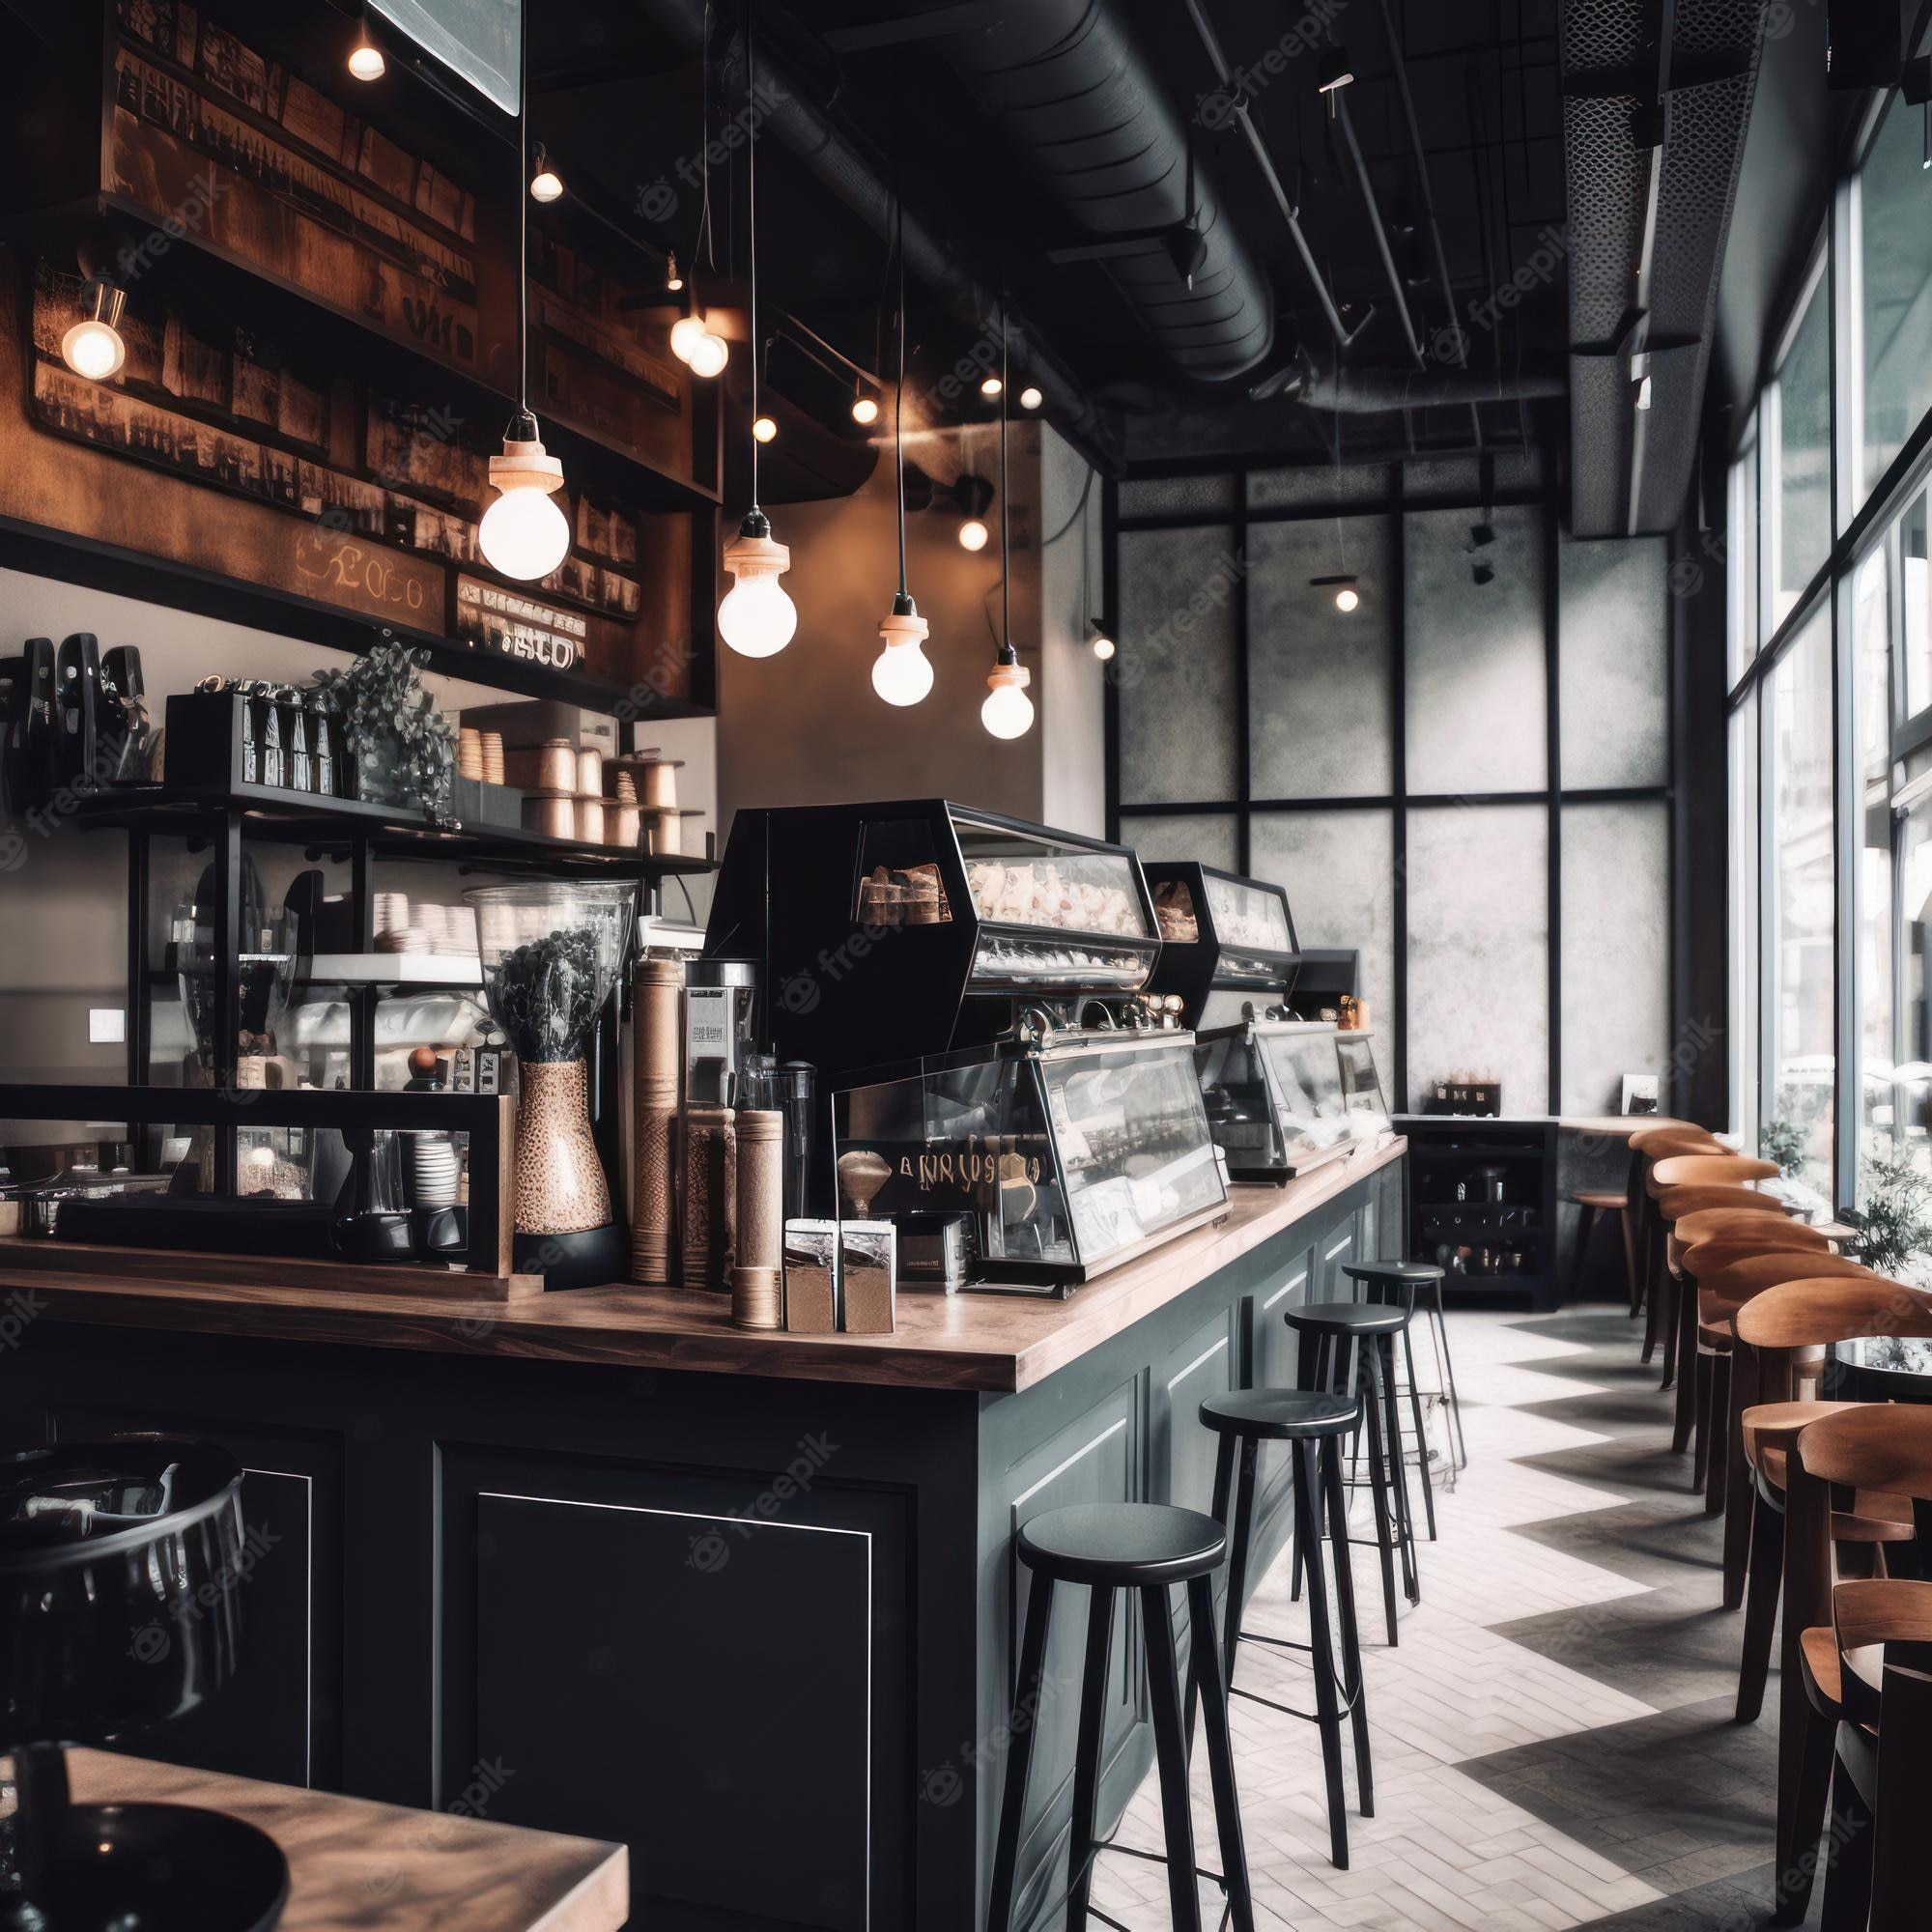
Look at the picture and say the shop’s name.
Coffee shop

Slide 27


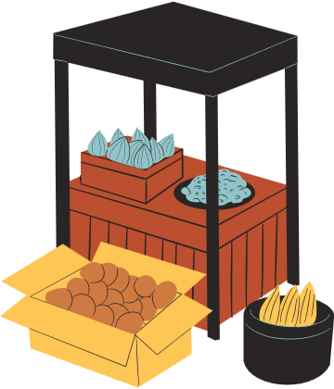
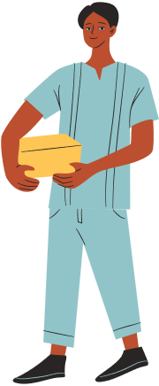
Wrap-up
What have we learned in this lesson?
identify the topic of the unit
use lexical items related to shopping
identify the language features that are covered in the unit

Slide 28
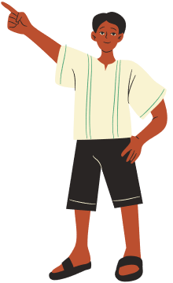
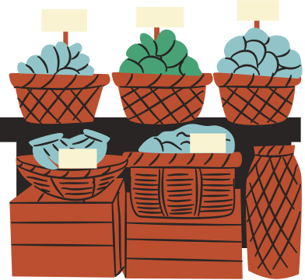
HOMEWORK
Name some places for shopping they have learnt about in the lesson.
Learn the new words and phrases by heart.
Prepare for the next lesson

Slide 29
Thank you
FOR LISTENING!

Slide 30
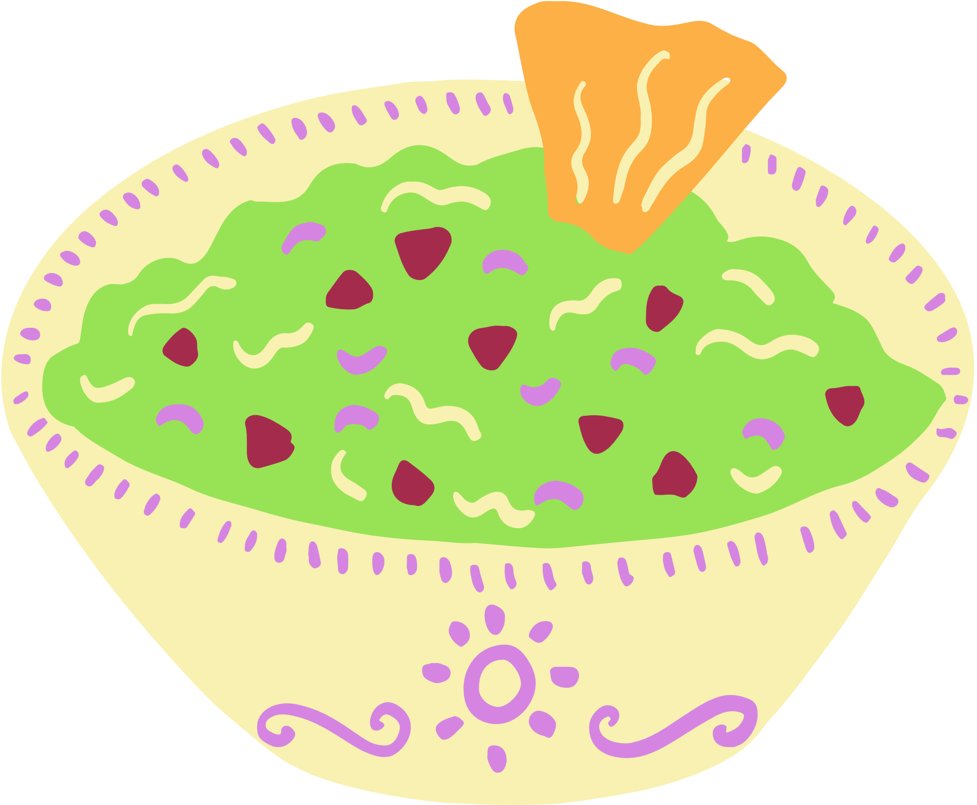
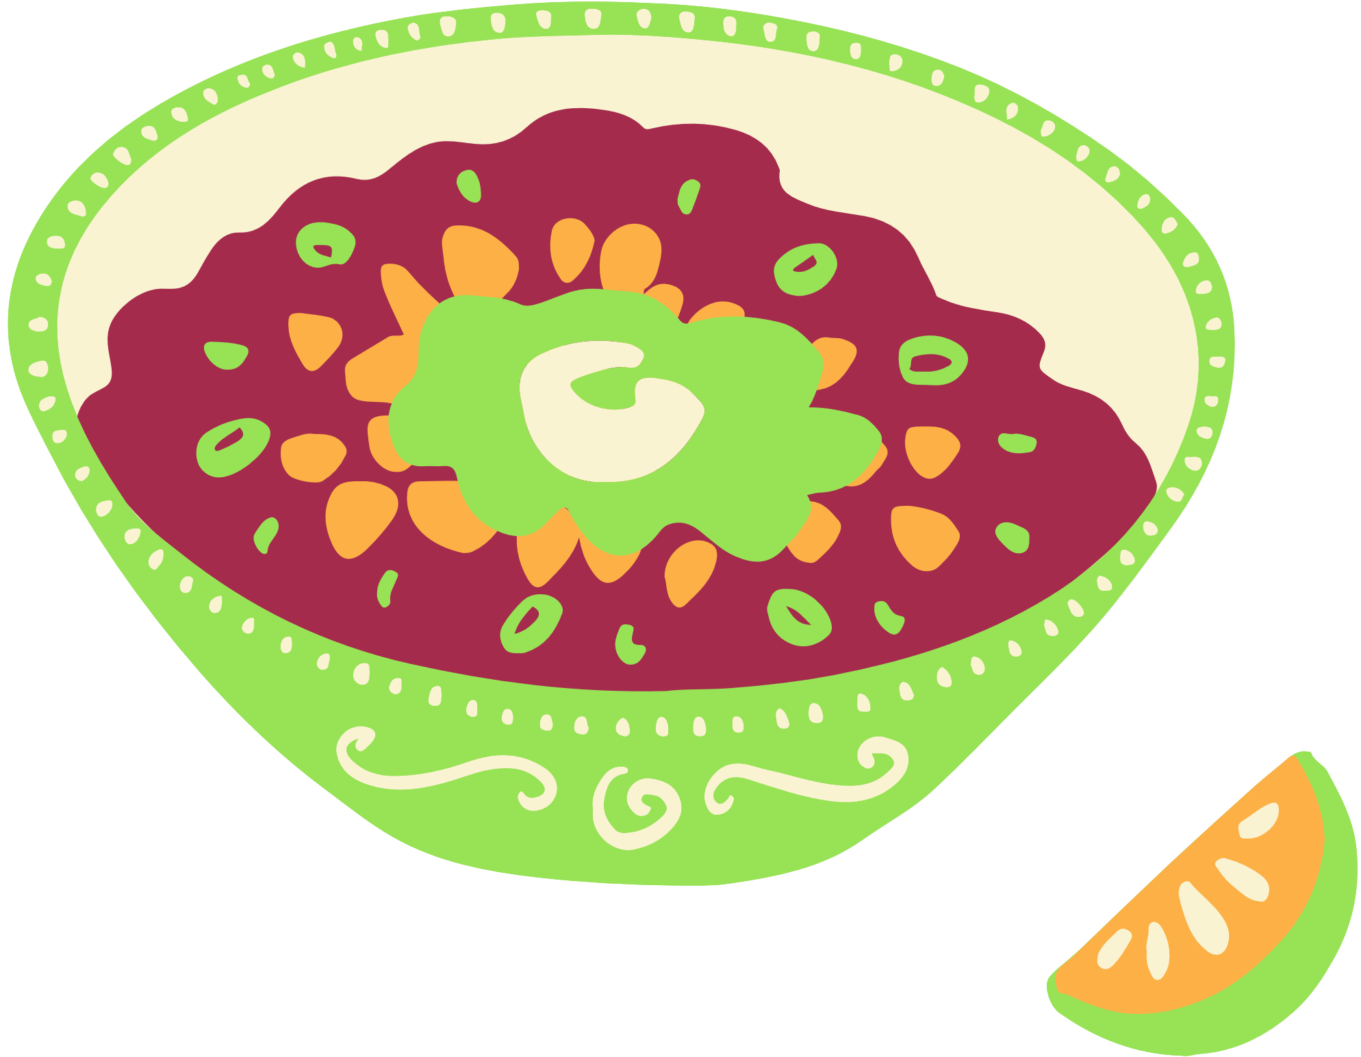



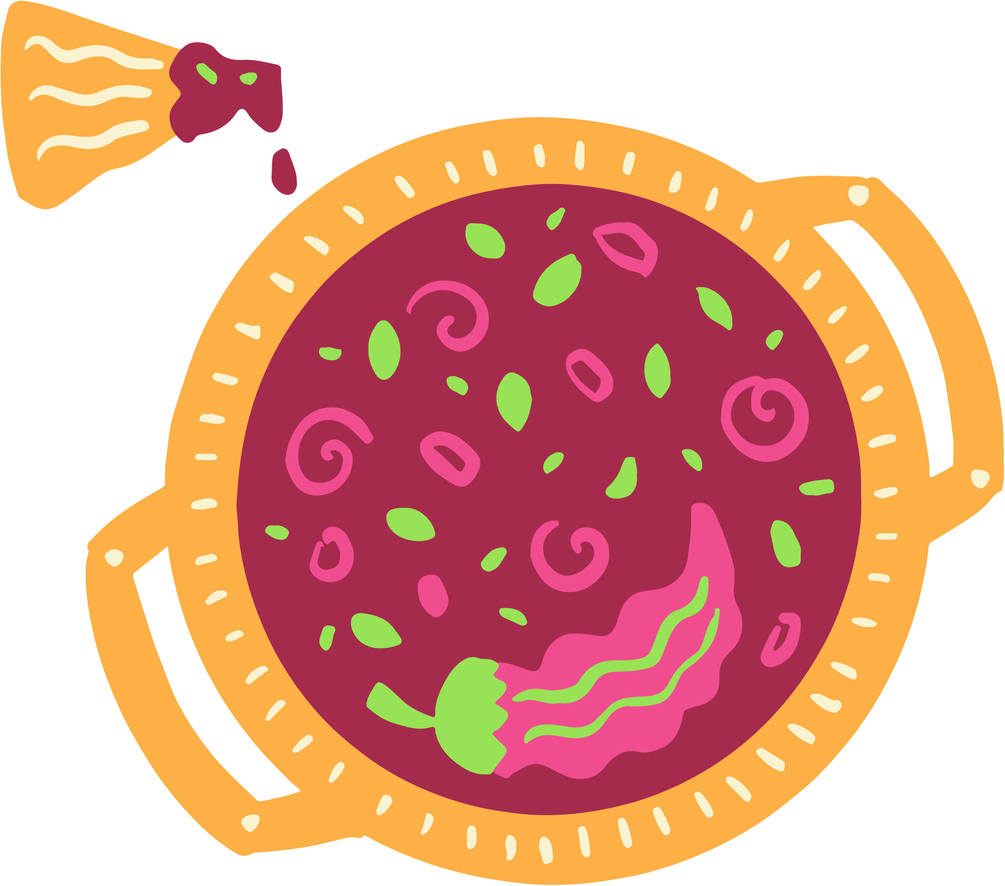

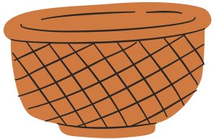
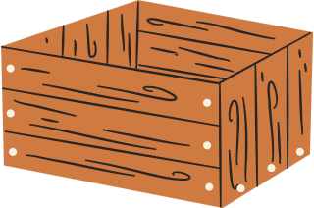
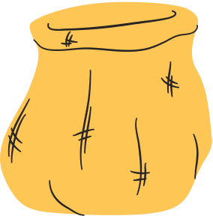





Free Resource Page

