Slide 1


Slide 2
WARM UP

Slide 3
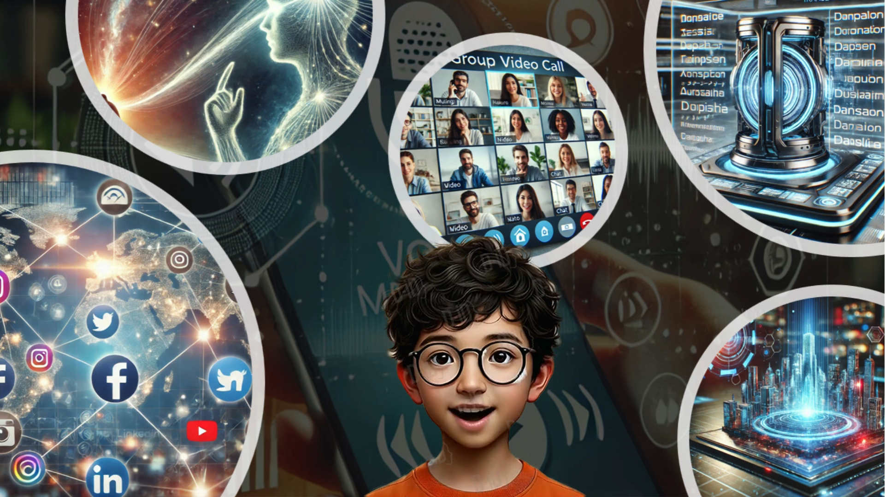
Watch and remember

Slide 4

Period 83
Unit 10:
COMMUNICATION IN THE FUTURE
Lesson 4: COMMUNICATION

Slide 5
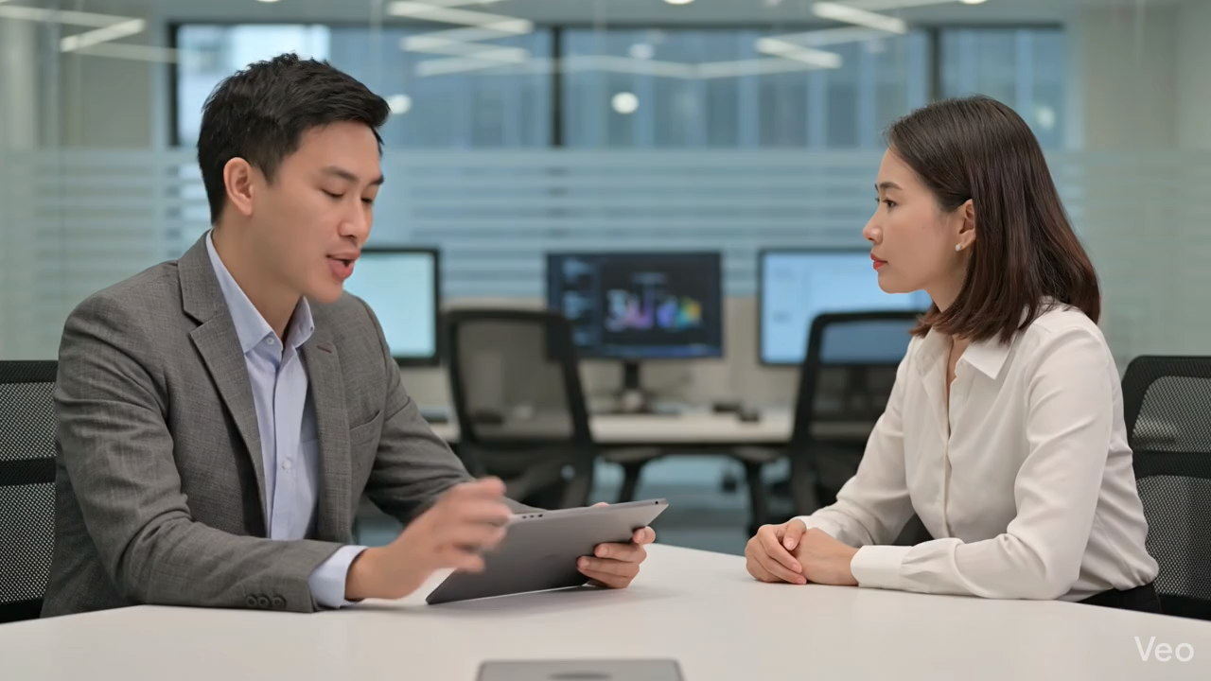
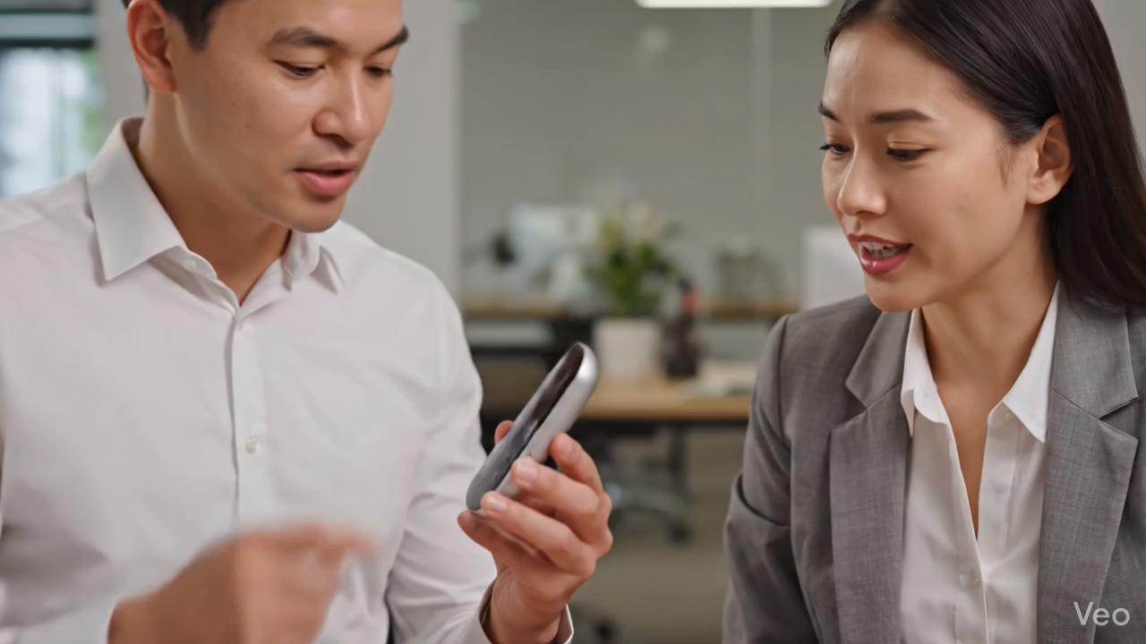
I./ EVERYDAY ENGLISH
Mark: Now, about the video conference ... Everyone must be here at 9:30 a.m., and ...
Trang: Sorry for interrupting, but I think we should meet at 9:00 a.m. We need to test the devices.
Nick: This webcam is easy to handle. You click these buttons to move it up or down and these to ...
Lan: Hold on. Can you repeat that, please?

Slide 6

Tick the ways to interrupt politely
Sorry, can I add an idea here?
Yes. That’s a great idea!
Excuse me, could I say something?
Well done!
Sorry, can I share my opinion?
Sorry, I have a new idea about this.
7. Sorry. I don’t have an idea!
8. Wait, I have an interesting idea!
9. I can’t agree with you more
10. Hold on! I have a suggestion.
Sorry, can I add an idea here?
Excuse me, could I say something?
Sorry, can I share my opinion?
Sorry, I have a new idea about this.
5. Wait, I have an interesting idea!
6. Hold on! I have a suggestion.

Slide 7

2. Work in pairs. Make similar conversations with the following situations.
1. Student A is telling student B how to make a video call. Student B interrupts student A to ask for clarification.
a. A: Now about the video call. Everyone should have a laptop or a smartphone and that’s enough….
b. A: Yes. And then you select from your contactor or you type their phone number ...
c. B: I'm sorry for interrupting but we should also need to download Zoom
A. c-a-b B. b-c-a C. c-b-a D. a-c-b
2. Student A is telling student B the place for their next meeting. Student B interrupts student A to suggest another place.

Slide 8
1. Student Ann is telling student Ba how to make a video call. Student Ba interrupts student Ann to ask for clarification.
An: Now about the video call. Everyone should have a laptop or a smartphone and that’s enough….
B

Slide 9
2. Work in pairs. Make similar conversations with the following situations.
1. Student A is telling student B how to make a video call. Student B interrupts student A to ask for clarification.
a. A: Now about the video call. Everyone should have a laptop or a smartphone and that’s enough….
b. A: Yes. And then you select from your contactor or you type their phone number ...
c. B: I'm sorry for interrupting but we should also need to download Zoom
A. c-a-b B. b-c-a C. c-b-a D. a-c-b
2. Student A is telling student B the place for their next meeting. Student B interrupts student A to suggest another place.

Slide 10
Choose the most suitable response A or B to complete the following situations.
1. Student Ann is telling student Ba how to make a video call. Student Ba interrupts student Ann to ask for clarification.
2. Student Anna is telling student Bi the place for their next meeting. Student Bi interrupts student Anna to suggest another place.
Anna: For the next meeting, I think we should organize it at the conference Room and ….
Bi: ____________.
A. Sorry. I don’t know B. Sorry for interrupting, but I suggest we use the library to hold the meeting.
B

Slide 11
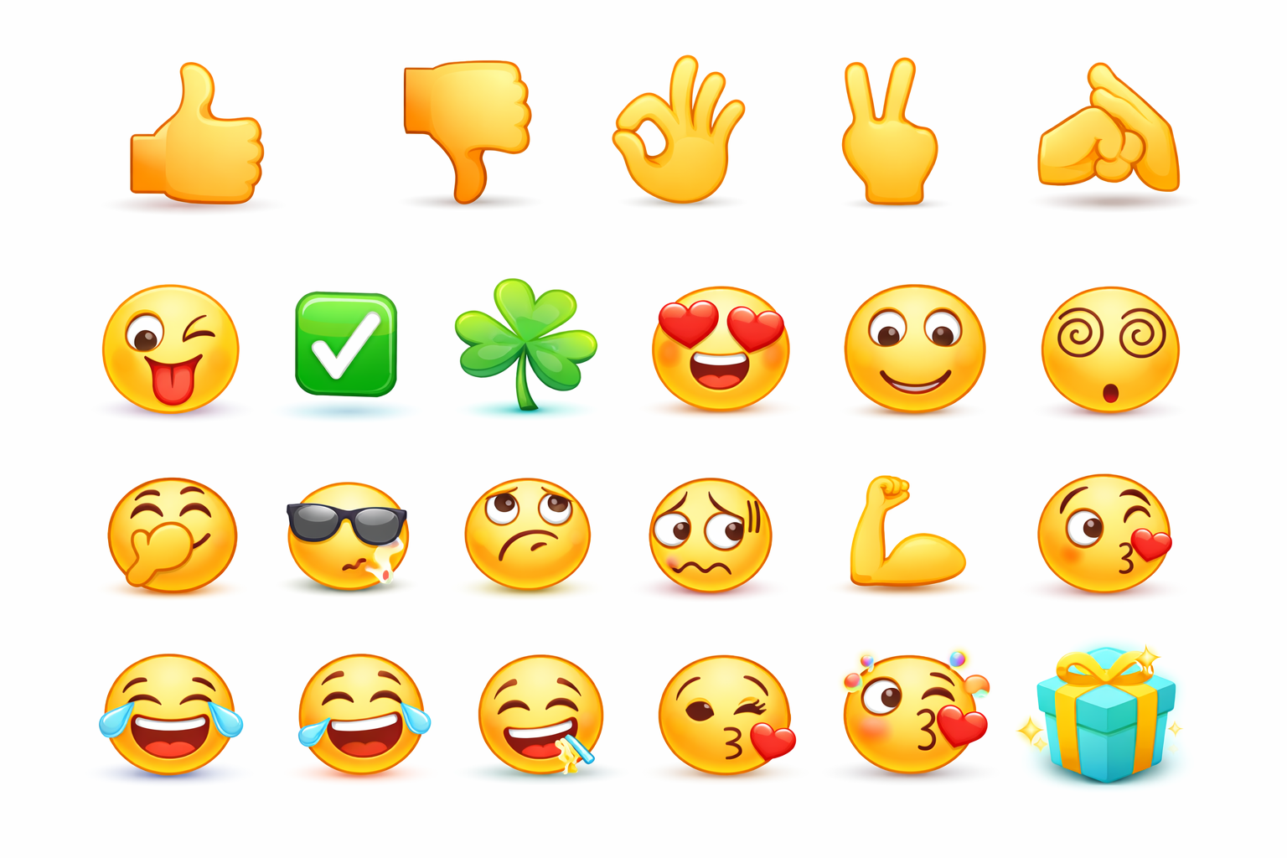
Role-play. Make similar conversations

Slide 12

Wordwall
https://wordwall.net/play/109697/256/443
🎮 How to Play Wordwall Games:
A Student Guide
Step 1: Open the Link
Enter the link or scan the QR code.
Step 2: Enter Your Name
Click the Start button
Step 3: Read the Instructions
Read the brief instructions
Click the big Start button
Step 4: Play the Game
Interact: Use your finger to tap and drag items.
Step 5: Check Your Score
Once you finish, the game will show your Final Score and your Time.

Slide 13
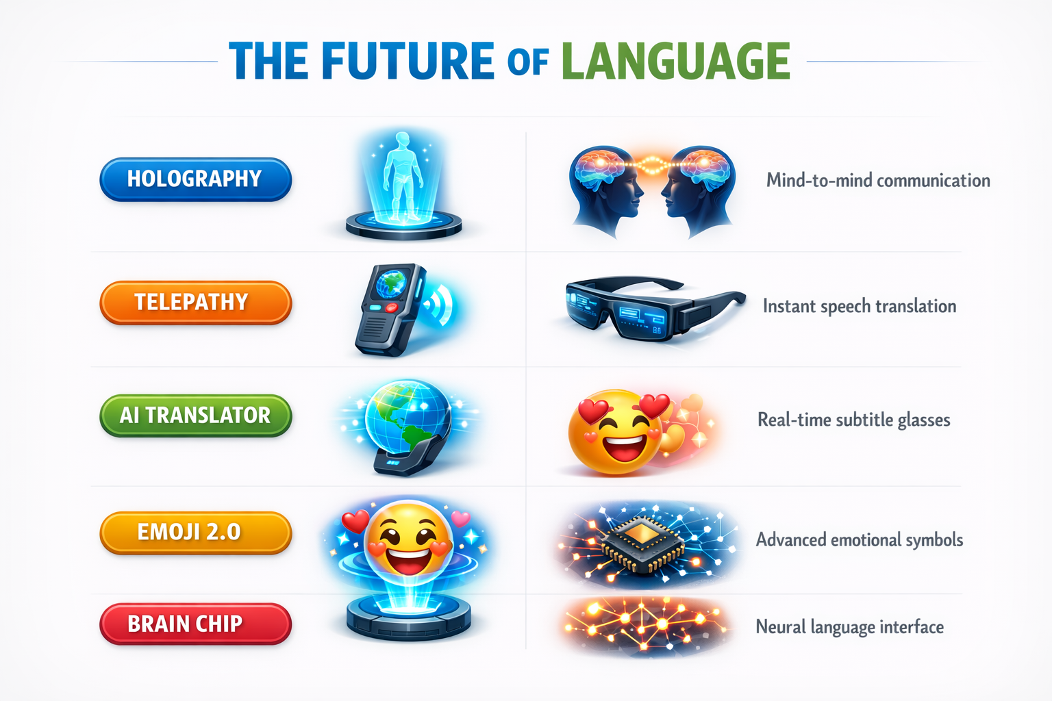
II./ THE FUTURE OF LANGUAGE

Slide 14

Listen to Mark’s prediction about a popular means of communication in the near future
Mark: In 20 years, people of all ages will be using emojis even more than now. Emojis help people communicate their emotions effectively regardless of the language they speak. For example, a smiley face expresses the same meaning everywhere. An emoji can replace words to a certain extent. One day, we might receive an email that contains only emojis!

Slide 15
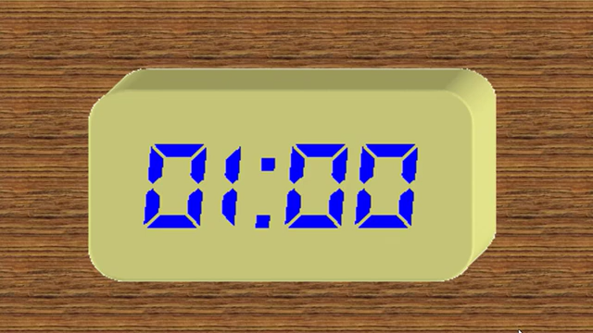
3. Work in pairs. Read Mark’s prediction about a popular means of communication in the near future. Then ask and answer the questions.
https://www.youtube.com/watch?v=NSGEJnXb3c8&pp=ygUyxJHhu5NuZyBo4buTIMSR4bq_bSBuZ8aw4bujYyAxIHBow7p0IGPDsyDDom0gdGhhbmg%3D
1. What means of communication is Mark talking about?
Mark: In 20 years, people of all ages will be using emojis even more than now. Emojis help people communicate their emotions effectively regardless of the language they speak. For example, a smiley face expresses the same meaning everywhere. An emoji can replace words to a certain extent. One day, we might receive an email that contains only emojis!
2. When will emojis become more commonly used?
3. Who will be using them?
4. How will they help in communication?
5. Why will they become more popular?

Slide 16













✅
😊
😆
👏
🥇
🎖️

Slide 17









1. What means of communication is Mark talking about?
Emojis
Emojis help people communicate their emotions effectively regardless of the language they speak.
You are given 3 emojis
GO HOME

Slide 18

You are given 5 emojis
GO HOME

Slide 19
5. Why will they become more popular?
Because an emoji can replace words to a certain extent.
You are given 7 emojis
GO HOME
An emoji can replace words to a certain extent.

Slide 20
2. When will emojis become more commonly used?
In 20 years
You are given 2 emojis
GO HOME
In 20 years, people of all ages will be using emojis even more than now.

Slide 21
3. Who will be using them?
People of all ages
You are given 8 emojis
GO HOME
In 20 years, people of all ages will be using emojis even more than now.

Slide 22
4. How will they help in communication?
Emojis help people communicate their attitudes effectively regardless of the language they speak.
You are given 6 emojis
GO HOME
Emojis help people communicate their emotions effectively regardless of the language they speak.

Slide 23
3. Work in pairs. Read Mark’s prediction about a popular means of communication in the near future. Then ask and answer the questions.
1. What means of communication is Mark talking about?
Mark: In 20 years, people of all ages will be using emojis even more than now. Emojis help people communicate their emotions effectively regardless of the language they speak. For example, a smiley face expresses the same meaning everywhere. An emoji can replace words to a certain extent. One day, we might receive an email that contains only emojis!
Emojis
2. When will emojis become more commonly used?
In 20 years
3. Who will be using them?
People of all ages
4. How will they help in communication?
Emojis help people communicate their attitudes effectively regardless of the language they speak.
5. Why will they become more popular?
Because an emoji can replace words to a certain extent.

Slide 24

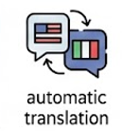
4. Work in pairs. Choose one means of communication below. Ask and answer questions about it.
Automatic
translation function
– When: in 10 years
– Who: social network users
– How: translate comments and private messages in all languages
– Why: remove language barriers
2. Chatbot
– When: in 10 years
– Who: sellers of online shops
– How: instantly reply to customers in all languages
– Why: help sell more products to customers from other countries

Slide 25
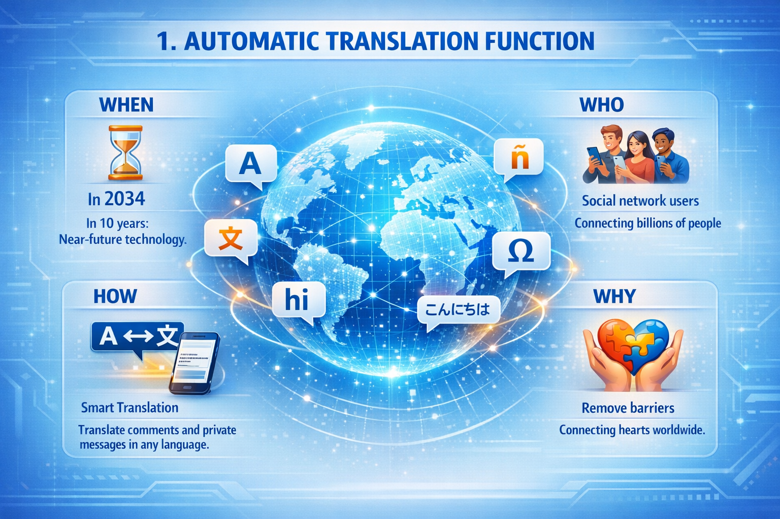

Slide 26
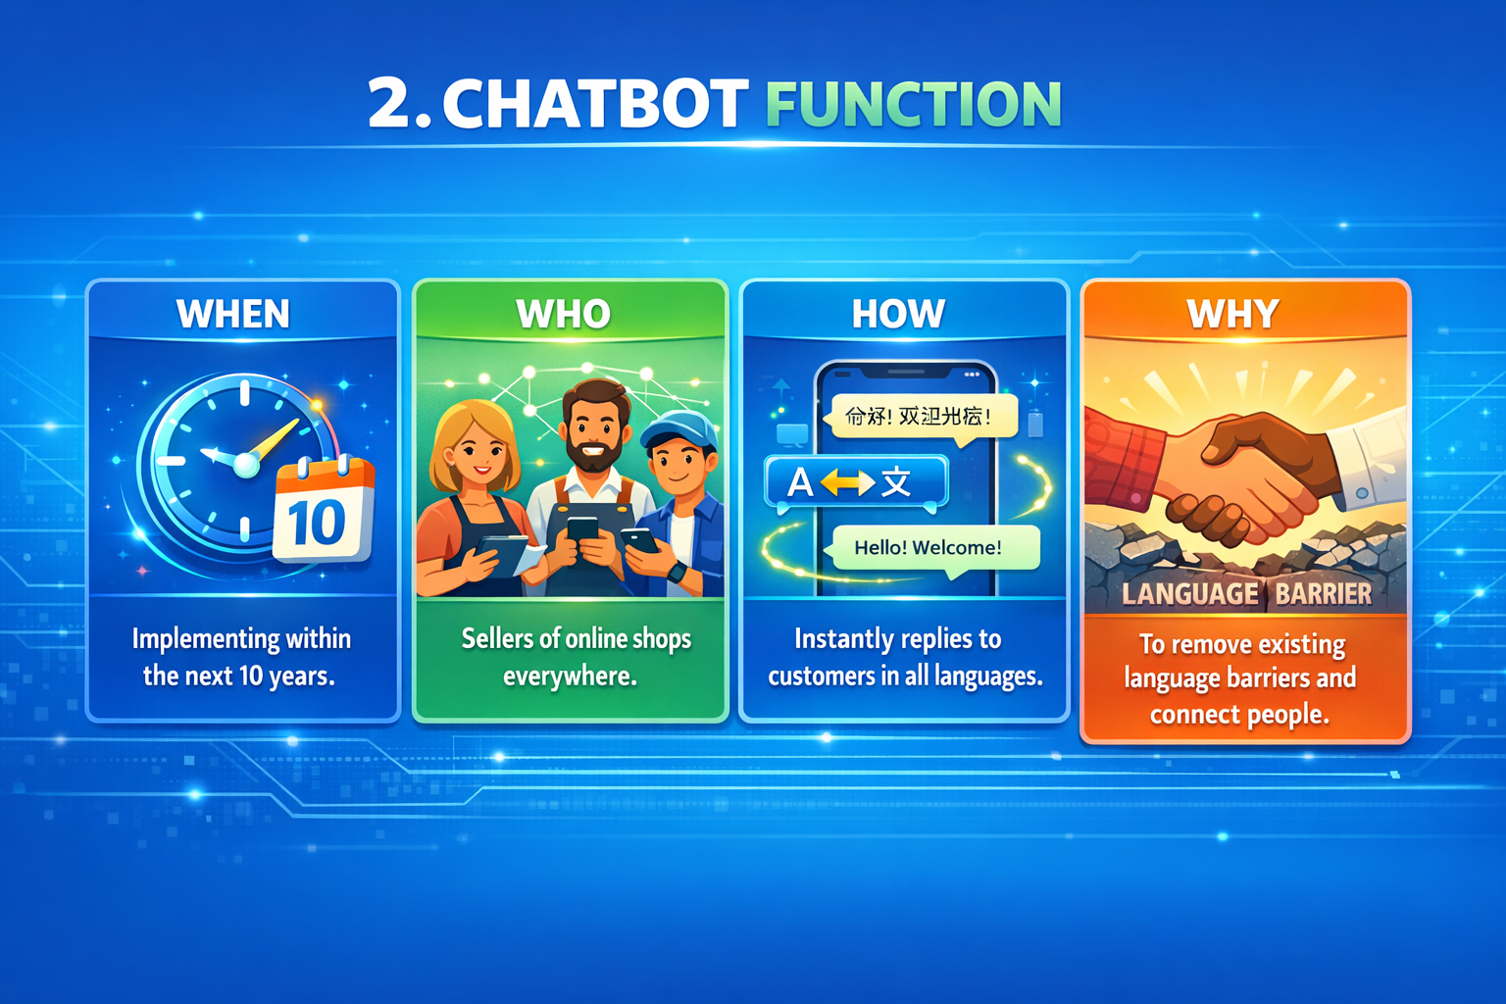

Slide 27

KAHOOT
https://play.kahoot.it/v2/lobby?quizId=2097537f-2e94-4322-9159-b06c3411c933
🚀 How to Join a Kahoot Game
Step 1: Get Ready
Enter the link or scan the QR code.
Step 2: Enter the Game PIN
Type in a 6 or 7-digit number (The Game PIN).
Press Enter.
Step 3: Choose Your Nickname
Type in your Name or the nickname
Click OK, Go!
Step 4: Answer the Questions
Look at the teacher's screen to read the question and the answer choices.
Tap the color shape on your device that matches the correct answer.
Hurry! The faster you answer correctly, the more points you get.
Step 5: Check the Podium
After each question, check the scoreboard to see your rank.
At the end of the game, stay tuned to see who makes it to the Podium (Top 3)!

Slide 29
WRAP UP
How to interrupt politely
The future of language

Slide 30

Homework:
1. Use Chat GPT/ Gemini to create 1-2 situations then make similar conversation as in 1
2. Talk about a popular means of communication in the future. Use Gemini to evaluate then post it on Google classroom
3. Do part C in workbook
https://gemini.google.com/share/5fe437068972

Slide 31
THANK YOU!

