Slide 1
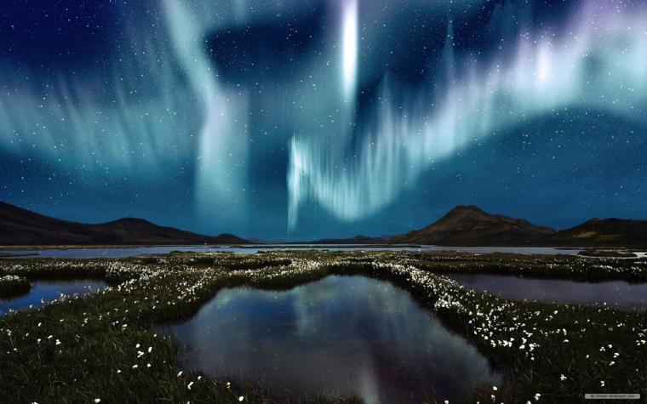


Unit
12
LESSON 2: A CLOSER LOOK 1

Slide 2
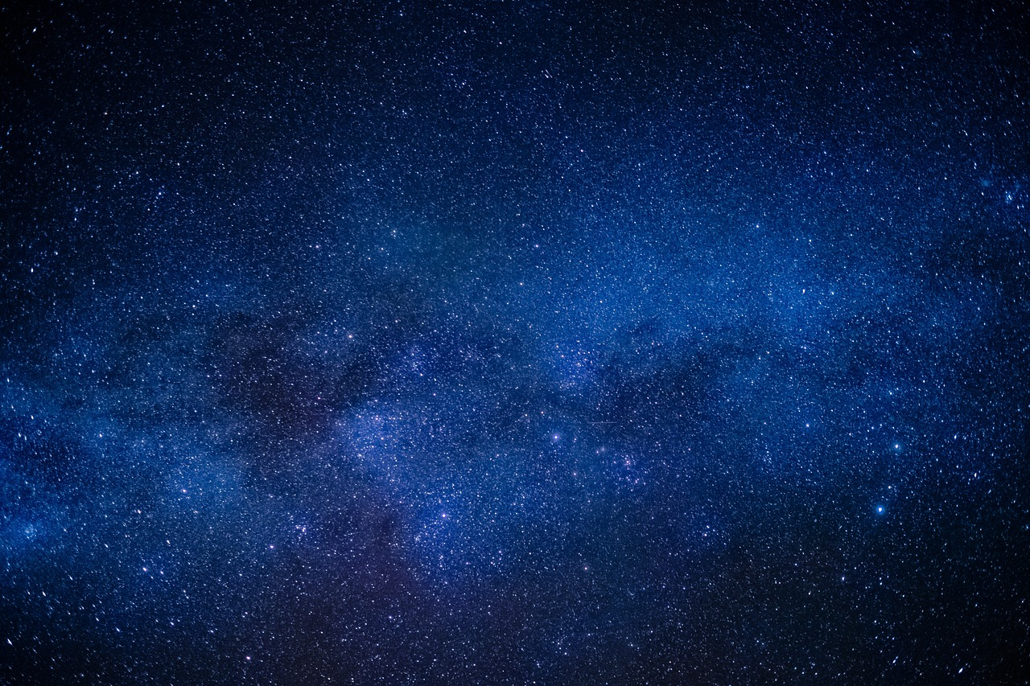

Unit
10
PLANET EARTH
LESSON 2: A CLOSER LOOK 1

Slide 3
Unit
10
PLANET EARTH
LESSON 2: A CLOSER LOOK 1

Slide 4

OBJECTIVES
By the end of the lesson, students will be able to:
Use the lexical items related to the topic Planet Earth
Have the right rhythm in sentences;

Slide 5
LESSON 2: A CLOSER LOOK 1
LESSON 2: A CLOSER LOOK 1
WARM-UP
Option 1: Brainstorm
Option 2: Wordly word chain.
Vocabulary
Task 1: Write a word or phrase from the box under each picture.
Task 2: Complete each sentence with a word or phrase from 1.
Task 3: Choose the correct answer A, B, C, or D.
VOCABULARY
Task 4: Listen to the sentences and pay attention to the bold syllables. Does the speaker place stress on them?
Task 5: Circle the stressed syllables in the sentences. Listen, check, and repeat.
PRONUNCIATION
CONSOLIDATION
Wrap-up
Homework

Slide 6
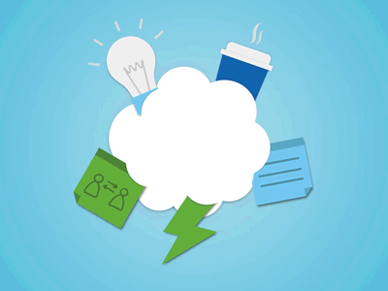
WARM-UP
OPTION 1
Brainstorm

Slide 7
WARM-UP
OPTION 1
- There are some strips of paper with words / phrases.
- Work in groups to stick the words / phrases to the right pictures.
- The group with most correct answers wins
Brainstorm

Slide 8
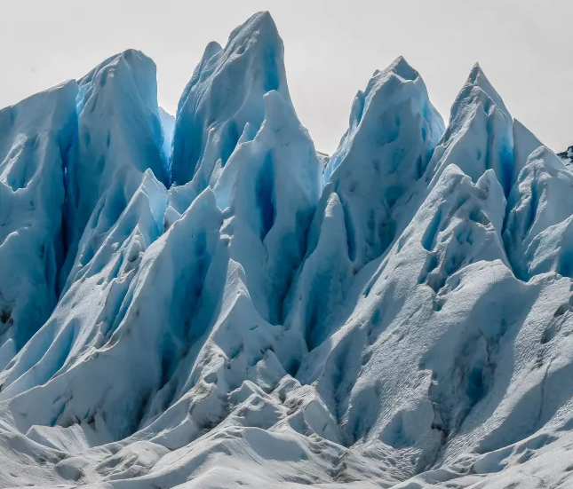
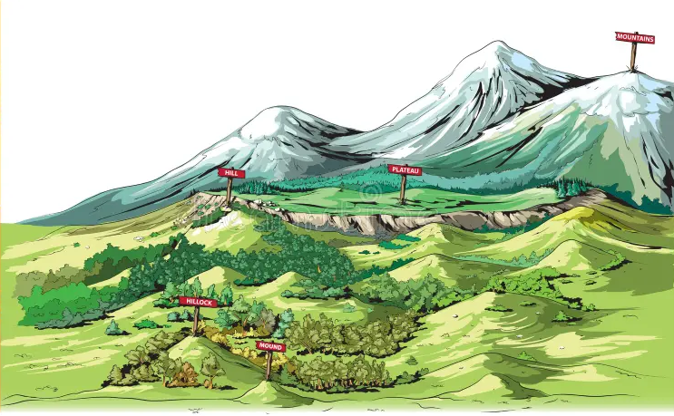
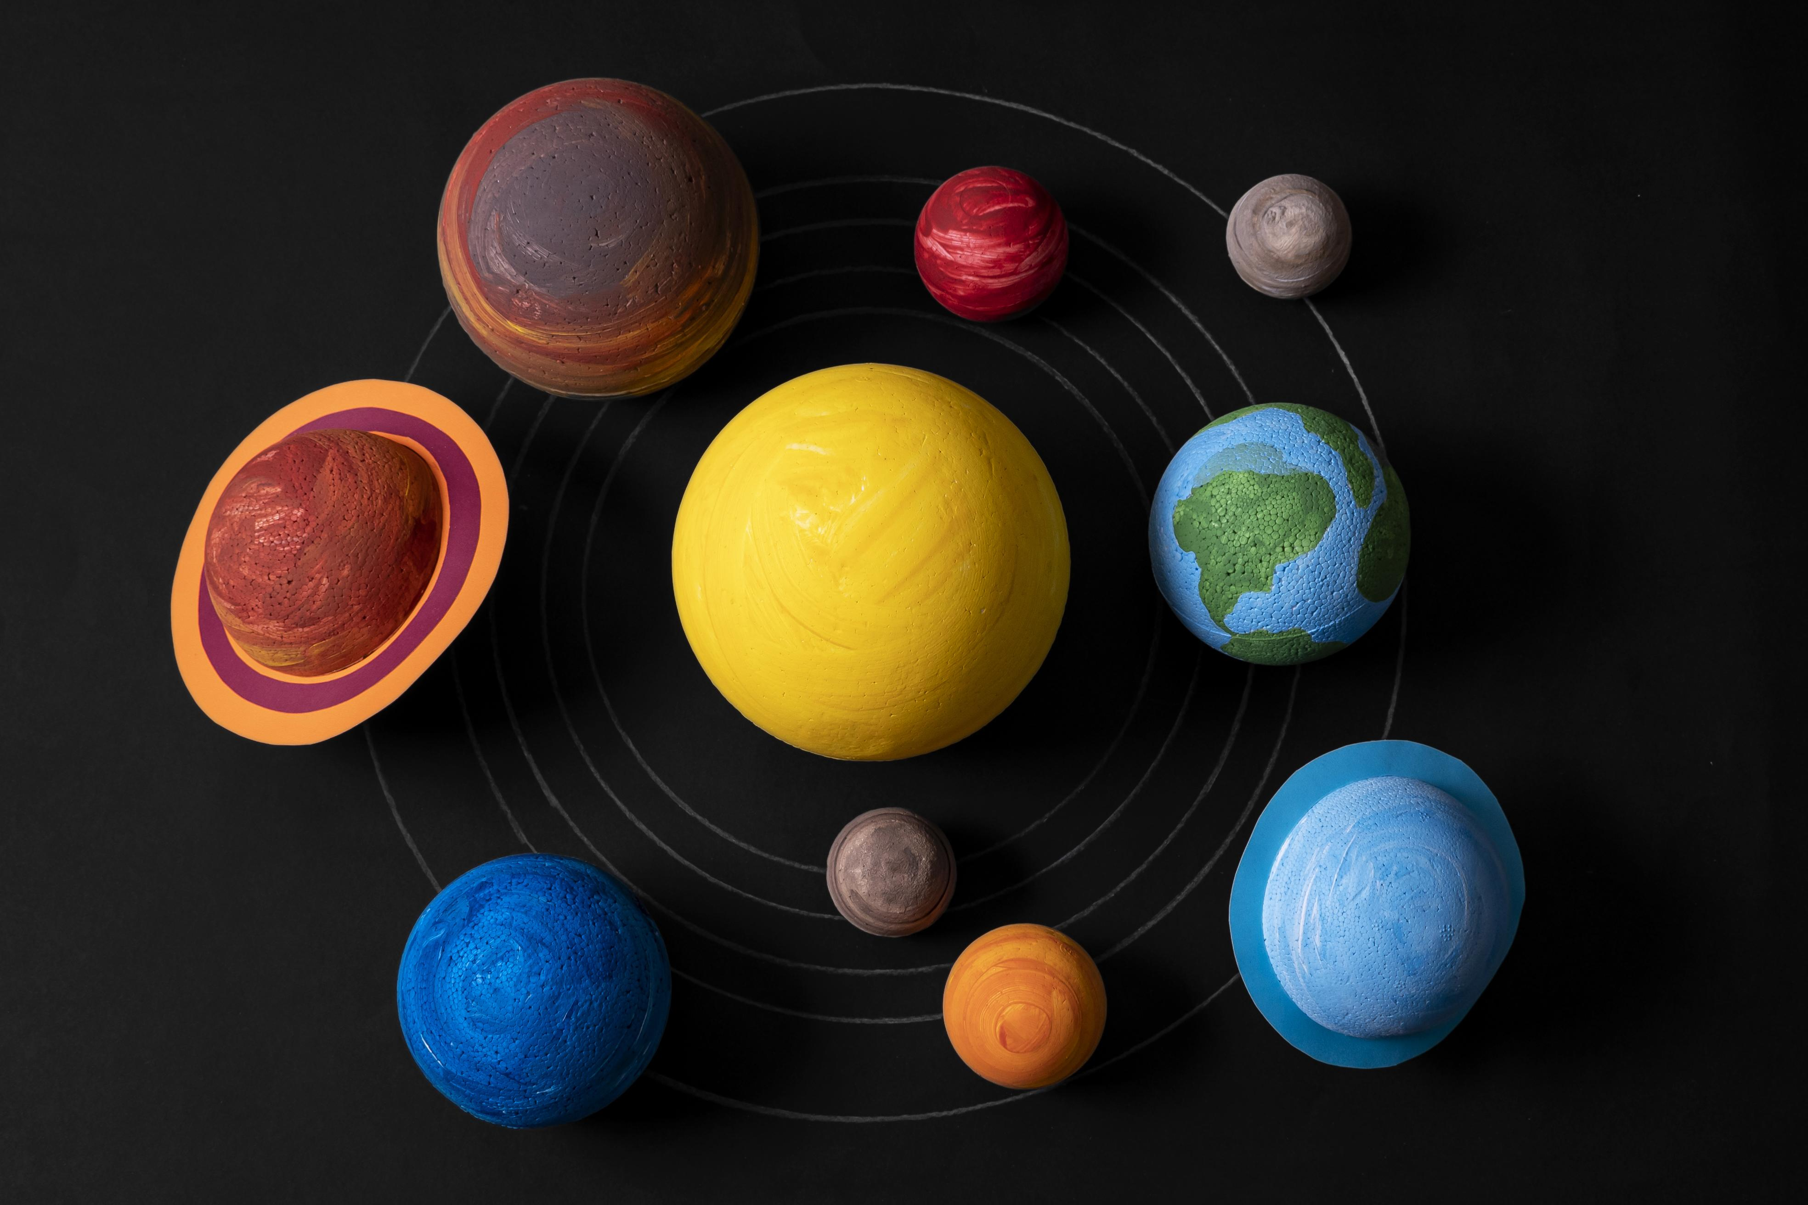
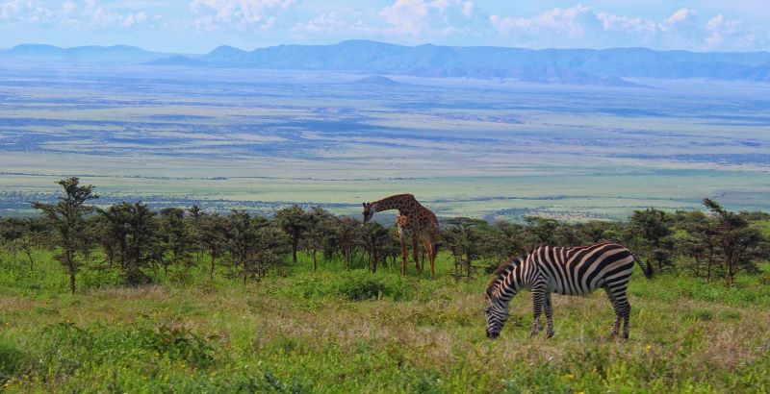
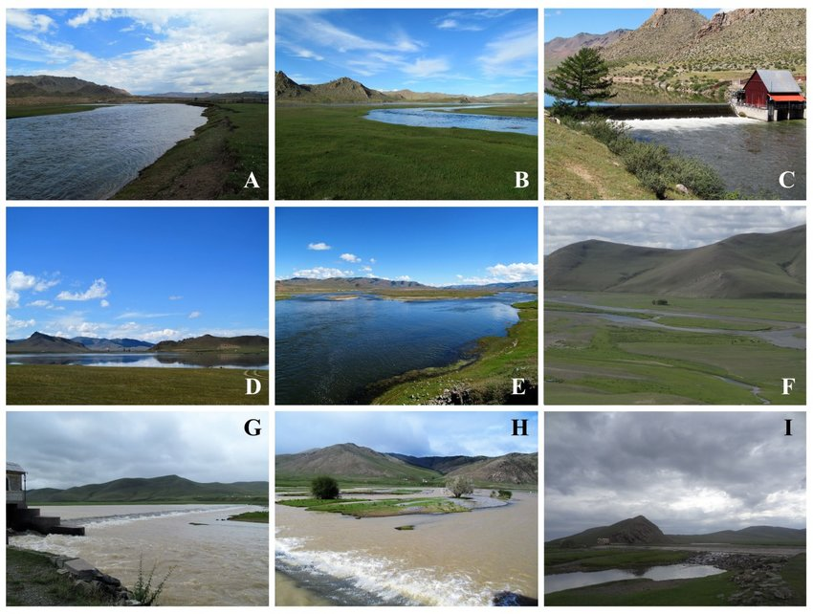
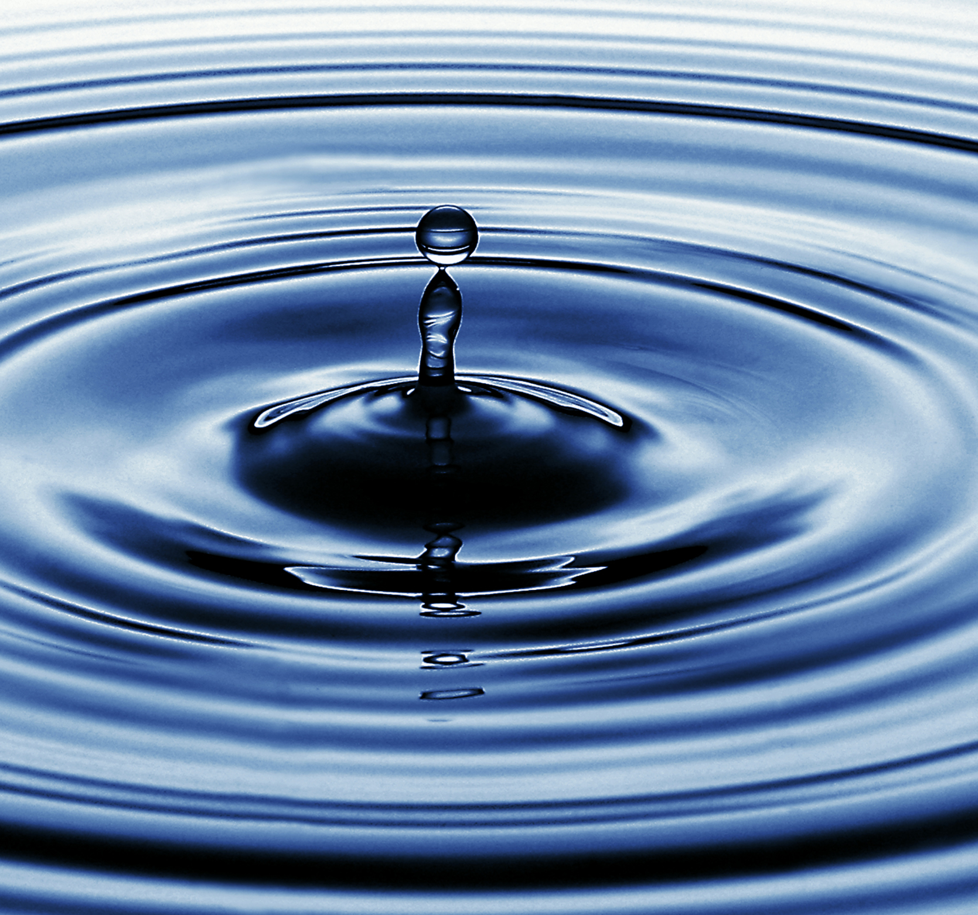
WARM-UP
OPTION 1
Pictures:

Slide 9
WARM-UP
OPTION 2
Wordly word chain

Slide 10
WARM-UP
OPTION 2
Wordly word chain
- Start with a nature-related word like “Earth”
- Write another word related to it. the next one writes something connected to that.
Example:
Earth -> water -> wave
- Continue creating a chain of words linked to Earth’s elements and processes.

Slide 11

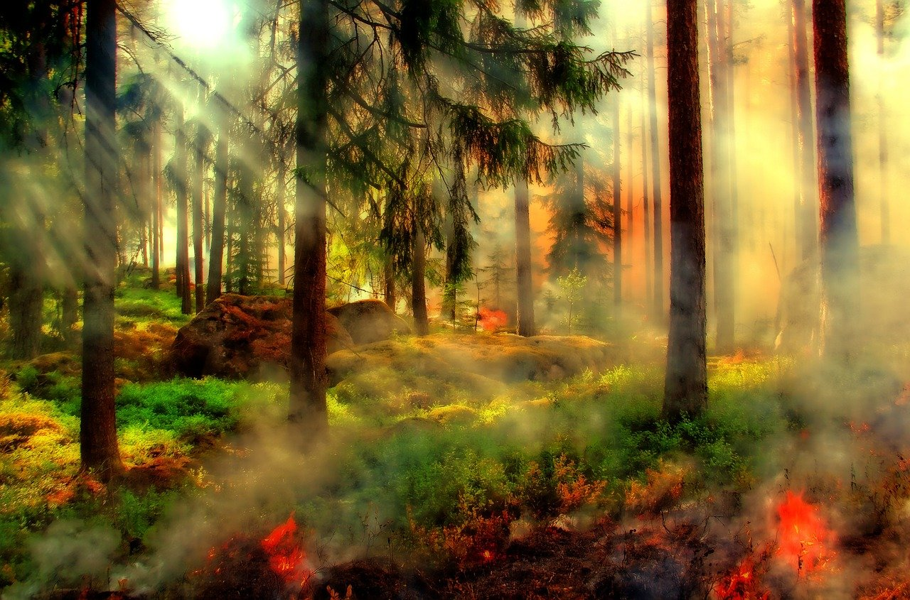
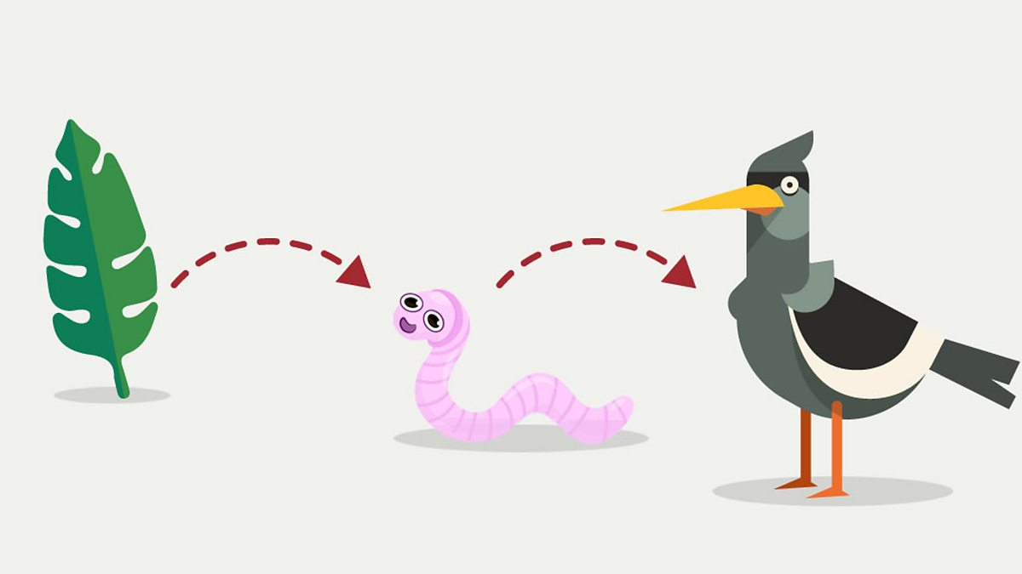
VOCABULARY
an area of land that is protected in order to keep safe the animals and plants that live there because they are rare.
nature reserve (n)
/ˈneɪtʃə rɪzɜːv/
khu bảo tồn thiên nhiên

Slide 12
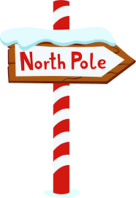
VOCABULARY
a sequence of organism where one eats another.
food chain (n)
/ˈfuːd tʃeɪn/
chuỗi thức ăn

Slide 13
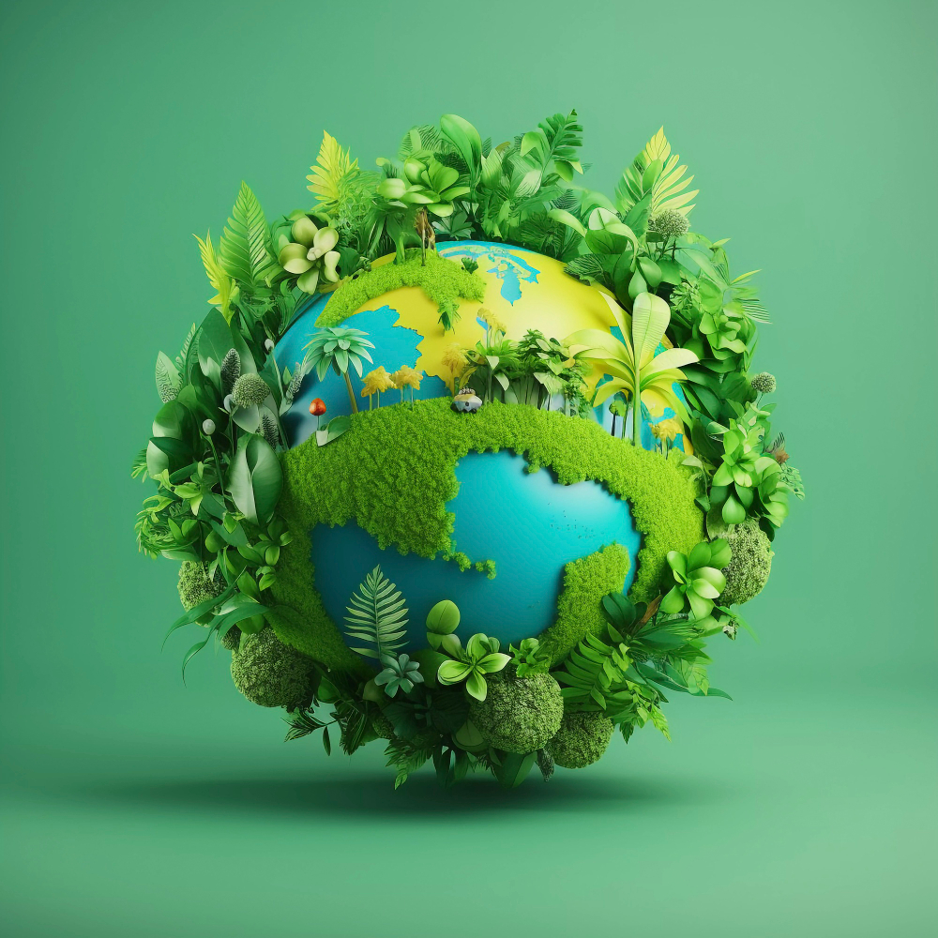
VOCABULARY
either of two points at the most northern and most southern ends of the earth around which the earth turns.
pole (n)
/pəʊl/
cực (Bắc/Nam)

Slide 14
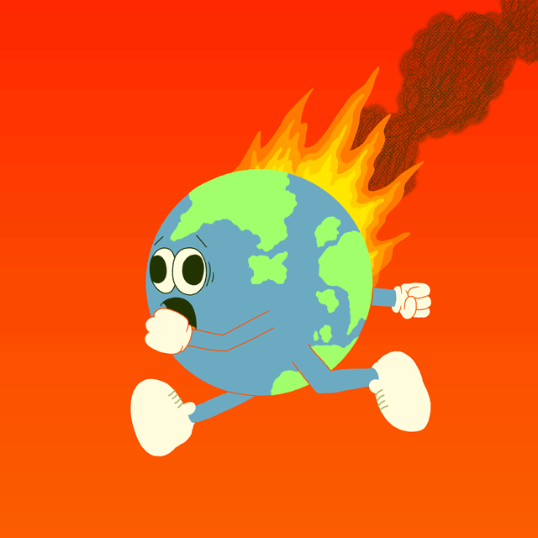
VOCABULARY
a term describing how ecosystems are organized in a state of stability where species coexist with other species and with their environment
ecological balance
/ˌiːkəˈlɒdʒɪkl ˈbæləns/
cân bằng sinh thái

Slide 15
VOCABULARY
changes in the world’s weather, particularly and increase in temperature.
climate change (n)
/ˈklaɪmət tʃeɪndʒ/
biến đổi khí hậu

Slide 16
VOCABULARY
New words | Pronunciation | Meaning
1. nature reserve (n) | /ˈneɪtʃə rɪzɜːv/ | khu bảo tồn thiên nhiên
2. food chain (n) | /ˈfuːd tʃeɪn/ | chuỗi thức ăn
3. pole (n) | /pəʊl/ | cực (Bắc/Nam)
4. ecological balance | /ˌiːkəˈlɒdʒɪkl ˈbæləns/ | cân bằng sinh thái
5. climate change (n) | /ˈklaɪmət tʃeɪndʒ/ | biến đổi khí hậu

Slide 17
VOCABULARY
New words | Pronunciation | Meaning
6. decisive (adj) | /dɪˈsaɪsɪv/ | quyết đoán
7. well-paid (adj) | /ˌwel ˈpeɪd/ | được trả lương cao
8. rewarding (adj) | /rɪˈwɔːdɪŋ/ | bổ ích, xứng đáng
9. demanding (adj) | /dɪˈmɑːndɪŋ/ | (yêu cầu) khắt khe, phức tạp
10. repetitive (adj) | /rɪˈpetətɪv/ | lặp đi lặp lại

Slide 18
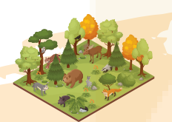
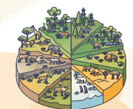
VOCABULARY
1
Write a word or phrase from the box under each picture.
habitats
flora and fauna
grassland
nature reserves
food chain
poles

Slide 19
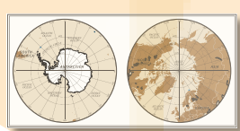
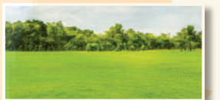
VOCABULARY
1
Write a word or phrase from the box under each picture.
habitats
flora and fauna
grassland
nature reserves
food chain
poles

Slide 20
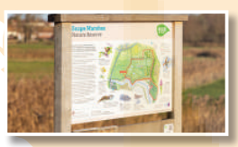
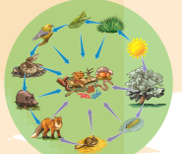
VOCABULARY
1
Write a word or phrase from the box under each picture.
habitats
flora and fauna
grassland
nature reserves
food chain
poles

Slide 21
PRACTICE
2
Complete each sentence with a word or phrase from 1.
food chain
1. In a _______________, some animals eat other animals and become food for a third group of animals.
grassland
2. A _____________ is often wide and its plants are mostly grass and flowers
3. Areas of land to protect animals and plants are called _________.
nature reserves
poles
4. The North and South ______ are both extremely cold and icy.
habitats
5. Natural ______________ for pandas are bamboo forests.

Slide 22
PRACTICE
3
Choose the correct answer A, B, C, or D to complete each sentence.
1. When humans use a natural habitat for farming and housing, they cause ______.
A. climate change
C. habitat loss
B. global warming
D. ecological balance
2. When Earth’s average temperature increases, we face ______.
A. ecological balance
C. pollution
B. global warming
D. protection

Slide 23
PRACTICE
3
Choose the correct answer A, B, C, or D to complete each sentence.
3. Each of us can lend a hand to ______the natural environment.
A. hunt
C. preserve
B. change
D. pollute
4. We can keep a(n) ______ by stopping hunting and cutting down trees.
A. ecological balance
C. climate change
B. habitat loss
D. nature reserve

Slide 24








PRACTICE
3
Choose the correct answer A, B, C, or D to complete each sentence.
3
5. One way to ______ Mother Earth is by planting more trees.
A. keep
C. provide
B. harm
D. protect

Slide 25
EXTRA ACTIVITY
3

Slide 26
EXTRA ACTIVITY
3
- Work in two groups.
- There is a picture with initial letter (s) of the word/ phrase describing the things in the pictures.
- The group with more correct answers wins.

Slide 27
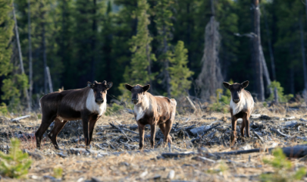
EXTRA ACTIVITY
h_______ l______
abitat
oss

Slide 28
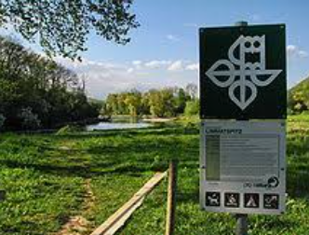
EXTRA ACTIVITY
eserves
n_______ r______
ature

Slide 29
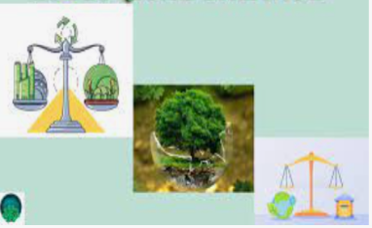
EXTRA ACTIVITY
cological
alance
e_______ b______

Slide 30
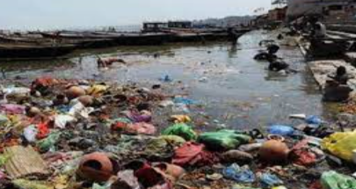
EXTRA ACTIVITY
ollut
p_______ed

Slide 31
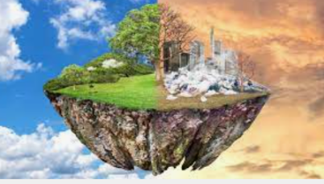
EXTRA ACTIVITY
arming
g_______w_______
lobal

Slide 32
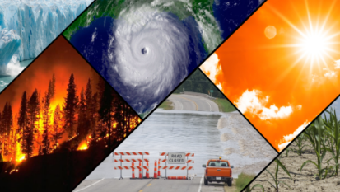
EXTRA ACTIVITY
limate
hange
c_______c_______

Slide 33
LESSON 2: A CLOSER LOOK 1
LESSON 2: A CLOSER LOOK 1
WARM-UP
Option 1: Brainstorm
Option 2: Wordly word chain.
Vocabulary
Task 1: Write a word or phrase from the box under each picture.
Task 2: Complete each sentence with a word or phrase from 1.
Task 3: Choose the correct answer A, B, C, or D.
VOCABULARY
Task 4: Listen to the sentences and pay attention to the bold syllables. Does the speaker place stress on them?
Task 5: Circle the stressed syllables in the sentences. Listen, check, and repeat.
PRONUNCIATION

Slide 34

PRONUNCIATION
Look at Remember box (p.106)
When we speak English, we place stress on certain syllables in a sentence. The combination of stressed and unstressed syllables produces rhythm in spoken English.
1. Earth is the third planet from the Sun.
2. Oceans, seas, rivers, and lakes are water bodies.
3. The North and South poles are extremely cold and icy.
4. Do moonquakes last up to half an hour?
5. Preserving natural resources is very important.

Slide 35
PRONUNCIATION
4
Listen to the sentences and pay attention to the bold syllables. Does the speaker place stress on them?
1. Earth is the third planet from the Sun.
2. Oceans, seas, rivers, and lakes are water bodies.
3. The North and South poles are extremely cold and icy.
4. Do moonquakes last up to half an hour?
5. Preserving natural resources is very important.

Slide 36
1. Earth is the third planet from the Sun.
2. Oceans, seas, rivers, and lakes are water bodies.
3. The North and South poles are extremely cold and icy.
4. Do moonquakes last up to half an hour?
5. Preserving natural resources is very important.
PRONUNCIATION
5
Circle the stressed syllables in the sentences. Listen, check, and repeat.
- Listen and circle the stressed syllabes
- Count the number of stressed syllables in each sentence.
1. We’re doing a study on climate change.
2. What is the distance from Earth to Mars?
3. They’ll have a discussion on natural habitats.
4. Plants provide us with food, oxygen, and energy.
5. Our school organised various activities on Earth Day.

Slide 37
PRONUNCIATION
5
Circle the stressed syllables in the sentences. Listen, check, and repeat.
4
1. We’re doing a study on climate change.
2. What is the distance from Earth to Mars?
3. They’ll have a discussion on natural habitats.
4. Plants provide us with food, oxygen, and energy.
5. Our school organised various activities on Earth Day.
4
4
5
6

Slide 38
LESSON 2: A CLOSER LOOK 1
LESSON 2: A CLOSER LOOK 1
WARM-UP
Option 1: Brainstorm
Option 2: Wordly word chain.
Vocabulary
Task 1: Write a word or phrase from the box under each picture.
Task 2: Complete each sentence with a word or phrase from 1.
Task 3: Choose the correct answer A, B, C, or D.
VOCABULARY
Task 4: Listen to the sentences and pay attention to the bold syllables. Does the speaker place stress on them?
Task 5: Circle the stressed syllables in the sentences. Listen, check, and repeat.
PRONUNCIATION
CONSOLIDATION
Wrap-up
Homework

Slide 39

CONSOLIDATION
1
Wrap-up
What have we learnt in this lesson?
Use the lexical items related to the topic Planet Earth
Have the right rhythm in sentences;

Slide 40

CONSOLIDATION
2
Homework
- Do exercises in the workbook.

Slide 41
Website: hoclieu.vn
Fanpage: facebook.com/www.tienganhglobalsuccess.vn/

