Slide 1
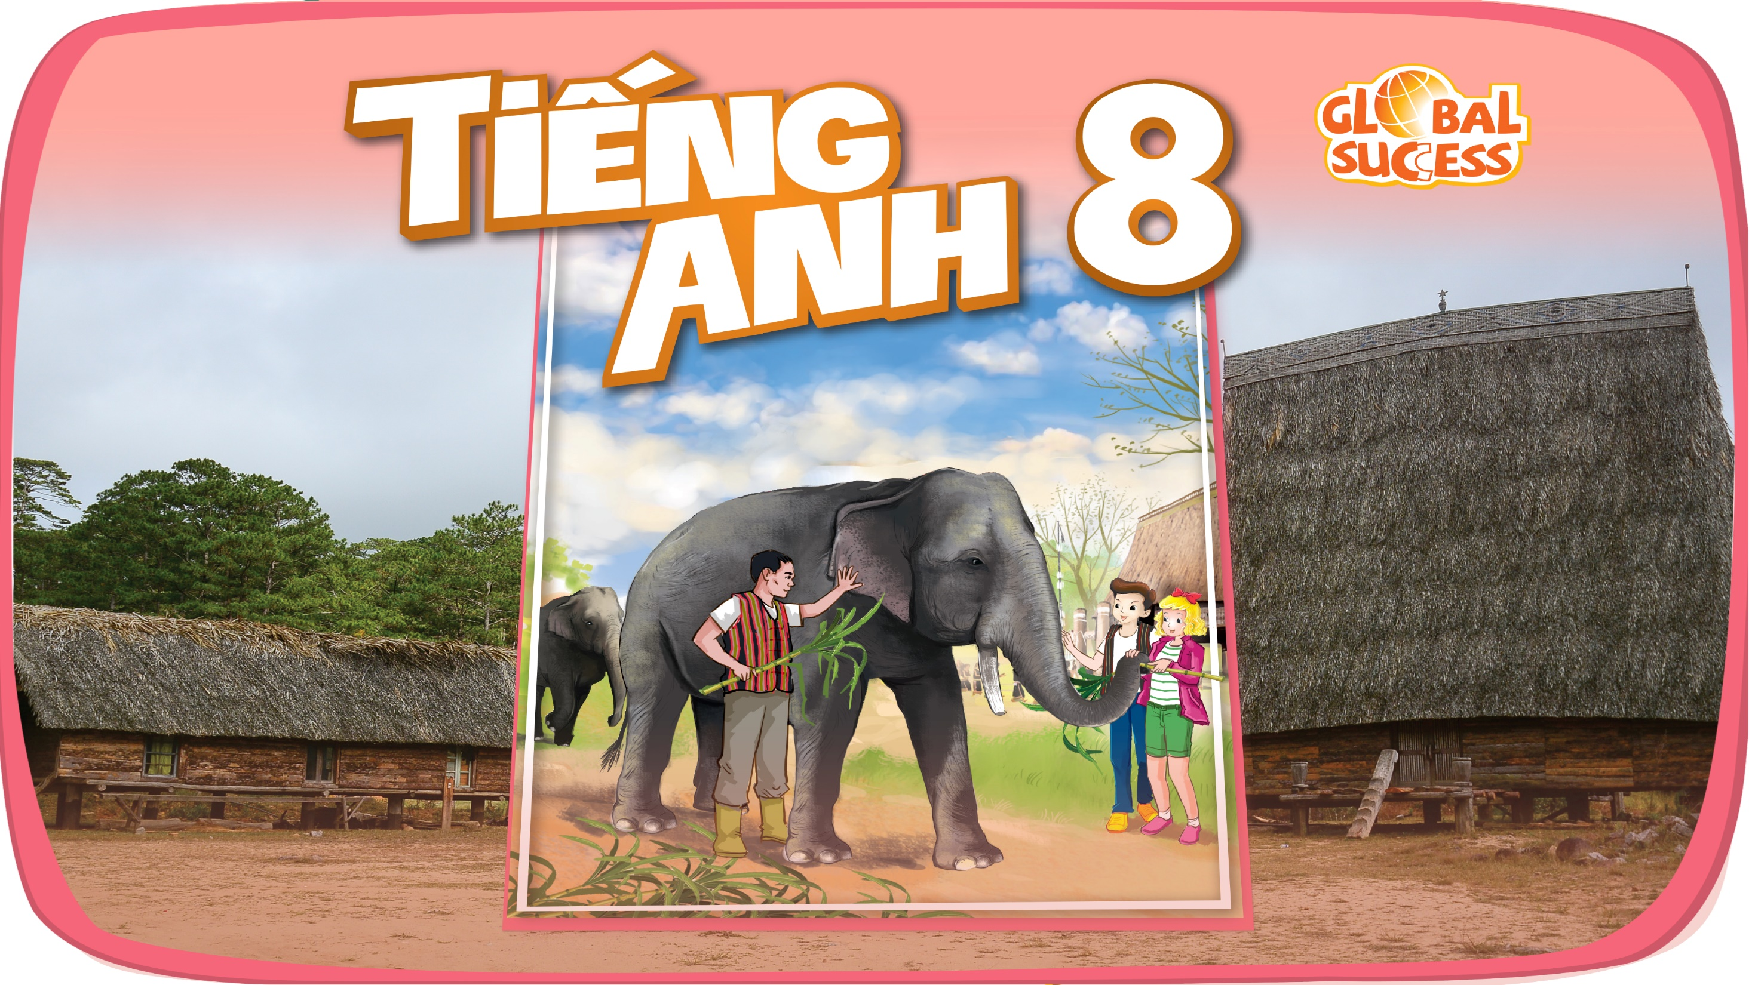

Slide 2


Unit
7
ENVIRONMENTAL PROTECTION
LESSON 5: SKILLS 1
1

Slide 3
LESSON 1: GETTING STARTED
WARM-UP
Task 1: Work in groups. Look at the picture and say what you see. Then list the names of some endangered species you know.
PRESENTATION
Vocabulary
Task 2: Read the text and choose the words or phrases to make the following statements correct.
Task 3. Read the text again and choose the correct option A, B, or C.
READING
Task 4: Work in pairs. Ask and answer about Vu Quang National Park.
Task 5: Work in groups. Talk about Vu Quang National Park, using the answers in 4.
SPEAKING
Wrap-up
Homework
CONSOLIDATION

Slide 4
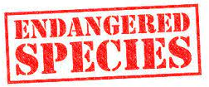
WARM-UP
1
Work in groups. Look at the picture and say what you see. Then list
the names of some endangered species you know.
BLUE WHALES
SEA LIONS
TIGERS
SAOLAS
DUGONG
POLAR BEARS
PANDAS
PENGUINES

Slide 5
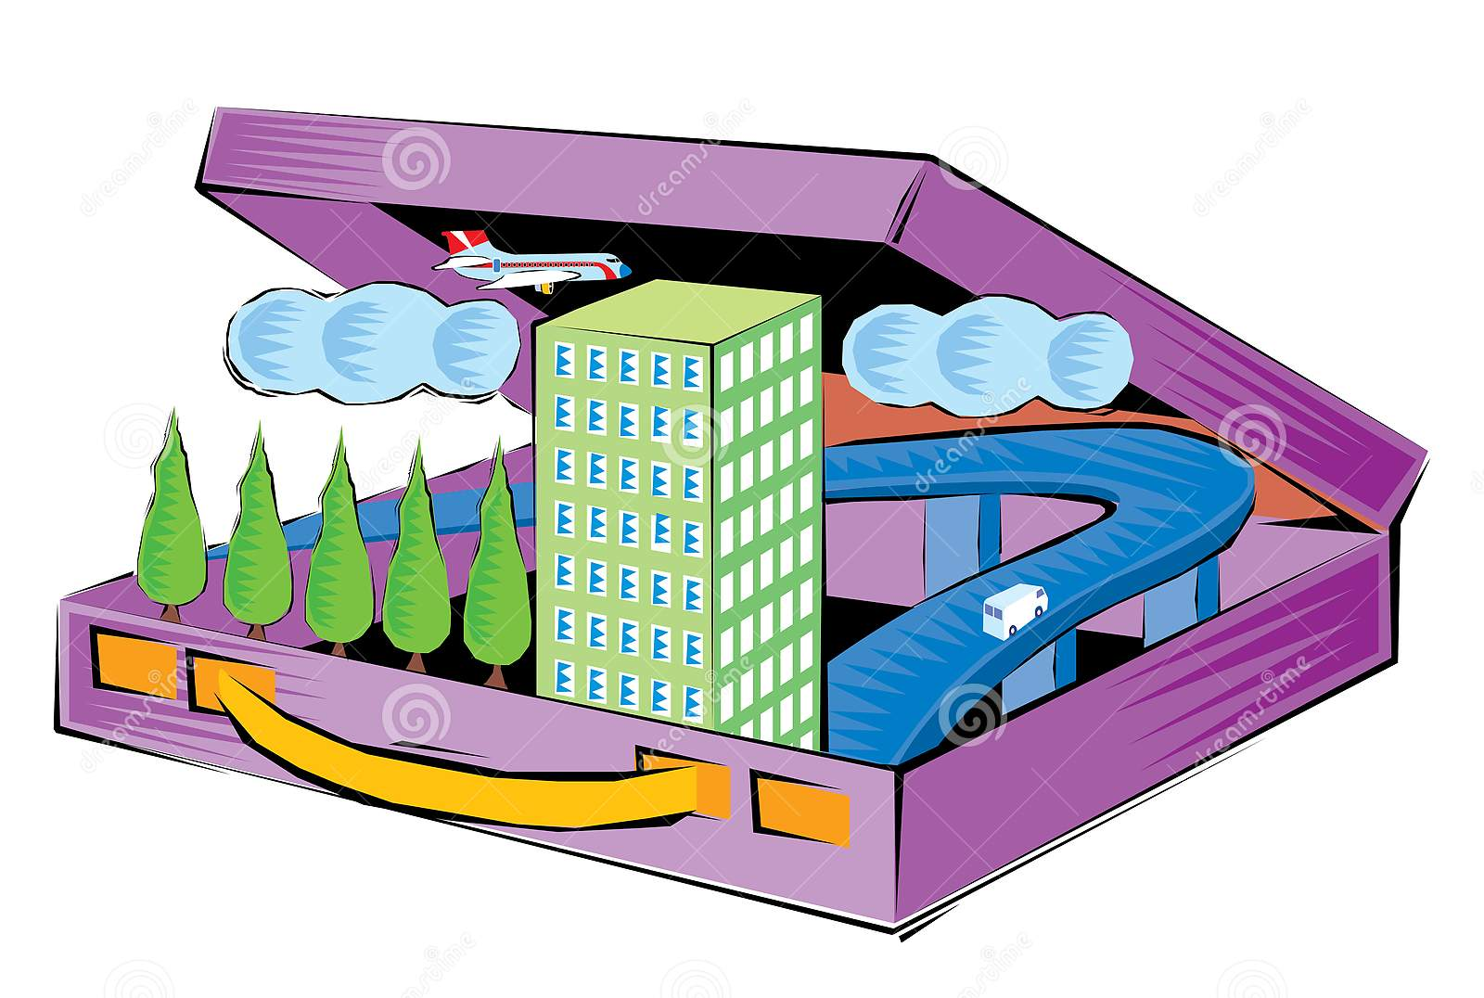
VOCABULARY
contain (v)
/kənˈteɪn/
chứa đựng

Slide 6
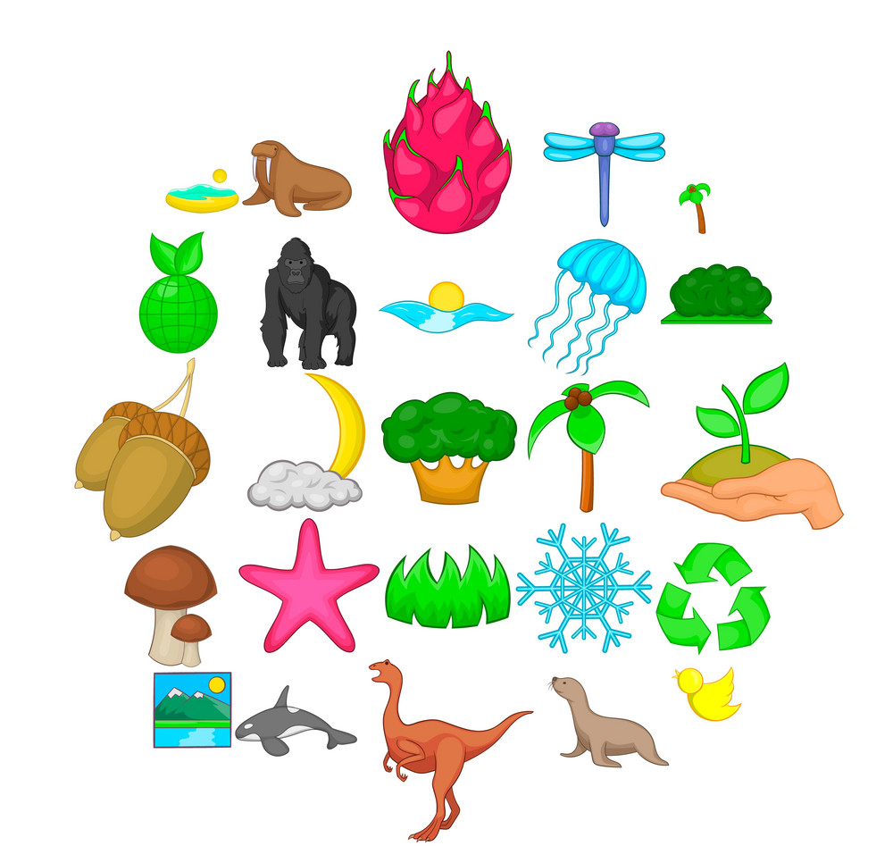
VOCABULARY
diverse (adj)
/daɪˈvɜːs/
phong phú

Slide 7

VOCABULARY
medical (adj)
/məˈdɪsɪnl/
(cây) thuốc

Slide 8
READING
2
Read the text and choose the words or phrases to make the following statements correct
Today, there are national parks all over the world, and the number is rising all the time. A national park is a special area for the protection of the environment and wildlife.
In Viet Nam, there are now 34 national parks. Con Dao National Park is one of them. It became a national park in 1993. The park is in Con Dao District, Ba Ria-Vung Tau Province. It contains 16 small islands covering 20,000 hectares. The ecosystem here is very diverse with thousands of species, including marine animals. Many species of corals as well as sea turtles, dolphins, and endangered dugongs live here as well. The park is also home to a lot of valuable kinds of woods and medicinal plants. Three ancient trees in the park were named “Vietnamese Heritage Trees”.
Con Dao National Park, like other national parks, plays a key role in saving endangered species as well as protecting the environment and natural resources. It also helps raise the awareness of local residents about the importance of nature
1. There are 34 national parks /nations’ parks in Viet Nam now.
2. The conservation / ecosystem in Con Dao is very diverse.
3. The dugong is a(n) dangerous / endangered animal.
4. National parks play a key role in saving the environment / small islands.

Slide 9
READING
3
Read the text again and choose the correct option A, B, or C.
1. What is the best title for the passage?
A. National Parks in Viet Nam
B. Con Dao National Park
C. The Protection of Wildlife
2. National parks are areas for ______.
A. the protection of the environment
B. the management of marine life
C. the sale of animal products

Slide 10
READING
3
Read the text again and choose the correct option A, B, or C.
3. What is the area of Con Dao National Park?
A. 34 hectares. B. 16 hectares. C. 20,000 hectares.
4. Con Dao National Park has many kinds of ______.
A. valuable plants B. ancient trees C. natural values
5. Which of the following is NOT true, according to the passage?
A. There are more and more national parks in the world.
B. Con Dao National Park is rich in animal species.
C. Con Dao National Park’s mission is to help other national parks.

Slide 11
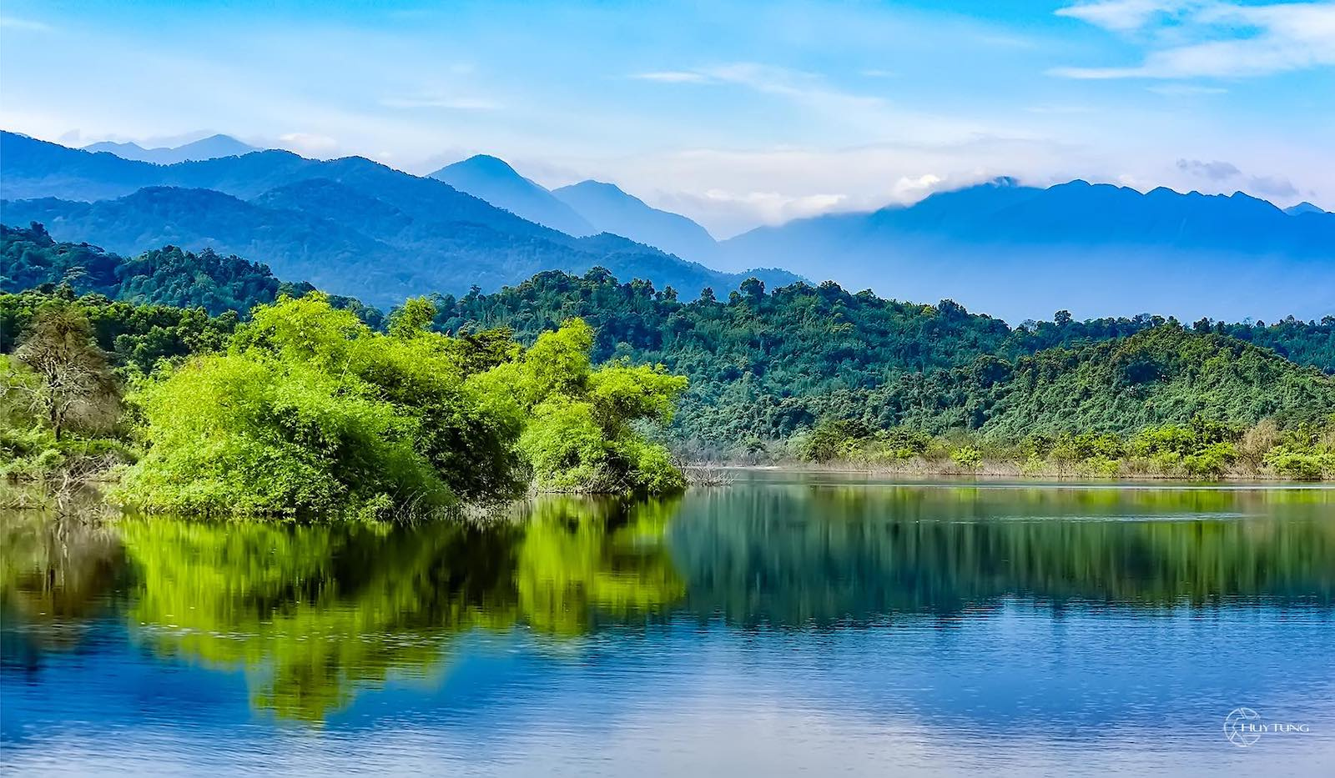
SPEAKING
4
Work in pairs. Ask and answer about Vu Quang National Park.
Look at the facts.
Location: Vu Quang District, Ha Tinh Province
Opened: 2002
Area: about 55,000 hectares
Animals: Saolas, “black deer”
Valuable plants: woods, medicinal plants
A: Where is Vu Quang National Park?
B: It’s in Vu Quang District, Ha Tinh Province

Slide 12

SPEAKING
5
Work in groups. Talk about Vu Quang National Park
It was opened in ...
Vu Quang National Park is in …
It has ...
It’s about …

Slide 13

CONSOLIDATION
1
Wrap-up
What have we learnt in this lesson?
Reading about Con Dao National Park
Talking about Vu Quang National Park

Slide 14

CONSOLIDATION
2
Homework
Workbook

Slide 15

Website: hoclieu.vn
Fanpage: facebook.com/sachmem.vn/

