Slide 1


Slide 2


Unit
7
ENVIRONMENTAL PROTECTION
LESSON 7: LOOKING BACK & PROJECT
1

Slide 3
LESSON 1: GETTING STARTED
WARM-UP
Revision
Task 1: Choose the correct answer A, B, or C to complete each sentence.
Task 2: Complete each of the sentences with a word or phrase from the box.
VOCABULARY
Task 3. Complete the sentences with suitable comparative forms of the adverbs from the box.
Task 4: Underline the mistakes in the sentences and correct them
GRAMMAR
Task P1: Choose a serious pollution problem in your area (noise pollution, air pollution, water pollution, …). Suggest solutions to the problem.
Task P2: Make a poster. Write your solutions on the poster. Use pictures to illustrate / decorate your poster.
Task P3: Present your poster to the class.
PROJECT
CONSOLIDATION
Wrap-up
Homework

Slide 4

WARM-UP
1
Work in groups. Make a list of some activities that cause water pollution
Pronunciation
Sounds: /bl/ and /kl/
Vocabulary
Environmental protection
Skills
• Reading about Con Dao National Park
• Talking about Vu Quang National Park
• Listening about water pollution
• Writing a notice
Grammar
Complex sentences with
adverb clauses of time

Slide 5
VOCABULARY
1
Choose the correct answer A, B, or C to complete each sentence
1. The panda’s natural ______ is the bamboo forest.
A. habitat B. ecosystem C. area
2. This forest provides a habitat for hundreds of ______ of plants and animals.
A. styles B. classes C. species
3. ______ the environment must be the job of everyone in the community.
A. Caring B. Protecting C. Keeping
4. We should ____ the consumption of single-use products like plastic bottles and bags.
A. reduce B. encourage C. raise
5. ______ trees and burning forests destroy a lot of wildlife habitats.
A. Watering B. Cleaning up C. Cutting down

Slide 6
VOCABULARY
2
Complete each of the sentences with a word or phrase from the box.
carbon footprint littering picking up rubbish habitat endangered species
LITTERING
1. Do you know that __________________ can cause pollution?
2. One effective way to reduce your ____________________ is to walk or cycle whenever you can.
3. By planting trees and _____________________, we can improve our environment.
4. Humans are harming the ______________________ of bees throughout the world.
5. Animals such as saolas and dugongs are _________________________.
CARBON FOOTPRINT
PICKING UP RUBBISH
HABITAT
ENDANGERED SPECIES

Slide 7
GRAMMAR
3
Complete the following sentences using a clause. Use your own ideas.
the teacher comes back
1. We should wait here until ___________________________________.
2. As soon as I arrived, _______________________________________.
3. Remember to lock the door before _____________________________.
4. There were not many animals on the mountain after __________________________________.
5. When we finished our picnic, _________________________________.
all of my classmates had already there
you leave the house
they built the factory there
we need to clean up all the rubbish

Slide 8
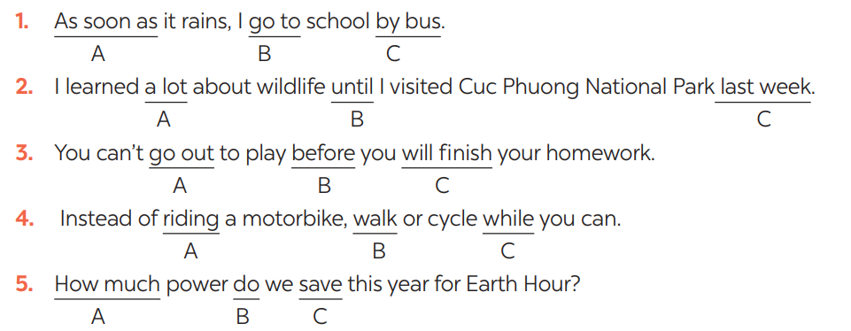
GRAMMAR
4
Circle A, B, or C to identify the underlined part that needs correction

Slide 9

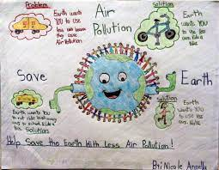
PROJECT
Choose a pollution problem and suggest the solutions
Make a poster. Use pictures and illustration.
Present the poster to the class.
5

Slide 10

CONSOLIDATION
1
Wrap-up
What have we learnt in this lesson?
review the vocabulary and grammar of Unit 7
apply what they have learnt (vocabulary and grammar) into practice through a project.

Slide 11

CONSOLIDATION
2
Homework
Workbook

Slide 12

Website: hoclieu.vn
Fanpage: facebook.com/sachmem.vn/

