Slide 1


Slide 2

Unit
8
SHOPPING
LESSON 4: Communication
1

Slide 3
LESSON 1: GETTING STARTED
WARM-UP
Warm up
Every day English: Making complaints
PRESENTATION
Task 1: Listen and read the conversation, paying attention to the highlighted parts.
Task 2: Work in pairs. In turns, make complaints about situations below.
PRACTICE
My favourite shopping place
Task 3: Listen to three people talking about their favourite shopping places and tick (v) the place they mention.
Task 4: Work in pairs. Take turns to ask and answer what each person in 3 likes about their shopping place.
Task 5: Work in groups. Share your favourite shopping place with your group.
PRODUCTION
CONSOLIDATION
Wrap-up
Homework

Slide 4
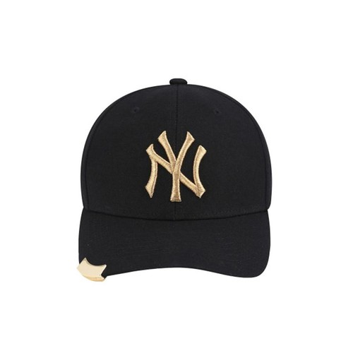
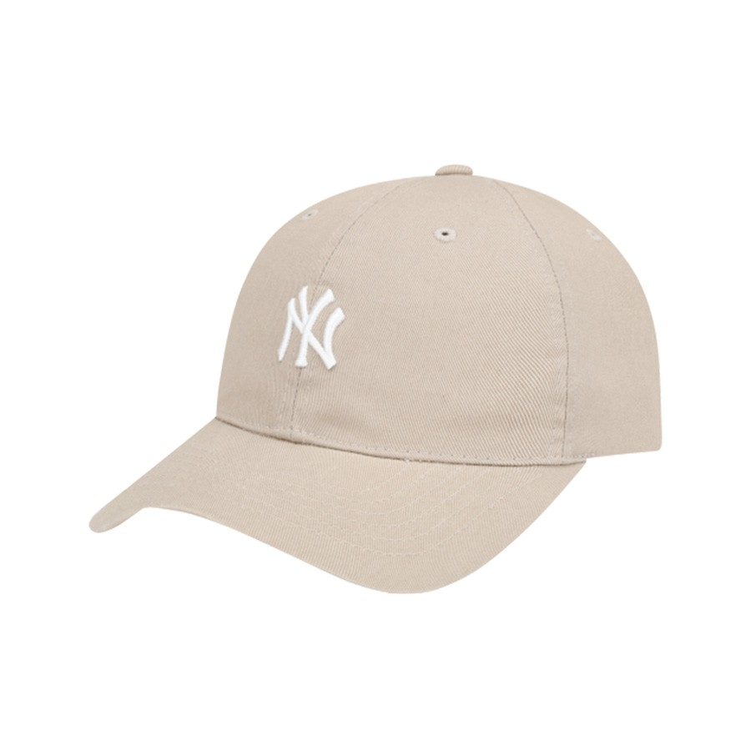
CHATTING
WARM-UP
Supposing you ordered a hat online, but when you got it, it didn’t have the same color as you ordered. What would you do in that case?
The hat you ordered
The hat you received
MAKING COMPLAINTS

Slide 5

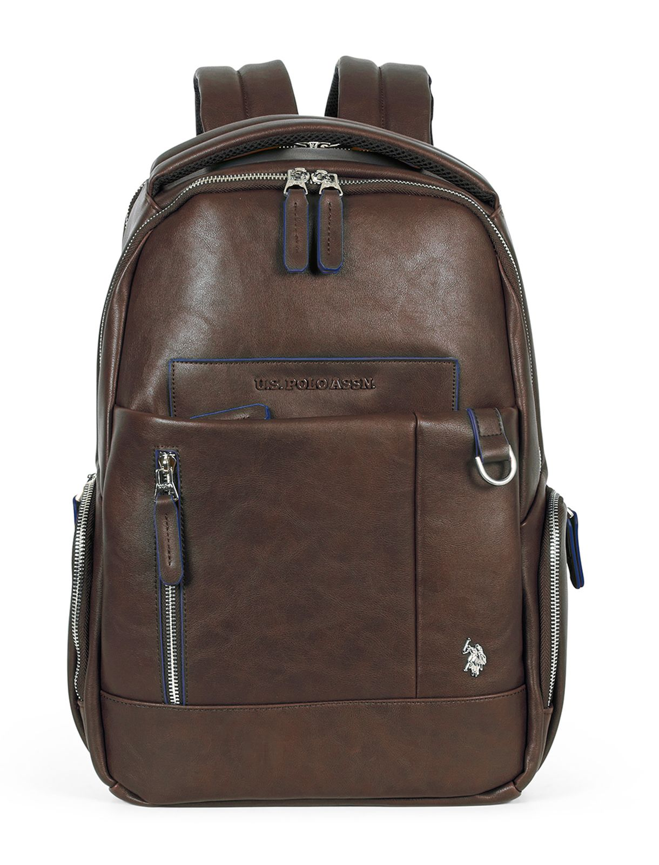
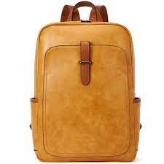
PRACTICE
EVERYDAY ENGLISH: Making complaints
1
Listen and read the conversation, paying attention to the highlighted parts.
Tom: I’m calling to make a complaint about the SMART backpack I ordered from you last week. I got it this morning and It’s smaller than the one you advertised online.
Trang: Well…Let me check it.
Tom: And I’m not happy with the colour, either. In your picture, it’s dark brown, and this one is yellowish brown.
Trang: I’m sorry about that. I’ll send you another one.

Slide 6
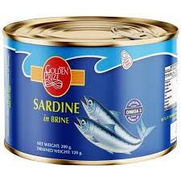
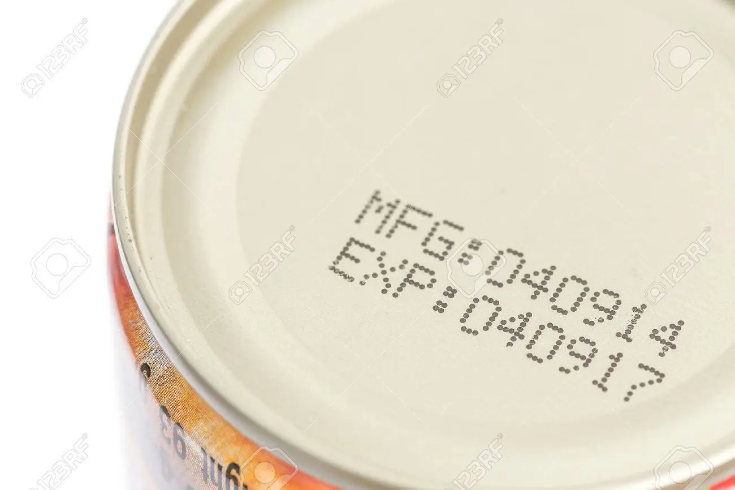
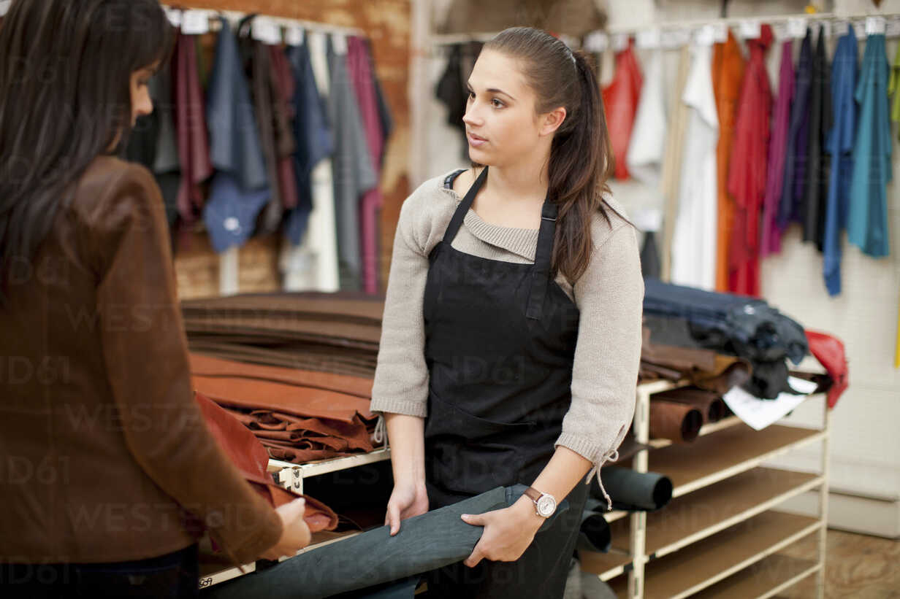
PRACTICE
EVERYDAY ENGLISH: Making complaints
2
Work in pairs. In turns, make complaints about the situations below.
The cans of fish you bought at the shop expired five days ago.
An assistant at the shop was not very helpful.

Slide 7

PRACTICE
MY FAVOURITE SHOPPING PLACE
3
Listen to three people talking about their favourite shopping places and tick (v) the place they mention.
People | Open-air market | Discount shop | Convenience store
1. Mai
2. Nam
3. Alice

Slide 8
PRACTICE
MY FAVOURITE SHOPPING PLACE
4
Work in pairs. Take turns to ask and answer what each person in 3 likes about their shopping place
1. Mai
2. Nam
3. Alice
Example:
A: What does Nam like about shopping at a convenience store?
B: It saves him time.

Slide 9

PRODUCTION
MY FAVOURITE SHOPPING PLACE
5
Work in groups. Share your favourite shopping place with your group.
You can conclude:
The name of the place
The reason(s) why you like it

Slide 10

CONSOLIDATION
1
Wrap-up
What have we learnt in this lesson?
Making complaints
Some favourite shopping places

Slide 11

CONSOLIDATION
2
Homework
Learn the ways to make complaints by heart.
Write a paragraph of 50-70 words about your favourite shopping place.
Do Exercise ………..page ……Unit 8/Workbook

Slide 12

Website: hoclieu.vn
Fanpage: facebook.com/sachmem.vn/

